Slide 1

Bolton English Hub
Wednesday, 30th September 2020
2.30pm – 3.30/4.00pm

Slide 2
Gerry Reynolds
Assistant Headteacher
Mount St Joseph Catholic School
Introductions:

Slide 3

Proposed changes to the GCSE examinations
Key Discussion Topic

Slide 4

We understand students preparing to take exams and assessments in 2021, and their parents, carers and teachers, are concerned about the impact coronavirus (COVID-19) has had on their education. We have consulted on proposals for changes to exams and assessments next year, given the disruption and potential for on-going public health safeguards, and developed a package of measures. Overall, these will free up teaching time, reduce pressure on students and allow assessments to be undertaken within current public health restrictions.
Changes include:
changes to GCSE English literature, to introduce a choice of topics on which students are required to answer questions in their exams. The government, which is responsible for content, has decided to allow for this change in light of the responses to the consultation. As this subject is taken by the majority of students, and typically taught alongside English language, this will ease the pressure on many students and teachers

Slide 5

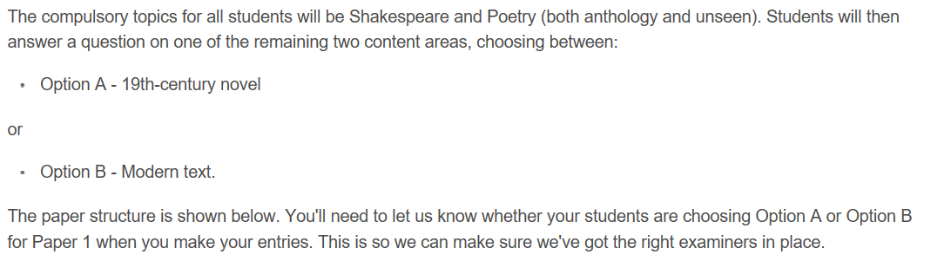
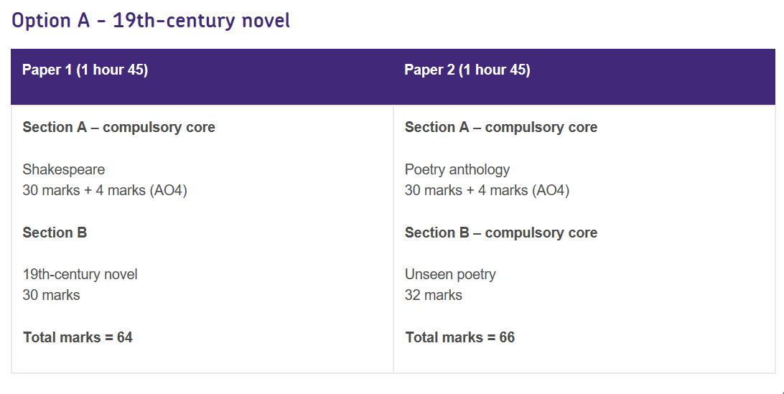
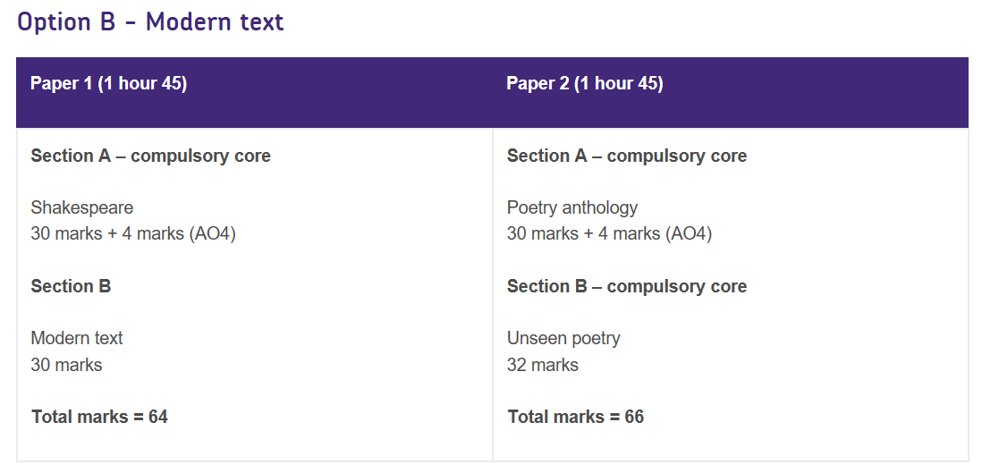

Slide 6

Learners must sit Component 1: there are no optional sections on this paper, although there are options within each section. Learners sit two out of the three equally weighted sections on Component 2.
This linear qualification will be available in summer 2021 only.
Candidates entering the qualification in 2022 should use the approved specification.
GCSE English Literature: Explanation of changes to 2021 assessment
Eduqas and the English team remain committed to supporting teachers and learners. We understand the concern that recent announcements have caused for centres and we would like to share the rationale behind our decisions.
What are the changes?
• Component 1 will be compulsory in its entirety. It will be two hours long and assess Shakespeare and the post 1914 text.
• Component 2 will have optionality. It will be two hours long and centres/candidate will choose two out of; the poetry anthology question, unseen poetry and 19C texts.

Slide 7

Changes to 2021 assessments
In response to feedback from English teachers to the Ofqual consultation on arrangements for the 2021 exams, we have made the following changes to the Pearson Edexcel GCSE (9-1) English Literature exams for assessment in 2021.
In order to support teachers delivering GCSE English Literature, we have eased the burden of teaching all four sections of the exam by giving students a choice between the two sections in Paper 2 optional:
- Paper 1: Shakespeare and post 1914 text – compulsory
- Paper 2: 19th century novel OR poetry
This means that for students sitting GCSE English Literature in 2021, they will study three of the four texts available.

Slide 8

GCSE English Language and English Literature
Strategies to close the gaps in learning and knowledge
Key Discussion Topic

Slide 9
Lock down/ Tiered Closures:
Pedagogy and strategies for remote learning
Key Discussion Topic

Slide 10
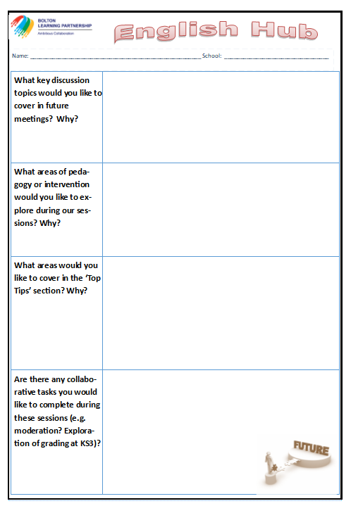

Future Meetings:
Tuesday, 19th January 2021
Thursday, 18th March 2021
Thursday, 24th June 2021
Future planning:

Slide 11
What would you like to see on the agenda for 2019-2010? Think about: • Leadership development • Pedagogy • Interventions | Further opportunities for moderation and standardisation Share strategies based on summer’s results KS3 curriculum Stretch and challenge (HAPs) Engagement of boys Teaching the structure question Effective interventions Pedagogy Discussion Visits from exam boards/ resource providers The chance to discuss successful intervention strategies used with key cohorts such as WBB To hear from colleagues who have made improvements in key areas (boys, writing etc.), unpacking how they have made an impact Further examples of how we engage students in reading Teaching top tips Accuracy of predictions Assessment points Data – PPE tracking and comparison to outcomes Leadership development Curriculum sharing Discussion on interleaving (spacing/ retrieval etc.)

