Slide 1


What makes effective feedback?
‘The quality of the interaction’ between the student and the teacher, ‘is at the heart of effective teaching and learning’
(Black and Wiliam , 1998)
Chris Bingley
Assistant Headteacher, Thornleigh Salesian College

Slide 2

Which feedback was more effective?

Slide 3
“I remember talking to a student who was looking at the feedback his teacher had given him on a science assignment.
The teacher had written, “You need to be more systematic in planning your scientific inquiries.”
I asked the student what that meant to him, and he said, “I don’t know. If I knew how to be more systematic, I would have been more systematic the first time.”
This kind of feedback is TBU — True But Useless! It is describing what needs to happen — but it is not helpful because the learner does not know how to use the feedback to improve. Too much effort is wasted in describing the work students produce or in giving generic wishful evaluative feedback. It is rather like telling an unsuccessful comedian to be funnier — accurate, but not particularly helpful, advice.”
Wiliam, 2011.

Slide 4

“You need a better first touch!”
“Look over your shoulder and take the ball on your back foot with an open body. This will allow you to see the next picture and play forwards”

Slide 5
Some important stuff about effective feedback
Feedback is a common feature of successful learning and outcomes
Hattie’s study on things that influence learning outcomes: +0.79 effect size.
(High effect size is +0.60; Questioning +0.55; Homework +0.29)
Its more important to invest time in planning feedback than time on marking
Feedback has to cause change in the student, otherwise it is not feedback.
The secret of effective feedback is that saying what’s wrong isn’t enough; to be effective, feedback must provide a specific recipe of actions for future action that will move learning forward.
It is hard to get right. It is time consuming! But we need to get it right. Because, poor feedback can be rejected, becoming meaningless, or cause students to give up.

Slide 6

Setting the environment for effective feedback
“This is an excellent answer”
“You have tried really hard”

Slide 7
Setting the environment for effective feedback
Meaningful feedback is an essential component of keeping students motivated and engaged with learning. In the context of future distance learning, providing feedback on work that students have completed independently is particularly important.
Try to avoid emotion. Feedback about students themselves is less effective than feedback focussed on the task or self regulation. If students receive feedback about themselves, combined with feedback about the task/self regulation, they are likely to focus on themselves. This will distract students from improving learning. Examples of distracting feedback:
“This is an excellent answer”
“You have tried really hard”
Or, keep it about self-regulation:
Feedback about students’ self-regulation can be very powerful. Acknowledge how impressed you have been with students controlling their specific behaviour, emotions, and thoughts in the pursuit of academic learning.
Strategy: If you want to add a personal comment, keep it factual:
“John, excellent Historians are well organised – thank you for submitting your work on time.”

Slide 8
Setting the environment for effective feedback
Why? This will ensure that students do not reject feedback
How students feel about feedback affects how well they respond to it (Shute, 2008). Students must be motivated and equipped to act on feedback. The language we use can really help.
Remove the association between feedback being criticism. Try to convey high standards and a belief students can meet those standards ‘I’m giving you this feedback because I have high expectations for you and I know you can achieve excellent outcomes’. This has a dramatic effect on student likelihood to redraft and their attainment. It also builds trust (Yeager et al., 2014).
Using framing – telling students “Don’t miss out on the chance to improve”
Highlighting how role models use the skill – “Great mathematicians always check their answers”
Emphasising social norms – noting that the majority of students act on feedback:
    “I gave this feedback to a student two years’ ago; she used it to…”
    “The chief examiner has said that…”

Slide 9

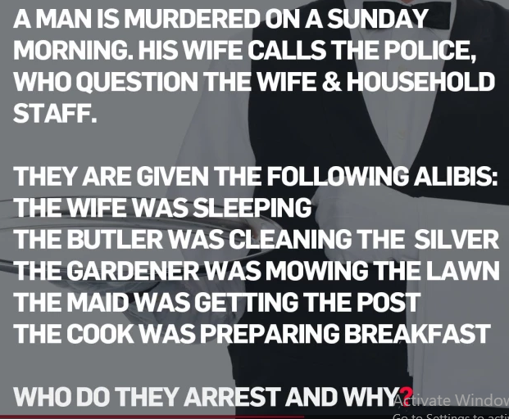
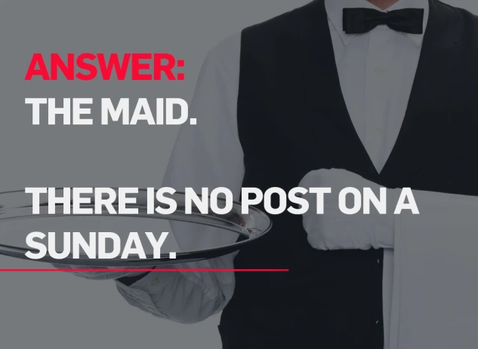
Setting the environment for effective feedback

Slide 10
Setting the environment for effective feedback
If it is possible, do not issue students with grades/marks before the feedback has been given
‘Take away the paper.’ Do not return the assessment before you have given feedback.
“As soon as students get a grade, the learning stops. We may not like it, but the research reviewed here shows that this is a relatively stable feature of how human minds work.”
Dylan William, Embedding Formative Assessment.

Slide 11
Deciding what to provide effective feedback for
Do not rely on the colours of your QLA sheet!
Make a professional judgement about learning you need to improve
What you could do to help you make the decision…
Take notes on common errors on blank lined paper
Split the errors into two; stuff you care about and can make a difference about // Stuff you don’t care about and can do little about.
Decide on a method to share the feedback…

Slide 12
Methods to communicate effective feedback
Whole class feedback sheets.
Using verbal feedback/voice recording/video as an alternative to written comments on pupils’ work.
Automated feedback to low stakes quiz questions.
Set up a quiz on Google Forms to give feedback when a pupil selects an incorrect answer, either to explain the right answer or to prompt the pupil to work out the right answer. It might be best to do this on hinge questions only. Provide challenge for the answers that students get right – how can they deepen learning?
4. Email

Slide 13





Whole class feedback sheet
Class |  | Details of learning:
Teacher
My personal highlight | Excellence / shout outs | Common misconceptions
Literacy – spelling, vocabulary or grammar

Slide 14

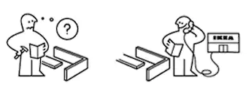
Specific tasks to respond to feedback – more, feed-forward
This is about choosing the right tool.
Hang on a minute…
Is the knowledge even there?
If not, re-teach common misconceptions or knowledge gaps in a fresh way.
What about the students who got it right though?
Re-teaching is still useful. Or, use them to offer explanations.

Slide 15

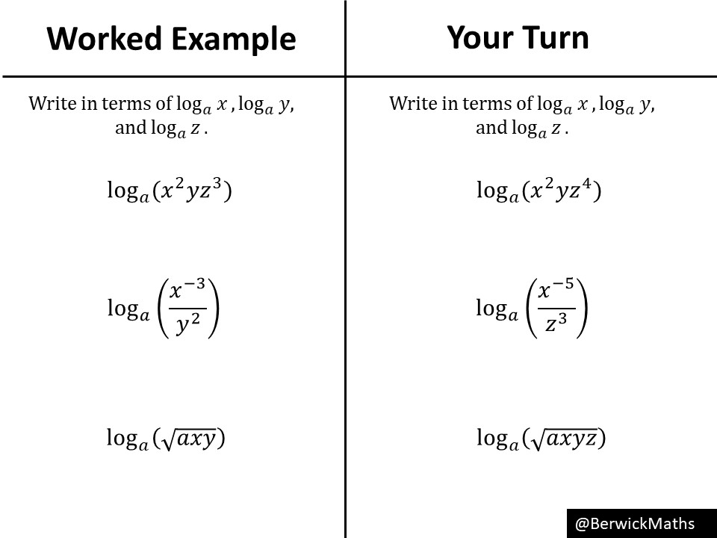
Specific tasks to respond to feedback – more, feed-forward
This is about choosing the right tool.
1. Revisit the learning goals:
Which of these answers was the best? Most marks? Why?
Provide a model answer. Students then understand what excellence looks like.
Provide a non-example (what success does not look like)
2. Provide step by step worked examples (example/problem/pair)

Slide 16
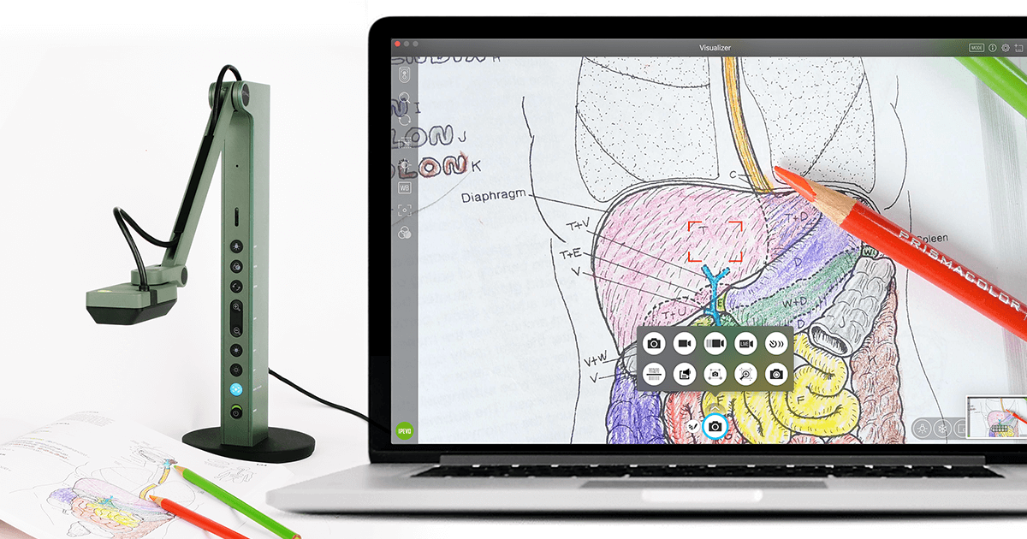
Specific tasks to respond to feedback – more, feed-forward
This is about choosing the right tool.
3. Conduct ‘live’ marking using a visualizer

Slide 17
Specific tasks to respond to feedback – more, feed-forward
This is about choosing the right tool.
4. Set more deliberate practice –
Assessment questions / Drill questions / Multiple Choice Question’s
5. Redraft the piece of work / the paragraph/ the graph and clearly point students to the parts of their writing that could be improved , with specific suggestions and examples …. by doing X, by adding Y, by correcting Z…
Redrafting is very powerful provided that the actions are very specific

Slide 18
What to do once the specific feedback tasks are complete?
A couple of options…
1. Respond to a new check of understanding by setting a ‘hinge question’ as a ‘do now task’ in the following lesson.
2. What about the good stuff that students have understood pretty well? Keep it fresh by setting homework tasks.

Slide 19
What makes effective feedback?
Lets make sure our feedback is not ‘true, but useless’!
cbingley@thornleigh.bolton.sch.uk

