Slide 1
Reading
Rebecca Dann @MissRD_83
‘Reading is the master skill of the school.’ Alex Quigley

Slide 2
But I’m not an English teacher...

Slide 3
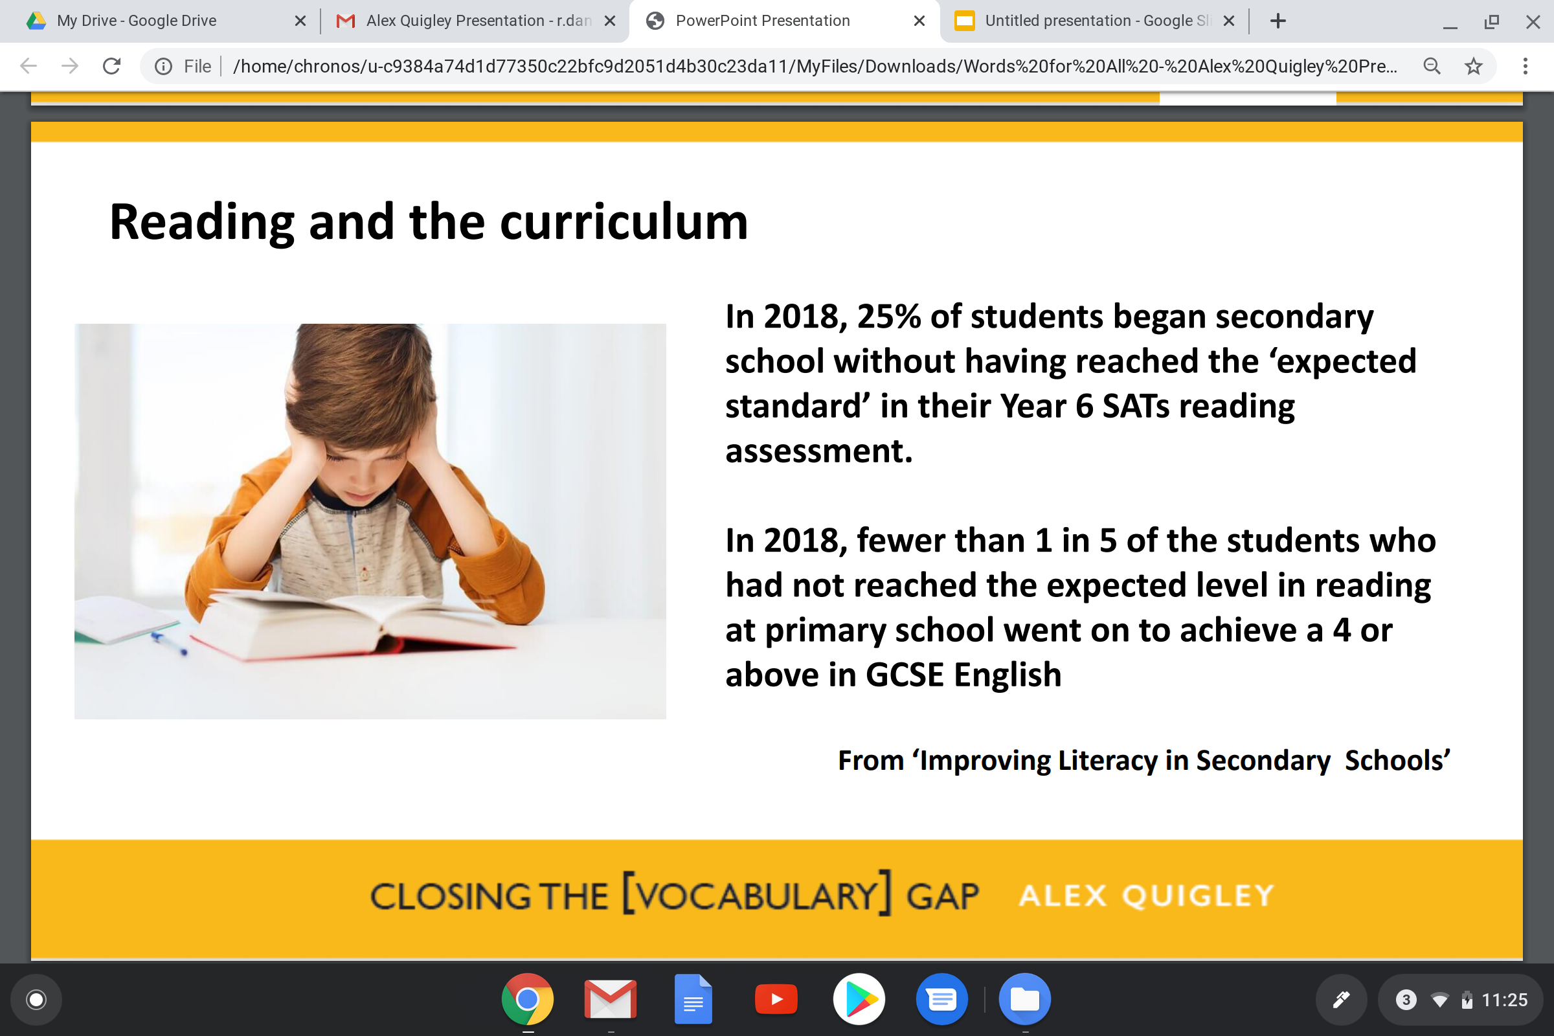
A Whole School Issue

Slide 4
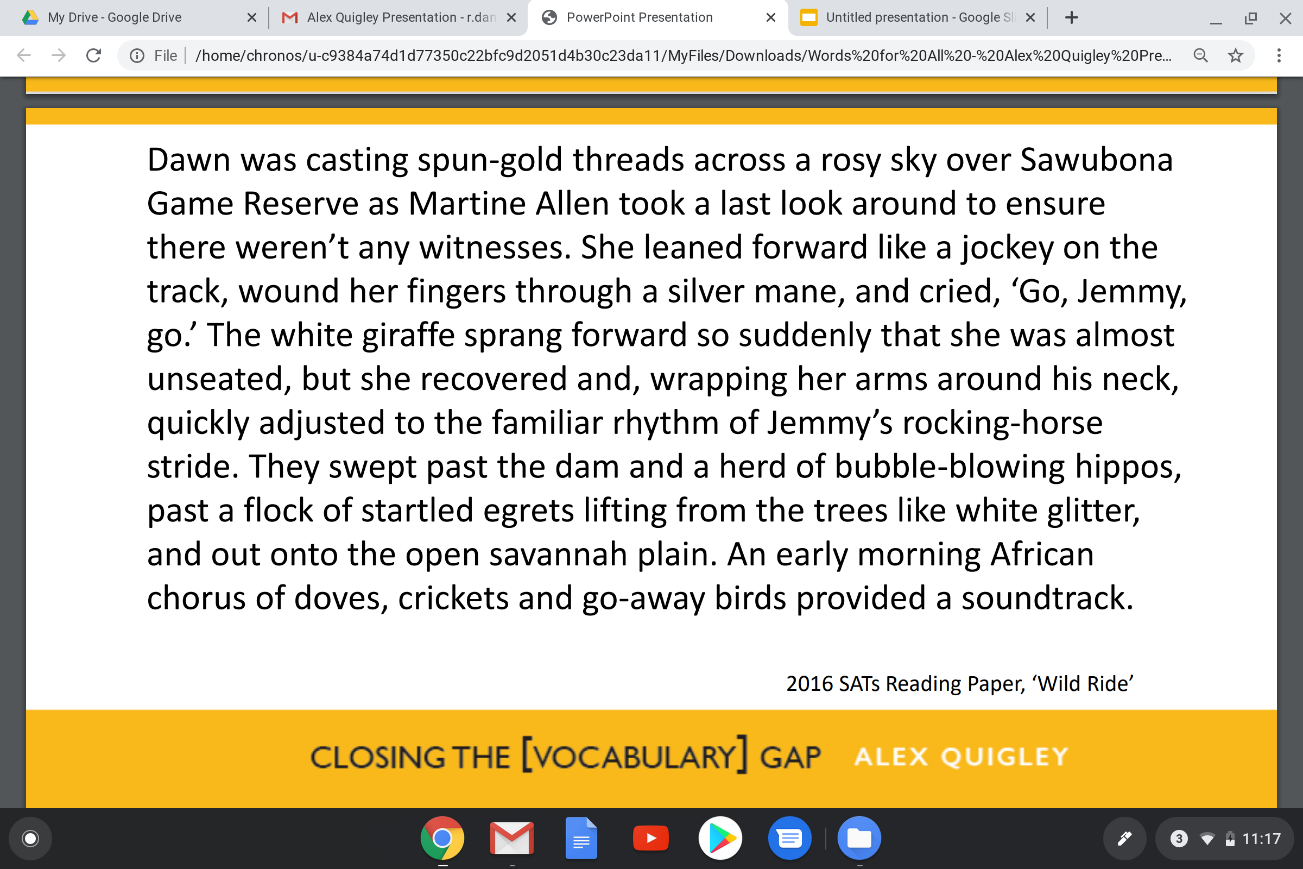
Notes:
I will model how to use reading strategies

Slide 5
KS2 SATs Reading Paper
Notes:
I will model how to use reading strategies

Slide 6
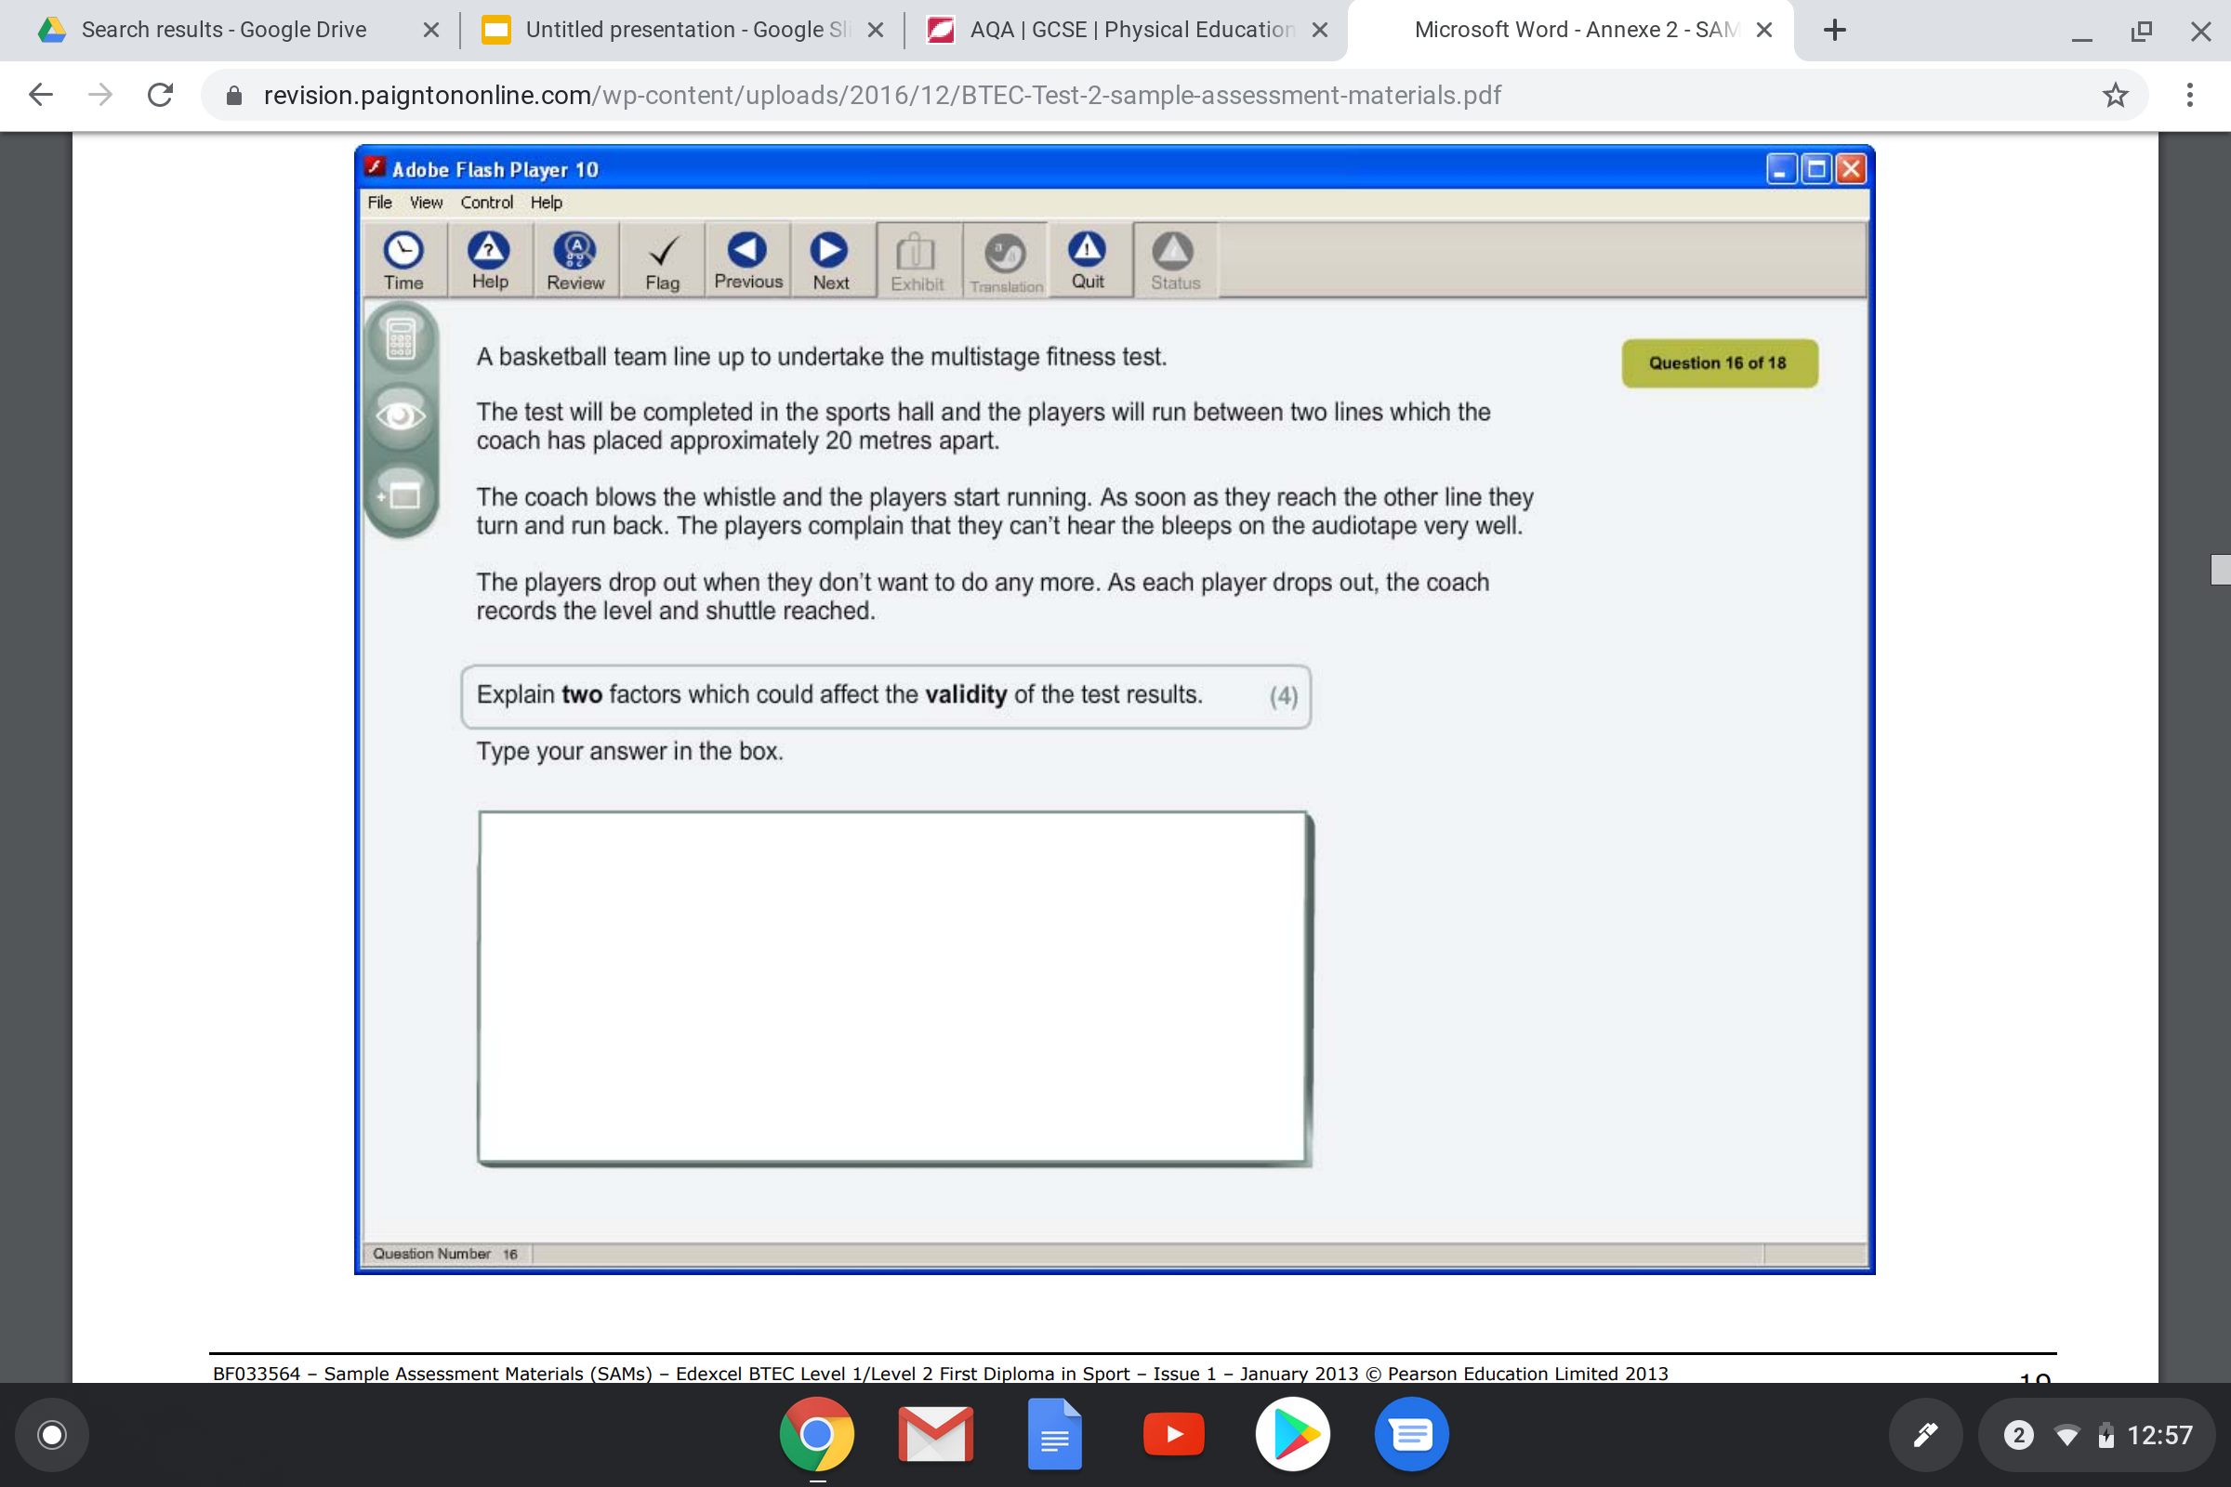
BTEC PE
Notes:
In departments, teachers discuss how they could use the four strategies to support students to read these texts.

Slide 7
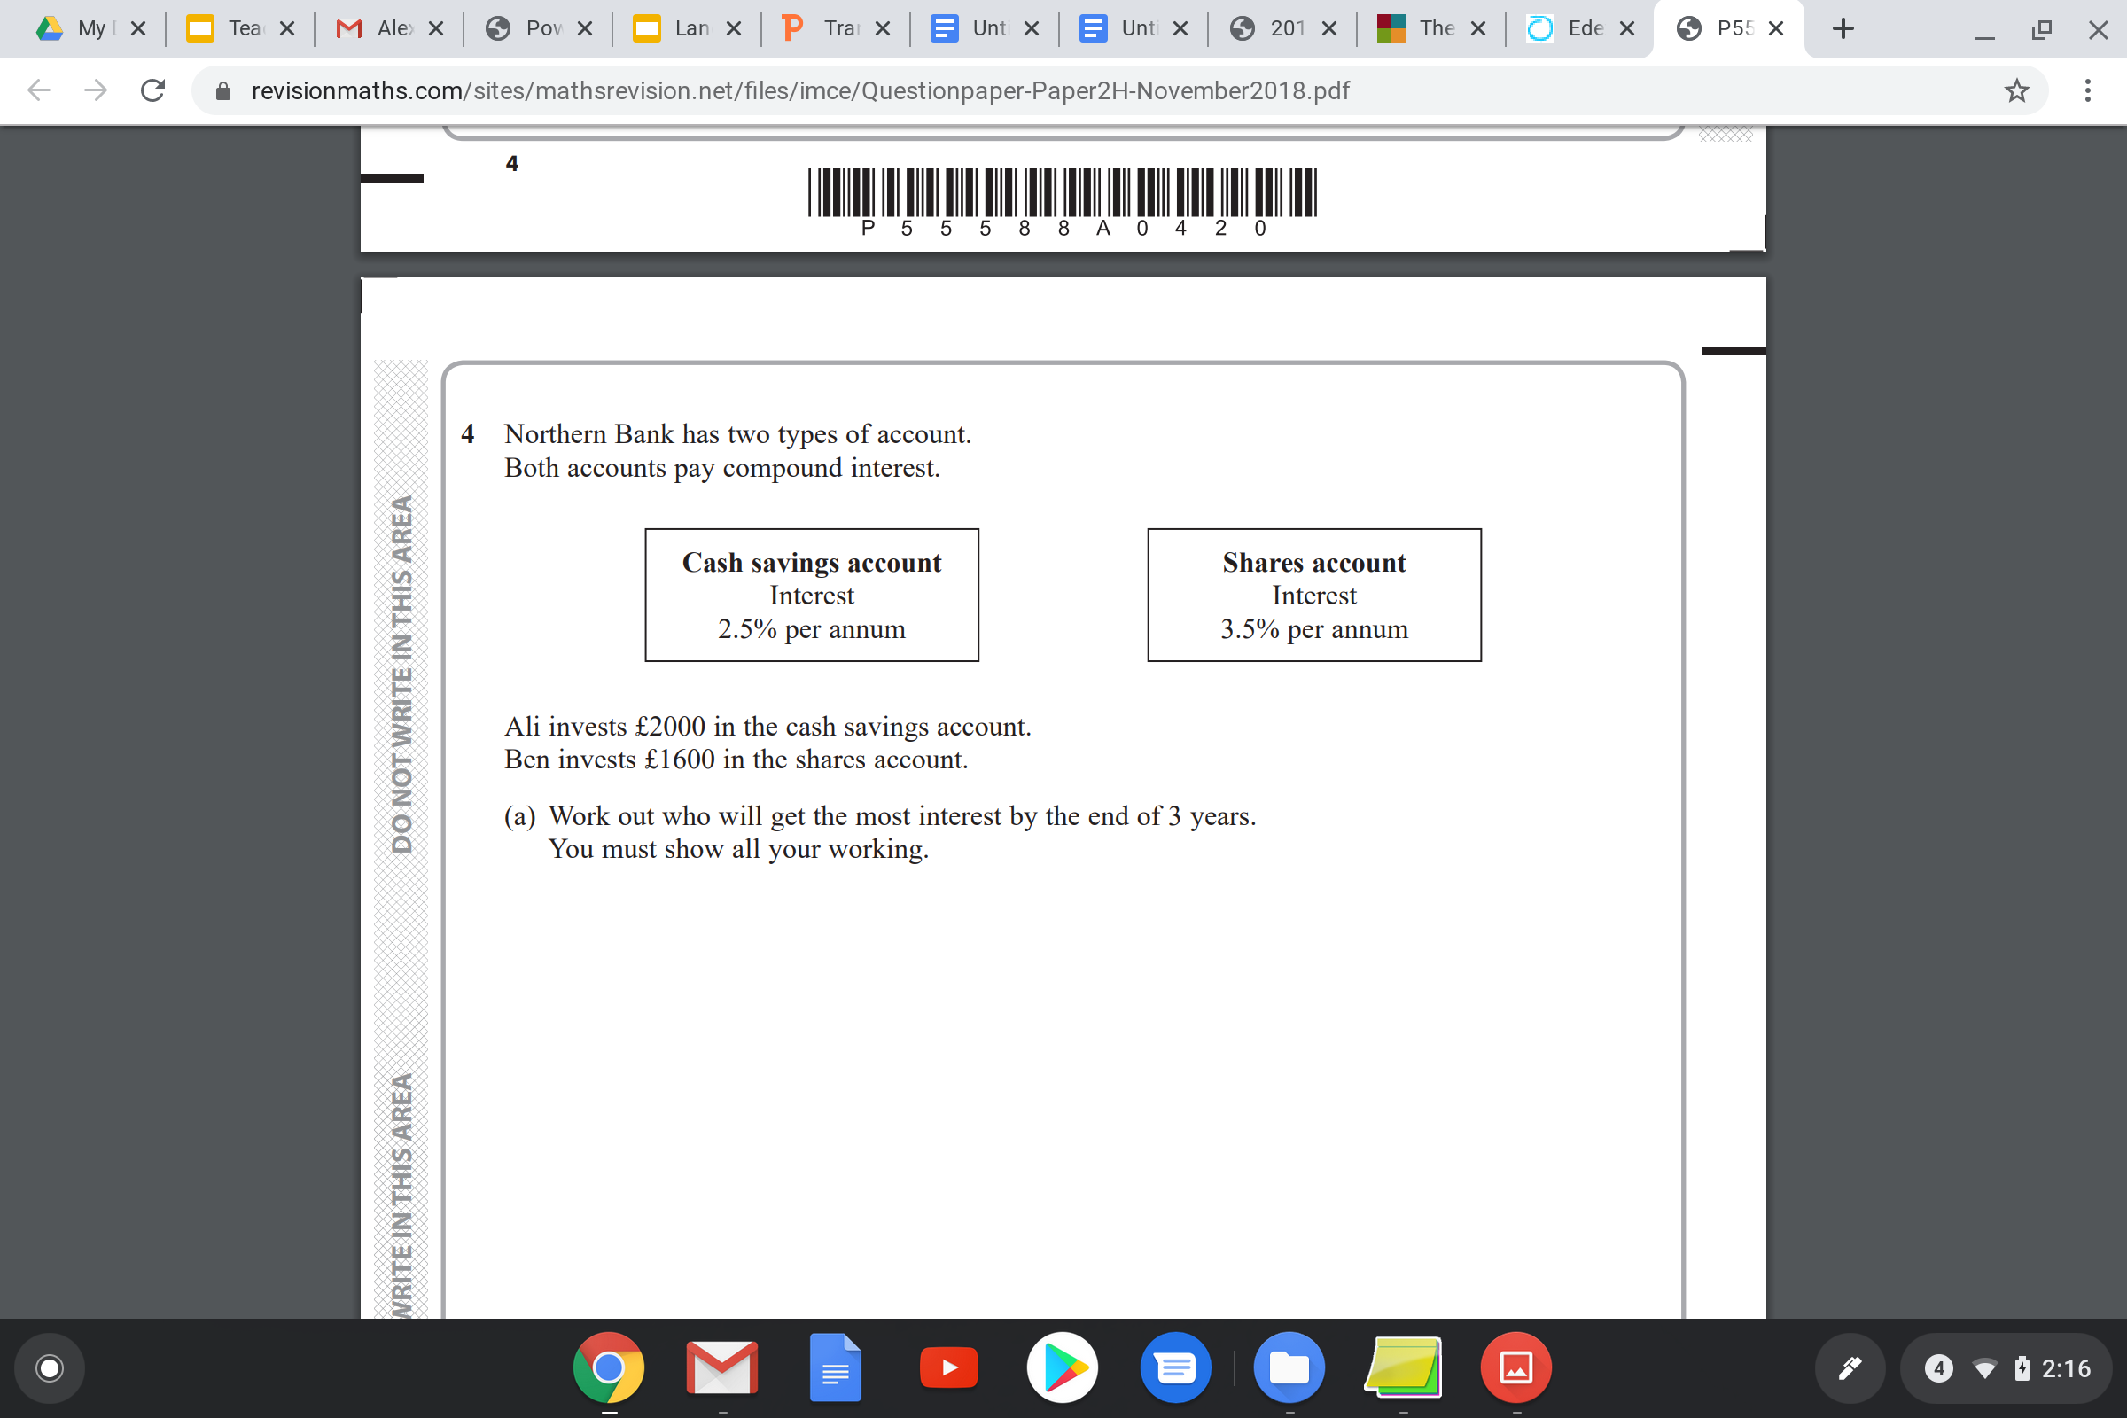
Foundation Maths

Slide 8
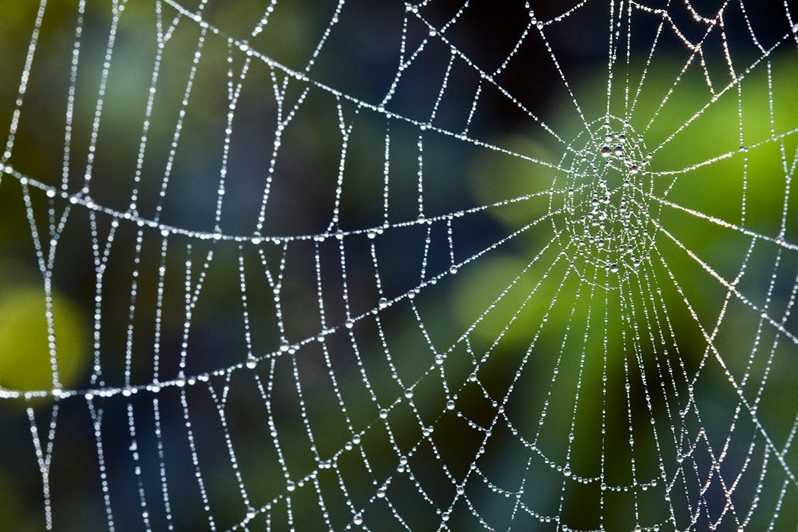
Building Schema
Notes:
They can act as cognitive shortcuts, in that information stored in long-term memory can help us to understand events and assist in learning new information.

Slide 9
KS2 SATs Reading Paper
Notes:
I will model how to use reading strategies

Slide 10
What can all teachers do?
Be a reader
Model fluent and expressive reading aloud
Model effective reading skills
Provide reading opportunities
Explicitly teach vocabulary and background knowledge

Slide 11
Teaching Reading Strategies

Slide 12
Reading with a Goal
‘Carefully framing our instructions for reading with specific goals, and sometimes different roles, will help both recall of what is read, but also deepen understanding.’
Alex Quigley, Closing the Reading Gap

Slide 13
Reciprocal Reading Strategies
Predicting
Clarifying
Questioning
Summarising

Slide 14
Predict
Activate prior learning
Examples:
What did we learn last lesson about this topic?
What do you already know about…?
What do you think…?
What methods might we need for this question?
Question
Give students a question to find the answer to whilst reading.
Ask questions to monitor understanding.
Examples:
Who,what,where,why,how?
What have you learnt so far about…?
Why is that word/sentence/point important?

Slide 15
Clarify
Define new vocabulary.
Check understanding of previously learnt vocabulary.
Check understanding of previously learnt concepts.
Remind us what…means.
Define…
What can you remember about…?
Summarise
Check students’ understanding of text.
Examples:
Explain what the question is asking you to do.
Summarise the paragraph in one sentence.
Overall, what have we learnt about…?

Slide 16
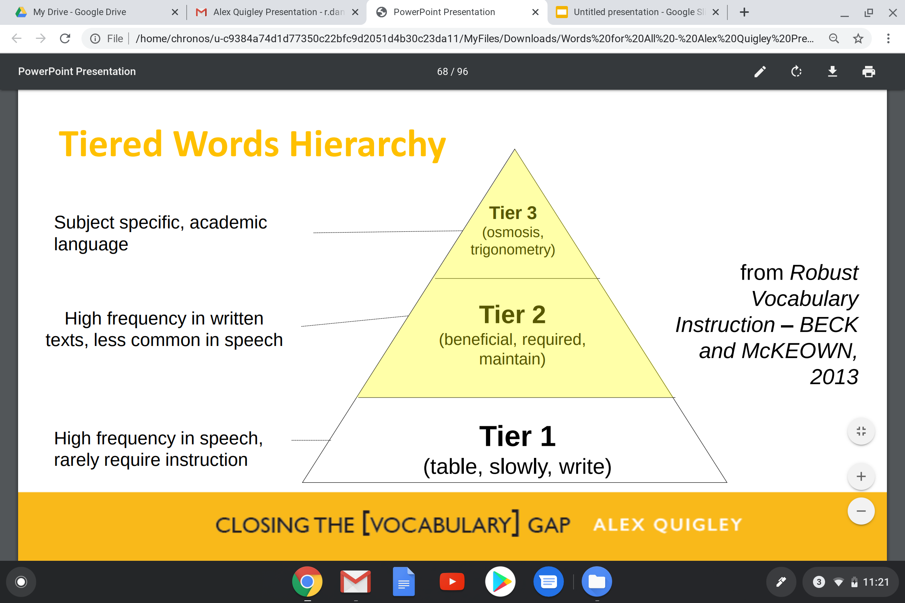

Slide 17
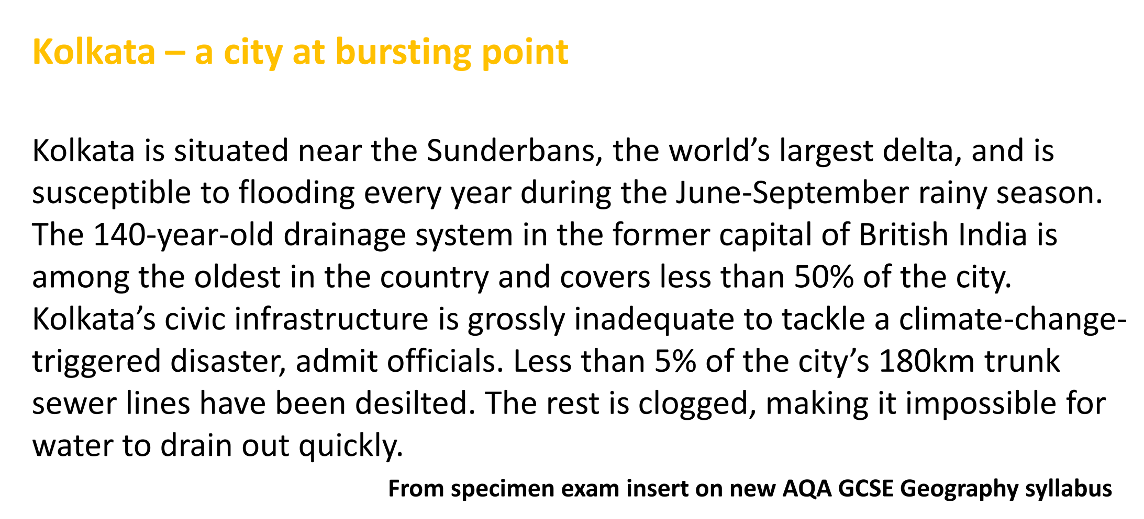
Geography

Slide 18
Teach Reading Strategies
Search for the proper nouns
Use the chronological order
Use headings and subheadings
Write the question above the text
Highlight/underline
Reread

Slide 19
Helping Students Overcome Reading Barriers

Slide 20
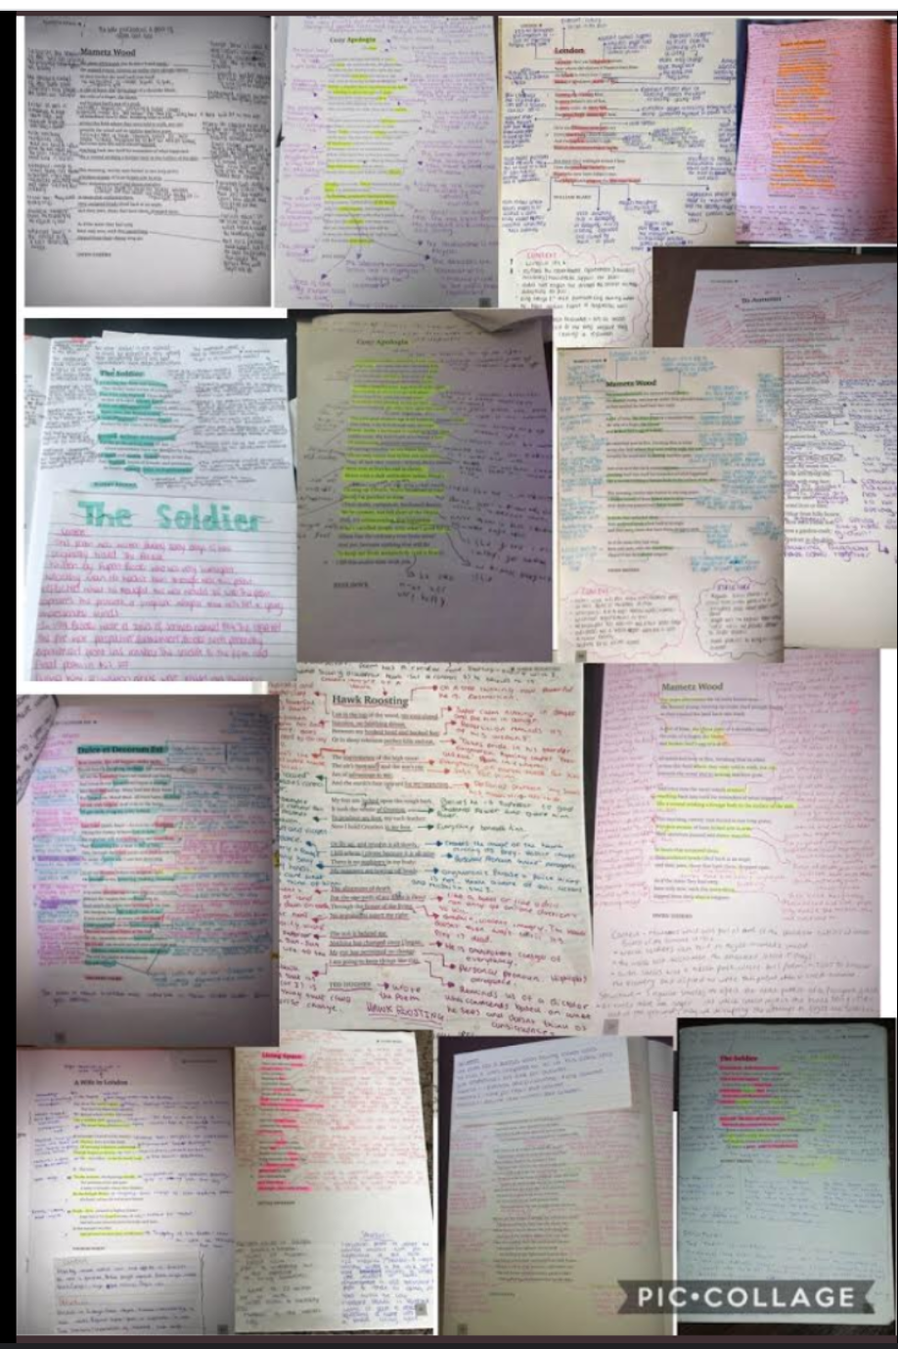
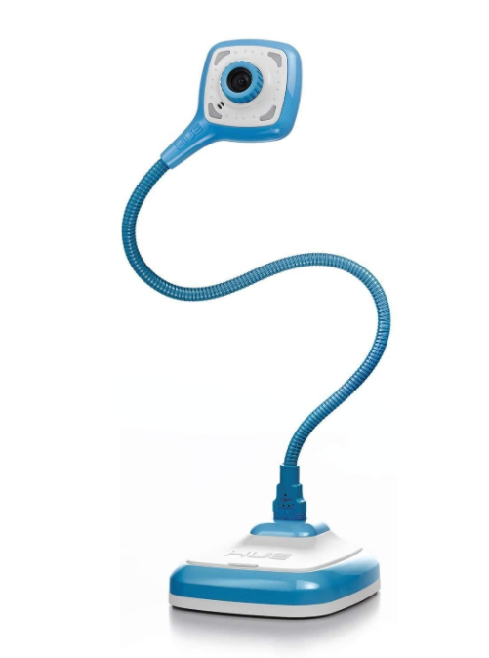
Modelling

Slide 21
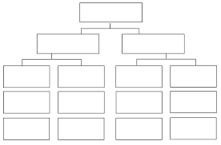
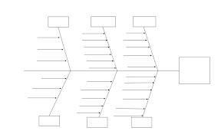
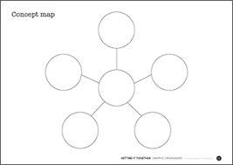
Graphic Organisers

Slide 22
Give each paragraph a heading
Write down 3 main ideas from each paragraph
Frida Kahlo and her paintings
Mexican artist Frida Kahlo is remembered for her self-portraits, pain and passion, and bold, vibrant colors. She is celebrated in Mexico for her attention to Mexican and indigenous culture and by feminists for her depiction of the female experience and form.
Kahlo, who suffered from polio as a child, nearly died in a bus accident as a teenager. She suffered multiple fractures of her spine, collarbone and ribs, a shattered pelvis, broken foot and dislocated shoulder. She began to focus heavily on painting while recovering in a body cast. In her lifetime, she had 30 operations.
Life experience is a common theme in Kahlo's approximately 200 paintings, sketches and drawings. Her physical and emotional pain are depicted starkly on canvases, as is her turbulent relationship with her husband, fellow artist Diego Rivera, who she married twice. Of her 143 paintings, 55 are self-portraits.

Slide 23
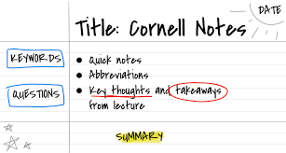

Slide 24
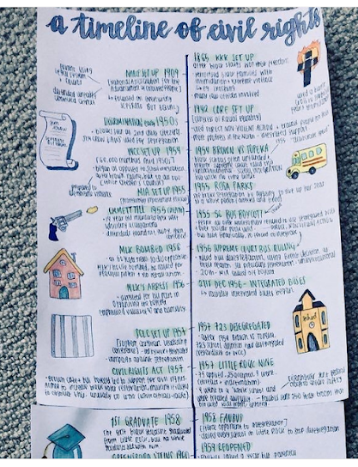
Dual Coding
Research by Mayer and Anderson (1991) found that when verbal information was presented alongside relevant images, it became much more memorable. And these images can be kept in place to aid pupils in subsequent tasks.

Slide 25
Scan, Step, Secure
Scan - Quickly scan the text to identify key words
Step - Read again to identify the steps, making notes or a diagram
Secure - Read to check you have not made any errors

Slide 26
Retrieval Practice
5,4,3,2,1
Give me 5
Because, but, so
Just a Minute
Summarise in 20 words

Slide 27
Reading for Scholarship

Slide 28
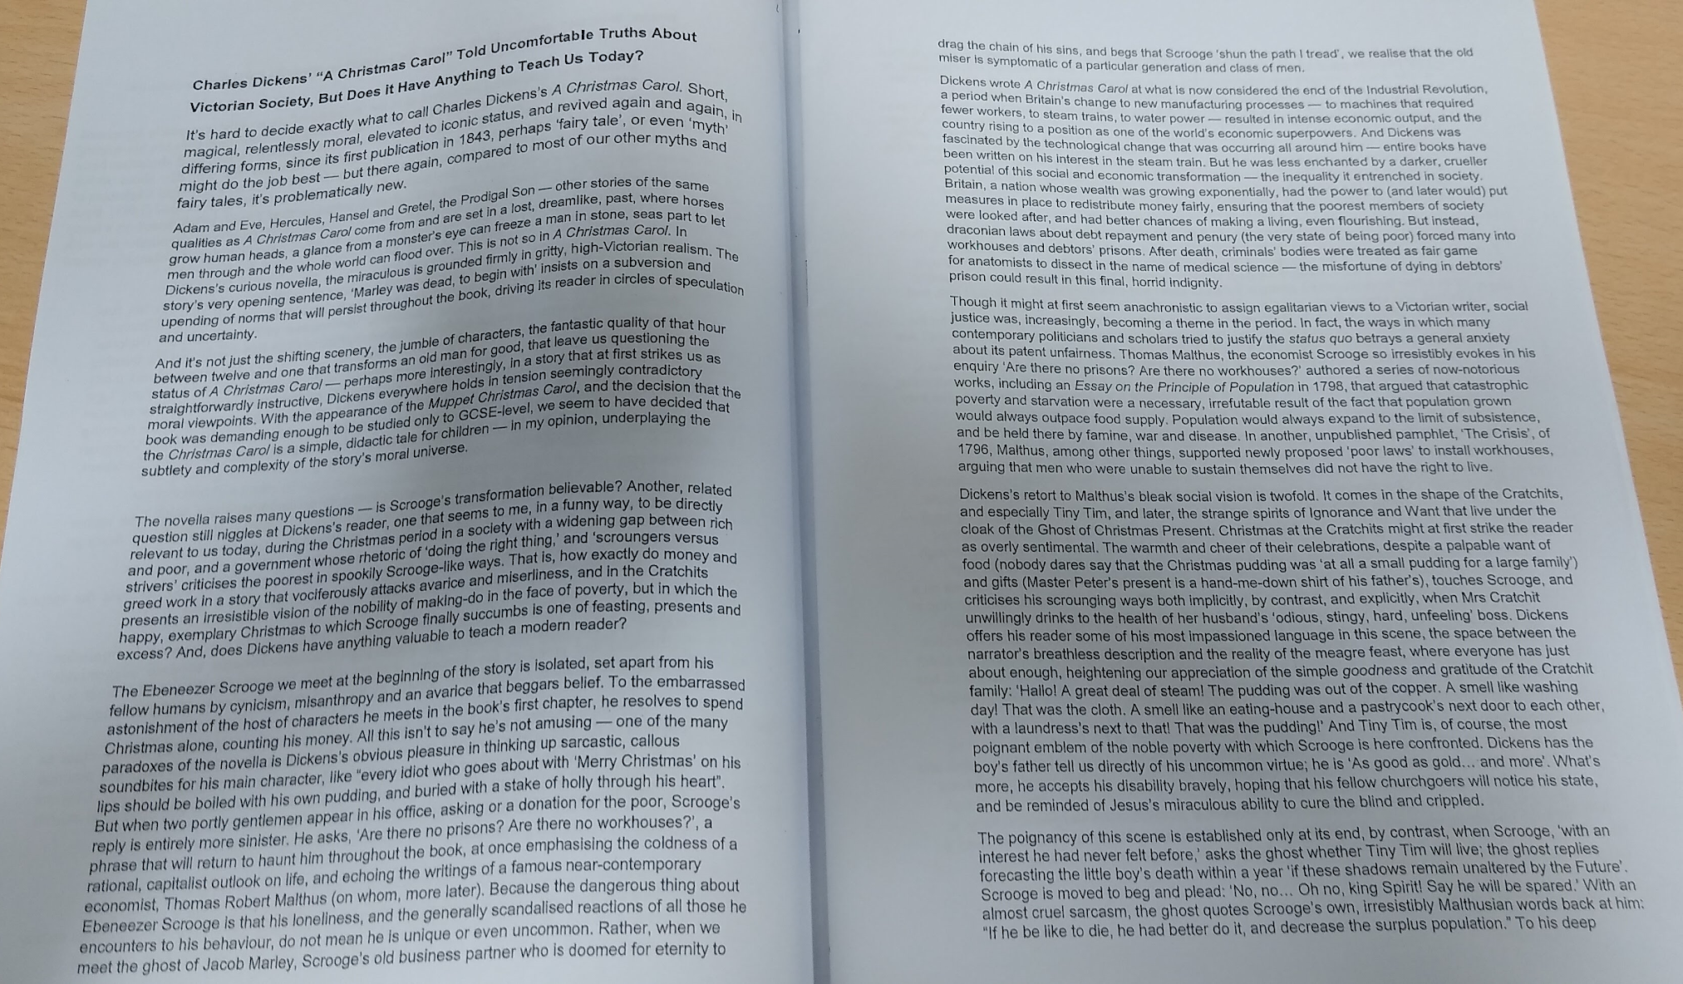
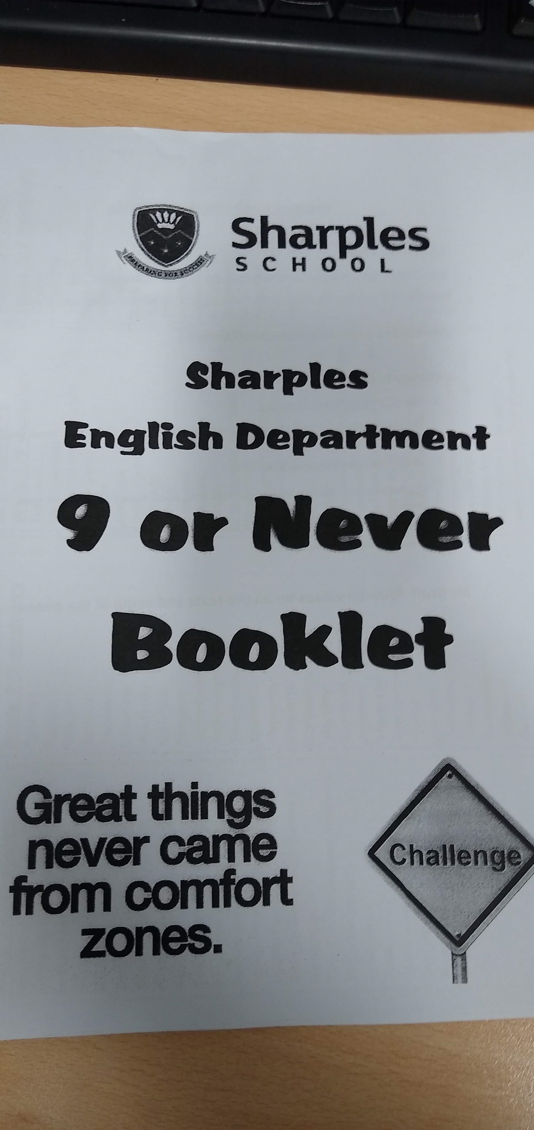
Read around your subject
Reading lists to extend students’ knowledge on a topic
Reading homeworks
Using extracts from books in lessons to add breadth to the perspectives students hear
Using quality newspapers/magazines for further reading, e.g. National Geographic

Slide 29
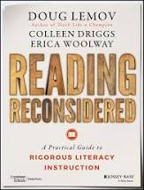
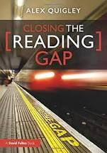
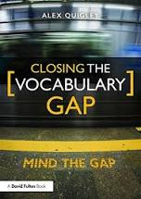
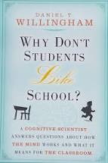
Further Reading

