Slide 1


Classroom Management in the Covid-19 World
(Carol Holmes)
Bolton Learning Partnership T&L Conference, July 2020

Slide 2



Starter activity
Jot down 3 worries you have about September
Don’t post them in the chat till I say!

Slide 3


My top 3 worries:
I’ve forgotten how to teach.
Lockdown has changed the students and they now know nothing, can do nothing, have no routines and hate all forms of authority.
I’ll catch Covid-19.
You think that every September and it’s never true.
Lockdown will have changed the students – but not like that!- and we’ll meet them where they are.
Risks have been minimised.

Slide 4
Outcomes of Today’s Session:
Increased confidence in your own ability to manage the classroom.
Clearer, evidence-based understanding of how lockdown is likely to have changed students.
Having a range of practical strategies for your classroom, to mitigate the effects of Covid-19 school closure.

Slide 5

What does the evidence say about how lockdown has changed students?

Slide 6
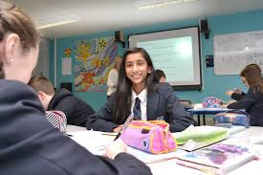
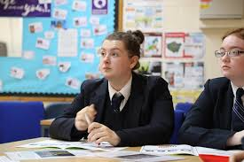
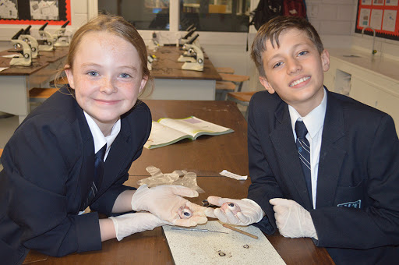

Two key ways in which students have changed:
1. Lost learning
  2. Emotional impact

Slide 7
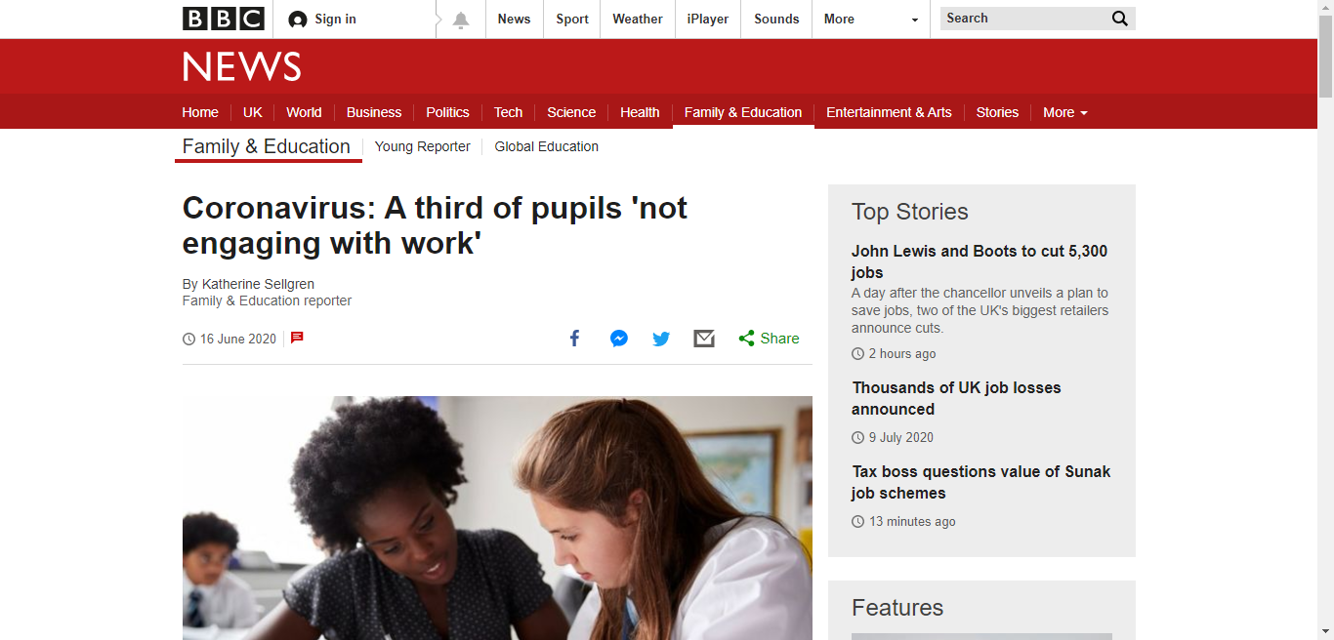

Slide 8

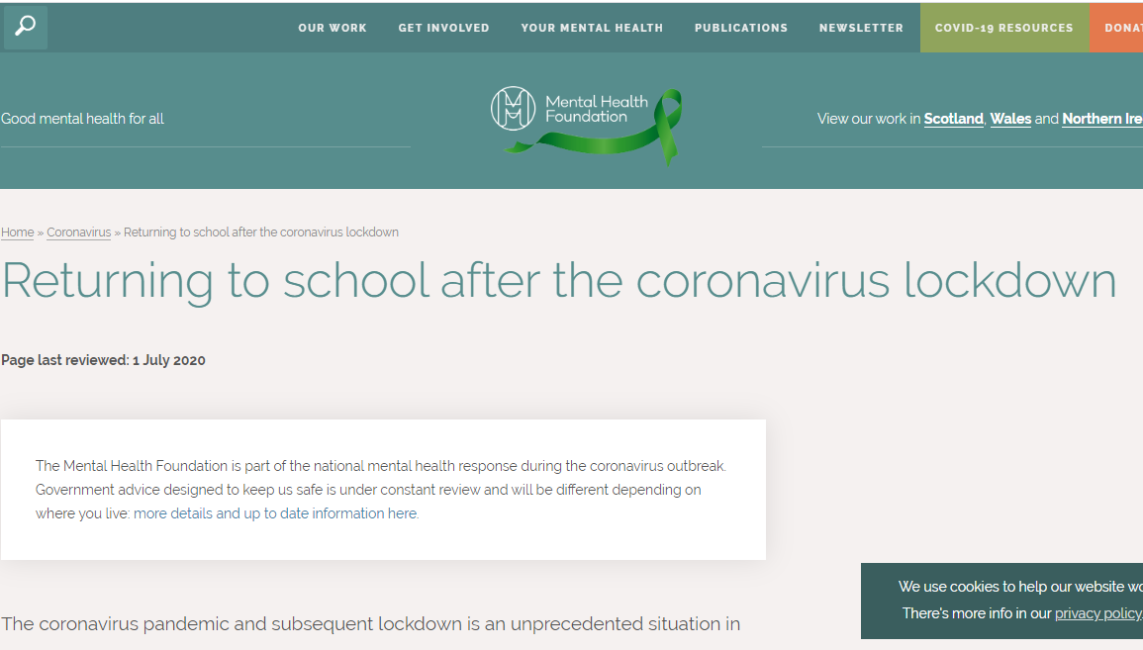
Loss/bereavement
Challenges at home (conflict, poverty …)
Unprepared for transitions
Friendships and bullying
Increased inequalities
Fears about safety and the future
Missing home/ parental care

Slide 9

Strategy 1: The ‘Recovery Curriculum’
Unique to your school
Clarity about the new school systems and rules…
…and explicit explanation of how that keeps people safe
Opportunities to talk and socialise
Signposting further support
Equipping students with IT/ independent skills to flow in and out of a local lockdown
Meeting pupils where they are – emotionally and academically

Slide 10
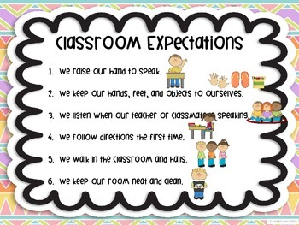


Strategy 2:
Classroom rules and expectations
Listening
Effort
Independence
Task completion
Facing forward
Type of voice to use
Where you will stand

Slide 11
Assess where pupils are – and meet them there

Slide 12


Assess where pupils are
Strategy 3
Red-amber-green confidence level questionnaires on
Skills
Topics

Slide 13
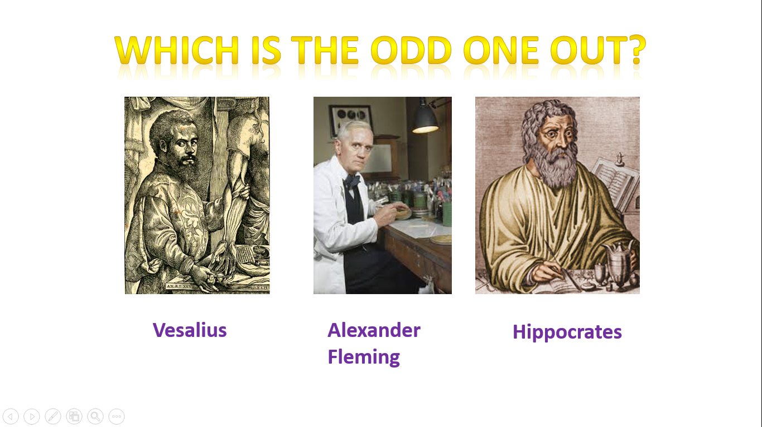
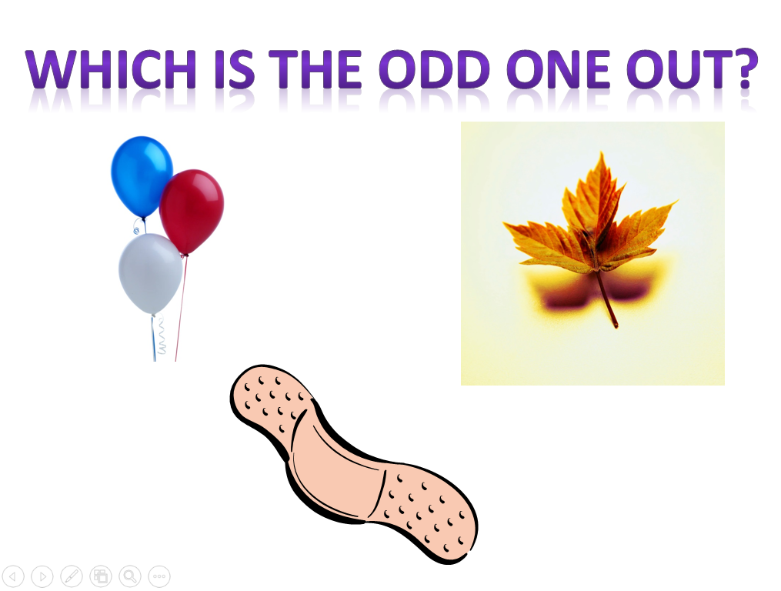
Assess where pupils are
Strategy 4
Odd one out quiz

Slide 14
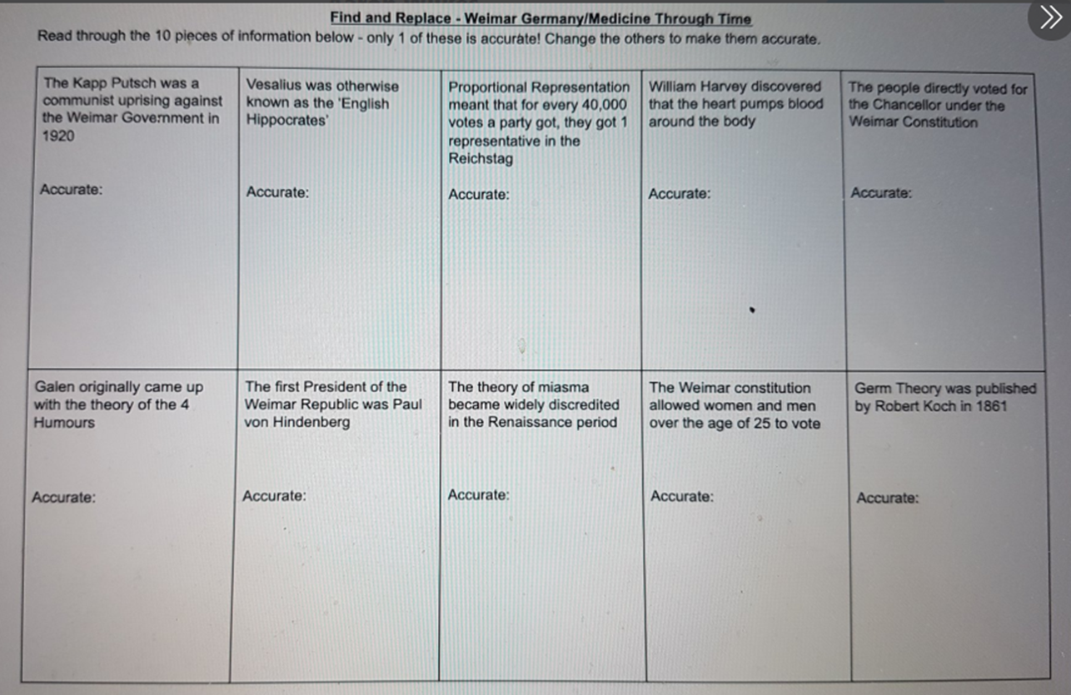
Assess where pupils are
Strategy 5
Find and replace

Slide 15
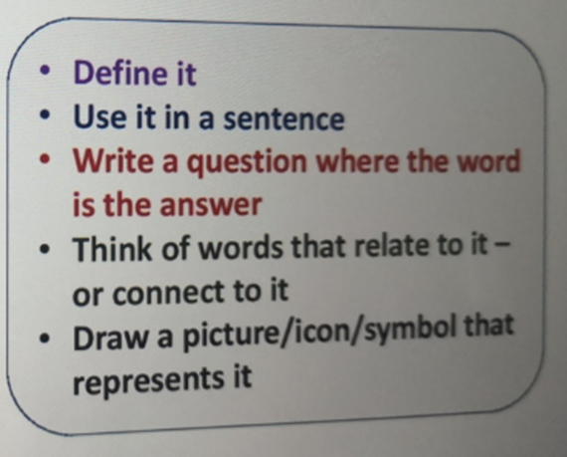

Assess where pupils are
Strategy 6
Key word
Scrabble

Slide 16
Assess where pupils are – and meet them there

Slide 17
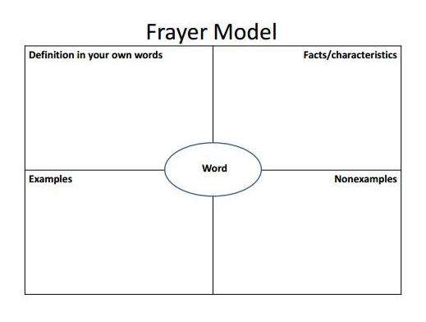
Meet the pupils where they are
Strategy 7
Reinforce key concepts

Slide 18
Meet the pupils where they are
Strategy 8
Differentiation!!!
By outcome
By task
By resource (alternative or additional)

Slide 19
Use your repertoire of Behaviour Management Skills

Slide 20
Behaviour Management Skills
Strategy 10
Clarity of instruction
Too much information
Zoning out
Chunked instructions
Chunked tasks
Name precedes instruction/ question

Slide 21

Behaviour Management Skills
Strategy 11
Be seen looking

Slide 22
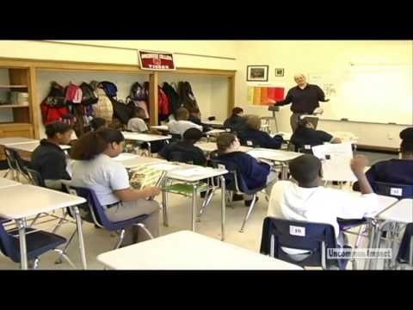
Behaviour Management Skills
Strategy 11
Be seen looking

Slide 23
Behaviour Management Skills
Strategy 12
Maybe…but

Slide 24
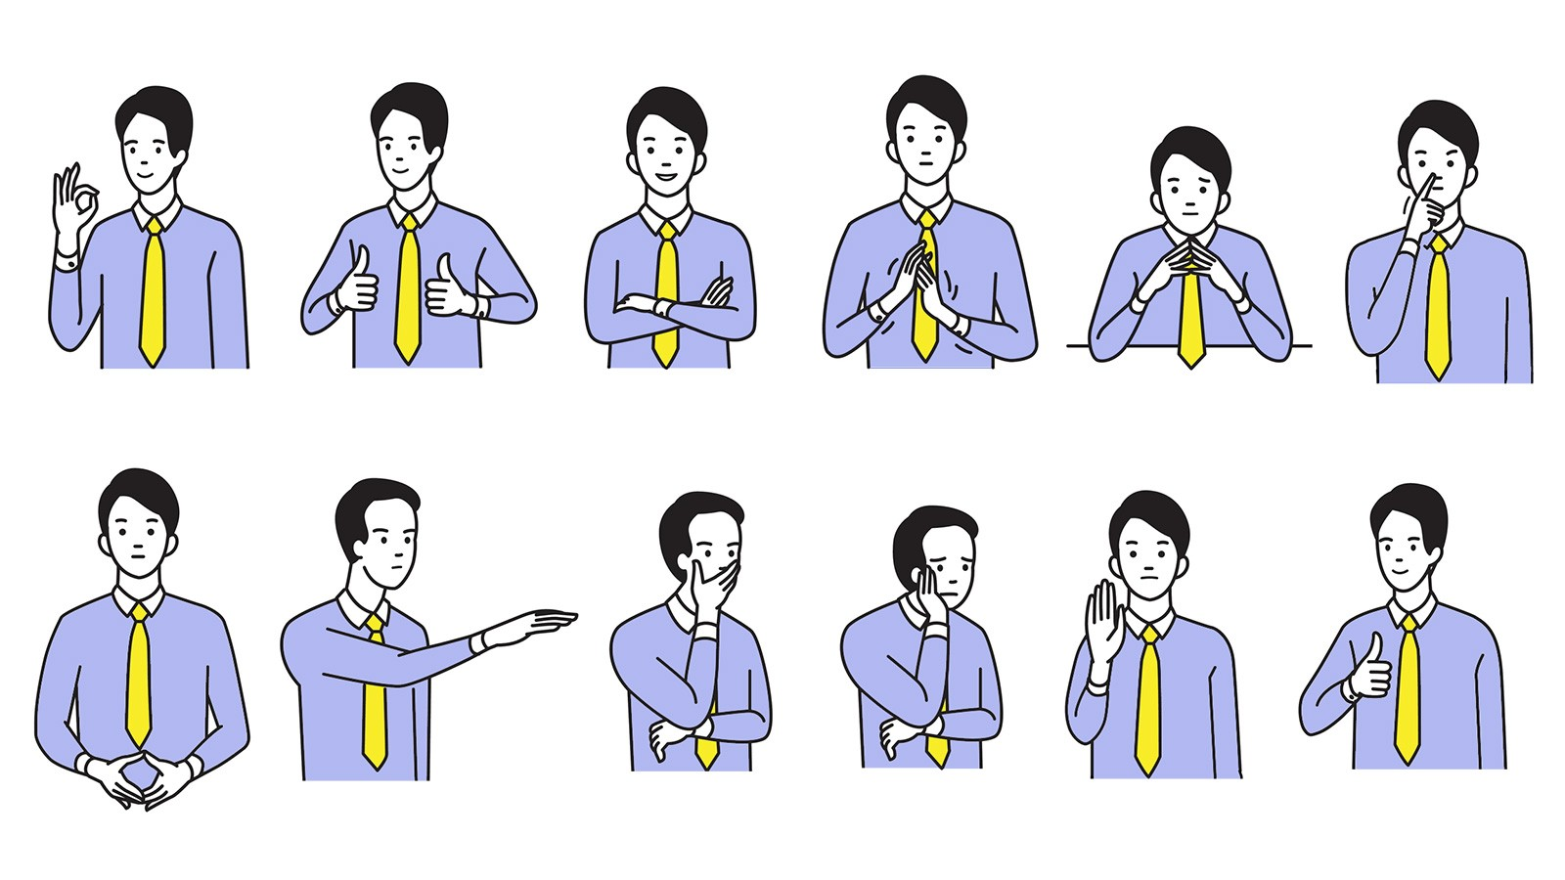
Behaviour Management Skills
Strategy 13
Body language and gesture

Slide 25

Behaviour Management Skills
Strategy 14
Deliberate botheredness

Slide 26
Outcomes of Today’s Session:
Increased confidence in your own ability to manage the classroom.
Clearer, evidence-based understanding of how lockdown is likely to have changed students.
Having a range of practical strategies for your classroom, to mitigate the effects of Covid-19 school closure.

