Slide 1


????????
The power of questions
Heads up! This is your enemy.
What is the purpose of questioning?

Slide 2
“More effective teachers ask more questions, involving more students, probing in more depth and taking more time to explain, clarify and check for understanding. In addition, they ask students to explain the process they have used to answer a question – to narrate their thinking”
T. Sherrington

Slide 3
Who am i?
Anna McDonnell – AHT – amcdonnell@st-josephs.bolton.sch.uk

Slide 4
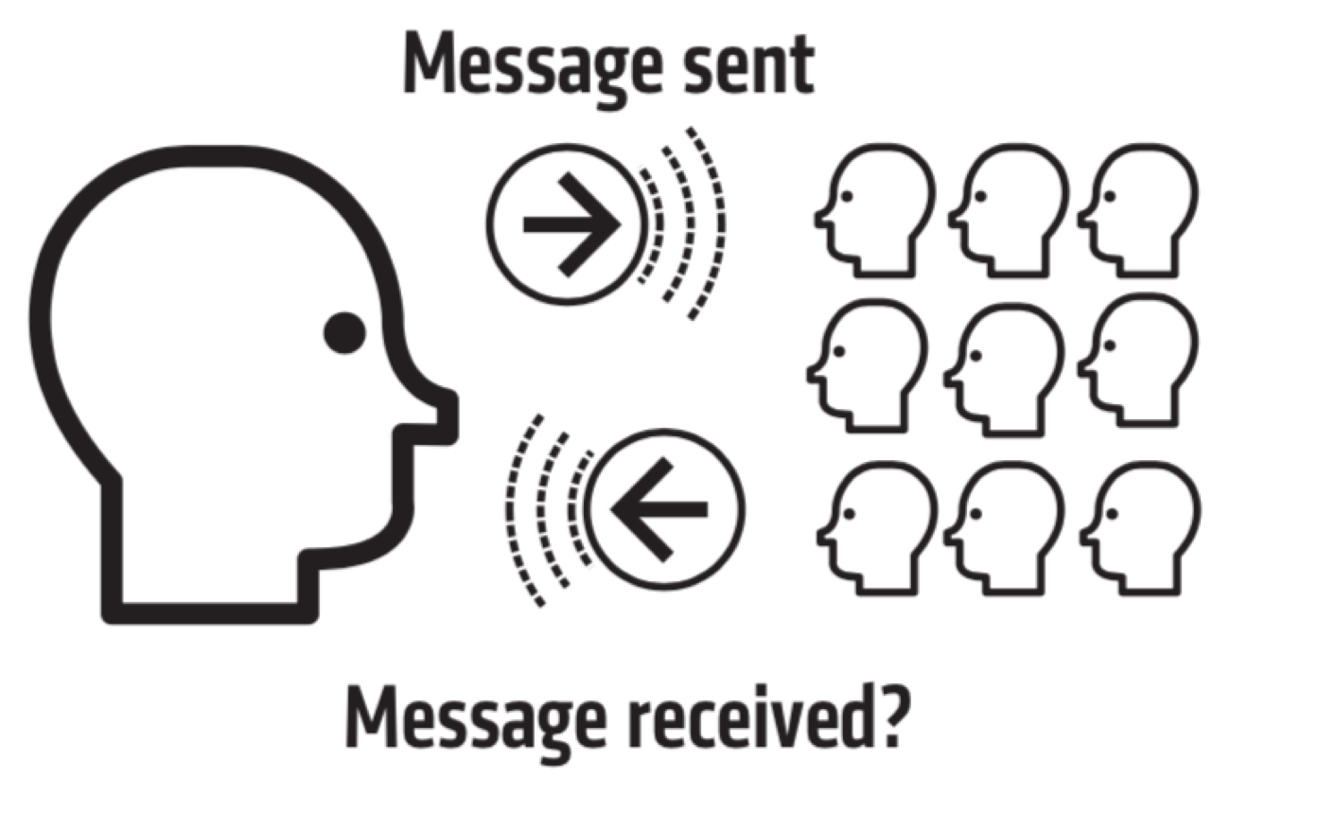
What are we going to cover?
The purpose of questioning in the classroom
How to involve all of your students
Checking for Understanding

Slide 5
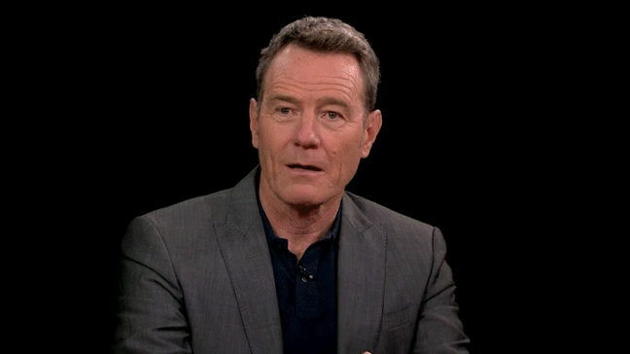
What about you?

Slide 6
Beware end
of
termitis
Relationships
matter
Age does not make you lose your enthusiasm

Slide 7

What is the purpose of questioning?
- to keep them on their toes
- to get to know them as learners
- to get them to think
- to check they understand
- to deepen their understanding
- to support them to verbalise their learning
- to support them to work out a process
- to improve their vocabulary

Slide 8

What is the purpose of questioning?
- to take charge of the classroom
- to support memory
- to support retrieval
- to let them fall into a trap!!!
- to work out where our teaching is not reaching!
as practice / drill
to understand your learners better so that you can continue to plan better and better episodes – and appropriate next steps
to enable you to be a RESPONSIVE TEACHER

Slide 9

What is the purpose of questioning?
- to use peers to model the behaviours you are looking for
-to give pupils attention and affirmation
-to help focus pupil attention
-to bring the class together
-to build pupil confidence and self-esteem
-as summative assessment

Slide 10


So not “What is the purpose?”
“What is MY purpose?
Why am I asking this question?
What do I hope to achieve?”
Beware
“Guess what’s in my mind?”
Questions they can’t be expected to know the answer to
Questions which don’t support the learning intention.

Slide 11
Checking for Understanding
‘Have you understood?’
Reject self report
Illustration by O. Caviglioli

Slide 12

http://www.mrbartonmaths.com/blog/diagnostic-questions/

Slide 13
Diagnostic questions
An infinitive is a verb.
An infinitive is a type of verb.
An infinitive is a verb tense.
An infinitive is an adjective.

Slide 14
Diagnostic questions
North is the opposite of South.
It always gets colder the further north you go.
There are 5 points to a compass.
South South East can be a point on the compass.
How many statements are true?
Green – 1
Red – 2
Amber 3

Slide 15
Plan for misconceptions
What are the common misconceptions in your subject?
Plan them into questions. Be on your guard.

Slide 16
Beware the false positive.
What are they? What can you do to pre-empt them?
“The biggest danger in assessment is a false positive. …A false positive is dangerous because it’s likely to go unaddressed. “ D. Lemov
Beware:
1 correct answer does not mean 32 correct answers.
1 correct answer may not even mean 1 correct answer.
Surface knowledge is not the same as deeper understanding.

Slide 17
Checking for Understanding
‘WHAt
Have you understood?’

Slide 18
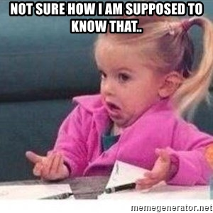

How to involve all of your students

Slide 19
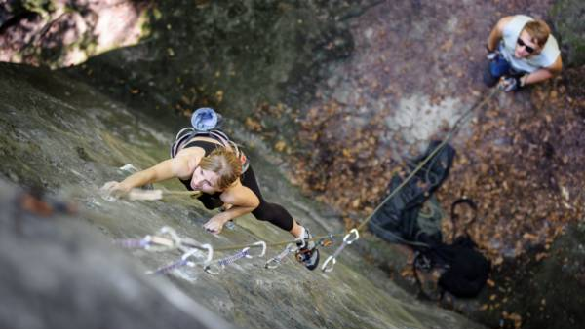

Slide 20

Think like Oprah… ease them in. Build their confidence. Avoid overly challenging questions.
Ask questions that don’t have a right or wrong answer.

Slide 21
Michaela
Let them practise it before they give you an answer.
https://twitter.com/i/status/1173672280477638663
Notes:
Build in activities where ALL students are involved. If they practice it together and their peers let them know it is right they are MUCH more likely to want to contribute, Climate is key

Slide 22

Notes:
Purpose – how do you check for understanding? How do we know that every child in the room has ‘got it’. What do we normally do?

Slide 23
THIS IS YOUR ENEMY
Remember your purpose.
It is not to find one right answer and then move on. They will trick you into thinking this and before you know it you are no longer teaching cause even this minion probably knew the answer before they came in the room.

Slide 24

We know about it but do we do it?
No hands up time.
PPPB
Notes:
Suggestion 1. – Why?

Slide 25

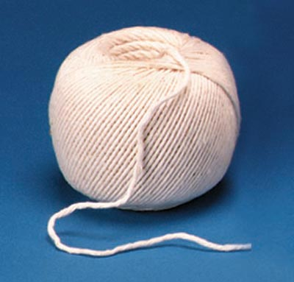
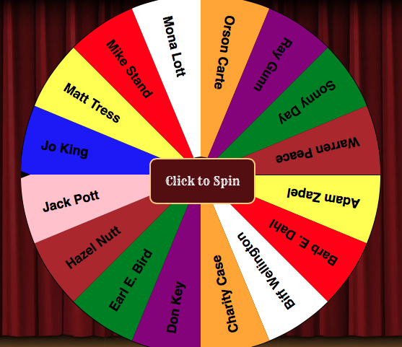
Vary your strategies

Slide 26



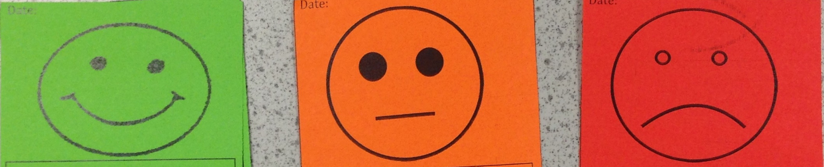
Have strategies that require whole class participation.

Slide 27

Don’t let them off with it.. .
Use body language..
Notes:
Right ‘ pick someone you think will give you a good enough clue to help you’

Slide 28
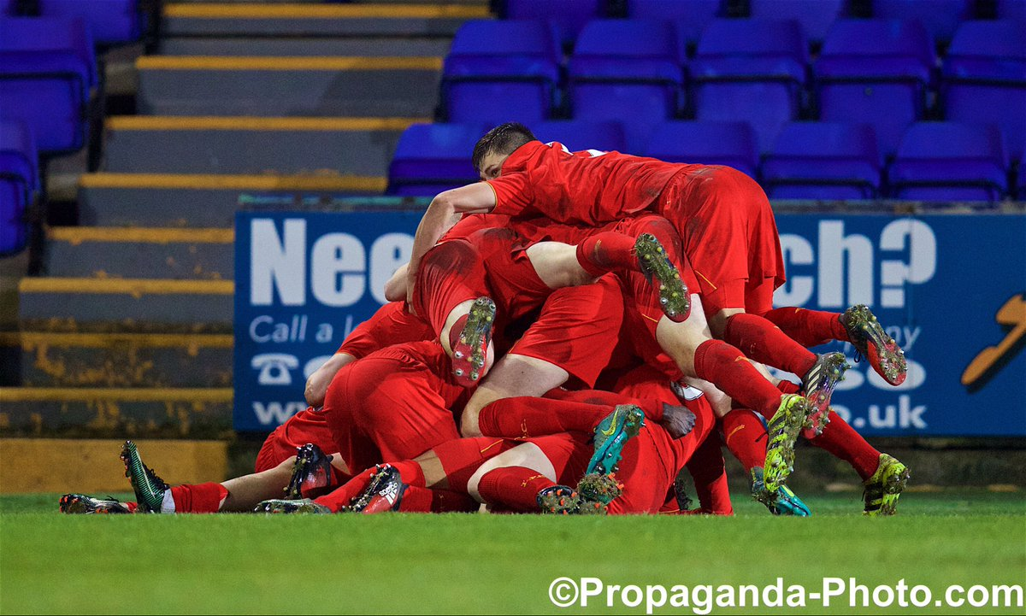

Slide 29


Don’t let them hide.
Understand and empathise but build their confidence to take part.

Slide 30

Questions you might ask when watching yourself f teach
Which children are taking part?
Which children are not taking part?
Do the questions support the learning intention?
How much time do you give before accepting an answer?
Do any pupils get chosen too often?
How often do you dig deeper with an answer to check their understanding?
Could you be accused of simply wanting the ‘right answer’ so you can move on?
How many examples are there of seeking self –report?
What evidence would an outsider see of the pupils having ‘learnt something?’

Slide 31

Recommended Actions
Learn EVERY name plan a section of questions know what your purpose is include wait time
Reject self-report use a variety of strategies record yourself and watch yourself ask someone else to watch you and feedback

Slide 32

You can’t do everything at once.
Notes:
Pick 1 strategy to embed. Pick 1 strategy you will use to show others. Go and see someone else. WHEN – put it in your diary. The value of viewing other staff.

Slide 33
Reflection
https://forms.office.com/Pages/ResponsePage.aspx?id=sHAoOFeTq0ONO_0gvTFzygaAbxmZJAFCtHoyyEOMuKpURFNUQlQ3TUlJRTZWUEFLWDNCN0dFRTFWNS4u
Notes:
Final reflection to inspire ways in which to move forward.

Slide 34


Notes:
P. 27-34 Read this. Discuss. What do you recognise? How does this look in your lesson? Are there any that you need explaining? What is in your comfort zone? What would you see yourself introducing easily? Message sent / Message received? Pick 3 favourites / of those 3 which do you do most often? Let’s poll them.

