Slide 1

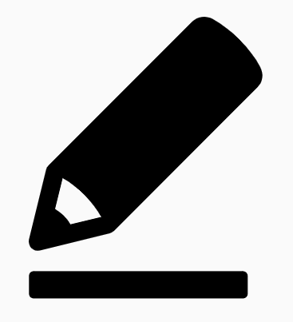
Eden Teaching and Learning
Session 5: Stages of Practice
Rosenshine’s Principles in Action by Tom Sherrington
‘Nobody ever excels at anything without lots of practice and that starts with the way we conduct our lessons.’
Welcome to the last in a series of five sessions exploring Rosenshine’s Principles in Action by Tom Sherrington (@teacherhead). We will be using this reflection booklet alongside Tom’s videos in which he delivers in depth training on the principles and how they can support us all to be more effective teachers in the classroom.
Whilst it is recommended to complete each session in one sitting, you can of course stop the video at any relevant point and break the session into smaller parts to fit in with your responsibilities.
Simply follow the instructions in this booklet that will provide you with relevant links, tasks and reflection points.
Prior Knowledge Check
What can you remember about the Principles of Retrieval Practice? Write notes below in one colour. Once you have done this, return to your booklet from Session 4 and add in anything you missed in another colour.

Slide 2

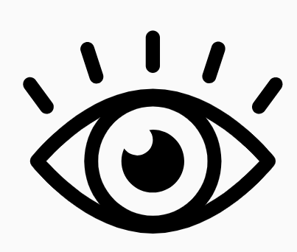
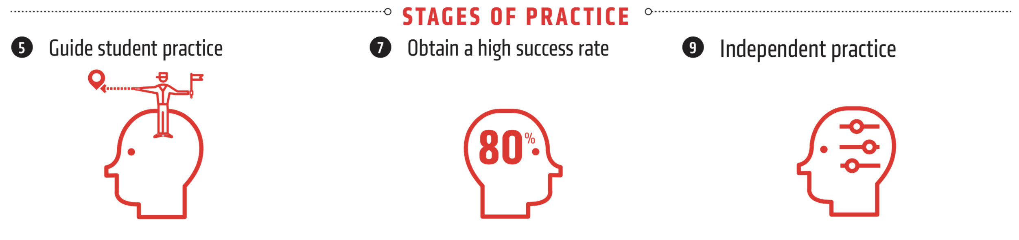
Go to the following link and play the fifth in the series of videos: Rosenshine Masterclass V- Stages of Practice
Watch the video until 15.50.
In the opening of the video, Tom talks us through the importance of practice and how it is often undervalued in the classroom.
Activity 1: 15 minutes
Consider the different ideas about practice we have just seen in this segment of the video as well as some of the strategies on isolating practice before putting it back into the big picture.
Write some notes on these key ideas below:

Slide 3
Activity 2: 20 minutes
We know from previous sessions that being a self-aware practitioner is essential in developing in the classroom.
Reflect on a lesson you have taught recently in which students did not make the progress you wanted them to and complete the reflection grid below.
Outline the lesson. What did you want students to learn? What did they actually learn? | How much practice did you include in the lesson? What did this look like?
How could a greater focus on practice have improved the outcomes of the lesson? | If you were to teach this lesson again, what changes would you make to incorporate more effective practice?

Slide 4
Practising Explanation
Resume the video and watch until 19.10.
This part talks us through the importance of asking students to evaluate, rehearse and improve their explanations. Tom explains that practising explanation is essential in students developing their understanding.
Activity 3: 10 minutes
Think carefully about what we have just been told about practising explanation and make notes on the following questions:
How frequently do you ask students to explain something better? If you do not do this very often, explain why.
What opportunities do you provide for students to evaluate their explanations, rehearse them and then improve them? Give one example of the process you follow when doing this.
How could you adapt your classroom practice to ensure that students are being given the opportunity for this improvement much more frequently?

Slide 5
Sequencing Concepts and Modelling
Resume the video and watch until 21.46.
Tom emphasises the significance of sequencing concepts and modelling and states that if your curriculum is well set up then the rest of it is easier to do and so this is where he suggests people begin.
Activity 4: 15 minutes
This activity requires you to consider the curriculum offer in your subject area.
Think carefully about your learning from these sessions and the focus here on sequencing and modelling.
What improvements or changes would you now like to explore with your team to ensure the curriculum in your area is well set up?
Think about some of the reflections you have made throughout the sessions and gaps you have identified. These might be a good place to start when evaluating as a team.

Slide 6
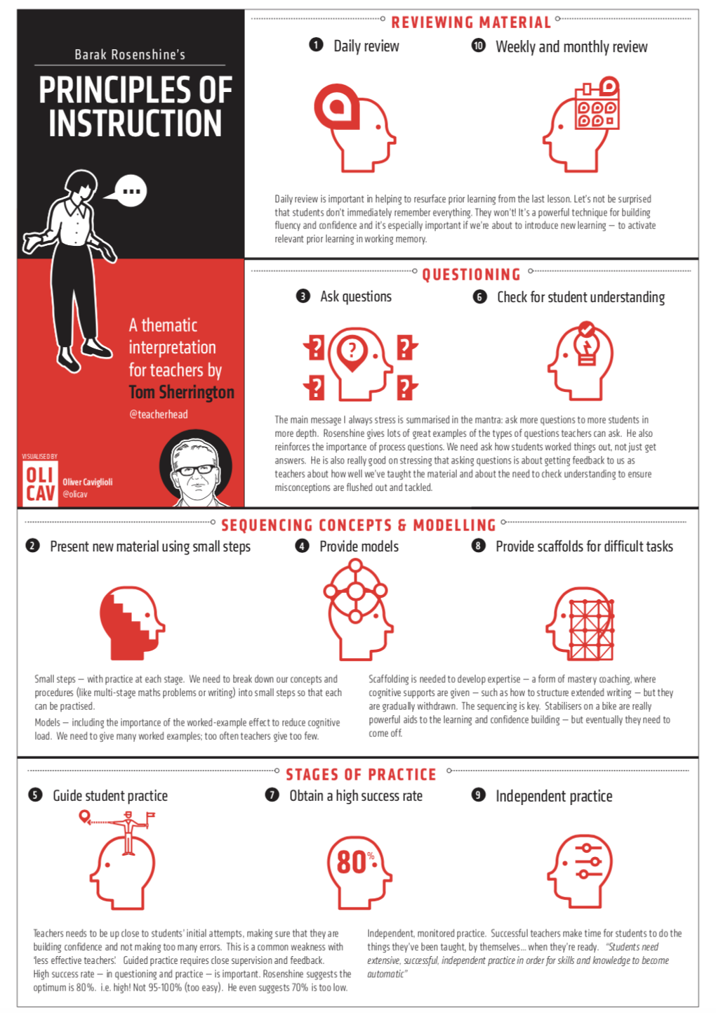
It’s Not a Checklist…
Resume the video and watch until the end.
In the final part of the video, Tom emphasises the fact that this is not a checklist and that we must remember they are principles of what effective instruction will typically have in it.
Activity 5: 25 minutes
Using the final part of the video, make notes around the image below about how the principles can be used most effectively and why it is important to return to the model.

Slide 7
Final Reflections
Activity 6: 20-30 minutes
Take some time to reflect on the video and your learning and make some notes on the following prompts:
Key takeaways from the session are…
I would now like to discuss the following ideas/thoughts/opinions with my team…
I would still like to know more about or need some additional support with…

