Slide 1

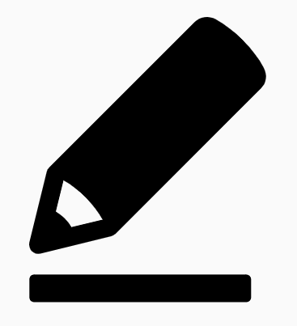
Eden Teaching and Learning
Session 4: Daily, Weekly, Monthly Review
Rosenshine’s Principles in Action by Tom Sherrington
‘A major issue in learning is the inevitable, predictable and natural process of forgetting. Unless we review what we’ve learned, our memory of that information diminishes…’
Welcome to the fourth in a series of five sessions exploring Rosenshine’s Principles in Action by Tom Sherrington (@teacherhead). We will be using this reflection booklet alongside Tom’s videos in which he delivers in depth training on the principles and how they can support us all to be more effective teachers in the classroom.
Whilst it is recommended to complete each session in one sitting, you can of course stop the video at any relevant point and break the session into smaller parts to fit in with your responsibilities.
Simply follow the instructions in this booklet that will provide you with relevant links, tasks and reflection points.
Prior Knowledge Check
Consider your learning from Session 3 and summarise below two questioning techniques, what they involve and how you will use them in the classroom:

Slide 2

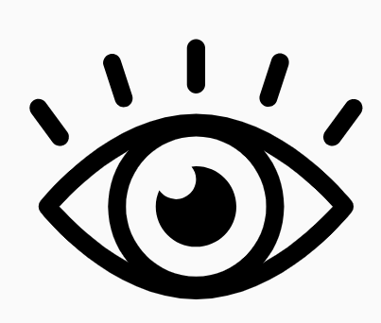

Go to the following link and play the fourth in the series of videos: Rosenshine Masterclass IV- Review
Watch the video until 5.04.
Here Tom introduces the difference between daily and monthly review. He states that the activities might be similar, but the purpose is different.
Activity 1: 15 minutes
Annotate the images below with details given in the video about the different types of review strategies.

Slide 3
Principles of Retrieval Practice
Resume the video and watch until 8.43.
In this section we are introduced to the principles of retrieval practice. You can see these detailed below.
Activity 2: 15 minutes
Write notes in the different sections of the table next to each principle based on the detail and explanation given in the video.
Involve everyone
Make checking accurate and easy
Specify the knowledge
Keep it generative
Vary the diet
Make it time efficient. Make it workload efficient.

Slide 4
Techniques for Retrieval Practice
Resume the video and watch until 14.59.
We are taken through an example of group work in this section and Tom explains how you can improve the accountability of individuals in the group to ensure everyone is learning.
Activity 3: 10 minutes
Take some time to reflect on your own experiences of group work. What might you adapt or change next time you use group work to ensure it is supporting learning?

Slide 5
Use of Terminology
Resume the video and watch until 23.00.
Tom looks at the use of terminology in the classroom and discusses the importance of students needing to say the words they are learning. As teachers we need to ask, do all students know all the words?
Activity 4: 20 minutes
Make some initial notes below on the key information given by Tom regarding the teaching of terminology/vocabulary in the classroom:
Now consider your typical approach to introducing new vocabulary and detail it below:
Taking into account your learning from this section of the video, what steps might you take to make improvements to this practice?

Slide 6
Improving Retrieval Practice
Resume the video and watch until the end.
Tom encourages teachers to reflect on how well they currently do retrieval practice. This links back to Session 1 when we thought about self-awareness and ensuring we were being honest about our own practice.
Activity 5: 25 minutes
How well do you do retrieval practice? Consider the everything discussed in the video and take this into consideration in your response.
What could you specifically tighten up? Give at least two examples of strategies you are going to try and how you will use them in your subject.

Slide 7
Final Reflections
Activity 6: 20-30 minutes
Take some time to reflect on the video and your learning and make some notes on the following prompts:
Key takeaways from the session are…
Thinking about the emphasis on precision of knowledge, key actions I will now take are…
I would still like to know more about or need some additional support with…

