Slide 1

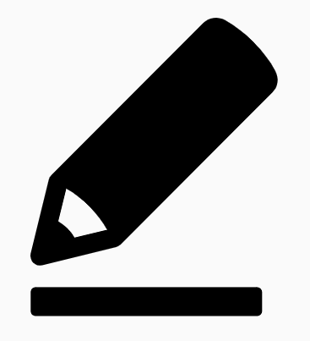
Eden Teaching and Learning
Session 2: Sequencing Concepts and Modelling
Rosenshine’s Principles in Action by Tom Sherrington
‘Rosenshine suggests that more effective teachers recognise the need to deal with the limitations of working memory and succeed in breaking down concepts and procedures into small steps.’
Welcome to the second in a series of five sessions exploring Rosenshine’s Principles in Action by Tom Sherrington. We will be using this reflection booklet alongside Tom’s videos in which he delivers in depth training on the principles and how they can support us all to be more effective teachers in the classroom.
Whilst it is recommended to complete each session in one sitting, you can of course stop the video at any relevant point and break the session into smaller parts to fit in with your responsibilities.
Simply follow the instructions in this booklet that will provide you with relevant links, tasks and reflection points.
Prior Knowledge Quiz
Answer the following question to see how much you can remember from Session 1.
What is cognitive processing?
What are the four key strands of Rosenshine’s principles?
Why is it important for teachers to consider working memory and long term memory?
How can we ensure students are learning and not simply recalling surface level facts?
Summarise Wiliam’s Five Key Strategies.

Slide 2


Go to the following link and play the second in the series of videos: Rosenshine Masterclass II: Sequencing Concepts and Modelling
At 0.50, Tom states that ‘when you start looking at Rosenshine’s principles you are actually looking at how to enact the curriculum you are designing.’
Watch the video until 6.38.
This section talks about how we need to practise multiple steps with students in order to support their understanding and demonstrate multiple stages.
It also discusses the need to revisit and reconnect with topics and form the schema that will then support the next stage. (This is why focusing on knowledge is so essential.)
Activity 1: 15 minutes
Consider your own curriculum area.
What aspects of different topics would your students benefit from you pausing and revisiting existing knowledge before introducing something more operational?
Write your thoughts on this below.
Activity 1 Notes

Slide 3
Worked Examples
Resume the video and watch until 8.52.
In this section, Tom emphasises the importance in using multiple step by step examples to demonstrate processes to students. Rosenshine states that ‘less effective teachers typically use fewer worked examples.’
Activity 2: 15 minutes
Consider the questions below and write your responses next to them.
What opportunities are there for frequent use of worked examples in the schemes of work in your subject area?
It is important to use more than one worked example. Why is this? Can you identify any topics that you teach in which you could make better use of worked examples?
Why is it important that a teacher discusses the underlying principles of what they have done during/after a worked example?

Slide 4
Experience and Knowledge
Resume the video and watch until 17.48.
Tom uses several Science based examples in this section to demonstrate the significance of experience working alongside knowledge to secure understanding. He also discusses the importance of gaining knowledge as well as being given it.
Activity 3: 20 minutes
Take some time to reflect on the following questions:
To what extent does the curriculum in your subject area allow for experience to support knowledge?
Where could you create greater opportunities for this in your curriculum?
3. How could you develop schema building in your subject?

Slide 5
Prior Knowledge
Resume the video and stop it again at 19.43.
Tom focuses on the importance of ensuring students are secure in their prior knowledge here and suggests that a scheme of work begins with some key details of the prior knowledge students would need to effectively access this unit of learning.
Activity 4 : 15 minutes
Consider a unit of work or topic that students typically find quite challenging in your subject and write it below:
What prior knowledge do students need to be able to access this unit of work or topic?
To what extent do you think you allow for revisiting of this and checking of understanding of this?
What could you change or improve in your implementation of the curriculum to take this prior knowledge into account?

Slide 6
Modelling Excellence
Resume the video now until the end.
In this final section, Tom focuses on success criteria needing to work alongside examples to be effective. If students are only exposed to the criteria and not the example, they will be unable to contextualise the criteria.
He also discusses the need for teachers to be modelling excellence and exposing our students to high quality examples.
Activity 5: 10 minutes
On a scale of 1-10, how confident do you feel that you provide
frequent opportunities for students to have exposure to examples alongside criteria?
2 3 4 5 6 7 8 9 10
1= Not confident at all
10= Fully confident.
Thinking specifically about your own teaching, what topics or units of work do you feel would benefit from greater use of examples to accompany criteria?
What steps do you need to take to secure these?

Slide 7
Final Reflections
Activity 6: 20-30 minutes
Take some time to reflect on the video and your learning and make some notes on the following prompts:
Key takeaways from the session are…
My key actions following this session are going to be…
I would still like to know more about or need some additional support with…

