Slide 1
GCSE Design & Technology:
NEA Planning
November 2018

Slide 2

The new GCSE specification
Slide 3
Copyright © AQA and its licensors. All rights reserved.

Slide 3
GCSE D&T Specification at a glance
Paper 1 Written Paper | 50% | Untiered | Single paper of 2 hours duration 100 marks Questions vary from MCQs to extended response
Non-exam assessment NEA | 50% | Untiered | 100 marks Single design and make task Select from a range of given contexts
Slide 4
Copyright © AQA and its licensors. All rights reserved.

Slide 4
Mathematics and science understanding in questions
It is a Department of Education requirement that the use of mathematical skill and scientific understanding be included in all GCSE Design and technology examinations.
15% of the paper is mathematical skill used in an application which is Design and Technology relevant. Pages 57–58 of the specification list the required skills.
The scientific knowledge and skills are listed on Pages 58–59.
Slide 80
Copyright © AQA and its licensors. All rights reserved.

Slide 5
Accessibility of the qualification
All GCSE examinations are intended to be accessible to the full ability range.
The new 1–9 grading system has more differentiation at the higher ability end of the scale.
In the first year of the examination grade boundaries will be based on the legacy specifications, as a result similar percentages of students will obtain grades at each boundary.
5
Copyright © AQA and its licensors. All rights reserved..

Slide 6
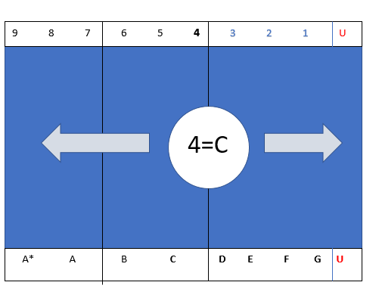
Reform overview – grading (from Ofqual)
Grading the new GCSEs in 2019
In the first year each new GCSE subject is introduced, broadly the same proportion of students will get a grade 4 or above as would have got a grade C or above in the old system.
Copyright © AQA and its licensors. All rights reserved.
6
Copyright © AQA and its licensors. All rights reserved.
Notes:
The new 1-9 grading scale (1 being equivalent to a G) will ensure that the grading is adequately differentiated for all learners. This qualification is accessible to all levels of learners (PLEASE STRESS THIS POINT). As part of wider reforms to GCSE qualifications, the subject content has been made more challenging .
There are 8 existing letter based grades, and 9 numerical ones – so simple matching across is not going to happen.
A grade four is going to be set at the level of the current grade C.
Broadly the same proportion of students that currently achieve an A grade will achieve a grade 7
Grade 9 is slightly above the current A* - we might expect that the top half of the current A* students will achieve a grade 9.
Further explanation of grading is available from Ofqual and the implication to schools.

Slide 7
Marking and Awarding
Standardisation
Lead Examiner and Assistant Principal Examiners mark and scrutinise a range of scripts, to set the standard and find responses at wide mark range. These responses are then used to make any necessary adjustments to the markschemes
1
Assistant Principals work through the mark scheme with their Team Leaders and the selected scripts their team of examiners will use. Team leaders then go through their own standardisation
2
Examiners complete standardisation, to ensure their marking is in line with the standard set by the Lead Examiner by working through marking of the scripts selected.
3
How do we create effective assessment?
Notes:
Standardisation is a crucial part of the process to ensure that candidates are awarded marks fairly, and that the assessment is consistently marked. The initial stages of standardisation take place within a few days following students sitting the examination and exam papers scanned. Throughout the process, examiners are monitored to ensure that the MS is applied consistently, and examiners prevented from marking more.
On the rare occasion where examiners are not consistently applying the correct standard, these examiners can be stopped, and their allocations remarked.

Slide 8
Marking and Awarding
Awarding
Awarding occurs after standardisation, once marking is completed.
Grade boundaries are set by assessing the standard of student work at judgemental boundaries.
This process is driven by statistical analysis of student outcomes and takes into account prior attainment of the cohort as well as expert judgement of the Senior Examining Team.
GCSE Food Preparation and Nutrition is a reformed qualification for 2018; the final grade is based on marks from all papers.
Boundary setting is overseen by Ofqual.
How Grade Boundaries are awarded at AQA
Notes:
The second point is particularly important to consider – grade boundaries are only awarded after students have sat the exam, and marks are entered. This is the reason why, prior to the sitting of this examination, AQA were not able to release grade boundary guidance, and is also a contributing factor as to why grade boundaries change year on year. This process is overseen by the regulator and we must follow specific guidelines in order to ensure no cohort of students is disadvantaged over another

Slide 9
Awarding
A useful link explaining how grade boundaries are calculated:
aqa.org.uk/a-guide-to-awarding
https://www.aqa.org.uk/about-us/what-we-do/getting-the-right-result/how-exams-work/making-the-grades-a-guide-to-awarding

Slide 10
Post Results – what happens next?
Question Paper Review
During the Autumn Term, a detailed analysis of the performance of the question papers takes place (using quantitative and qualitative data).
This process allows us to look at the performance at an item (question), component (paper) and subject level in order to discuss the reasons for patterns that appear in the data. It is particularly useful to see where some questions proved to be effective at assessing students, and also to look at areas for consideration in future series.
There is also opportunity here to put forward any feedback received from teachers in relation to question papers.
This is also an opportunity for the Senior Team to discuss how this influences the future series.
Notes:
The review process involves at different stages a detailed analysis of the exam papers and breaks it down to question level.
What this allows is for those creating the assessment to see how marks were awarded for these items and discuss possible reasons for the patterns shown. Where it shows questions performed well, it allows the team to consider the positive elements of that question type and how they might replicate that success in future questions, and equally for items where students didn’t perform so well, how might that be improved for the future?

Slide 11

NEA
Three contextual challenges will be set annually
Contexts will not carry over
Different approaches, either multi-material or through limited material or technologies, specialist strategies are equally valid
To be completed in approximately 30 – 35 guided learning hours
Produce a prototype and portfolio of evidence (maximum 20 pages)
Portfolios may be paper based or electronic format
50% of the student’s overall grade
11
Copyright © AQA and its licensors. All rights reserved.

Slide 12
Assessment criteria
 | Section | Criteria | Maximum marks
AO1 Identify, investigate & outline design possibilities | A | Identifying & investigating design possibilities | 10
 | B | Producing a design brief & specification | 10
AO2 Design & make prototypes that are fit for purpose | C | Generating design ideas | 20
 | D | Developing design ideas | 20
 | E | Realising design ideas | 20
AO3 Analyse & evaluate | F | Analysing & evaluating | 20
 | Total |  | 100
12
Copyright © AQA and its licensors. All rights reserved.
Notes:
Explain the criteria: AC1 Takes the design from the conceptual challenge to the point where a design brief and specification have been produced.
AC2 assess the refining of the design to the point where the prototype is complete. AC3 is assessing analysis and decision making and evaluative activity across the whole project.
Mention the mark allocations e.g. making now 20 marks

Slide 13
Contextual challenges
Set annually (1st June of penultimate year) through Secure Key Materials on eAQA
Teachers may select a single contextual challenge or alternatively may allow students to choose one from the three provided
All three contextual challenges can be undertaken by any of the materials areas
The release of this challenge will allow teachers to prepare material ready for the start of the final year of study
Example contextual challenges provided in sample materials:
  A high profile sporting event
  Addressing the needs of the elderly
  Children’s learning and play
13
Copyright © AQA and its licensors. All rights reserved.
Notes:
Explain any pre-release materials and levels of control for teachers.
Explain how each task can be completed by any material area
Mention teachers may choose to offer just one task

Slide 14
Analysing the contextual challenges
  Students are expected to analyse a contextual challenge in order to focus on a design possibility.
  Contextual challenges 2018/19:
Addressing the needs of people with disabilities
Supporting Developing Countries
Encouraging a Healthy Lifestyle

Slide 15
Students who don’t follow the set contexts
Now the new term is underway we would like to take the opportunity to remind teachers that new GCSE D&T and AS level D& T (Fashion and Textiles and Product Design) requires all students to respond to a set context. These contexts were released on EAQA in secure key materials on 1st June for students completing their qualification at the end of this academic year. Please do ensure that your students use one of these set contexts as failure to do so may lead to candidates not being able to access the full range of marks.
Candidates studying A level D&T will not be given contexts by AQA, as they are expected to write their own as an initial step in their NEA

Slide 16
The iterative process
Investigating
Developing
Realising
Evaluating
Generating
Notes:
Explain the criteria: AO1 Takes the design from the conceptual challenge to the point where a design brief and specification have been produced – it can be assessed through the whole portfolio.
AO2 assess the refining of the design to the point where the prototype is complete. AO3 is assessing analysis and decision making and evaluative activity across the whole project.
Mention the mark allocations e.g. making now 20 marks

Slide 17
Section A: Identifying & investigating design possibilities
4.4.4.1 Section A: Identifying & investigating design possibilities (10 marks)
By analysing the contextual challenge students will identify design possibilities, investigate client needs and wants and factors including economic and social challenges. Students should also use the work of others (past and/or present) to help them form ideas. Research should be concise and relate to their contextual challenge. Students are also advised to use a range of research techniques (primary/secondary) in order to draw accurate conclusions. Students should be encouraged to investigate throughout their project to help inform decisions.
Mark band | Description
9 – 10 | Design possibilities identified and thoroughly explored, directly linked to a contextual challenge demonstrating excellent understanding of the problems/opportunities. A user/client has been clearly identified and is entirely relevant in all aspects to the contextual challenge and student has undertaken a comprehensive investigation of their needs and wants, with a clear explanation and justification of all aspects of these. Comprehensive investigation into the work of others that clearly informs ideas. Excellent design focus and full understanding of the impact on society including; economic and social effects. Extensive evidence that investigation of design possibilities has taken place throughout the project with excellent justification and understanding of possibilities identified.
17
Copyright © AQA and its licensors. All rights reserved.
Notes:
Go through the introduction paragraph to give ideas on what we are expecting.
Emphasise:
Link to contextual challenge
Primary & secondary research
User or Client
Investigation work throughout

Slide 18
NEA do’s and don’ts – Section A
Do:
relate investigations to the contextual challenge
clearly identify the client or user
carry out primary research
investigate the work of others
reflect on the impact on society
ensure investigation work actually informs design ideas
credit investigation work throughout.
Do not:
encourage irrelevant research
see investigation as something that only happens at the beginning.
18
Copyright © AQA and its licensors. All rights reserved.

Slide 19
Section B: Producing a design brief & specification
4.4.4.2 Section B: Producing a design brief & specification (10 marks)
Based on conclusions from their investigations students will outline design possibilities by producing a design brief and design specification. Students should review both throughout the project.
Mark band | Description
9 – 10 | Comprehensive design brief which clearly justifies how they have considered their user/client’s needs and wants and links directly to the context selected. Comprehensive design specification with very high level of justification linking to the needs and wants of the client/user. Fully informs subsequent design stages.
19
Copyright © AQA and its licensors. All rights reserved.
Notes:
Really important stage of the portfolio!!!!
Without this it will impact on the analysis and evaluating stages
Ensure the brief takes into account any analysis into the context analysis and clearly identifies the user/client
Specification must be clear and SMART criteria:
Specific
Measureable
Achievable
Realistic
Time

Slide 20
NEA do’s & don’ts – Section B
Do:
relate design brief to the contextual challenge
ensure the specification criteria have real purpose
make the criteria measurable
clearly address the clients or users needs and wants
take into account any investigations
justify your points clearly
ensure this informs your design stages.
Do not:
over structure the approach
produce generic statements.
20
Copyright © AQA and its licensors. All rights reserved.

Slide 21
Section C: Generating design ideas
4.4.4.3 Section C: Generating design ideas (20 marks)
Students should explore a range of possible ideas linking to the contextual challenge selected. These design ideas should demonstrate flair and originality and students are encouraged to take risks with their designs. Students may wish to use a variety of techniques to communicate. Students will not be awarded for the quantity of design ideas but how well their ideas address the contextual challenge selected. Students are encouraged to be imaginative in their approach by experimenting with different ideas and possibilities that avoid design fixation. In the highest band students are expected to show some innovation by generating ideas that are different to the work of the majority of their peers or demonstrate new ways of improving existing solutions.
Mark band | Description
16 – 20 | Imaginative, creative and innovative ideas have been generated, fully avoiding design fixation and with full consideration of functionality, aesthetics and innovation. Ideas have been generated, that take full account of on-going investigation that is both fully relevant and focused. Extensive experimentation and excellent communication is evident, using a wide range of techniques. Imaginative use of different design strategies for different purposes and as part of a fully integrated approach to designing
21
Copyright © AQA and its licensors. All rights reserved.
Notes:
Similar to initial ideas stages.
Emphasise avoiding design fixation.
No set amount of sketches they just need to show imaginative, creative and innovative flair
Link investigation work
Use a range of strategies e.g. sketches(2D, 3D), modelling, CAD, Diagrams etc

Slide 22
NEA do’s & don’ts – Section C
Do:
encourage flair originality and risk taking
annotate designs and explain your points
relate your designs to any investigation work
encourage different design approaches.
Do not:
over generate ideas
become fixated on a design or a strategy
allow the quality of sketch to be more important than quality of the idea.
22
Copyright © AQA and its licensors. All rights reserved.

Slide 23
Section D: Developing design ideas
4.4.4.4 Section D: Developing design ideas (20 marks)
Students will develop and refine design ideas. This may include, formal and informal 2D/3D drawing including CAD, systems and schematic diagrams, models and schedules. Students will develop at least one model, however marks will be awarded for the suitability of the model(s) and not the quantity produced. Students will also select suitable materials and components communicating their decisions throughout the development process. Students are encouraged to reflect on their developed ideas by looking at their requirements; including how their designs meet the design specification. Part of this work will then feed into the development of a manufacturing specification providing sufficient accurate information for third party manufacture, using a range of appropriate methods, such as measured drawings, control programs, circuit diagrams, patterns, cutting or parts lists.
Mark band | Description
16 – 20 | Very detailed development work is evident, using a wide range of 2D/3D techniques (including CAD where appropriate) in order to develop a prototype. Excellent modelling, using a wide variety of methods to test their design ideas, fully meeting all requirements. Fully appropriate materials/components selected with extensive research into their working properties and availability. Fully detailed manufacturing specification is produced with comprehensive justification to inform manufacture.
23
Copyright © AQA and its licensors. All rights reserved.
Notes:
Developing draws on the generation and investigation stages.
See this as the decision stage. It allows student to test, develop, take risks in order to create a final solution.
Emphasise the importance of developing a Manufacturing Specification.

Slide 24
NEA do’s & don’ts – Section D
Do:
use a range of techniques to develop designs
model and test designs
investigate and justify material and component selection
produce a manufacturing specification eg cutting list, parts list, working drawing etc
explain your decisions.
Do not:
concentrate on irrelevant materials
artificially separate generating and developing ideas, and investigation.
24
Copyright © AQA and its licensors. All rights reserved.

Slide 25
Section E: Realising design ideas
4.4.4.5 Section E: Realising design ideas (20 marks)
Students will work with a range of appropriate materials/components to produce prototypes that are accurate and within close tolerances. This will involve using specialist tools and equipment, which may include hand tools, machines or CAM/CNC. The prototypes will be constructed through a range of techniques, which may involve shaping, fabrication, construction and assembly. The prototypes will have suitable finish with functional and aesthetic qualities, where appropriate. Students will be awarded marks for the quality of their prototype(s) and how it addresses the design brief and design specification based on a contextual challenge.
Mark band | Description
16 – 20 | The correct tools, materials and equipment (including CAM where appropriate) have been consistently used or operated safely with an exceptionally high level of skill. A high level of quality control is evident to ensure the prototype is accurate by consistently applying very close tolerances. Prototype shows an exceptionally high level of making/finishing skills that are fully consistent and appropriate to the desired outcome. An exceptionally high quality prototype that has the potential to be commercially viable has been produced and fully meets the needs of the client/user.
25
Copyright © AQA and its licensors. All rights reserved.
Notes:
This slide is important as making has decreased from 32 to 20 marks. To reflect the amount of time available.
Focus on the following:
The term prototype not product.
Use of CAD/CAM and appropriate equipment
It is about how it meets the clients need and potentially commercially viable
We are not expecting a perfect product but a good idea that has been executed well.
Mention the importance of providing high quality photos as there are no visits

Slide 26
NEA do’s & don’ts – Section E
Do:
show clear quality control checks
take pictures to record the stages and techniques used for making
take a range of final photos of the prototype
annotate the CRF explaining what techniques have been used.
Do not:
take poor quality/minimal photos
limit the techniques used
spend a disproportionate amount of time on this section.
26
Copyright © AQA and its licensors. All rights reserved.

Slide 27
Section F: Analysing & evaluating
4.4.4.6 Section F: Analysing & evaluating (20 marks)
Within this iterative design process students are expected to continuously analyse and evaluate their work, using their decisions to improve outcomes. This should include defining requirements, analysing the design brief and specifications along with the testing and evaluating of ideas produced during the generation and development stages. Their final prototype(s) will also undergo a range of tests on which the final evaluation will be formulated. This should include market testing and a detailed analysis of the prototype(s).
Mark band | Description
16 – 20 | Extensive evidence that various iterations are as a direct result of considerations linked to testing, analysis and evaluation of the prototype, including well considered feedback from third parties. Comprehensive testing of all aspects of the final prototype against the design brief and specification. Fully detailed and justified reference is made to any modifications both proposed and undertaken. Excellent on-going analysis and evaluation evident throughout the project that clearly influences the design brief and the design and manufacturing specifications.
27
Copyright © AQA and its licensors. All rights reserved.
Notes:
This section should not just happen at the end.
Analysis should have happened throughout the project to form a brief and both specifications.
Feedback must have a purpose and client/user testing would be strongly recommended.
Don’t see this as the end of the process but the start of future developments……Dyson didn’t just create one vacuum they continue develop and change to make future improvements

Slide 28
NEA do’s & don’ts – Section F
Do:
encourage analysis throughout
test against the criteria
test the prototype with the client or user and third parties
discuss future modifications/improvements
look at the prototype’s strengths and weaknesses
include photographic evidence of any testing.
Do not:
see the evaluation as something at the end of the project
rely excessively on peer assessments
reward for testing that is not relevant.
28
Copyright © AQA and its licensors. All rights reserved.
Notes:
Maybe more to add here.

Slide 29
Prototype examples
Definition:
…a functioning design outcome. A final prototype could be a highly finished product, made as proof of concept prior to manufacture, or working scale models of a system where a full-size product would be impractical. DfE
Our expectations:
demonstrates high level of skill
elements showing a high quality finish
CAM maybe a common feature
scale models where necessary.

Slide 30
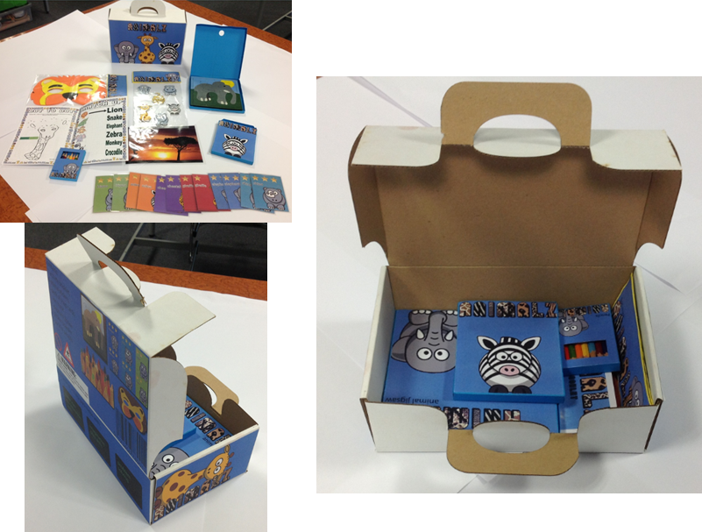
Section E: Prototype expectations
Notes:
Talk about use of CAD/CAM and how elements may be finished etc

Slide 31
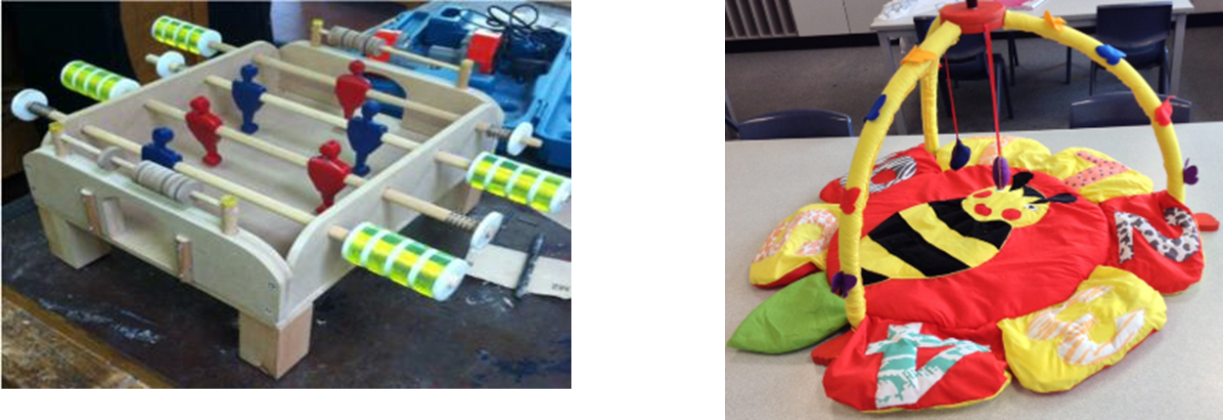
Section E: Prototype expectations
Notes:
Talk about use of CAD/CAM and how elements may be finished etc

Slide 32
Example portfolios
What is included:
20 page example portfolio
CRF – marked as a teacher with marks & teacher annotation
commentary – why marks have been awarded & what could be improved.
Notes:
Explain examples will be available of eAQA for each material area.
More will be developed throughout the year.

Slide 33
Section A: NEA dos and don’ts
Do:
relate investigations to the contextual challenge
clearly identify the client or user
carry out primary research
investigate the work of others
reflect on the impact on society
ensure investigation work actually informs design ideas
credit investigation work throughout.
Don’t:
over-structure the approach
produce generic statements.

Slide 34
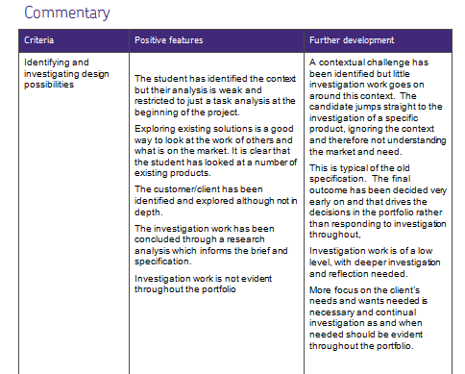
Section A: Identifying and investigating design possibilities
4/10

Slide 35
Section B: NEA dos and don’ts
Do:
relate design brief to the contextual challenge
ensure specification criteria have real purpose
make criteria measurable
clearly address the clients’ or users’ needs and wants
take into account any investigations
justify your points clearly
ensure this informs your design stages.
Don’t:
over-structure the approach
produce generic statements.

Slide 36
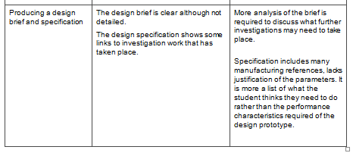
Section B: producing a design brief and specification
5/10

Slide 37
Section C: NEA dos and don’ts
Do:
encourage flair originality and risk taking
annotate designs and explain your points
relate your designs to any investigation work
encourage different design approaches.
Don’t:
over-generate ideas
become fixated on a design or strategy
allow the quality of sketch to be more important than quality of the idea.

Slide 38
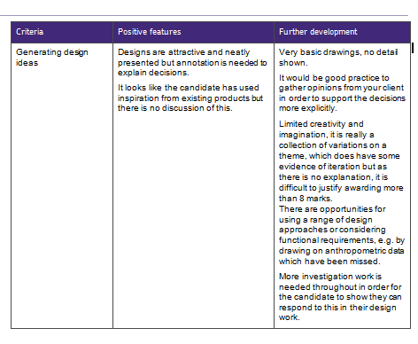
Section C: Generating design ideas
8/20

Slide 39
Section D: NEA dos and don’ts
Do:
use a range of techniques to develop designs
model and test designs
investigate and justify material and component selection
produce a manufacturing specification eg cutting list, parts list, working drawing etc
explain your decisions.
Don’t:
concentrate on irrelevant materials
artificially separate generating and developing ideas and investigation.

Slide 40
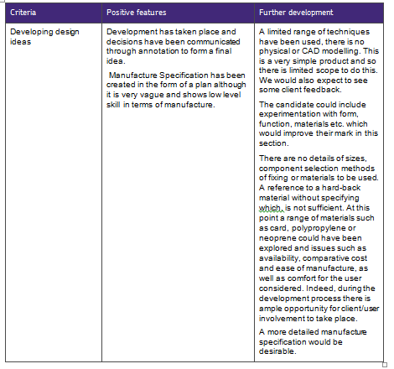
Section D: Developing design ideas
5/20

Slide 41
Section E: NEA dos and don’ts
Do:
show clear quality control checks
take pictures to record the stages and techniques used for making
take a range of final photos of the prototype
annotate the CRF explaining what techniques have been used.
Don’t:
take poor quality/minimal photos
limit the techniques used
spend a disproportionate amount of time on this section

Slide 42
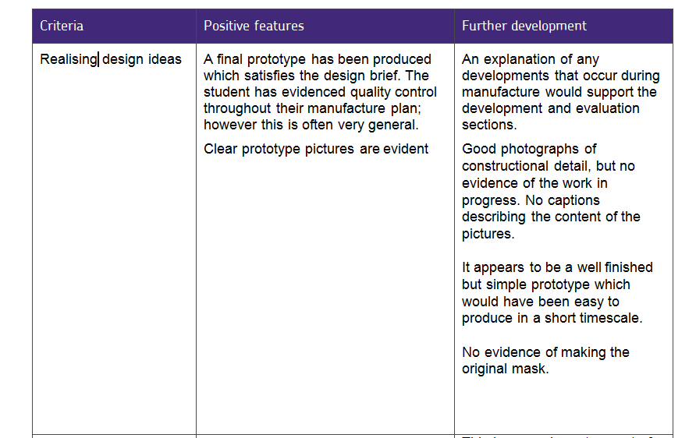
Section E: Realising design ideas
9/20

Slide 43
Section F: NEA dos and don’ts
Do:
encourage analysis throughout
test against the criteria
test the prototype with the client or user and third parties
discuss future modifications/improvements
look at the prototype’s strengths and weaknesses
include photographic evidence of any testing.
Don’t:
see the evaluation as something at the end of the project
rely excessively on peer assessments
reward for testing that is not relevant.

Slide 44
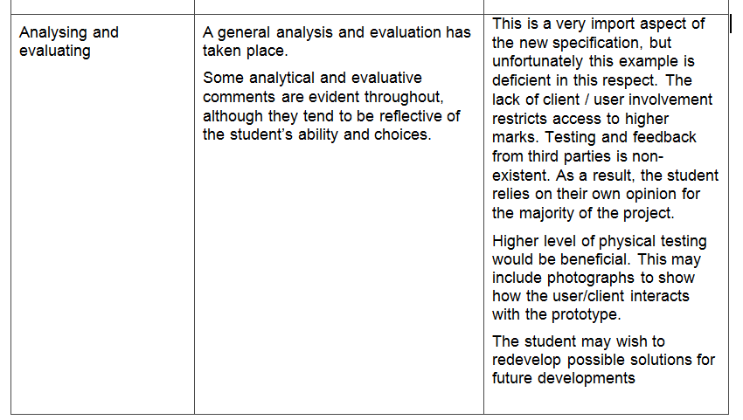
Section F: Analysing and evaluating
7/20

Slide 45
Marking grid
Example 1 | Section | Criteria | Final mark
AO1 | A | Identifying and investigating design possibilities | 4
 | B | Producing a design brief and specification | 5
AO2 | C | Generating design ideas | 8
 | D | Developing design ideas | 5
 | E | Realising design ideas | 9
AO3 | F | Analyse and evaluate | 7
 |  | Total | 38

Slide 46
Levels of control – Feedback
Do:
Provide generic feedback
Explain syntax in general terms
Advise on resources that could be used
Remind students of the key sections needed in their folder
Encourage students to draw from prior knowledge
Do not:
Correct students work
Provide specific guidance
Provide templates or model answers
Give examples of how to implement
Provide feedback when work is incomplete
Notes:
Allow 15-20 minutes then go through the actual marks

Slide 47
Levels of control
We recommend that students should spend approximately 30-35 hours (unless specific access requirements need to be considered)
Teachers must follow the JCQ NEA guidance when setting tasks
If a part of a prototype has been produced by a 3rd party (eg welding) you must declare this on the Candidate Record Form (CRF)
Notes:
Allow teachers to discuss how they feedback to share good practice.

Slide 48
Preparing for moderation
Folders can be submitted electronically or paper based
Ensure clear pictures of the prototype(s) are present
Ensure the CRF is clear and shows where the evidence can be found
Post samples in good time (within 5 working days)
If you have any issues contact your adviser and/or moderator
Notes:
Revisit CRF to ensure they know what they are doing.

Slide 49
Final summary
Look at the SOW and use this as a guide
Develop NEA skills before they start their NEA
Mark the portfolio holistically
Use TOLS to support standardisation
Provide detailed CRF and pictures of the final prototype

Slide 50
NEA support and resources
NEA advisers
T-OLS
Marked examples
SOW
CPD
Approved publishers – PG Online and Hodder

Slide 51
Contact points
Contact us
aqa.org.uk/contact-us
Customer Support Team
Tel: 0161 957 3334
Email: dandt@aqa.org.uk
Events Team
0161 696 5994
events@aqa.org.uk
aqa.org.uk/professional-development

Slide 52

Your questions
52
Copyright © AQA and its licensors. All rights reserved.
Notes:
Give opportunity for questions and comments (if appropriate)

Slide 53
Thank you

