Slide 1
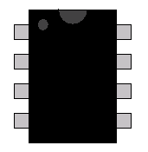
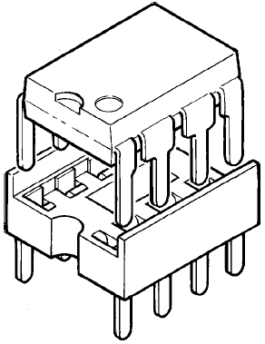
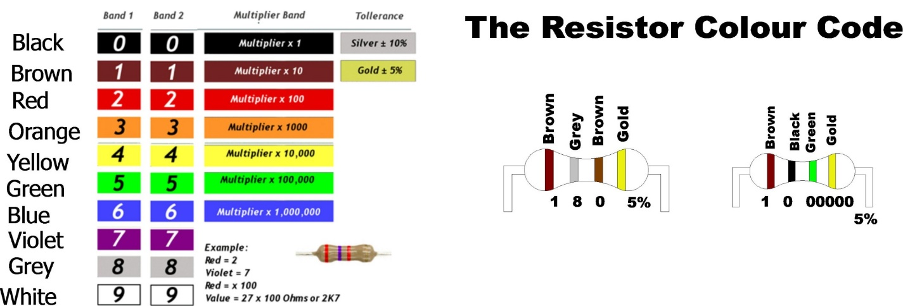
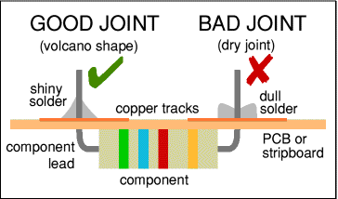
KS3 KEY KNOWLEDGE & SKILLS
designtechnology
Year 7 Electronics
HOW TO SOLDER WELL
Hold the soldering iron like a pen, near the base of the handle.
Imagine you are going to write your name! Remember to never touch the hot element or tip.
Touch the soldering iron onto the joint to be made.
Make sure it touches both the component leg and the track. Hold the tip there for a five seconds and...
Feed a little solder onto the joint.
It should flow smoothly onto the track to form a volcano shape as shown in the diagram.
Remove the solder, then the iron, while keeping the joint still.
Allow the joint a few seconds to cool before you move the circuit board. If you burn your finger then put it under cold running water immediately
Inspect the joint closely.
It should look shiny and have a 'volcano' shape. If not, you will need to reheat it and feed in a little more solder.
Integrated circuits (or I.C’s) are everywhere! They are an electronics circuit on a microchip.
The Genie 08 microcontroller is the I.C that we are using in the year 7 project. The chip is shown below
The pins on the chip are numbered in an anti-clockwise direction
1
8
The IC chips fit into sockets. The socket is soldered into the circuit first and then the chip is ‘pushed’ into the socket
2
7
3
6
4
5
Resistors are components which ‘slow down’ the flow of electrical current through an electronic circuit. Their resistance value, measured in ohms, is found using the coloured bands and the chart below
Year 7 keywords and terms
Printed circuit board (PCB), Microcontroller, Light emitting diode (LED), solder, soldering iron, Wire cutters, pliers, multi core wire, components, resistor, capacitor, transistor, diode, sponge.
Module learning outcomes
Produce a WORKING sensor alarm PCB (Genie 08)
Programme your microcontroller to become a sensor alarm
Produce an original (one off) case design for your product
Produce a blister style packaging design for your product
Module learning objectives
Work to develop/improve your soldering skills to GCSE level 4+ standard
Increase your understanding of the tools used in building electronic circuits
Develop your skills in microcontroller programming and the software used
CHOOSE A FUTURE THAT’S BETTER
‘BETTER BY DESIGN’

Slide 2
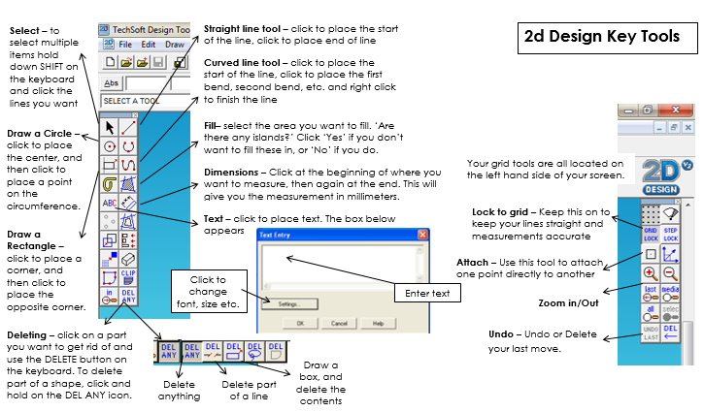
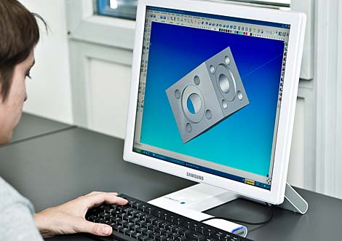
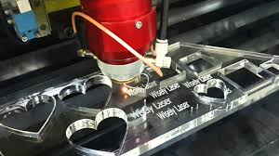
KS3 KEY KNOWLEDGE & SKILLS
designtechnology
Year 7 Product Design
Module learning objectives:
To be able to analyse a design problem
To be able to use product analysis
How to use primary data to understand a customers needs
To be able to generate a range of creative ideas
How to develop design ideas
Module learning outcomes:
To produce a functioning earphone holder.
To use CAD/CAM to produce a laser cut product.
Year 7 keywords and terms
Product analysis, function, design problem, design brief, aesthetics, user profile, initial ideas, creative, design development, CAD (computer aided design), CAM (computer aided manufacture)
Annotation/labelling your design ideas:
Why is the design successful/unsuccessful? Is there space for the ear buds, wire wrapping & jack plug? Is it safe to use? Does it look good?
Are there any changes you would need to make?
Is it suitable for your user/target market and their likes? How?
Get someone else to give you some feedback i.e. which is their favourite & why?
What is Computer Aided Design (CAD)?
Computer Aided Design (CAD) is mainly used for detailed engineering of 3D models and 2D drawings of physical components. The designed product on the computer can be tested, modified and finalised for real production
What is Computer Aided Manufacturing (CAM)?
CAM is used for planning the different manufacturing operations to create a product. CAM involves milling, drilling, turning, punching, laser and plasma cutting and additive manufacturing (3D printing). CAM uses data from CAD software to control automated machinery and generate tool paths to ensure the part machined is the same as the model.
User/customer profile
It is important consider who your customer is & to think about their likes, needs and wants from the product you are designing. The designer can then ensure they are meeting their requirements.
Design development
Design development is about looking at your ideas and improving or refining them through iterative design.
Iterative design is a methodology based on a cyclical process of analysing, prototyping and testing to refine a product. Each iteration and result starts the process again.
CHOOSE A FUTURE THAT’S BETTER
‘BETTER BY DESIGN’

Slide 3

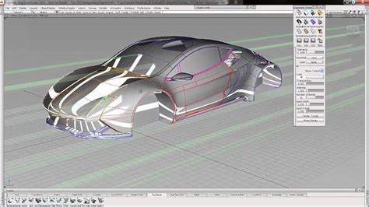
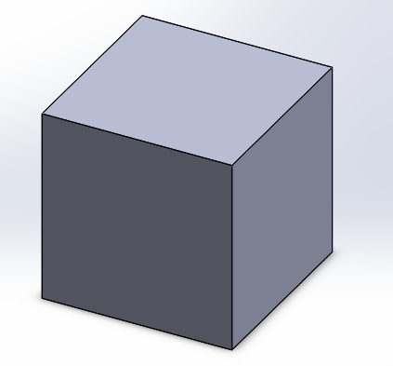
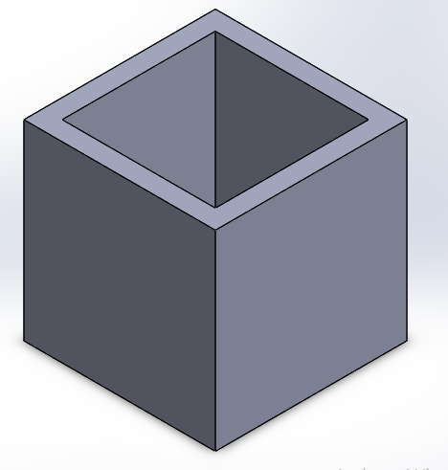
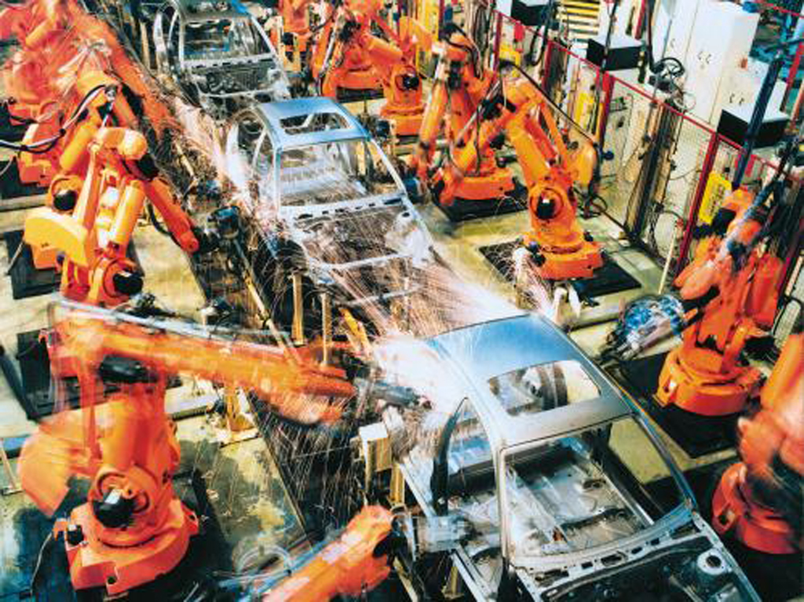
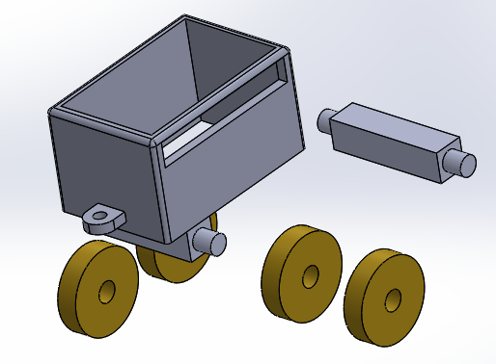
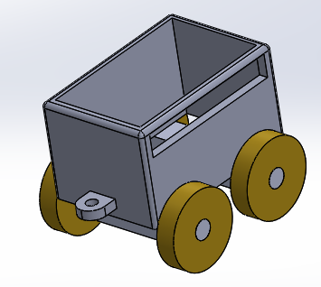
KS3 KEY KNOWLEDGE & SKILLS
designtechnology
Year 7 CAD
HOW TO USE SOLIDWORKS
Open SolidWorks 2018 Edition
File
New
Select Part, to create a model from a single piece.
Features can be added to the Sketch using the
Features Tab.
Basic features include Extrude Boss/Base
where the sketch is pulled out into a 3D form.
Or Extrude Cut where a sketch can be placed
on a 3D form and cut in to make a cavity or recess.
Select Assembly, to create a model from multiple
pre-made parts that can be ‘mated’ (joined) together.
Computer-aided design
Computer-aided design is the use of computer systems to aid in the creation, modification, analysis, or optimization of a design. CAD software is used to increase the productivity of the designer, improve the quality of design, improve communications through documentation, and to create a database for manufacturing. CAD output is often in the form of electronic files for print, machining, or other manufacturing operations.
Computer-aided Manufacture
Computer-aided manufacturing (CAM) is an application technology that uses computer software and machinery to facilitate and automate manufacturing processes. CAM is the successor of computer-aided engineering (CAE) and is often used in tandem with computer-aided design (CAD).
Year 7 keywords and terms
Computer Aided Design, Computer Aided Manufacture, SolidWorks, TechSoft 2D, Google SketchUp, AutoCAD, Extrude Boss/Base, Extrude Cut, Fillet, Smart Dimensions, Planes, Render Appearances, Scale, Proportion.
Module learning outcomes
Produce a CAD 3D model of a London bus
Assemble a TOY TRAIN from pre-designed parts
Render all models with correct materials and appearances
Produce learning journal that reflect on and consolidate learning
Module learning objectives
Work to develop/improve your 3D modelling skills to GCSE level 4+ standard
Increase your understanding of how CAD/CAM is utilised within industry
Develop your skills in modelling from a single part as well as creating models from multiple parts
CHOOSE A FUTURE THAT’S BETTER
‘BETTER BY DESIGN’

Slide 4
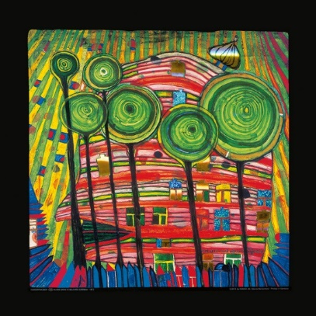
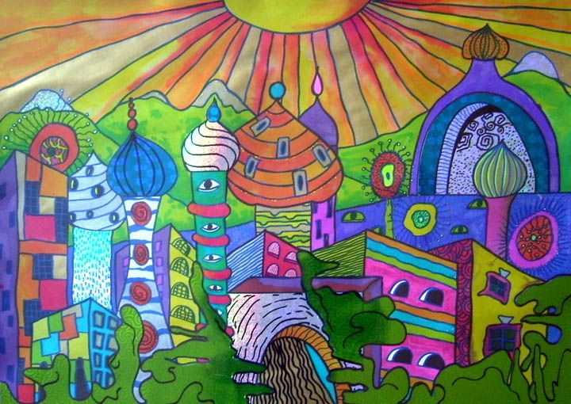
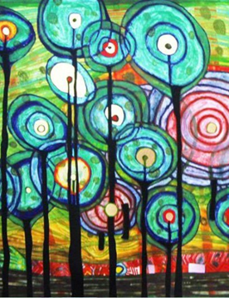
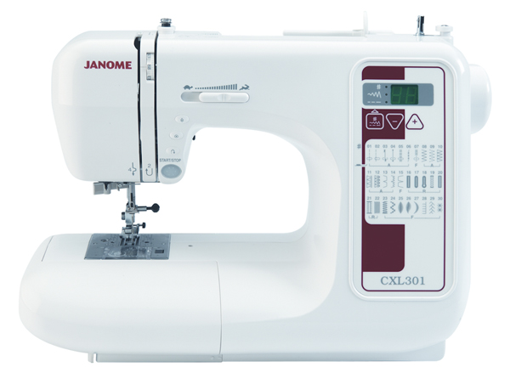
KS3 KEY KNOWLEDGE & SKILLS
designtechnology
Year 7 TEXTILES
Health & Safety Rules for Textiles
Pupils should wait OUTSIDE the room for a member of staff.
COATS should be hung on hooks or on backs of chairs.
BAGS should be placed in the bag store near the door as you enter the room.
No FOOD or DRINK is allowed in the classroom near the desks and the machine bench.
Long hair MUST be tied back when doing any practical task.
All electrical equipment – irons, machines, overlockers, waxpots etc.. are only to be used when you have permission from a member of staff.
Use equipment correctly and safely, following the specific instructions.
DO NOT TOUCH any equipment, materials etc unless you are told to do so.
Keep your work area tidy.
Report any breakages / damages immediately.
Hundertwasser
Hundertwasser is a German artist famous for his unique and visionary paintings, art and architecture that reflect his philosophy of interaction between human beings and nature. He is well-known for being an independent artist, with a unique style of artwork. He is also very famous for his efforts in the field of environmental protection.
Bold, colourful, abstract, eccentric, stylised, dramatic, vibrant
What colours does the artist use?
What kind of shapes can you find?
What kind of patterns can you see?
Sewing Machine Instructions
To Begin to Machine
Place the material under the presser foot.
Lower the presser foot gently.
Lower the needle into the fabric and press the foot control bringing the handwheel towards you.
Never push or pull the material through the machine, guide it slowly.
Remember to keep your fingers well away from the needle.
To Turn a corner
STOP with the needle down in the fabric.
LIFT the presser foot
TURN the fabric
LOWER the presser foot
  When stitching is completed, always pull the work out the left of the machine
  REMEMBER to leave a tail of two threads at the back of the machine.
To Finish off Machine Stitching
Put the machine into reverse and stitch back over the line of machine stitching for approximately 1.5cm.
Cut off the ends of the threads.
The Sewing Machine
This is a picture of the sewing machine you are going to be using in Textiles.
There are some key parts of the sewing machine you will need to know the names of.
The Handwheel
Presser foot
Needle
Take-up lever
Start/stop button
Reverse button
Digital display panel
Year 7 keywords and terms
Designing: Hundertwasser, initial designs, developed designs, final design, repeat patterns surface decoration, cushion designs
Surface decoration: Transfer printing, tempera paper, disperse dyes, heat press, polyester satin fabric
Making :Health & safety, Sewing Machine, Seam allowance, stitching line, pins interfacing, right side (RS) wrong side (ws), front panel , back panel, cushion
Module learning objectives
Learn how to safely use the sewing machine
Develop designing skills
Learn a method of surface decoration – transfer printing
Module learning outcomes
Produce two sewing machine skills samples
Produce a range of design ideas for cushion
Create a transfer print inspired by a German artist Hundertwasser
Produce a cushion
CHOOSE A FUTURE THAT’S BETTER
‘BETTER BY DESIGN’

Slide 5
KS3 KEY KNOWLEDGE & SKILLS
designtechnology
Year 7 FOOD
CHOOSE A FUTURE THAT’S BETTER
‘BETTER BY DESIGN’

Slide 6
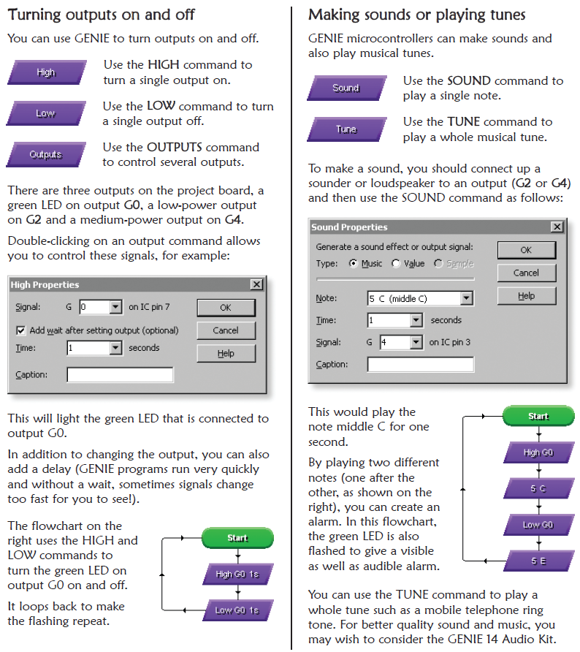
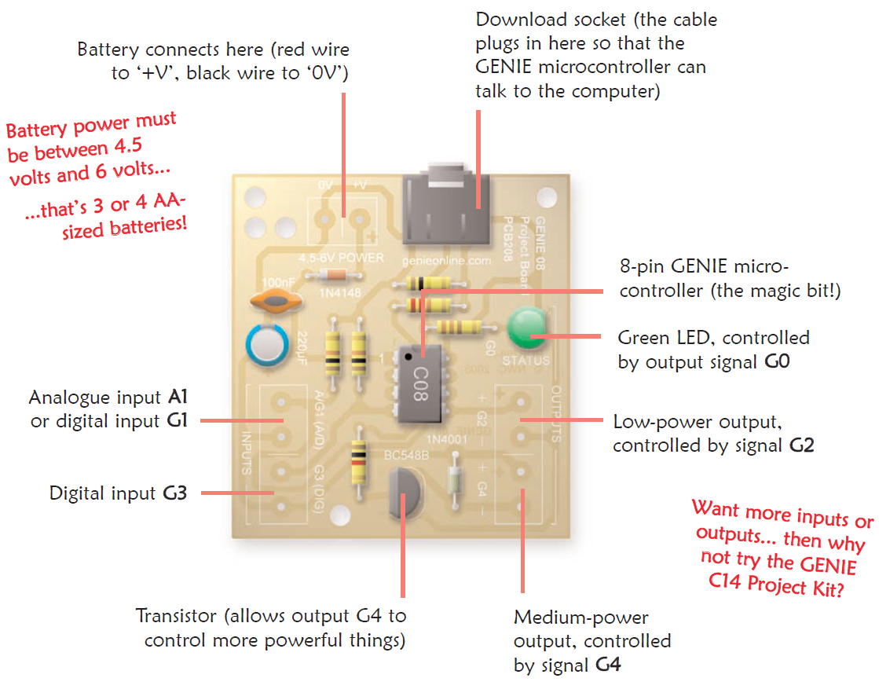
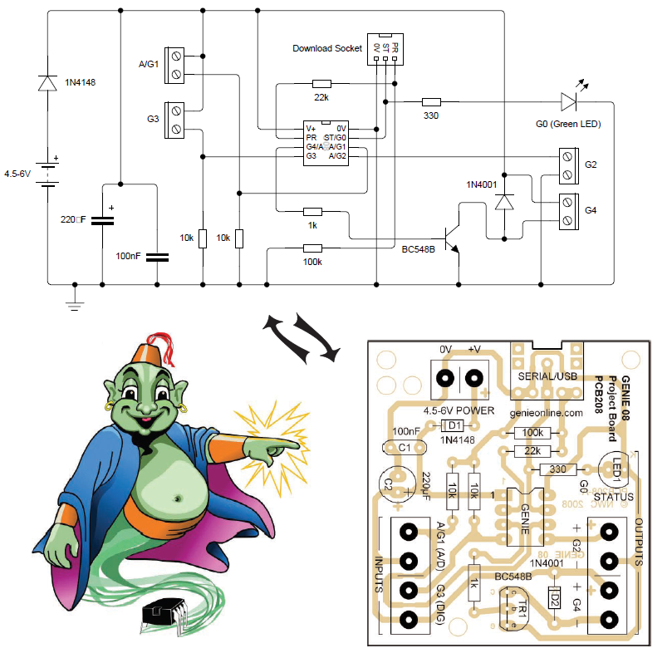
KS3 KEY KNOWLEDGE & SKILLS
designtechnology
Year 8 Electronics
This is the genie 08 circuit layout and circuit diagram. This show you how all the components in the circuit are connected on the actual circuit board you will build in this module.
Circuit diagrams are made up of circuit symbols rather than actual components which are difficult to draw
We can program our genie microcontroller using a range of commands that we then connect together in a ‘flow chart’. The most common of these commands are the ‘high’ and ‘low’ boxes, used to control output components, like an LED for example. Digital and analogue command boxes are used to control out input components such as switches (digital) and sensors (analogue)
The key to a program working successfully is using the correct commands in the correct order or ‘flow’.
Module learning outcomes
Produce a WORKING lie detector PCB
Programme your microcontroller to become a lie detector
Produce an original (one off) case design for your product
Produce a blister style packaging design for your product
Module learning objectives
Work to develop/improve your soldering skills to GCSE level 5+ standard
Further increase your understanding of the tools used in building electronic circuits
Further develop your skills in microcontroller programming and the software used
CHOOSE A FUTURE THAT’S BETTER
‘BETTER BY DESIGN’

Slide 7
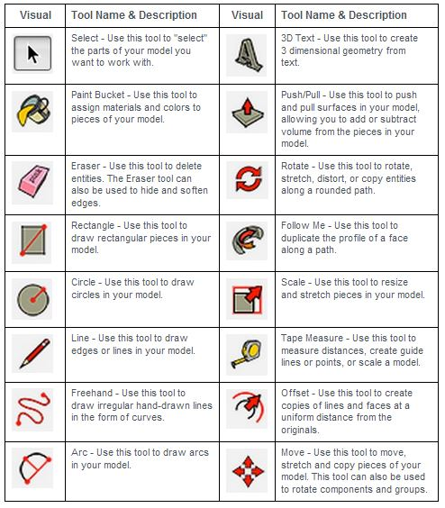
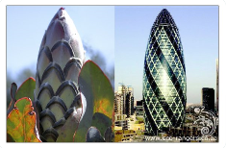
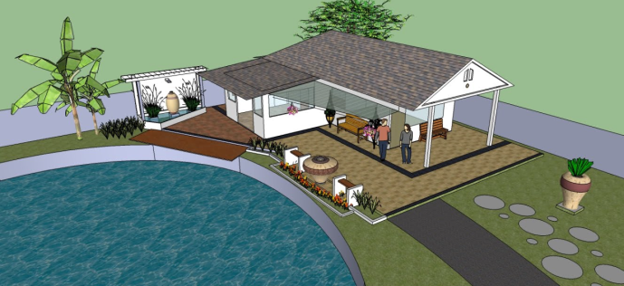
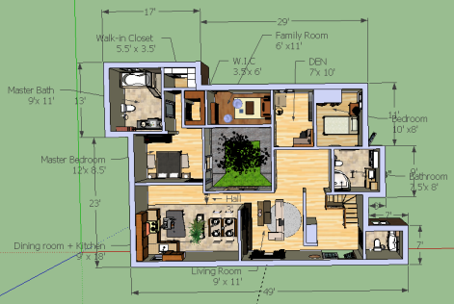
KS3 KEY KNOWLEDGE & SKILLS
designtechnology
Year 8 CAD
Module learning objectives:
How to use secondary data to understand a target markets needs
To be able to generate a range of creative ideas
To be able to use 3D CAD (computer aided design) software
Module learning outcomes:
To create a 3D piece of architecture
.To produce a professional looking portfolio of work.
Year 8 keywords and terms
Research, function, design brief, aesthetics, initial ideas, creative, CAD (computer aided design), design specification, evaluation, Sketch Up, biomimicry
Sketch Up- main tools
Biomimicry
Bio means life; mimicry means imitate. So biomimicry is the practice of imitating life. It looks to Nature to provide inspiration and direction to sustainably solve our most pressing challenges; it’s innovation & design inspired by nature.
What is Computer Aided Design (CAD)?
Computer Aided Design (CAD) is mainly used for detailed engineering of 3D models and 2D drawings of physical components. The designed product on the computer can be tested, modified and finalised for real production.
What is a Design Specification?
A list of criteria that the design should meet.
It should consider the research that has been done.
Should start with a point and then be justified e.g. My building with use bamboo as this is a more eco-friendly material.
CHOOSE A FUTURE THAT’S BETTER
‘BETTER BY DESIGN’

Slide 8
KS3 KEY KNOWLEDGE & SKILLS
designtechnology
Year 8 FOOD
CHOOSE A FUTURE THAT’S BETTER
‘BETTER BY DESIGN’

Slide 9
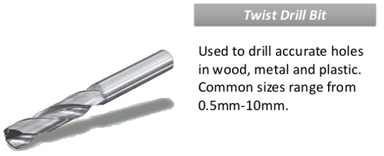
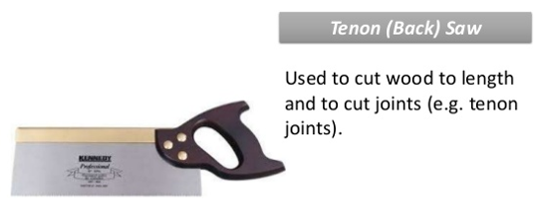
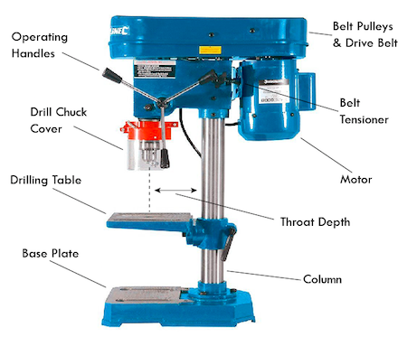
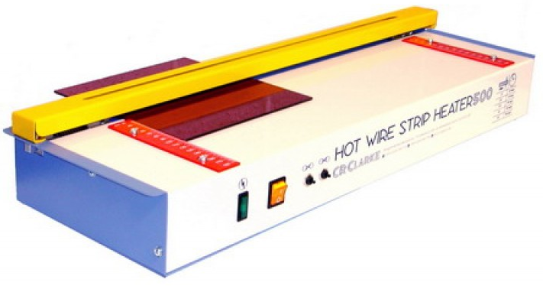
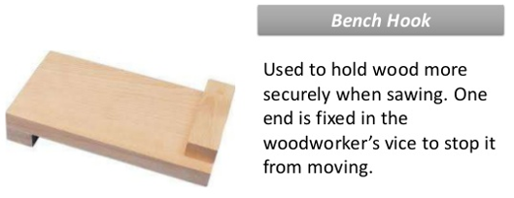
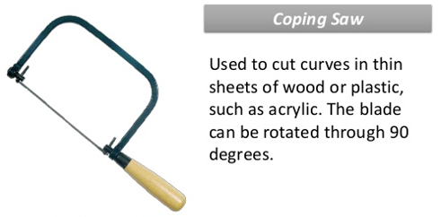
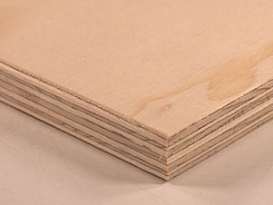
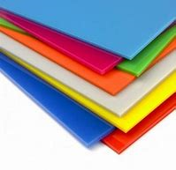
KS3 KEY KNOWLEDGE & SKILLS
designtechnology
Year 8 Product Design
Line Bender
Pillar Drill
Tools and equipment used in this module
Bending
Thermoplastics cannot be bent when cold. They are bent using a strip heater or line bender which will heat the plastic in a straight line, so it can be bent by hand or using a forming jig.
Materials used in this module
Plywood is a material manufactured from thin layers or "plies" of wood veneer that are glued together with adjacent layers having their wood grain rotated up to 90 degrees to one another. This alternation of the grain is called cross-graining and has several important benefits: it reduces the tendency of wood to split when nailed in at the edges; it reduces expansion and shrinkage, providing improved dimensional stability; and it makes the strength of the panel consistent across all directions.
Acrylic is classed as a thermoplastic. This means that it becomes soft and mouldable on heating without undergoing any significant chemical change. This process can be repeated many times.
Acrylic is available in a wide range of colours. Acrylic sheet is susceptible to scratching. Excellent weatherability and resistance to sunlight.
Rigid, with good impact strength. Excellent dimensional stability and low mould shrinkage.
Module learning outcomes
Examine the principles of modern architecture.
Develop an understanding of the working properties of plastics and manufactured woods
Produce a WORKING clock made from one piece of A6 Plywood and one piece of A6 Acrylic.
Module learning objectives
Demonstrate an excellent understanding of using external sources to subtly influence and inspire their initial design ideas.
They will be able to accurately transfer these 2D concepts into workable 3D models.
They will demonstrate an excellent understanding of the manufacturing processes being taught, applying this knowledge and skill to accurately and precisely produce a functioning product of quality.
CHOOSE A FUTURE THAT’S BETTER
‘BETTER BY DESIGN’

Slide 10
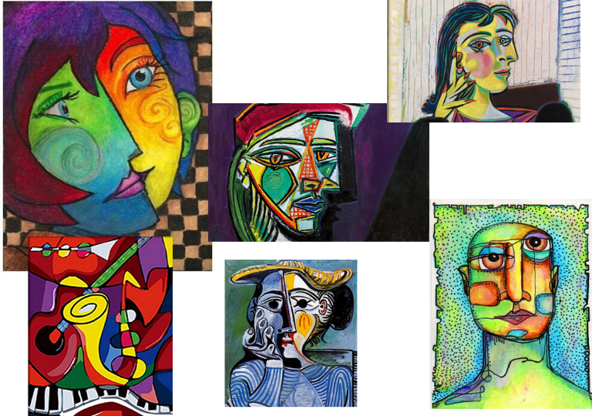
KS3 KEY KNOWLEDGE & SKILLS
designtechnology
Year 8 TEXTILES
Health & Safety Rules for Textiles
Pupils should wait OUTSIDE the room for a member of staff.
COATS should be hung on hooks or on backs of chairs.
BAGS should be placed in the bag store near the door as you enter the room.
No FOOD or DRINK is allowed in the classroom near the desks and the machine bench.
Long hair MUST be tied back when doing any practical task.
All electrical equipment – irons, machines, overlockers, waxpots etc.. are only to be used when you have permission from a member of staff.
Use equipment correctly and safely, following the specific instructions.
DO NOT TOUCH any equipment, materials etc unless you are told to do so.
Keep your work area tidy.
Report any breakages / damages immediately.
Picasso
Picasso was a Spanish painter, sculptor, printmaker, ceramicist, stage designer, poet and playwright who spent most of his adult life in France.
Sewing Machine Instructions
To Begin to Machine
Place the material under the presser foot.
Lower the presser foot gently.
Lower the needle into the fabric and press the foot control bringing the handwheel towards you.
Never push or pull the material through the machine, guide it slowly.
Remember to keep your fingers well away from the needle.
To Turn a corner
STOP with the needle down in the fabric.
LIFT the presser foot
TURN the fabric
LOWER the presser foot
  When stitching is completed, always pull the work out the left of the machine
  REMEMBER to leave a tail of two threads at the back of the machine.
To Finish off Machine Stitching
Put the machine into reverse and stitch back over the line of machine stitching for approximately 1.5cm.
Cut off the ends of the threads.
Bold, colourful, abstract, eccentric, stylised, dramatic, vibrant
What colours does the artist use?
What kind of shapes can you find?
What kind of patterns can you see?
The Sewing Machine
This is a picture of the sewing machine you are going to be using in Textiles.
There are some key parts of the sewing machine you will need to know the names of.
The Handwheel
Presser foot
Needle
Take-up lever
Start/stop button
Reverse button
Digital display panel
Year 8 keywords and terms
Designing: Picasso, initial designs, developed designs, final design, t-shirt Fabric Printing methods
Fabric Construction: Weaving – Warp (vertical strands), Weft (horizontal strands), Plain Weave – under over one, Gingham,
Making :Health & safety, Sewing Machine, Seam allowance, stitching line, pins interfacing, right side (RS) wrong side (ws) Zig Zag Stitching – (Stitch No 8), templates, felt, running stitch, buttons, turn through,
Module learning objectives
Develop sewing machine skills
Develop designing skills
Learn the various methods for fabric printing
Learn a method of fabric construction – weaving
Create a 3D product – Funky Chicken Door stop
Module learning outcomes
Produce a woven piece of fabric, embellished with machine stitching
Create t-shirt designs for a placement print inspired by a French artist Picasso
Produce a doorstop – funky chicken
CHOOSE A FUTURE THAT’S BETTER
‘BETTER BY DESIGN’

