Slide 1
Stretch, challenge and deeper thinking
Steven Ladley – Assistant Maths Hub Lead, Turing North West

Slide 2
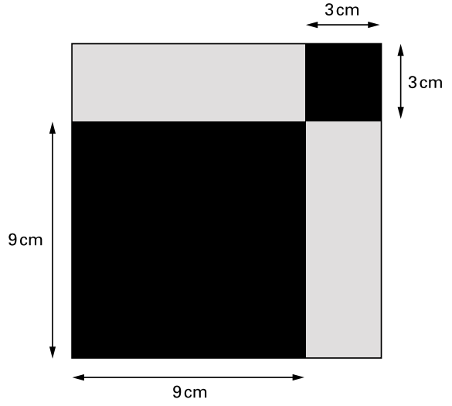
Starter
What fraction of the shape is black?
What questions could you ask to extend a pupil who has finished?
How else could you do this questions?
Do you get the same answer?
What else do you know?
Notes:
KS3 SATs paper

Slide 3
Adapting the question
What advantage is there to making the question goal free?
Any disadvantages?
What else can you tell me?
Lowers the stakes (accessibility & resilience)
  They remove the cognitive load of the goal (helping students to access the problem)
  They help to avoid means-end analysis (I failed if I didn’t get the answer)
They encourage freedom, creativity and exploration
Several topics can be reinforced at once (you may cover more than you had planned!)

Slide 4
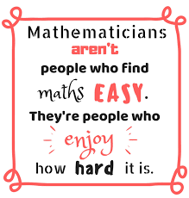
Classroom Culture
Resilience is a key requirement in Maths (and life)!
Regular exposure to questions that make pupils think and get stuck is crucial to develop this.

Slide 5
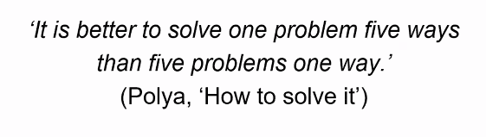
Encouraging Multiple Solutions
“Solving problems in multiple ways contributes to the development of students’ creativity and critical thinking.”
Leikin, R. and Levav-Waynberg 2008
Change the emphasis from ‘the answer’
Try “how many ways can you answer…”
Or “is there another solution”
Or “is there a better solution”
Efficiency…

Slide 6
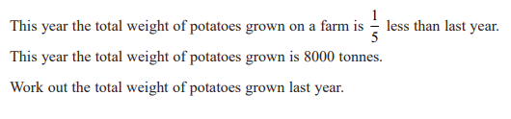
How many different ways can you answer this?
How many marks was this?
How do you think your students would do it?
Which method is best? (Most efficient?)
Edexcel 2F Q24, 2H Q5
3 Marks

Slide 7
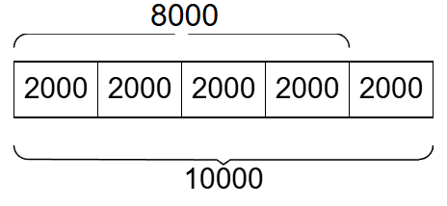
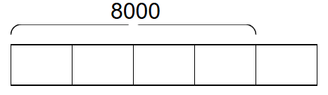
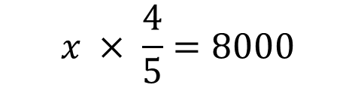
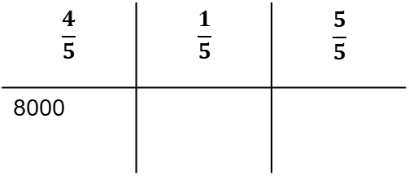
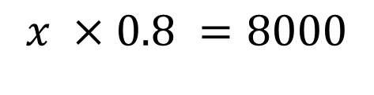
$$\frac{4}{5}$$ | $$\frac{1}{5}$$ | $$\frac{5}{5}$$
8000
$$x ×0.8 =8000$$
$$x × \frac{4}{5}=8000$$

Slide 8
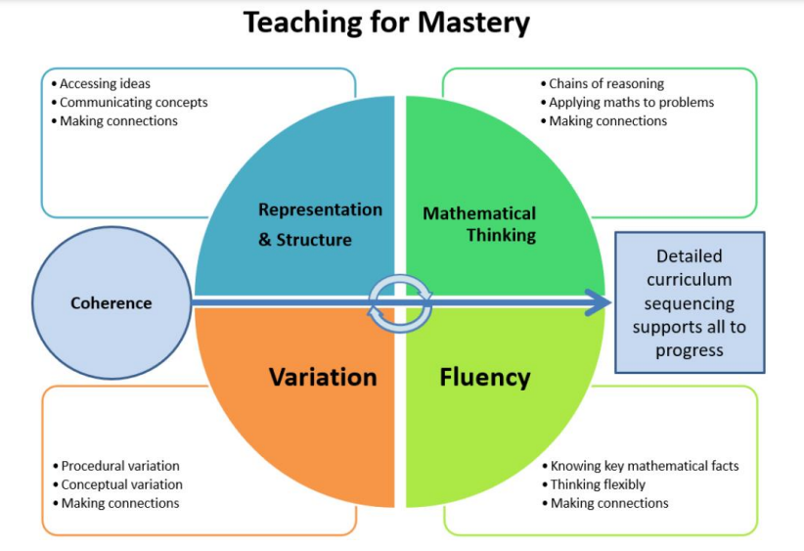
Encouraging deeper thinking

Slide 9
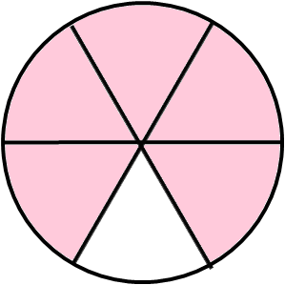
Planning for deeper thinking – representation and structure
Which diagram shows $\frac{5}{6}$ of the whole is shaded?
B
C
A
Which representations would you use with students?
D
E
0
1

Slide 10
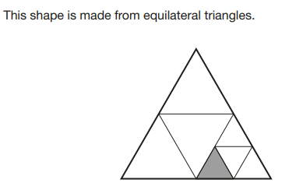
Questions from the 2025 exam series
Where is the question from?
How would you expect students to answer it?
KS2 SATs 2025 P3
What fraction of the whole shape is shaded?

Slide 11




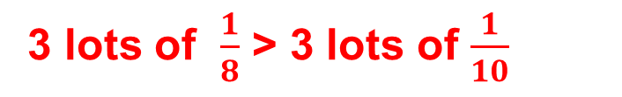


Which representation would you use for each question?
Compare these fractions.
Think of the reason and fill in the blank.
Can you generalise using words or algebra?
Compare these fractions.
Think of the reason and fill in the blank.
$$\frac{2}{5} \frac{3}{5}$$
$$\frac{6}{7} \frac{4}{7}$$
$$\frac{3}{8} \frac{3}{10}$$
0
3
1
8
0
1
$$\frac{a}{c} > \frac{b}{c}$$
3
10
3 lots of $\frac{1}{8}$ > 3 lots of $\frac{1}{10}$
What specific conditions are required for this to be true?
（a>b>0 c>0 ）

Slide 12
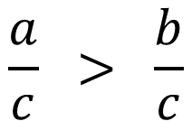
Which representation would you use for each question?
Do the representations offer pupils the chance to understand this more deeply?
$$\frac{a}{c} > \frac{b}{c}$$
（a>b>0 c>0 ）
When
Generalising offers opportunities to stretch pupils and deepen undersanding
0
3
1
8
0
1
3
10

Slide 13
Planning for deeper thinking – generalising
“A lesson without the opportunity to generalise mathematically, is not a mathematics lesson.”
John Mason

Slide 14
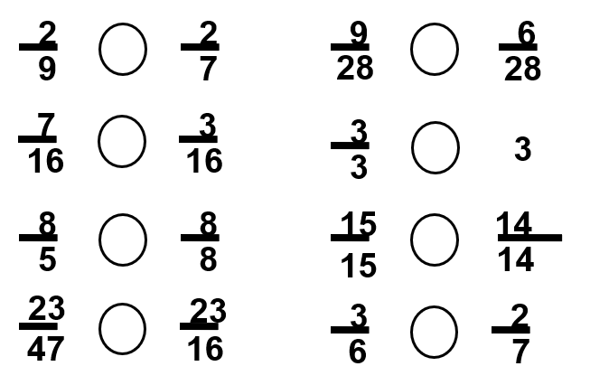
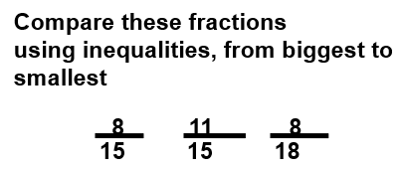

Practice - Compare these fractions using inequalities:
Do the activity. What do you notice?
How have the questions been designed to encourage deeper thinking?
How might pupils answer these?

Slide 15
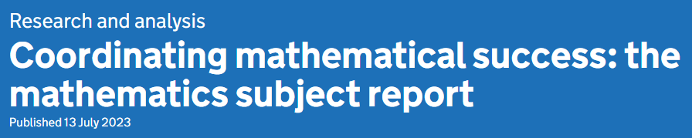

Planning for deeper thinking
“Curriculum planning around the teaching of mathematical facts and methods is usually strong. Where it is weaker, however, it tends to take less account of what pupils have learned previously and what they will study later. In these schools, pupils often are taught a series of disconnected mathematical methods and ‘tricks’ that apply only in specific circumstances.”
“teaching ‘tricks’, such as ‘keep, flip, change (KFC)’ for dividing fractions, that taught pupils to answer questions of the specific type likely to come up in assessments but did not prepare them for future learning. These approaches often led to pupils viewing mathematics as a list of unconnected methods to remember and apply.”
“This sometimes led to ‘cul-de-sac’ approaches being taught, which could be used to solve questions of the precise type identified in the curriculum for this year, but were not extendable as pupils developed mathematically. This risks pupils seeing mathematics as a collection of unconnected algorithms to be memorised and applied in specific situations. In these schools, pupils were often taught a range of methods and approaches, but no links were drawn between them”

Slide 16
Planning for deeper thinking

Slide 17

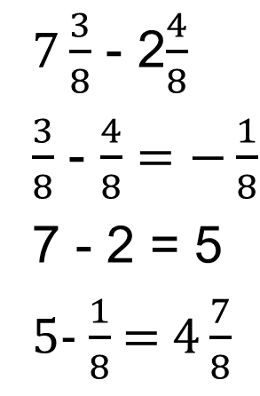
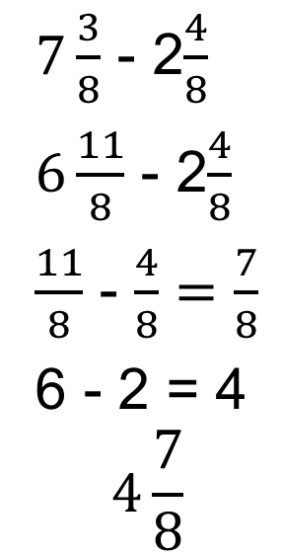
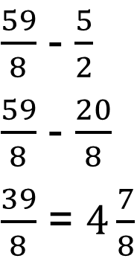
Deeper thinking and fluency
Edexcel H1 2023 Q2 3 Marks
How would you expect pupils to answer this question?
$7\frac{3}{8}$ - 2$\frac{4}{8}$
$6\frac{11}{8}$ - 2$\frac{4}{8}$
$\frac{11}{8}$ - $\frac{4}{8}=\frac{7}{8}$
6 - 2 = 4
$$4\frac{7}{8}$$
$7\frac{3}{8}$ - 2$\frac{4}{8}$
$\frac{3}{8}$ - $\frac{4}{8}=−\frac{1}{8}$
7 - 2 = 5
5- $\frac{1}{8}$ =$4\frac{7}{8}$
$\frac{59}{8}$ - $\frac{5}{2}$
$\frac{59}{8}$ - $\frac{20}{8}$
$\frac{39}{8}$ = $4\frac{7}{8}$
Whats the same and what’s different about each method?
Which is best?

Slide 18

Deeper thinking and fluency
What if the question had been
7$7\frac{3}{8}$ - 22$\frac{1}{2}$
Would your choice of method be different?

Slide 19






Checkpoint 27: The greatest product
Without calculating, decide which is the greater product in each pair.
$$\frac{1}{5}×\frac{1}{6}$$
$$\frac{1}{6}×\frac{1}{7}$$
$$\frac{3}{4}×\frac{8}{27}$$
$$\frac{3}{27}×\frac{8}{4}$$
$$\frac{2}{3}×\frac{2}{5}$$
$$\frac{2}{3}×\frac{5}{2}$$
Place all six products in order from least to greatest.
How might you use this with students?
How would you want students to approach it?
What questions could you ask to stretch pupils?
Notes:
This slide is animated. Each question will appear separately so you can choose the pace at which to work with your class.
Answers
$\frac{1}{5}×\frac{1}{6}$ is greater than $\frac{1}{6}×\frac{1}{7}$
$\frac{3}{4}×\frac{8}{27}$ is the same as $\frac{3}{27}×\frac{8}{4}$
$\frac{2}{3}×\frac{5}{2}$ is greater than $\frac{2}{3}×\frac{2}{5}$
? $\frac{1}{6}×\frac{1}{7};$ $\frac{1}{5}×\frac{1}{6};$ $\frac{3}{4}×\frac{8}{27}$ = $\frac{3}{27}×\frac{8}{4};$ $\frac{2}{3}×\frac{2}{5};$ $\frac{2}{3}×\frac{5}{2}$.
Suggested questioning
What is the same and what is different about each pair?
If the numerator is the same, what does the denominator tell us about the size of the fraction?
What do you notice about the product of the numerator/denominator?
How could you change one thing to make the two products the same?
Things to think about
Students will have a method for multiplying fractions: this Checkpoint asks students to put this method aside and reason about the products instead. This may reveal where students have become unthinkingly reliant on the method. The Guidance slide details some key assessment points: use these to plan what you will draw students’ attention to each time.

Slide 20
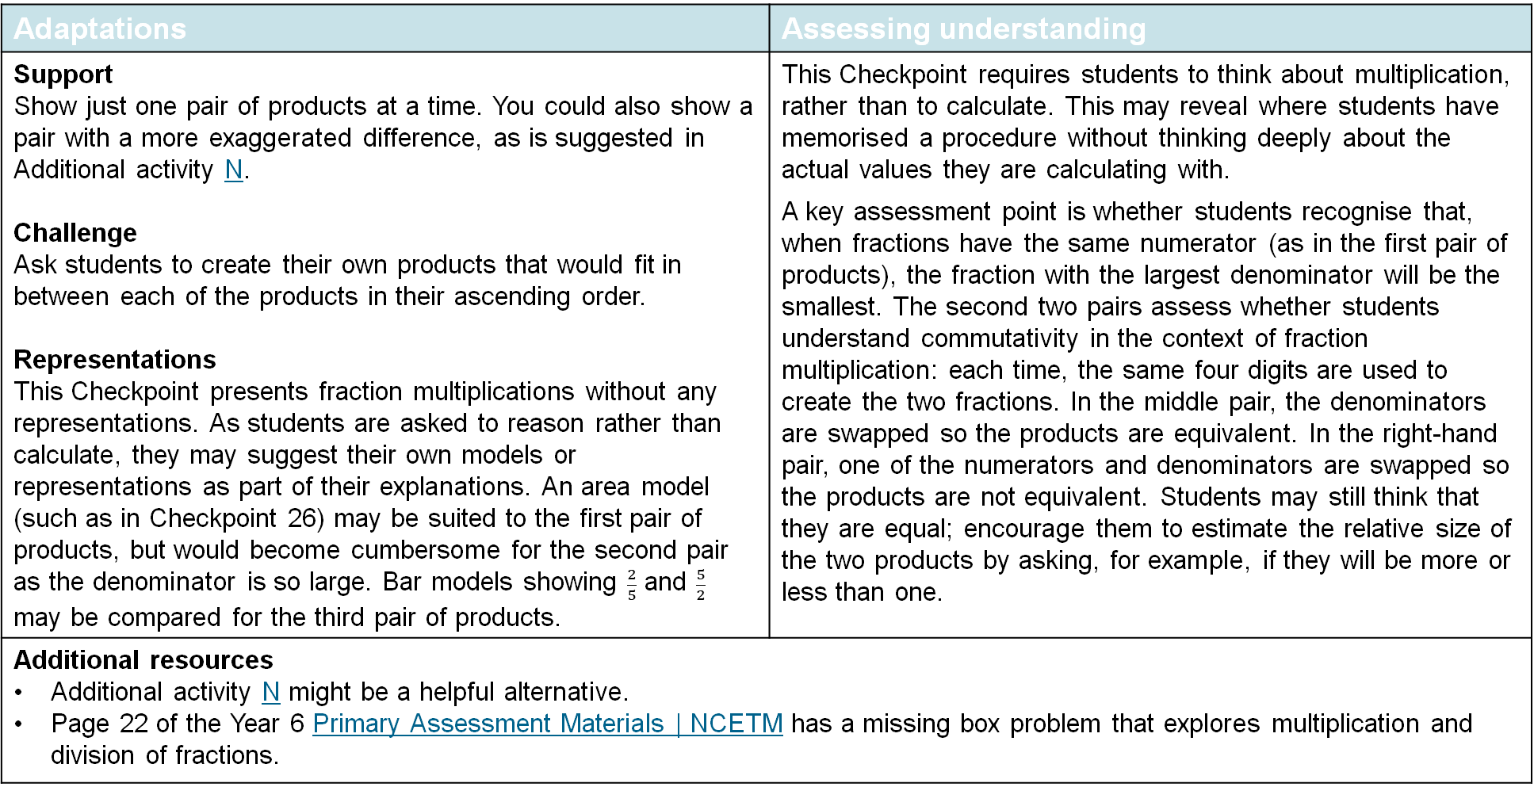
Checkpoint 27: Guidance
Adaptations | Assessing understanding
Support Show just one pair of products at a time. You could also show a pair with a more exaggerated difference, as is suggested in Additional activity N. Challenge Ask students to create their own products that would fit in between each of the products in their ascending order. Representations This Checkpoint presents fraction multiplications without any representations. As students are asked to reason rather than calculate, they may suggest their own models or representations as part of their explanations. An area model (such as in Checkpoint 26) may be suited to the first pair of products, but would become cumbersome for the second pair as the denominator is so large. Bar models showing $\frac{2}{5}$ and $\frac{5}{2}$ may be compared for the third pair of products. | This Checkpoint requires students to think about multiplication, rather than to calculate. This may reveal where students have memorised a procedure without thinking deeply about the actual values they are calculating with. A key assessment point is whether students recognise that, when fractions have the same numerator (as in the first pair of products), the fraction with the largest denominator will be the smallest. The second two pairs assess whether students understand commutativity in the context of fraction multiplication: each time, the same four digits are used to create the two fractions. In the middle pair, the denominators are swapped so the products are equivalent. In the right-hand pair, one of the numerators and denominators are swapped so the products are not equivalent. Students may still think that they are equal; encourage them to estimate the relative size of the two products by asking, for example, if they will be more or less than one.
Additional resources Additional activity N might be a helpful alternative. Page 22 of the Year 6 Primary Assessment Materials | NCETM has a missing box problem that explores multiplication and division of fractions.

Slide 21
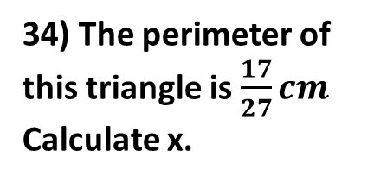
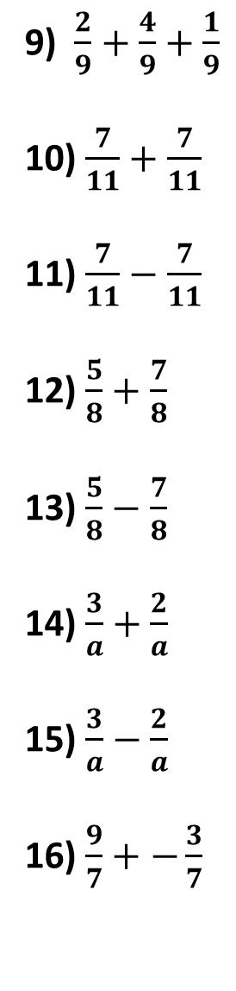

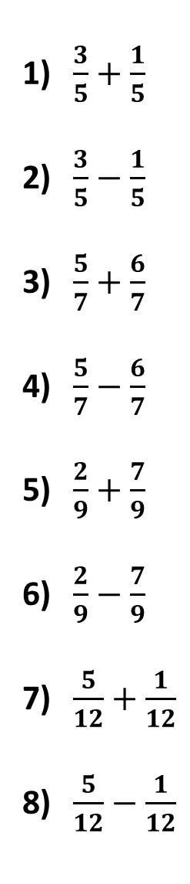

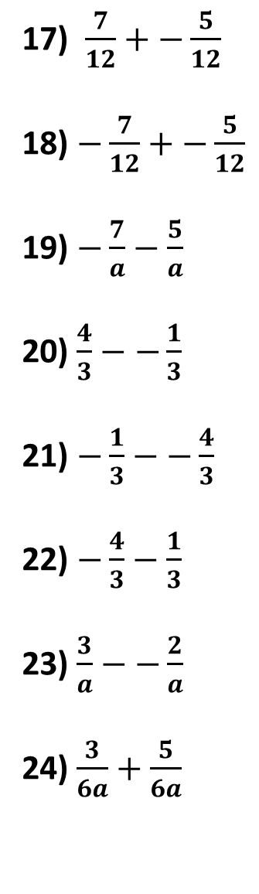
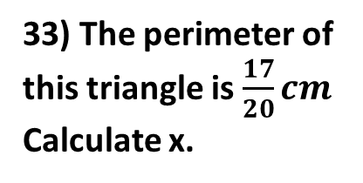
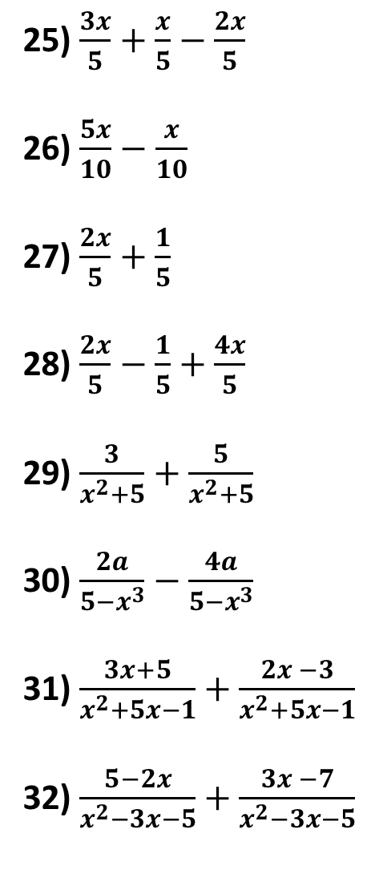

Independent Practice: Calculate…
33) The perimeter of this triangle is $\frac{17}{20}cm$
Calculate x.
$\frac{3}{5}+\frac{1}{5}$
$\frac{3}{5}−\frac{1}{5}$
$\frac{5}{7}+\frac{6}{7}$
$\frac{5}{7}−\frac{6}{7}$
$\frac{2}{9}+\frac{7}{9}$
$\frac{2}{9}−\frac{7}{9}$
$\frac{5}{12}+\frac{1}{12}$
$\frac{5}{12}−\frac{1}{12}$
9) $\frac{2}{9}+\frac{4}{9}+\frac{1}{9}$
10) $\frac{7}{11}+\frac{7}{11}$
11) $\frac{7}{11}−\frac{7}{11}$
12) $\frac{5}{8}+\frac{7}{8}$
13) $\frac{5}{8}−\frac{7}{8}$
14) $\frac{3}{a}+\frac{2}{a}$
15) $\frac{3}{a}−\frac{2}{a}$
16) $\frac{9}{7}+−\frac{3}{7}$
17) $\frac{7}{12}+−\frac{5}{12}$
18) $−\frac{7}{12}+−\frac{5}{12}$
19) $−\frac{7}{a}−\frac{5}{a}$
20) $\frac{4}{3}−−\frac{1}{3}$
21) $−\frac{1}{3}−−\frac{4}{3}$
22) $−\frac{4}{3}−\frac{1}{3}$
23) $\frac{3}{a}−−\frac{2}{a}$
24) $\frac{3}{6a}+\frac{5}{6a}$
25) $\frac{3x}{5}+\frac{x}{5}−\frac{2x}{5}$
26) $\frac{5x}{10}−\frac{x}{10}$
27) $\frac{2x}{5}+\frac{1}{5}$
28) $\frac{2x}{5}−\frac{1}{5}+\frac{4x}{5}$
29) $\frac{3}{x^{2}+5}+\frac{5}{x^{2}+5}$
30) $\frac{2a}{{5−x}^{3}}−\frac{4a}{{5−x}^{3}}$
31) $\frac{3x+5}{x^{2}+5x−1}+\frac{2x −3}{x^{2}+5x−1}$
32) $\frac{5−2x}{x^{2}−3x−5}+\frac{3x −7}{x^{2}−3x−5}$
x cm
$\frac{3}{20}$ cm
$\frac{9}{20}$ cm
34) The perimeter of this triangle is $\frac{17}{27}cm$
Calculate x.
$\frac{4}{27}$ cm
x cm

Slide 22
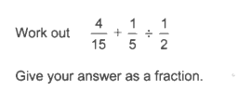
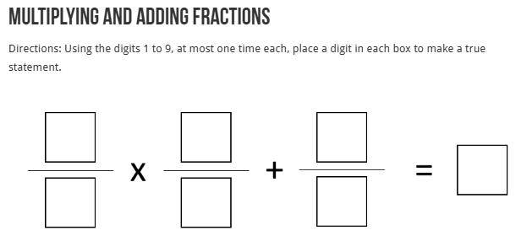
Questions from the 2025 exam series
Where is it from?
How many marks was it?
AQA H1 2025 Q8
3 Marks

Slide 23
Checkpoint 25: Less than, more than
What digit could you use to fill in the missing denominators? Is there more than one possible answer?
$$\frac{1}{7}+\frac{1}{7}<\frac{1}{}$$
$$\frac{1}{5}+\frac{1}{5}<\frac{1}{}$$
$$\frac{1}{3}+\frac{1}{3}<\frac{1}{}$$
What digit could you use to fill in the missing denominators now? Is there more than one possible answer?
$$\frac{1}{7}+\frac{1}{7}>\frac{1}{}$$
$$\frac{1}{5}+\frac{1}{5}>\frac{1}{}$$
$$\frac{1}{3}+\frac{1}{3}>\frac{1}{}$$
$$\frac{1}{}>\frac{1}{}+\frac{1}{}$$
What digits could you use to fill in the missing denominators? What digits can you not use?
Notes:
This slide is animated. Each question will appear separately so you can choose the pace at which to work with your class.
Answers
a) For $\frac{1}{7}+\frac{1}{7}$, the denominator could be 3, 2 or 1. For $\frac{1}{5}+\frac{1}{5}$, the denominator could be 2 or 1. For $\frac{1}{3}+\frac{1}{3}$, the denominator could only be 1.
b) For $\frac{1}{7}+\frac{1}{7}$, the denominator should be 4 or greater. For $\frac{1}{5}+\frac{1}{5}$, the denominator should be 3 or greater. For $\frac{1}{3}+\frac{1}{3}$, the denominator should be 2 or greater.
? There are numerous correct answers; use a calculator to check students’ statements are correct. Students might continue the pattern of adding two equivalent unit fractions, and ascertain that the denominators of 1 or 2 are not possible. Equivalent fractions are not specified, and so students may create statements using different denominators, such as $\frac{1}{2}>\frac{1}{5}+\frac{1}{6}$. In such an example, students might identify that, for pairs of fractions that sum to greater than $\frac{1}{2}$ (e.g. $\frac{1}{3}+\frac{1}{4}$), then only a denominator of 1 will work for the remaining fraction (i.e. $\frac{1}{1}>\frac{1}{3}+\frac{1}{4}$).
Suggested questioning
Is your total more or less than $\frac{1}{2}$? If you kept the denominator given, what numerator would give a fraction equivalent to $\frac{1}{2}$?
For part a: what is the smallest fraction that would work? Is there more than one possible answer?
For part b: what is the largest fraction that would work? Is there more than one possible answer?
Which had more possible answers, $\frac{1}{7}+\frac{1}{7}<\frac{1}{}$ or $\frac{1}{7}+\frac{1}{7}>\frac{1}{}$? Why?
Things to think about
Checkpoint 25 may look straightforward at first: adding two unit fractions is part of the Year 3 curriculum. However, students are then asked to reason about which unit fractions will be greater than this total, which should stretch their understanding of the relative size of fractions under 1, and particularly of fractions under $\frac{1}{2}$. Listen out for their strategies, as this may reveal a lot about how they are most comfortable in thinking about numbers less than 1. Consider how you might deal with the different strategies in the classroom: will you encourage students to share and compare their approaches? What are the advantages and disadvantages of exposing students to lots of different ways of thinking about a problem?

Slide 24
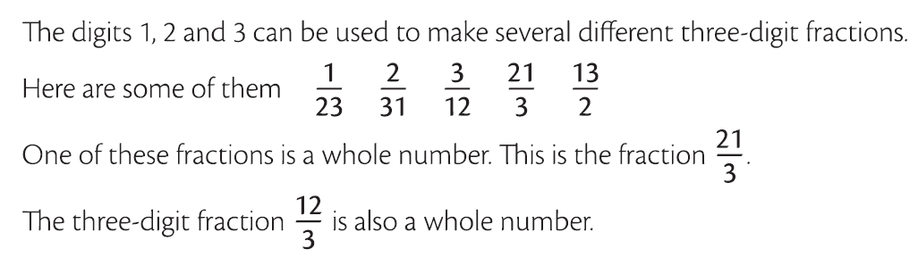
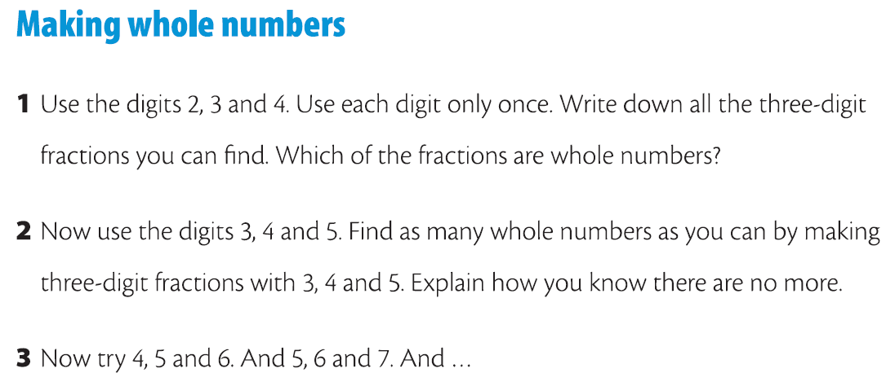
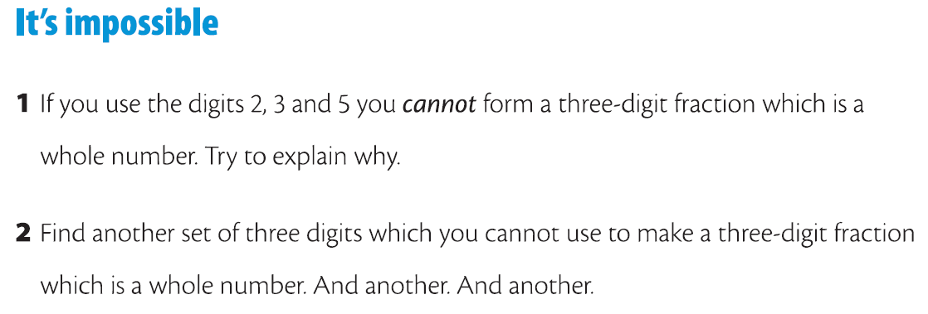
Planning for deeper thinking – rich tasks

Slide 25
Sort the statements into the categories
Always, sometimes, never true
Challenge in the maths classroom is about:
Wordy problems
Using information from different maths topics to solve a problem
Having extension problems ready for those who finish quickly
Doing more of the same maths
Moving on in the curriculum
Swapping integers for fractions and/or decimals
Thinking about the same concept in a different way
Using bigger numbers

Slide 26
Always, sometimes, never true
Challenge in the maths classroom is about:
Wordy problems
Using information from different maths topics to solve a problem
Having extension problems ready for those who finish quickly
Share your ideas and give reasons to justify your choices
Doing more of the same maths
Moving on in the curriculum
Swapping integers for fractions and/or decimals
Thinking about the same concept in a different way
Using bigger numbers

Slide 27
A possible solution?
Always, sometimes, never true
Challenge in the maths classroom is about:
Wordy problems
Using information from different maths topics to solve a problem
Having extension problems ready for those that finish quickly
Doing more of the same maths
Moving on in the curriculum
Swapping integers for fractions and/or decimals
Thinking about the same concept in a different way
Using bigger numbers

Slide 28

Maths Hub Opportunities 25/26
Dates:
Three days face-to-face
15/10/2025 27/01/2026 23/03/2026
Covering:
Additive reasoning
Multiplicative reasoning
Fractions
Securing Foundations at Year 7
High-quality resources designed by experts in the pedagogy and expectations of maths at both KS2 and KS3.
Professional development - better equipped to support students with gaps in understanding from previous Key Stages.
Teachers working with Year 7 students whose attainment is in the bottom 20-30% of the national cohort at the end of KS2.
It is suitable for experienced or novice teachers.

Slide 29
Maths Hub Opportunities 25/26
Dates:
Three days face-to-face
17/10/2025
28/01/2026
26/03/2026
Covering:
Arrays and area
What is a fraction?
Representations of fraction multiplication
Multiplication and division relationships
Double number lines
Ratio tables
Developing Fluency with Multiplicative Reasoning at KS3
High-quality resources designed by experts in the pedagogy and expectations of multiplicative reasoning at KS3.
Professional development - better equipped to support students to become fluent with multiplicative reasoning.
Open to all schools and all teachers.
Recommended to send 2 teachers.

Slide 30
Maths Hub Opportunities 25/26
Teaching for Mastery Work Groups
Open to all schools and all teachers.
Can send up to 2 teachers.
Themes of next year:
Mathematical Thinking
Collaborative Planning
Mastery Approaches to tricky topics
Dates:
Three days face-to-face
TBC

Slide 31
Maths Hub Opportunities 25/26
Dates:
Face-to-face
TBC
Specialist Knowledge for the Teaching of Mathematics
ECTs (2nd and 3rd year of teaching)
4 days exploring: Sequences and graphs
Adapting resources
Adaptive teaching
TAs
4 days exploring:
Addition and subtraction
Multiplication and division
Fractions
Ratio
Non specialists
6 days exploring:
6 themes of the KS3 curriculum
Plus bespoke support

Slide 32
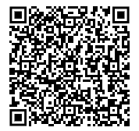
PD this year – Level 2 Further Maths
UoM
Dates:
Face-to-face
Wednesday 9th July 2025,
10:00 – 16:00
A day of workshops looking at the AQA Level 2 Certificate in Further Maths and the
Pearson Level 2 Extended Mathematics Certificate: why you might consider running one of
them as an extension course for your Year 10s or 11s; how they can be delivered in and
around the school curriculum; what new maths are in the courses; what is best practice for
teaching them.
Sign up -

