Slide 1

Pillar 5: Assessment and Feedback
June 2025
Pete Ware
Deputy Headteacher
Harper Green School

Slide 2

Our vision
To facilitate the gathering of best practice curriculum implementation strategies.
This is so that we help subject leaders and teachers to in turn help all children to know and remember important knowledge across subject curriculums.
To support subject leaders in evaluating the impact of their subject curriculums.
Notes:
Linda
The 19k
Let us recap the analysis of the 19k
6456 pupils in the 19k live in the 10% most deprived area in UK and 13293 live in the 30% most deprived areas.
Our work is to facilitate learning of and sharing of best generic and subject specific implementation practice across schools.
Our focus must be on improving outcomes for disadvantaged pupils and those with SEND.
However, across the partnership impact so far has been positive.
It is wonderful that working collectively together as leaders of the 19k, we can have a hugely positive impact on pupils across Bolton.

Slide 3
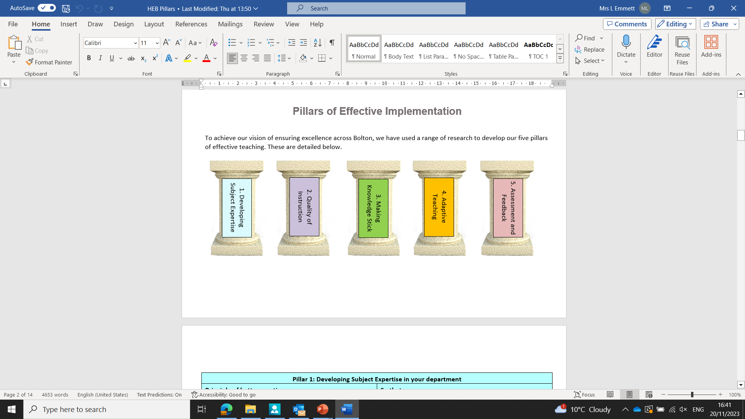
The Pillars of Effective Curriculum Implementation

Slide 4
Teachers accurately gather information on all pupils’ learning.
Teachers give pupils high-quality feedback.
Teachers provide pupils with opportunities to act on feedback.
Responses inform the next steps in the learning process.
Notes:
Linda

Slide 5
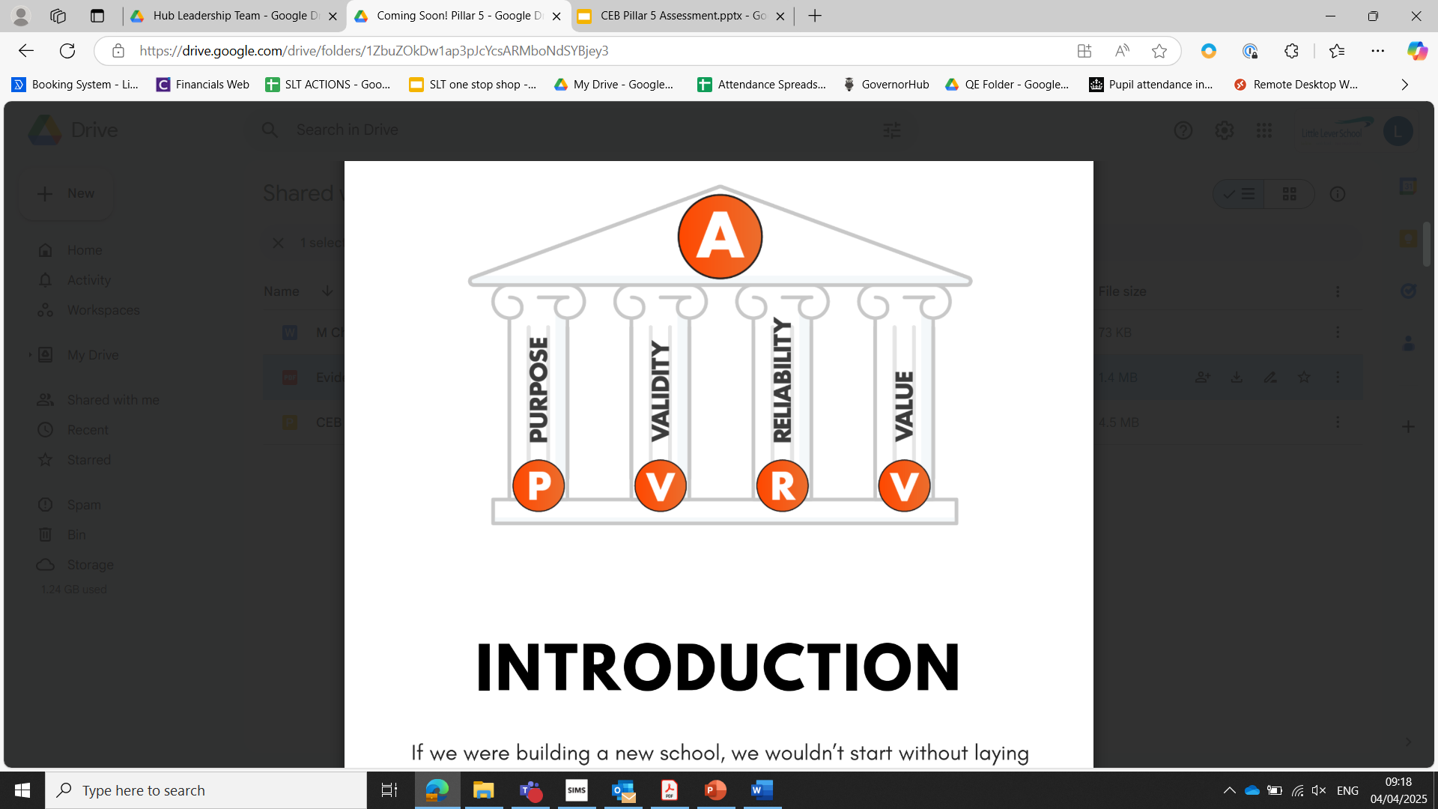
Notes:
Linda
See above image from Evidence Based Education, the document is available on the reading list.
Today we will focus predominantly on formative assessment.
If you get your formative assessment right, you should know what you are going to see in summative assessments.
And some of the theory about purpose, validity, design and value apply to both formative and summative assessment.
Purpose – what is the purpose of the assessment – as we assessing knowledge, skill, reading ability? What will the data be used for?
Validity – outcome influenced by other factors (eg reading age). Consider Hemingway app to assess reading age. – “Students perform poorly on river”- actually it is timing/stamina
Reliability - The accuracy of teachers’ interpretations of these responses, importance of standardisation and agreement on precision knowledge – eg “to what extent questions…”
Value - Need to reflect on the cost of the time to assess vs the time giving curriculum input. We can use assessment to build a bridge between teaching and pupils’ learning. We can do this by having strong links between the assessment and subsequent pedagogy, curriculum adaptations. Better information - better decisions - better learning.

Slide 6
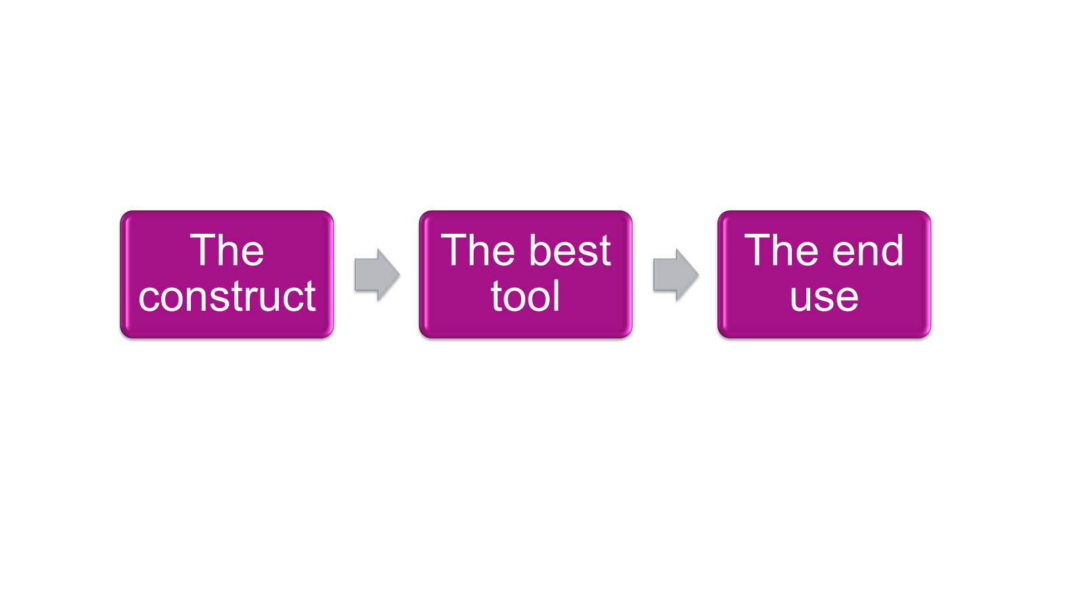
Three steps for robust assessment
Notes:
Linda
The construct - what is the specific knowledge, skills and understanding (from the intended curriculum) that we intend or need to assess.
The best tool - what and when is the best way to assess at that point in the lesson/at that point in the curriculum?
The end use - How do we want to use the information that we gather around pupils’ learning? (interpret - make a decision - take action)

Slide 7
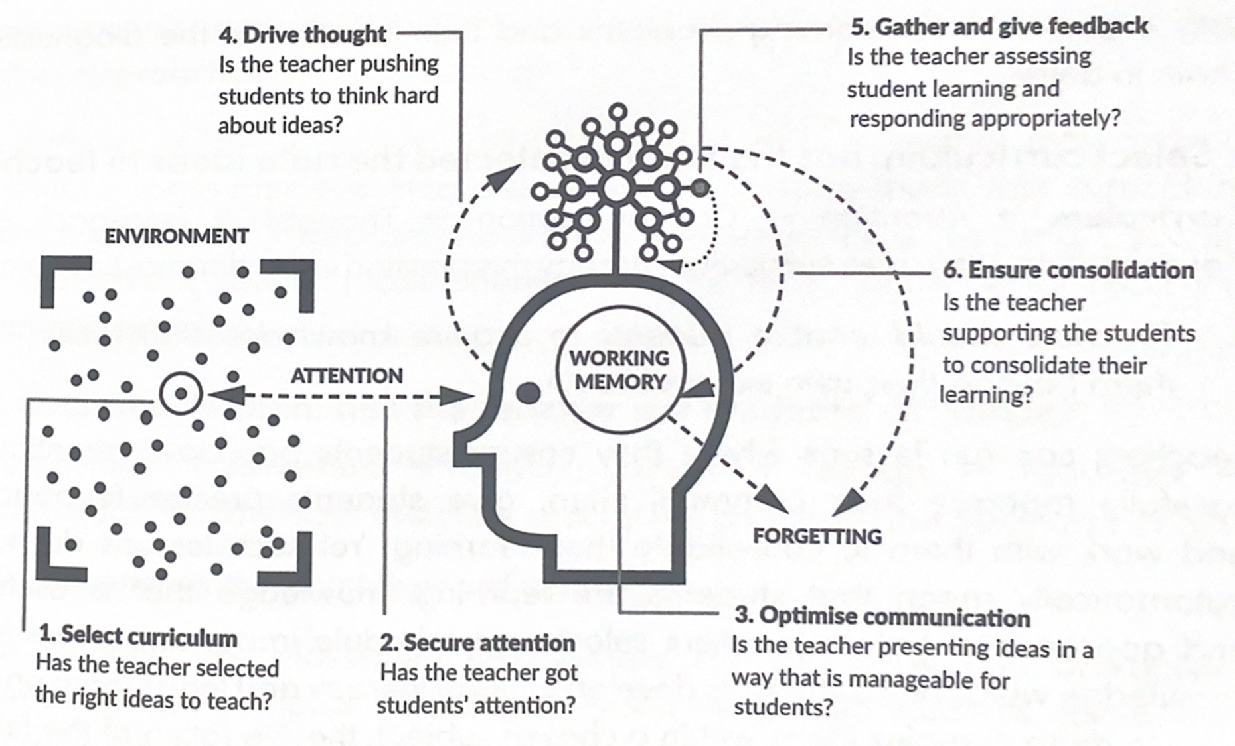
Notes:
Linda
So if we think back to Willingham’s model of memory for the fifth time, we can cover element 5. We can also cover elements 1, 3, 4 and 6.
Is assessment for learning happening in lessons?
Are staff aware of the powerful knowledge that students must know?
Do staff have the precision knowledge?
Are they using assessment/feedback/verbal to deepen and extend understanding as well as check for understanding?

Slide 8
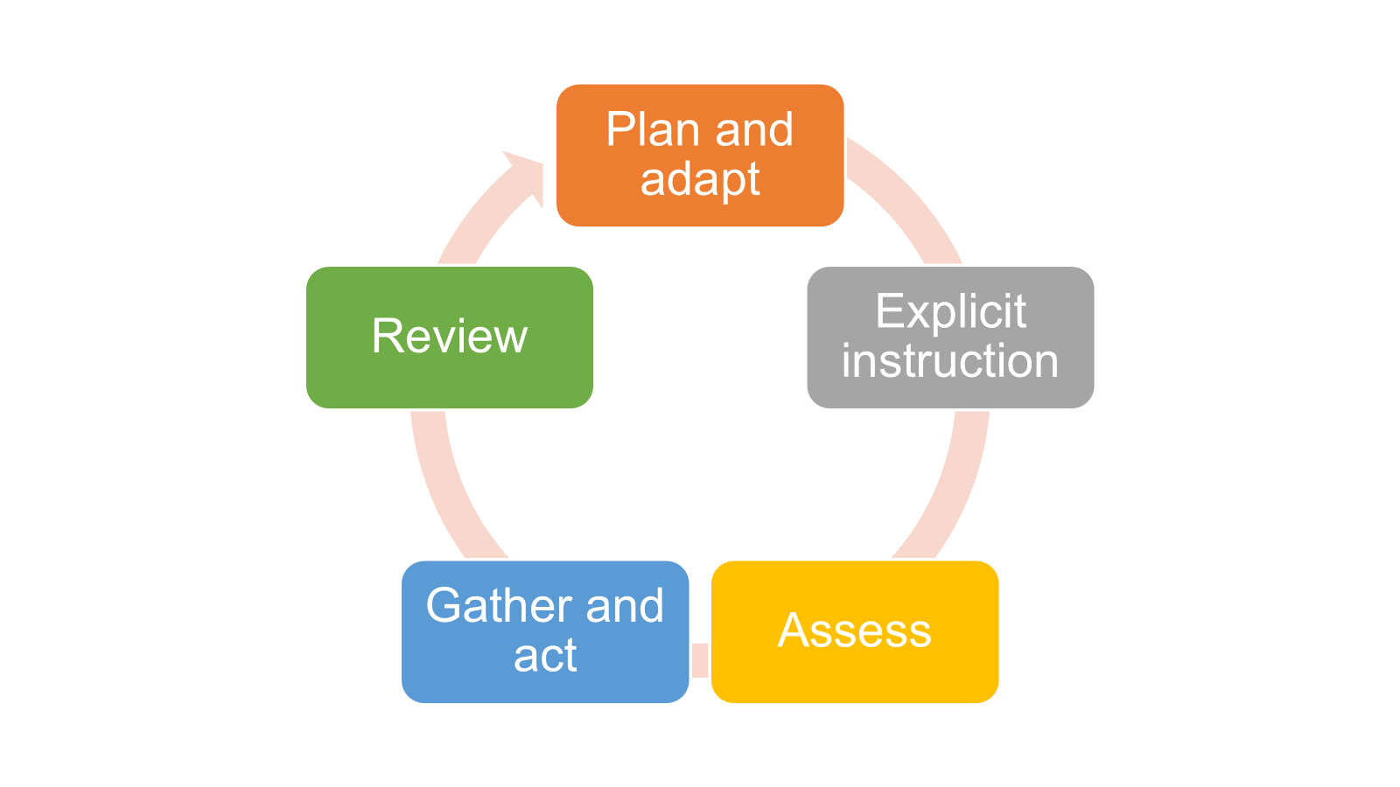

Notes:
Linda
Here is a new Bolton assessment model, based on our own curriculum hub pillars. You will see our previous pillars reflected in this.
Again, this can be applied within the classroom formatively, and also summatively.
Schools will have their own curriculums, their own sequencing, their own summative assessment processes.
This cycle can fit any of these, and any subject curriculums.
Plan - you will plan you subject curriculum and associated resources. In doing this, you will need to reflect on powerful knowledge that you will need to check is secure. You will also have planned when you will summatively assess whether pupils’ knowledge is secure in the medium and long term, and whether pupils can apply their learning in increasingly complex ways.
Explicit Instruction - Deliver the curriculum, bearing in mind cognitive load theory, smaller building blocks where needed, reading age, etc. You will need to always reflect on the possible need to stop and assess should the need arise.
Assess - There is no one-size-fits all approach. What is the most appropriate means of assessment in your subject? What kinds of approaches will you use in the classroom? MWBs? Low-stakes quizzing? Cold-calling? Hinge questions? Patrol and position? Live marking? Messy markbooks?
Gather and Act (feedback) - What are your strategies to respond to, address and adapt what are you doing? (else, what is the purpose of the assessment?)
Review - This is where subject departments gather together to monitor the curriculum so far. This can be done by looking at books, data, teacher discussion. Beware of data use.
Plan and Adapt - There is no point taking the assessment, gathering the information, discussing in departments if you don’t then adapt the curriculum and resources.

Slide 9
Notes:
Linda
Plan - you will plan you subject curriculum and associated resources. In doing this, you will need to reflect on pivotal pieces of knowledge that you will need to check is secure. You will also have planned when you will summatively assess whether pupils’ knowledge is secure in the medium and long term, and whether pupils can apply their learning in increasingly complex ways.
Explicit Instruction - Deliver the curriculum, bearing in mind cognitive load theory, smaller building blocks where needed, reading age, etc. You will need to always reflect on the possible need to stop and assess should the need arise.

Slide 10
Planning and explicit instruction discussion point
In your subject, when planning a scheme of work, what considerations are needed around assessment?
Notes:
Linda
5 minutes to discuss and feedback.

Slide 11
Feedback
You may have considered:
Powerful knowledge
Knowledge vs skill
Command words
Knowledge of place – “singly story knowledge”
Pre-planned hinge questions/low stakes quizzes
Questions/misconceptions to probe/extend
Known adaptations that are needed to access assessments, such as reading ages - Hemingway
How to assess fieldwork knowledge – 30% of GCSE but “underdeveloped in most schools” – OFSTED (2023)
Notes:
Linda Mention Hemingway App again.

Slide 12
Mark Enser (2025)
Fluency – Are students becoming more fluent with using the procedural knowledge they have been taught. For example, can they quickly work out a six-figure grid reference? Providing students with ample opportunities to practice such skills until they become automatic allows teachers to check for impact.
Accuracy – Speed and fluency are meaningless if students are inaccurate. Ensure they can not only perform a task, such as drawing a scatter graph, but also interpret it correctly and identify a line of best fit.
Connection – Students often answer questions by listing disconnected or isolated facts. For example, when asked about deforestation in tropical rainforests, they may state reasons for tree removal, list some impacts, and mention prevention strategies. But can they connect these ideas—linking specific impacts to their causes? Can they relate this knowledge to deforestation in other regions or similar environmental issues?
Enabling – Knowledge should empower students to do something. Do they understand how to use their knowledge in different contexts? Can they apply it to new scenarios? Does it help them access other parts of the course or lead more informed, fulfilling lives?
Depth – The most challenging aspect to assess is the depth of students’ knowledge. Can they grapple with complex geographical issues, such as why countries struggle to cooperate on climate change? If teaching is truly impactful, students should move beyond superficial responses. As they progress, their answers should become more sophisticated and nuanced.

Slide 13
Notes:
Helen
Assess - There is no one-size-fits all approach. What is the most appropriate means of assessment in your subject? What kinds of approaches will you use in the classroom? MWBs? Low-stakes quizzing? Cold-calling? Hinge questions? Patrol and position? Live marking? Messy markbooks?

Slide 14
Assess: Teachers accurately gather information on all pupils’ learning.
Teachers identify gaps in pupil learning and know which topics to re-teach that were not grasped the first time.
Eliciting Evidence of learning
Strategy 2: Eliciting Evidence of Learning - YouTube
Hinge Questions
Mini Whiteboards
Cold Calling
Quizzing
Patrol and Position
Notes:
John Hattie defines formative assessment as the information we glean as teachers that “closes the gap” between where a student is and where the student needs to be.(Hattie and Clark, 2019). When done well formative assessment dramatically improves the progress of pupils.(Black and Wiliam, 2005)
Dylan Wiliam and Siobhan Leahy have written extensively about five key formative assessment strategies (Embedded Formative Assessment, 2011). The five strategies promoted by Wiliam and Leahy are:
Clarifying, sharing and understanding learning intentions and success criteria
Eliciting evidence of learning
Providing feedback that moves learners forward
Activating students as learning resources for one another
Activating students as owners of their own learning.
In this section, we will focus on eliciting evidence of learning, which is gathering evidence of pupils’ learning to establish what the pupils have learnt and any gaps in their learning so that this can be addressed. (Play the video at this point)
Strategy 2: Eliciting Evidence of Learning - YouTube
PullOut-April-SSAT.pdf
A Summary of Evidence Based Formative Assessment Strategies - Evidence Based Education
Formative-Assessment-In-Action-booklet.pdf

Slide 15
Assess: Teachers accurately gather information on all pupils’ learning.
Eliciting Evidence Task:
For your subject area, discuss:
the different ways that evidence can be gathered on a pupil’s learning
the benefits of each one
any potential pitfalls
Hinge Questions
Mini Whiteboards
Cold Calling
Quizzing
Patrol and Position
Notes:
Task:
Microdata
Spend time discussing the points above, there will be additional formative assessment strategies and ways of eliciting evidence from pupils to the 5 listed here. You should discuss the most impactful for your subject area.
You can use the information below to prompt discussion, if required.
Multiple choice hinge questions (see doc from Chartered College)
Lemov, Control the Tell TLAC
● Plan closed multiple choice question sequences, which include common misconceptions and mistakes as answers.
● Ensure all the answers are plausible.
● Invite responses, don’t reveal answers straight away.
● Explore and respond to the responses before revealing the correct answer.
Potential Pitfall: a) Multiple choice questions with answers that are too obviously ‘right’ and ‘wrong’. b) revealing the correct answer too quickly, missing the opportunity to explore misconceptions and why pupils have them.
Mini Whiteboards
● Set the question which can be answered succinctly.
● Building in thinking time
● Lids off pens and onto the end of them
● Pupils to a) fill their board b) ‘write on chest’ and c) ‘hover when ready’
● Signal: “3,2,1”. Pupils show boards on ‘1’.
● Sampling student responses and reshape learning
Potential Pitfall: Pupils are allowed to see answers on others’ boards; ensure ‘boards are down’ before everyone shows on 1. Questions require answers which are too lengthy; plan questions which are wordy and allow answers which are succinct.
Cold call
Lemov, Control the Tell TLAC
● Prime the class for cold call.
● Ask the class the question.
● Giving thinking time.
● Select someone to respond.
● Invite responses, don’t reveal answers straight away.
● Explore and respond to the responses before revealing the correct answer.
Potential Pitfall: Pre-plan target groups so that PP and quieter pupils aren't avoided. Avoid giving hints- you are checking for understanding. If they need the hint, they don’t understand.
Quizzing
● Be specific about the material you will quiz on
● Design a series of low stakes questions which are easy to self-mark and allow you to pinpoint misconceptions.
● After completing the quiz, provide answers in a time efficient way (on a single slide or sheet) which pupils check and change in purple pen.
● Take the time to then explore where common misconceptions are and plan how to address this.
Potential pitfall: Taking too long when going through the answers, e.g. revealing one answer at a time. Have the answers ready to mark immediately and spend the time instead addressing common misconceptions.
Patrol and Position for assessment
Lemov, ‘Active Observation’ p92 TLAC 3
● Set up your seating plan.
● Be intentional about what knowledge you are looking for.
● Circulate the room during independent work.
● Give 1:1 feedback to pupils: praise and support.
● Make a written note of success points and misconceptions.
● Respond to assessment data.
Potential Pitfall: The classroom you are teaching in provides less opportunity for movement so you may need to ask pupils to bring their work to you.

Slide 16
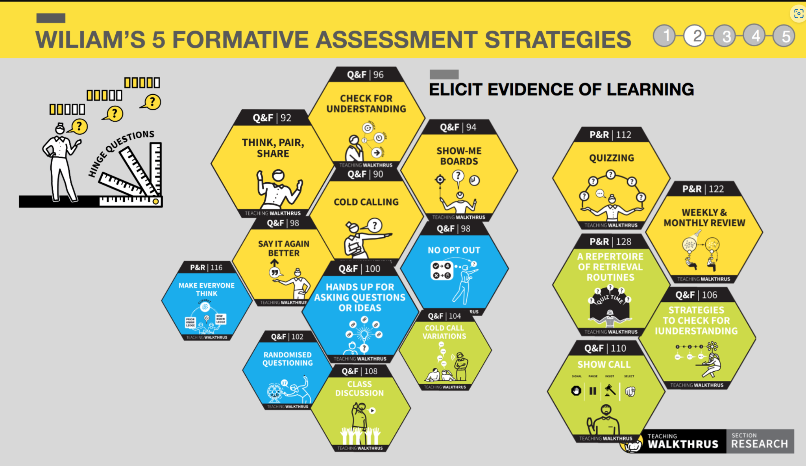
Assess: Teachers accurately gather information on all pupils’ learning.
Notes:
These are the sections of the Teaching Walkthru series that provide more information about strategies for eliciting evidence of learning from pupils. It is Section 4 in the Walkthu Guide that provides further information on each of these strategies.

Slide 17
Notes:
Jenny Let’s go back to our Bolton assessment model.
Gather and Act (feedback) - What are your strategies to respond to, address and adapt what are you doing? (else, what is the purpose of the assessment?)

Slide 18
Assess: Teachers accurately gather information on all pupils’ learning.
Responses inform the next steps in learning
What are your strategies to respond to, address and adapt what are you doing?
Give pupils another chance to think deeply and learn
Move onto new learning
Address misconceptions or gaps in learning
Reteach key learning points
Whole class feedback or individual/groups of pupils?
Notes:
Following eliciting evidence from pupils, it is important to respond and adapt to the information that has been gathered. This response needs to be impactful and timely so that explicit instruction can be adapted in real time. Pupils may require another opportunity to learn and think deeply about the learning that has taken place or they may be ready to move onto new learning.
Misconceptions or gaps in learning may need to be addressed, key learning points may need to be re-taught and it is important to consider whether you need to give whole-class feedback to address whole-class errors or misconceptions? Or whether you need to give feedback to a group of learners or an individual learner?
Responding to the information gathered may also impact your curriculum, planning, scheme of work etc.

Slide 19
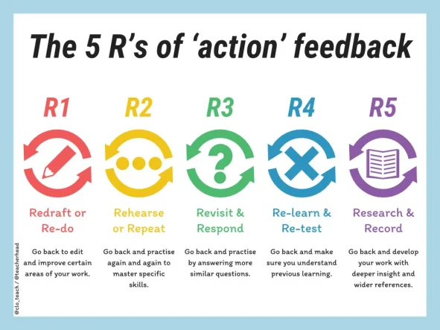
Actionable Feedback
Discussion Point
How would this work in your subject area?
Do you use some more than others?
Notes:
Jenny
The 5 Rs of actionable feedback - Tom Sherrington (@teacherhead) and Walkthurs
This shows examples of what the action from feedback could include.
How would this work in you subject area? Would you lean towards some more than others (Quick discussion and feedback)

Slide 20
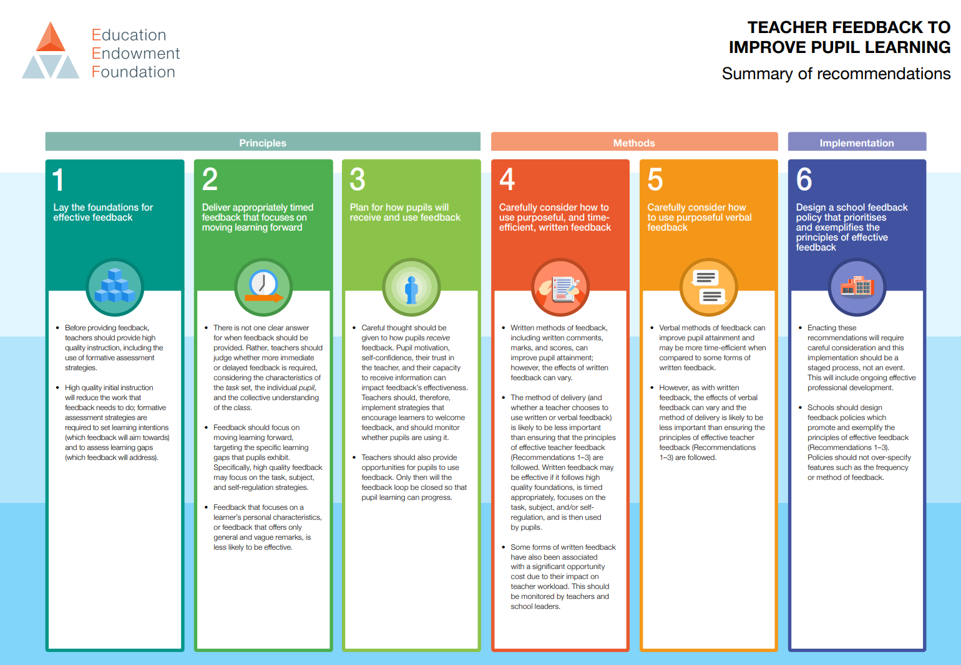
Notes:
Linda
EEF 6 recommendations around teacher feedback to improve pupil learning. The link to this is in the reading list. 6 months impact.
Lay the foundations
Before providing feedback, teachers should provide effective explicit instruction. This reduces the work that feedback has to do. It will also help to properly target assessment approaches to the right knowledge at the right time. Start with the end in mind.
Deliver appropriately timed feedback that focuses on moving learning forward
There is not one clear answer for when feedback should be provided. Immediate or delayed feedback? Feedback should move learning forward, targeting specific and important learning gaps. Feedback should focus on knowledge, skill or self regulation strategies.
Plan for how pupils will receive and use feedback
Pupil motivation, self-confidence, their trust in the teacher and capacity to receive feedback can affect its effectiveness. Teachers should develop and use strategies to encourage pupils to welcome feedback, and provide opportunities for pupils to act on feedback. Culture of error.
Carefully consider how to use purposeful, and time-efficient, written feedback.
The effects of written feedback can vary. Think of appropriate timing, focus on knowledge, appropriate pupil use of feedback. Consider workload/impact assessment.
Carefully consider how to use purposeful verbal feedback
These are more time efficient compared to written feedback. However, the effects can vary according to the effectiveness of planning and delivery of verbal feedback.
Design a school feedback policy that prioritises and exemplifies the principles of effective feedback.
Our Bolton schools will have their own feedback policies, so we will not focus on policy today. However, we will weave in some sharing of practice throughout the session.

Slide 21
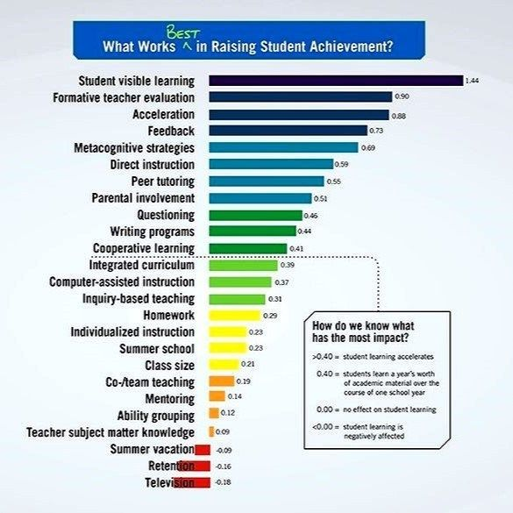
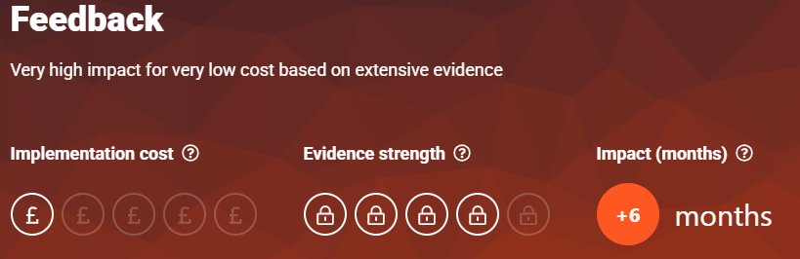
Feedback
Notes:
Jenny
EEF Guidance Report: Teacher_Feedback_to_Improve_Pupil_Learning.pdf
Research from both Hattie and the EEF show how impactful high quality feedback can be on pupils’ learning.
The key findings of the EEF research are:
1. Providing feedback is a well-evidenced and has a high impact on learning outcomes. Effective feedback tends to focus on the task, subject and self-regulation strategies: it provides specific information on how to improve.
2. Feedback can be effective during, immediately after and some time after learning. Feedback policies should not over specify the frequency of feedback
3. Feedback can come from a variety of sources ­– studies have shown positive effects of feedback from teachers and peers. Feedback delivered by digital technology also has positive effects (albeit slightly lower than the overall average).
4. Different methods of feedback delivery can be effective and feedback should not be limited exclusively to written marking. Studies of verbal feedback show slightly higher impacts overall (+7 months). Written marking may play one part of an effective feedback strategy – but it is crucial to monitor impacts on staff workload. The most impactful feedback comes from the teacher (the expert)
5. It is important to give feedback when things are correct ­– not just when they are incorrect. High-quality feedback may focus on a task, subject, and self-regulation strategies.
Interestingly, low attaining pupils benefit more from explicit feedback that their high-attaining peers.
There is evidence to suggest that feedback involving metacognitive and self-regulatory approaches may have a greater impact on disadvantaged pupils and lower prior attainers than other pupils. Pupils require clear and actionable feedback to employ metacognitive strategies as they learn, as this information informs their understanding of their specific strengths and areas for improvement, thereby indicating which learning strategies have been effective for them in previously completed work.

Slide 22
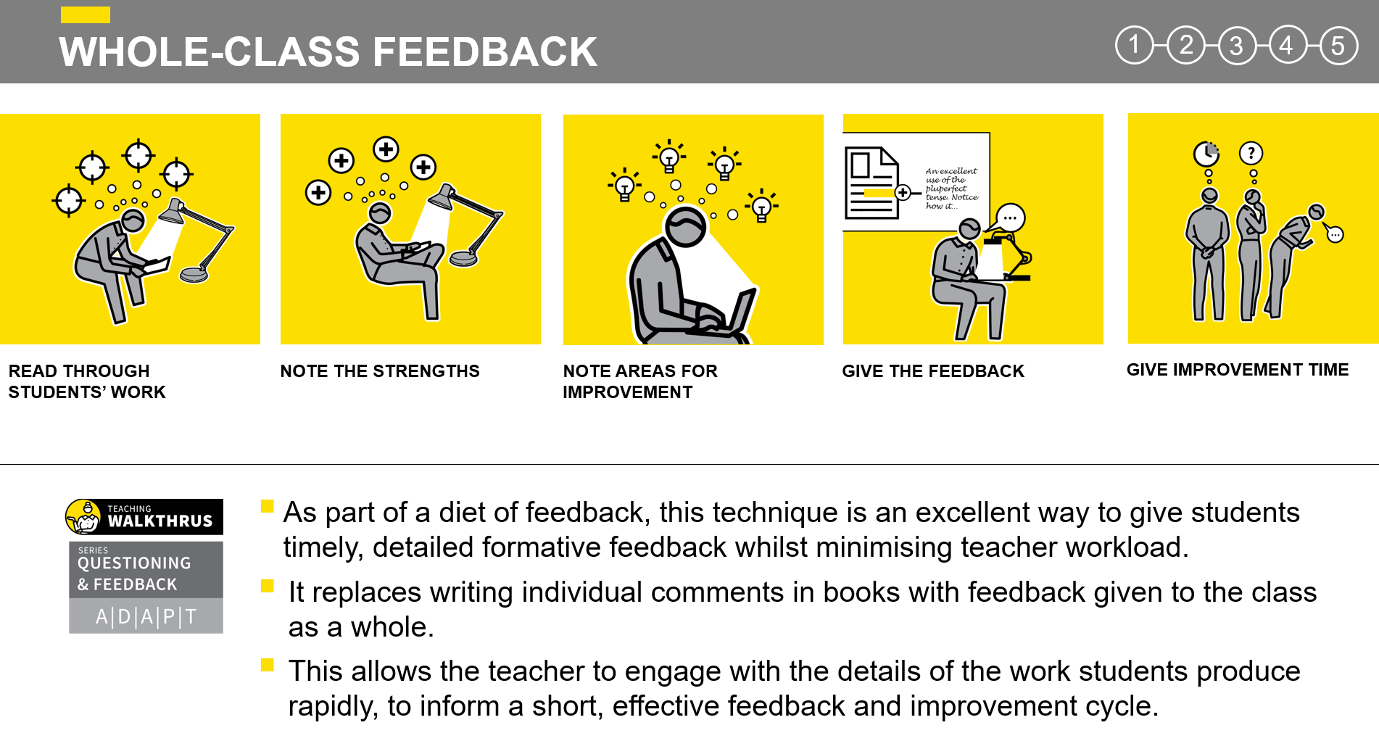
Whole-Class Feedback
Notes:
Jenny
Walkthrus on WCF
After collecting in a set of books, read through them, focusing on specific recent pieces of work. It’s important that this happens before the next time you will see the students so it forms part of the flow of ideas in your teaching. Ideally read all the books but, if time is pressing, a sample can be sufficient.
Identify common areas of strength; when reporting back to students, it will help to stress the things that are being done well so that they are reinforced as well as serving as a prompt to the few students not yet doing them. Identify specific examples of excellent work with the intention of showcasing them as models.
Reading through, make a manageable list of common misconceptions, spelling errors, technical errors and any other areas for improvement. As the feedback will be public, don’t attach errors to individuals. Note students who you might need to speak to individually because of specific issues.
The next lesson, give the work back and present the feedback to the whole class, running over the strengths and areas for improvement. Use a one-slide presentation or a visualiser to show your notes. Highlight examples of excellence using a visualiser or other appropriate showcase method.
After the feedback, give students time to make immediate improvements. They need to identify where in their work common errors occur and where they have improvements to make in line with the Feedback. This makes them think hard about the quality of their work, fostering a stronger understanding of standards.

Slide 23
Other methods of feedback
Discussion Point
What are the most commonly used methods for delivering feedback in your Department?
Does the research support their effectiveness?
What other areas of feedback would you like to explore?

Slide 24
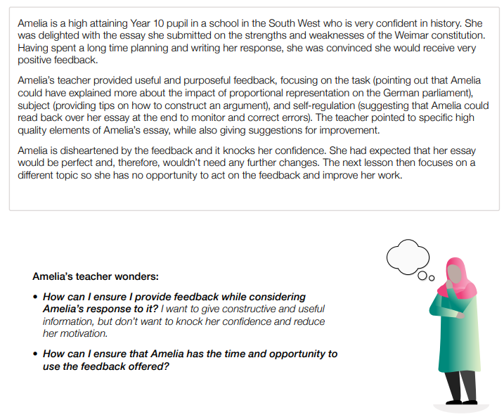
Improving feedback
How can this teacher provide feedback whilst considering the pupil’s response to it? She wants to give constructive and useful feedback without knocking Amelia’s confidence or motivation.
How can the teacher ensure that Amelia as the time and opportunity to use the feedback offered?
Notes:
Jenny
Discussion task - read this vignette from the EEF related to feedback in KS4 History. How can we help teachers plan for and ensure pupils use feedback most effectively?

Slide 25
Notes:
Review - This is where subject departments gather together to monitor the curriculum so far. This can be done by looking at books, messy markbooks, data, teacher discussion.
Plan and Adapt - There is no point taking the assessment, gathering the information, discussing in departments if you don’t then adapt the curriculum and resources.

Slide 26
Subject Team Meetings
In pillar 1 (subject expertise) we talked about department meetings.
Let’s look at how these meetings can be structured to make maximum use of assessment information.
On the following slides, see how subject leaders in mathematics and computing/ICT have analysed assessment information with their teams to identify important curriculum adaptations and next steps around pedagogy.
Notes:
All the way back in pillar 1, we discussed what we would see in department discussions. We talked about:
A review of prior learning and what learning is coming up (books).
A discussion around intent and essential knowledge.
A discussion about sequencing within an upcoming lesson.
A discussion about potential misconceptions or tricky/abstract concepts.
A discussion about effective pedagogy or explanations to support tricky concepts.
Exploring modelling or scaffolding for a particular concept.
A discussion about approaches to address misconceptions that have arisen from previous lessons.

Slide 27
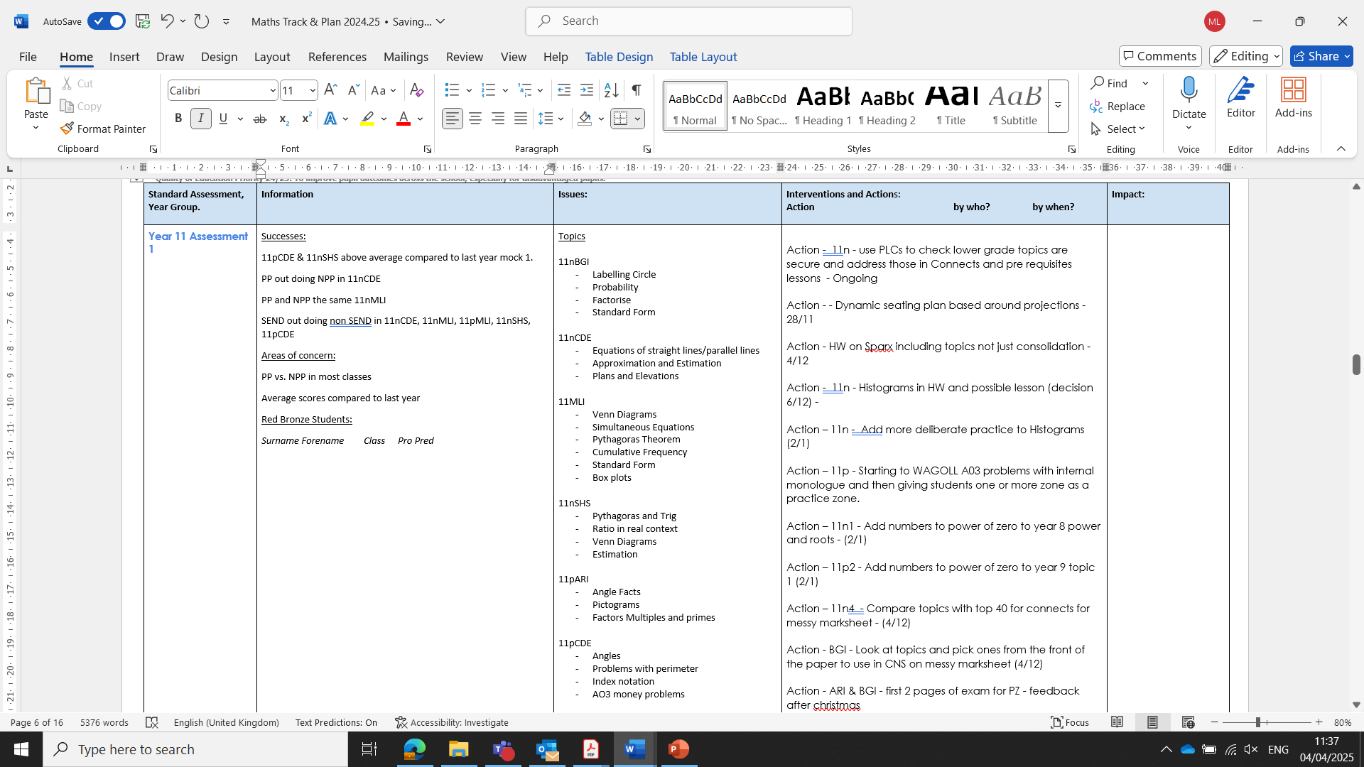
Notes:
Linda - Examples of department Year 11 assessment focus and curriculum adaptation, mathematics.
Look at how in column 2, the subject leader and teachers have identified key topics that need strengthening. There are actions on the right hand column.
Importantly, within the department meetings, teachers will share strategies around explicit instruction, and will also make resources together.
In this department, the team decided one week that they needed to restructure the whole approach to a mathematics lesson, with a focus on number fluency for some.
This led to strong buy-in around this approach across the department.

Slide 28
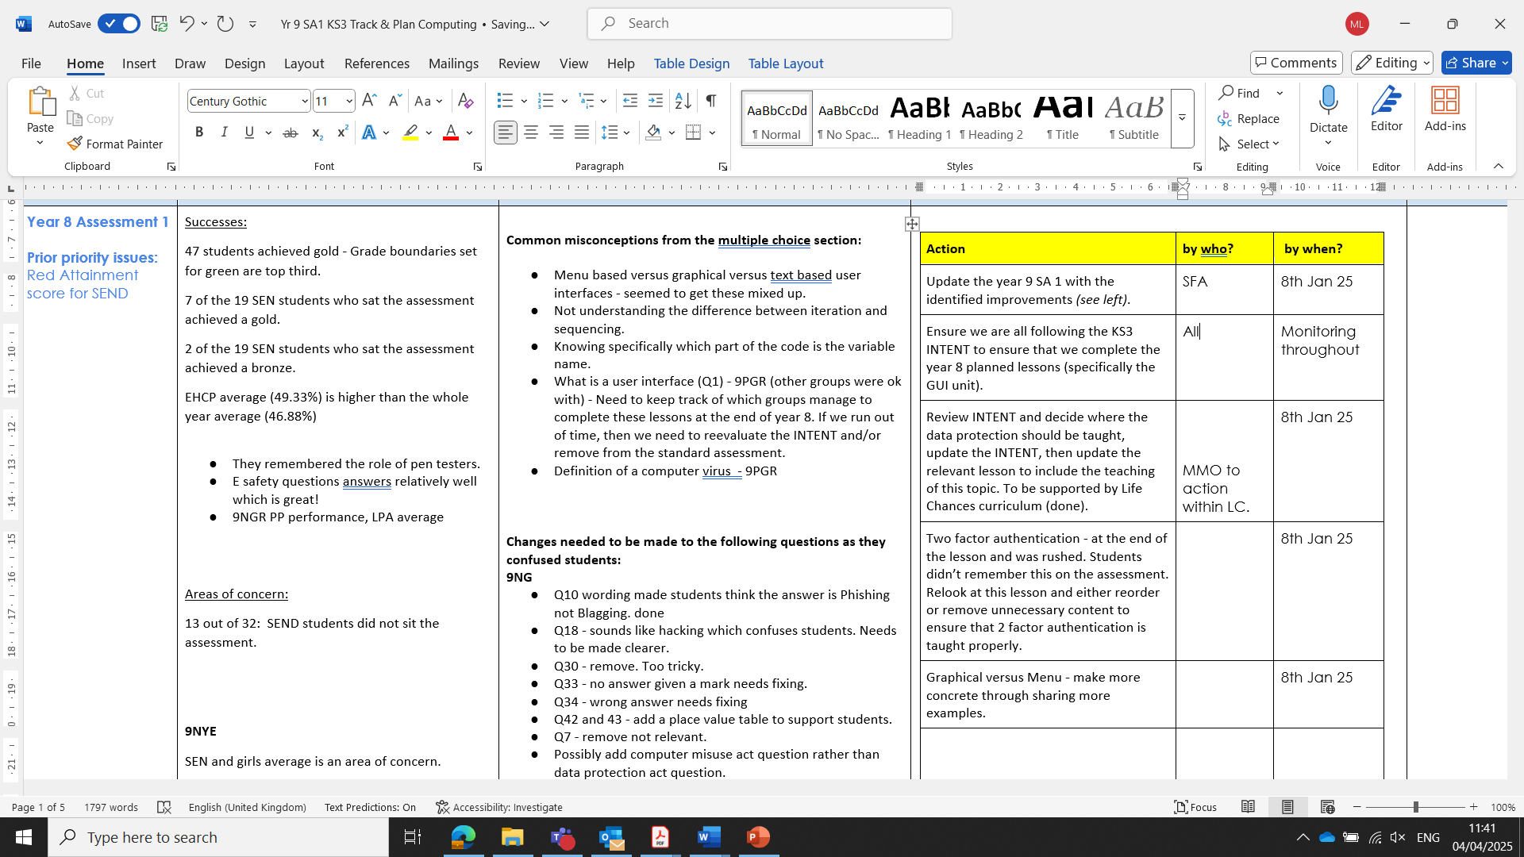
Notes:
Linda - Examples of department Year 9 assessment focus and curriculum adaptation, computing.

Slide 29
Discussion Point
How might curriculum discussions around adaptation work in your curriculum subject?
What would you look at to inform your discussions?
What are common areas that might need to be adapted in your curriculum subject following such a discussion?
Be prepared to feed back to the group.
Notes:
Reflect and be prepared to feed back to the group.

Slide 30
Key Reflections
Assessments need to be planned as part of curriculum development.
The purpose of any assessment needs to be clear.
Effective explicit instruction will decrease the need for assessment and feedback.
Explicit instruction needs to include preparedness to stop and use assessment to check learning.
Assessment needs to be appropriate and focus on the right knowledge.
Assessment needs to be acted on, else there is no point in assessing.
Action needs to be timely and meaningful.
Consider the workload/benefit. In-class approaches are often more impactful.
Subject teams can use assessment to inform training and curriculum adaptations.

Slide 31
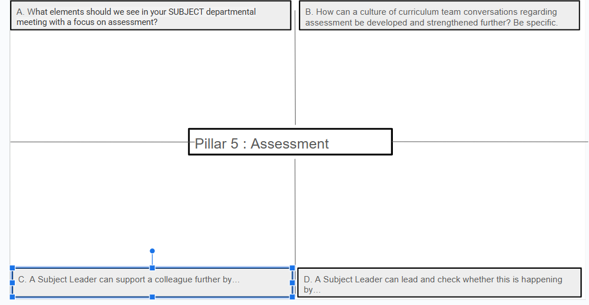
Subject Hub Reflection Tool
Notes:
The subject hub reflection tool is one document completed with all hub members contributing. This will be fed back to the Hub Executive Board to aid next steps.
We can also use this to create a reference library for best practice resources. Please list any resources that you have discussed in your sessions.
Also please share with us any research that you have found useful and we will add this to the resource bank.

Slide 32
Further Reading
Teacher Feedback to Improve Pupil Learning | EEF
The Four Pillars of Assessment, A Resource Guide, Evidence Based Education
A Summary of Evidence Based Formative Assessment Strategies - Evidence Based Education
Making Good Progress? Daisy Christodoulou, 2016
Formative Assessment in Action, A Guide for Teachers, The Curriculum Foundation.
Teach Like A Champion 3.0 - Doug Lemov
Walkthrus, Tom Sherrington, Oliver Caviglioni, 2020
The Power of Feedback, Hattie and Timperley, 2007
Notes:
Exemplar ‘what to dos’ based on Teach Like a Champion are also available in the curriculum hub folder.

Slide 33

Notes:
All
Next steps and questions
Take questions.
Be prepared to feedback any key points to the hub executive team.
Is there anything you have seen that is not working? What have me missed? What is a stumbling block?

Slide 34

Notes:
ALL

