Slide 1

Welcome to
Design
Technology
Engineering
Art
At University Collegiate School

Slide 2
DT HUB Tuesday 20th May
Agenda
Introduction to Bolton Learning partnership Pillars (How we can introduce them to best suit us as a subject)
KS3 curriculum - How can we meet the NC inc budget restrictions. (also including food planning for cost of living for those who want to discuss food)
KS3 formative assessment/summative.
Practical task - team car task (This will be a task we will be continued with in July too

Slide 3
Introduction to Bolton Learning partnership Pillars (How we can introduce them to best suit us as a subject)
How are we going to approach these?
Pillar 1 – Developing Subject Expertise
Pillar 2 – Quality of Instruction
Pillar 3 – Making Knowledge Stick
Pillar 4 – Adaptive Teaching
Pillar 5 - Pillar 5 Assessment & Feedback (TBC)

Slide 4
2. KS3 curriculum - How can we meet the NC inc budget restrictions. (also including food planning for cost of living for those who want to discuss food)
With the cost of living and government budget restrictions how can we keep technology at the fore front of our schools minds?
How do we avoid being a ‘design’ only curriculum?

Slide 5
Aims
The national curriculum for design and technology aims to ensure that all pupils:
develop the creative, technical and practical expertise needed to perform everyday tasks confidently and to participate successfully in an increasingly technological world
build and apply a repertoire of knowledge, understanding and skills in order to design and make high-quality prototypes and products for a wide range of users
critique, evaluate and test their ideas and products and the work of others
understand and apply the principles of nutrition and learn how to cook.

Slide 6
Key stage 3
Through a variety of creative and practical activities, pupils should be taught the knowledge, understanding and skills needed to engage in an iterative process of designing and making. They should work in a range of domestic and local contexts [for example, the home, health, leisure and culture], and industrial contexts [for example, engineering, manufacturing, construction, food, energy, agriculture (including horticulture) and fashion].
When designing and making, pupils should be taught to:
Design
D1 - use research and exploration, such as the study of different cultures, to identify and understand user needs
D2 - identify and solve their own design problems and understand how to reformulate problems given to them
D3 - develop specifications to inform the design of innovative, functional, appealing products that respond to needs in a variety of situations
D4 - use a variety of approaches [for example, biomimicry and user-centred design],to generate creative ideas and avoid stereotypical responses
D5 - develop and communicate design ideas using annotated sketches, detailed plans, 3-D and mathematical modelling, oral and digital presentations and computer-based tools
Make
M1 - select from and use specialist tools, techniques, processes, equipment and machinery precisely, including computer-aided manufacture
M2 - select from and use a wider, more complex range of materials, components and ingredients, taking into account their properties
Evaluate
E1 - analyse the work of past and present professionals and others to develop and broaden their understanding
E2 - investigate new and emerging technologies
E3 - test, evaluate and refine their ideas and products against a specification, taking into account the views of intended users and other interested groups
E4 - understand developments in design and technology, its impact on individuals, society and the environment, and the responsibilities of designers, engineers and technologists
Technical knowledge
TK1 - understand and use the properties of materials and the performance of structural elements to achieve functioning solutions
TK2 - understand how more advanced mechanical systems used in their products enable changes in movement and force
TK3 - understand how more advanced electrical and electronic systems can be powered and used in their products [for example, circuits with heat, light, sound and movement as inputs and outputs]
TK4 - apply computing and use electronics to embed intelligence in products that respond to inputs [for example, sensors], and control outputs [for example, actuators], using programmable components [for example, microcontrollers].

Slide 7
How can we cover these in practical lessons?
How can we cover these in design lessons without losing skill?

Slide 8
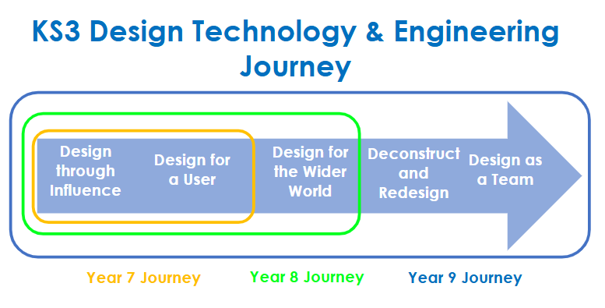

Slide 9
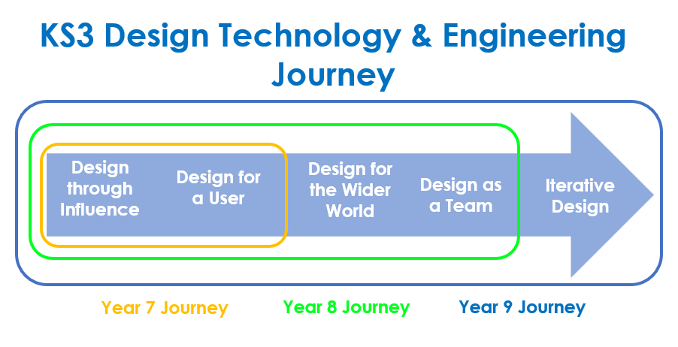

Slide 10
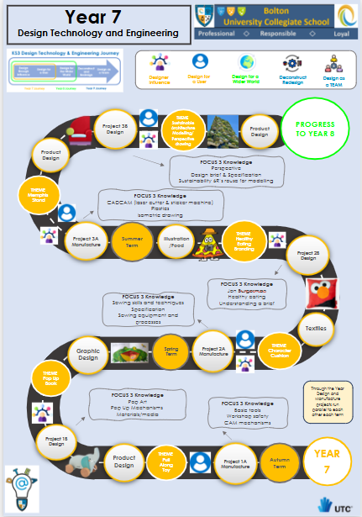
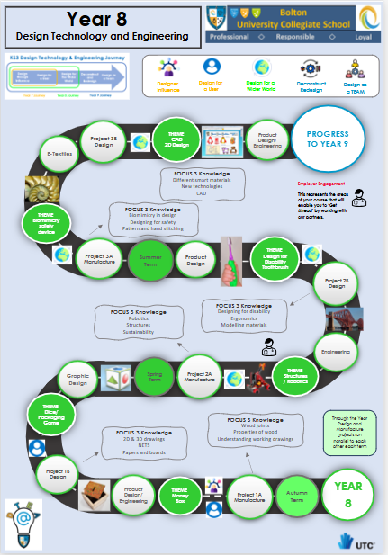
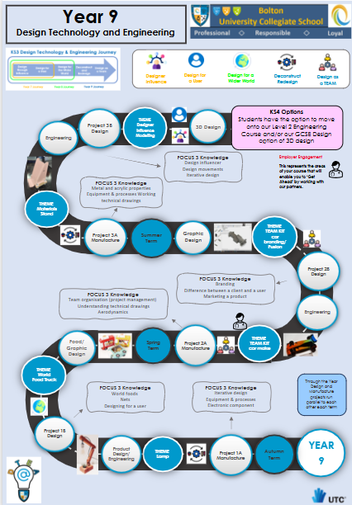

Slide 11
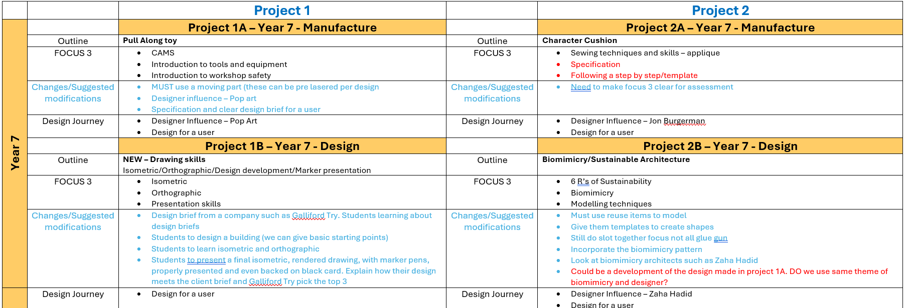

Slide 12
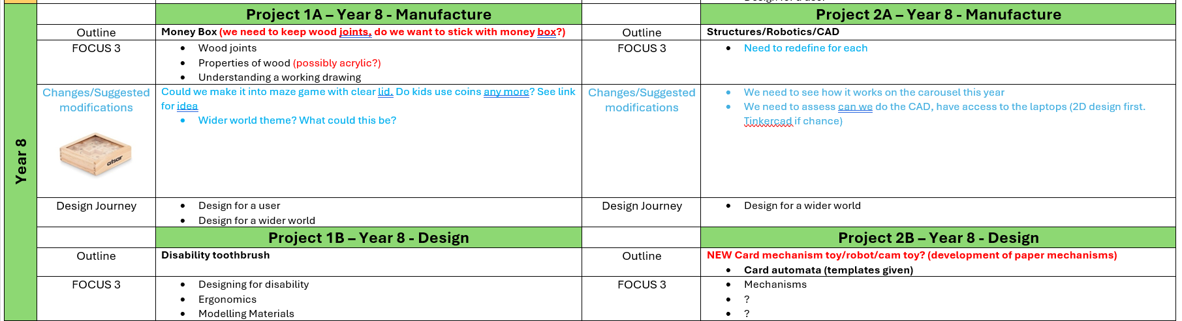

Slide 13
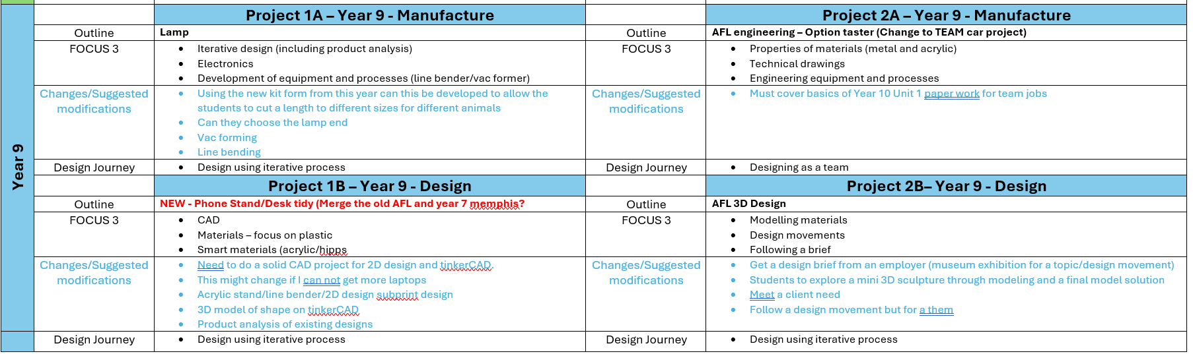

Slide 14
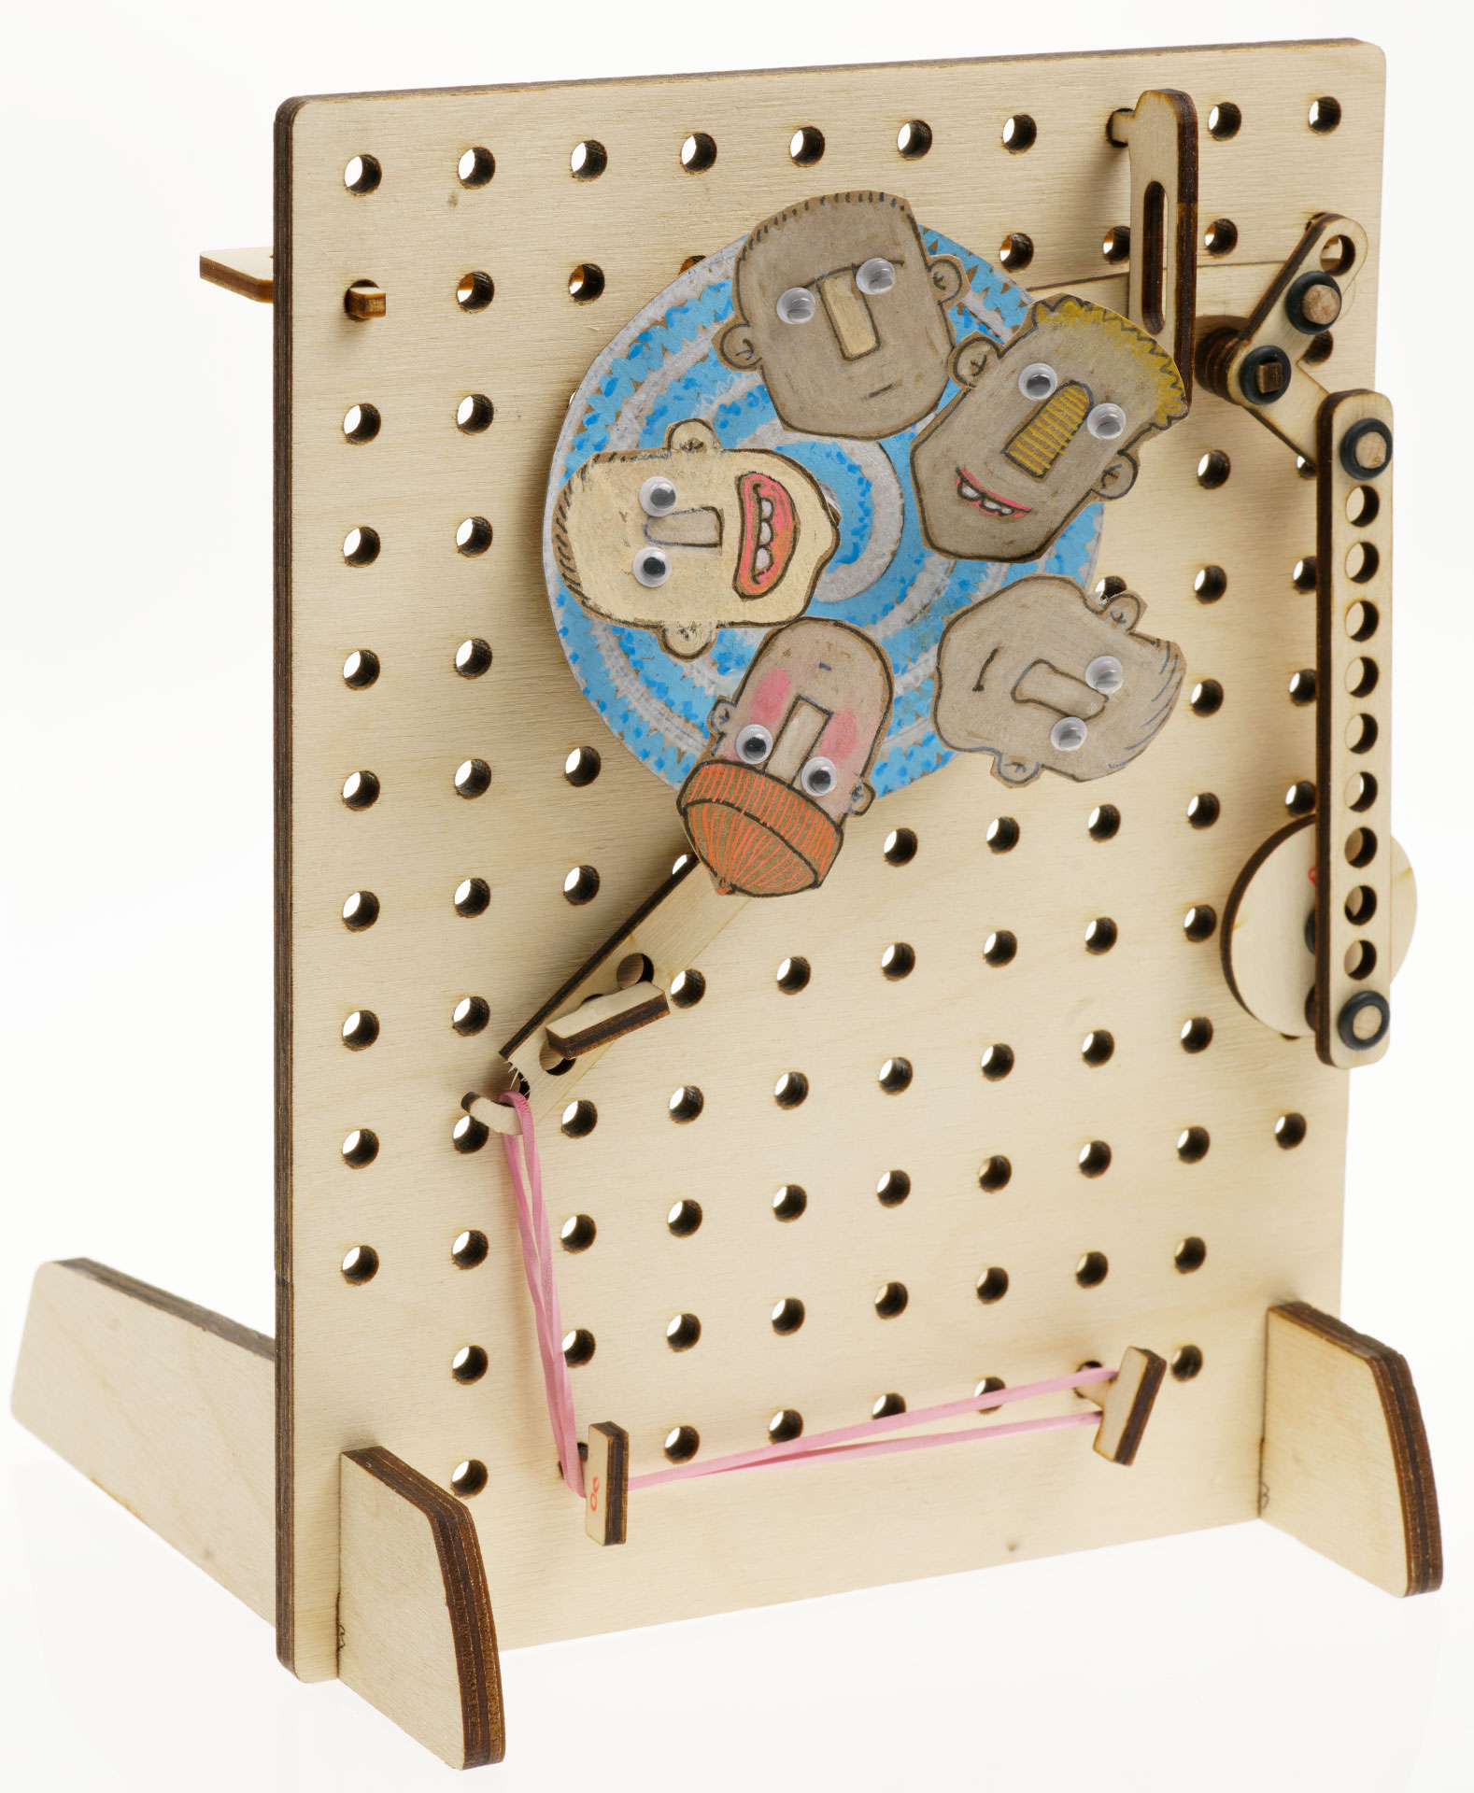
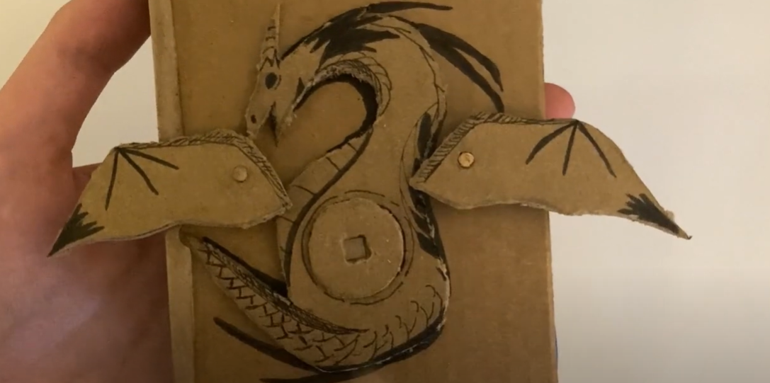
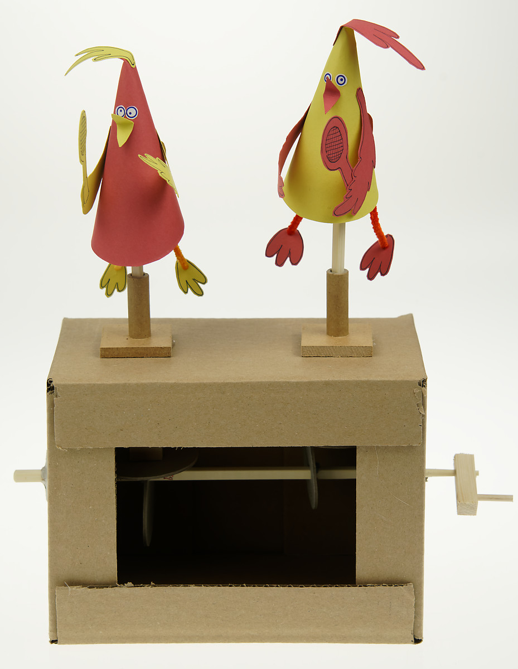
https://www.youtube.com/watch?v=GWGU9xw9sXI

Slide 15
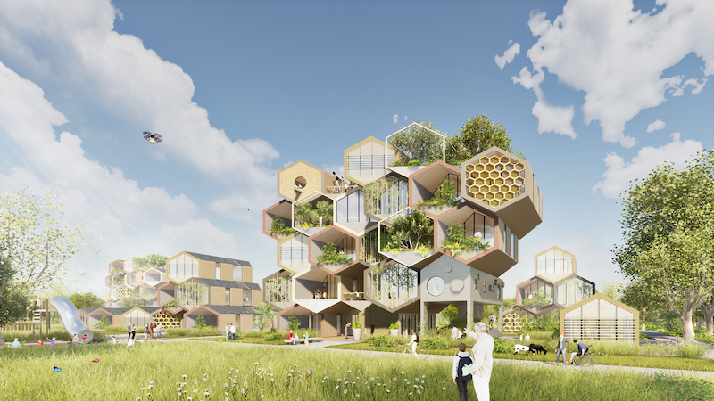
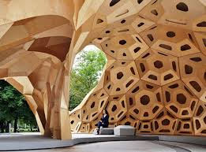
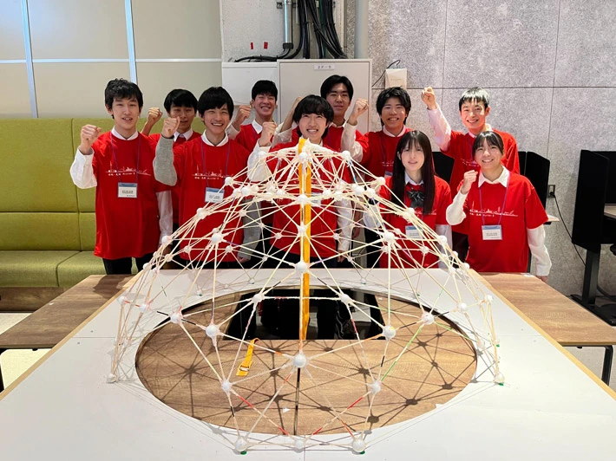
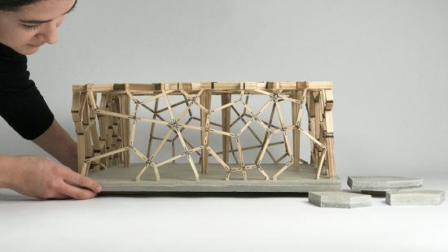

Slide 16
Thoughts on what we can do?
DT

Slide 17
Cooking and nutrition
As part of their work with food, pupils should be taught how to cook and apply the principles of nutrition and healthy eating. Instilling a love of cooking in pupils will also open a door to one of the great expressions of human creativity. Learning how to cook is a crucial life skill that enables pupils to feed themselves and others affordably and well, now and in later life.
Pupils should be taught to:
Key stage 3
CN1 - understand and apply the principles of nutrition and health
CN2 - cook a repertoire of predominantly savoury dishes so that they are able to feed themselves and others a healthy and varied diet
CN3 - become competent in a range of cooking techniques [for example, selecting and preparing ingredients; using utensils and electrical equipment; applying heat in different ways; using awareness of taste, texture and smell to decide how to season dishes and combine ingredients; adapting and using their own recipes]
CN4 - understand the source, seasonality and characteristics of a broad range of ingredients
What do we need to cover?
What skills/knowledge are a MUST
How can we do this in small 1 portion size for cost (both providing for PP and students bringing in?)
What practical’s are easy to prepare (lack of technician/students not weighing at home?)
Quick and easy for short lessons?
Quick and easy for organisation?

Slide 18
Thoughts on what we can do?
Food

Slide 19
3. KS3 formative assessment/summative.
How to assess against a whole school % policy?

Slide 20
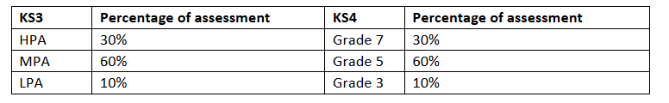
Mid topic
10 question multiple choice
Summative
Worth 20/40 marks

Slide 21
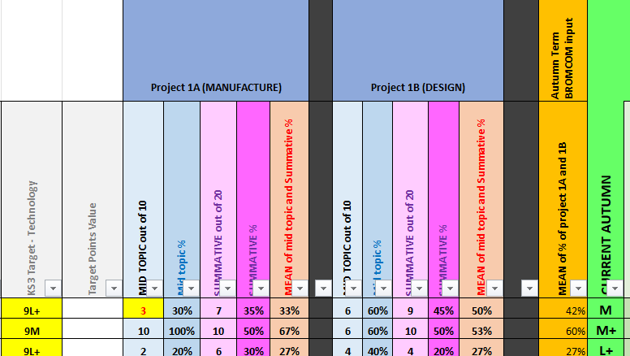

Slide 22
Issues
How to include the practical skill?
How to ensure scaffolded questioning across different skills areas?
Do we assess both projects separate or together?

Slide 23
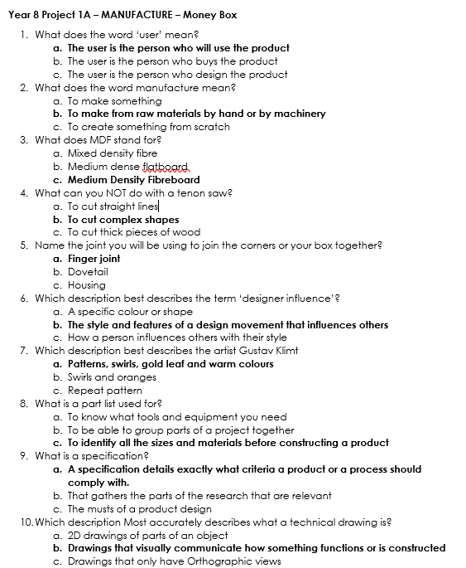
Mid topic

Slide 24
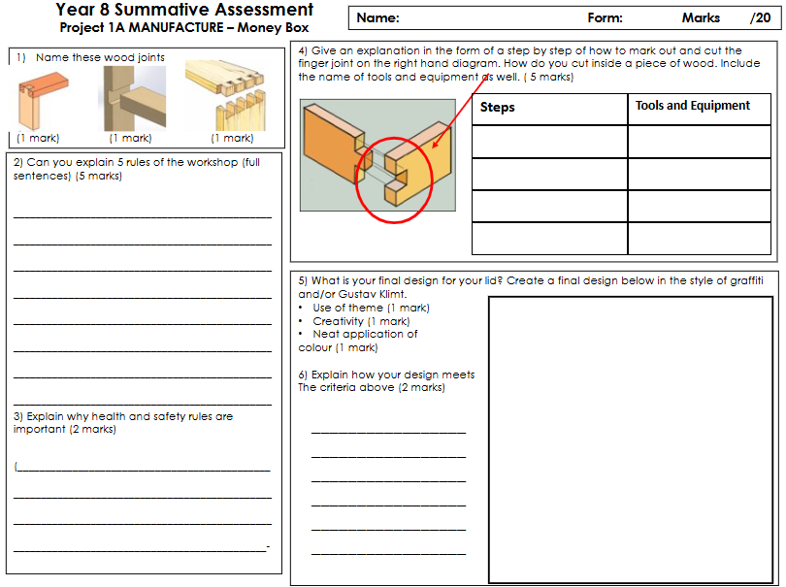
Summative round 1
Per project
To restrictive in layout
Not in depth enough
Too much marking
But allow for staff to assess correctly for their project

Slide 25
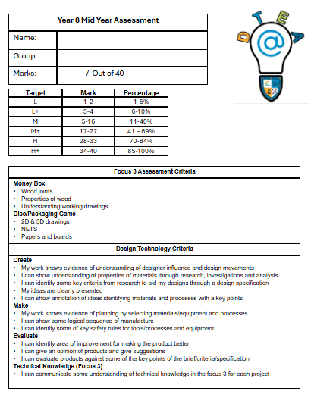
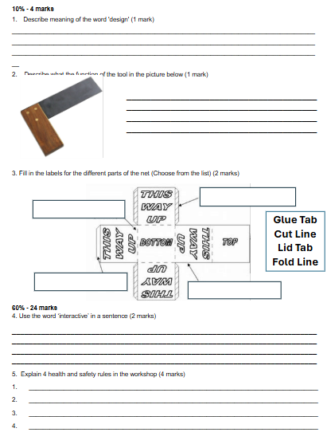
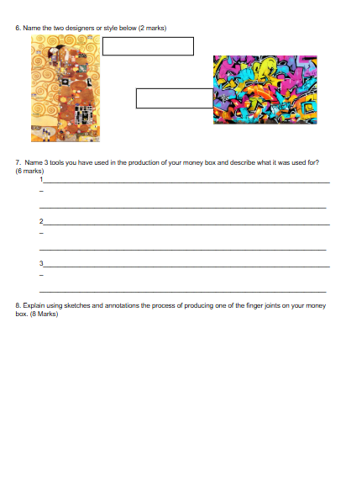
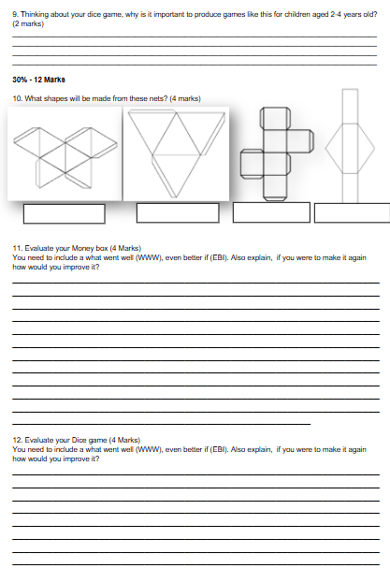
Summative round 2
Design and Manufacture projects assessed together (may be an issue if not on track/staff absences etc)
Saved time in marking
Better layout
More scaffolded and in depth questioning
Still not assessing the practical

Slide 26
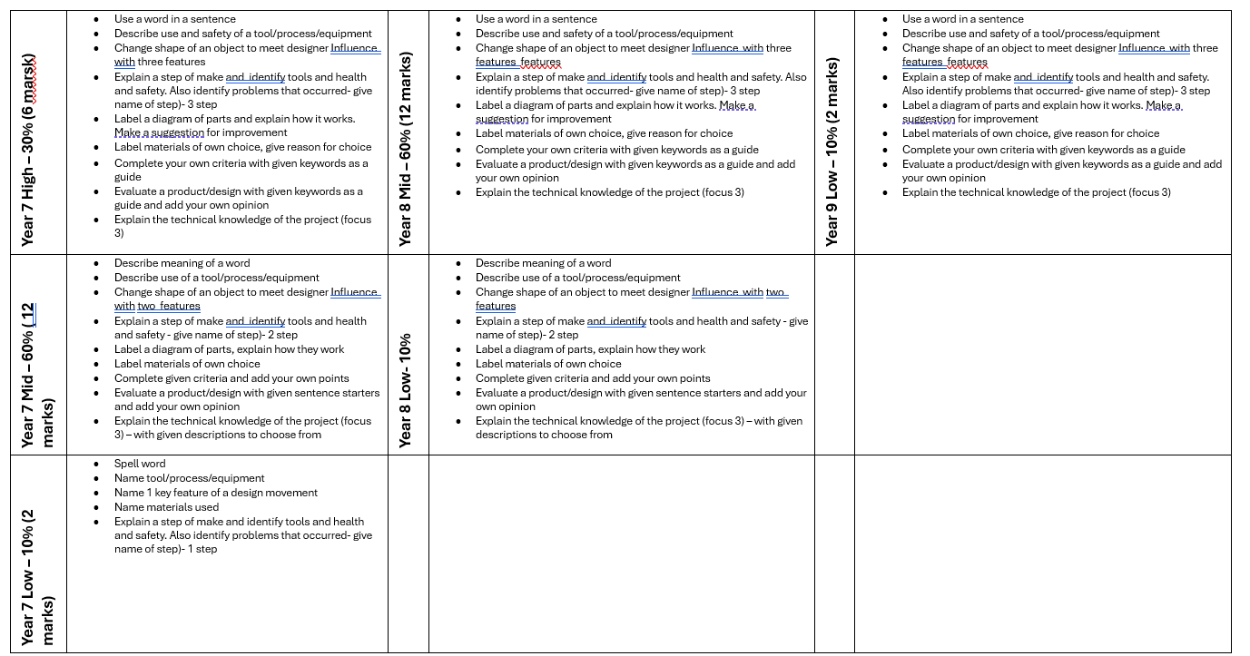
Structure ladder for assessment questions
Adapted from original assessment criteria
KS3 TECH Focus 3 assessment criteria guide.docx

Slide 27
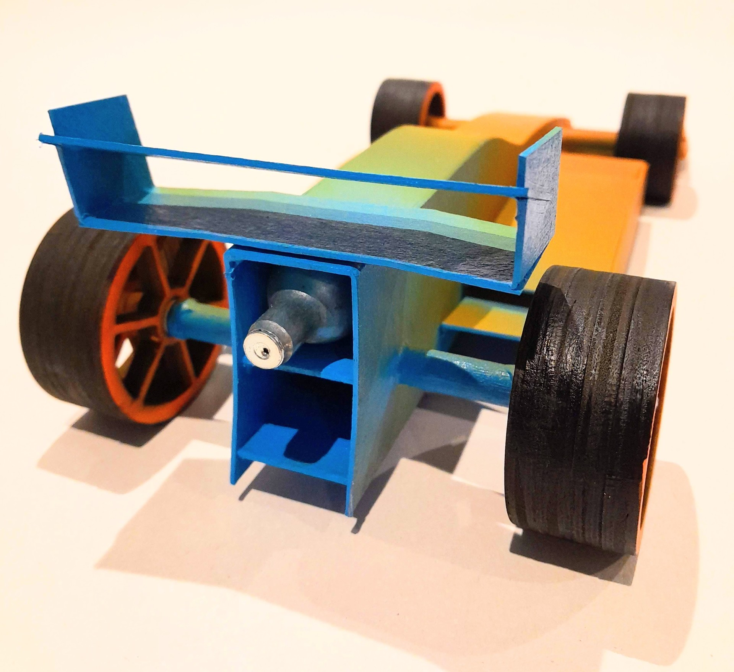
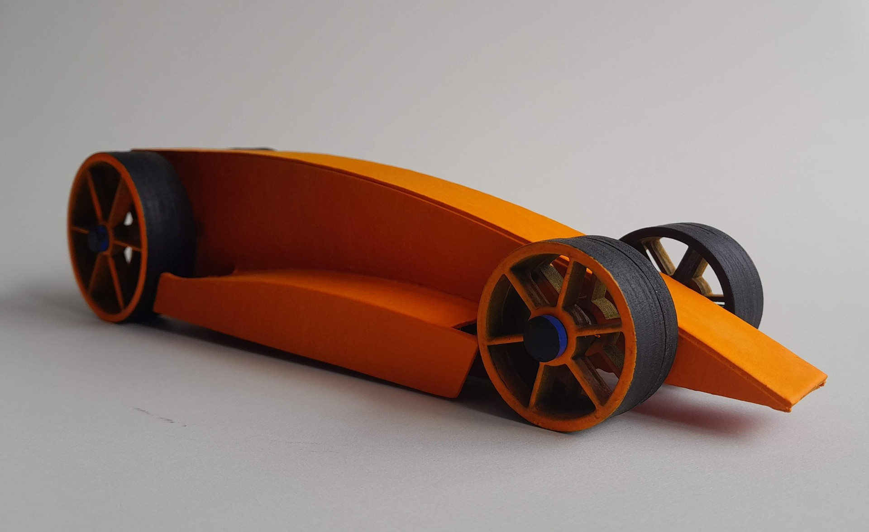
4. Practical task - team car task (This will be a task we will be continued with in July too)
TEAM KIT CAR

Slide 28
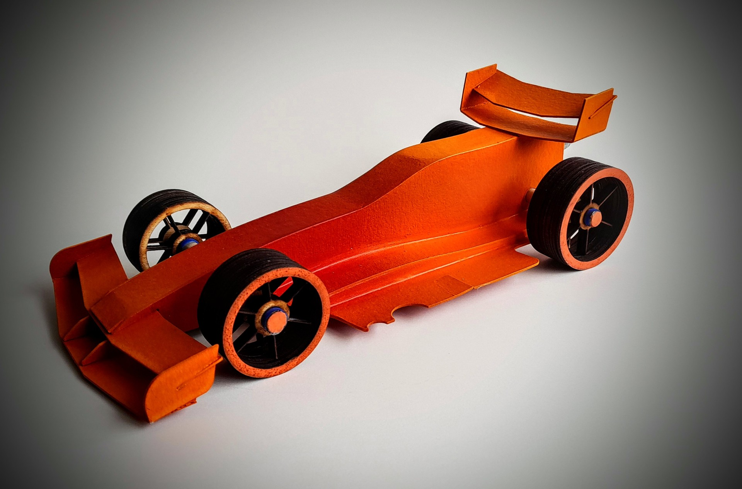
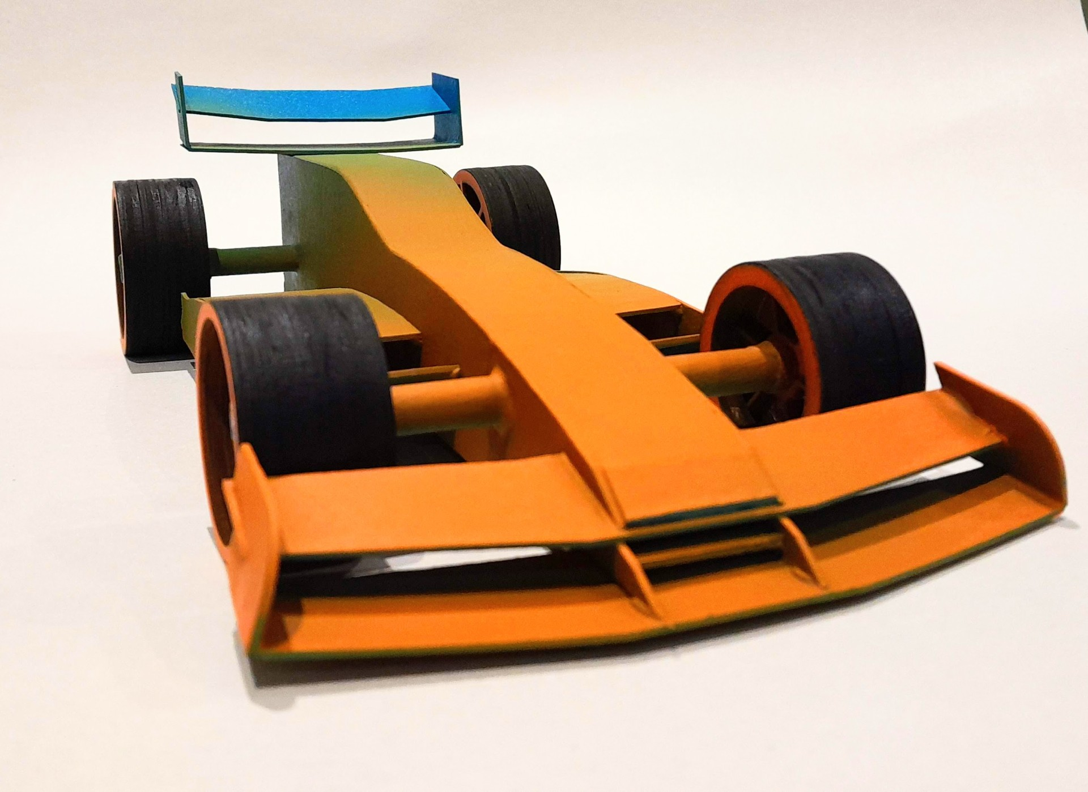
Easier to adapt to customise parts/shapes
Great team project
In school form of F1 in schools

Slide 29
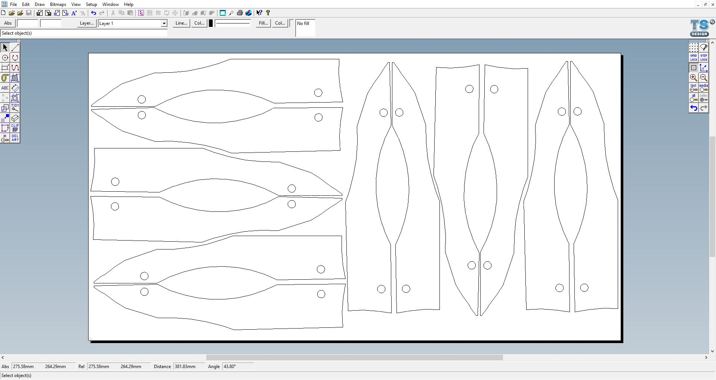

Slide 30
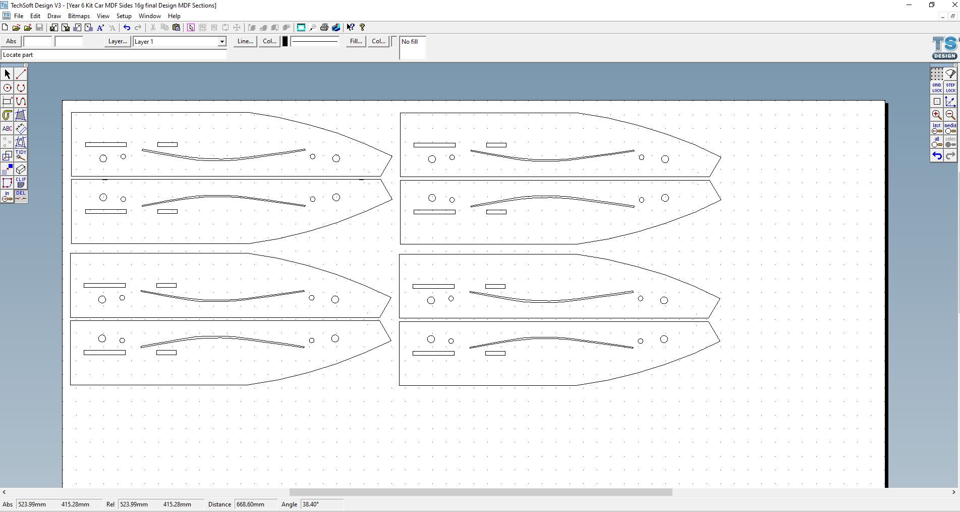

Slide 31
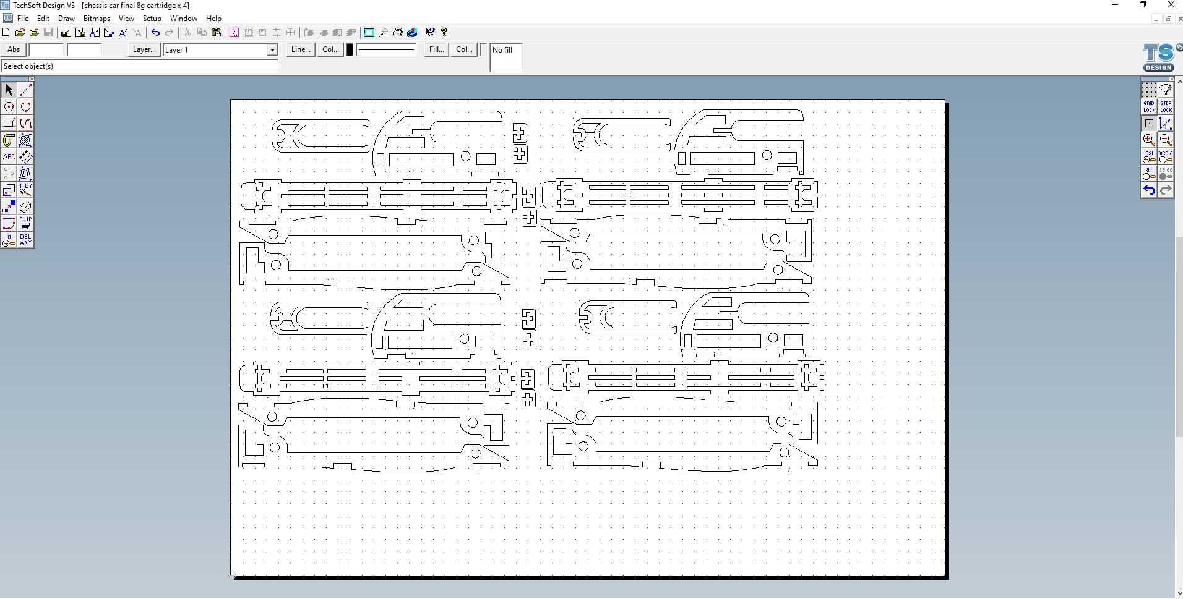

Slide 32
Draft plan of attack for July 4th
(all TBC nearer the time)
Pillar training
Mini projects (materials stand/card mechanisms/?)
Race day of the car
Tour of the new build
Food input TBC?

