Slide 1

Pillar 4: Adaptive Teaching
March 2025
Katie Parkinson
Notes:
Introduction and welcome
Picture shows a team effort with everyone having same aim.
Everyone can get to their summit. Some people may need ropes, porters, oxygen, more equipment, more energy gels.

Slide 2

Our vision
To facilitate the gathering of best practice curriculum implementation strategies.
This is so that we help subject leaders and teachers to in turn help all children to know and remember important knowledge across subject curriculums.
To support subject leaders in evaluating the impact of their subject curriculums.
Notes:
The 19k
Let us recap the analysis of the 19k
6456 pupils in the 19k live in the 10% most deprived area in UK and 13293 live in the 30% most deprived areas.
Our work is to facilitate learning of and sharing of best generic and subject specific implementation practice across schools.
Our focus must be on improving outcomes for disadvantaged pupils and those with SEND.
However, across the partnership impact so far has been positive.
It is wonderful that working collectively together as leaders of the 19k, we can have a hugely positive impact on pupils across Bolton.

Slide 3
Progress 8 Trajectory
All Pupils | 2021/22 | 2022/23 | 2023/24
Bolton | -0.12 | -0.08 | +0.05
England | -0.03 | -0.03 | -0.03
North West | -0.16 | -0.20 | -0.17
Disadvantaged Pupils | 2021/22 | 2022/23 | 2023/24
Bolton | -0.51 | -0.53 | -0.30
England | -0.55 | -0.57 | -0.57
North West | -0.69 | -0.75 | -0.71

Slide 4
Progress 8 Trajectory - pupils with SEND
SEND EHCP | 2021/22 | 2022/23 | 2023/24
Bolton | -1.41 | -1.17 | -1.07
England | -1.33 | -1.12 | -1.13
North West | -1.31 | -1.08 | -1.18
SEND Support | 2021/22 | 2022/23 | 2023/24
Bolton | -0.54 | -0.74 | -0.23
England | -0.47 | -0.45 | -0.45
North West | -0.58 | -0.59 | -0.56

Slide 5
% 5+ English and Mathematics Trajectory
All Pupils | 2021/22 | 2022/23 | 2023/24
Bolton | 47.2 | 43.8 | 46.0
England | 50.0 | 45.5 | 46.2
North West | 46.8 | 41.7 | 42.5
Disadvantaged | 2021/22 | 2022/23 | 2023/24
Bolton | 30.5 | 26.1 | 29.0
England | 29.7 | 25.4 | 26.0
North West | 26.6 | 21.9 | 22.8
Notes:
We have included the 5+ attainment information due to lack of progress 8 next year.
5+ will be a key performance measure.
As leaders, we will also need to focus on 7+ and this could be something we work on together in the coming year - Jenny has been doing a research project at Canon Slade.

Slide 6
% 5+ English and Mathematics Trajectory - pupils with SEND
SEND EHCP | 2021/22 | 2022/23 | 2023/24
Bolton | 7.2 | 5.1 | 6.6
England | 7.0 | 6.9 | 7.0
North West | 5.5 | 6.4 | 6.3
SEND Support | 2021/22 | 2022/23 | 2023/24
Bolton | 15.7 | 11.1 | 18.2
England | 22.5 | 20.7 | 21.6
North West | 20.6 | 19.0 | 19.3
Notes:
NASEN - The attainment gap (nationally) between pupils with SEND and their peers is twice as big as the gap between pupils eligible for free school meals and their peers. However, pupils with SEND are also more than twice as likely to be eligible for free school meals.’

Slide 7
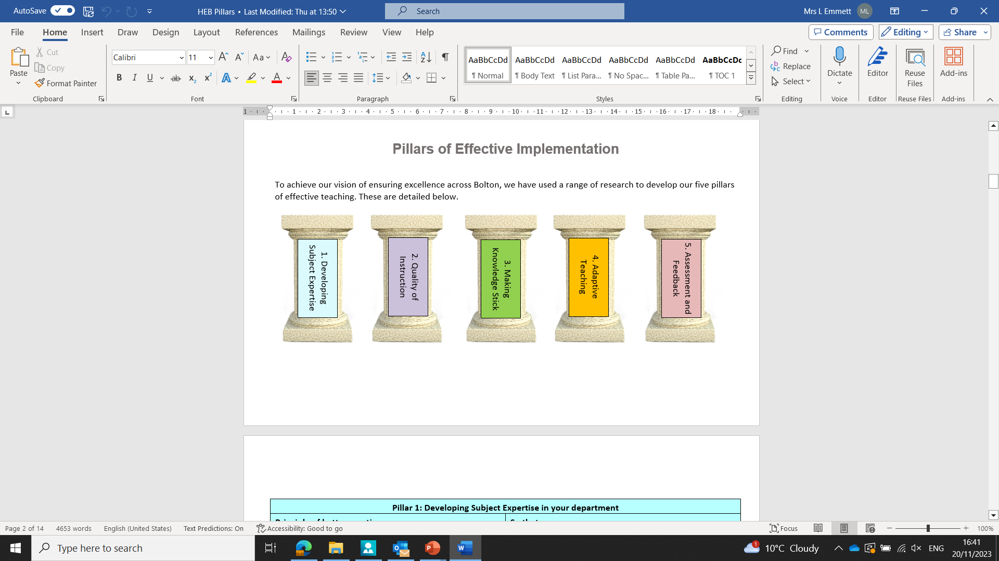
The Pillars of Effective Curriculum Implementation
Notes:
As discussed in the last two sessions, we have used a range of research, including the work of the Bolton teaching and learning hub, feedback and work from the curriculum hub, best practice visits to high-performing trusts, to inform the five pillars of implementation detailed above.
They are developing subject expertise
Quality of instruction
Making knowledge stick
Adaptive teaching
Assessment and feedback.

Slide 8
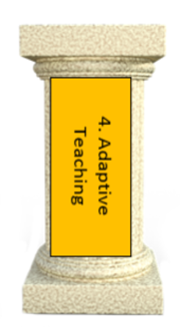
Teachers have a strong understanding of pupils’ needs, especially SEND.
Teachers engineer success so that pupils develop confidence.
Teachers use a range of information to adapt teaching as needs emerge.
Teachers provide scaffolds for demanding tasks.
Notes:
In this session, we will be building on the previous sessions on subject expertise and quality of instruction.
This pillar focuses on how we help all pupils, especially disadvantaged pupils and those with SEND, to know and remember the most important knowledge.
As ever, this pillar links to many of our pillars.
We will follow this with assessment and feedback which is intrinsically linked with this pillar.
We will link this pillar with the EEF. If you look at the four focus areas on the board… these link with the 5 focus areas of the EEF around effective support for pupils with SEND in the classroom.
Engineering success to give pupils confidence links back to explicit instruction as well as adaptive teaching.

Slide 9
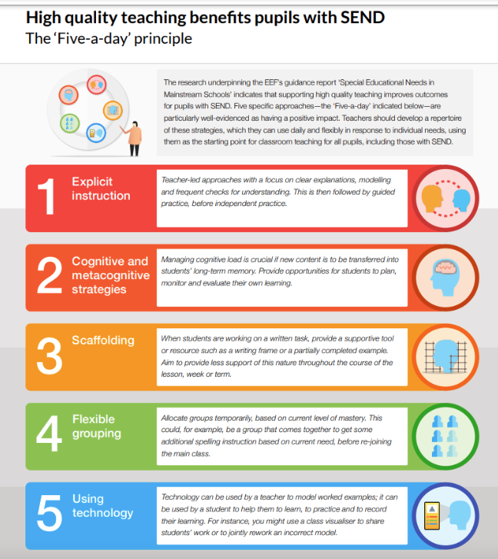
EEF Guidance Report - October 2021
Special Education Needs in Mainstream Schools
Pupils with SEND have the greatest need for excellent teaching and are entitled to provision that supports achievement at, and enjoyment of, school.
Notes:
LEM Introduce the EEF guidance report from 2021.
EEF_Special_Educational_Needs_in_Mainstream_Schools_Guidance_Report.pdf
Link this back to the data - As seen, SEND is an improving picture pupils in Bolton make over a grade less progress than their peers.
The ‘five a day’ recommendation from this report gives five highly effective strategies that you can use in your classrooms to improve the learning of SEND pupils. Remember, if we get it right for the most vulnerable in our classrooms, we get it right for them all.
The overriding message from the report is a positive one. It is tempting to talk about the challenge of SEND as a specific and distinct issue. Yet, far from creating new programmes, the evidence tells us that teachers should instead prioritise familiar but powerful strategies, like scaffolding and explicit instruction, to support their pupils with SEND. This means understanding the needs of individual pupils and weaving specific approaches into everyday, high quality classroom teaching—being inclusive by design not as an afterthought.
The report used the best available research on how to improve outcomes for pupils with SEND ages 5-16 in mainstream schools. What came out of this was five key recommendations (five a day) that are the ‘best bets’ for improving SEND provision in mainstream schools.
Today, we will recap explicit instruction and then explore cognitive and metacognitive strategies and scaffolding

Slide 10


Slide 11
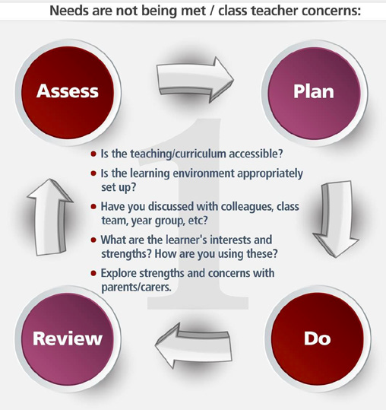
Most learners with special educational needs will receive the majority of their support in the classroom. The aim of this support is to ensure that they access the curriculum and maximise their potential. Your contact with them is crucial since you are the expert on the learner.
Notes:
NASEN Teacher Toolkit

Slide 12
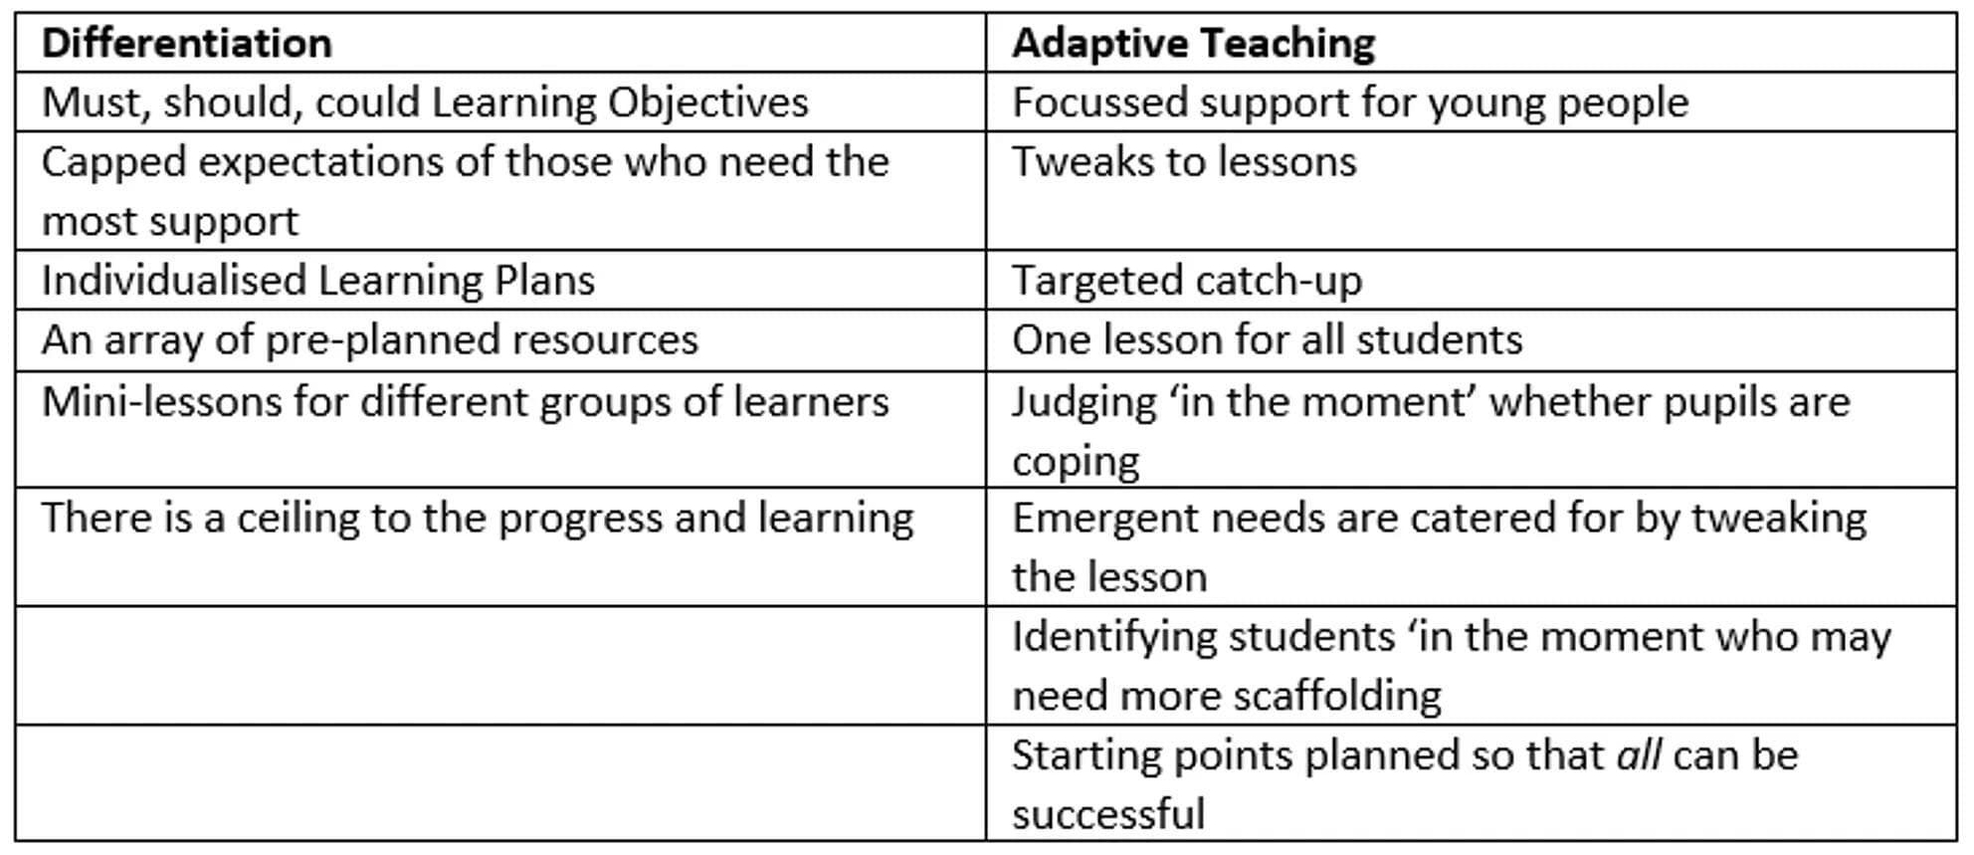
What is adaptive teaching?
Notes:
A summary of adaptive teaching.
Taken from structural learning.com
We have focused today on EEF and NASEN research. We have included the extensive research pieces in the reading list for this session.
The NASEN teacher handbook includes subject-specific guidance information for you to use to adapt this presentation.

Slide 13
Notes:
Let’s look again at recommendation 1, explicit instruction

Slide 14
Explicit Instruction (Recap) - EEF Guidance
Clear and succinct language
Chunking and small steps
Model how to complete a task
Check pupils’ understanding regularly
Notes:
Prior to moving to adaptive teaching, let’s recap and delve deeper into some of pillar 2 - explicit instruction in line with EEF guidance
EEF blog: What exactly is explicit instruction? | EEF Gary Aubin
To benefit pupils with SEND, the EEF supports the work we have done so far on explicit instruction.
The EEF outlines that we need to use clear and succinct language, chunking and small steps, modelling and regular checks for understanding.
For example, think back to the work we did on being clear and succinct, and avoiding seductive details.
Also think back to the summary of Lemov’s TLAC technique 21 - take the steps. Identify the small steps, sequence the steps, help pupils to understand the steps, check for understanding and give exemplars.

Slide 15
Rosenshine’s Quality of Instruction Principles
Provide Highly Effective Explanations
Present new material in small steps
Provide models
Guide student practice
Monitor independent practice
Notes:
Let’s look back at some of Rosenshine’s principles that we covered in pillar 2.
The EEF guidance relates very well to these.
Highly effective explanations links to clear and succinct language
Small steps links to chunking and small steps
modelling and guided practice
regular checks for understanding links to monitoring independent practice.
So let’s delve a bit deeper into modelling as our colleagues may think it is more abstract than it actually is!

Slide 16
Modelling
Think aloud as you model
Highlight misconceptions
Include contrasting non-examples
Reduce the language load
Pace your speech
Highlight essential information
Notes:
So we have used small steps and chunked information where needed.
Let’s explore the concept of modelling in more detail.
The EEF states the following:
Only present small amounts of new material at any time and assist students as they practice this material
Think aloud as you model and highlight any misconceptions including contrasting non-examples that will draw pupils’ attention to the deep structure of the concept
Include varied examples
Reduce the language load. Limit words and only state that is necessary
Explain ambiguous or tricky language - (as a curriculum executive board, we are looking at ways to explore quick methods of doing this using a current research piece from LEAD academy trust in the East of England)
Pace your speech to aid processing time
Highlight any essential information to remove distracting information that may add to cognitive load.
Here are some examples from Research Schools Network
support, instruction, pupil, explicit,… | Research Schools Network

Slide 17
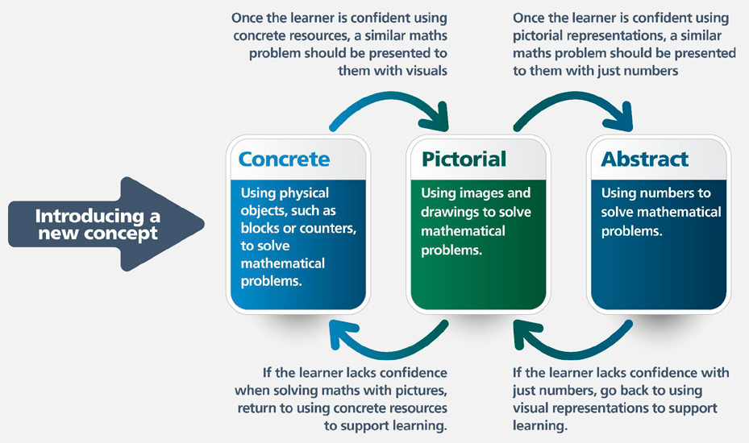
Notes:
Useful summary from NASEN in relation to primary mathematics, page 59
This highlights the movement between concrete to pictorial to abstract and how you might need to use assessment to move back between each step
In secondary, the concrete may be needed for a small number of pupils. Or, it could be breaking down abstract concepts into manageable steps or ‘thinking aloud’
The pictorial element may be the use of visualisers, visual stimuli
How can this be used in your subject area?

Slide 18
Explicit Vocabulary Teaching - Etymology
Adjective | Clues | Meaning
Inaccurate | In = now Accurate = correct
Startling | Startle = shock ing = creates an adjective
Motionless | Motion = movement Less = without
Sinuous | Sinus = curve, fold ous = full of
Notes:
In the key stage 3 element of NASEN teacher handbook, explicit instruction of key vocabulary is important, including etymology and Greek/Latin root words. This will help to create links and also in time give pupils strategies to unpick words.
Example of explicit vocabulary instruction to support weaker readers to understand etymology - courtesy of Jayne Calvert at LLS.
However we are doing more work on this at the moment in relation to fast and focused models.

Slide 19
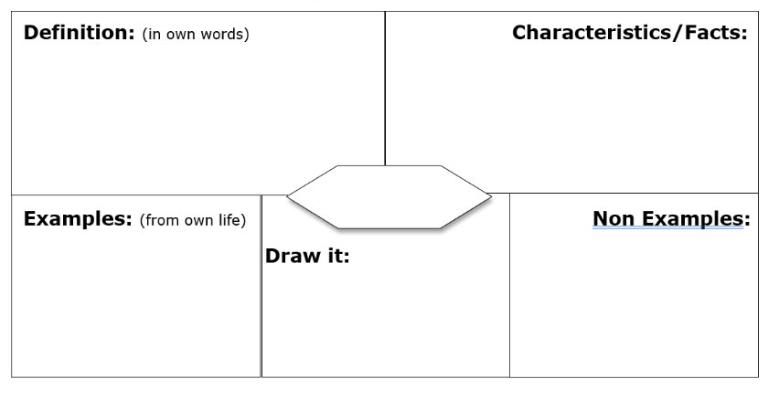
Explicit Vocabulary Teaching – Frayer Model
Biodiversity is the VARIETY of life on earth including the variety of species, genes and ecosystems
We have only discovered 19% of ALL life on earth but humans have destroyed 75% of this since 1970.
Biodiversity
Bacteria
Fungi
Flowering plants
Ants
Beetles ….
Abiotic factors
Monocrops
Carbon dioxide

Slide 20
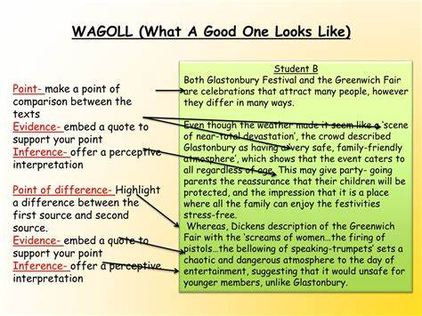
Modelling Examples
Notes:
run a brief task
Look at the example on the board.
Discuss the effectiveness of this approach when supporting pupils with SEND.
Make the point of cognitive load - the arrows across the text, the definitions are too complex and add to cognitive load rather than diminish it. Think back to ‘optimising communication’.
Here you could ask hub members to bring a subject-specific example for comment and discussion, or to share any best practice.

Slide 21
You may have considered…
Knowledge of pupils’ needs
Impact on cognitive load
Distraction theory
Pupils’ existing knowledge - do pupils know the components of inference? Do they know to offer perspective interpretation?
Notes:
What are the principles for using WAGOLLS effectively? (Alex Quigley)
Utilise multiple WAGOLLs where possible. When pupils are faced with one example of good writing, they too often simply imitate it. But shift pupils to comparing two examples and pupils begin to better to discriminate their key ingredients. If you have three examples – this could be a bit overwhelming – but with more confident pupils, they begin to get a rich picture of writing styles and moves for their own writing. They can better notice patterns of writing quality (whilst getting a healthy dose of reading).
Ensure pupils dig beneath the surface features of WAGOLLs. For novice pupils, it is understandable that they’d fixate on surface features of examples. For instance, for a written argument, they may notice the number of paragraphs, but not discern the crucial argument structure (e.g. such as the classic ‘thesis, antithesis, synthesis’ structure). Sophisticated vocabulary can be visible to pupils, but they don’t notice there is a subtly connected pattern of language. Explicit teaching of the most important ingredients of the WAGOLL is essential.
Apply the ‘Goldilocks principle’ to WAGOLLs. Too often, we can use examples that are simply beyond the reach of pupils to imitate well. For instance, if we are teaching complex sentence structures, utilising Dickens, and David Copperfield, isn’t always ideal. We can apply the Goldilocks principle: ensuring the example is within reach. A good example is using past pupil exemplar – with their understandable flaws and mistakes – and not simple the most sophisticated examples we can find.
Read aloud, annotate live, and ensure pupils pay close attention to sentence-level choices. Pupils can judge a good piece of writing when they see one, but they can easily miss nuanced effects. By reading the WAGOLL aloud, whilst narrating the writer’s potential thinking and sentence choices, we help pupils notice nuances of writing craft. We have been annotating to pay attention to writing moves, for thousands of years, so let’s be deliberate and explicitly model good quality annotation too.

Slide 22
Notes:
Let’s move on to look at recommendation 2, cognitive and metacognitive strategies

Slide 23

Metacognition
Notes:
Metacognition - what is it?
Metacognition and self-regulation approaches support pupils to think about their learning more explicitly, often by teaching them specific strategies for planning, monitoring and evaluating their learning. Teachers may refer to this as ‘thinking about thinking’ This terms however is vague and slippery- it doesn’t help a the teacher with bottom set Y8 on a wet Wednesday afternoon or a Y11 maths teacher tackling trigonometry after break-time.
Other definitions like ‘learning to learn’ are equally vague and can promote the misconception that MC is a generic skill and that we are not actually thinking about something!
By defining MC better we can make it concrete for teachers and pupils, whilst dispelling some common misconceptions about what MC is and isn’t
1.Cognition – what you know and that includes knowledge of strategies like memorisation techniques
2.Metacognition – how you control your thinking – how you self-monitor and deploy what you know at the right time

Slide 24
Metacognition
Activate Prior Knowledge
Independent Practice
Structured Reflection
Model Your Thinking
Notes:
We know that how pupils think about their learning can lead to improvements in this learning. Understanding and reflecting on the process by which they learn information will give pupils more control of this process, and support them to learn independently. Pupils’ ability to reflect on their own work will unlock their creativity and capacity to improve. It will also help them to focus on the steps they need to take next time to improve their learning, or more importantly, reflect and improve on the process they used to approach the task and how this could be replicated for future learning.

Slide 25
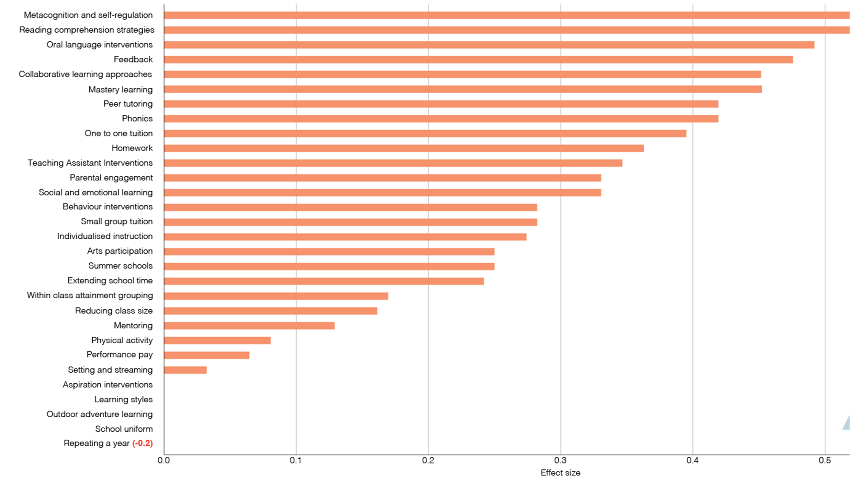
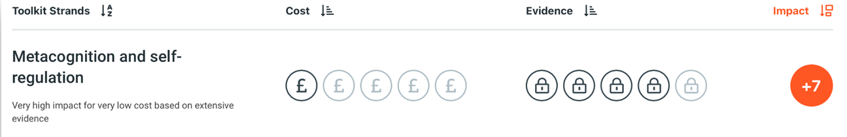
Metacognition
Notes:
Does it work?
EEF Toolkit data shows that developing pupils’ metacognitive and self-regulation strategies has the biggest impact on pupil outcomes (based on all the strategies they have data for).
Done well, this can lead to +7 months progress for pupils. The evidence base for this is strong and the cost implications for school is very low.
Hattie Effect size of these approaches: Self-judgement and reflection = 0.74, Meta-cognition strategies = 0.59
Veenman et al. (2004) study reveals that metacognition has been shown in various studies to have a sig impact on pupils’ academic performance. It is a powerful predictor of learning. Improving a learners MC practices may compensate for any cog limitation they have. MC skills developed and contributed to learning performance partly independently of intelligence.
See: https://pdfs.semanticscholar.org/324f/9c2c9a147cc122446e8df3614af9b861ef5e.pdf.

Slide 26
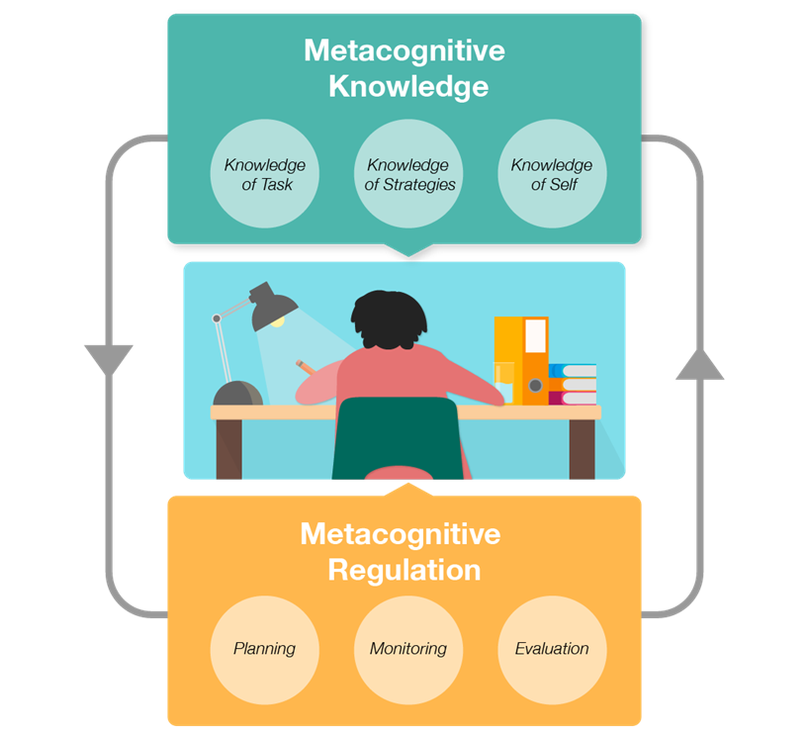
EEF Recommendations on Metacognition
Notes:
EEf Research on metacognition.
Draw attention to Recommendation 2: Planning, monitoring and evaluating (metacognitive self-regulation). We need to explicitly teacher pupils metacognitive strategies including how to plan, monitor and evaluate their learning.
Explicit instruction in cognitive and metacogntive strategies can improve pupils’ learning
While concepts like ‘plan, monitor and evaluate’ cna be introduced generically, the strategies are best applied in relation to subject specific content or tasks.
A series of steps is needed, beginning with activation of prior knowledge and leading to independent practice before ending with structured reflection. These can be applied to different subjects, ages and contexts.
This is perhaps the most well-known aspect of metacognition. Crucially, however, most teachers consider that they ’do this already’ but how effective is this? Is this planned for in their lessons / your curriculum? Do you every use curriculum conversations to delve into how teachers are doing this in their classrooms and what good practice in your subject areas look like?

Slide 27
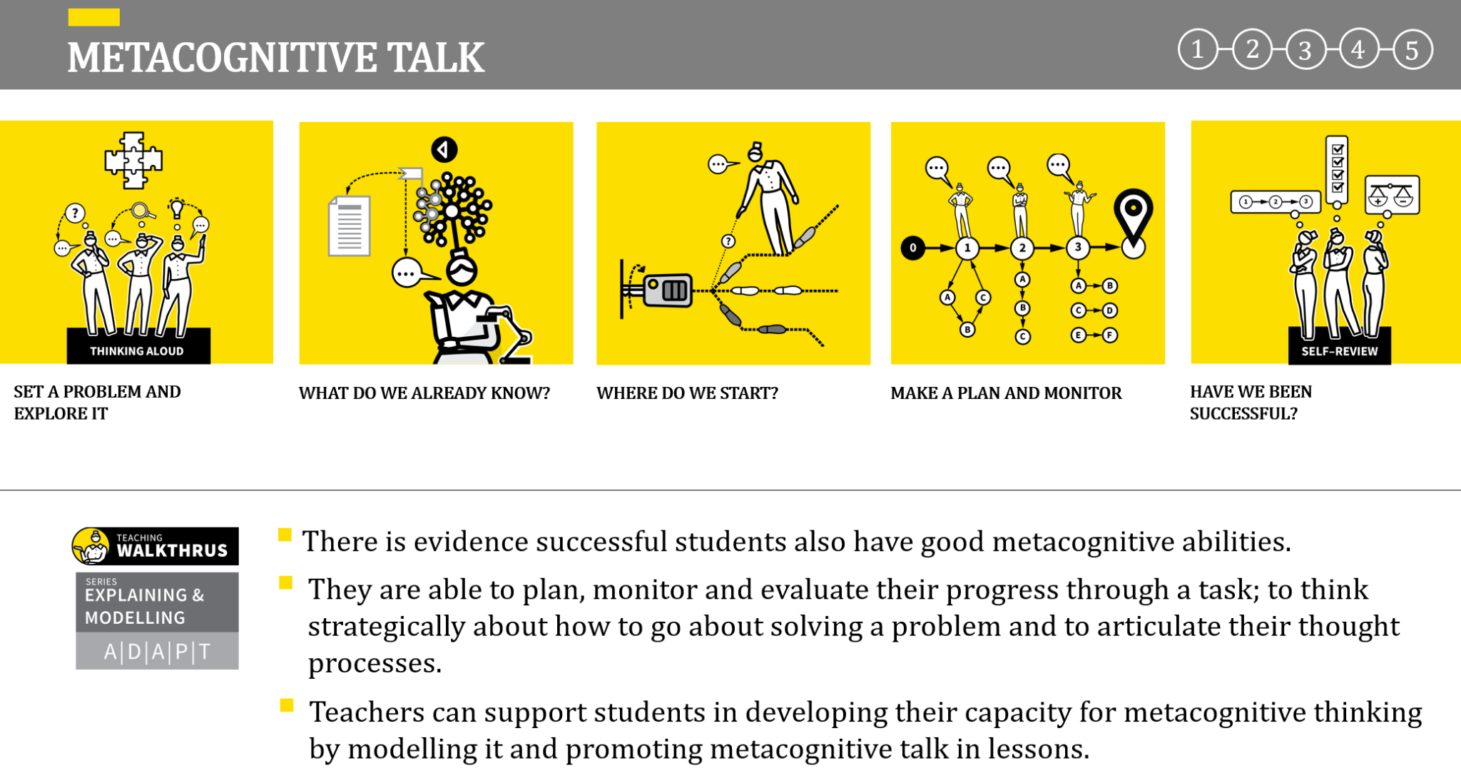
Notes:
Walkthrus (Tom Sherrington and Oliver Caviglioli)
This strategy really supports recommendation 2 from the EEF.
Set a problem: Read through a question; establish what the question is asking or what the task might entail. The initial process is to establish which problem-type it is. This allows you and students to draw on relevant past experience and prior knowledge.
What do we already know? Talk through the information that is available in the question and supporting resources. What do we already know from the question? What do we also know from previous learning that might be relevant? Model making notes so that this becomes explicit.
Where do we start? Talk through the first steps in solving the problem or completing the task. Explore explicitly why you choose a particular strategy in this case. If any path is as good as another, make this explicit. Aim to demystify the whole process.
Make a plan and monitor: Model the process of setting out an overview plan. Be as explicit as possible about every choice, every step, providing a logical reason for each one. As you go through the task, narrate your
progress through each of the steps.
Have we been successful? When the task has been completed or the problem solved, model the process of self-review. Check back over it to see if it is correct, complete, accurate, finished to a high standard. Explore ways of knowing if an answer is
correct within the context of the subject.

Slide 28
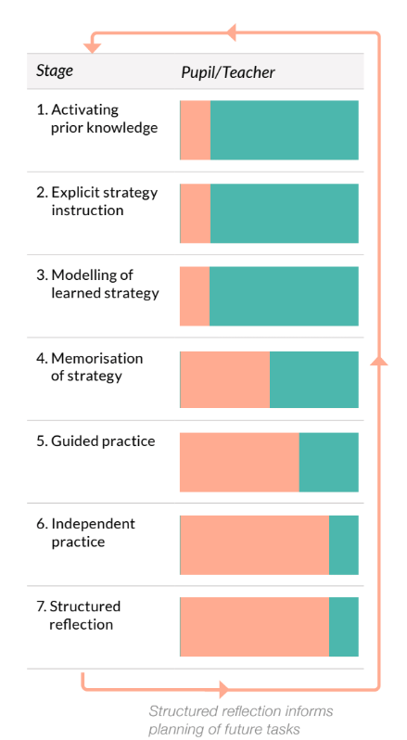
Metacognition - The seven Step Model
Notes:
The EEFs seven-step model is a scaffolding framework to deliberately shift responsibility for learning from the teachers to the pupil. The orange part of the bar represents the pupil and the turquoise part represents the teacher input.
All seven steps could take place in a single lesson or over a series of lessons.
The arrow leading from stage 7 to 1 signifies structured reflection information planning when pupils come to do a similar task in the future.
1.Activating prior knowledge. What useful knowledge do they already have?
2.Explicit strategy instruction. Which strategy are we going to use and why
3.Modelling of learned strategy. Watch me use this strategy while I talk out loud
4.Memorisation of learned strategy. Check the class understanding of what I’ve done
5.Guided practice. Let’s do part of one together
6.Independent practice. Do it by yourself and think about how well it’s going
7.Structured reflection. How well did you do?

Slide 29
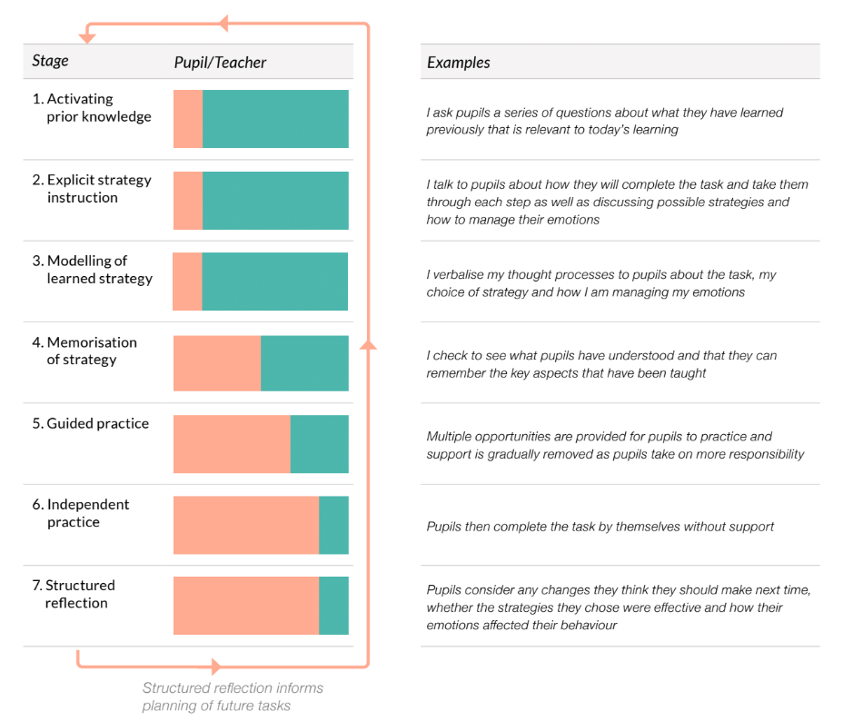
Notes:
Jenny
Example modelled out.
How could you use this, or Walkthrus to develop metacognition in your subject areas?
TASK: Think of a lesson on your curriculum where metacognitive strategies would support all pupils to learn. In groups, script how you would do this and how you would then train teachers in your team how to do this. Do your lessons already follow this model?
The seven step model planning worksheet may help here
What support materials do you already provide to support pupils to plan, monitor and evaluate their learning? See example on the next slide of how English at Little Lever support pupils to plan an answer before beginning a written response.

Slide 30
Notes:
Let’s move on to look at recommendation 3, Scaffolding

Slide 31

Scaffolding: High Expectations for all
“High quality teaching, differentiated for individual pupils, is the first step in responding to pupils who have or may have SEN.
Additional intervention and support cannot compensate for a lack of good quality teaching”.
Notes:
SEND Code of Practice
Effective planning for high expectations is important for all students. The SEND Code of Practice states that there is no better provision for all students, especially for those with SEND, than high quality teaching delivered by an expert.
Subject experts “anticipate which aspects of their lessons some (or all) pupils might find conceptually tricky, which content is particularly knowledge-rich or which tasks require pupils to acquire and apply a new skill. The best teachers do this with a strong understanding of the pupils they teach, including considering where barriers to learning may be relevant for pupils with SEND” EEF.
Planning for and removing barriers to learning impacts on all learners. We can see from the image that one solution benefits all learners, different students are not provided with different adjustments, the lesson and learning is accessible for all. To ensure that gaps in outcomes between pupils with and without SEND needs are addressed we need to ensure that we have high expectations for all learners and that we support all students in achieving these.

Slide 32
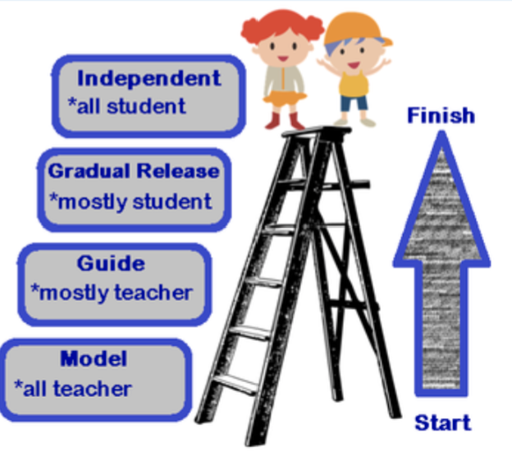
Scaffolding
“Scaffolding is a metaphor for temporary support that is removed when no longer required. It may be visual, verbal or written.”
SEN in Mainstream guidance report, EEF, 2020
Notes:
Scaffolding is a method that that teacher might use to address and support students in removing barriers to learning.
The SEN in Mainstream guidance report, EEF, 2020 states that “Scaffolding is a metaphor for temporary support that is removed when no longer required. It may be visual, verbal or written.”
McLeskey et al in 2017, in research on supporting students with SEND states that “Scaffolded supports provide temporary assistance to students so they can successfully complete tasks that they cannot yet do independently and with a high rate of success. Teachers select powerful visual, verbal and written supports; carefully calibrate them to students’ performance and understanding in relation to learning tasks; use them flexibly; evaluate their effectiveness; and gradually remove them once they are no longer needed. Some supports are planned prior to lessons and some are provided responsively during instruction.”
McLeskey et al. (2017)—high-leverage practice 15 SEN in Mainstream Schools Evidence Review, EEF, 2020

Slide 33




Scaffolding in Practice: EEF
Visual | Verbal
Written | Additional
NASEN Handbook: Subject specific guidance
Notes:
5-a-Day_Reflection_Tool_Teaching_AssistantsV0.4.pdf
The attached resource can be provided at this point to support the information provided here.
There are different forms of scaffolding these are:
Visual - Visual scaffolds may support a pupil to know what equipment they need, the steps they need to take or what their work should look like, such as a task list or model examples of work
Verbal - Providing a verbal scaffold may involve reteaching a tricky concept to a group of pupils, or using questioning to identify and address any misconceptions, such as questioning or prompting or reteaching in a different way
Written - A written scaffold will typically be provided for a pupil to support them with an independent written task. It could be the notes made on the whiteboard during class discussion; it could even be the child’s own previous work used to support their recall, such as sentence starters or a writing frame
Other methods - Some students need
Access arrangements are a form of scaffolding
Use of additional adults
Removing student specific barriers through knowing students well, such as access arrangements or additional adults
Teachers should plan to gradually remove scaffolding and make practice more challenging as competence and pupil confidence increases.

Slide 34
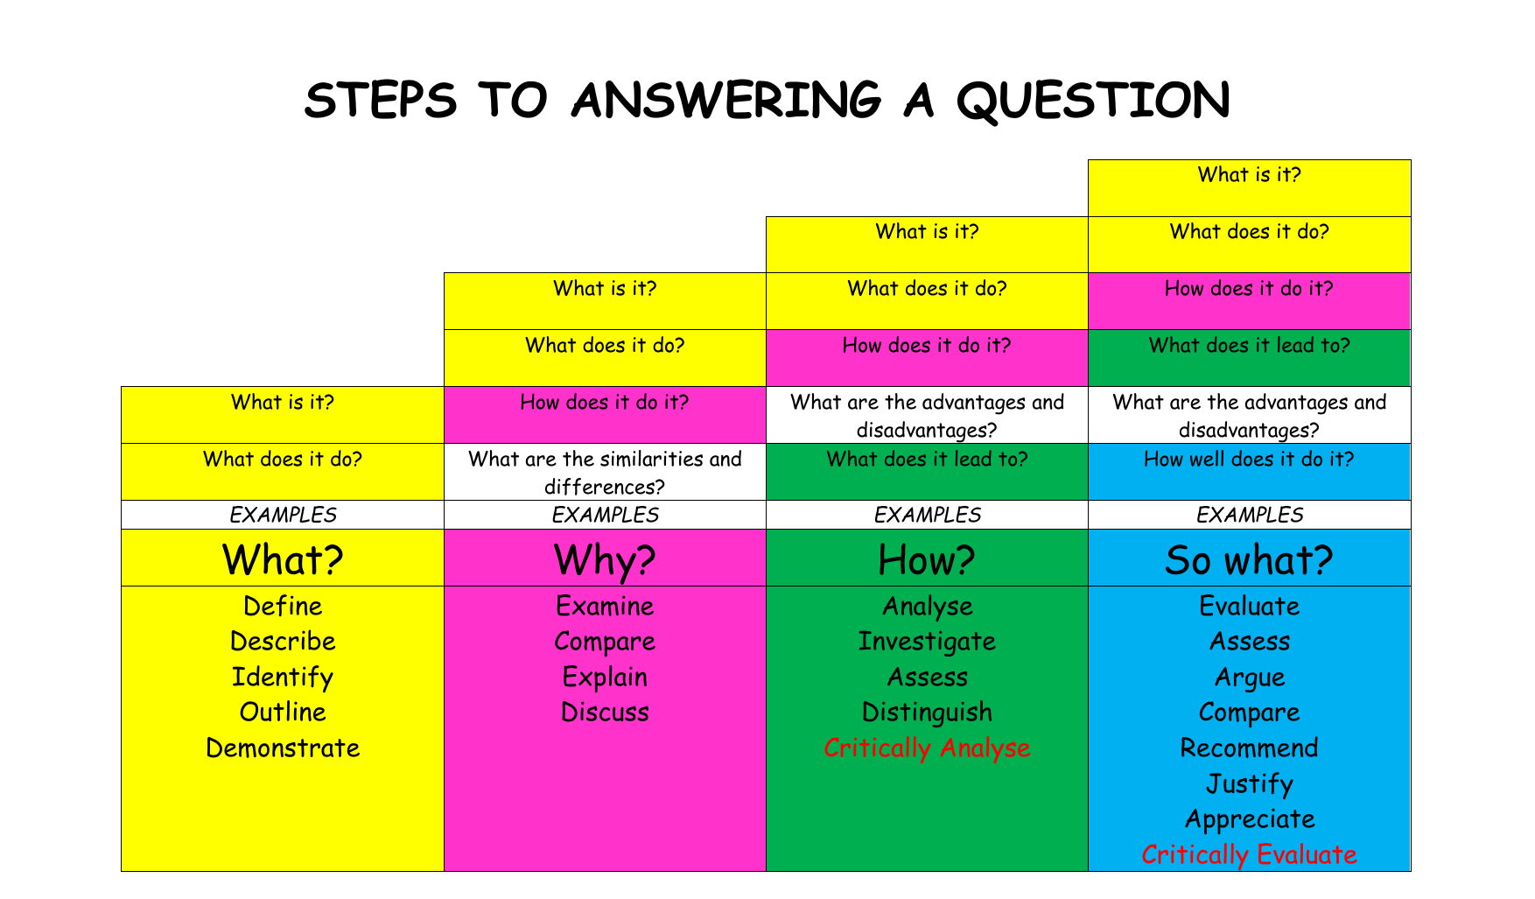
Scaffolding in Practice
Notes:
Helen
Scaffolds need to be temporary and focused on the most important learning in a lesson.
For example,

Slide 35

Scaffolding in Practice
Notes:
Scaffolds need to be temporary and focused on the most important learning in a lesson.

Slide 36
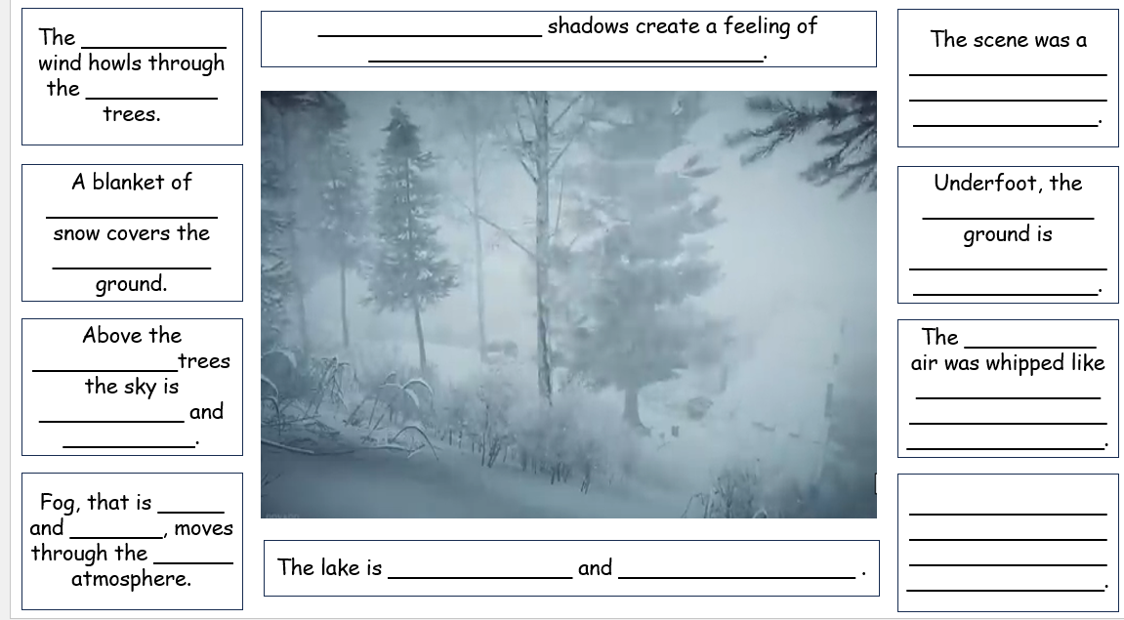
Notes:
Courtesy of Jayne Calvert at Little Lever School.

Slide 37
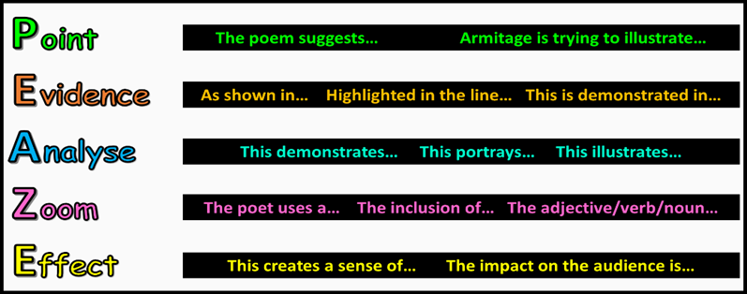
Notes:
Poetry analysis using a scaffold developed by an examiner.

Slide 38
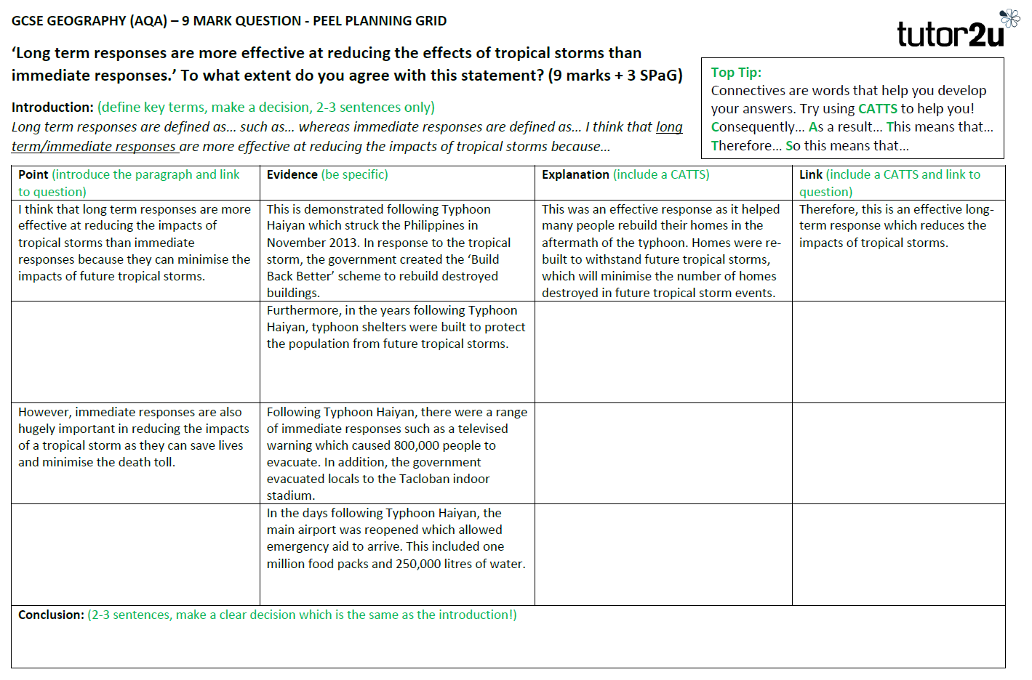

Slide 39
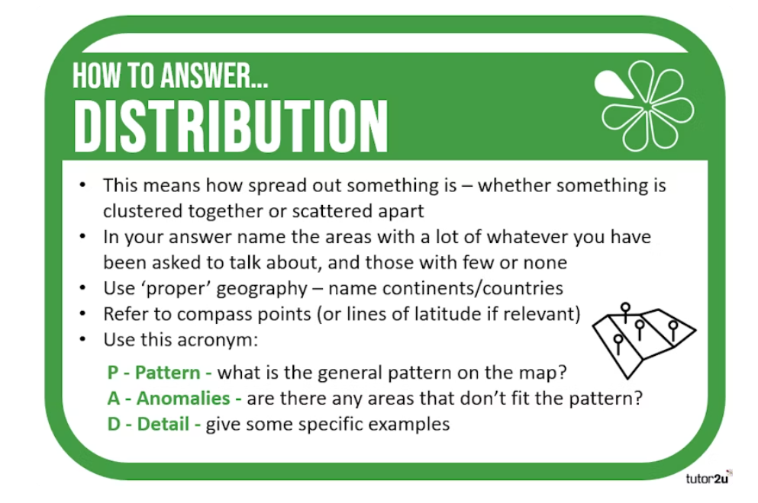
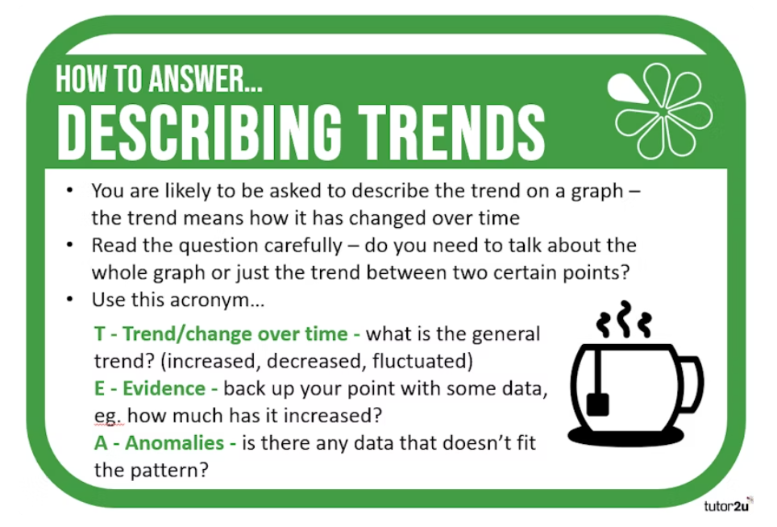

Slide 40
Discussion: Scaffolding in Practice
How do you work with your subject team to ensure that high expectations evident for ALL learners in the classroom in your department?
What strategies for scaffolding does your department have?
How/when is scaffolding removed for those students that no longer need it?
Notes:
Task - using your examples of adaptive teaching.
What does scaffolding look like in your department?
How and when is this removed? Are scaffolds used and integrated throughout the lesson and gradually withdrawn or are they just given when pupils work independently?
How do you know when to remove these? Do all teachers in your department share the same thinking?
Review the three questions and use the NASEN handbook to look at subject specific examples of how effective scaffolding can be implemented in your subject area.
Teacher-Handbook-SEND-14th-Dec-2021.pdf

Slide 41
Notes:
NASEN Teacher Toolkit
What is the role of the teacher?
How does the teacher’s expertise support effective and appropriate provision in response to the barriers being faced by each learner?
What might have been the impact had a holistic understanding of these learners’ needs not been considered?
Noticing, observation, listening, partnership working – what is their role in assuring the appropriate provision?
How is appropriate provision determined? What are the key factors in determining this provision?
All provision is monitored through the Assess-Plan-Do-Review cycle, it ensures practice is continually reviewed for impact in the best interests of the students.

Slide 42
Monitoring and Impact
How might you monitor the impact of your focused work around adaptive teaching?
Discuss and feedback to the group
Notes:
Monitoring processes are a hot potato for Ofsted at the moment.
And rightly so!
The most high performing trusts for pupils with SEND monitor closely against the EEF 5 a day.
For example, Gorse academies have a one-page document with their 5 strategies against which they summarise training, strategies and impact on pupils’ learning (with pictures!)

Slide 43
You may have considered…
Look closely at pupils’ with SEND alongside their peers of similar prior attainment.
Lesson visits to see how well teachers use information about pupils in their classroom
Work scrutiny
Pupil voice
Colleagues’ voice
Notes:
It is important to use pupil information when monitoring.
Then, use this information to look closely at the effectiveness of provision and strategies to support pupils in lessons. What is working well and can be shared? Some high-performing trusts collate this information and review with SLT and trustees, including photos of pupils’ work. This makes shared strategies much less abstract and is a far more effective way of sharing ideas.
TAs are an underutilised resource when it comes to gathering great practice and information on what works well with particular pupils.
Jenny - give input as to what it feels like to be in the role of a TA in a classroom.

Slide 44
Key Reflections
Do our pupils with SEND benefit from expert, quality teaching in our subject areas?
Are our teachers playing an integral part in the Assess, Plan, Do, Review cycle?
Are our teachers up to date on the research backed strategies from the EEF and NASEN? Does this inform their practice?
Does our QA focus on pupils with SEND? If we are getting it right for them, we are getting it right for all pupils.
Are scaffolding, modelling and metacognition integral parts of our curriculum plans or are they add ons?

Slide 45
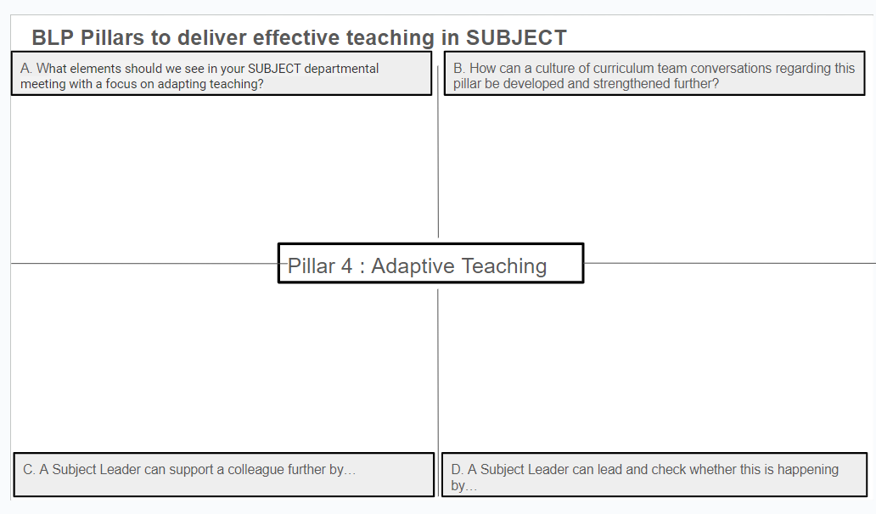
Subject Hub Reflection Tool
Notes:
Jenny The subject hub reflection tool is one document completed with all hub members contributing. This will be fed back to the Hub Executive Board to aid next steps.
We can also use this to create a reference library for best practice resources. Please list any resources that you have discussed in your sessions.
Also please share with us any research that you have found useful and we will add this to the resource bank.

Slide 46



AQA Pre-Release

Slide 47
Detail from AQA
From June 2024, AQA has increased the total exam time for Paper 3 to 1 hour 30 minutes.
This is following a lot of feedback that students were struggling to complete the exam to the best of their ability in the given time.
The intention of this additional 15 minutes is to allow students to:
  refamiliarise themselves with the pre-release material to use in response to questions in Section A
  read and understand the unfamiliar fieldwork contexts
  think about the details of their own fieldwork investigations
  ensure they can answer all exam questions and therefore better access all available SPaG marks.
It’s important to encourage students to use this time as a way to improve their outcome.

Slide 48
The Pre-Release
The pre-release equates to 49% of the marks in Paper 3.
Students normally engage well with the pre-release because they:
  realise that having the resource booklet beforehand can improve their success.
  know that becoming familiar with the resources will build their confidence for the exam.
  know that you’ll invest a lot of time to ensure that no stone is left unturned.

Slide 49
Strategies to support delivery
Structuring answers using AOs – no AO1 in this paper. Most of the marks are AO3.
Direct instruction
Mock exams (PPEs) and walking talking mocks
Work booklets and knowledge organisers
Glossaries and low stake quizzing

Slide 50
Structuring answers using AOs
Students risk dropping marks in the longer questions in the pre-release because they get stuck in Level 1 responses according to the mark scheme. There are two common reasons for this:
  Students overload their responses with information from the pre-release booklet verbatim that is generally not explained/developed well.
  Their AO3 is often lacking or confused so the examiner finds it hard to see a clear argument in their writing.
Giving students writing frameworks or structures helps them to write answers that respond to all the elements of the mark scheme. This means they go beyond lifting points or developing ideas simply and therefore they can access Level 2 and Level 3 with their answers.
Tips for use:
When first using structures like this, scaffold heavily. Seeing your thinking as you write an entire model into the different sections of the grids, emphasising how the requirements for AO3 differ to AO4 can be extremely valuable for students.
In the exam they will face a blank page, so the scaffolding needs removing as soon as they’re comfortable.

Slide 51
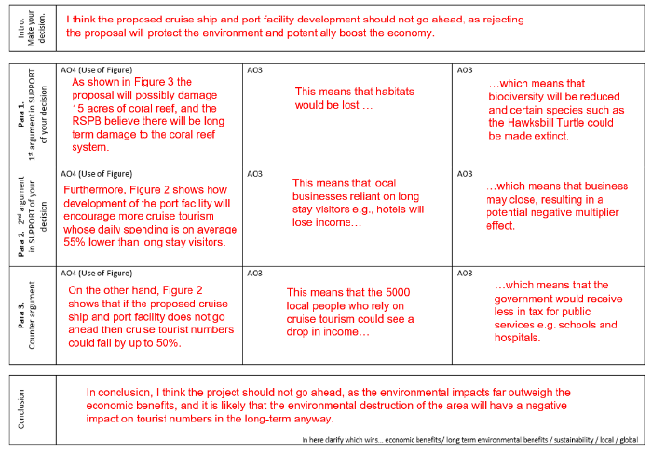
Example from 2023

Slide 52
Template
Intro- make your decision
Point 1- first argument in support of your decision | AO4 (use of the figure) | AO3 | AO3
Point 2 – second argument in support | AO4 (use of the figure) | AO3 | AO3
Point 3- counter argument | AO4 (use of the figure) | AO3 | AO3
Conclusion- in here clarify the decision- consider SEE and different scales

Slide 53
Direct instruction
Read through the pre-release as a group.
Have your pre-release under the visualiser and highlight key ideas and themes which appear in each figure. This could be as detailed as working out elements such as the mean, median and mode from graphs/data etc.
You might want to suggest and share with the students the types of questions which could be asked by the exam board in relation to each figure.
Work through the pre-release as a group, following this process with intermittent quizzing to check for understanding. This should take no longer than 2 or 3 60-minute lessons.

Slide 54
Mocks/ WTMs
We know that the students will complete an exam based upon the resources within the pre-release. Therefore, time permitting, producing some mock exams for the students based on the pre-release material which they will sit can be very beneficial.
Look at previous Paper 3 questions (1-3), to look at the structure and style.
Create (or use pre-prepared ones from places such as Internet Geography) a mock paper(s) based on the pre-release.
Complete the mock paper(s) in class, independently, or as a walking talking mock, or a pre-seen mock etc.
This will build student independence and engagement with the figures.
Ensure that mock papers are marked, and feedback is given to the students in the follow-up lesson.
Repeat the process with a further mock if appropriate.

Slide 55
Work booklets and knowledge organisers
Historically, there has always been a lot of information in the pre-release. Condensing this information to promote fluency and ensuring that students continually engage with the figures will improve their confidence during the exam.
Create a work booklet of low stakes questions and exam questions related to each figure. Students could complete this as part of home learning over a series of weeks.
Create a knowledge organiser of the key bits of information from each figure. Ensure that regular low stakes quizzing of this information takes place to transfer this into the long-term memory of the students.

Slide 56
Glossaries and low stakes quizzing
The pre-release will contain many important key words. It’s important that students understand the key words as they may appear within question stems. Students will also need to use the key words fluently within their responses.
Create a glossary of the key words, with one clear definition shared across the department.
Ensure that regular low stakes quizzing of the key terms takes place, to transfer this knowledge into the long-term memory of the students.
This will free up their working memory in the exam to answer questions and ensure full engagement with the different figures.

Slide 57
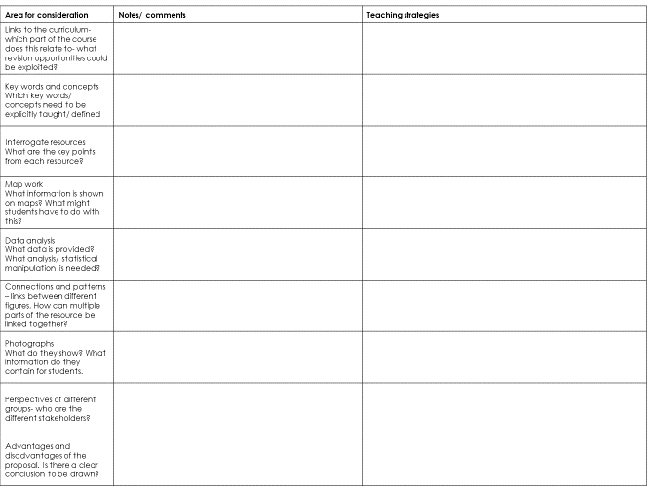
Unpicking the pre-release

Slide 58
AOB?

Slide 59
Further Reading
Teachers’ Handbook - SEND. Embedding Inclusive Practice, NASEN, Katherine Walsh and Amelie Thompson
EEF SEND Guidance Report, Special Educational Needs in Mainstream Schools | EEF
Metacognition and Self-regulated Learning | EEF (educationendowmentfoundation.org.uk)
Making Things Hard for Yourself, Bjork and Bjork https://bjorklab.psych.ucla.edu/wp-content/uploads/sites/13/2016/04/EBjork_RBjork_2011.pdf
Notes:
All

