Slide 1

Welcome to
Design
Technology
Engineering
Art
At University Collegiate School

Slide 2
DT HUB Tuesday 3rd December
Agenda
KS3 journey against the national curriculum
Moderation of coursework
Practical task - team structures challenge
Food teachers will be discussing some other areas while the rest do the structures challenge which I will clarify once I know numbers

Slide 3
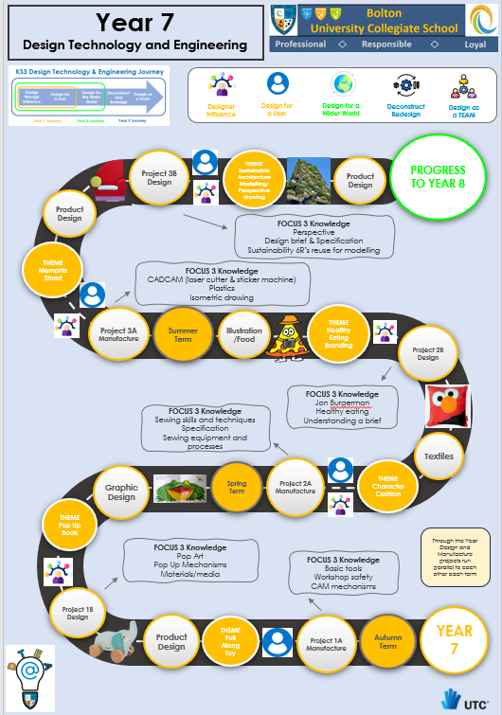
KS3 journey against the national curriculum
Design
Manufacture

Slide 4
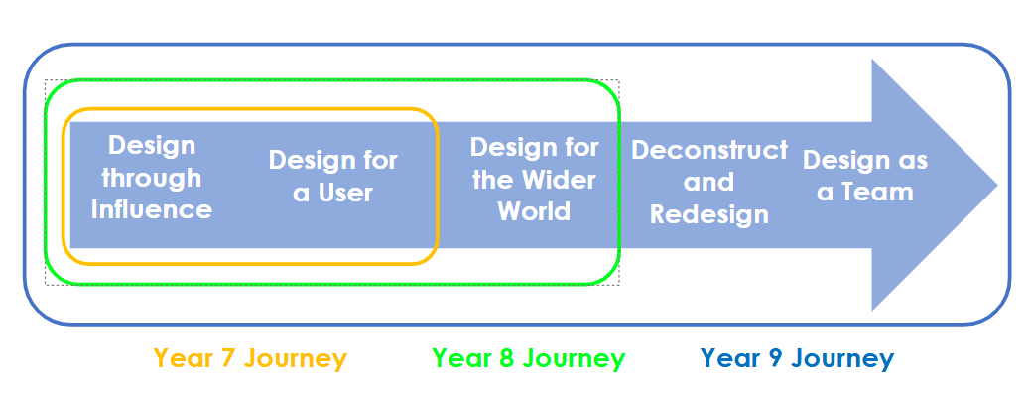
How did we get to this ?

Slide 5
Purpose of study
Design and technology is an inspiring, rigorous and practical subject. Using creativity and
imagination, pupils design and make products that solve real and relevant problems within
a variety of contexts, considering their own and others’ needs, wants and values. They
acquire a broad range of subject knowledge and draw on disciplines such as mathematics,
science, engineering, computing and art. Pupils learn how to take risks, becoming
resourceful, innovative, enterprising and capable citizens. Through the evaluation of past
and present design and technology, they develop a critical understanding of its impact on
daily life and the wider world. High-quality design and technology education makes an
essential contribution to the creativity, culture, wealth and well-being of the nation.
Aims
The national curriculum for design and technology aims to ensure that all pupils:
▪ develop the creative, technical and practical expertise needed to perform everyday
tasks confidently and to participate successfully in an increasingly technological world
▪ build and apply a repertoire of knowledge, understanding and skills in order to design
and make high-quality prototypes and products for a wide range of users
▪ critique, evaluate and test their ideas and products and the work of others
▪ understand and apply the principles of nutrition and learn how to cook
Attainment targets
By the end of key stage 3, pupils are expected to know, apply and understand the matters,
skills and processes specified in the programme of study.
Schools are not required by law to teach the example content in [square brackets]

Slide 6
Evaluate
▪ analyse the work of past and present professionals and others to develop and broaden
their understanding
▪ investigate new and emerging technologies
▪ test, evaluate and refine their ideas and products against a specification, taking into
account the views of intended users and other interested groups
▪ understand developments in design and technology, its impact on individuals, society
and the environment, and the responsibilities of designers, engineers and technologists
Technical knowledge
▪ understand and use the properties of materials and the performance of structural
elements to achieve functioning solutions
▪ understand how more advanced mechanical systems used in their products enable
changes in movement and force
▪ understand how more advanced electrical and electronic systems can be powered and
used in their products [for example, circuits with heat, light, sound and movement as
inputs and outputs]
▪ apply computing and use electronics to embed intelligence in products that respond to
inputs [for example, sensors], and control outputs [for example, actuators], using
programmable components [for example, microcontrollers].
Cooking and nutrition
As part of their work with food, pupils should be taught how to cook and apply the
principles of nutrition and healthy eating. Instilling a love of cooking in pupils will also open
a door to one of the great expressions of human creativity. Learning how to cook is a
crucial life skill that enables pupils to feed themselves and others affordably and well, now
and in later life.
Pupils should be taught to:
Key stage 3
▪ understand and apply the principles of nutrition and health
▪ cook a repertoire of predominantly savoury dishes so that they are able to feed
themselves and others a healthy and varied diet
▪ become competent in a range of cooking techniques [for example, selecting and
preparing ingredients; using utensils and electrical equipment; applying heat in different
ways; using awareness of taste, texture and smell to decide how to season dishes and
combine ingredients; adapting and using their own recipes]
▪ understand the source, seasonality and characteristics of a broad range of ingredients.
Subject content
Key stage 3
Through a variety of creative and practical activities, pupils should be taught the
knowledge, understanding and skills needed to engage in an iterative process of designing
and making. They should work in a range of domestic and local contexts [for example, the
home, health, leisure and culture], and industrial contexts [for example, engineering,
manufacturing, construction, food, energy, agriculture (including horticulture) and fashion].
When designing and making, pupils should be taught to:
Design
▪ use research and exploration, such as the study of different cultures, to identify and understand user needs
▪ identify and solve their own design problems and understand how to reformulate
problems given to them
▪ develop specifications to inform the design of innovative, functional, appealing products that respond to needs in a variety of situations
▪ use a variety of approaches [for example, biomimicry and user-centred design],
to generate creative ideas and avoid stereotypical responses
▪ develop and communicate design ideas using annotated sketches, detailed plans, 3-D and mathematical modelling, oral and digital presentations and computer-based tools
Make
▪ select from and use specialist tools, techniques, processes, equipment and machinery precisely, including computer-aided manufacture
▪ select from and use a wider, more complex range of materials, components and
ingredients, taking into account their properties

Slide 7
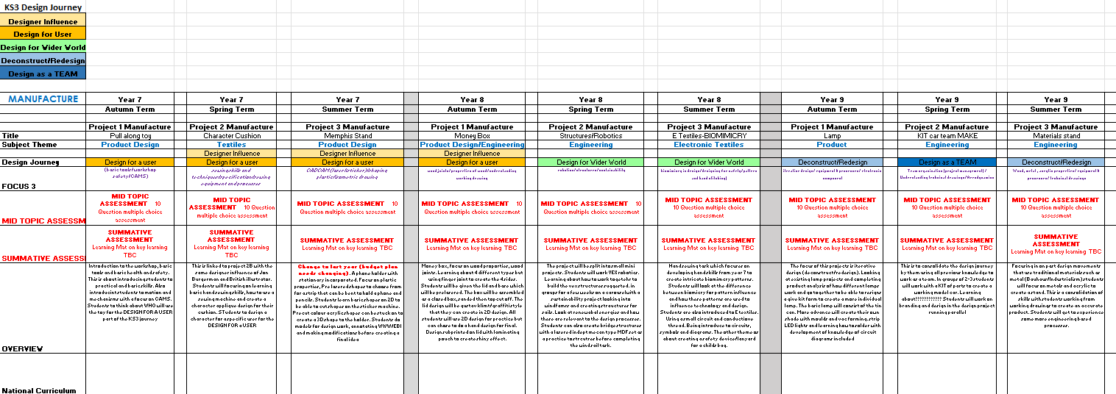
Mapping
https://thekeysfederation.sharepoint.com/:x:/r/sites/TheUCSBolton/_layouts/15/Doc.aspx?sourcedoc=%7BE4957EF7-9B41-4611-8C46-4D17C092C5E5%7D&file=KS3%20DT%20projects%20overview%20and%20mapping%202024-25.xlsx&action=default&mobileredirect=true

Slide 8
2. Moderation of coursework
Where are people up to?
Who needs a check in?

Slide 9
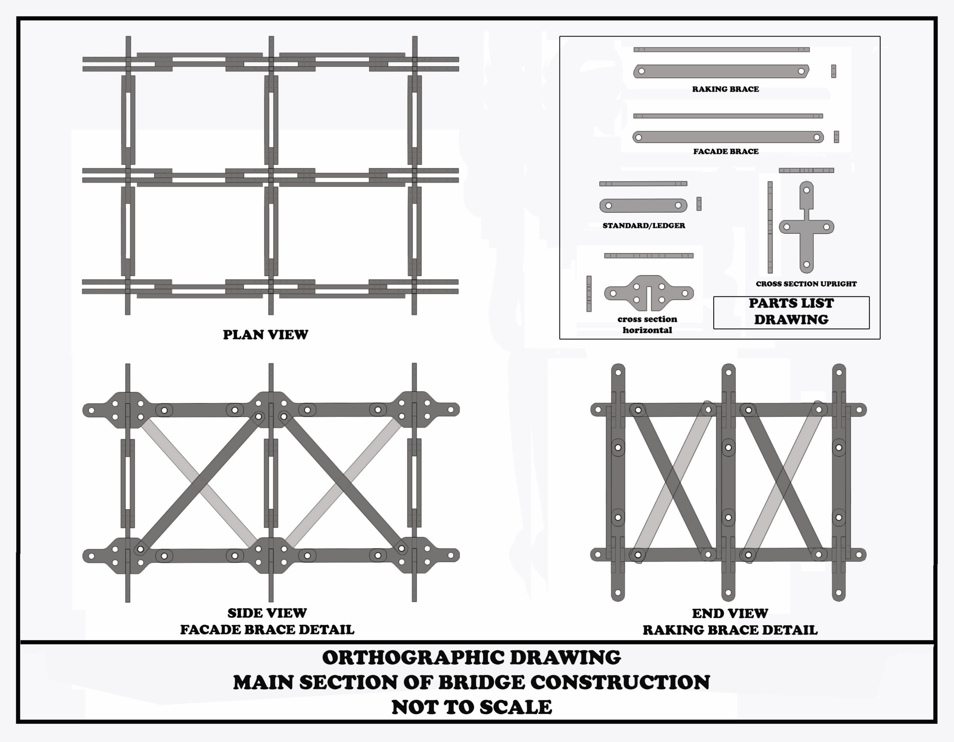
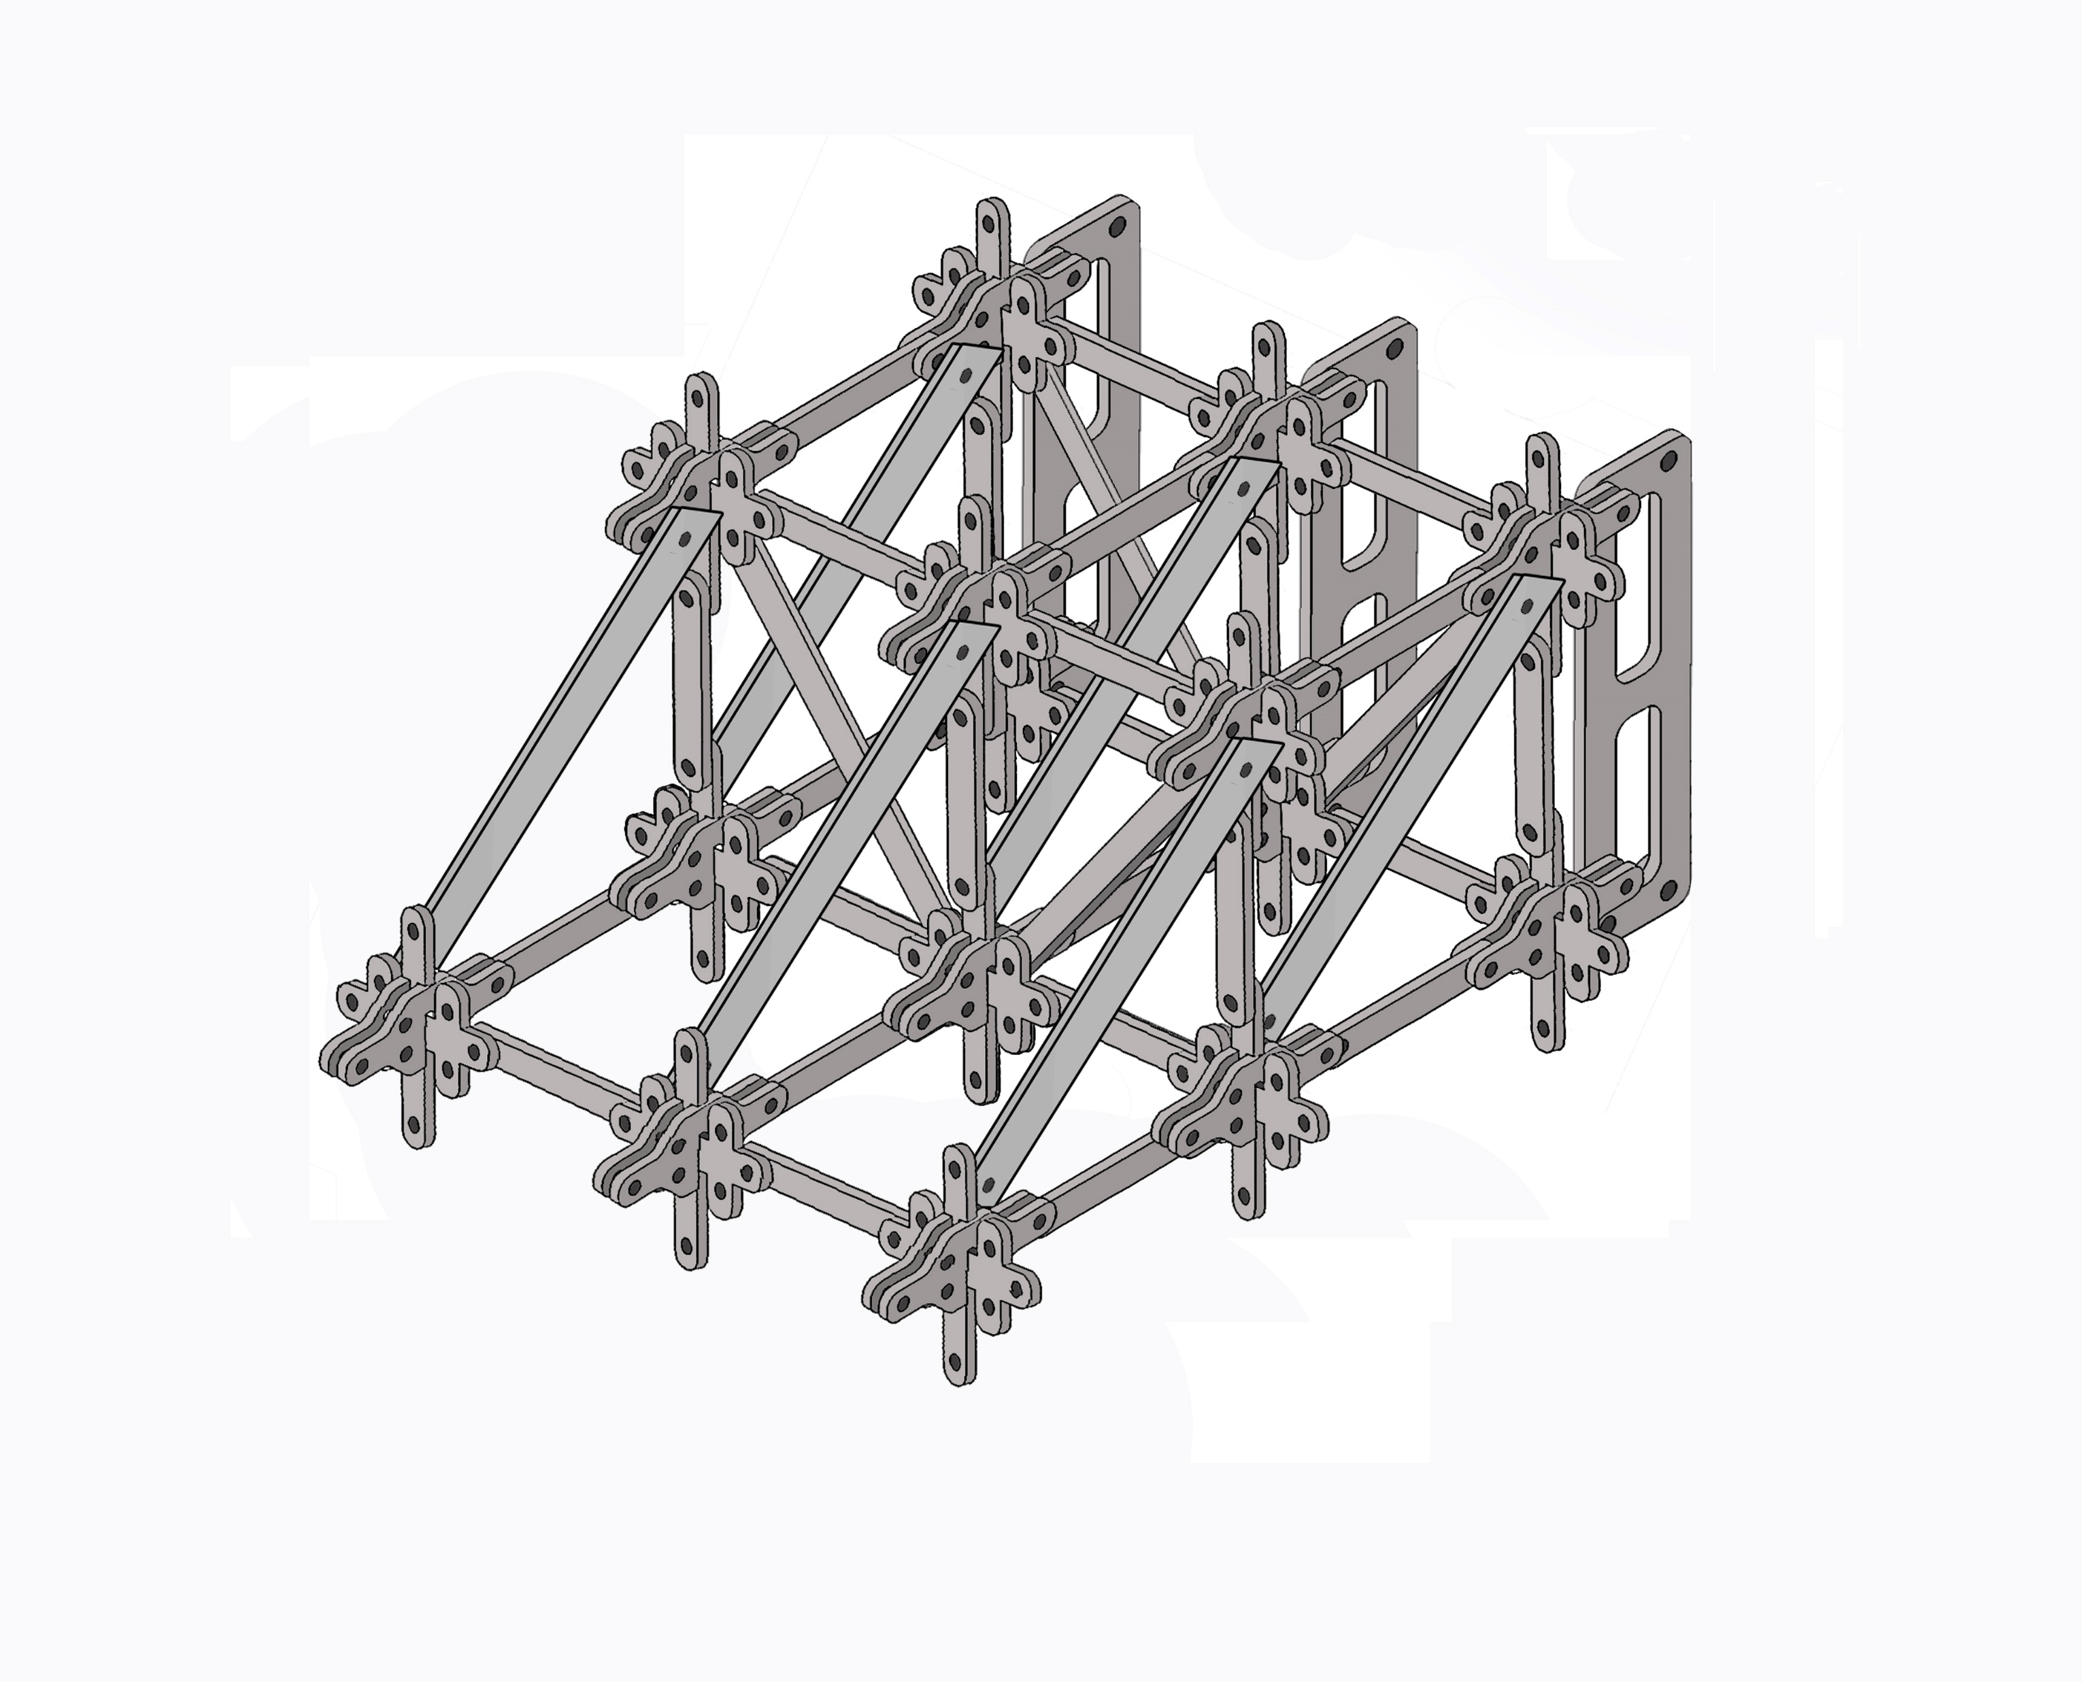
3. Practical task - team structures challenge

Slide 10
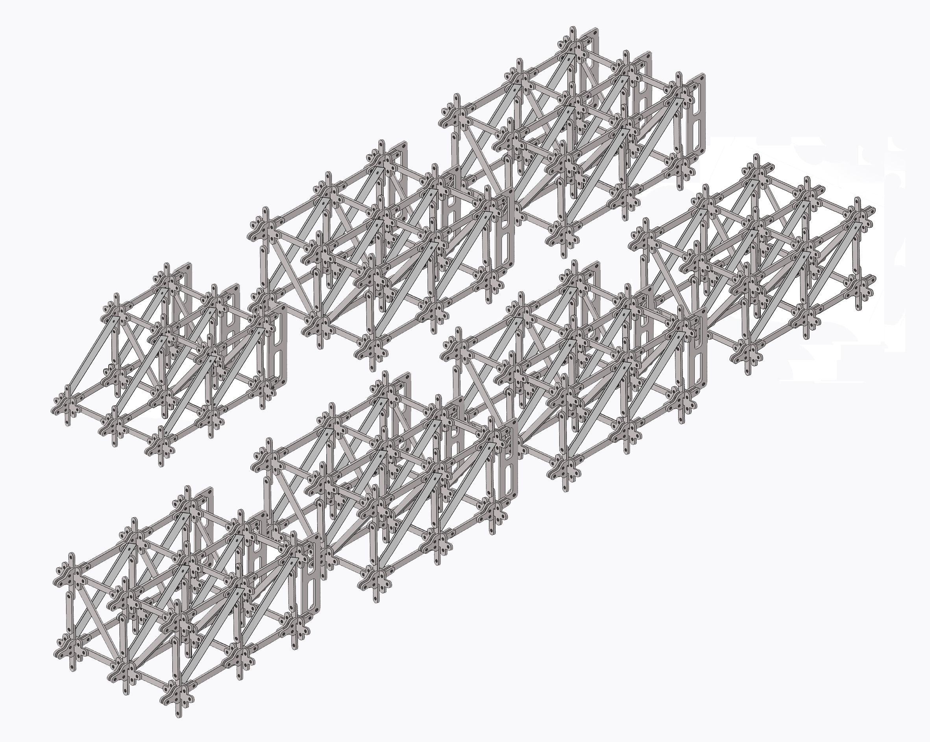

Slide 11
4. Food teachers KS3
What works well for short lessons
What works well?
What works well for low ability/EAL
What do we want to cover this year?
What works well for cost of living issues

Slide 12
???

