Slide 1
MODELLING…

Slide 2
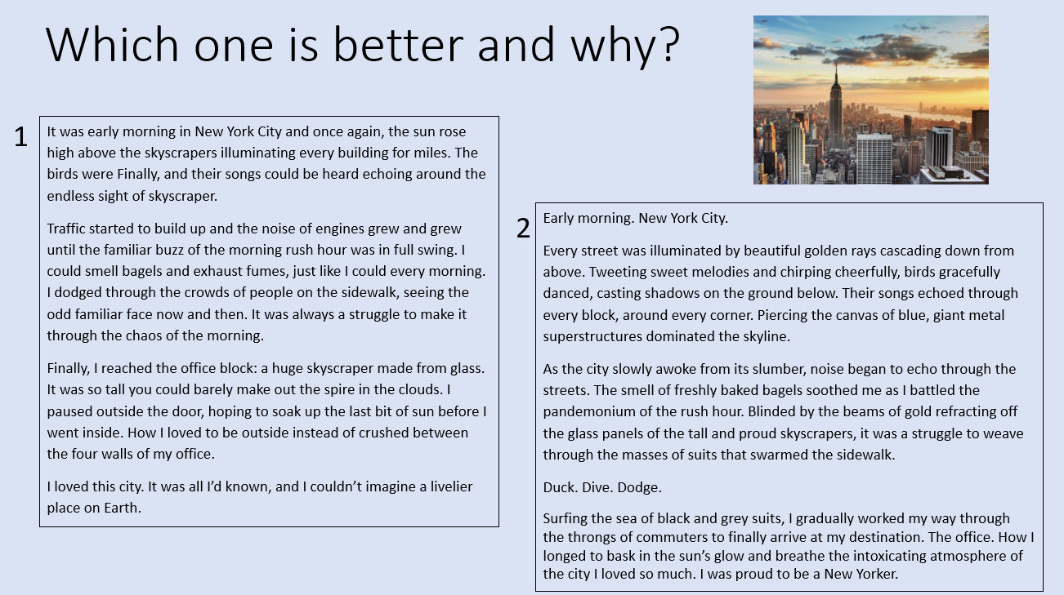
Modelling…
WAGOLLs and WABOLLs.
Active engagement with WAGOLLs essential.
Not just a ‘copying’ aid.

Slide 3
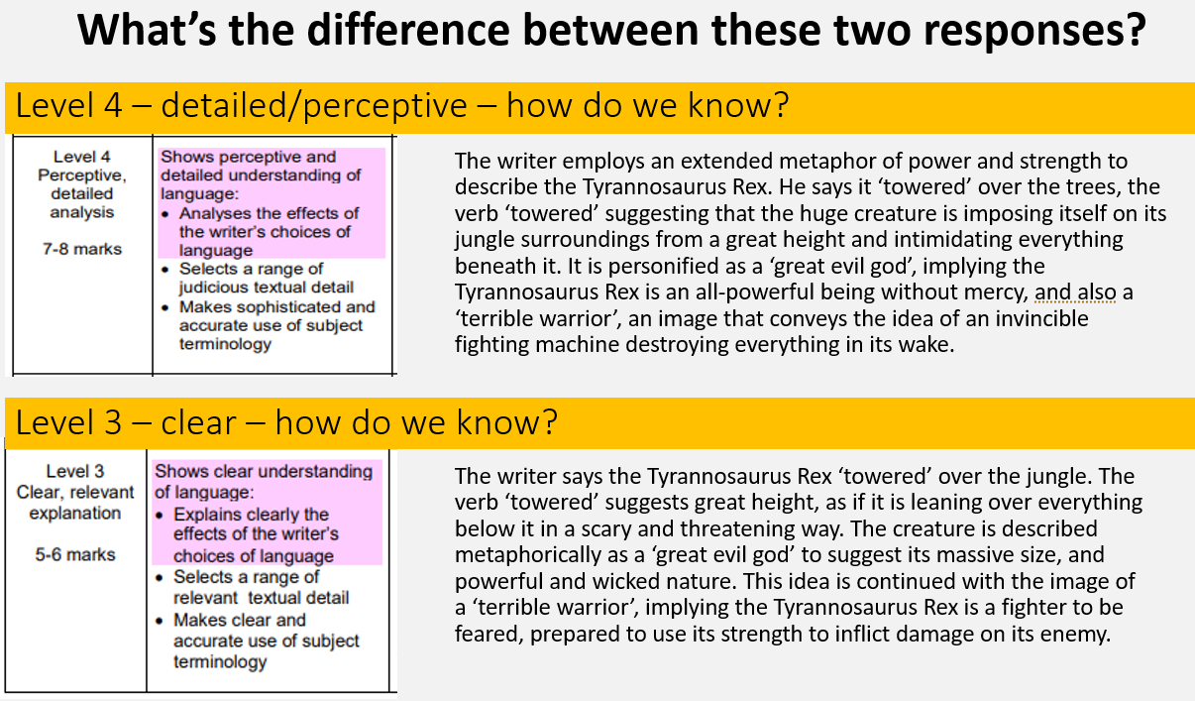
Modelling…
Active engagement with WAGOLLs essential.
Encourage students to annotate them.

Slide 4
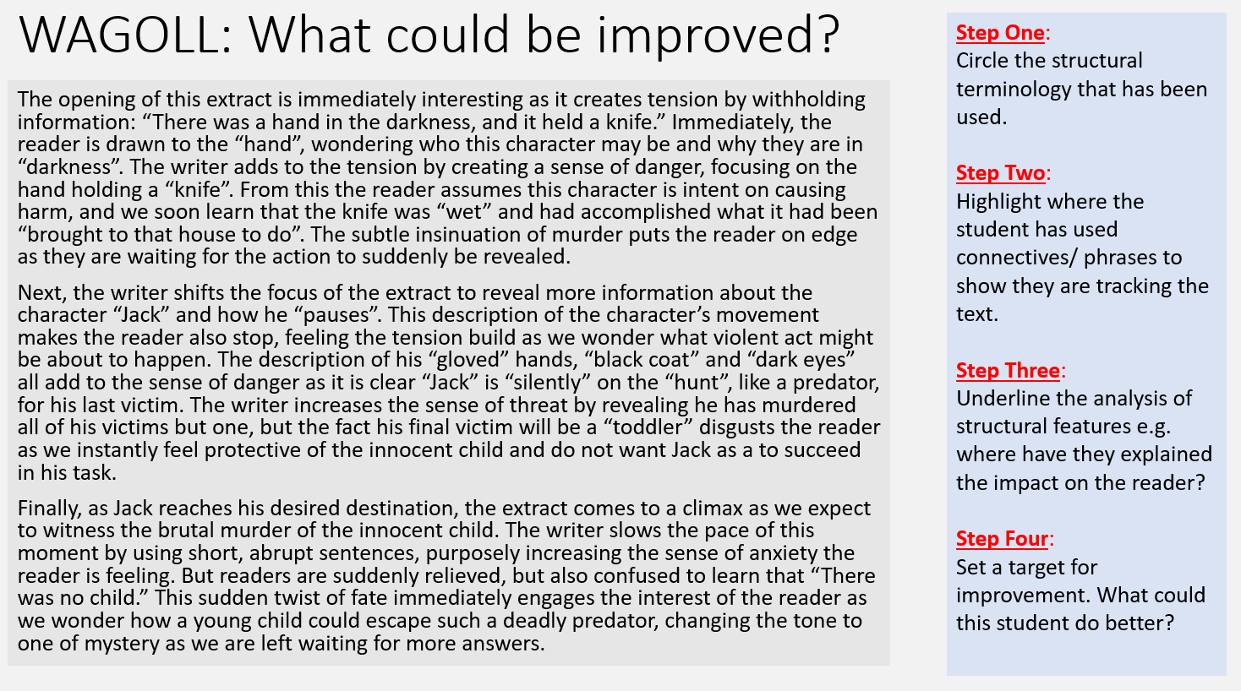
Modelling…
Attempt to scaffold engagement with WAGOLL can be seen here.
Arguably still overwhelming.
Could this be reduced/scaffolded further?

Slide 5
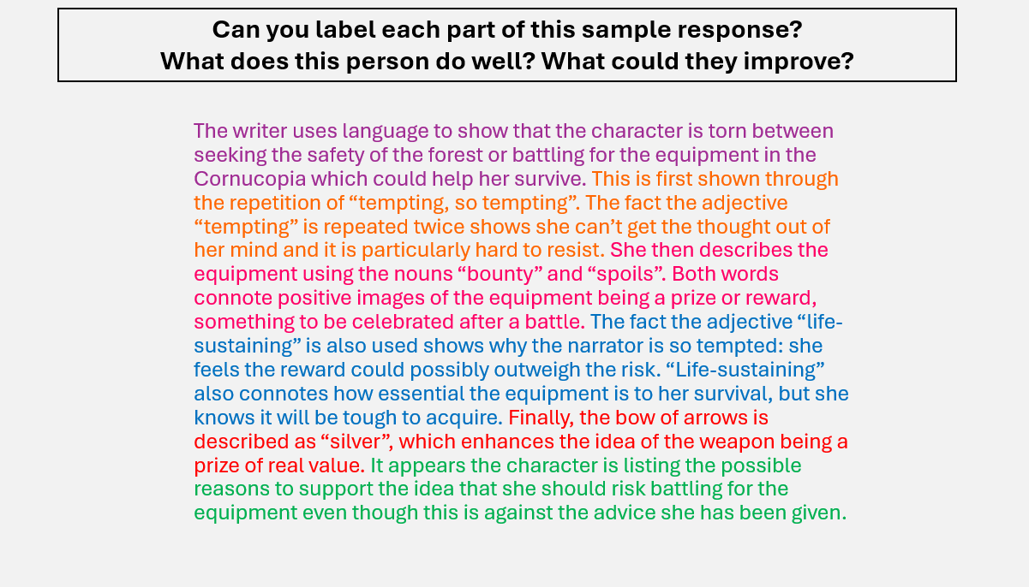
Modelling…
Colour-coding helps dyslexic learners.
Active engagement with WAGOLL planned for.

Slide 6




Modelling…
Further visual cues could be added to support LA or EAL learners.

Slide 7
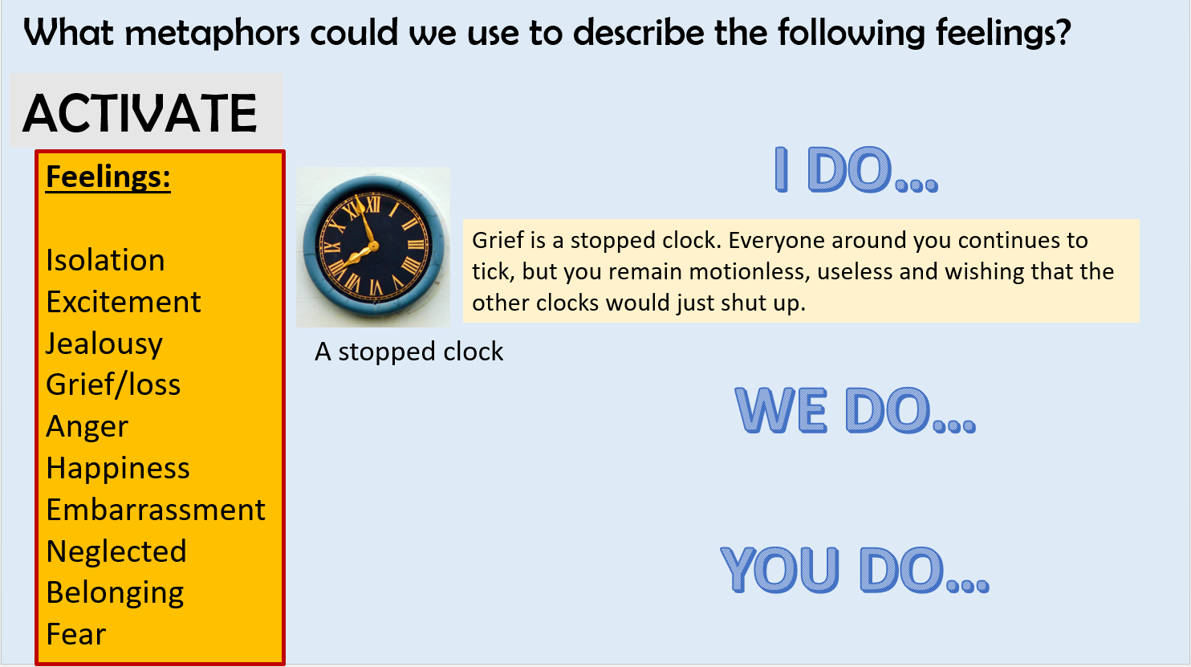
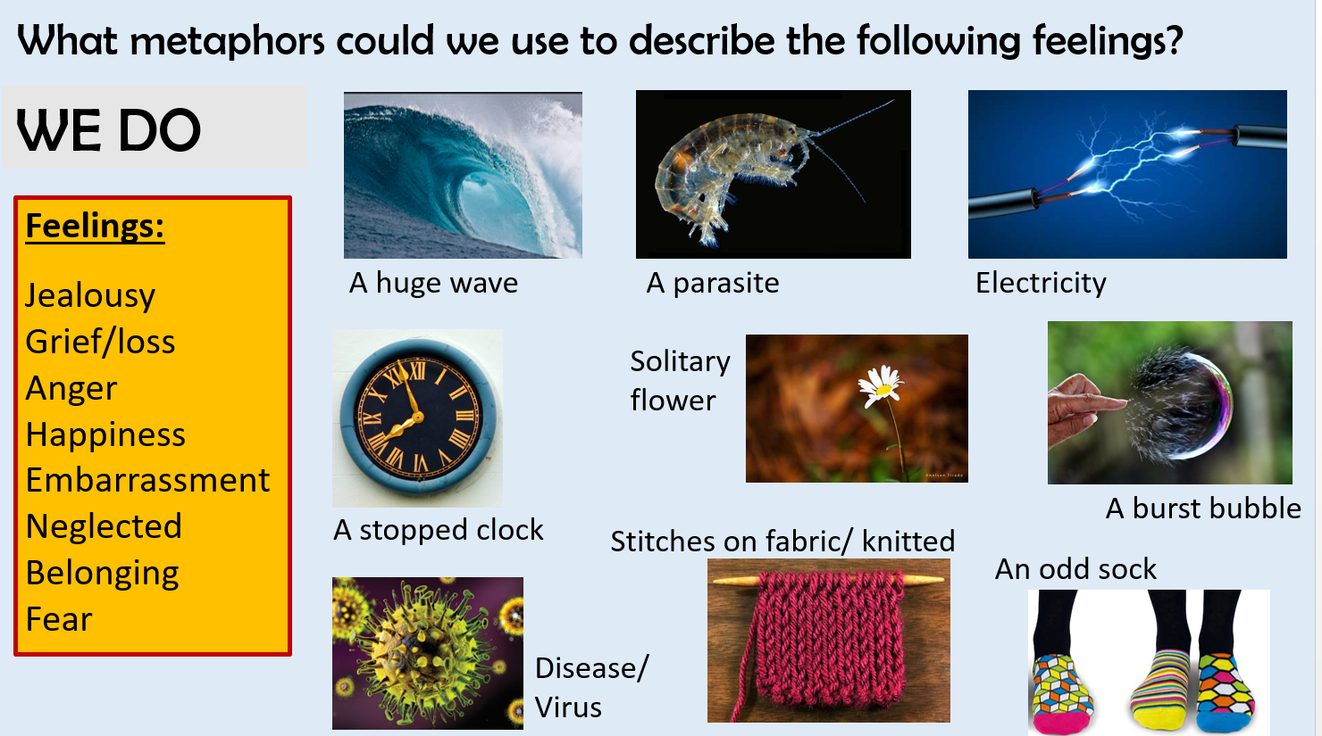
Modelling…
Modelling to support independent resilience.
Scaffolding to support stretch and challenge.
Collaborative learning.

Slide 8
Modelling…

Slide 9
SCAFFOLDING…

Slide 10
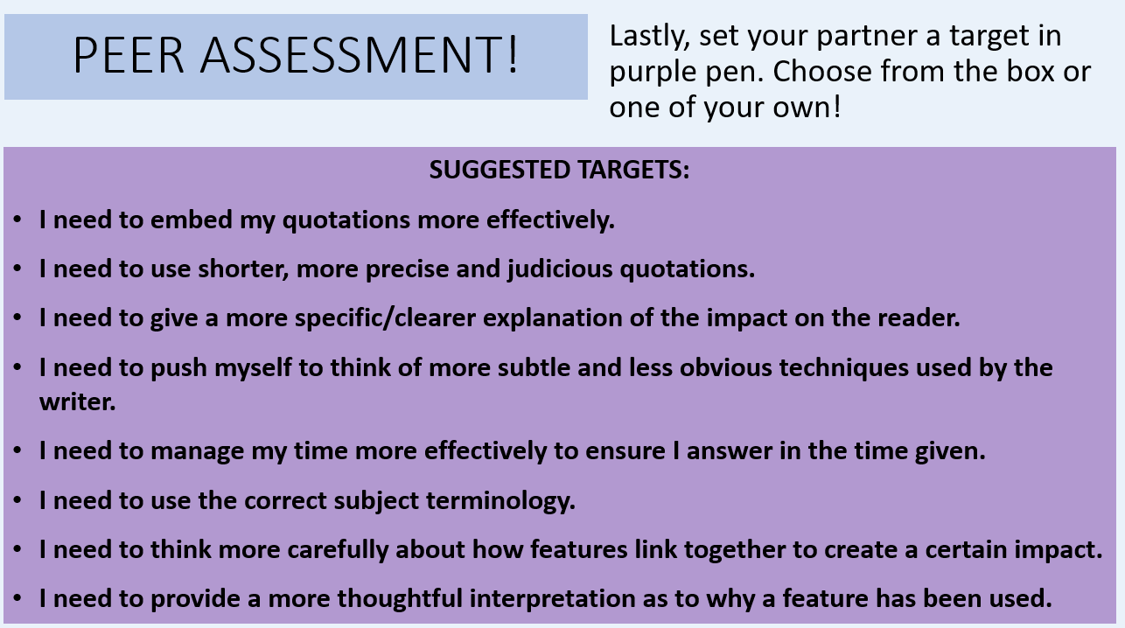
Scaffolding…
Scaffolding self/peer assessment tasks can lead to students providing quality feedback to each other.
E.g. avoid comments like ‘better handwriting’.
However, also means they’re not actively ‘thinking’. Might just choose a target at random to write down and so aren’t actually engaging in the task properly.

Slide 11
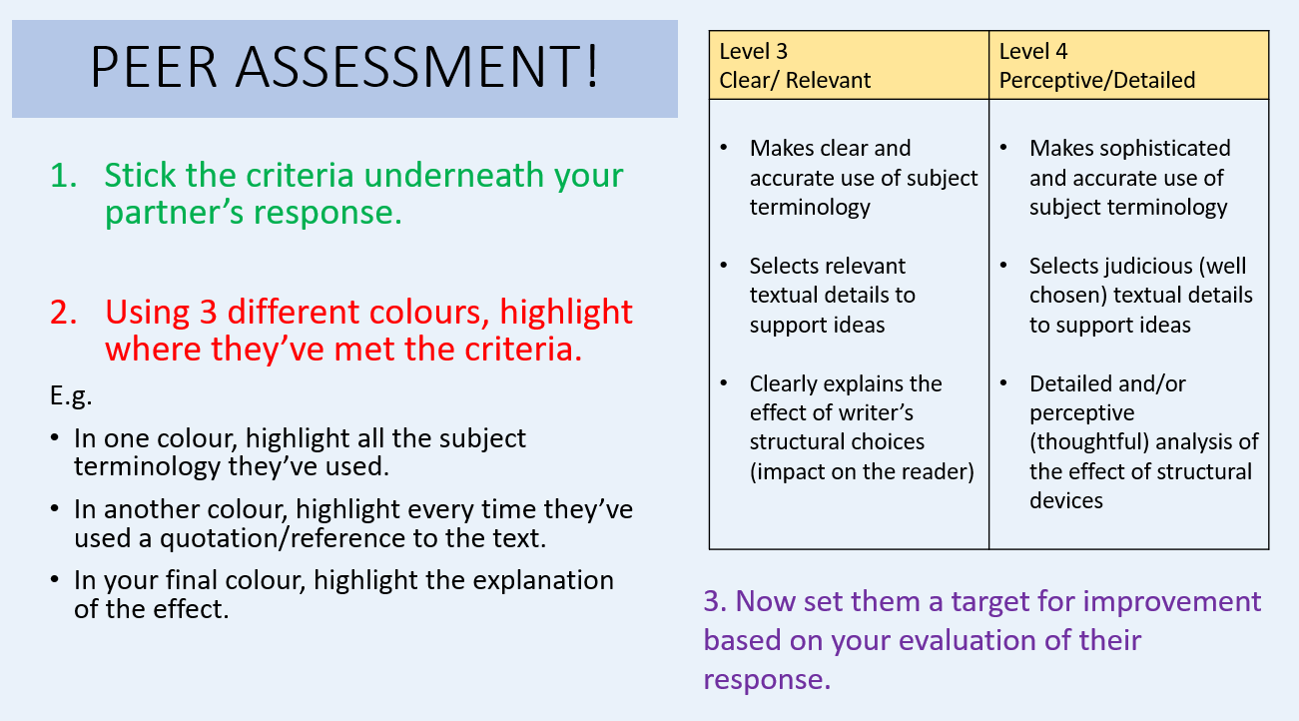
Scaffolding…
Instead, taking the time to scaffold what students need to do to properly self/peer assess something can lead to students receiving quality feedback.
What still needs to be improved here?
Student friendly criteria is a must!

Slide 12
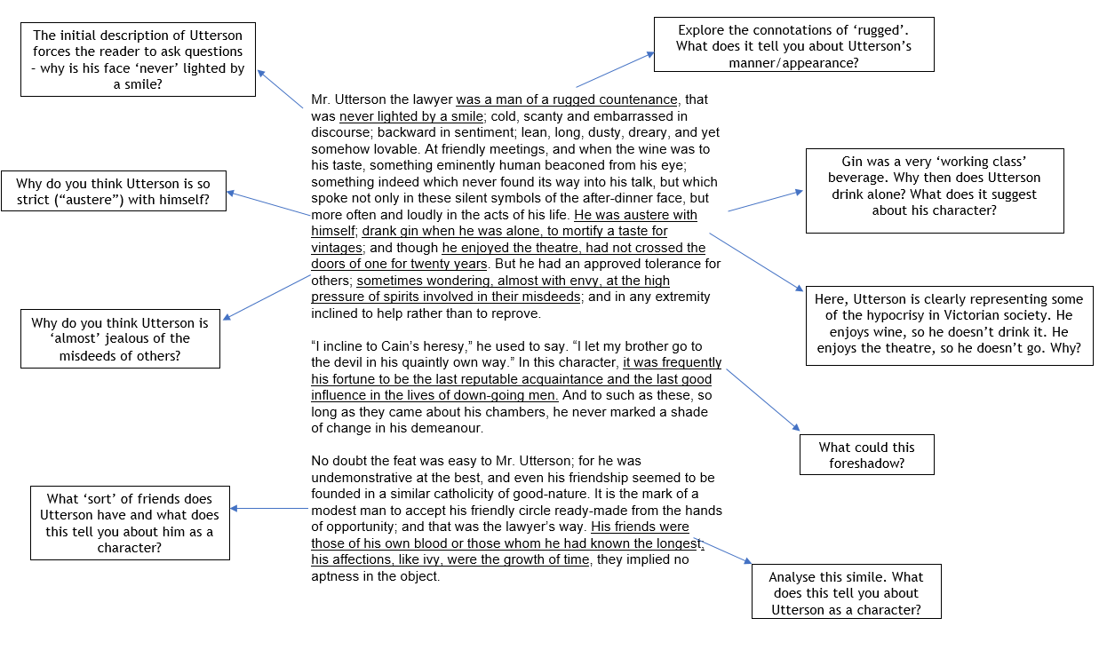
Scaffolding…
Things to avoid
What can I do instead?
Reading large chunks/chapters of a book. Audiobook.
Pick the vital extract they need for the lesson’s skill focus. Scaffold it to promote independent engagement before consolidating.

Slide 13
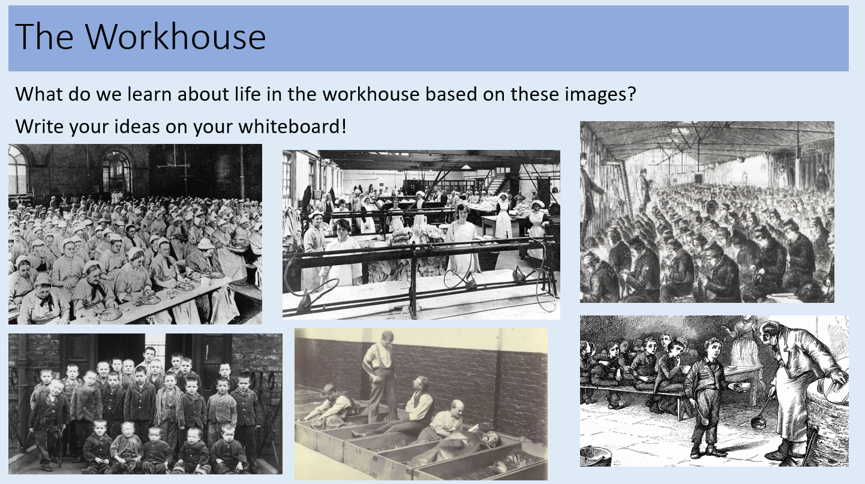
Scaffolding…
Things to avoid
What can I do instead?
Watching a clip/ reading information off the board and making notes.
Risk of the ‘wrong’ seductive details being learned.
Modify the task to prompt inference/deeper thinking.
Is there any purpose to copying notes?
Lessons should evidence skill development/progress.

Slide 14
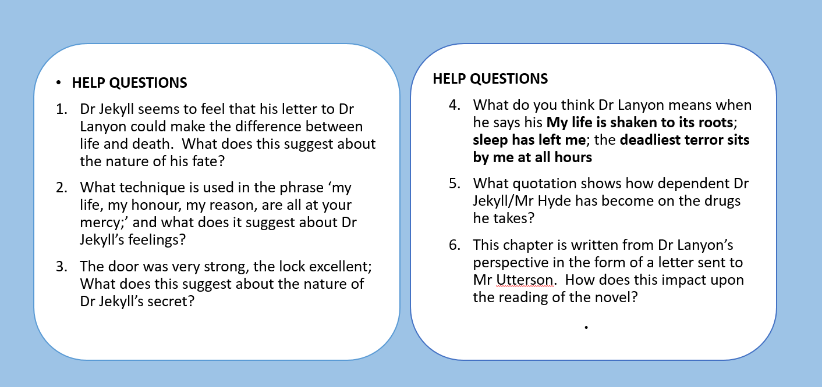
Scaffolding…
Things to avoid
What can I do instead?
Reading a long extract can be overwhelming.
Analysing an extract can lead to just ‘feature spotting’ / picking out examples.
There needs to be an added element of challenge to stretch all learners. The goal shouldn’t be to just ‘pick something out’ but to then consider the impact. Planning needs to scaffold this so it is explicit to students what they’re looking for and what they need to do with it.

Slide 15
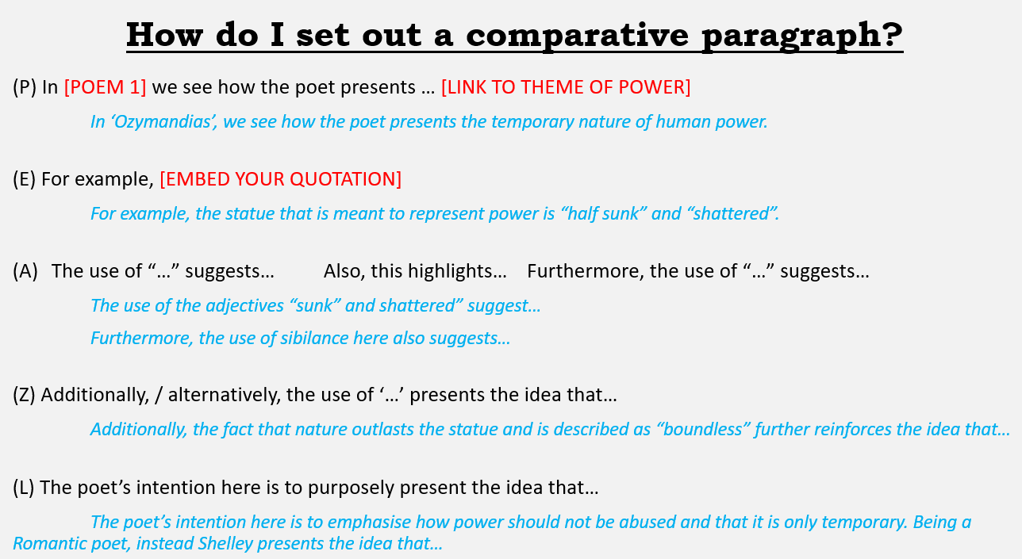
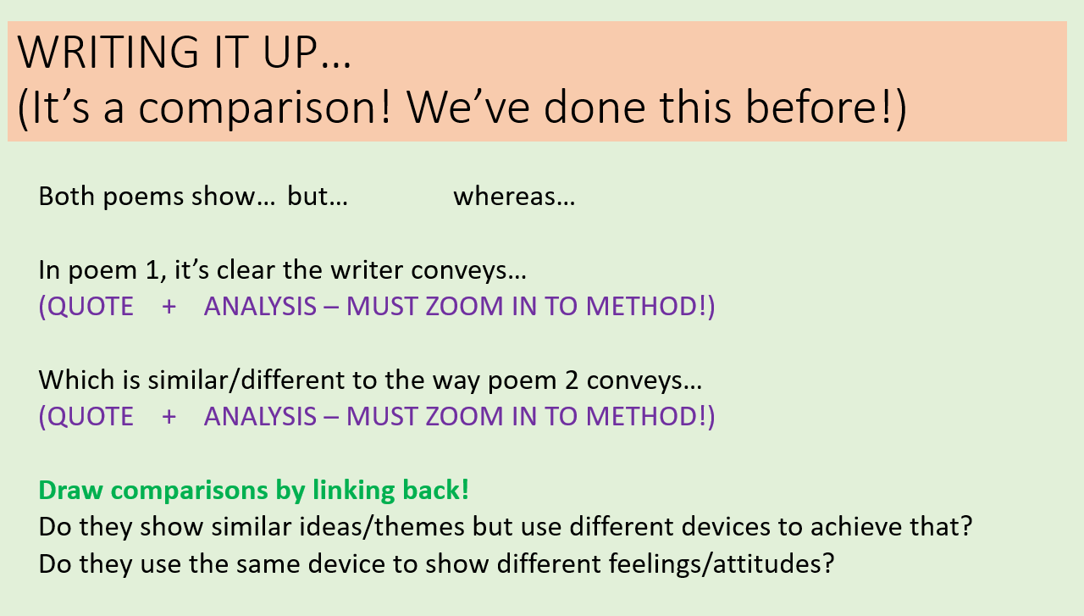
Scaffolding…
Knowing when to scale back the scaffolding is just as important as knowing when it will be needed!
Students need to build resilience. Scaffolding is therefore a TEMPORARY support that will slowly need to be taken away so students can do something independently.

Slide 16
METACOGNITION…
What is it exactly?
= how you control your thinking.
E.g. how you self-monitor and deploy what you know at the right time

Slide 17
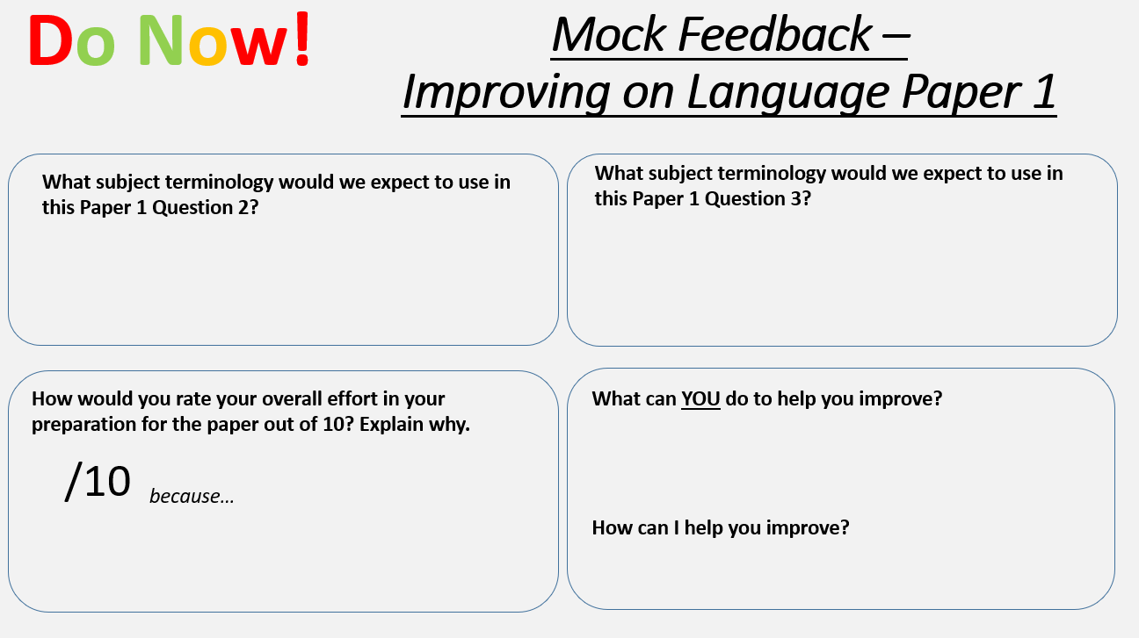
Metacognition…
Many of us plan metacognitive tasks without even realising it!
Can you spot any here?

Slide 18
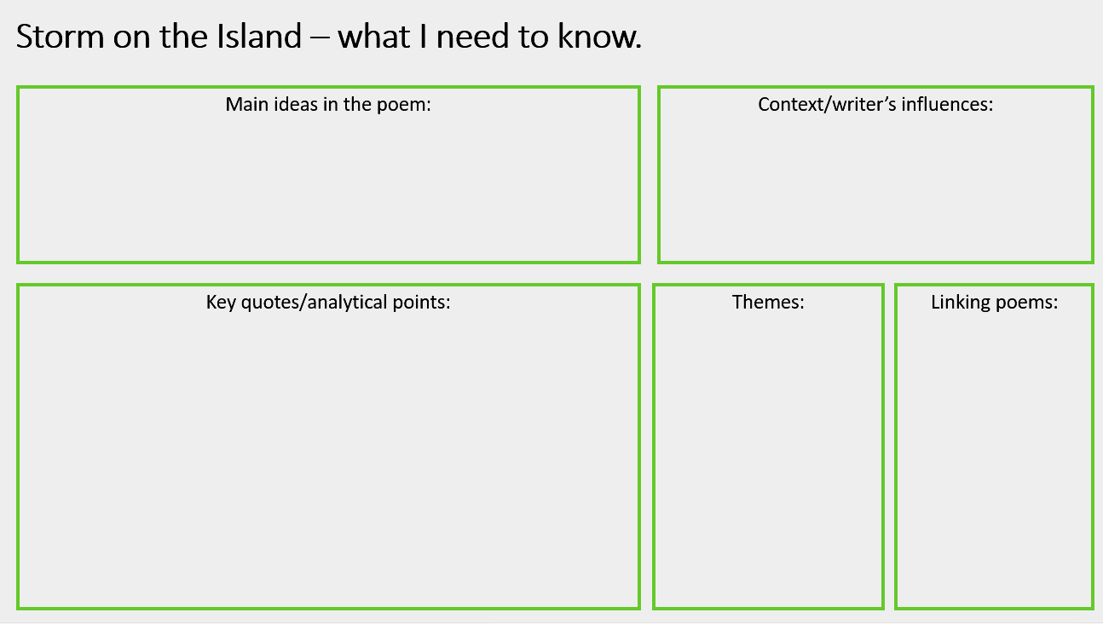
Metacognition…
Providing students with resources that can scaffold their thinking is a good way to engage them in metacognitive reflections.
Students can use templates like this to help them recognise what they know and what they don’t know. Possibly a good way to visually show them their gaps in their learning.

Slide 19
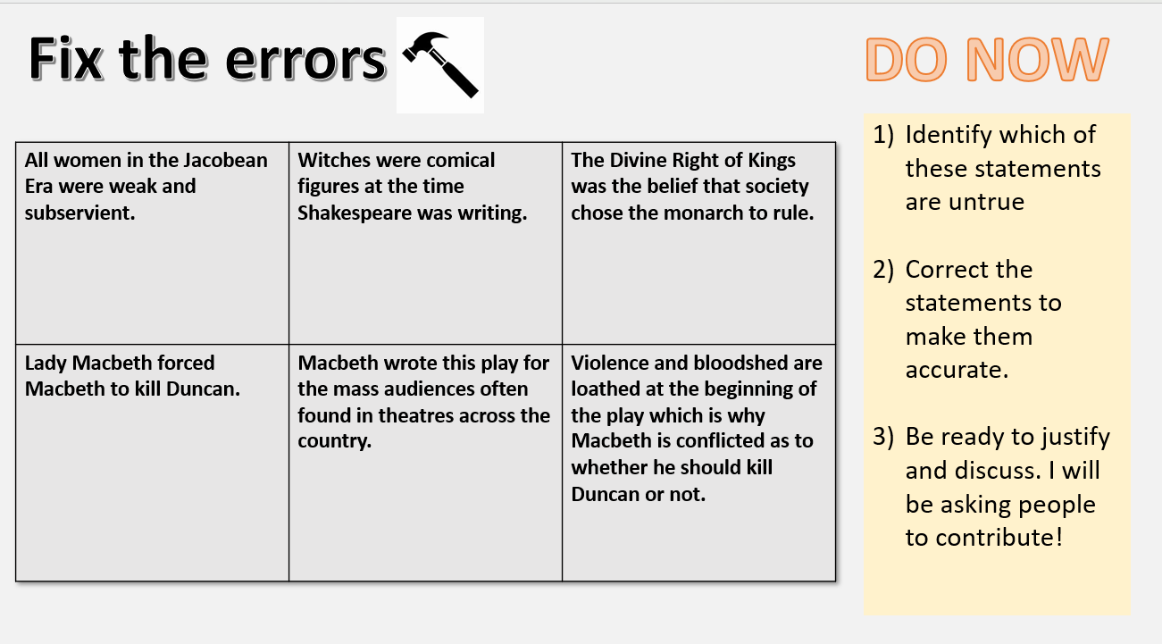
Metacognition…
Providing students with purposeful opportunities to APPLY PRIOR KNOWLEDGE helps them to engage well with what they know, but most importantly, WHY THEY SHOULD KNOW IT!

Slide 20
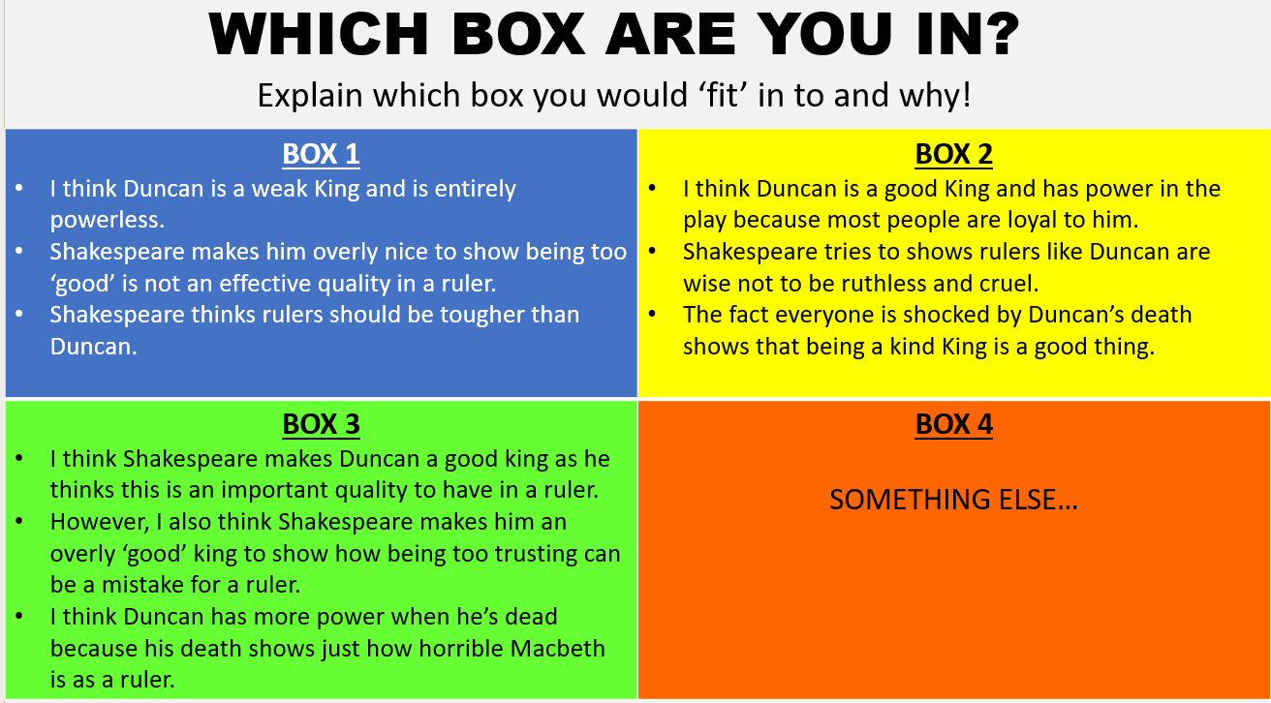
Metacognition…
Planning time for purposeful reflection is important when wanting to engage students in metacognitive tasks.
This can be scaffolded to provide support for those who need it but also encourage wider thinking.
The explaining WHY here is arguably the most important part of the process!

Slide 21
Metacognition…
Danger Zone
Don’t discount students’ perception of their learning.
Their ‘perception’ is their ‘reality’.
If they don’t feel confident about something, it’s worth knowing about it.
Challenge Zone
Comfort Zone

Slide 22
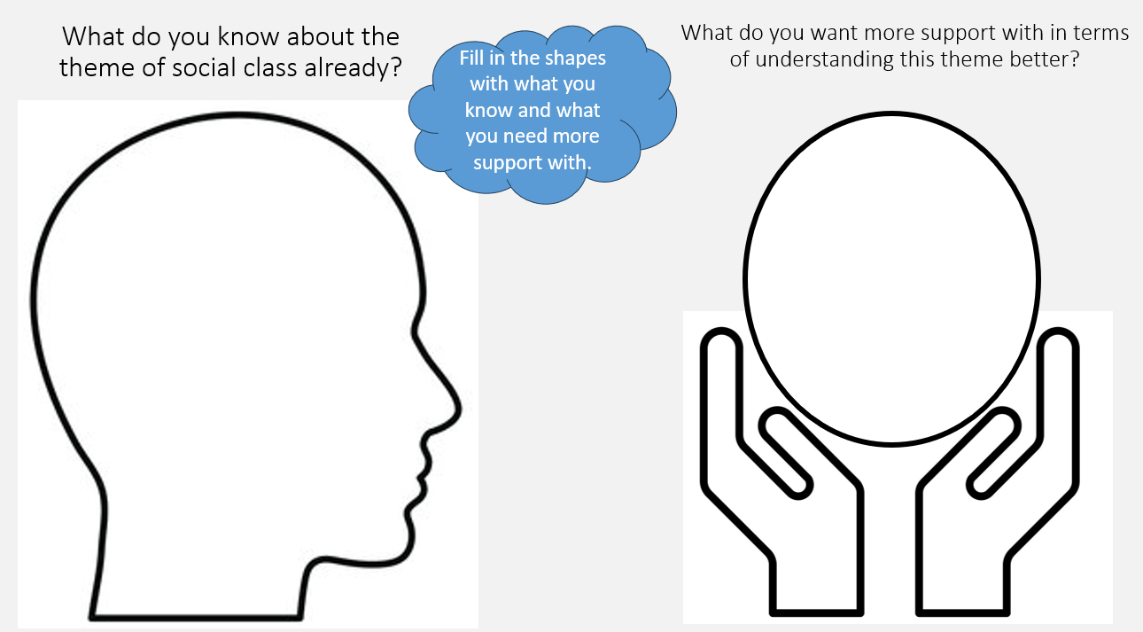
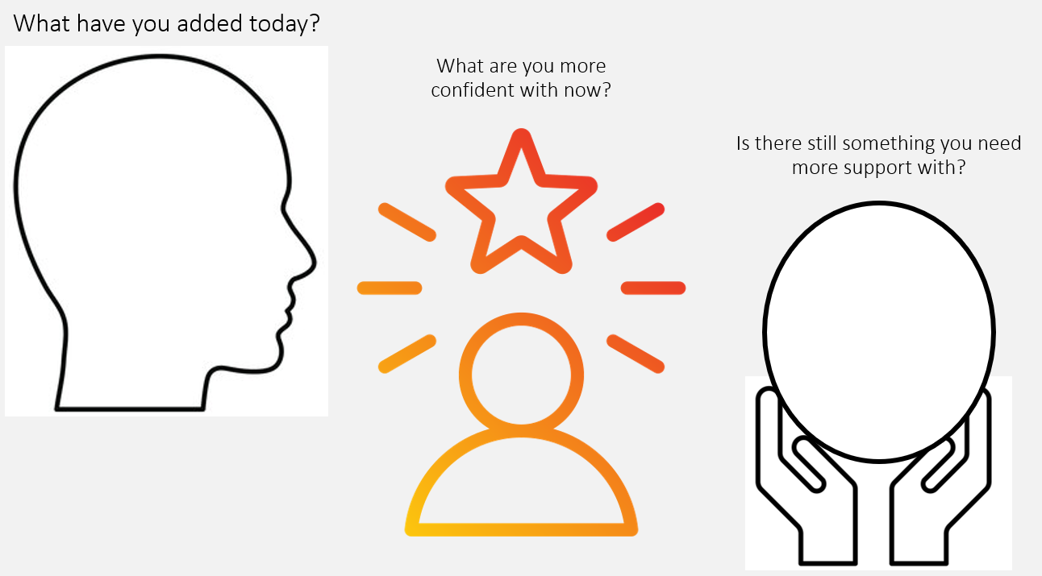
Metacognition…
Don’t discount students’ perception of their learning. Book-ending lessons with a reflection can help students recognise their learning and their next steps.

