Slide 1


Aspire Behaviour Management
Danny Maher
Director & Head of Outreach Support

Slide 2
Who are Aspire?
At Aspire Behaviour Management we take pride in offering comprehensive Outreach, Training, Specialist Supply and Educational Psychology services that empower schools and organisations to create positive, inclusive and nurturing learning environments.
​
We are dedicated to improving the lives of children/young people and transforming the way behaviour management is perceived and practiced.
​
We have worked with over 250 schools, Local Authorities and Organisations providing support through our various services.
​
At Aspire, we don't just provide services; we ignite positive transformations within schools. Our passion lies in crafting inclusive and nurturing learning environments that empower every pupil to reach their full potential.
​
Imagine a world where behavioural challenges become stepping stones to success, and differences are celebrated as strengths. That's the vision we bring to life at Aspire Behaviour Management.

Slide 3
What do we do?
Work with Schools, Educational Settings, Children/Young people and Families and Local Authorities to improve wellbeing, emotional regulation & subsequently behaviour, supporting schools in providing positive outcomes for children & young people.
We do this through our various services....

Slide 4




Services
        Our Outreach Support team, comprised of knowledgeable specialists, provide bespoke, expert, consistent, relational and impactful Outreach Support to Schools, Academies, MATs, EYFS settings, and Local Authorities.
        Aspire provides tailor-made training sessions to suit school's specific needs in supporting children/young people with SEND and SEMH in a classroom environment and more advanced behaviour management, child development, neurodevelopmental and trauma informed practice.
        Aspire Specialist Supply supports children/young people with SEMH and SEND to remain in their mainstream classrooms, using trained staff to support 1:1 in the classroom, removing emotional barriers to pupils everyday learning.
        Our Aspire EP Service prides itself on the quality and speed of work. Our associate EP’s have held senior positions within Local Authorities across the North West and provide the highest quality of service.

Slide 5
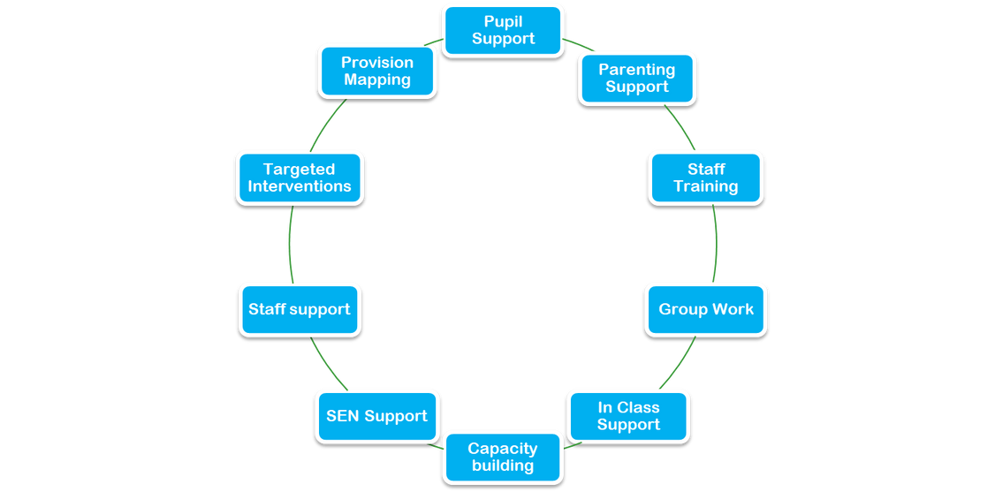

Aspire Outreach Support
Providing bespoke holistic Positive Behaviour Management support to schools

Slide 6
Bespoke Service
  Flexible & tailored to needs and priorities of schools.
  Schools shape the service required.
  Adapt to the ethos of every school whilst remaining consistent in evidenced based relational approaches.
  Quality and consistent approach to schools.
  Consistent Keyworkers for schools – ensuring relationships and consistent approaches maintained.
  School able to tailor bespoke support package based on need.
  All work linked to SEN Code of Practice

Slide 7
Menu of Support
  1:1 focussed intervention support
  Pupil group work intervention support
  Observations, recommendations & monitoring support
  SEN Support & Development
  Ongoing staff support & supervision relating to SEND and SEMH
  Direct intervention work - pupils/families/parents
  Parenting Support – universal and targeted
    home visits, weekly parent contact, Virtual Parenting Programme accessible for ALL parents
  In Class Support – modelling of approaches

Slide 8
Menu of Support (cont.)
Sensory Profiling – including overview of need, strategies & interventions
Referrals to neurodevelopmental/neurodiverse pathways
EHCP Advice Reports – supporting schools EHCP applications
Early Help Process – Lead Professional role or supporting
Partnership work

Slide 9
What can Aspire bring?
  10 years experience of supporting children, schools and families, displaying SEMH & SEND as Aspire and many years prior.
  Up to date knowledge of best relational and reflective practice.
  Strong & collaborative approach and relationships with schools
  Specialist and consistent support
  Discounted Training and Supply for SLA Schools

Slide 10
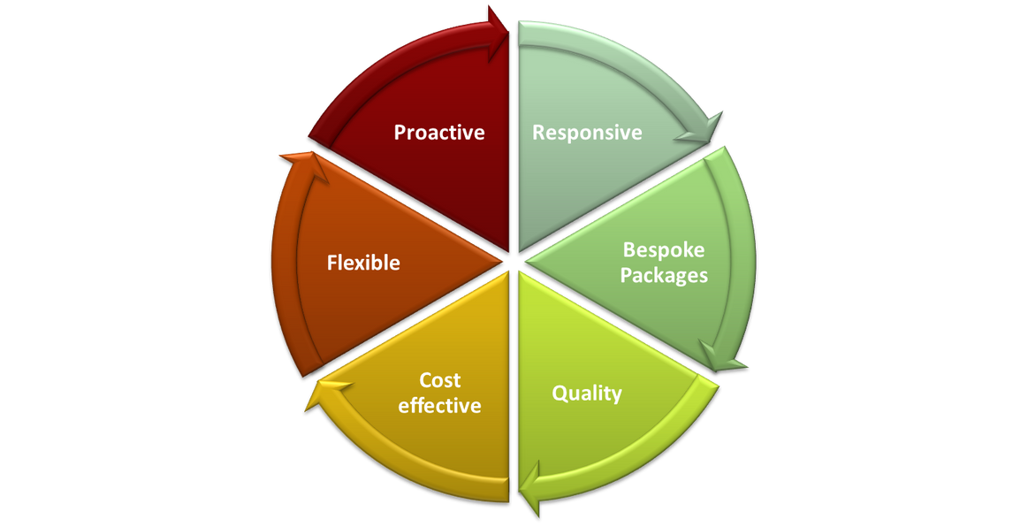
What makes us different?

Slide 11

Testimonials
“Aspire have had a huge impact on the children’s social, emotional and mental health. Aspire provide an exceptional service, share their knowledge and expertise with the staff and work closely with the school to provide the highest level of support for the children.”
St Thomas C.E. Primary School

Slide 12
Testimonials
“Professional, impactful services centered on relationships.”
University Collegiate School Bolton
“We are always happy with the bespoke and responsive service we get from the knowledgeable team of staff at Aspire.”
Pikes Lane Primary School
“Aspire provide effective support for learners, their parents and teaching staff”
Brandwood Primary School
Indispensable!
Queensbridge Primary School

Slide 13
Costs
Example:
Half Day Annual SLA - Primary School
Same dedicated staff member all year, on-site at
your school for 3.5 hours every week.
£6,795 for 136.5 hours
Example:
Full Day Annual SLA - Secondary School
Same dedicated staff member all year, on-site at
your school for 7 hours every week.
£13,695 for 273 hours
Get in touch for a bespoke cost for your school.

Slide 14

Aspire Training & Development
Aspire provides tailor-made training sessions to suit school's specific needs, whether that be learning about the basics of supporting children and young people with SEND and SEMH in a classroom environment or more advanced behaviour management training. We have both face to face and Whole School Online Training Packages to meet your schools needs, which are all CPD Accredited. Our training programmes include:
    Safer Schools – de-escalation and positive handling training
    Complex Trauma & Informed Practice
    Emotion Coaching
    PACE Approach
    Supporting Mental Health in the Classroom
    Attachment & ACE’s
    Supporting neurodivergent needs, such as ADHD and Autism
    Lunchtime Supervisors
    https://www.aspirebm.co.uk/training
    https://www.aspirebm.co.uk/online-training

Slide 15
Aspire Safer Schools Training
The training is called Safer Schools for a reason; we want to reduce the requirement for physical intervention in schools.
Our Safer Schools Programme will help you:
  Recognise why a child/young person is presenting with specific behaviours and factors associated with these.
  Support the child/young person to understand the emotions they may be feeling, driving the behaviours that accompany these.
  Build practical skills in relational approaches and de-escalation to ensure challenging situations with pupils do not escalate further and crisis situations are de-escalated in an effective, supportive, relational and timely manner.
  Understand the importance of and learn relational and co-regulation techniques to support pupils emotions that are driving their behaviours.
  And if you absolutely need to intervene physically, we will show you how to do it calmly and safely, with all physical interventions BTEC Conflict Management & Positive Handling and NFPS affiliated.
If you would like to become a ‘Safer School’ and join the 100’s of schools supporting and co-regulating the emotional wellbeing of their pupils, contact us.
​
We now also provide an award for you to display to show your commitment to reducing physical intervention in your school.
Safer Schools starts from £1395+VAT for up to 20 staff members or less than £70pp.

Slide 16
Aspire Whole School Online Training Platform
  Safeguarding Level 2
  Challenging Behaviour and De-escalation
  Complex Trauma & Informed Practice
  Emotion Coaching
  The PACE Approach
  PDA / Demand Avoidance
  Attachment
  Supporting pupils with ADHD
  Supporting pupils with Autism
  Anxiety
  Resilience
  Lunchtime Supervisor Training
  Every course is CPD accredited, ensuring that each staff member not only gains important knowledge but receives a CPD certificate as a testament to their knowledge & growth.
From £195
per school
per year

Slide 17
Aspire Specialist Supply
Aspire Specialist Supply was created to support children & young people with SEMH and SEND to remain in their mainstream classrooms. Using our robustly trained Specialist Supply staff to support 1 to 1 in the classroom on a daily full time or part time basis, we are able to support in reducing incidents and have a meaningful impact on emotional regulation, engagement and learning, through effective relational approaches.
All of our Specialist Supply staff have completed our robust training programme, including:
  Safeguarding
  Challenging Behaviour & De-escalation
  ACES
  Emotion Coaching
  Prevent Training
https://www.aspirebm.co.uk/supply

Slide 18
Aspire Education Psychology
Our Aspire Education Psychology Service prides itself on the quality and speed of work to support the growing and often urgent need for assessment of children/young people with complex SEN and supporting resource stretched Local Authority EP & SEN Services. Our associate Chartered EP’s have held senior positions among Local Authorities across the North West and provide the highest quality of service.
Our associate EP’s offer support and assessment in the following areas:
  Assessments & Panel Reports for EHCP Applications – within 2 weeks of the assessment taking place.
  Cognitive Assessments
  ADOS Assessments
  Face to Face & Remote Assessments
https://www.aspirebm.co.uk/ep

Slide 19


Slide 20
Any Questions?

Slide 21
Contact details:
www.aspirebm.co.uk
Email:
enquiries@aspirebm.co.uk
d.maher@aspirebm.co.uk

