Slide 1

Pillar 3: Making Knowledge Stick
November 2024
Notes:
Linda Introduction and welcome

Slide 2
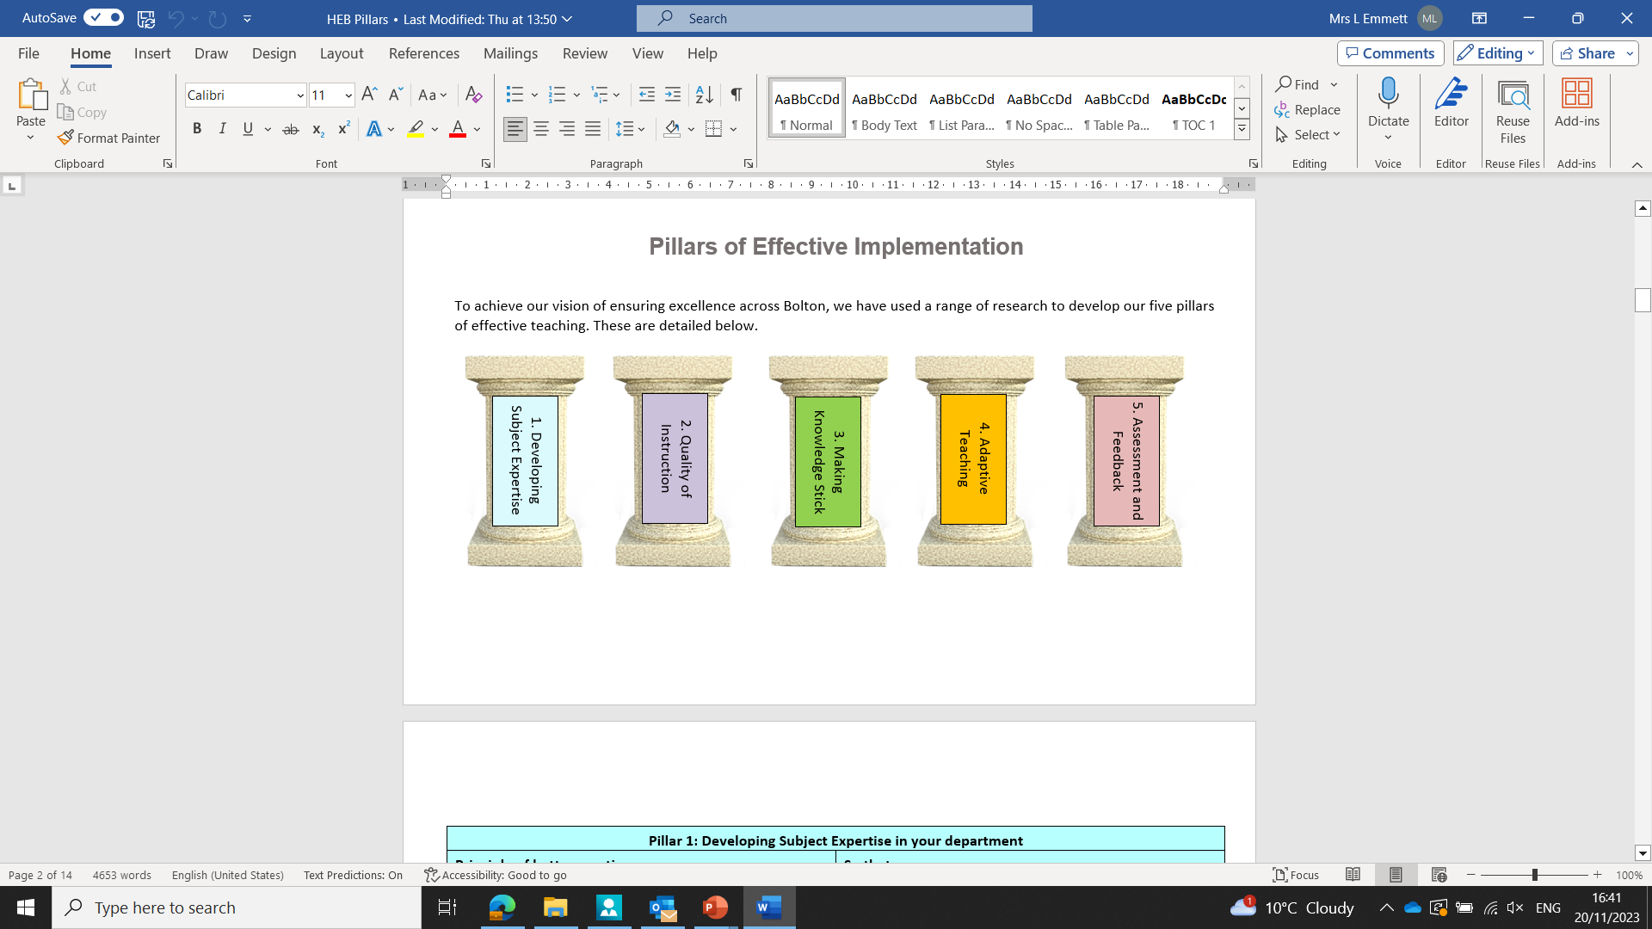
The Pillars of Effective Curriculum Implementation
Notes:
Jenny As discussed in the last two sessions, we have used a range of research, including the work of the Bolton teaching and learning hub, feedback and work from the curriculum hub, best practice visits to high-performing trusts, to inform the five pillars of implementation detailed above.
They are developing subject expertise
Quality of instruction
Making knowledge stick
Adaptive teaching
Assessment and feedback.

Slide 3
Teachers make links to prior learning.
Teachers ensure high pupil participation, including in tasks to promote thinking.
Teachers give opportunities to practice.
Notes:
Jenny In this session, we will be building on the previous sessions on subject expertise and quality of instruction.
This pillar focuses on how we help all pupils, especially disadvantaged pupils and those with SEND, to know and remember the most important knowledge.
As ever, this pillar links to many of our pillars.
We will follow this with adaptive teaching, and assessment and feedback.

Slide 4
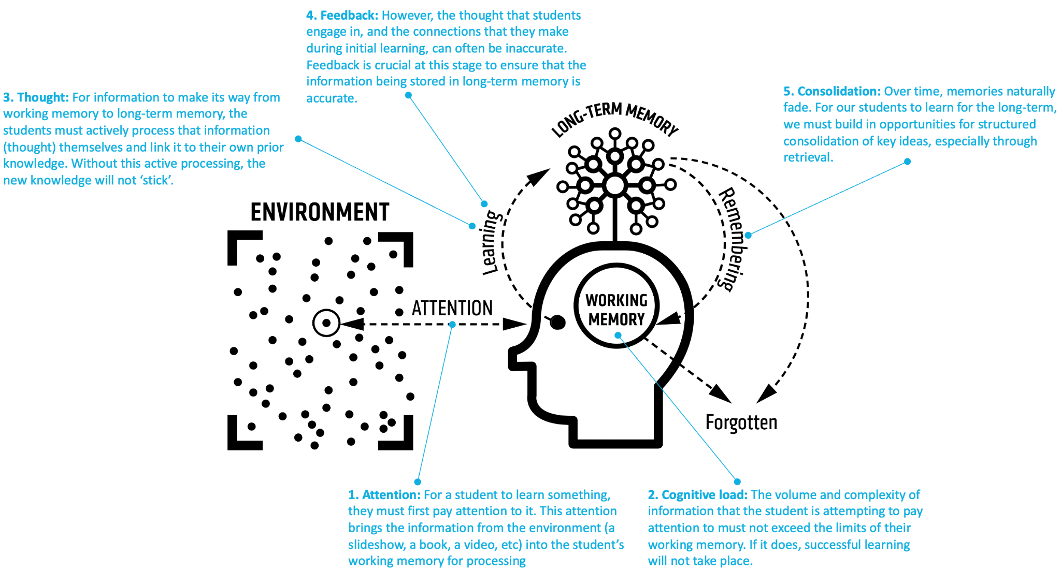
Notes:
Jenny
Over the last two sessions, we have seen this interpretation of Daniel Willingham’s model of memory.
We see that working memory has limited capacity and to help pupils to remember more, we need to help them to move knowledge to long-term memory.
A focus on helping pupils to remember important knowledge is key to overcoming limits in short-term memory.
This session will look at thought (active processing linked to prior knowledge) and consolidation (opportunities to retrieve key ideas) whilst considering attention and cognitive load.
We will shortly explore research around memory in more detail.

Slide 5
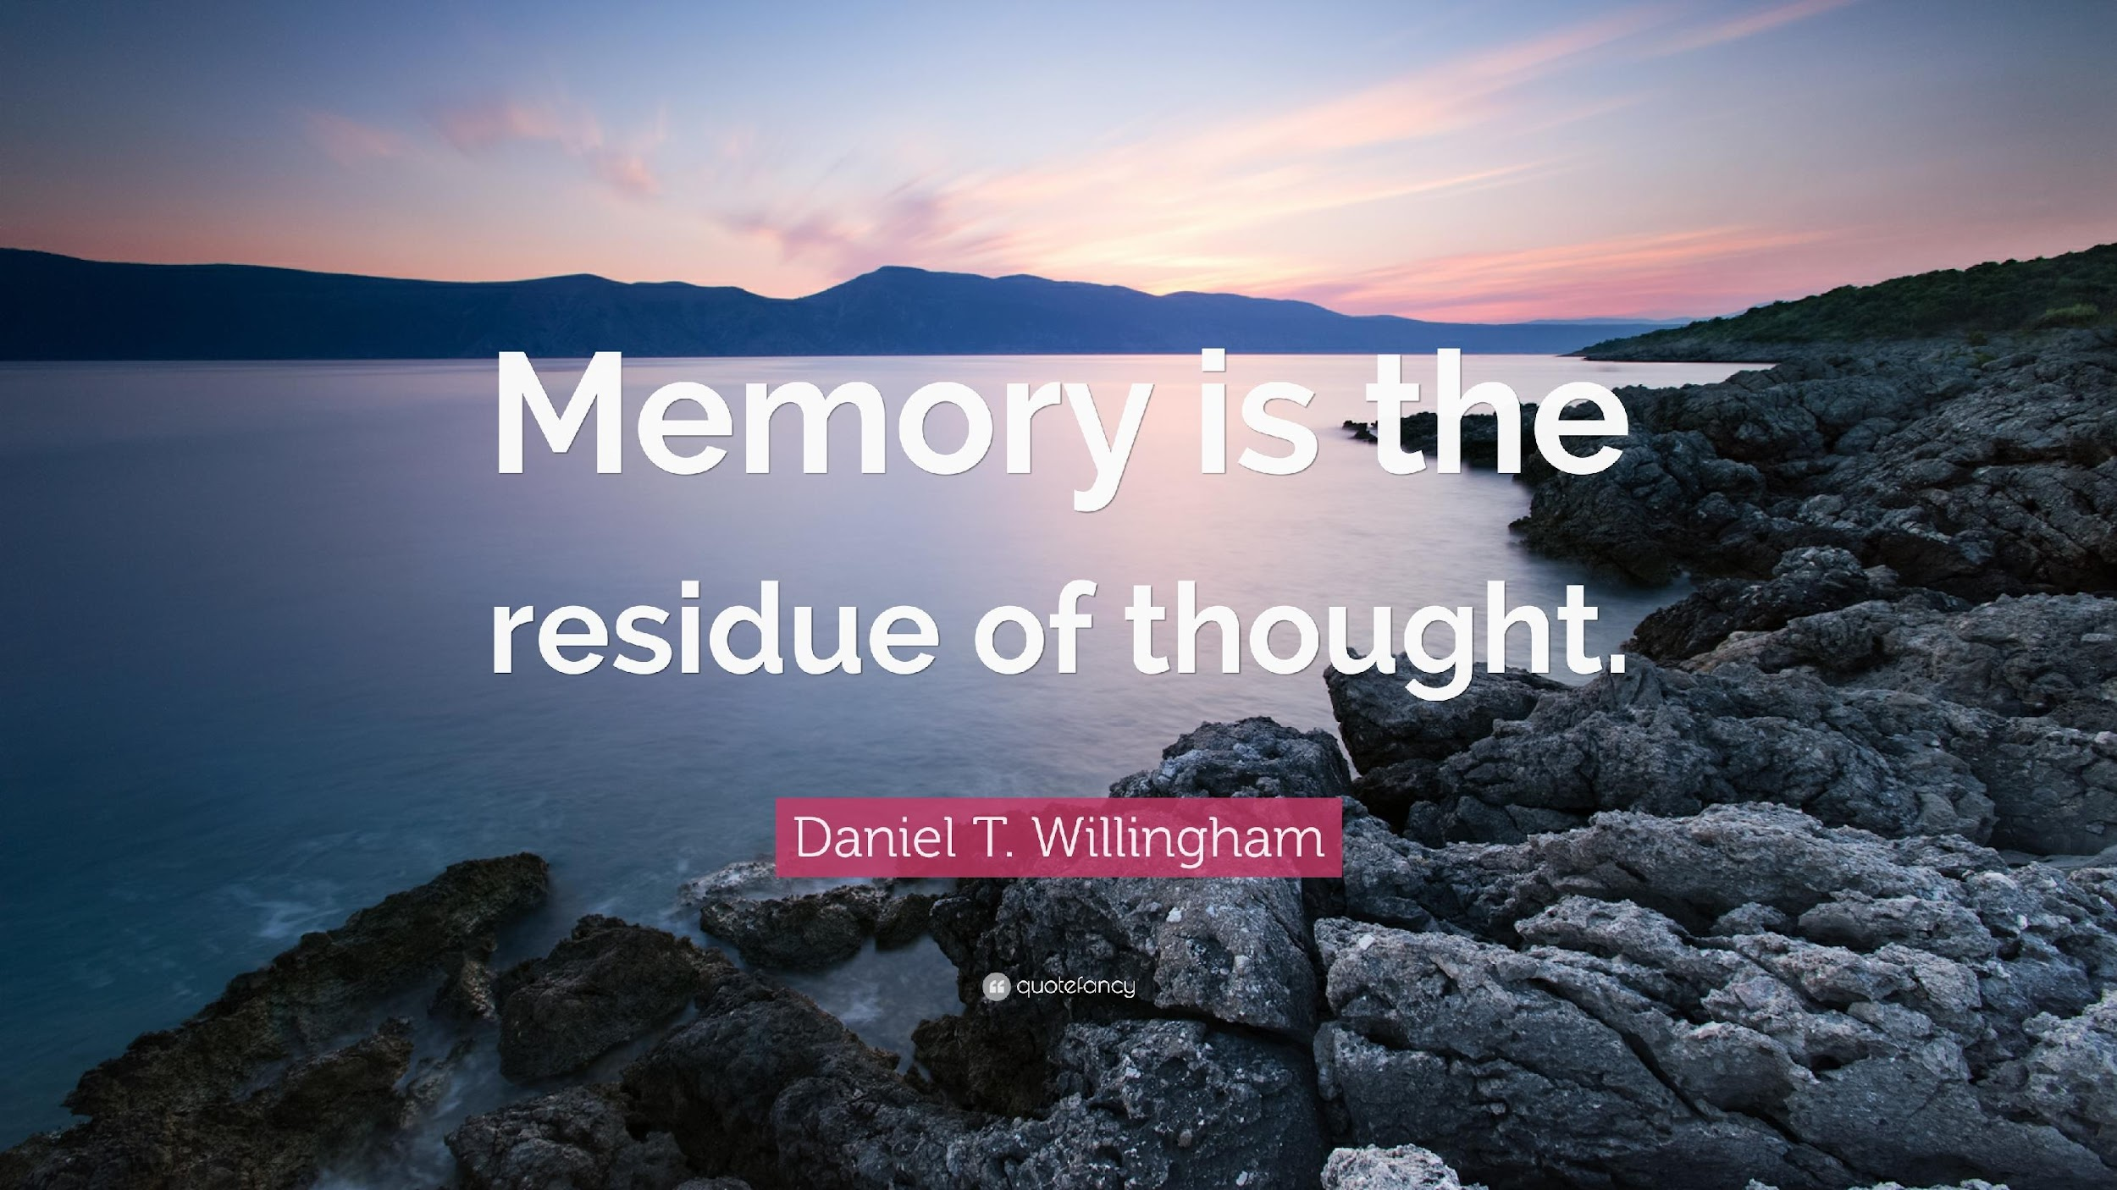
Notes:
Linda We know that Willingham states that memory is the residue of thought.

Slide 6

Notes:
Linda
In Willingham’s article ‘why don’t students like school’ - he summarises that it is because the brain is not designed for thinking, it is designed to not think as thinking is slow and unreliable.
Willingham states that successful thinking relies on information from the environment, facts and procedures in long-term memory, and space in working memory. Working on problems that are at the right level of difficulty is rewarding, but working on problems that are too easy or too difficult is unpleasant for anyone, but especially our pupils. Goldilocks effect.
So, people enjoy mental work if it is successful. So work needs to be challenging to allow a pupil to think.
Thinking back to explicit instruction, we need to focus on the right knowledge, minimising cognitive load. We also need to give pupils to link new knowledge to existing knowledge, give pupils time to think about what they are learning.

Slide 7
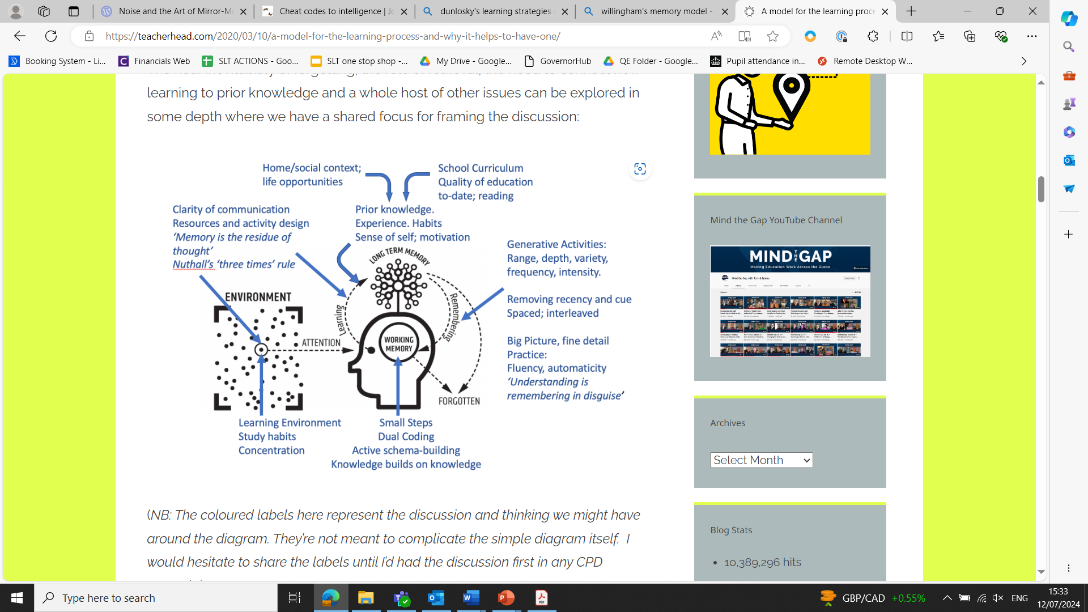
Notes:
Linda
So let’s look at Willingham’s model a slightly different way and in a bit more depth.
Pupils might not remember what you are teaching for all kings of reasons. This might be to do with:
From previous sessions we have done…
Attention deficits: pupils’ attention is not given to the specific learning points in question; it might be elsewhere. Think back to our previous session on pinpointing the right knowledge in the right order, avoiding seductive details. Solution: strategies around securing attention on the right knowledge.
Memory overload: working memory is finite; often students are dealing with too many ideas and pieces of information; they can’t process it all and things don’t make sense or stick . Solution: break concepts and tasks into smaller practicable steps and elements.
Lack of prior knowledge:the big hidden variable across the class: pupils will often not have a schema for new concepts being taught. This is a barrier to making sense of or retaining new knowledge. Solution: develop a broad curriculum packed with knowledge and experiences. Check students’ prior knowledge as a routine element of teaching rather than making assumptions.
And the focus of today’s session: Insufficient fluency of recall: very often a learning issue is simply a question of practice. Pupils haven’t yet had the opportunity to think about, practise retrieving and applying their knowledge with enough frequency, intensity or variety to have developed the fluency and confidence. Solution: increase the range, intensity and frequency of practice tasks so that students gain confidence and fluency.
Task completion is a poor proxy for learning: we can do all kinds of things immediately after being shown something, simply by accessing information presented to us, without it forming part of long-term memory for use at a later date. Solution: engage in checks for understanding and more generative activity with supports removed; space practice so that long-term memory and recall are strengthened away from the illusion of knowing through recency.
We will explore some of these in more detail today, based on a range of research.
As you can also see on this diagram, home and social context, learning environments have a big input on pupils’ ability to remember. Let’s look at this a bit more on the next slide given the nature of the 19k.

Slide 8
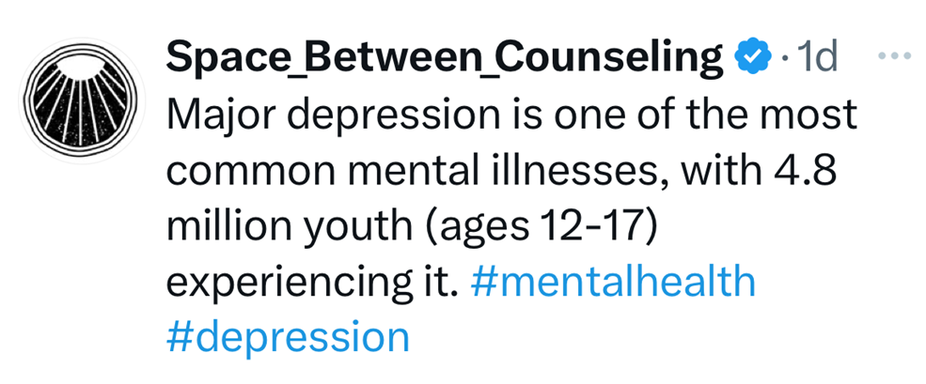
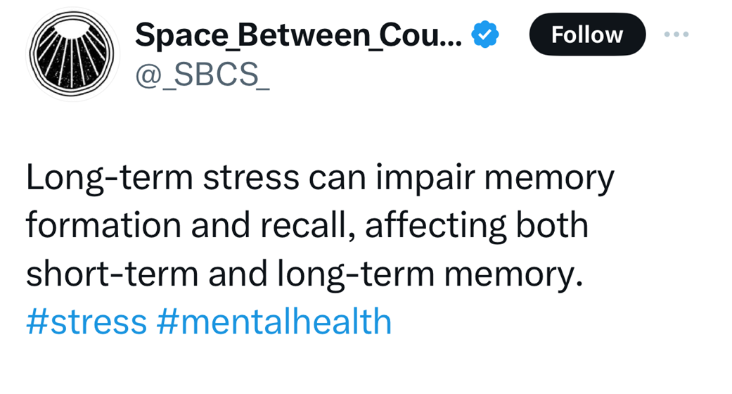
Notes:
Linda
‘Space Between Counseling’ on X (formerly Twitter) outlines barriers faced by young people that exacerbate moving knowledge to long-term memory.
So we also need to be very mindful about how we create a sense of success. This is particularly the case for any pupils who struggle with their learning, including some disadvantaged pupils and some pupils with SEND. We are also aware of the effects of mental health on many pupils’ well-being, which in itself is a barrier to memory.
If we get our learning strategies right, it will have a disproportionately positive impact on these pupils but benefit all pupils.
Linking back to Willingham, if we create a goldilocks effect of ‘not too easy, not too difficult, but just right’ we can help all pupils to feel a sense of success.

Slide 9
The power of working memory is prodigious. It has allowed humankind to discover penicillin, create the musical Hamilton, and conceptualise String Theory. But beyond its immense power, the most dominant characteristic of working memory is its tiny capacity.
Notes:
Ed Lemov from TLAC. Leave on the board and read it to delegates and ask them to follow along with the reading.
Don’t tell delegates that this is a recall task.

Slide 10
Your Task
Notes:
Ed
Task - Please write out, verbatim, the first two sentences of the paragraph that we have just read together. 2 minutes.
You will likely struggle to remember those two sentences.
This is because you are at the limits of your working memory. This is also because you have not had time to think about the information, link it with prior learning (create schema)
In our classrooms, this may happen over and over again for learners. If you begin to think consciously about something in working memory, for example a scene in a novel you are reading, the connections with long-term memory start to pour in. Quite a lot of the time, someone who is thinking is actually engaged in memory retrieval. You can’t teach critical thinking without facts.
So, a well-developed long-term memory is the solution to the limitations of working memory. As Sweller, Kirschner and Clark state, ‘the aim of all instruction is to alter long-term memory. If nothing has changed in long-term memory, nothing has been learned’.
How do you show students what are the important elements of your subject that they need to remember?
How do you give them time to think about the information and link it to prior learning?

Slide 11
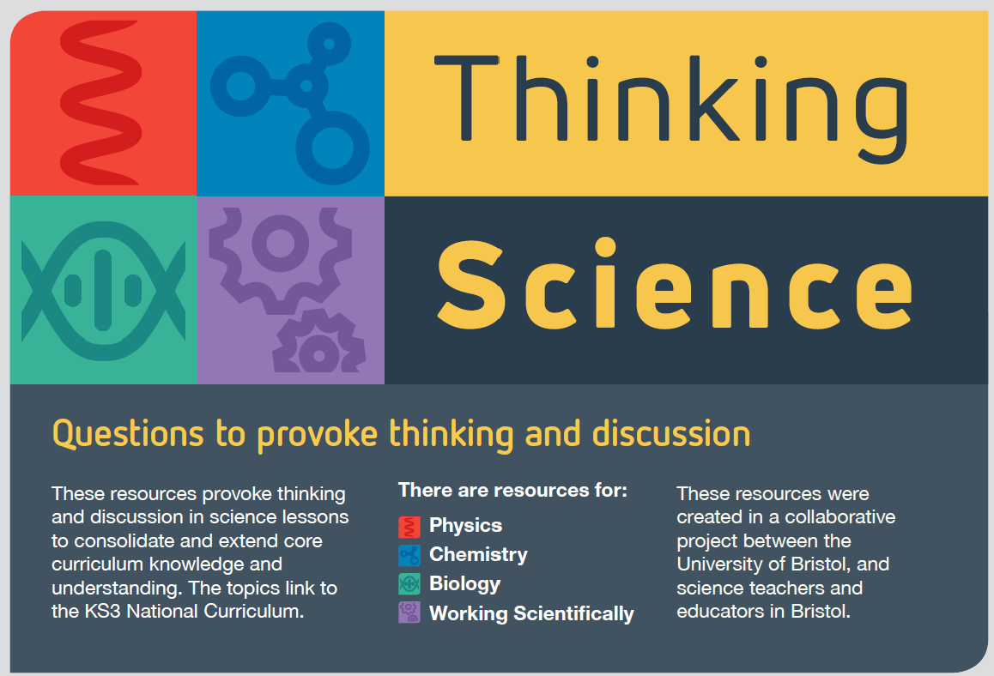
Thinking Deeply in Science
“If you are made to think, you’ll learn”
John Dewey, Approaches to learning and teaching Science
Notes:
Ed
Task - Please write out, verbatim, the first two sentences of the paragraph that we have just read together. 2 minutes.
You will likely struggle to remember those two sentences.
This is because you are at the limits of your working memory. This is also because you have not had time to think about the information, link it with prior learning (create schema)
In our classrooms, this may happen over and over again for learners. If you begin to think consciously about something in working memory, for example a scene in a novel you are reading, the connections with long-term memory start to pour in. Quite a lot of the time, someone who is thinking is actually engaged in memory retrieval. You can’t teach critical thinking without facts.
So, a well-developed long-term memory is the solution to the limitations of working memory. As Sweller, Kirschner and Clark state, ‘the aim of all instruction is to alter long-term memory. If nothing has changed in long-term memory, nothing has been learned’.
How do you show students what are the important elements of your subject that they need to remember?
How do you give them time to think about the information and link it to prior learning?

Slide 12
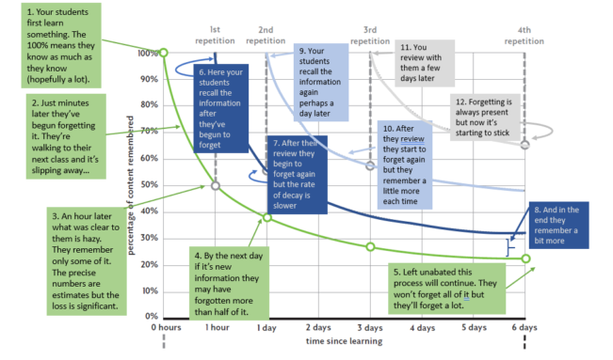
Notes:
Ed The above image is from TLAC 3.0, page 11.
Based on Ebbinghaus’s forgetting curve.
However, Sweller’s guidance fading effect argues that experts learn differently from novices. Thinking back to the last two sessions on subject expertise and quality of instruction, we know that novices need clear, guided instruction from the expert in the room (the teacher) This is because novice learners have little knowledge of a topic in long-term memory so can’t make connections.
The learner may feel secure in knowledge immediately after the lesson but the retention of this knowledge diminishes quickly.
In Ebbinghaus’s model above, we can see how memory diminishes very quickly after learning. Each time you practice something, the rate and amount of forgetting is reduced.
There are a range of research-informed strategies that can help us to overcome this, such as within Dunlosky and Lemov, that we will explore today.
Perhaps give time to discuss and feedback
Thinking about the memory task that we have just attempted, if we chunked that and revisited it, we would probably have a good go at recalling it fully with time.

Slide 13
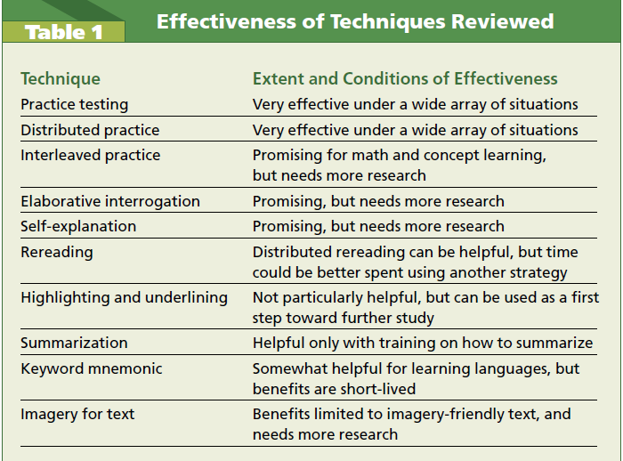
Notes:
Jenny
John Dulosky, Professor Emeritus, Director of the Science for Learning, Kent State University.
You can see from Dunlosky’s analysis, practice testing, distributed practice are the most effective techniques.
https://drive.google.com/file/d/1pUw_HlZwKeEgYwqfT2GTi18-zQ_Pmhbr/view?usp=drive_link

Slide 14
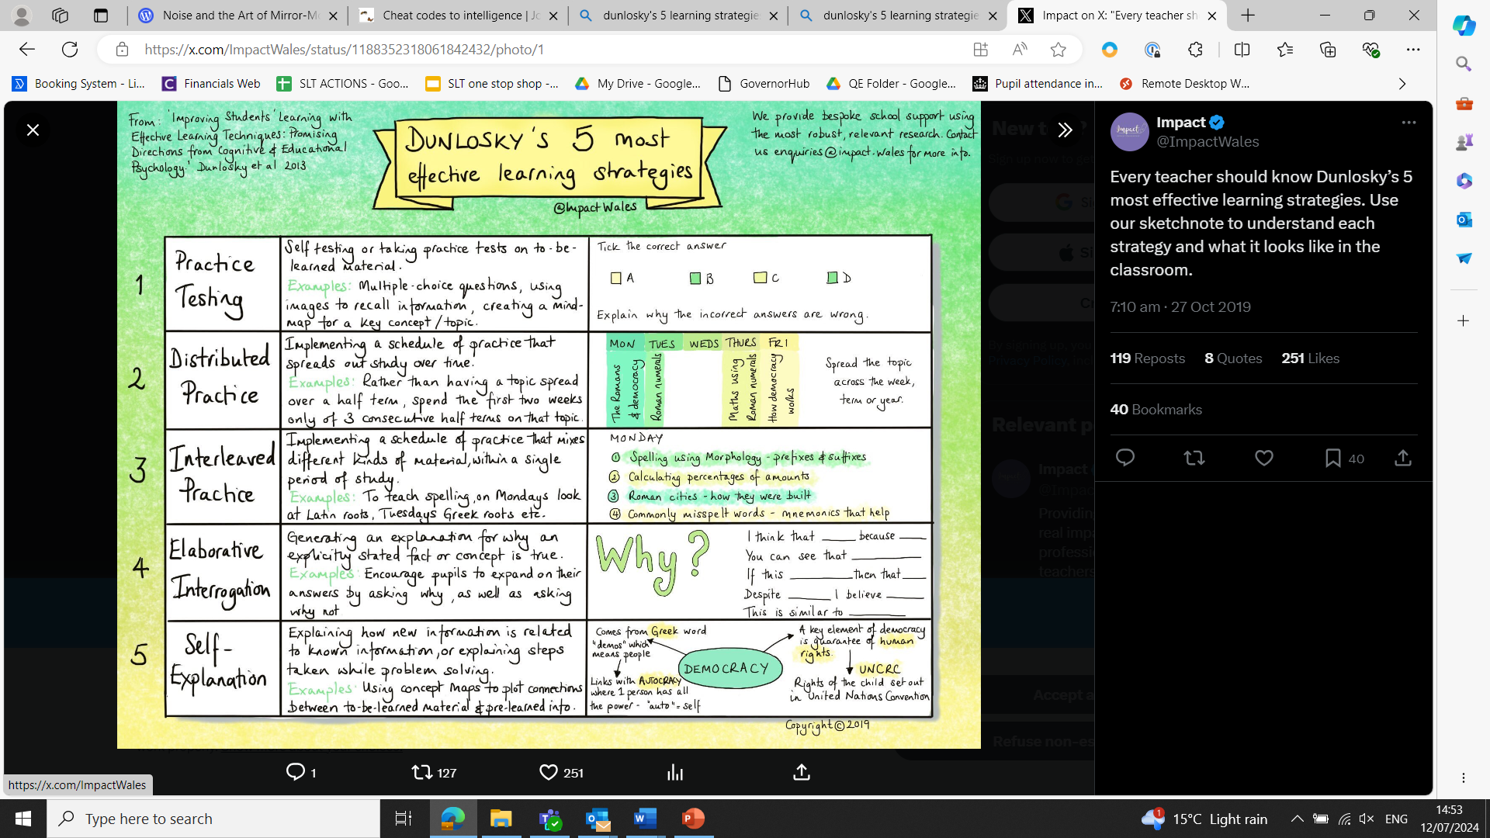
Notes:
Jenny
Here is John Dunlosky’s view of the most effective learning strategies where the 5 most impactful learning strategies have been identified.
In this article, an example is given for each technique.
Give a low-stakes quiz at the beginning of each class, calling it a review to make it less intimidating.
Use cumulative assessments which will encourage pupils to study material again over a period of time.
Help pupils to do a study planner so they can spread revisits our rather than ‘cramming’.
Encourage pupils to elaborate about what they are reading by asking them ‘why’ (think deeply)
Encourage pupils to retrieve rather than passively reading books and notes.
Let’s go into some of these in more detail.

Slide 15
Practice Testing (Quizzing)
Students will benefit from almost any form of practice testing. The most impactful tests require recall from memory and not simply recognising the correct answer.
Students should also be encouraged to work in a way that will foster practice tests such as flash cards with terms and definitions.
Help students to the point where they can continue testing themselves.
Notes:
Jenny
Dunlosky
Viewing tests as the end-all assessment after all learning has been completed means students and teachers are missing out on one of the most effective strategies for improving learning.
Done well, teachers would use worksheets to involve practice problems with an appropriate order to encourage interleaved practice.
For example, interleaving questions and problems from newly taught materials with those from prior classes.
This allows pupils to practice solving indicated problems from material already taught, it will also help them to practice the difficult tasks of identifying problems and choosing the correct steps needed to solve them.

Slide 16
Our Test
Which learning technique did Dunlosky say was most effective? | Heimlich manoeuvre | b. Practice testing | c. the off-side rule
2. In Beth Budden’s article ‘Seductive Teaching’ what are the three techniques? | Disturbance, distribution, disinformation | b. Diversion, disconnect, distribution. | c. distraction, disruption, diversion.
3. Describe the novice vs expert theory
4. What is the topic of pillar 4? | Adaptive teaching | b. Newton’s law | c. Curriculum intent
5. Complete the following gap fill. Use the words below to help: Thinking, dogs, cognitive, people, swimmers, thinkers, drinking, weather. | ______ are naturally curious but we are not naturally good _______. Unless the ______ conditions are right we will avoid ________.
Notes:
Linda
Critique the test on the board. What are the strengths and weaknesses?
Q1 answer is B
Q2 answer is C
Q4 is A
You may have discussed that answers to Q1, Q4 and Q5 are too obvious to help pupils to think deeply about their learning. Q4 is about future learning so it might not be reasonable to test novices on what has not yet been taught. Q2 is good as it involves revisiting and appropriately challenging options.
This test also misses the opportunity for pupils to identify problems and choose the correct steps needed to solve them.
Furthermore…
Willingham says it is“absolutely crucial” that students store the right subject-specific knowledge in their long-term memories, because this would allow them to develop “the thinking skills that are, for many teachers, the real goal”.
However, he said too many students take the wrong approach to committing information to memory, because “what they mostly do is read stuff over and over again”. This meant they were “not really thinking about the meaning at all”
Instead, Willingham said, pupils should spend time reflecting on the meaning and trying to understand which aspects they needed to commit to memory and why. “It sounds very simple but students seldom do that,” he said.

Slide 17
Tom Sherrington’s Walk Thru on Quizzing
Specify material in advance
Only quiz what has previously been taught and needs to be learned.
Ask a set of short factual recall questions, varying in style.
Think about the questions making sure they require recall of knowledge taught and not common sense - what style would suit this the best?
Give all students time to answer all the questions.
Usually this means that each student has their own quiz paper.
Provide answers for students to check.
Doing this one at a time with an explanation helps all students revisit knowledge and learn more.
Review answers to find out where individuals’ gaps in knowledge are.
Here it is important to use affirmative praise and spend time with individuals on areas that have not yet been learned.
Notes:
Linda
Tom Sherrington also gives input on effective quizzing in his book ‘walkthrus.

Slide 18
Over to you…
Building Low Stakes Quizzing into Schemes of Learning
Consider your scheme of learning.
How are low-stakes quizzes embedded?
How do they retrieve knowledge from last lesson, last week, last month and last year?
How can they be improved?
Notes:
Linda
Give colleagues 5 minutes.
Circulate and check.
Pick out strong examples where answers are nuanced rather than obvious.
Ask colleagues to share examples also.

Slide 19
Distributed Practice
Massed practice (cramming) vs Distributed practice
Distributed practice means that practice is spread across a period of time and the time between each practice is filled with other learning.
Students believe massed practice is more effective because they see gains quickly, with distributed practice learning feels tougher.
Distributed practice is easier for a teacher to plan and map than it is for a student to complete independently.
How can we support students with this?
Notes:
Ed
Massed vs Distributed practice - massed is writing the same word out 10 times before moving on. Distributed practice, write 10 different words out and repeat until practice is completed. At secondary school mass practice is known as cramming and does not lead to high levels of retention of knowledge.
How to help students use distributed practice independently?
Map out how many study sessions they will need before the exam
When sessions should take place
What should be practiced in each session
Students would ideally use practice testing during these sessions.
In Hendrick and Kirschner’s book ‘How Learning Happens’.
Appropriate processing time is also discussed.
As well as revisiting knowledge, and relating knowledge to what has already been learned, Kirschner and Hendrick state to include activities that include application of knowledge. This is to encourage the learner to interact with what they are learning so knowledge retention is enhanced. If a learner thinks about knowledge in a range of ways, they will remember and recall it more effectively. This has to be focused on the right things. For example, creating a PPT on the Battle of Hastings might make a pupil better at using PPT rather than knowing more about the Battle of Hastings.

Slide 20
Distributed Practice - Top Tips
Plan for it in advance.
Guide your teams - is it explicit in schemes of learning?
Consider knowledge taught a week ago, two weeks, a month and longer.
Build in a specific session in the lesson.
Ensure repetition.
Remember - just because pupils know it at the end of the lesson does not mean they have learned it.
Notes:
Ed
This links back to task completion being a poor proxy for learning.

Slide 21
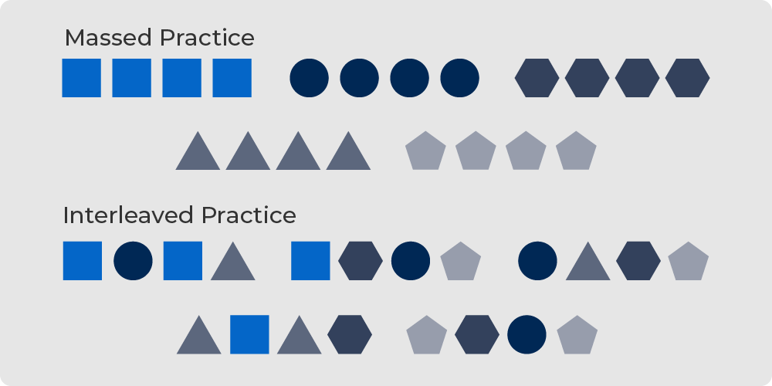
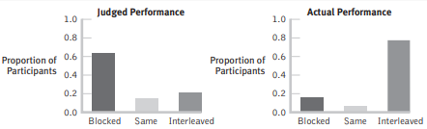
Interleaved practice
Building on distributed practice but mixing up the order across multiple topics.
Causes students to compare, contrast and discriminate.
https://bjorklab.psych.ucla.edu/wp-content/uploads/sites/13/2016/04/EBjork_RBjork_2011.pdf
Notes:
Ed
Based on Bjork and Bjork (2011).
Linked again to the goldilocks effect, this refers to making things difficult on yourself, but in a good way: Creating desirable difficulties to enhance learning.
https://bjorklab.psych.ucla.edu/wp-content/uploads/sites/13/2016/04/EBjork_RBjork_2011.pdf
Bjork and Bjork compared learning vs performance. Performance - what we observe during training. Learning - permanent change in knowledge.
They found that learning improves when conditions are varied including interleaving and using tests rather than presentations as study events.
Their example included children throwing bean bags at a target. Those who only practised at a set distance away were less successful than those that varied distance during practice sessions. This links to application of existing knowledge in more complex problems, drawing on what is known.

Slide 22
Interleaving example. Think about preparing for a driving test after two years’ learning. How might a driving instructor interleave the following two lessons per week for six weeks, to support memory?
Hill starts
Mirror-signal-manoeuvre
Reversing
Varying speeds
Emergency stops
Turning
Notes:
If you left it like the above over six weeks, learners will have forgotten hill starts by week 3. The chances of failing the test will be greater.
You might break down the components of each.
Then interleave at an appropriate time.
For example, interleaving, mirror signal manoeuvre when doing hill starts and reversing.
Or, recapping turning when reversing.

Slide 23
Interleaving - top tips
No single, correct way.
Effectiveness depends on the environment, material used as well as pupils’ ability and preferences.
Does become more effective if topics are related in some way.
Do not interleave too many topics.
Gaps between each interleaving session should be consistent and not too long.
Only begin once students have developed the fundamentals - master the basics first!
Notes:
Ed
Discuss -
Where do you plan for interleaving? Is it evident on your scheme of learning? How do you determine which topics to interleave and when? What is the rationale? What examples do we have?

Slide 24
Over to you…
Building Distributed Practice into Schemes of Learning
Think about your schemes of learning.
What might interleaving look like in Science?
        Use the dos and don’ts of interleaving to help you.
What Quality Assurance activities are used to ensure all topics are covered? Spaced at correct intervals?
Notes:
Ed
Give colleagues 5 minutes.
Circulate and check.
Ask colleagues to share any discussion points.

Slide 25
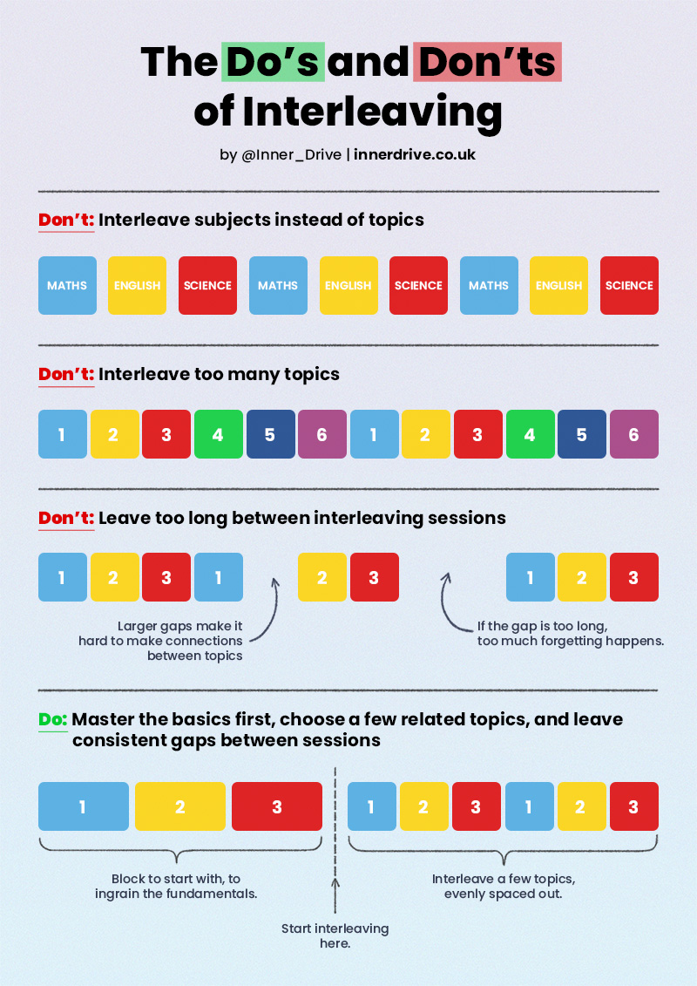
Interleaving - top tips
No single, correct way.
Effectiveness is dependent on the environment, material used as well as pupils’ ability and preferences.
Does become more effective if topics are related in some way.
Do not interleave too many topics.
Gaps between each interleaving session should be consistent and not too long.
Only begin once pupils have developed the fundamentals - master the basics first!
Notes:
Ed Where do you plan for interleaving? Is it evident on SoL? How do you determine which topics to interleave and when? What is the rationale? What examples do we have?

Slide 26
Further Reading
Walkthrus, Tom Sherrington, Oliver Caviglioni, 2020
Strengthening the Student Toolbox, John Dunlosky, 2013
Why Don’t Students Like School, Daniel T Willingham, 2009
Noise and the Art of Mirror Modelling, Roundlearning, January 2021 Noise and the Art of Mirror-Modelling | Round Learning
Cheat Codes to Intelligence, Joe Kirby, January 2014 Cheat codes to intelligence | Joe Kirby (joe-kirby.com)
Metacognition and Self-regulated Learning | EEF (educationendowmentfoundation.org.uk)
Making Things Hard for Yourself, Bjork and Bjork https://bjorklab.psych.ucla.edu/wp-content/uploads/sites/13/2016/04/EBjork_RBjork_2011.pdf
Teach Like a Champion 3.0 - Doug Lemov
How Learning Happens - Kerschner and Hendrick
Notes:
Linda

Slide 27
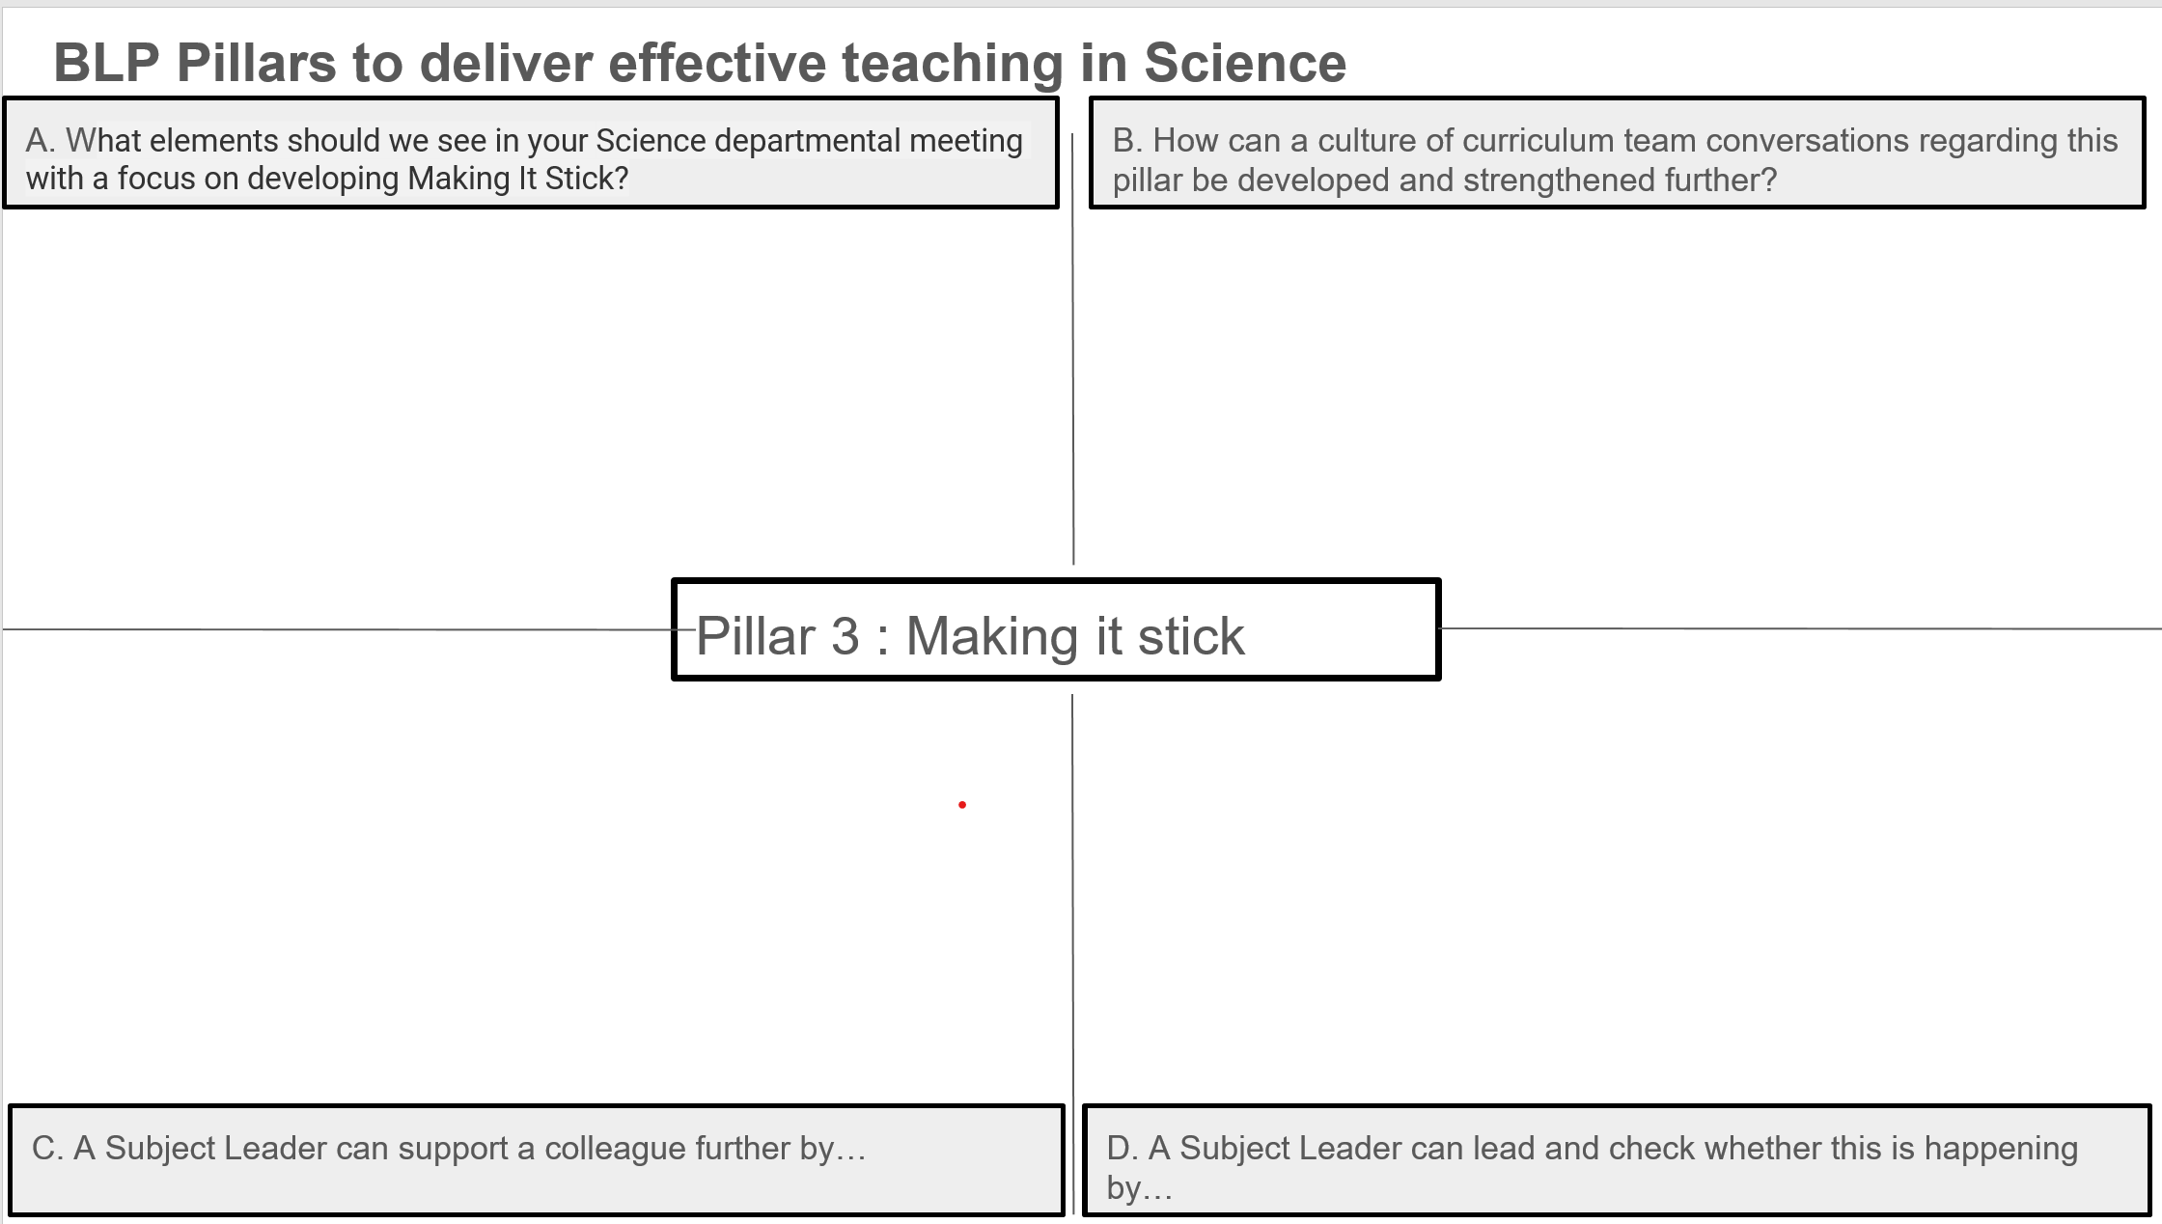
Subject Hub Reflection Tool
Notes:
Linda
The subject hub reflection tool is one document completed with all hub members contributing. This will be fed back to the Hub Executive Board to aid next steps.
We can also use this to create a reference library for best practice resources. Please list any resources that you have discussed in your sessions.
Also please share with us any research that you have found useful and we will add this to the resource bank.
Please upload this to the BLP website directly.

Slide 28

Notes:
Linda
Next steps and questions
Take questions.
Be prepared to feedback any key points to the hub executive team.
Is there anything you have seen that is not working? What have me missed? What is a stumbling block?

Slide 29

Notes:
ALL

