Slide 1
How to hold difficult conversations
Prepare thoroughly
Set clear targets – have a script ready if necessary, think about what you want to achieve from the meeting, set clear goals
Keep it fact based – make sure you have any data or evidence to hand
Time and place – hold the meeting somewhere private and free from distractions, set enough time aside so it’s not rushed
Be direct but compassionate
Empathy – acknowledge the conversation may be uncomfortable, ‘this is a professional conversation not a personal one’
Honesty – clearly state the issue, but do so respectfully
Use ‘I’ statements
Focus on your feelings and observations e.g. ‘I have noticed you have not been marking your books’ rather than
‘you never mark your books’
Listen actively
Give them the opportunity to express their thoughts or feelings
Try not to interrupt them so they know you value their perspective
Focus on solutions
Discuss possible options together, focusing on how to improve things moving forward

Slide 2
Reflection on Y11 outcomes
Biggest impact
Lowest impact
Emphasis on highest frequency questions
– first class maths
- common questions booklet
- using topic revision cards created themselves
Starter and exit questions at the end of lesson
Biggest impact intervention was with a booking system
after school
Form time sessions doing 5 a days – 20-30mins a day
(put in new forms for Y11 with different specialists)
Tier decisions (higher/foundation)
    70/30
    65/35
    60/40
    40/60
    50/50
    45/55
    35/65
Revision techniques – is it worthwhile time spent
Intervention classes, when don’t have the correct students
Teaching some higher topics that are inaccessible
Non specialists delivering maths intervention
Independent revision – more structure needed
Maths residential

Slide 3
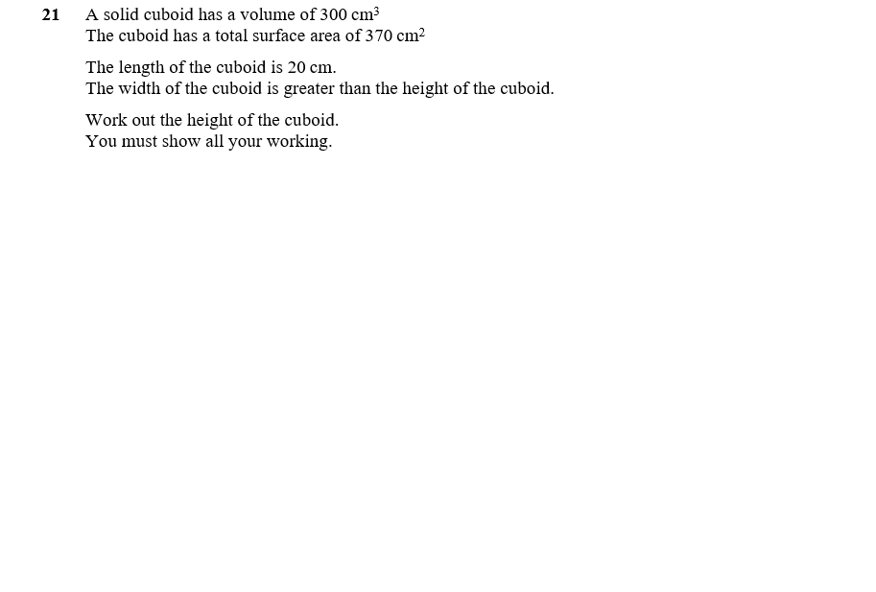

How to prepare Y11 for the more challenging questions
What skills are needed?
What topics are needed?
How would you start?
What are the steps involved?
Where are the marks allocated?

Slide 4
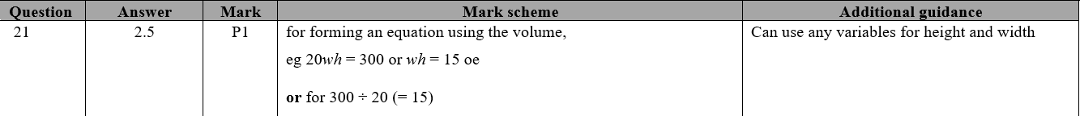
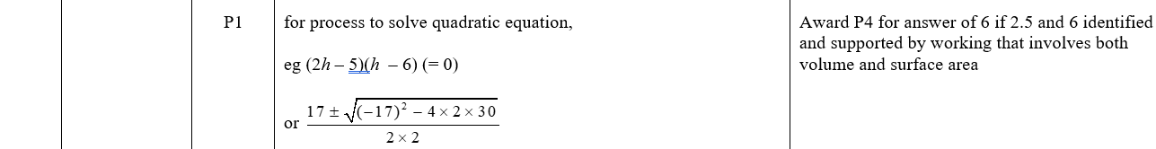
How to prepare Y11 for the more challenging questions
What skills are needed?
What topics are needed?
How would you start?
What are the steps involved?
Where are the marks allocated?

Slide 5
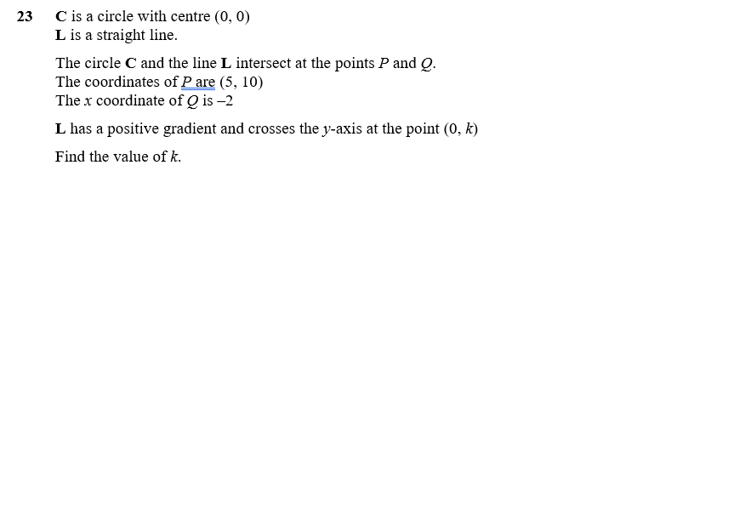

How to prepare Y11 for the more challenging questions
What skills are needed?
What topics are needed?
How would you start?
What are the steps involved?
Where are the marks allocated?

Slide 6

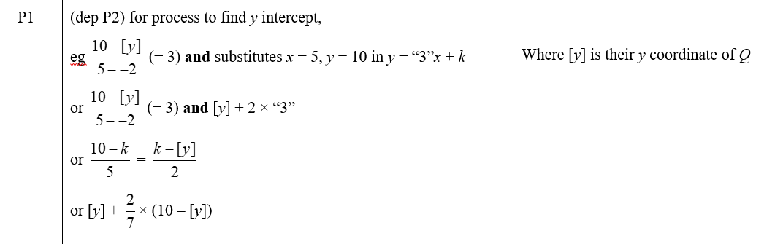
How to prepare Y11 for the more challenging questions
What skills are needed?
What topics are needed?
How would you start?
What are the steps involved?
Where are the marks allocated?

Slide 7
How to prepare Y11 for the more challenging questions
Target Higher-Level Topics
Focus on Key Topics: Ensure students master topics that appear frequently in the higher-tier papers
Deepen Conceptual Understanding
Develop problem-solving skills
Practice Multi-Step Problems: Introduce multi-step questions where students have to combine knowledge from different areas (e.g., algebra and geometry).
Teach Problem-Solving Strategies:
  Breaking down complex problems into smaller parts
  Identifying the key information and deciding which maths concepts apply
  Estimating answers to see if the solution is reasonable
Work Backwards: Give them the answer and challenge them to figure out the steps taken to arrive at it.
Expose students to challenging questions
Use Past Exam Papers
Use timed questions

Slide 8
Challenges facing subject leaders
Quality Assurance
Pressures from SLT
What QA techniques do you use?
How do you know all teachers are delivering the
essential knowledge?
How do you know what students are doing?
How do you QA data?
GCSE and A level outcomes
Underperformance in the team (difficult conversations)
Parental complaints
Timetabling, rooms, resources

Slide 9
Lessons Learned from GCSE 2023
Tier entry / exam board decisions
Key Topics
Timing of tier decisions – no later than Feb
Dots needed on recurring decimal proof!
Harsher mark schemes
Key Skills/Exam Strategy
Changes for current Y11 cohort
Training not to leave gaps
Trying to improve confidence
Start at the back of the exam in lead up to final exams
Improve literacy – helping students to understand the wording
and key points (goal free problems)
Communication mark, encouraging students to answer the
question
Marking more harshly – increasing grade boundaries
Ruler for frequency polygons – very harsh on mark scheme
Checking all topics are covered in mock exams
Staple challenge

