Slide 1
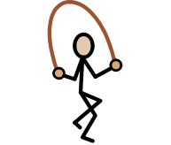
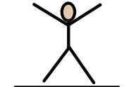
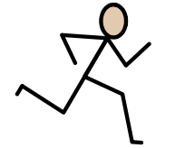
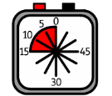
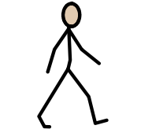
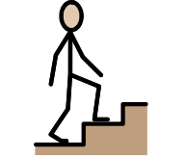

Star Jumps
Sprinting
Sprint on the spot for
___ seconds.
Rest for ___ seconds.
Do ___ star jumps.
Rest for ___ seconds.
___ minutes
___ minutes
Marching
Step ups
Step up and down a step ___ times.
Rest for ___ seconds.
March to and from the markers.
___ minutes
___ minutes

Slide 2
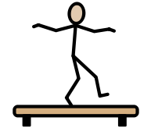




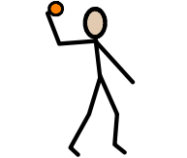
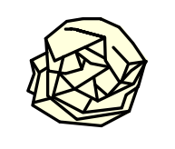
Star Draw
Bottle Roll
Draw the biggest star you can on the wall in chalk
Push and roll the bottle along the chalked path
___ minutes
___ minutes
Bucket Throw
Throw + Catch
Throw in a pair / against a wall.
Can you do a rally of ___.
Throw ___ paper balls into the bucket
___ minutes
___ minutes

Slide 3

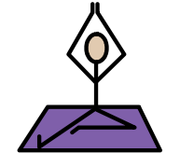





Yoga
Lift and Carry
Hold ___ yoga positions for ___ seconds each.
Carry a box between the markers. Put the box down at each marker.
___ minutes
___ minutes
Seated Blanket
Arm stretches
Wrap yourself in the weighted blanket.
Feel the weight on your shoulders and lap.
Stretch the resistance bands. Hold stretches for ___ seconds.
___ minutes
___ minutes

