Slide 1

Pillar 2: Quality of Instruction
June 2024
Notes:
Introduction and welcome

Slide 2

Our vision
To facilitate the gathering of best practice curriculum implementation strategies.
This is so that we help subject leaders and teachers to in turn help all children to know and remember important knowledge across subject curriculums.
To support subject leaders in evaluating the impact of their subject curriculums.
Notes:
A reminder:
Our work is to facilitate learning of and sharing of best generic and subject specific implementation practice across schools.
This is so that we can continue to learn from each other.
We are not saying that we are dictating what school leaders should do. We are facilitating access to research and helping each other to ‘keep our eyes on the ball’.
This work will happen in tandem with subject hubs’ work. The sessions we deliver will not replace subject hubs’ work. The session can take half of the hub’s time together, or more if you wish to do so.
We would like feedback from each session to inform our work going forward. Your ideas and insights are invaluable to us so we can continue to help thousands of young people across Bolton to benefit from an excellent education.

Slide 3
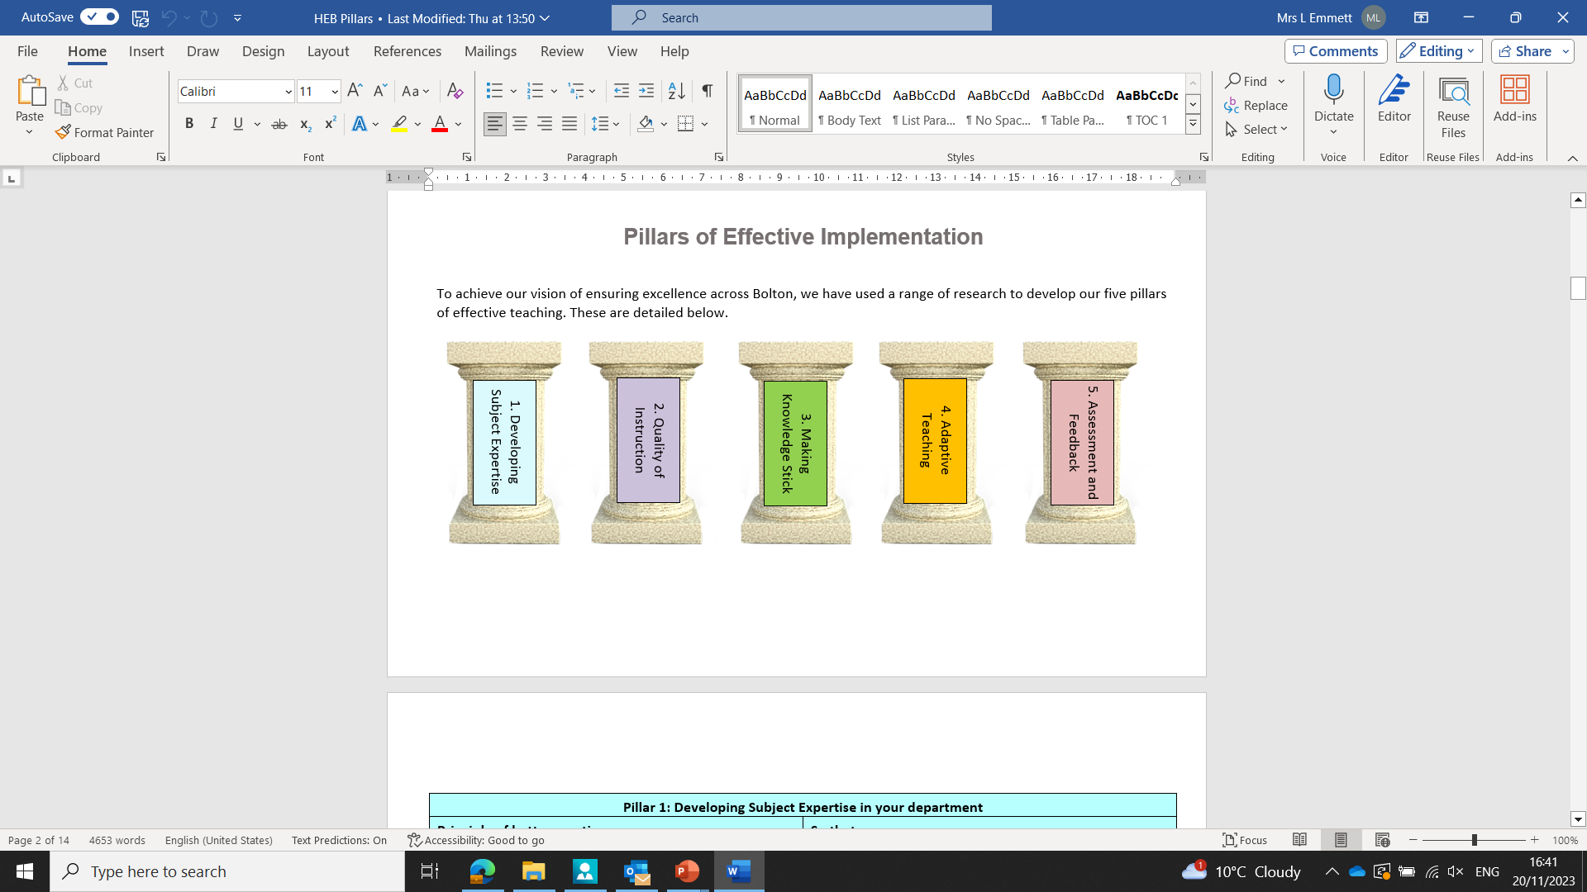
The Pillars of Effective Curriculum Implementation
Notes:
As discussed in the last session, we have used a range of research, including the work of the Bolton teaching and learning hub, feedback and work from the curriculum hub, best practice visits to high-performing trusts, to inform the five pillars of implementation detailed above.
They are developing subject expertise
Quality of instruction
Making knowledge stick
Adaptive teaching
Assessment and feedback.

Slide 4
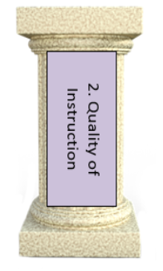
Teachers present new knowledge in small steps
Teachers give highly effective explanations.
Teachers model excellence and how to achieve it.
Notes:
In this session, we will be building on the previous session on subject expertise. This pillar focuses on how we can deliver the most important knowledge that we have identified in curriculum plans so that all pupils, especially disadvantaged pupils and those with SEND, can feel a sense of success in our subject. If we get it right for disadvantaged pupils and pupils with SEND, we get it right for everyone.
As ever, this pillar links to many of our pillars.
WE WILL FOLLOW THIS WITH MEMORY AND ADAPTIVE TEACHINGS, ASSESSMENT AND FEEDBACK

Slide 5

Discussion Point
What is ‘quality of instruction’?
Notes:
What does quality of instruction mean to you? And in your subject area?
Take feedback.
This might look different in different subjects, such as practical subjects where instruction may focus heavily on modelling, or in history where it might focus heavily on explanation and stories. In languages and science there will be abstract concepts to consider in our instruction.

Slide 6

Recall
Notes:
Recap
Remember that pupils are novices and teachers are experts.
Just like learning to drive, the learner is a novice until well after they have taken their test.
So we need to reflect on the quality of our instruction to help novice learners to understand important and sometimes abstract concepts.
Therefore, they need to benefit from highly effective explanations, an appropriate sequencing of component knowledge, small steps, modelling to help make abstract concepts more concrete. As we mentioned in the last session, the teacher is the expert in the room who helps the novice to know more and remember more. Expertise is particularly important with pupils who may struggle with their learning in a particular subject.

Slide 7
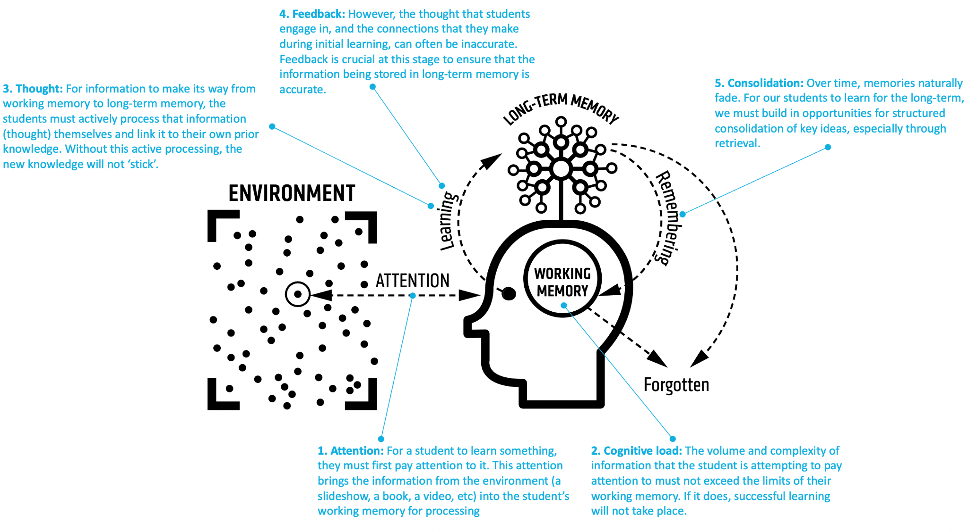
Notes:
Recap
We have seen this interpretation of Willingham’s model of memory.
We see that working memory has limited capacity and to help pupils to remember more, we need to help them to move knowledge to long-term memory.
Following curriculum design itself, the quality of our instruction is the next most important element.
This is because it touches on elements 1, 2 and 3 here namely - attention - (helping pupils to pay attention to the right things), cognitive load (ensuring that the amount and complexity of information does not exceed pupils’ working memory), and thought (giving pupils the opportunity to process information and link it to prior knowledge to make it sticky). This also links with pillar 3 (making knowledge stick).
We will look further at element 4 (feedback) and element 5 (consolidation) in pillars 3 (making knowledge stick), 4 (adaptive teaching), and 5 (assessment and feedback)

Slide 8

Seductive Teaching
Notes:
Introduction - you may want to give pre-reading on this article, or give time to read during the session
Beth Budden, in her article ‘Seductive Teaching’ outlines the frustration of when you have taught what you think is a memorable lesson but then you realise that pupils have taken away the wrong facts and knowledge. This is based on research from Harp and Meyer ‘How Seductive Details Do Their Damage’.
Much like the picture of this cake is luring your thoughts away from this session. We we are now looking at gooey chocolate, how tasty the Oreos may be, what is inside the cake…
Let’s remove the cake…

Slide 9
Selecting
Organising
Integrating
Notes:
Article summary:
There is a tug of war to get pupils to focus on the most important knowledge anyway due to them thinking elsewhere (last night’s TV show etc)
But we can help to focus on the most important facts. So first of all, we need to have identified the right knowledge in the right order within curriculum intent.
Harp and Meyer outline a three-way process that is helpful for pupils in constructing a coherent mental model of new information.
Selecting - the teacher pays full attention to the most important knowledge from the intended curriculum. The example in the research piece is that the main idea is that animals can be grouped into three different groups (carnivore, herbivore, omnivore) depending on their types of diet. Through everything that a learner hears or sees in the lesson, this is the information they need to select and focus on. There is effective explanation of key words and most important points
Organising - this is when teachers help pupils to build connections around the new information that is presented to them. For example, that there are different types of animals and that they have different teeth or can be predators or prey.
Integrating - building external connections between new information and and prior knowledge. For example, cats have pointy teeth, chase small animals and eat meat in the form of cat food.
It all goes back to curriculum intent. A more specific intent aid effective content delivery.

Slide 10
Distraction
Hypothesis
Disruption
Hypothesis
Diversion
Hypothesis
Notes:
However, going off on a tangent can increase cognitive load of some pupils. Can activate inappropriate schema.
This is set out in three categories.
Firstly, distraction hypothesis where a learner’s attention is seduced to something else. For example, the cake we saw on the previous slide. An example linked to the lesson on types and groups of animals, a picture is used of a cute kitten wearing a bell. The learner now focuses on the fluffy cute kitten, a kitten they may have at home, how much they want a kitten, the kitten’s bell and what noise the bell might make when the kitten is jumping around and playing. Or, during the explanation, the teacher may start talking about their own cat that is fussy and leaves its food. The pupils then want to focus on the fussy cat, what it looks like, the wasted food, what it eats instead. This is because it is much easier for them to think of this that categorising animals. We know that imagery is important in supporting learning, but we need to choose images carefully.
Secondly, disruption hypothesis is where pupils learn new information in isolation rather than with links between new information and previous knowledge. This hinders schema building. To build schema within animal categorisation, we can link the categories carnivore, herbivore and ominivores to types of teeth, predators and prey. However, in disruption hypothesis, teacher may play a ‘fun clip’ of animals before discussing teeth and prey, which disrupts the link in learning. We know that videos and stories can be helpful in reinforcing knowledge, but we need to ensure that any activities support the learning of the intended knowledge.
Thirdly, diversion hypothesis is where inappropriate activities activate inappropriate prior knowledge so a learner builds a mental model around the seductive (wrong) idea. For example, the use of an image of a shark attack to highlight knowledge of carnivores which means pupils focus on shark attacks rather than the important knowledge. We have previously discussed an example of this in a curriculum intent training session where a teacher had planned a lesson around women in Tudor times when one of the tasks is for pupils to act out a role play with a focus on appropriate props and acting skills rather than subject content.
There is also a range of research around split attention (Sweller and Ayres) that further outlines challenges that teachers accidentally introduce resources that distracts pupils from their learning, especially pupils with SEND. An example of this is when a teacher asks pupils to focus on two things at once, such as a text and picture with information in a different format. Other examples are a busy powerpoint slide, lack of alignment on a slide which may distract a pupil with ASD, low-level classroom disruption. This has a detrimental impact on cognitive load. Ways of overcoming this include integrated diagrams linked explicitly to intended learning; use of simple and clear worked examples in the same format as pupils have in front of them.
Harp and Mayer suggest, ‘one way to discourage inappropriate schema activation is to delay the introduction of seductive information until after the reader has processed the important material. Another way is simply not to introduce seductive details at all.’ and ‘to find a way to present knowledge in lessons in a way that is interesting, without resorting to the use of entertaining but irrelevant details.’ i.e. we need pupils to remember the right things from the lesson.

Slide 11
Technique 21 Take The Steps
Identify and sequence small steps.
Help pupils to understand the steps
Build steps with time for practice
Ask questions
Give exemplars.
Reduce guidance.
Notes:
Teach Like a Champion 3.0 Technique 21
There is a further range of research available to us to support our work. Today we will point you in the direction of the specific chapters and articles that we have found helpful. However, s subject specialists, you will also be aware of a range of reading that you might be able to share across the hubs or your own subject hub. Don’t make assumptions on the level of reading ability of the group.
In Teach Like A Champion 3.0 Take The Steps (Technique 21) is an interesting read that we will explore today. Within Teach Like a Champion, there is also a range of techniques within focus area 5 ‘lesson structures’ such as Board=Paper (Technique 22) that are interesting reads but we will not have time to go through today.
Technique 21 builds on the novice vs expert theory. It asks us to put ourselves in the shoes of the novice learner so that there are no assumptions around pupils’ knowledge.
Identify the most important knowledge, break it into small steps and sequence this appropriately.
Use annotated models or worked examples to help pupils to understand the steps. As mentioned earlier, be careful of split attention here. Ensure the worked examples or models on the board match anything that the pupils have in front of them. If using images, make sure that they appropriately represent knowledge. In TLAC, Lemov exemplifies this through the diagram of an animal cell. The cell is circular, mitochondria are the same size. In reality, cells can vary hugely in their shape, and mitochondria are not the same shape. This introduces misconceptions.
Build the steps one at a time. Allow students to practice after each step (this links to Rosenshine’s principles of instruction) Pupils can then consolidate which reduces load on working memory.
After each step ask a high quantity of process and factual questions to check understanding before moving on. They can be conceptual/factual (what are we doing?) or procedural (how do we do it?) or both. Cold-calling helps with this so that all pupils are ‘on the hook’ for their thinking.
If doing something complex, use worked examples. This can be helpful for extended essays where you want to exemplify abstract concepts such as ‘use sensory language’. So you can break the worked example into well sequenced component parts and talk pupils through this. Again, be careful of split attention. Consider use of visualiser to model your thinking, with pupils working on a sheet that aligns to what is under the visualiser.
Reduce guidance as pupils become more confident (Sweller’s guidance fading effect)
Potential Pitfalls: Pupils lose focus during ‘teacher talk’. Ensure you prime pupils for Cold Call after each step to ensure they remain attentive and are thinking hard
Be wary of split attention
Potential Pitfalls: Pupils lose focus during ‘teacher talk’. Ensure you prime pupils for Cold Call after each step to ensure they remain attentive and are thinking hard.

Slide 12
Rosenshine’s 10 Principles of effective instruction
Review previous learning
Present new material in small steps
Ask a large number of questions
Provide models
Guide student practice
Check for student understanding
Attain a high success rate
Scaffold
Monitor independent practice
Engage students in weekly and monthly review
Notes:
Here are Rosenshine’s 10 principles.
As we know, in writing Teach like a Champion, Doug Lemov called a lot on Barak Rosenshine’s principles of effective instruction. Rosenshine’s research is also used by Kirschner, Hendrick and Heal in their book ‘How Teaching Happens’.
The elements of Rosenshine’s principles that we will focus on today are in violet bold on the board.
Clearly, the other elements such as review prior learning, asking questions, checking for understanding and scaffolding are important, but they fit into pillars that we will explore in later sessions.

Slide 13
The Quality of Instruction Principles
Provide Highly Effective Explanations
Present new material in small steps
Provide models
Guide student practice
Monitor independent practice
Notes:
So here is a summary of the focus areas.
In addition to this is the provision of highly effective explanations which ties in with ‘helping pupils to understand the small steps’ outlined in Teach Like a Champion. This also ties in with avoiding seductive teaching that accidentally leads to pupils learning the wrong knowledge.

Slide 14
Highly Effective Explanations
Be mindful of teachers’ subject knowledge.
Do not assume prior knowledge.
Make abstract concepts more concrete.
Break concepts into smaller components where needed.
Link to relevant concepts.
Use ‘hinterland’ knowledge.**
Notes:
Here, we firstly need to think about teachers’ subject knowledge if they are ECTs or non-specialists. You also need to be aware of any barriers to vocabulary that this presents - so that teachers use vocabulary that pupils can understand when introducing tricky concepts.
Do not assume prior knowledge, including cultural capital. In addition to being novice learners, pupils we teach may have unexpected gaps in knowledge.
Hub Leadership Team - try and get the hub lead to think of an example of a an assumed knowledge or cultural capital deficit that has happened before.
Think about whether the knowledge you are delivering is abstract for pupils. If this is the case, think of strategies to make this knowledge more concrete e.g. when teaching the weather cycle, use a video or diagram if pupils have never visited the beach. For fully abstract concepts such as adjectival agreement in languages, recalling prior knowledge of masculine and feminine nouns is important before teaching about he spelling of an adjective matching the gender of the noun. You might want to break knowledge into smaller components, such as securing masculine nouns and adjective agreement first. When teaching acapela in music, you could use relevant concepts to help pupils to understand, such as a link to the film ‘Pitch Perfect’. Stories and sources help pupils to have a greater insight into life in medieval times. **Be careful not to fall into the trap of seductive details here!
Give think time
Discuss feedback!

Slide 15
Present New Material in Small Steps
Decide the most important knowledge
Decide the order
Take each step one by one
Practice and master new material after each step.
Give think time where needed.
Notes:
Decide what the most important knowledge is - are ensure that the small steps really are small steps.
How will you introduce each step and in what order
Working memory is overloaded by too much material at once. Take each step one by one. Only present small amounts of new material
How will you check each small step is secure? Don’t move on before mastering the small step - practice the new material after each step. This makes the implicit explicit for pupils before working memory is overloaded.
Give think time

Slide 16
Provide Models and Worked Examples
Identify abstract concepts
Annotated examples
Talk through thinking - what and why
Use demonstrations, pictures, diagrams.
Notes:
This helps pupils to learn, and also to solve problems, faster.
Be aware of abstract concepts.
Pictures, diagrams
Share annotated exemplars for more complex content that can’t easily be broken down into smaller steps, e.g writing an essay or painting a watercolour.
Use visualiser to talk through thinking and annotations
Demonstrations. Talk through Caroline’s potato example.
Metacognition. Include not just talking through what you are doing, but also why you are doing it.
Explain any technical terms clearly so that pupils can understand them.
Be careful of cognitive overload or split attention.
Avoid digressing or accidentally incorporating seductive details.
Be careful of unannotated rubrics and work samples as these will be obvious for experts, but not for novices. For example an essay that is annotated with ‘provides phrases telling details using sensory language to vividly convey experiences and events’ will be clear to an expert in English but not to a novice. They will not necessarily have the knowledge of sensory language or vivid details needed to pick out these details.

Slide 17
Guide Student Practice
Model example (I Do)
Allow pupils to practice (We Do)
Question and check.
Reduce guidance as learning happens.
Notes:
Guided practice requires cognitive effort to process information. This means that pupils will better learn and retain information.
I do we do approach helps.
So, model example,
Have a go at one together including setting it out
Then allow pupils to practice alone with proper guidance from you.
Ask conceptual (what are we doing?) and procedural (how do we do it) questions, going back and forth between the two question types where possible.
Consider the use of cold-calling, mini whiteboards to identify mistakes and ensure a high success rate.
Be clear about what needs to be written down and how.
Consider the use of a visualiser to model where needed or appropriate.
Guidance minimises cognitive load and can be faded as learning happens. Continue guided practice until pupils have automated their new learning.

Slide 18
Monitor Independent Practice
‘You do’
Different contexts.
Check, check, check!
Reshape where needed.
Recap.
Notes:
Monitoring independent practie
‘You do’
Pupils have a go and apply new learning. This helps the transfer of knowledge from short-term memory to long-term memory.
Allowing pupils to continue their practice helps them to overlearn new knowledge to automaticity. This makes knowledge instantaneously usable in new and different scenarios,
So, don’t use too much of the same thing.
Think about how you can add challenge using the delivered knowledge by changing context or adding multiple steps.
Links with assessment such as pose and position, live marking. Optimum time for contacts is 30 seconds or less.
Information from your checks can be used to inform explicit instruction one-to-one or in small groups if needed.
Once you are fairly certain that pupils have mastered new learning, let pupils do new tasks or solve problems for themselves. At this point, provide assistance only when necessary.
Touching briefly on memory, ensure weekly and monthly reviews so that pupils do not forget previously learned content.

Slide 19
Highly Effective Explanations
New Material in Small Steps
Models and Worked Examples
Guide Student Practice
Monitor Independent Practice
Pillars 3, 4 and 5 - memory, adaptive teaching, assessment and feedback
Notes:
As you can seem, the 5 elements that we have gone through today are knitted together.
They also link with to the other pillars and it is difficult to go through the session without touching on elements of memory, the need to adapt teaching or to do assessment effectively.
However, although we have briefly mentioned some of these elements, we will go through them fully in our sessions later this year onwards.
However, we have provided links to reading within the PowerPoint so you can undertake further research if you would like.
We will continue to summarise research and provide articles due to request from your feedback.

Slide 20
Writing an effective input in our own subject
What is the most important knowledge that needs to be presented?
What are the small steps?
How will you model this?
How would you sequence this knowledge?
What are you emphasising to avoid cognitive overload?
How will you guide and monitor practice?
Notes:
Hub leadership team - prior to the session, choose a tricky or abstract topic that is appropriate for discussion around effective explanations and sequencing. Liaise with the subject hub lead in doing this.
With the hub lead, talk hub members through the planning of an effective input in this topic.
Use the prompts on the board to help.
Tell subject leaders that this is an interesting thing to do in departments (e.g. choose a topic and get the team to go through the same process and deliberately practice it). Advise hub delegates to use this as a tool in their own schools.
Allow 10 minutes for discussion. Perhaps have a think about your own subject. Circulate to capture any interesting discussion points.
Ask people to be prepared to feed back.

Slide 21
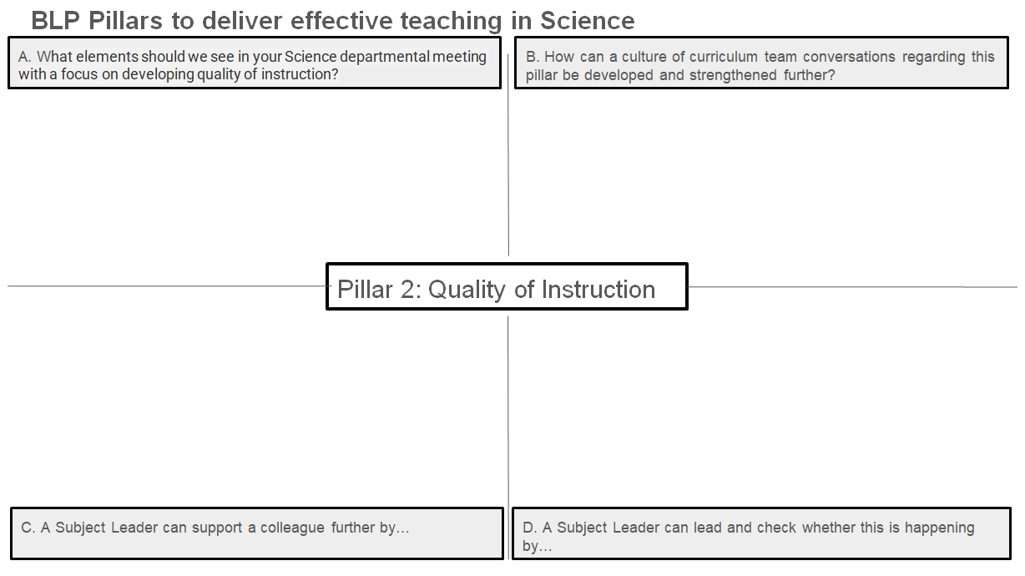
Subject Hub Reflection Tool
Notes:
The subject hub reflection tool is one document completed with all hub members contributing. This will be fed back to the Hub Executive Board to aid next steps.
We can also use this to create a reference library for best practice resources. Please list any resources that you have discussed in your sessions.
Also please share with us any research that you have found useful and we will add this to the resource bank.

Slide 22
Further Reading
Rosenshine’s Principles of Instruction https://www.teachertoolkit.co.uk/wp-content/uploads/2018/10/Principles-of-Insruction-Rosenshine.pdf
Seductive Teaching Thoughts on how ‘seduction’ might damage learning … – BethBudden@school (wordpress.com)
Split Attention The Split Attention Effect: A quick guide | InnerDrive
Split Attention and Cognitive Load What contributes to the split-attention effect? The role of text segmentation, picture labelling, and spatial proximity - ScienceDirect
Teach Like a Champion 3.0 - Doug Lemov
How Teaching Happens - Kerschner, Hendrick and Heal, chapter 12
How Learning Happens - Kerschner and Hendrick
Visible Learning for Teachers - John Hattie, chapter 6

Slide 23

Notes:
Next steps and questions
Take questions.
Be prepared to feedback any key points to the hub executive team.
Is there anything you have seen that is not working? What have me missed? What is a stumbling block?

Slide 24

Notes:
ALL

