Slide 1
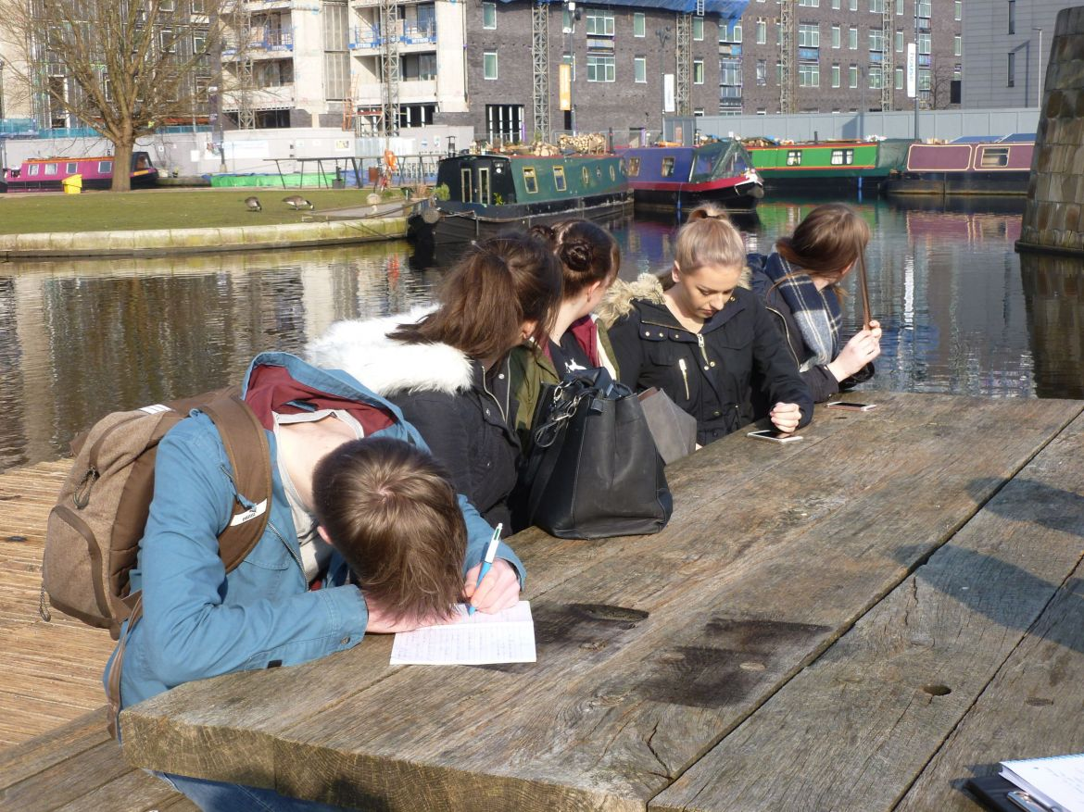
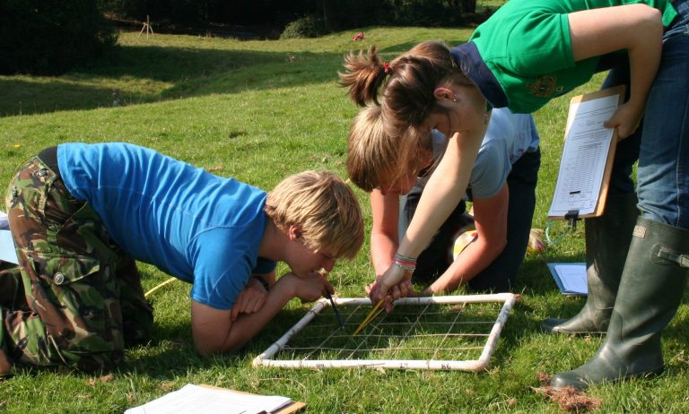
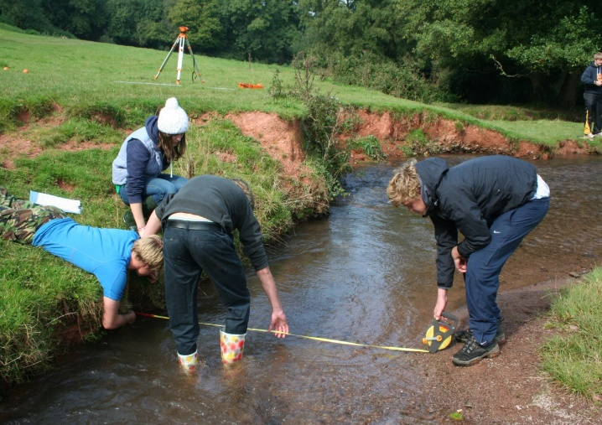
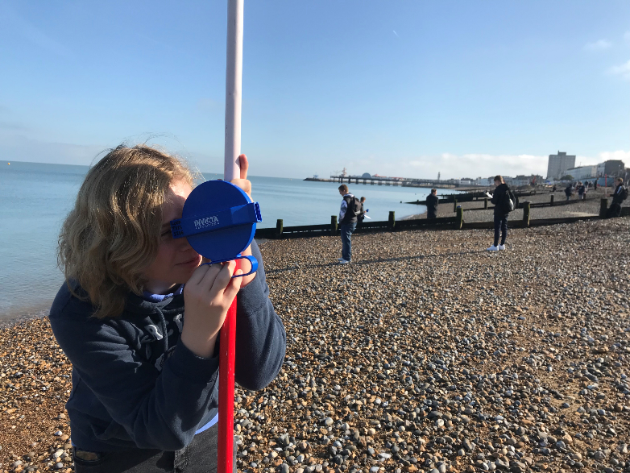
Fieldwork opportunities in Geography
Keith Bartlett
Ke

Slide 2
Content of the session
^{Ofqual Report}
^{Importance of fieldwork}
^{GA Comments}
^{Fieldwork enquiry sequence}
^{Fieldwork opportunities}
^{Enquiry opportunities}
Please ask as many questions as you like throughout the session.

Slide 3

Tapas

Slide 4
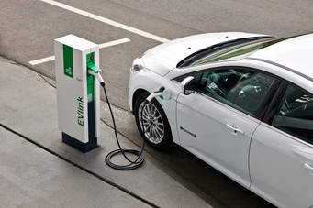
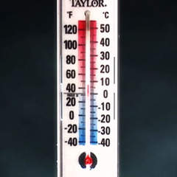

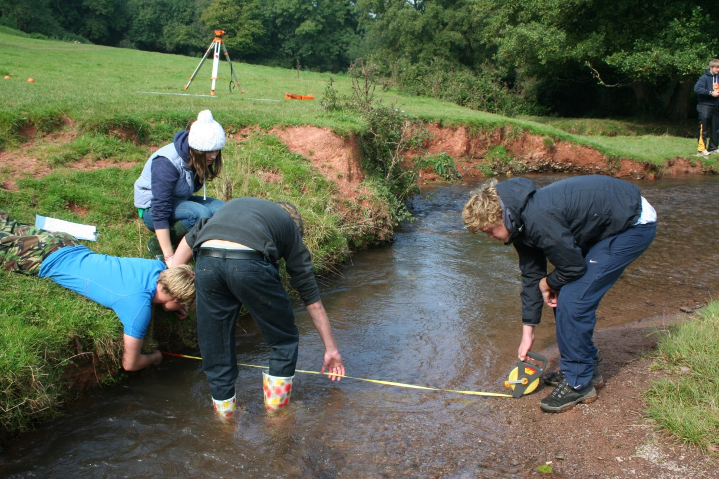
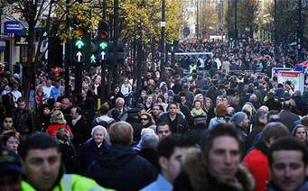
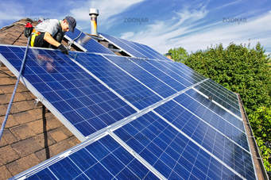
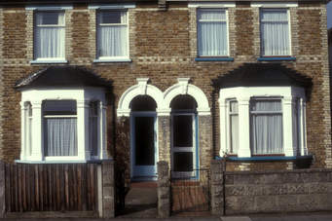
Fieldwork Tapas

Slide 5
What was your first geography fieldwork experience?
At what stage of your education did this take place?
How was it carried out?
Why do you remember it?

Slide 6
Fieldwork confidence level
Where are you on this scale?
Totally Totally
Terrified Confident
0 % | 10 | 20 | 30 | 40 | 50 | 60 | 70 | 80 | 90 | 100 %
What are the constraints on your ability to develop fieldwork opportunities?

Slide 7


Slide 8

Other Ofsted observations
In most schools, leaders had done very little curriculum thinking about fieldwork.
They had not decided what they wanted to achieve and therefore could not plan for how best to achieve it.
Fieldwork was rarely taught as part of the wider geography curriculum and opportunities to carry out fieldwork either on the school site or at home were rarely taken.

Slide 9
Other Ofsted observations
In a minority of schools, there was a clear curriculum for fieldwork.
Leaders approached fieldwork alongside other aspects of procedural knowledge, so that pupils had frequent opportunities to collect and present data and to analyse it.
These opportunities were not limited to occasions when pupils were taken out of the school site.

Slide 10
Other Ofsted observations
In schools where fieldwork was done well, it was built into the curriculum.
Pupils were taught in class how fieldwork was done and were then given regular opportunities to carry out elements of it.
This did not always involve going out of school.
Pupils sometimes collected data from within their classroom or school. On other occasions pupils were given fieldwork data to focus on another aspect of the fieldwork process rather than data collection.

Slide 11
Summary of research relevant to planning fieldwork
Through observing, collect data for themselves, analysing it and describing their findings, pupils learn how to notice and record the environment around them.
One benefit of this is that they become immersed in relevant thinking, and so key geographical knowledge sticks in their memory.
Fieldwork also provides opportunities to draw together different forms of geographical knowledge.
To be able to explain what they have observed, pupils must draw on their knowledge of human and physical processes, as well as knowledge about location.

Slide 12
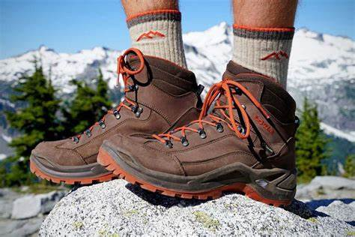
‘Geography should be learned through the soles of your boots’

Slide 13
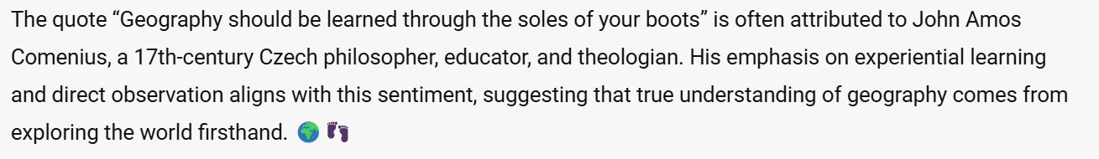
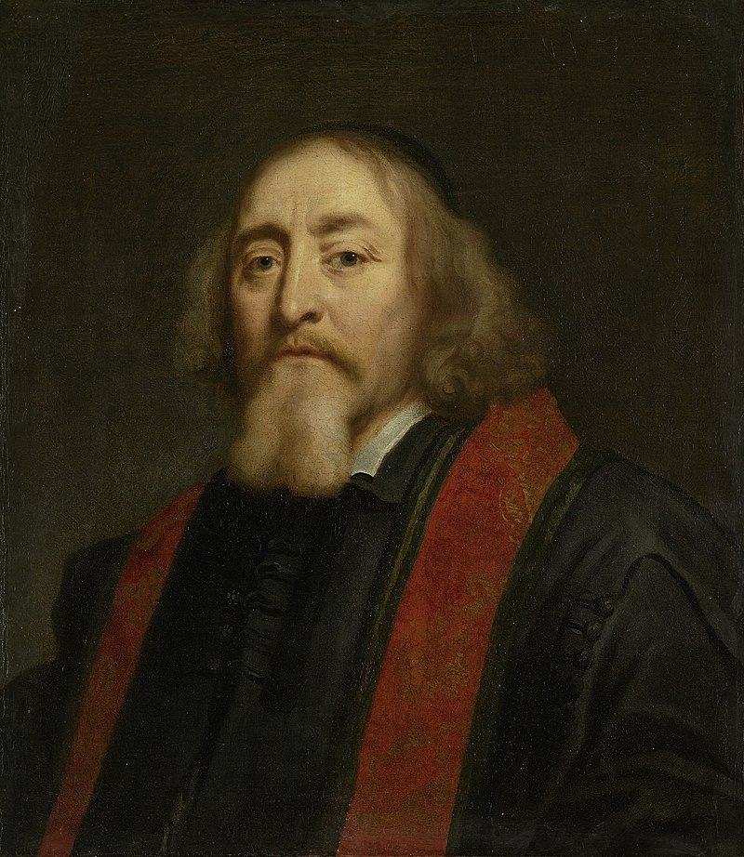

Slide 14

Review and refine
When you have created a first draft of your curriculum, review it with these ten questions and adapt:
Have we remained true to our vision set out in the intent statement? Do we develop students’ cultural capital and include diverse voices?
Have we included a range of places studied at different scales from local to global?
Will students see this curriculum as relevant and interesting and want to learn geography?
Is there coherence between our curriculum goals, pedagogy and the assessments we propose?
Does the curriculum develop in a logical sequence and provide a clear journey to progressively develop conceptual understanding and skills?
Is there breadth of understanding? Is this at the expense of depth?
Have we built in opportunities to revisit, deepen and consolidate subject understanding?
Have we included rich fieldwork experiences that are connected to the rest of the curriculum?
Have we built in a secure understanding of maps, GIS, and geographical enquiry?
Does the curriculum address social disadvantage and ensure all students will have access to the intended knowledge and skills?
From intent to implementation: curriculum making

Slide 15


Lead Geography writer for DfE
Geographical fieldwork is widely recognised as an essential component of the practice of geography.
It involves learners developing and applying a wide range of skills and methods outside the classroom.
It provides learners with practice at working like a geographer.
Fieldwork can provide enjoyment and inspiration for young people through memorable school experiences.
Fieldwork can provide opportunities for developing practical group work.
Fieldwork can provide opportunities to acquire knowledge of the world through direct observation.

Slide 16
Some principles of fieldwork
Fieldwork and enquiry
Enquiry lies at the heart of fieldwork
There are other approaches e.g. ‘look-see’ – but investigation lies at the heart of fieldwork
Investigate and understand relationships within and between physical and human environments
The importance of student engagement
… being involved in the whole enquiry process
… in integrating fieldwork into wider ethos of enquiry

Slide 17

If I asked you to outline the enquiry sequence as stated in the GCSE specification, could you do it?

Slide 18
Fieldwork enquiry process
Identifying suitable question for geographical enquiry
Selecting, measuring and recording data appropriate to the chosen enquiry
Selecting appropriate ways of processing and presenting fieldwork data
Describing, analysing and explaining fieldwork data
Reaching conclusions
Evaluating the geographical enquiry
18
.
Notes:
The enquiry route is well known - each element can be assessed. Draw attention to the different stages and aspects to be considered. This is a summary of the spec requirements, but emphasise that the scale of enquiry is much smaller than existing controlled assessments eg one or two methods of data collection, 2 or 3 methods of data presentation.
1. Suitable question for geographical enquiry
The factors that need to be considered when selecting suitable questions for their enquiries.
The geography underpinning the enquiries.
Availability of primary and secondary evidence.
An appreciation of the potential risks of both human and physical fieldwork and how these risks might be reduced.
2. Selecting, measuring and recording data appropriate to the chosen enquiries
Difference between primary and secondary data.
How to identify appropriate data required for their geographical enquiries.
An understanding of different sampling methods.
How to describe their data collection methods.
How to justify the data collection methods selected.
3. Selecting appropriate ways of processing and presenting fieldwork data
Appreciate that a range of visual, graphical and cartographic methods is available.
Identify and describe the chosen presentation methods used in their enquiries.
Explain why the presentation methods were chosen.
4. Describe, analyse and explain fieldwork data
Describe results of fieldwork data.
Analyse results of fieldwork data.
Explain results of fieldwork data.
Establish links between data sets.
Use of appropriate statistical techniques.
Identify anomalies in fieldwork data.
5. Reaching conclusions How to draw evidenced conclusions in relation to original aims of their enquiries.
6. Evaluation of geographical enquiry Identify problems of data collection methods.
Identify limitations of data collected.
Suggest other data that might be useful.
Consider the extent to which conclusions were reliable.
Some, not necessarily all, of these steps in the enquiry process will be assessed each year. Therefore candidates must not ‘skip’ any of them. This is exactly what candidates do now for controlled assessment anyway. However, within each part of the process there are features to consider. Many of the features that will be covered on the next six slides can be covered over time with candidates, even starting in year 7, they do not necessarily have to be taught en bloc as part of the GCSE.

Slide 19
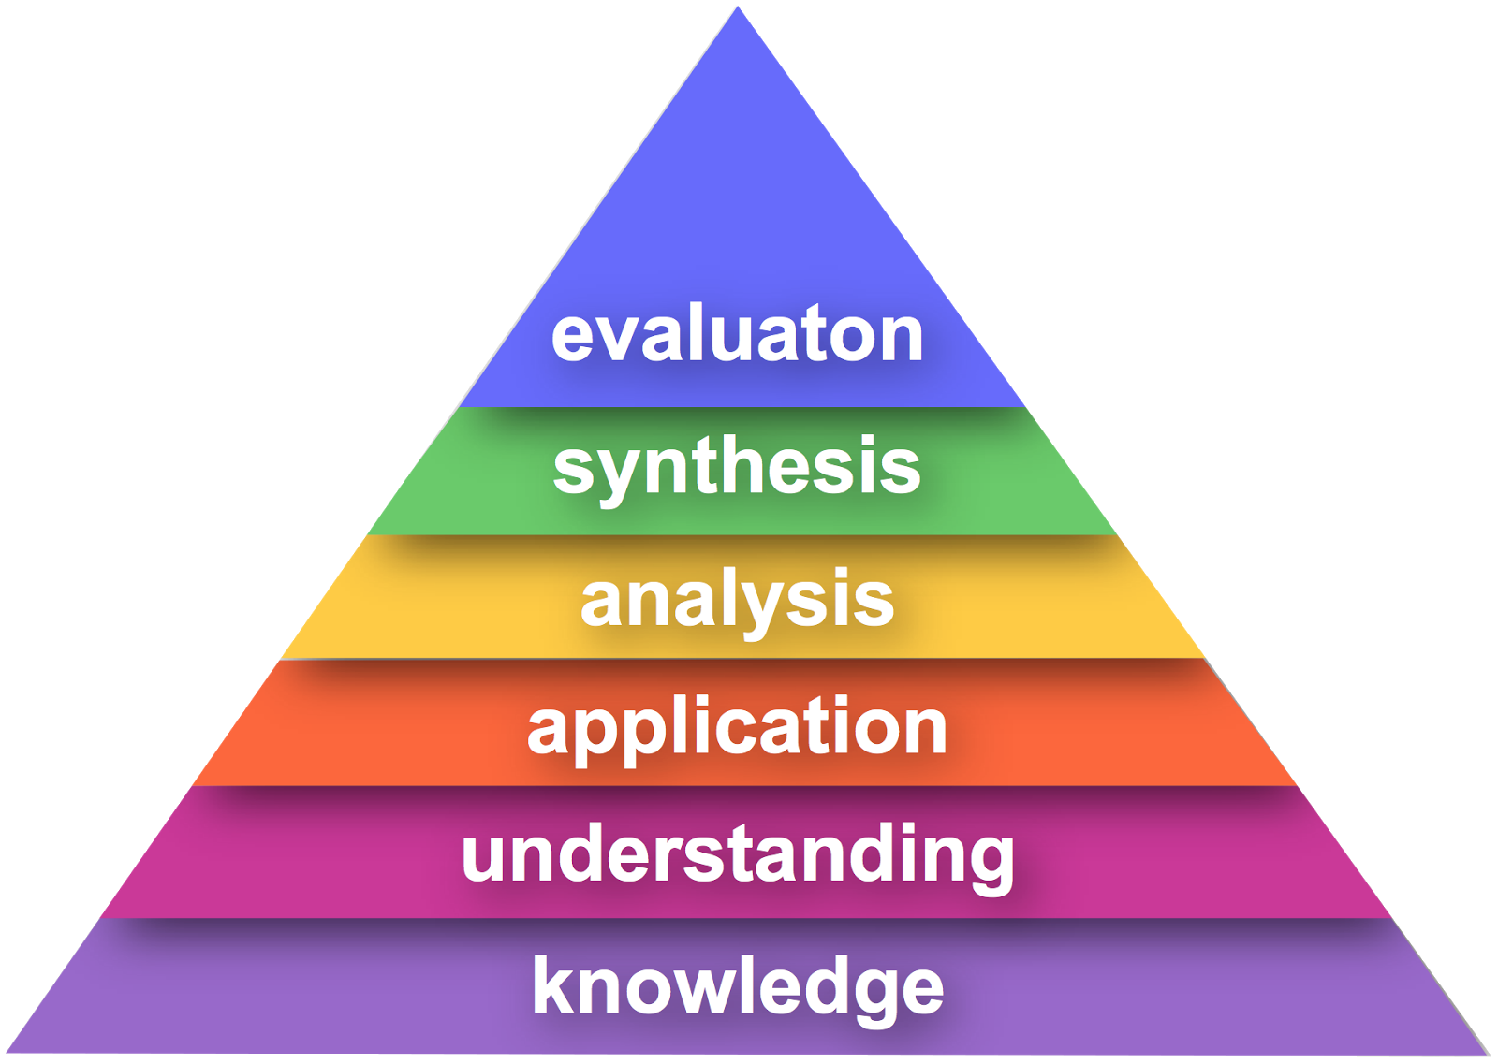
Hierarchy of educational objectives

Slide 20
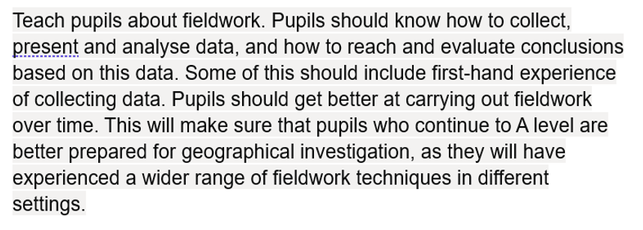

Slide 21
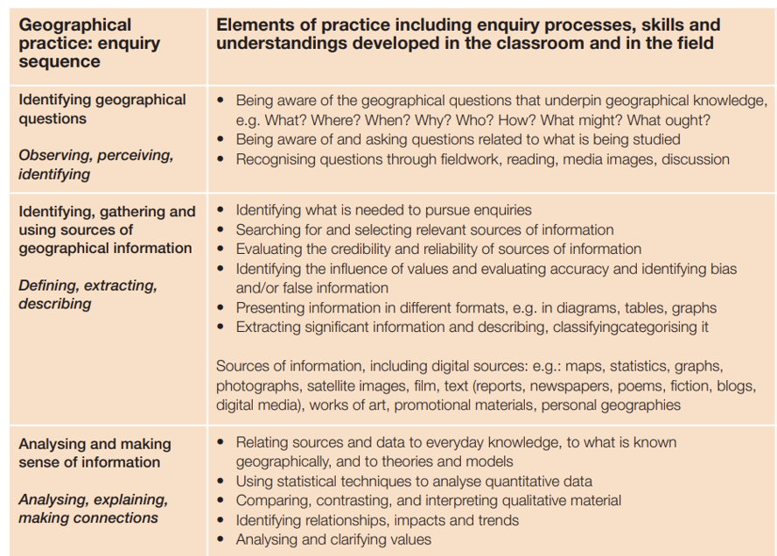

Slide 22
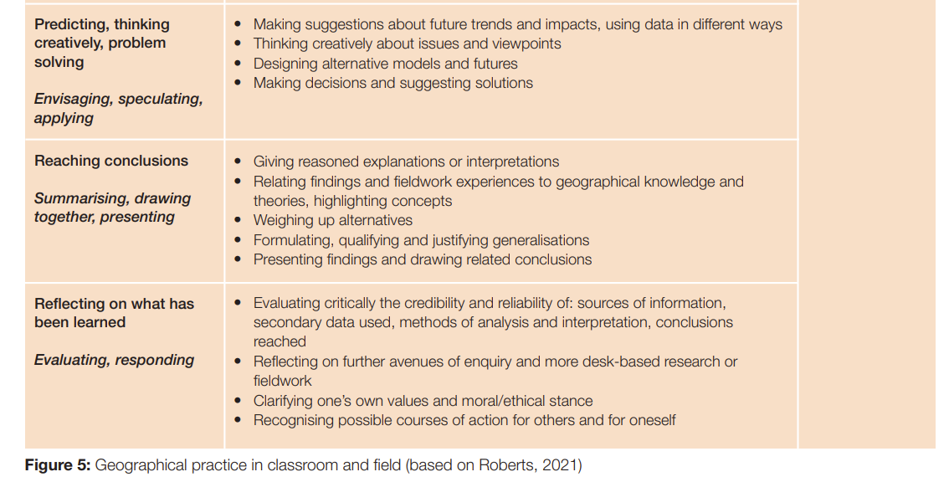

Slide 23
Note the language of geographical enquiry.
Identify key words used.
Think about how you can build this into your geography curriculum from Year 7.

Slide 24
Strand 1. Suitable question(s) for geographical enquiry
Question, key idea, aim or hypothesis? Gives a focus to any enquiry.
Factors to be considered – relevance, topicality, practicalities, accessibility.
Theory/concept/process – what is the geography underpinning this enquiry? Is there an established theory? Is it current?
Primary and secondary data – appropriate sources.
Locations – safety, accessibility, appropriateness, permissions.
Risks – identification of potential risks and strategies to reduce risk.

Slide 25
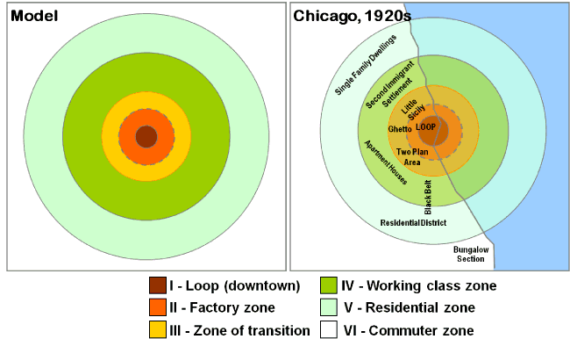
Burgess Model

Slide 26
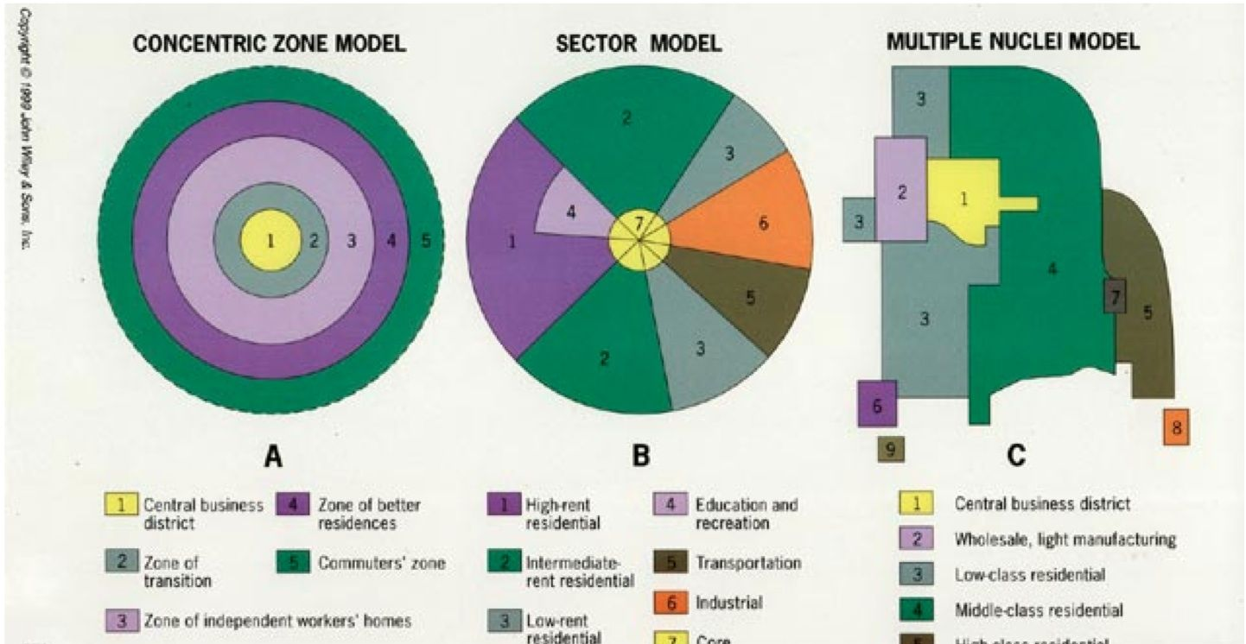

Slide 27
Self-catering, caravan and camping – close to seafront and tourist facilities yet on edge of settlement where greater space and cheaper land
Residential areas - located in a ring shaped sector, furthest away from seafront
Resort model
Guest Houses and small Hotels – located next to the RBD and CBD so that tourists are close to all facilities
BEACH
SEA
RBD
CBD
RBD
Industrial area - centred around lines of communication (road / rail) – likely to be newer industry on edge of settlement
Recreational Business District - encompasses all tourist based facilities and is located along the seafront
Self-catering

Slide 28
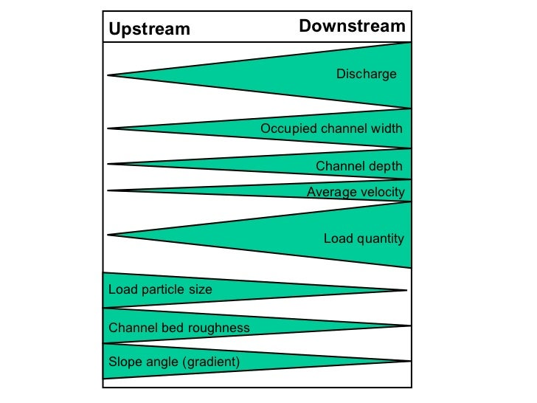
Bradshaw’s Model

Slide 29
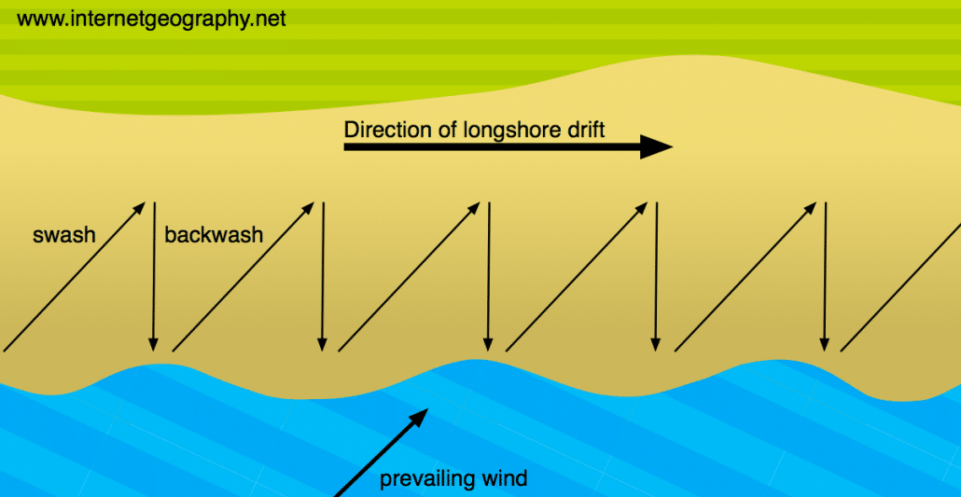

Slide 30
GROYNE

Slide 31
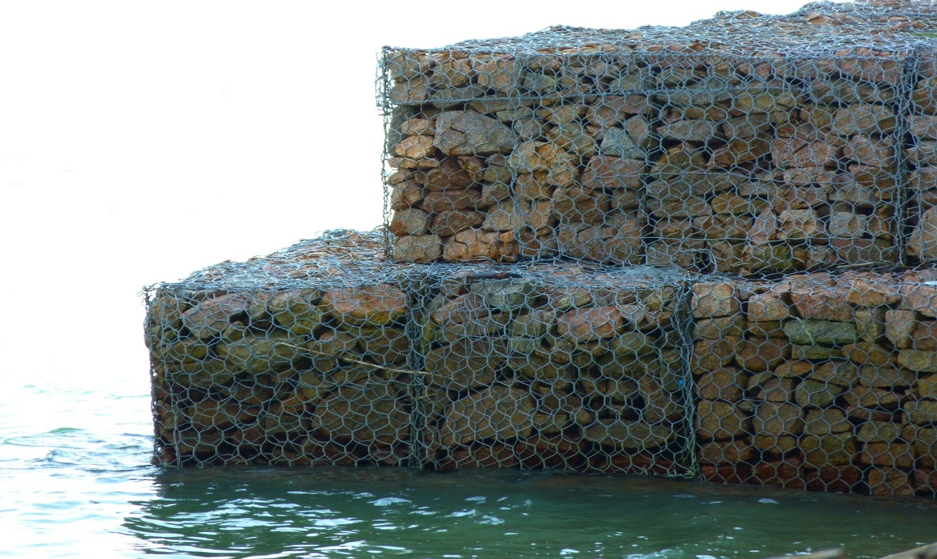
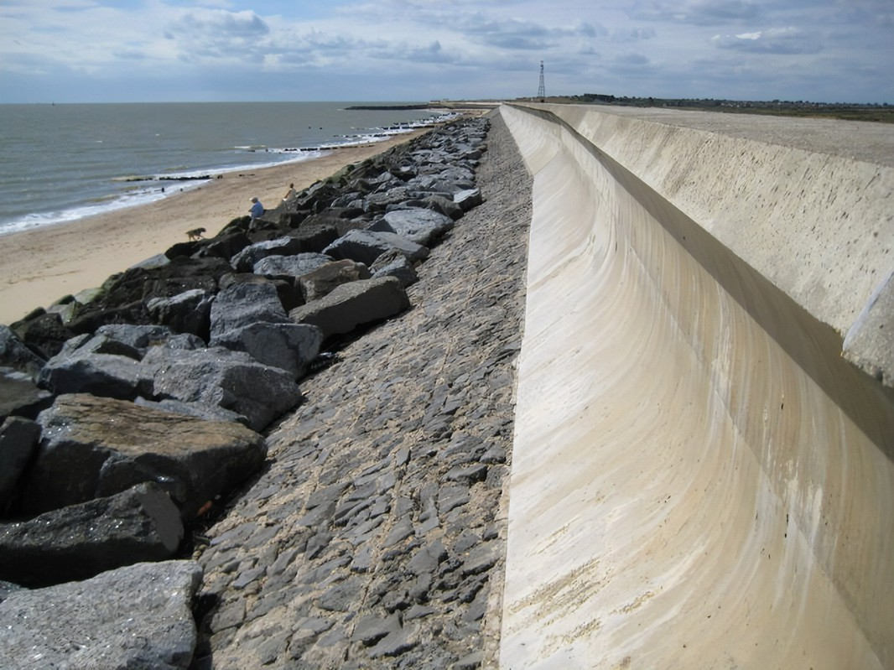
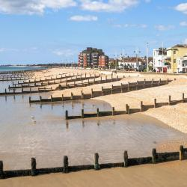
Hard engineering strategies
Gabions
Rock armour
Sea Walls
Groynes

Slide 32
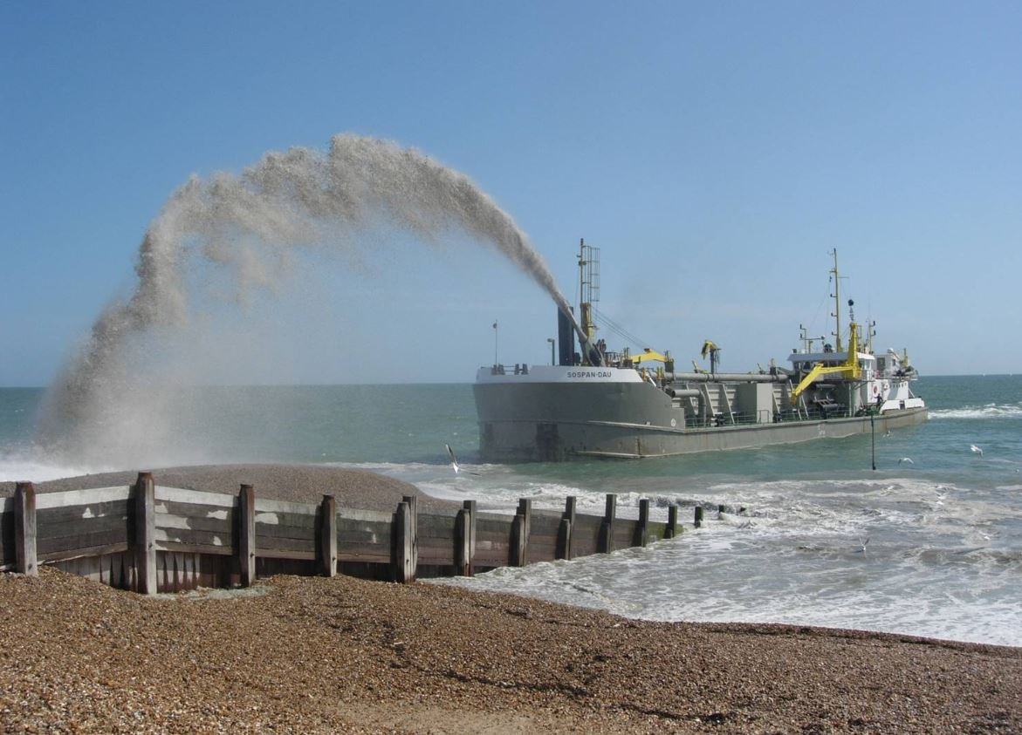
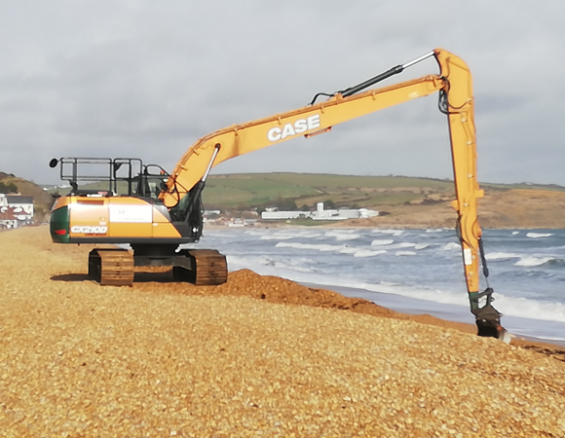
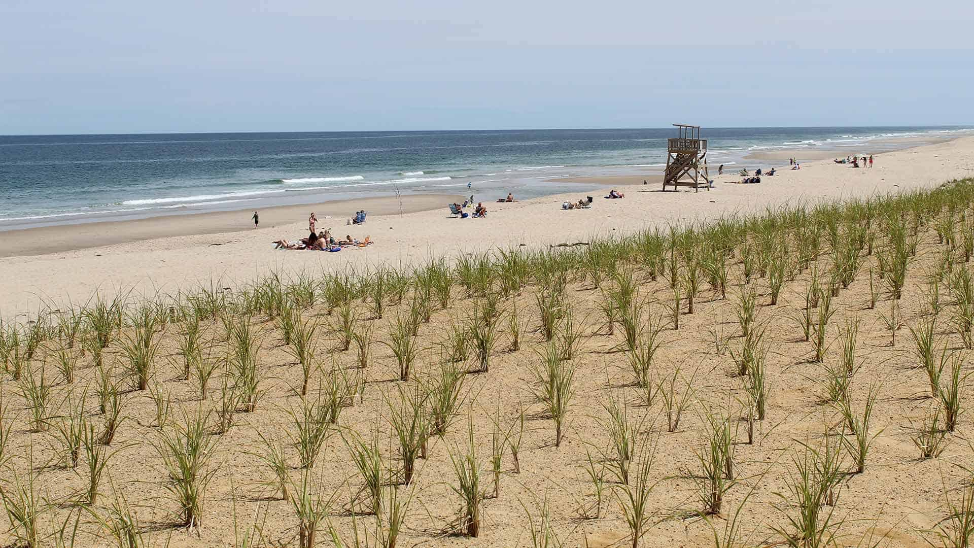
Beach nourishment
Soft engineering strategies
Beach reprofiling
Dune regeneration

Slide 33
Strand 2. Methodology. Selecting, measuring and recording
Primary and secondary data – difference(s).
Identification and selection of appropriate data. Link to theory and key question/hypothesis.
Measuring and recording.
Sampling methods – biased, opportunity, random, stratified, systematic.
Description and justification. Description enhances efficiency of collection.
Justification needed for assessment.

Slide 34
Sampling Strategies
Biased – where you deliberately pick samples to give specific outcomes.
Opportunity – you measure what you have available (it might not be much!)
Random – where samples are chosen completely at random.
Stratified – ‘layers’ of data, eg purposefully selecting equal numbers of responders to age groups in a questionnaire.
Systematic – working to a system (for example collecting data every 5m along a transect).

Slide 35
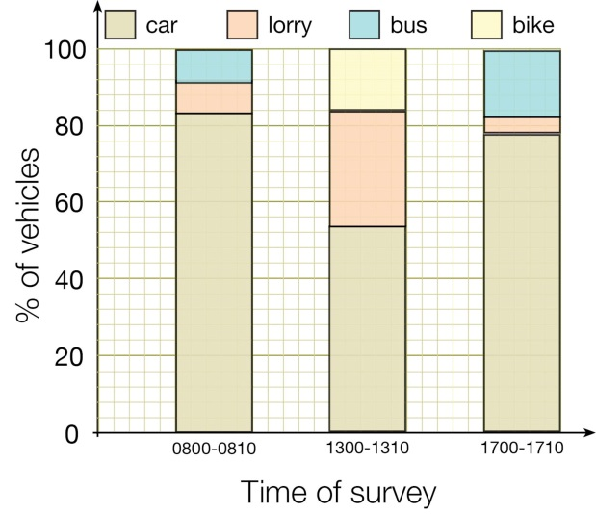
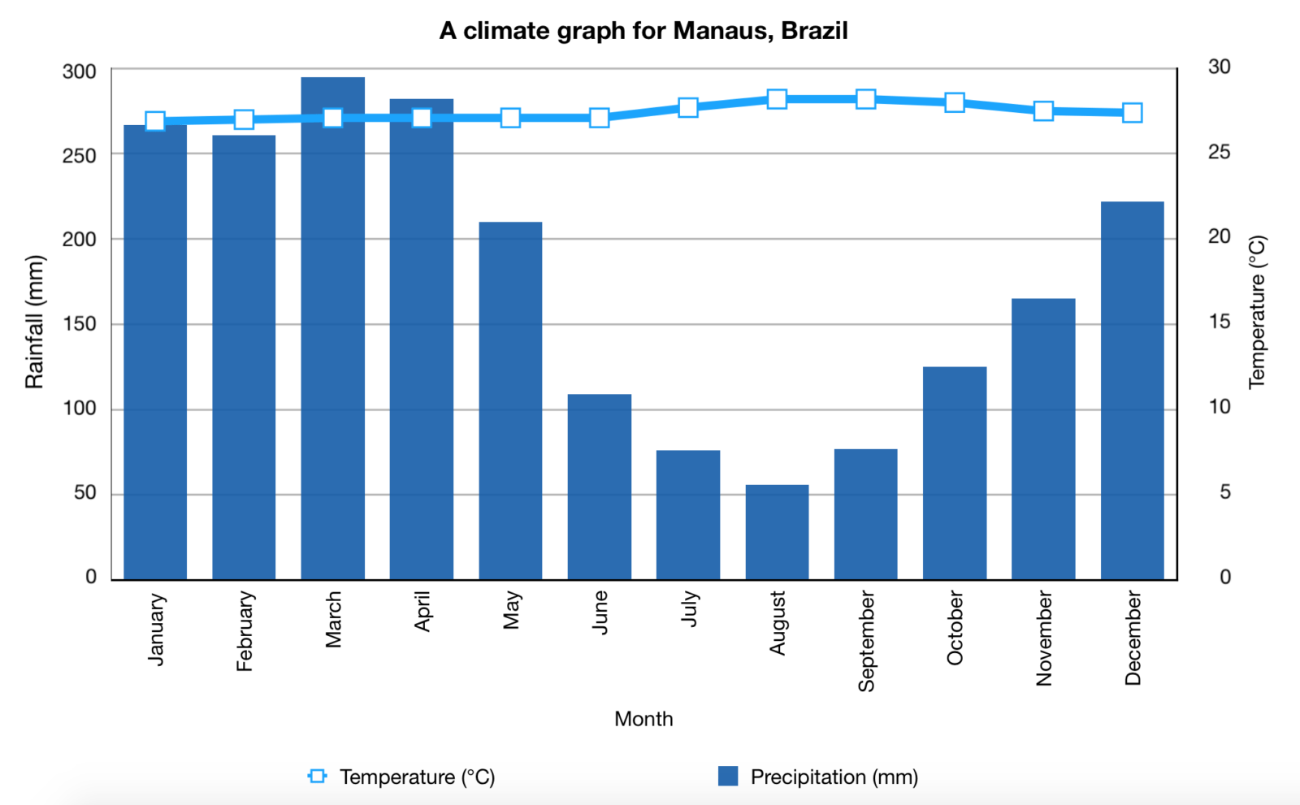
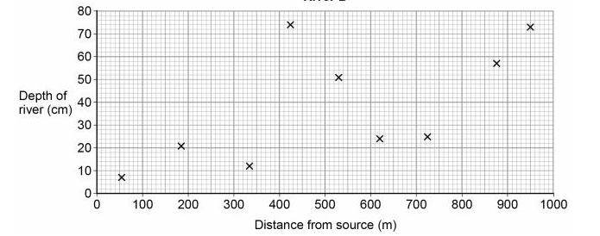
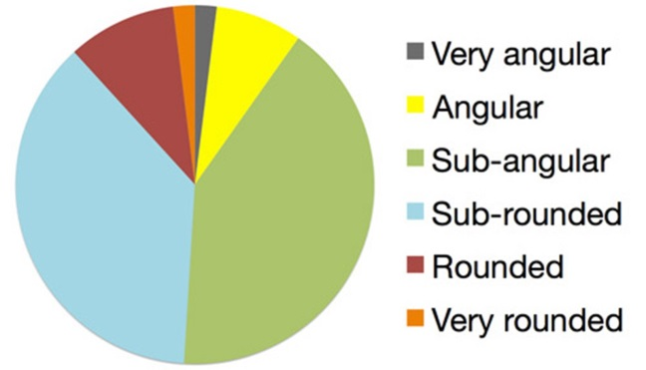
Strand 3. Processing and presenting
Understand the range of options here.
Selection and accurate use of appropriate presentation methods.
Know when not to use line graphs!
Description, explanation and adaption of methods.

Slide 36
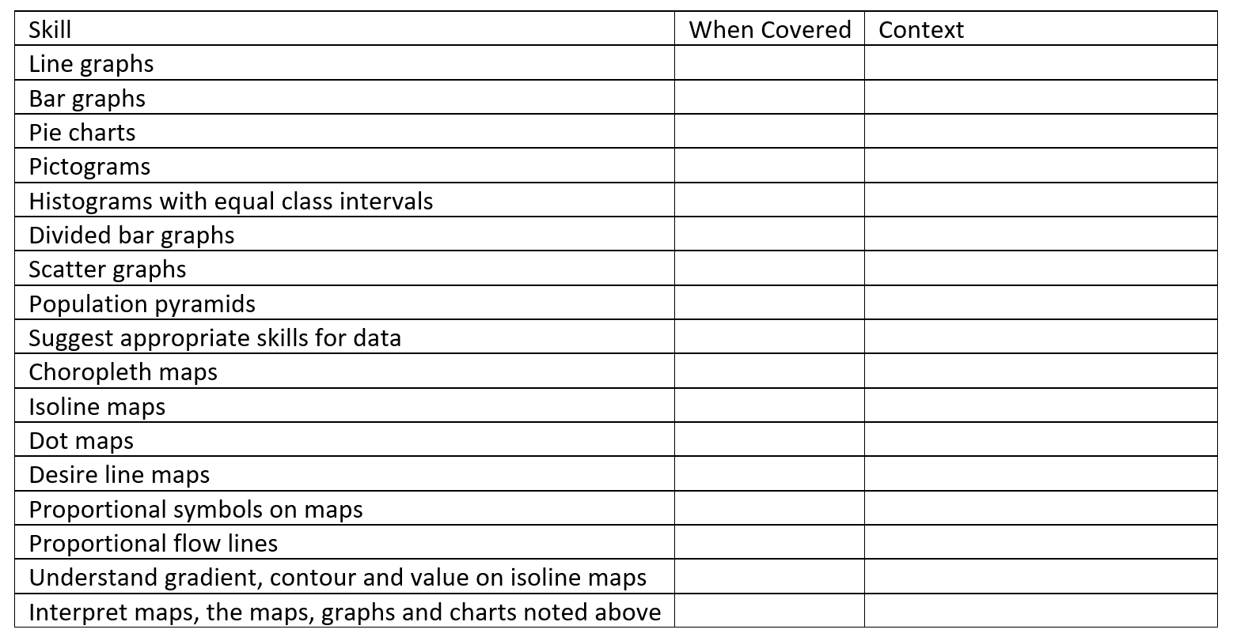

Slide 37
Strand 4. Describing, analysing and explaining
fieldwork data
Using own results or those presented – describe, analyse and explain.
Establish links between data sets – river velocity and bedload size; pedestrian flows and environmental quality.
Use appropriate statistical techniques.
Identify trends, patterns and anomalies in fieldwork data.

Slide 38
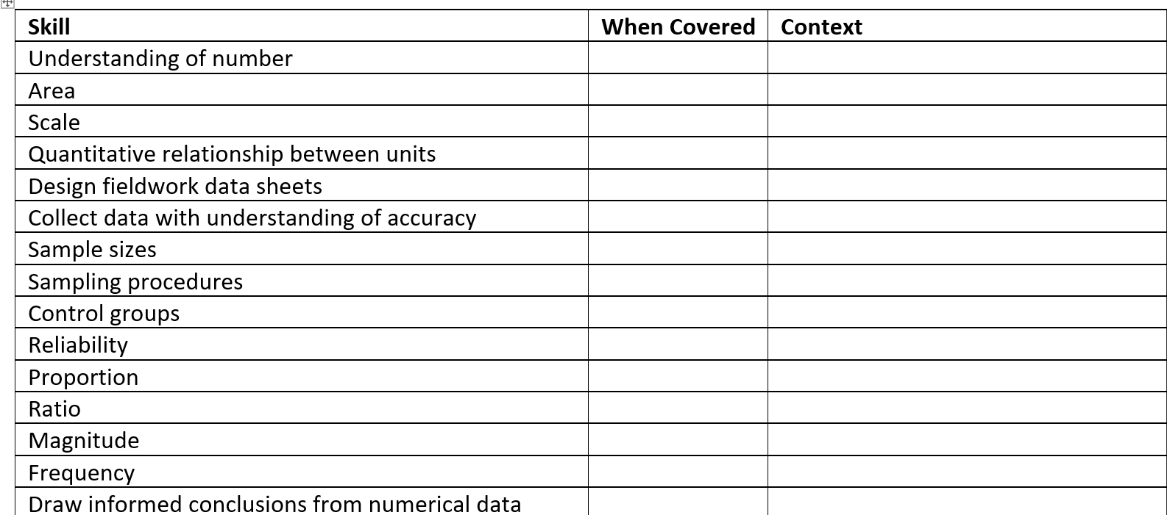

Slide 39
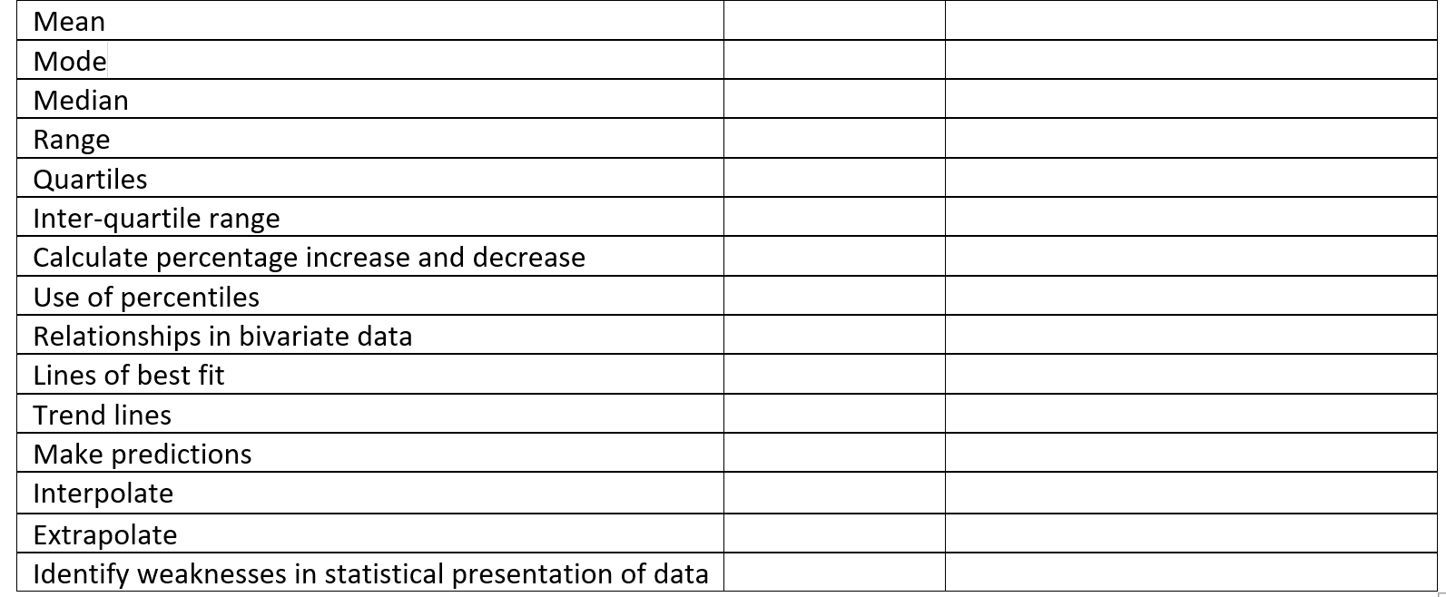

Slide 40
Strand 5. Reaching conclusions
Draw evidenced conclusions in relation to the original
aims of the enquiry.

Slide 41
Strand 6. Evaluation of geographical enquiry
Identification problems re: methods.
Accuracy of data collected.
Reliability of methods and results
Adaptation and suggestions for other data.
Validity of conclusions.

Slide 42
Key terms linked to enquiry and fieldwork
Hypothesis Theory Concept Process
Primary data Secondary data Accessibility Risks
Methodology Sampling Biased Opportunity Random
Stratified Systematic Justification Describe
Analyse Explain Link Trends
Patterns Anomalies Conclusions Evaluation
Accuracy Reliability Adaptation Validity

Slide 43


Building fieldwork and enquiry into the curriculum.

Slide 44
Big idea | Big idea summary | Strands
1. Physical processes affect the earth’s surface, its climate and people. | Physical change takes place via tectonic, geomorphological, biological and meteorological processes. Tectonic processes involve the movement of continental and oceanic plates, which causes hazards including earthquakes, volcanic eruptions and tsunamis. Geomorphological processes relate to weathering, erosion and deposition, which continually shape the Earth’s surface, for example the ever-changing shape of the land in a river valley system or glaciated landscape. Biological processes involve the weakening of rock by plants, animals and microbes. Meteorological processes take place in the earth’s atmosphere, determining weather and climate patterns. As well as affecting the earth’s surface and climate, these processes affect people and societies. Also, human activity interacts with the Earth and its atmosphere. Steps can be taken to sustainably manage the challenges resulting from physical processes, for example limiting the impacts of flood risk and erosion, and mitigating against the causes of climate change and adapting to its effects. | Weather, climate and hazards
 |  | Water and changing landscapes
2. Population, urbanisation and economic development vary place to place as a result of physical and human processes. | The world’s population is growing rapidly. Growth rates are highest in low income countries (LICs) and newly emerging economies (NEEs). Rapid development in these countries improves quality of life (QOL) which reduces death rates (DR) and causes rapid natural increase (NI). Urbanisation refers to the increasing proportion of the world’s population living in cities. 55% of the world’s population is now urban and this is rising as people in LICs and NEEs migrate to cities for work and other opportunities. Levels of economic development across the world vary as a result of physical factors such as resource distribution and propensity to natural disaster, and historical factors such as colonialism and slavery. Processes such as trade and technological change create opportunities for development, and increase globalisation. | Population and urbanisation
 |  | Economic Development
 |  | The UK
3. Human activities impact the natural world. | All human activities affect the natural world in some way, meaning that all strands bear some relation to this big idea. Some human activities affect the geosphere, hydrosphere, biosphere and atmosphere in particularly significant or even irreversible ways. For example, fossil fuel reliance can lead to: exploration, drilling and extraction of oil in fragile ecological regions; irreparable oil spills; the permanent emission of greenhouse gases into the atmosphere and increased trapping of solar radiation; increase in global average temperatures and consequent melting of ice sheets; sea level rise; habitat change; endangerment and extinction of species and resulting changes to food chains; (etc.). Individual, local and large scale strategies exist to reduce the impact of human activities on the natural world, e.g. reduced consumption, recycling, and investment in renewables. Each strategy has associated costs and benefits. | Synoptic big idea relating to all strands, especially: Climate change, Energy, The challenge of resource management and The living world
4. Geography is about enquiring to understand relationships between the physical and human worlds to inform decision-making. | Information about the physical and human worlds is presented in a range of mediums, including maps, photos, graphs and charts. Geographers must apply cartographic, graphical, numerical and statistical skills in order to extract information from geographical sources and to make meaning from them. Geographical Information Systems (GIS) are finding new ways to represent data, helping geographers to identify important patterns and correlations. Decision-making involves applying understanding of physical and human geographical issues, and using a range of evidence to justify decisions. Fieldwork involves gathering, analysing, interpreting and using data in order to answer geographical enquiries. | Passport to Geography
 |  | Decision-making
 |  | Fieldwork

Slide 45
Fieldwork Opportunities Big Idea 1
Temperature
River processes and landforms
Flood risk
Hard and soft engineering – Rivers
Hard and soft engineering - Coasts
Coastal processes and landforms

Slide 46
Fieldwork Opportunities Big Idea 2
Economic and social opportunities
Migration
Crime
Housing
Quality of life/Standard of living
Local industrial structure
Business/Science Parks
Regeneration

Slide 47
Fieldwork Opportunities Big Idea 3
Local strategies to mitigate climate change
Renewable energy within the locality
Food miles
Ecosystems
Biodiversity

Slide 48

Fieldwork Opportunities Year 7
Local weather/microclimate
Local strategies to mitigate
climate change
Migration
Local employment structure

Slide 49
Any thoughts on how to carry out one of these?
Take 5 minutes to plan one investigation.
(This is a good way to start within your own school)
Local weather/microclimate
Local strategies to mitigate climate change
Migration
Local employment structure

Slide 50
Would a fieldwork enquiry template help?

Slide 51
Fieldwork enquiry template
Strands | Activities – still think ‘how’ and ‘why’
Focus, questions and theory | Question or Aim or Hypothesis? (That….) Theory and/or key concepts.
Methodology | Data collection method(s); sampling; strategy. Justifications.
Data processing and presentation | Maths and stats skills. Justification. Graphical skills. Justification. (Checklist)
Data analysis | Maths and stats skills. Descriptions; interpretations.
Conclusions | Key findings. Overall conclusion(s) – link to strand 1.
Evaluation | Accuracy. Reliability. Validity. Replication.

Slide 52
Fieldwork enquiry - microclimate
Strands | Activities
Temperature
Methodology
Data processing and presentation
Data analysis
Conclusions
Evaluation

Slide 53


.
Introduction:
Briefly describe what you need to do in this assessment. You must also define Microclimate and talk about the factors that affect the microclimate of our school.
What is microclimate?
?
What factors affect microclimate?
?

Slide 54


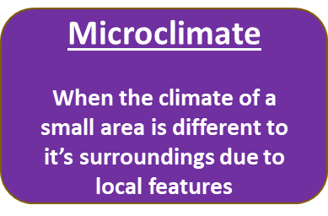



Explain how microclimate affects different sites around the school.

Slide 55
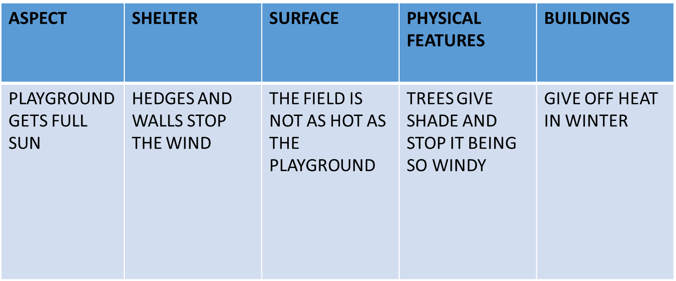


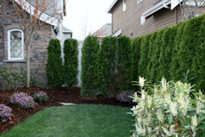
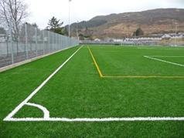

You need to consider the above factors when thinking about where to locate the equipment.

Slide 56
Fieldwork enquiry - microclimate
Strands | Activities
Temperature | ‘That a pattern of temperature exists/does not exist around the school’
Methodology | Systematic sampling. Thermometers given 5 minutes to settle then 3 readings 5 mins apart.
Data processing and presentation
Data analysis
Conclusions
Evaluation

Slide 57
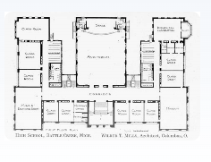
N
X
X
X
X
X
X
X
X
X

Slide 58
Fieldwork enquiry - microclimate
Strands | Activities
Temperature | ‘That a pattern of temperature exists/does not exist around the school’
Methodology | Systematic sampling. Thermometers given 5 minutes to settle then 3 readings 5 mins apart.
Data processing and presentation | Calculate means, tabulate results, plot on graph, plot on map.
Data analysis
Conclusions
Evaluation

Slide 59
N
X
SUN
X
SHADE
X
X
X
X
Wind direction
X
X
X
Sun Position
1mm = 1C

Slide 60
Fieldwork enquiry - microclimate
Strands | Activities
Temperature | ‘That a pattern of temperature exists/does not exist around the school’
Methodology | Systematic sampling. Thermometers given 5 minutes to settle then 3 readings 5 mins apart.
Data processing and presentation | Calculate mean, tabulate results, plot on graph, plot on map.
Data analysis | Use mean and range. Relate results to sun, shade, shelter, exposure.
Conclusions | Key findings. Go back to hypothesis (question/aim).
Evaluation | Methods, results, conclusions, adaptations, replication.

Slide 61
Fieldwork enquiry – local employment structure
Strands | Activities
Focus, questions and theory
Methodology
Data processing and presentation
Data analysis
Conclusions
Evaluation

Slide 62
Fieldwork enquiry – local employment structure
Strands | Activities
Focus, questions and theory | ‘That the local employment structure matches (does not match) that of the UK.’
Methodology | Questionnaire completed for homework. Ask three people what their most recent job is/was.
Data processing and presentation | Collate class results. Classify. Graph against UK structure.
Data analysis
Conclusions
Evaluation

Slide 63
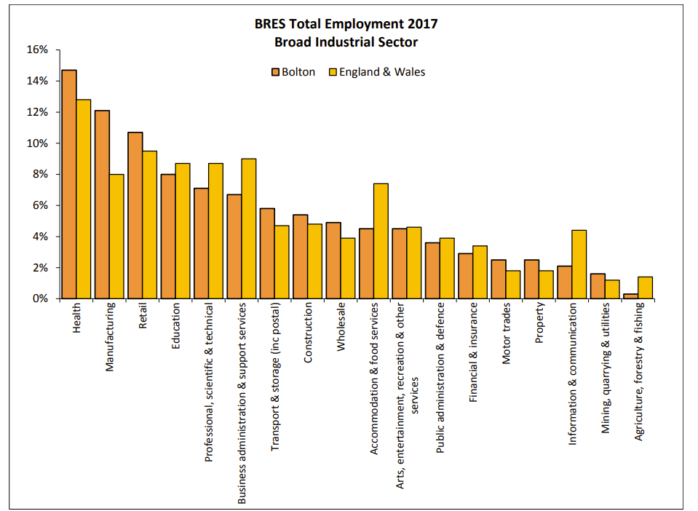

Slide 64
Fieldwork enquiry – local employment structure
Strands | Activities
Focus, questions and theory | ‘That the local employment structure matches (does not match) that of the UK.’
Methodology | Questionnaire completed for homework. Ask three people what their most recent job is/was.
Data processing and presentation | Collate class results. Classify. Graph against UK structure.
Data analysis | Look at similarities and differences. % variations. Offer reasons.
Conclusions | Key findings. Overall conclusion(s) – link to strand 1.
Evaluation | Accuracy. Reliability. Validity. Replication.

Slide 65
Fieldwork enquiry – Migration
Strands | Activities
Focus, questions and theory
Methodology
Data processing and presentation
Data analysis
Conclusions
Evaluation

Slide 66
Fieldwork enquiry – Migration
Strands | Activities
Focus, questions and theory | ‘That the population structure of Bolton is (is not) the result of international migration’
Methodology | Questionnaire at home. Ask any three people the country of their birth. If outside UK, ask why they came to Bolton.
Data processing and presentation | Could be a graph. Could be a world map with proportional symbols. Colour-coded flow lines.
Data analysis
Conclusions
Evaluation

Slide 67
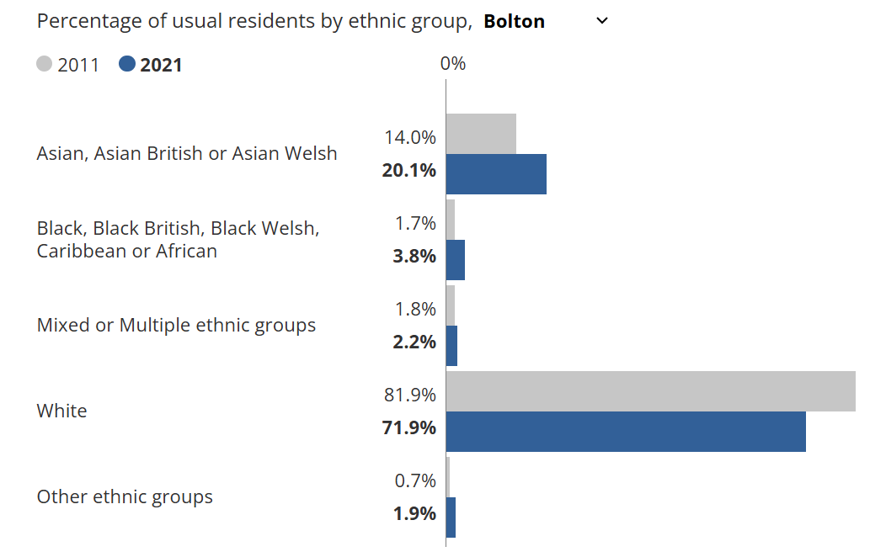
Population data from Census

Slide 68
Fieldwork enquiry – local strategies to mitigate climate change
Strands | Activities
Focus, questions and theory
Methodology
Data processing and presentation
Data analysis
Conclusions
Evaluation

Slide 69
Fieldwork enquiry – local strategies to mitigate climate change
Strands | Activities
Focus, questions and theory | That the local community is doing enough (not enough) to mitigate climate change.
Methodology | Sample local housing for solar panels and electric car charging points. Recycling.
Data processing and presentation | Range of calculations, mapping skills.
Data analysis
Conclusions
Evaluation

Slide 70
Results – Solar Panels and Electric Car Charging Points
100 houses (out of 114 in the street)
Solar Panels Electric Car Charging Point
10 1
21 1
12 1
6
14
6
13

Slide 71
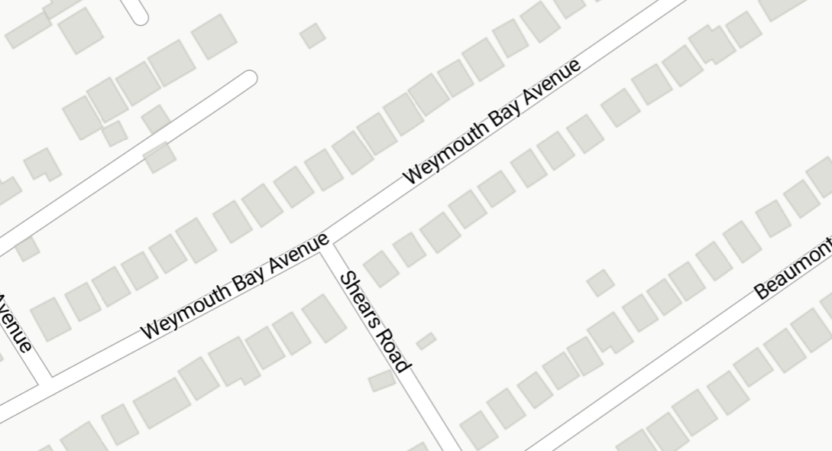

Solar panels and electric charging points
10
12
6
6
12 = number of solar panels = electric car charging point

Slide 72
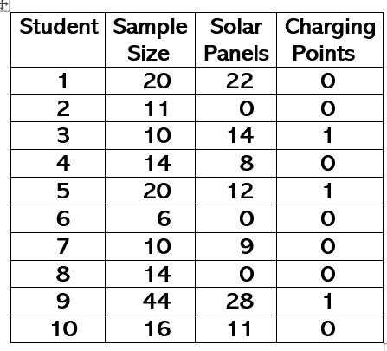
Group Results
Solar Panels and Electric Car Charging Points

Slide 73
Fieldwork enquiry – local strategies to mitigate climate change
Strands | Activities
Focus, questions and theory | That the local community is doing enough (not enough) to mitigate climate change.
Methodology | Sample local housing for solar panels and electric car charging points. Recycling.
Data processing and presentation | Range of calculations, mapping skills.
Data analysis | Look at solar panel to house ratio. % properties with charging points.
Conclusions | Key findings. Overall conclusion(s) – link to strand 1.
Evaluation | Accuracy. Reliability. Validity. Replication.

Slide 74
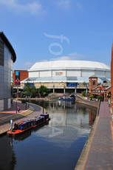
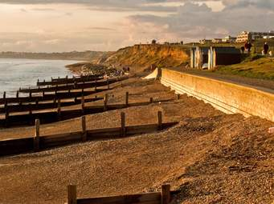
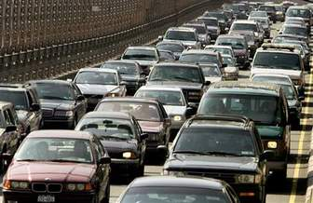
Fieldwork Opportunities Year 8
River processes and landforms
Regeneration
Coastal processes and landforms
Renewable energy
Transport

Slide 75
Any thoughts on how to carry out one of these?
River processes and landforms
Regeneration
Coastal processes and landforms
Renewable energy
Transport

Slide 76
Fieldwork enquiry - transport
Strands | Activities
Focus, questions and theory
Methodology
Data processing and presentation
Data analysis
Conclusions
Evaluation

Slide 77
Fieldwork enquiry - transport
Strands | Activities
Focus, questions and theory | That patterns of traffic flow exist (do not exist) in X.
Methodology | 2 x 10 minute traffic counts in named street for homework. All vehicles, both directions.
Data processing and presentation | Calculate means. Plot as proportional flow line map.
Data analysis
Conclusions
Evaluation

Slide 78
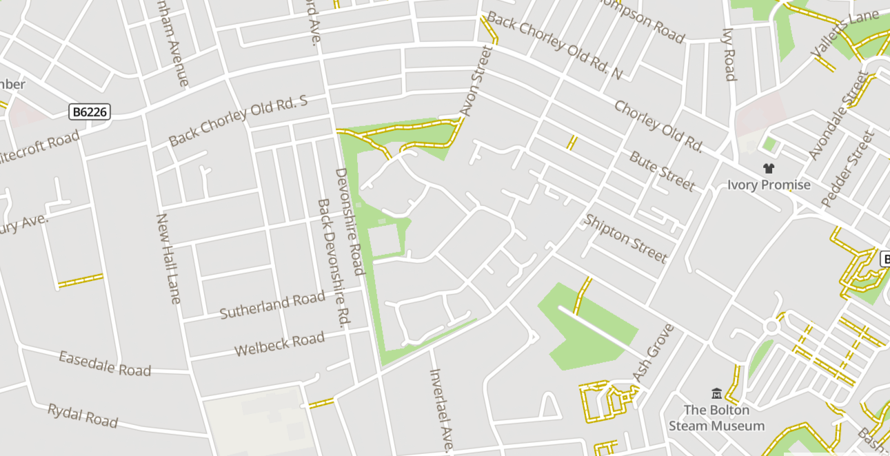
1mm width = 5 vehicles per minute

Slide 79
1mm width = 5 vehicles per minute
Can colour code bars based on amount of traffic per minute

Slide 80
Fieldwork enquiry - transport
Strands | Activities
Focus, questions and theory | That patterns of traffic flow exist (do not exist) in X.
Methodology | 2 x 10 minute traffic counts in named street for homework. All vehicles, both directions.
Data processing and presentation | Calculate means. Plot as proportional flow line map.
Data analysis | Identify patterns, trends, anomalies.
Conclusions | Key findings. Overall conclusion(s) – link to strand 1.
Evaluation | Accuracy. Reliability. Validity. Replication.

Slide 81
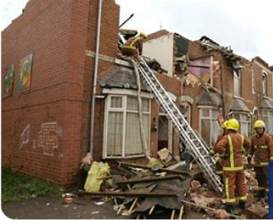
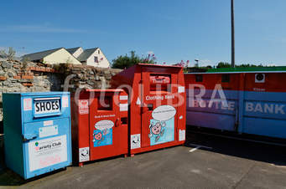

Fieldwork Opportunities Year 9
Impacts of extreme weather event
Climate change mitigation
Urban opportunities – social, economic and environmental (SEE)
Housing
Regeneration

Slide 82
Any thoughts on how to carry out one of these?
Impacts of extreme weather event
Climate change mitigation
Urban opportunities – social, economic and environmental (SEE)
Housing
Regeneration

Slide 83
Fieldwork enquiry - housing
Strands | Activities
Focus, questions and theory | That zones of housing quality exist (do not exist) in X.
Methodology
Data processing and presentation
Data analysis
Conclusions
Evaluation

Slide 85
Fieldwork enquiry - housing
Strands | Activities
Focus, questions and theory | That zones of housing quality exist (do not exist) in X.
Methodology | Sample home area using EQS. Possibly take photographs. Find house price online.
Data processing and presentation
Data analysis
Conclusions
Evaluation

Slide 86
Environmental Quality Surveys
 | -2 | -1 | 0 | +1 | +2
Lots of litter | X |  |  |  |  | No litter
Lots of traffic |  |  |  | X |  | No traffic
Buildings in poor condition |  |  | X |  |  | Buildings in good condition
Lots of vandalism |  | X |  |  |  | No vandalism
No green space |  |  |  |  | X | Lots of green space

Slide 87
Environmental Quality Surveys
 | -2 | -1 | 0 | +1 | +2
Lots of litter | X |  |  |  |  | No litter
Lots of traffic |  |  |  | X |  | No traffic
Buildings in poor condition |  |  | X |  |  | Buildings in good condition
Lots of vandalism |  | X |  |  |  | No vandalism
No green space |  |  |  |  | X | Lots of green space
Total score = 0

Slide 88
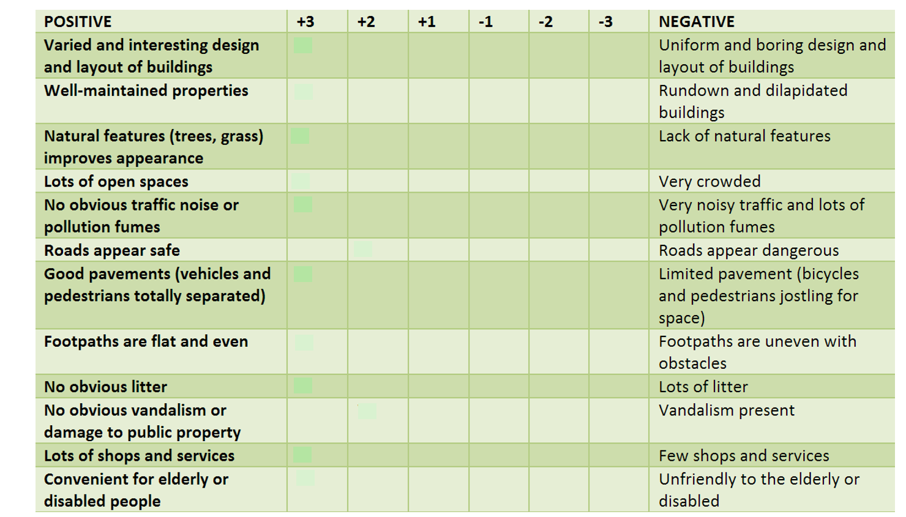

Slide 89
Fieldwork enquiry - housing
Strands | Activities
Focus, questions and theory | That zones of housing quality exist (do not exist) in X.
Methodology | Sample home area using EQS. Possibly take photographs. Find house price online.
Data processing and presentation | Collate data. Take mean EQS scores for same area. Proportional symbol mapping. Scatter of EQS v House value.
Data analysis
Conclusions
Evaluation

Slide 90

Avoid using radar graphs

Slide 91


Slide 92


Slide 94





Slide 95
Fieldwork enquiry - housing
Strands | Activities
Focus, questions and theory | That zones of housing quality exist (do not exist) in X.
Methodology | Sample home area using EQS. Possibly take photographs. Find house price online.
Data processing and presentation | Collate data. Take mean EQS scores for same area. Proportional symbol mapping. Scatter of EQS v House value.
Data analysis | Identify patterns, trends, anomalies.
Conclusions | Key findings. Overall conclusion(s) – link to strand 1.
Evaluation | Accuracy. Reliability. Validity. Replication.

Slide 96
Classroom based enquiry
Hypothesis driven teaching and learning

Slide 97
Classroom based enquiry
Hypothesis driven teaching and learning

Slide 98


Tropical Rainforests

Slide 99



Pre-load the thinking and learning
Two weeks before starting the unit on tropical rainforests, set students a homework to research the Amazon rainforest and produce a brief report.
Also ask them to select an animal, bird, insect or plant from the Amazon rainforest and draw it (or print a picture) with three facts about it.

Slide 100
Tropical rainforests
Discuss homework assignments presented.
Get students thing about scale of the Amazon.
Get students thinking about the biodiversity of the rainforest.

Slide 101
Classroom based enquiry – Tropical rainforests
Strands | Activities
Focus, questions and theory | ‘That people make (do not make) good use of the world’s tropical rainforests’. Start each lesson reinforcing hypothesis.
Methodology | Physical features. Climate. Biodiversity. Impact of people. 2018 pre-release booklet.
Data processing and presentation
Data analysis
Conclusions
Evaluation

Slide 102

Global distribution of tropical rainforests

Slide 103
1
RANGE
3
2
MOST
LEAST

Slide 104







Rainforest vegetation and animals- adaptation

Slide 105


Slide 106


Features of tropical rainforest clearance.
Figure X1
Figure X2
Outline the impacts large-scale deforestation has on the environment of tropical rainforests.

Slide 107


Strategies to manage rainforests sustainably
Ecotourism

Slide 108
Classroom based enquiry – Tropical rainforests
Strands | Activities
Focus, questions and theory | ‘That people make (do not make) good use of the world’s tropical rainforests’. Start each lesson reinforcing hypothesis.
Methodology | Physical features. Climate. Biodiversity. Impact of people. 2018 pre-release booklet.
Data processing and presentation | Various
Data analysis | Various
Conclusions | Key findings. Overall conclusion(s) – link to strand 1.
Evaluation | Accuracy. Reliability. Validity. Replication.

Slide 109

River enquiry – homework and classwork enquiry
Show students photograph below.

Slide 110
River enquiry – homework and classwork enquiry
Set homework (or classroom) task asking them to devise efficient and accurate methods to:
Measure width
Measure depth
Measure velocity
Measure bedload
Check ideas, discuss. Opportunity to cover sampling strategy options.
Introduce terminology linked to methodology.
Look at risks and how to minimise any risks identified.

Slide 111
A
1
B
B
2
A

Slide 112


Slide 113


Slide 114


Slide 115
River cross-profile data – systematic sampling
A B
River Width cm | 0 | 20 | 40 | 60 | 80 | 100 | 120 | 140 | 160 | 180 | 200 | 220 | 240 | 260
1 Depth cm | 43 | 45 | 45 | 41 | 36 | 30 | 25 | 19 | 12 | 5 | 0
2 Depth cm | 3 | 11 | 14 | 16 | 19 | 20 | 23 | 22 | 23 | 21 | 14 | 9 | 4 | 0

Slide 116
Activities
Draw x profiles
Lots of data processing options – mean/mode/median/range
Add proportional symbols for mean bedload
Maps with prop symbols for velocity
Possibly scatter of velocity against bedload size

Slide 117


Slide 118



Slide 119


Slide 120


Slide 121


Slide 122


Slide 123


