Slide 1

Great Shout Out for Science
Careers Chats
2024

Slide 2

ABOUT THE CAMPAIGN
When communicating about Great Science Share for Schools, you may wish to use the following sentences:
The award-winning campaign continuing to inspire 5–14-year-olds to take the lead in asking, investigating and sharing scientific questions they care about with new audiences.
The Great Science Share for Schools was launched in 2016 and inspires 5–14-year-olds to
ask, investigate and share the scientific questions that really matter to them.
The Great Science Share for Schools (GSSfS), a pioneering campaign dedicated to fostering scientific curiosity and education among young learners, has been granted the prestigious patronage of the United Kingdom National Commission for UNESCO (UKNC) in 2024. Patronage granted by the UK National Commission for UNESCO serves as a hallmark of quality, signifying an event's contribution in advancing UNESCO's mission in promoting education, scientific research, and cultural understanding. GSSfS has been acknowledged by the UKNC for its exceptional contributions to these crucial areas, affirming its pivotal role in shaping the next generation of scientists, innovators, and global citizens.
3 core values
inclusive
non-competitive
collaborative
Annual celebration day
Tuesday 11th June 2024
However, this is flexible – participants can engage at a date suitable for their school

Slide 3

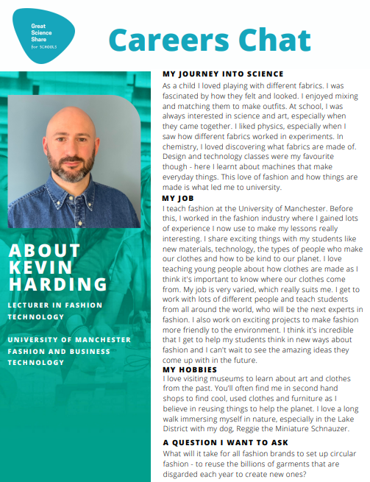
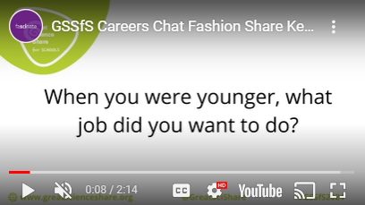
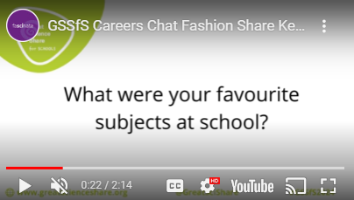
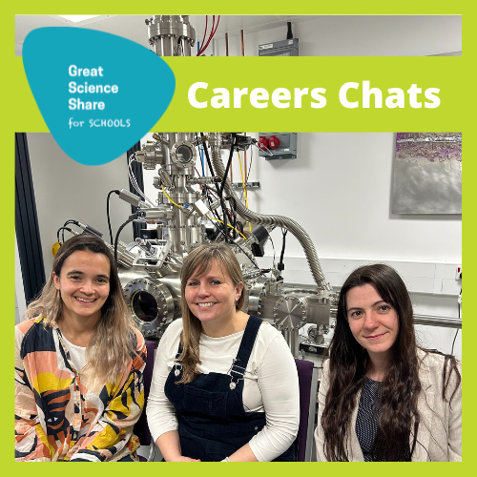
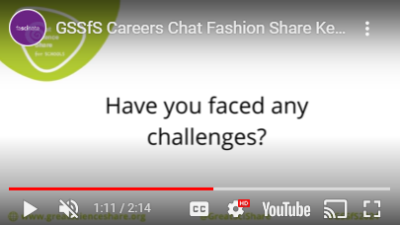
NEW FOR 2024
Careers Chats: fact files and short videos profiling the STEM people linked to the 2024 Great Guided Enquiries. From scientists working in sports science with the British Cycling Team, to materials scientists looking at sustainable fashion, meet the people behind the job!
Access here: Great Science People — The Great Science Share for Schools

Slide 4

Great Shout Out for Science
Reach the target of at least 200 letters - will you take part?
Enhance pupil voice by writing and sharing letters to make a great noise about why science is important in our lives. Support us in getting these to parliament to advocate for your views and those of our young people.
Resources available to support include teachers’ notes and writing scaffolds for pupils of all ages.
Access here: Great Science Shout Out — The Great Science Share for Schools

Slide 5
CONNECT WITH US
‘THANK YOU’ for supporting Great Science Share for Schools 2024. Your collaboration is valued.
Actively share to make the greatest difference we can together!
Your comms/marketing
Do you have a publication, newsletter or other opportunity to promote Great Science Share for Schools?
Let us know! Put us in touch with your comms/marketing person.
If you have any queries about this pack, or want to explore more ways of working together, please contact us…
Email greatscishare@manchester.ac.uk
Web www.greatscienceshare.org

