Slide 1
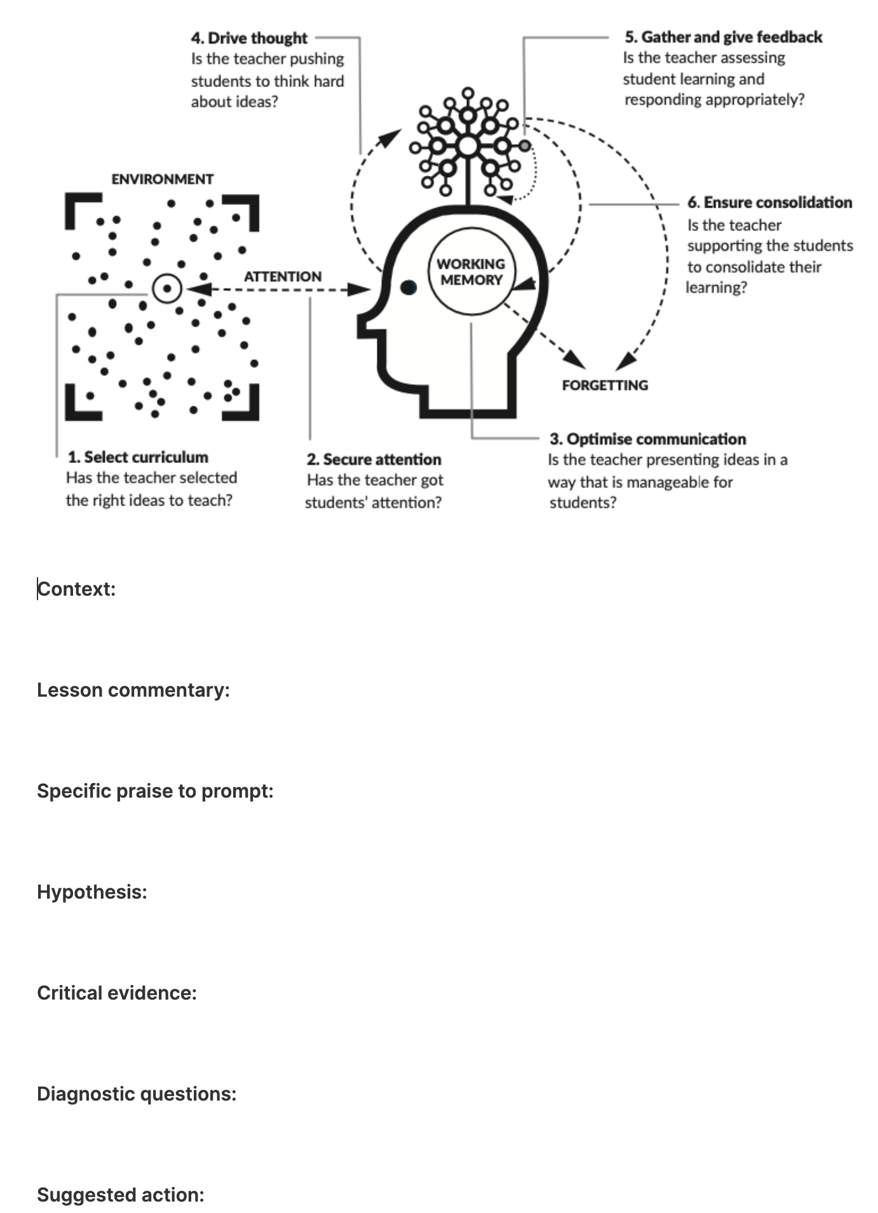
My current proforma
The 6 big teaching challenges
Context
Lesson commentary
Specific praise to prompt
Hypothesis
Critical evidence
Diagnostic questions
Suggested actions

Slide 2
5 features of effective Walking-Talking Mocks
1. Get students to try the question first, and use confidence scores
2. Gather data on their understanding using mini-whiteboards
3. If understanding is not secure, ask a follow-up question
4. Ask What-if questions
5. Ask students to create review cards

