Slide 1



Geography Hub
25/03/24
Welcome! Please sign in and help yourself to refreshments.

Slide 2
Agenda
Developing subject expertise
AQA GCSE – Pre-release

Slide 3

Pillar 1: Subject Expertise
December 2023

Slide 4

Our vision
To facilitate the gathering of best practice curriculum implementation strategies.
This is so that we help subject leaders and teachers to in turn help all children to know and remember important knowledge across subject curriculums.
To support subject leaders in evaluating the impact of their subject curriculums.

Slide 5
Structure
BLA Executive Board
Hub Executive Board
Linda Emmett
Caroline Molyneux
Ed Kirk
Michelle Dickinson
Hub Leadership Team
Subject Hubs and SEND Hub

Slide 6
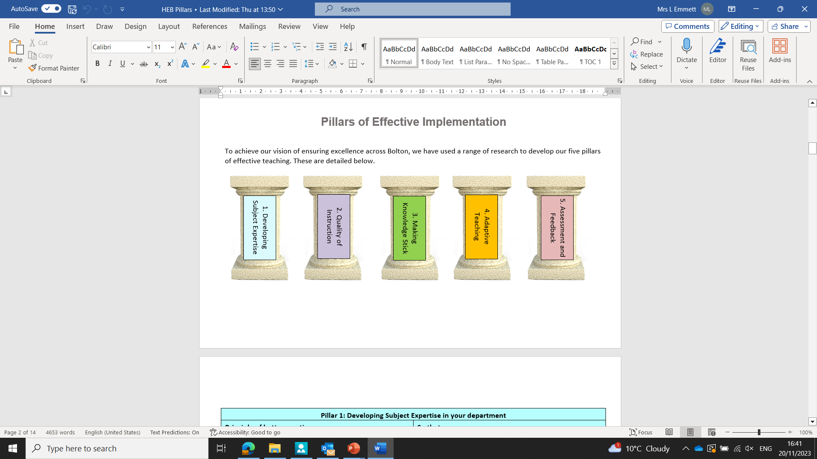
The Pillars of Effective Curriculum Implementation

Slide 7
Developing subject expertise so that teachers demonstrate strong expertise in their curriculum area.
Teachers use effective pedagogy to help pupils to know and remember more.
Pupils form a deep understanding of intended knowledge.

Slide 8

Discussion Point
What was on the agenda of your most recent subject department meeting?

Slide 9
What proportion of the time was allocated to developing colleagues’ curriculum expertise?
Discussion Point 2: What do we mean by subject expertise?

Slide 10
What does high quality subject expertise look like? In your subject?
Subject Knowledge
Subject Expertise
Relevant qualifications
Can design an appropriately sequenced lesson and develop longer term schema.
Secure knowledge of methods and facts
Can give effective explanations to help all pupils to understand
Examiner knowledge for exam board
Can adapt a lesson in response to assessment information.
Ability to readily apply facts within complex scenarios
Can pre-empt misconceptions and give effective explanations to overcome them

Slide 11

Why is subject expertise important?

Slide 12
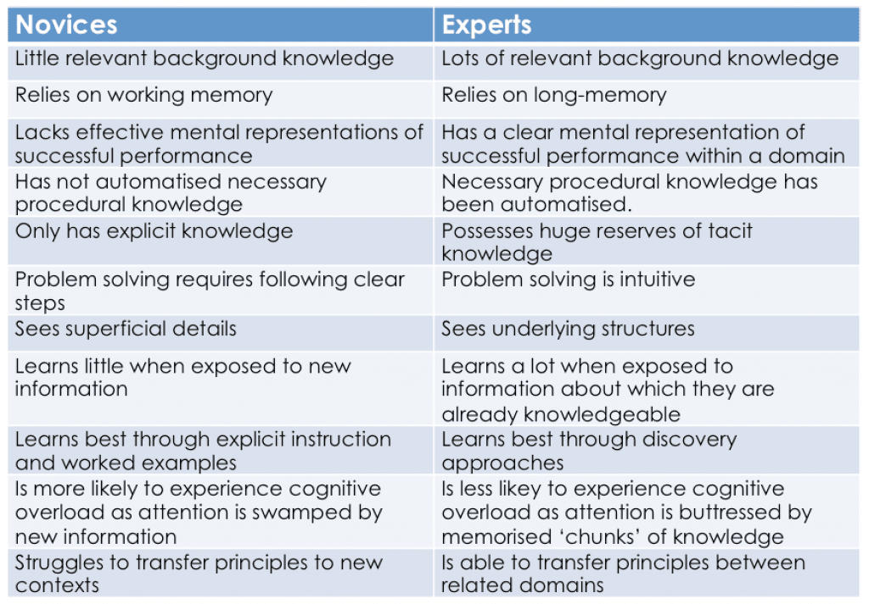

Slide 13
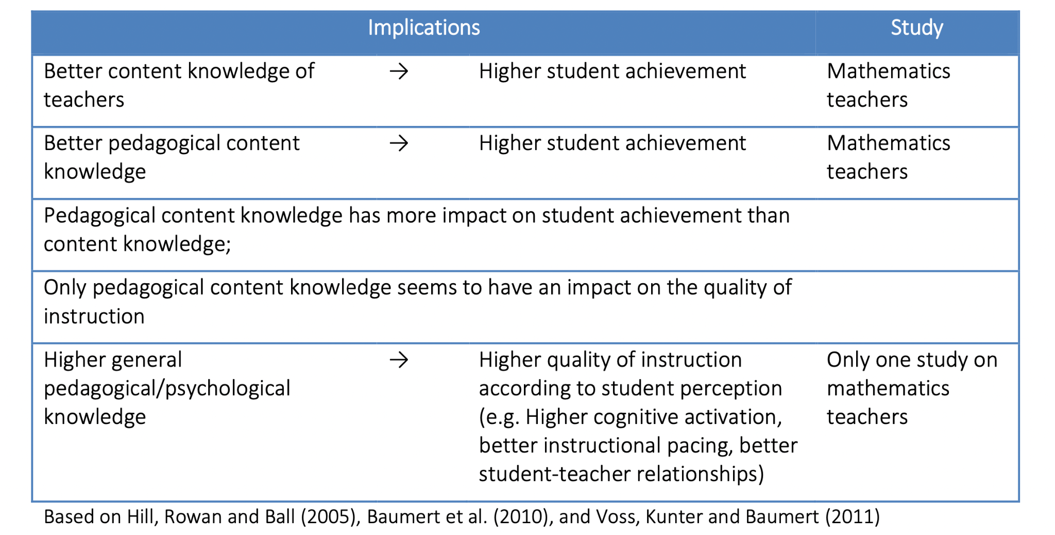
Teachers as Learning Specialists

Slide 14
How do we help with these challenges?

Slide 15





School and subject curriculum planning
Commensurate with the national curriculum (or better)
The curriculum identifies the most important knowledge that all pupils need to learn and when.
Curriculum is planned and sequenced to build on, and deepen, what has been taught before.
‘End points’ - what the curriculum is building towards.
Reading, vocabulary and cultural capital, are prioritised.

Slide 16
Powerful Curriculum Team Discussions
“Continuously curious, continuously reflective”
Allocate Regular Time
Review of prior learning
Implementation of future learning
Facilitate Peer Planning
Check!

Slide 17

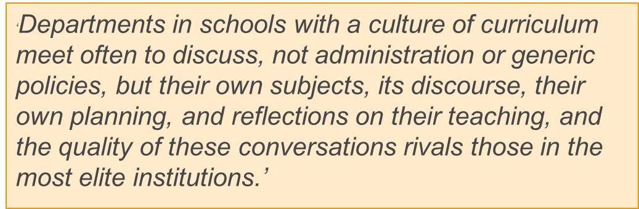

Slide 18
Activity: What might this look like?
Jane is leading her history department meeting. Last week, the department delivered lessons on ‘how William secured control of England in the 11th century’. Jane asks teachers which misconceptions were identified from formative assessment in lessons. All classes confused Harald Hardrada and Harold Godwinson. In one class, pupils struggled to understand why the Doomsday Book was so significant.

Slide 19

Discussion Point
Take a forthcoming lesson or learning point from your scheme of learning.
Use the ‘powerful curriculum discussion’ to talk about how you might have a departmental discussion in your subject.
What has been taught before?
What misconceptions arise from this?
Where do you place X in your lesson sequence and why?
What pedagogy do you use to deliver this (include abstract concepts).
How do you break X down to smaller components for pupils with SEND.

Slide 20
Facilitating Effective Curriculum Discussions
What could be on your department agenda to support the development of effective curriculum expertise in your subject department?
To help specialist teachers?
To help non-specialist teachers?

Slide 21
What would we see in X department meetings?
A review of prior learning and what learning is coming up (books).
A discussion around intent and essential knowledge.
A discussion about sequencing within an upcoming lesson.
A discussion about potential misconceptions or tricky/abstract concepts.
A discussion about effective pedagogy or explanations to support tricky concepts.
Exploring modelling or scaffolding for a particular concept.
A discussion about approaches to address misconceptions that have arisen from previous lessons.

Slide 22
Discuss and Share:
How else can we further develop our colleagues’ subject expertise?

Slide 23
Subject Hub Reflection Tool

Slide 24
Summary Points
Curriculum intents are not good when left sat on a shelf!
Subject expertise is more than knowing subject content.
Pupils all the way to Year 11 are novice learners and need to benefit from strong pedagogy which helps them to know and remember more.
Subject leaders should have regular time to develop their teachers’ expertise in how we deliver our subject to novice learners.
Be outward looking – there is a range of books, research pieces and sources of best practice across subjects.

Slide 25


Slide 26


Slide 27

AQA Pre-Release

Slide 28
Detail from AQA
From June 2024, AQA has increased the total exam time for Paper 3 to 1 hour 30 minutes.
This is following a lot of feedback that students were struggling to complete the exam to the best of their ability in the given time.
The intention of this additional 15 minutes is to allow students to:
  refamiliarise themselves with the pre-release material to use in response to questions in Section A
  read and understand the unfamiliar fieldwork contexts
  think about the details of their own fieldwork investigations
  ensure they can answer all exam questions and therefore better access all available SPaG marks.
It’s important to encourage students to use this time as a way to improve their outcome.

Slide 29
The Pre-Release
The pre-release equates to 49% of the marks in Paper 3.
Students normally engage well with the pre-release because they:
  realise that having the resource booklet beforehand can improve their success.
  know that becoming familiar with the resources will build their confidence for the exam.
  know that you’ll invest a lot of time to ensure that no stone is left unturned.

Slide 30
Strategies to support delivery
Structuring answers using AOs – no AO1 in this paper. Most of the marks are AO3.
Direct instruction
Mock exams (PPEs) and walking talking mocks
Work booklets and knowledge organisers
Glossaries and low stake quizzing

Slide 31
Structuring answers using AOs
Students risk dropping marks in the longer questions in the pre-release because they get stuck in Level 1 responses according to the mark scheme. There are two common reasons for this:
  Students overload their responses with information from the pre-release booklet verbatim that is generally not explained/developed well.
  Their AO3 is often lacking or confused so the examiner finds it hard to see a clear argument in their writing.
Giving students writing frameworks or structures helps them to write answers that respond to all the elements of the mark scheme. This means they go beyond lifting points or developing ideas simply and therefore they can access Level 2 and Level 3 with their answers.
Tips for use:
When first using structures like this, scaffold heavily. Seeing your thinking as you write an entire model into the different sections of the grids, emphasising how the requirements for AO3 differ to AO4 can be extremely valuable for students.
In the exam they will face a blank page, so the scaffolding needs removing as soon as they’re comfortable.

Slide 32
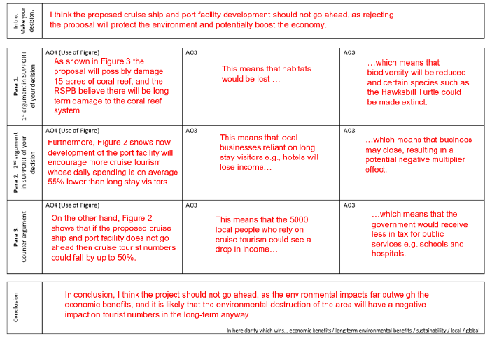
Example from 2023

Slide 33
Template
Intro- make your decision
Point 1- first argument in support of your decision | AO4 (use of the figure) | AO3 | AO3
Point 2 – second argument in support | AO4 (use of the figure) | AO3 | AO3
Point 3- counter argument | AO4 (use of the figure) | AO3 | AO3
Conclusion- in here clarify the decision- consider SEE and different scales

Slide 34
Direct instruction
Read through the pre-release as a group.
Have your pre-release under the visualiser and highlight key ideas and themes which appear in each figure. This could be as detailed as working out elements such as the mean, median and mode from graphs/data etc.
You might want to suggest and share with the students the types of questions which could be asked by the exam board in relation to each figure.
Work through the pre-release as a group, following this process with intermittent quizzing to check for understanding. This should take no longer than 2 or 3 60-minute lessons.

Slide 35
Mocks/ WTMs
We know that the students will complete an exam based upon the resources within the pre-release. Therefore, time permitting, producing some mock exams for the students based on the pre-release material which they will sit can be very beneficial.
Look at previous Paper 3 questions (1-3), to look at the structure and style.
Create (or use pre-prepared ones from places such as Internet Geography) a mock paper(s) based on the pre-release.
Complete the mock paper(s) in class, independently, or as a walking talking mock, or a pre-seen mock etc.
This will build student independence and engagement with the figures.
Ensure that mock papers are marked, and feedback is given to the students in the follow-up lesson.
Repeat the process with a further mock if appropriate.

Slide 36
Work booklets and knowledge organisers
Historically, there has always been a lot of information in the pre-release. Condensing this information to promote fluency and ensuring that students continually engage with the figures will improve their confidence during the exam.
Create a work booklet of low stakes questions and exam questions related to each figure. Students could complete this as part of home learning over a series of weeks.
Create a knowledge organiser of the key bits of information from each figure. Ensure that regular low stakes quizzing of this information takes place to transfer this into the long-term memory of the students.

Slide 37
Glossaries and low stakes quizzing
The pre-release will contain many important key words. It’s important that students understand the key words as they may appear within question stems. Students will also need to use the key words fluently within their responses.
Create a glossary of the key words, with one clear definition shared across the department.
Ensure that regular low stakes quizzing of the key terms takes place, to transfer this knowledge into the long-term memory of the students.
This will free up their working memory in the exam to answer questions and ensure full engagement with the different figures.

Slide 38
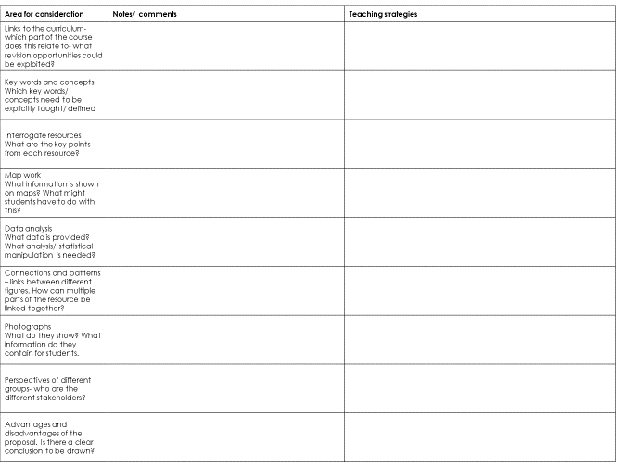
Unpicking the pre-release

Slide 39
AOB?

