Slide 1
GCSE Geography
Increasing attainment for LPA and MPA- Grades 1-6
Vicky mckinlay
Linkedin: Victoria-mckinlay-fcct
x/Twitter: @vmckinlayfcct
Email: Vicky.mckinlay@icloud.com

Slide 2
Housekeeping
Fire exits
Toilets
Please feel free to share my resources in your schools and with your colleagues in your departments but do not share them more widely and/or publish them online
Thank you for inviting me!

Slide 3
Introductions
Where do you work?
What is your experience? (how many years teaching?)
What is your school context?
Do you have any exam marking experience?
What board do you follow?

Slide 4
About me- Vicky McKinlay
Assistant Lead Examiner for a well-known exam board (Papers 1 and 3)
Over 12 years examiner experience
Middle Leader for over 10 years in NW England in Outstanding, Good and RI schools
Previous Lead Practitioner for Geography
Currently employed in Blackburn
Involved in whole school coaching
Deliver face-to-face CPD and online CPD for a well known exam board and Education Companies
Produce educational content for well-known companies
Active member of #WomenEd and #WomenEdNW
Mother to 2 children: High ability girl KS2 and MPA boy KS3. The least that I can say about my children! I will discuss my son later, as an example. I have his consent.

Slide 5
Examiner CPD
One of the best forms of CPD
Changes how you teach
Strengthens understanding of the assessment
Helps with internal mocks

Slide 6
Aims of the session
Consideration of factors determining low and middle achieving student success (assessment, revision, support strategies)
Focus on key issues associated with Papers 1 and 2
Focus on Paper 3 (maximising the pre-release booklet, skills and fieldwork)
Opportunities for informal discussion and sharing good practice

Slide 7
Session content
Maximising Potential and inspiring Learning
Improving exam technique
Issues with papers 1 and 2 2023 exams (AQA) and strategies to move forward
The pre-release and fieldwork strategies

Slide 8
Upcoming courses and events
Hodder:
Preparing for exam success in 2024
Book through Hodder
21/03/2024 in Manchester and
25/03/2024 in London
Vicky McKinlay and Sarah Wheeler
Feedback from the 2024 GCSE AQA exams
Book through Hodder
11/10/2024 in Birmingham and
14/10/2024 in London
Vicky McKinlay and Sarah Wheeler
WomenEd:
WomenEdNW Wellbeing walk (free event)
Book through www.womened.com
Turton tower
16/03/2024
Chris Reddy and Vicky McKinlay and the Women Ed NW Leads
WomenEdNW Unconference (nominal fee)
Venue TBC
20/04/2024
Book through www.womened.com when it is published

Slide 9

1. Maximising Potential and inspiring learning

Slide 10

Who are the students?

Slide 11

Who are the students?
‘Lazy boys!’
‘Hard working students who seem stuck at L1’
‘Students who need to write a bit more’
‘Students with barriers such as family situation, SEND and/or EAL’
‘Poorly organised students’
‘Students with time management issues’
‘Students who write too much waffle and go off topic’
‘Careless students’
‘Students lacking motivation and ambition’
Does this sound like your students?
Any other suggestions?

Slide 12

Who are the students?- One example
13 year old boy
Year 8
Set 3 of 5 in his half of the year group for History, Geography, RE and MFL
Autistic
Average maths SATS score
Just above average English SATS score
Predicted GCSE grades: 5
https://www.vectorstock.com/royalty-free-vector/topic-icon-question-mark-with-male-user-person-vector-28785241

Slide 13
What does he say about himself and setting and why does it matter?
“I’m in set 3, I’m not clever”
“Teachers don’t care” (When they teach set 3? Lack of ambition from teachers?, Which leads to a lack of motivation for students?)
“60 children are more clever than me”
He is very self-aware and this is a sad situation
Issues with mental health and wellbeing
This could become a self-fulfilling prophecy and affect attainment
https://www.vectorstock.com/royalty-free-vector/topic-icon-question-mark-with-male-user-person-vector-28785241

Slide 14
Context matters!
He struggled during his SATS because he is autistic, and probably did not achieve his potential
The average grade in our school is 6, nationally it is 4. He would probably be in a higher set in another school and have a more positive view about his progress and relationships with teachers
https://www.vectorstock.com/royalty-free-vector/topic-icon-question-mark-with-male-user-person-vector-28785241

Slide 15
What can be done if setting is an issue?
Talk to the students about SATS and how some students performed well and others struggled and how that result does not define their future potential
Talk to your school leadership team about changing the setting system so that learning is not capped and students are not defined by their prior attainment. Middle ability students should ideally work with students of higher abilities so that they are exposed to higher-level thinking. In addition, middle ability students benefit from explaining their thinking to lower ability students. Some ideas include total mixed ability classes, one low set and the rest are mixed ability or a high and a low set and the middle are mixed ability.
https://www.vectorstock.com/royalty-free-vector/topic-icon-question-mark-with-male-user-person-vector-28785241

Slide 16
What are the barriers to higher achievement?
I asked my MPA son in year 8 to imagine that he was going to have a week of exams the week before Christmas. He would have a 1 hour exam for every subject. The content would be what he has learnt from the start of year 7 to his current year 8 topic.
I asked him what his revision plan would be:
When would he start revising?
How would he revise?
Would he prioritise any subjects? If so, which subjects and why?
Suggest what his answers were
https://www.vectorstock.com/royalty-free-vector/topic-icon-question-mark-with-male-user-person-vector-28785241

Slide 17
Curiosity! Is this a trend at your school?
Forms quizzes which include gender
Year 8 revision research https://forms.office.com/Pages/ShareFormPage.aspx?id=6TlgTaPq9k22IgNa28aAvlya2mDcKFxHi23xs4_Dr_pURUJHRjdKUE9GNVdKVU1QOTBMTkhMNkxXUS4u&sharetoken=4e5yxilOnedILwMV1Cje
Year 10 revision research https://forms.office.com/Pages/ShareFormPage.aspx?id=6TlgTaPq9k22IgNa28aAvlya2mDcKFxHi23xs4_Dr_pUMExPOUlVMjAxUzhLRzBUUTFERTc2UTQ2VC4u&sharetoken=eTOIgjuyUhKOygeiCq72
Year 11 revision research https://forms.office.com/Pages/ShareFormPage.aspx?id=6TlgTaPq9k22IgNa28aAvlya2mDcKFxHi23xs4_Dr_pUQkcxT1VYQTQ5Nk9ETkZDUUdTRzhTSk5RQi4u&sharetoken=GuScJo87QRGUwiMTDKz7

Slide 18
So what can the evidence be used for?
Informs whether study skills are being taught explicitly and/or students use them
Informs whether students prioritise Geography revision. (Evidence for SLT to justify poor option results?)
Trends can be seen between abilities and gender
Enables teachers to put strategies in place early- teach year 7 revision strategies

Slide 19
What are the barriers to higher achievement?
Parental support
Retrieval practice
Motivation
Lower attainment and weaker social skills
High effort, lower attainment
Lower attainment
Factors affecting success
Spaced practice
Attendance
Physiological and phycological needs
High effort, lower attainment
Lower attainment
Lower attainment

Slide 20
What are the barriers to higher achievement?
SEND/EAL
Overconfident boys and the link with poor study skills: supporting good organisation, problems with retrieving information or seeing how it links and issues with cognitive load
Low teacher expectations
Weak ability
Issues with writing extended answers: model writing (addressed in part 3)
Low motivation:
seeing the intrinsic value of learning rather than performance goals
not knowing what they have to do (teacher clarity, teachers lack assessment knowledge, lack of effective feedback (addressed in part 3)
abstract ideas
competitive boys
Boys do achieve lower grades than girls but some girls struggle with the same issues. I have highlighted the issues that boys tend to have.

Slide 21
Recommended reading:
The Boy Question by Mark Roberts

Slide 22
SEND/EAL
Huge and complex area
Adaptive teaching can be used to scaffold responses
Links with other factors, e.g. motivation
Suggested strategies for SEND:
ASC:
-possible sensory issues, so uncluttered slides and displays
-consider positioning around the edge of the room
ADHD/ADD: handing out equipment, consider positioning at the edge of the room
VI: verbal descriptions, raised diagrams, immersive reader on word
EAL strategy: google translate (including whole documents), ppt translation tool
Liaise with skilled colleagues

Slide 23
Overconfident boys
Boys tend to overestimate their potential by an average of 1 grade, which means that they do not put as much effort into their work, or utilise study skills and revise as effectively as girls and so they underperform
We need to teach them how to study and how to plan to revise
We need to do this from KS3 onwards

Slide 24
Supporting good organisation
Revision file/folder
Organise revision notes and knowledge organisers (addressed later) by paper and question

Slide 25
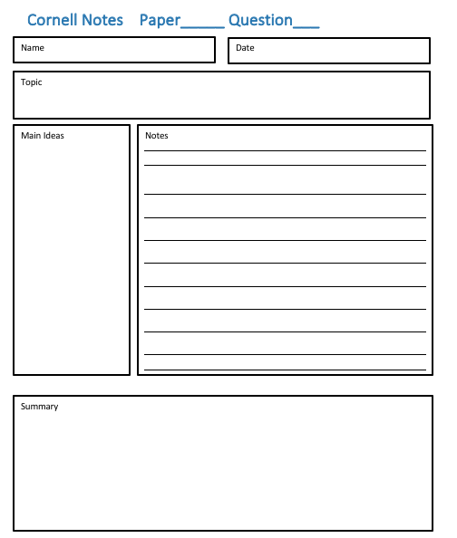
Cornell notes to support good organisation

Slide 26
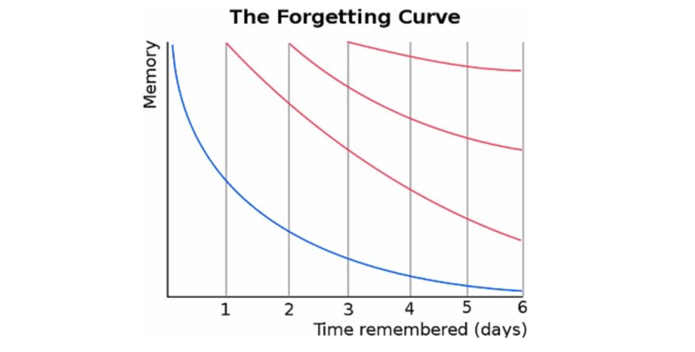

Problems with retrieving information or seeing how it links
Study skills clip with evidence-based practice.
https://www.youtube.com/watch?v=CPxSzxylRCI
https://80000hours.org/2013/04/how-to-improve-your-memory/

Slide 27
Problems with retrieving information or seeing how it links
Retrieval practice is low effort and high impact
Used throughout the years as a part of learning
It is active learning

Slide 28
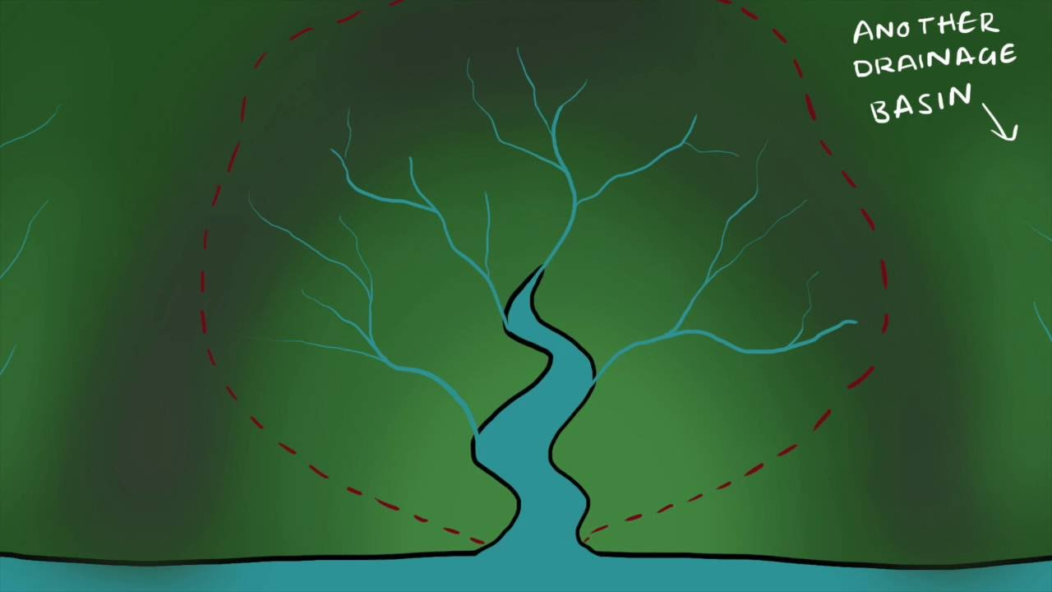
Brain dump
Starter: write down as many things as you can about the rivers topic that you learnt in the summer term

Slide 29

Revision clock
5 min intervals
2 different colours (one for the ‘brain dump’, one for additional info)
The additional information comes from revision notes/ KO/ a book that is provided for them

Slide 30
Retrieval grid

Slide 31
One Point | Two Points | Three Points | Four Points
A
What is the difference between primary and secondary effects? | 2) How does using GPS help predict when a volcano will erupt? | 3) Identify 2 immediate responses for the Haiti earthquake | 4) Identify 2 long term responses for the Haiti earthquake
5) How do convection currents in the mantle cause plates to move via continental drift? | 6) Identify 2 items in an earthquake kit and explain how they reduce the effects | 7) What is the name of the boundary where plates move apart? | 8) Why did differences in wealth mean that the effects were more severe for the earthquake in Haiti, a LIC, rather than in Japan, a HIC?
9) Identify 2 primary effects of the Haiti earthquake | 10) How does using shaking maps reduce the effects of an earthquake? | 11) What is the difference between oceanic and continental crust? | 12) Name 2 features of earthquake proof buildings and explain how they work to reduce effects
13) Explain how earthquakes occur at a conservative boundary | 14) Identify 2 secondary effects of the Haiti earthquake | 15) Explain why hazards occur at a destructive boundary | 16) Why Is population density a hazard risk factor?

Slide 32
One Point | Two Points | Three Points | Four Points
B
What is the difference between primary and secondary effects? | 2) How does using GPS help predict when a volcano will erupt? | 3) Identify 2 immediate responses for an earthquake | 4) Identify 2 long term responses for an earthquake
5) How do convection currents in the mantle cause plates to move via continental drift? | 6) Identify 2 items in an earthquake kit and explain how they reduce the effects | 7) What is the name of the boundary where plates move apart? | 8) Why do differences in wealth mean that the effects are more severe for an earthquake in LIC rather than a HIC?
9) Identify 2 primary effects of an earthquake | 10) How does using shaking maps reduce the effects of an earthquake? | 11) What is the difference between oceanic and continental crust? | 12) Name 2 features of earthquake proof buildings and explain how they work to reduce effects
13) Explain how earthquakes occur at a conservative boundary | 14) Identify 2 secondary effects of an earthquake | 15) Explain why volcanoes occur at a destructive boundary | 16) Why Is population density a hazard risk factor?

Slide 33
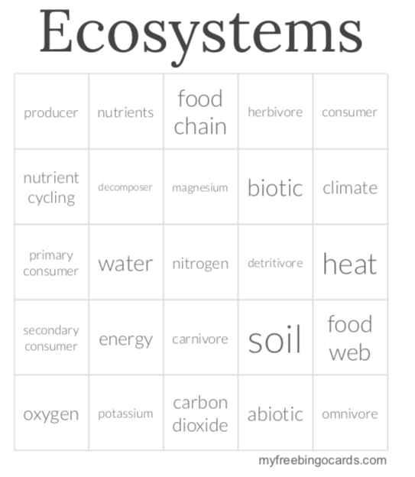
Linking Grid
1 2 3 4 5
Roll two dice twice
and explain how
two ideas link
Exploring themes
and make
Connections
https://myfreebingocards.com/
1 2 3 4 5

Slide 34
Schema of learning
A framework in our long-term memory that helps us to organise and interpret information
If an existing schema can be used through memory retrieval new knowledge can be given context
Recapping allows schemas to develop
Memory retrieval links new ideas to a schema
Recapping and testing isn’t neutral, knowledge is reconstructed in the light of new contexts and information
Harder than restudying, but more effective

Slide 35
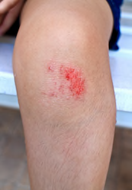
Hook
Hook the schema to what they already know to make the leaning concrete rather than abstract
Rivers
-abrasion
-attrition
-local river
-bum on a water slide/car on a roundabout

Slide 36
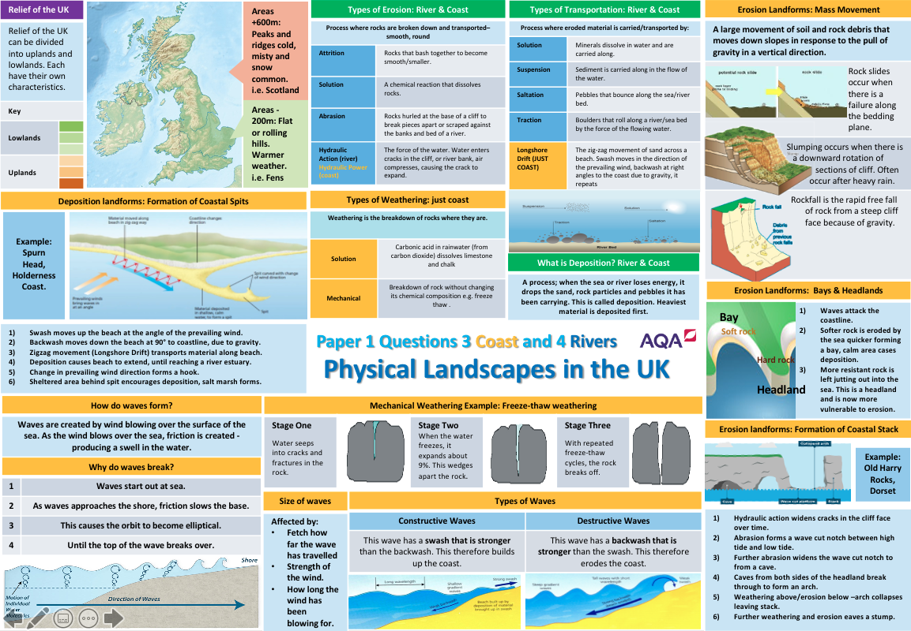

Slide 37
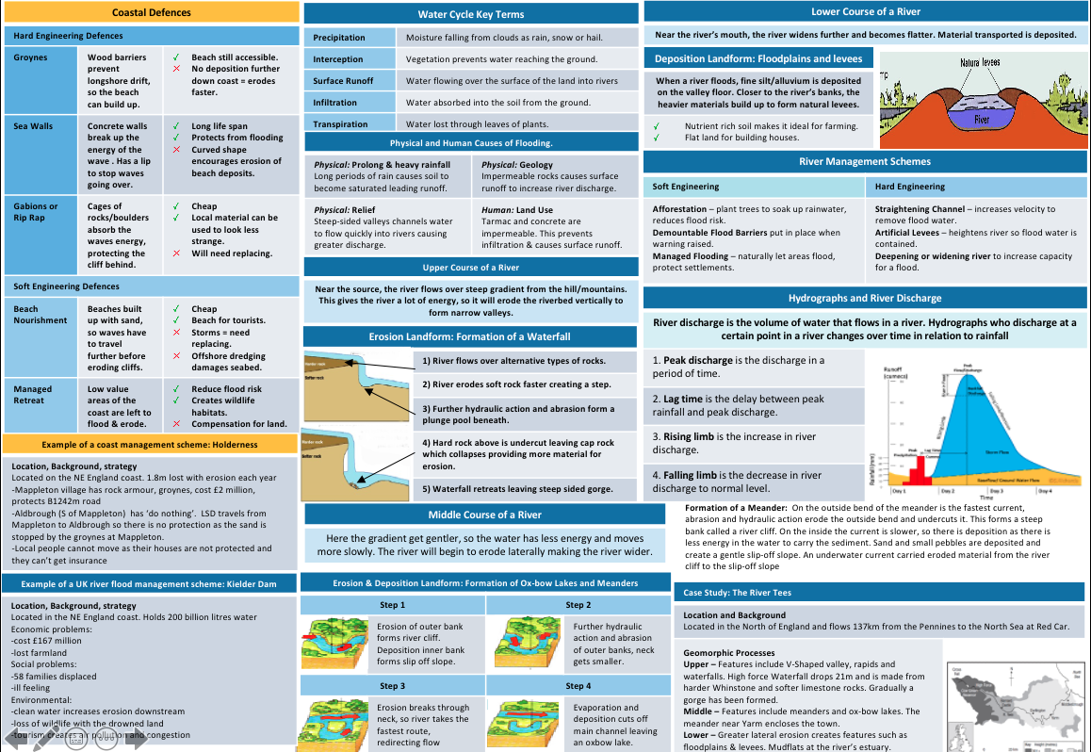

Slide 38
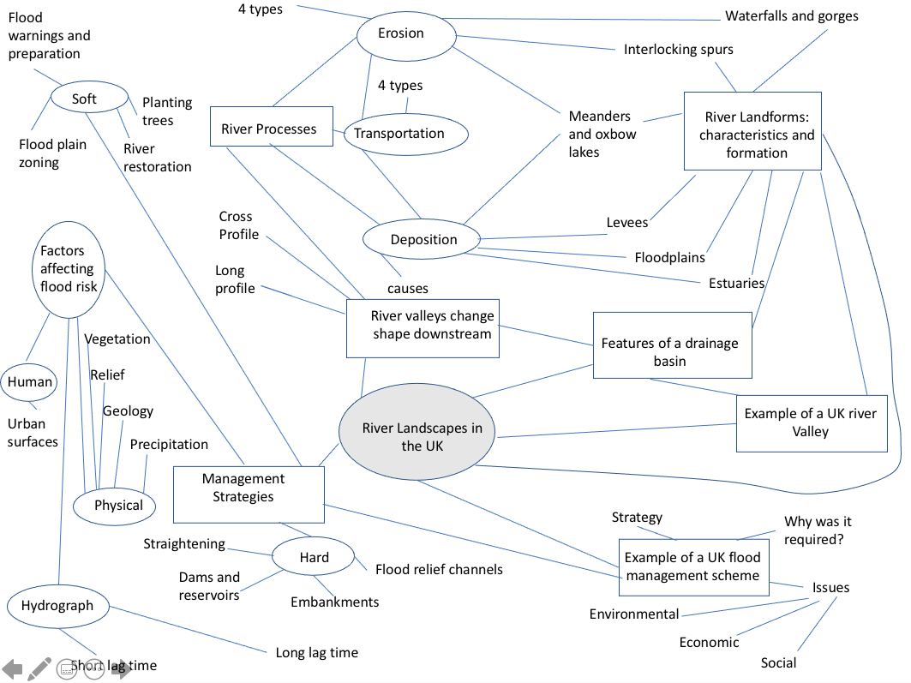

Slide 39
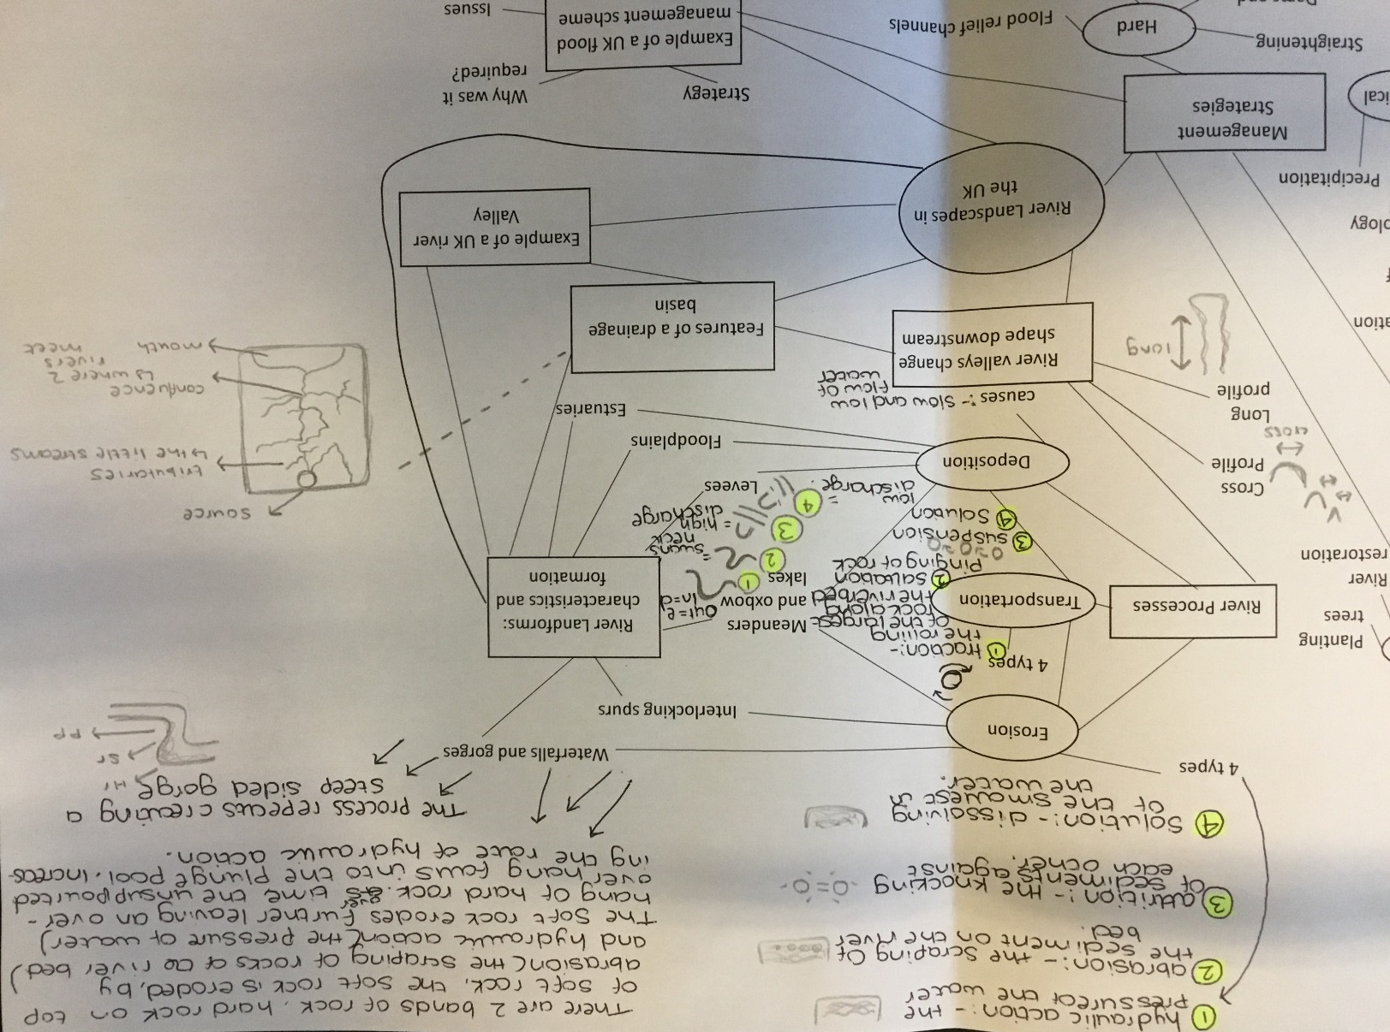

Slide 40
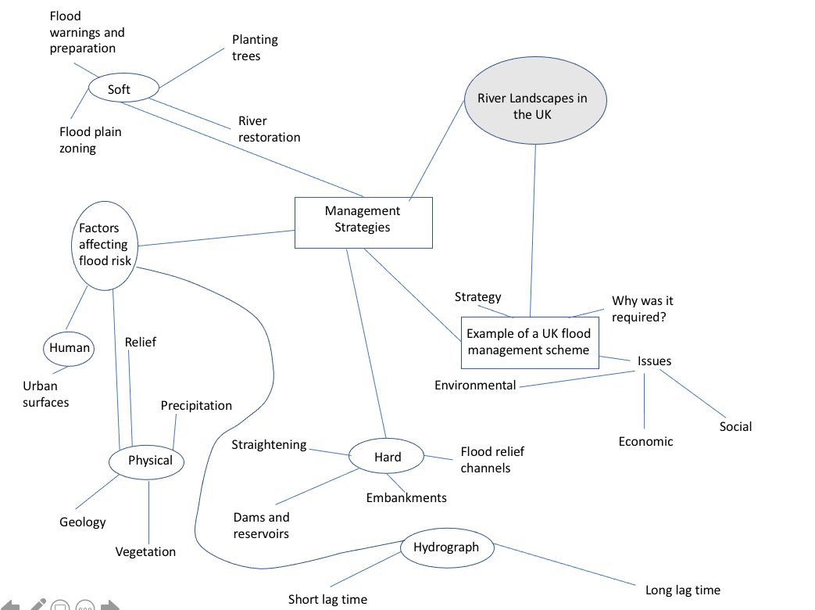

Slide 41
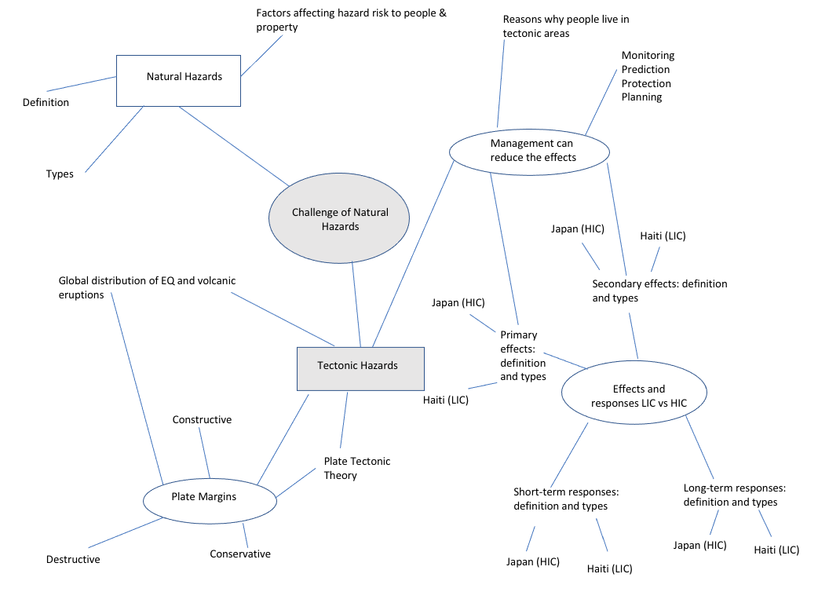

Slide 42
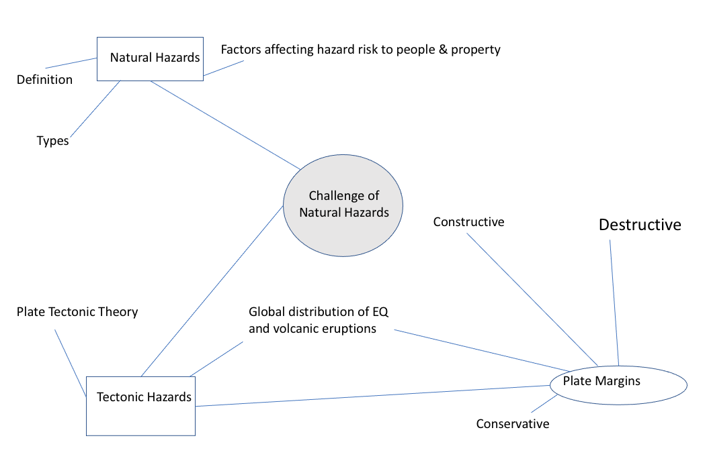
Break it down to reduce cognitive load
For LPA consider removing case study examples

Slide 43
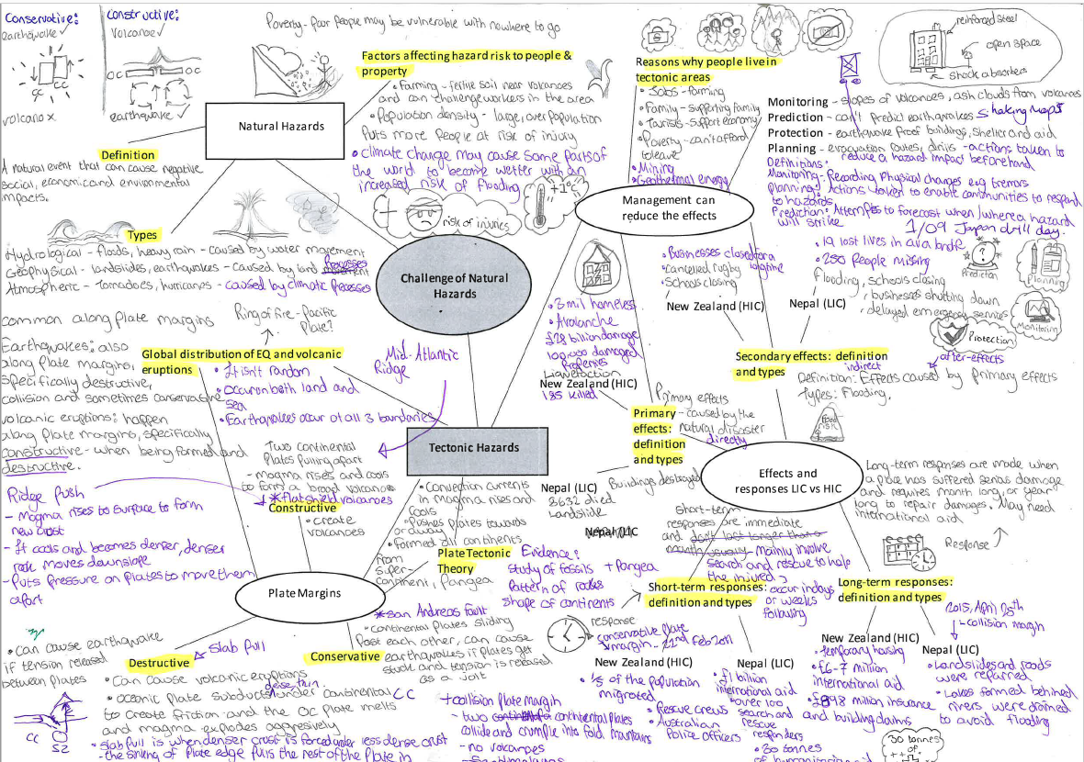

Slide 44
AFL: hinge questions and threshold concepts
A threshold concept is a portal that allows a greater understanding into a subject
If students get ‘stuck’ and don’t understand a threshold concept in their schema it prevents them from making progress later on, e.g. why the climate is colder at the poles than the equator
If a student understands a TC they can access other parts of the spec quicker, because they have a firm foundation to build their knowledge and understanding
Mark Enser
https://www.tes.com/news/watch-how-close-covid-19-learning-gap

Slide 45

Threshold concepts
Social, economic and environmental (and political?)
Scale – understanding the importance of time scale (climate change, short-term/long-term) and spatial scale (local, regional, national and global)
Sustainable development
Synopticity (showing how separate threads of the subject connect)

Slide 46
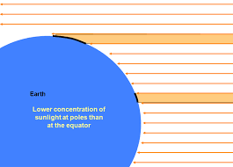
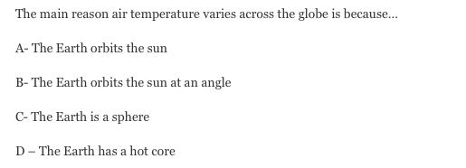
Constant recall/retrieval practice to check the threshold concepts: Set hinge questions to divert the learning
https://srenshaw.wordpress.com/2014/01/12/developing-hinge-questions-in-geography/

Slide 47

Short low stakes quizzes and games to reduce cognitive load and build schemas
‘Register wars’

Slide 48

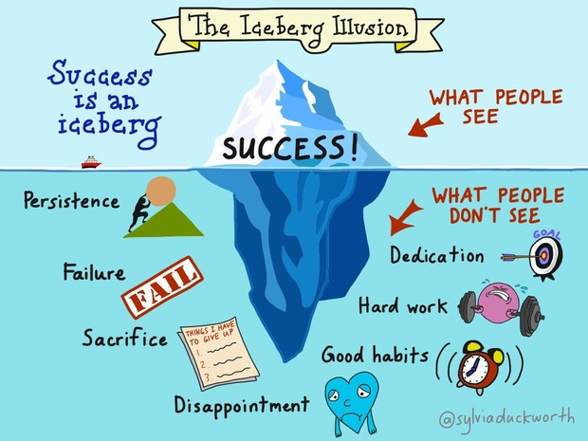
Do now: Quick 6
1 What does deforestation mean?
2 What does logging mean?
3 What is an example of a small-scale ecosystem?
4 What is a food web?
5 What is economic development?
6 What does life expectancy measure?
Challenge: Explain how deforestation can bring economic benefits to a country

Slide 49
Do now: Quick 6
1 What does deforestation mean? | Removal of trees
2 What does logging mean? | Removing trees by cutting them down
3 What is an example of a small-scale ecosystem? | A pond, hedgerow, tree etc
4 What is a food web? | A complex set of links between producers and consumers, many connected food chains
5 What is economic development? | When a country improves and becomes more wealthy. The standard of living increases
6 What does life expectancy measure? | Healthcare, nutrition and housing quality.
Challenge: Explain how deforestation can bring economic benefits to a country

Slide 50
Revision checklist
Questions rather than topics

Slide 51
Short low stakes quizzes and games
Odd one out
1) Attrition Abrasion Saltation
2) Meander Waterfall Gorge

Slide 52

Short low stakes quizzes and games
Just a minute
No repetition, deviation or hesitation

Slide 53
Self mark quizzes/tests Forms, Seneca etc.
Multiple choice questions on ‘Forms’ or similar
Seneca
Educake

Slide 54
Cornell notes quizzing
Plenary in their exercise book
Write quiz questions on the left
Write a summary at the bottom
Test and answer at home

Slide 55
Low teacher expectations
‘Boy friendly’ KS3 SOL can lack high expectations as content doesn’t necessarily drive interest and promotes stereotypes. This is less of an issue with the current national curriculum.
Teachers can sometimes expect less from boys than girls
Setting can be an issue, as previously discussed

Slide 56
Good practice for ensuring high expectations
Recap previous learning
Use models and examples (part 3)
Scaffold for success
Check for understanding (AFL)
Avoid gimmicks
Treat boys and girls the same; high expectations and high challenge
Change our view of them; low and middle ability is fixed
Notes:
Rosenshine’s principles of instruction

Slide 57
Low motivation: seeing the intrinsic value of learning rather than performance goals
Boys tend to focus on a long-term goal rather than enjoy the learning process
Many boys complete learning activities to avoid negative consequences or to get something in return rather than finding the learning process satisfying
Ideas for engagement through effective teaching:
-provide a scaffold for a challenging task (key words/ sentence starters). Circulate and ensure boys are on-task. Get them to experience success.
-discuss ideas with boys and then choose those boys to answer with a developed point
-use a students example under a visualiser and model the writing process to enable metacognition

Slide 58
Low motivation: seeing the intrinsic value of learning rather than performance goals
“You’re better than this” for some students
“I bet you can’t…” for some students
Promote curiosity (addressed later)
Use praise often and specifically

Slide 59
Low motivation: teacher clarity and assessment knowledge
Clarity of explanations (the curse of the expert):
Explicit instruction:
teaching skills and concepts in small steps. Use of audio and video, GCSEpod, Seneca
using examples and non-examples. Use of models such as a walking talking demo and wagolls and wabolls and how to get the most out of them
using clear and unambiguous language
anticipating and planning for common misconceptions. Planning in AFL and hinge-questions
Purposeful feedback
The learning journey (medium and long-term plan)
Understanding exam technique and assessment

Slide 60
Low motivation: Abstract ideas to concrete
Be a ‘story teller’ so students can hook their new learning to their schema
’abstract’ to ‘concrete’

Slide 61
Low motivation: competitive boys
Boys are generally competitive
Competition in lessons can have unintended consequences; ‘losers’ and ‘don’t try’ for risk of failure

Slide 62
Low motivation: competitive boys strategies
Low stakes retrieval quizzing is best
‘Personal’ competition (run your own race/ PB)
Don’t display test scores/grades
Whenever possible do not share grades
Praise effort

Slide 63
Reflection
Which strategies will you try with your students and why?
What have you already tried and has worked well? Why did it work well?

Slide 64

Inspire, motivate and enthuse!
Building in ‘botheredness’
Bring enthusiasm/passion to the classroom
Freshness (starter activities, QI facts, etc)
‘Variety is the spice of life’ (content delivery)
Fieldwork – inside and outside school grounds
Eccentricity (resource ‘souvenirs’, quirky is memorable)
Geographical Association meetings/speakers; Worldwise Quiz, local manufacturers, Colleges, Organisations linked with KS3 topics
Trips to enhance the curriculum, e.g. Chester Zoo for Ecosystems and Cadburyworld for Changing Economic World (TNC Ghana)
Geography environment (classroom posters, weather station, etc)
Rewards and prizes (merits, trip souvenir, etc)
Notes:
Oil sample, headscarf . .etc.

Slide 65
Curiosity – at the heart of a good geographical education
Why is the weather like this?
What is causing climate change?
Why are there homeless people in Rio de Janeiro?
Why are some people facing food shortages in Nigeria?
Why have there been so many fires in Brazil?
Why did the river flood?

Slide 66
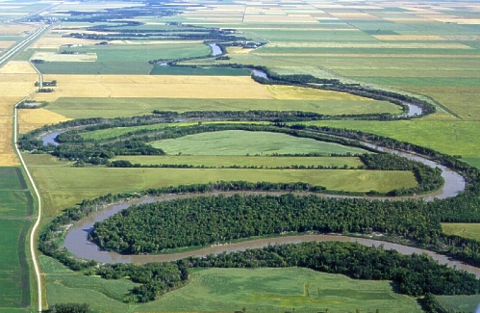
How did the river get like this?
Promote curiosity through starters
Red River, Canada

Slide 67
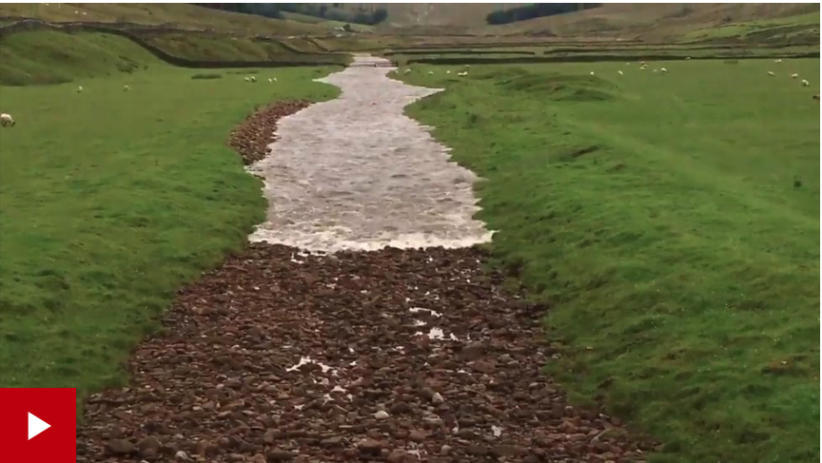
Why is the sediment that shape?
Promote curiosity through starters
Where did the water come from?
https://www.bbc.co.uk/news/av/uk-england-york-north-yorkshire-40672629

Slide 68
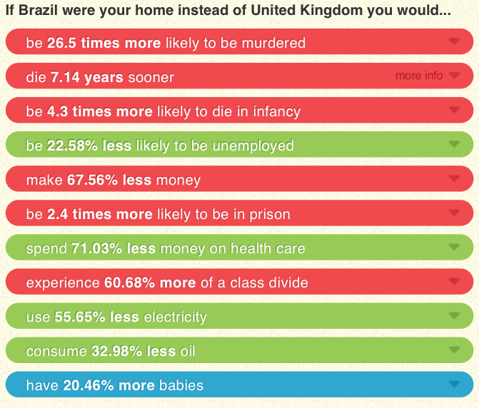
If it were my home….
Promote curiosity through starters
Level 1: What do you know for certain?
Level 2: What can you infer?
https://www.ifitweremyhome.com

Slide 69
Geography outdoors
Fieldwork investigations . . . ask questions, promote curiosity, consider the ‘big picture’, have fun
Use the school grounds . . . consider weathering processes, local ecosystems, urban land use
Bring the outdoors inside . . . encourage use of photos (competitions), homework focusing on local geography (weathering, urban)
Consider ‘interest’ trips, (e.g. Iceland)

Slide 70
Homework
Examples homework (hook to schema- abstract to concrete)

Slide 71
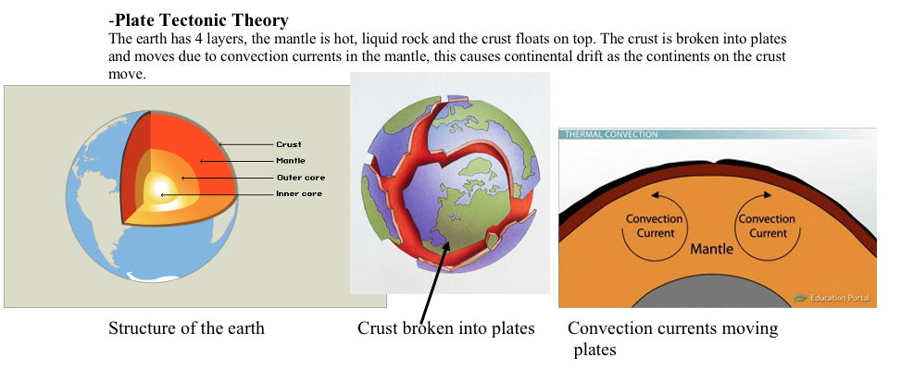

Slide 75

Removing Barriers
Parental engagement:
Increased through communication through phone calls, email, text, postcards, etc.
Promoted through an engaging curriculum, merits, postcards, etc.
Retrieval practice parent card
Date | Topic | / 5 | Comment

Slide 76
2. Improving exam technique

Slide 77
Assessment summary
Exam questions will have an incline of difficulty (high facility-low facility questions)
They will involve multiple choice, stimulus response, skills, and extended written prose
Assessment equates to about 1 mark per minute
Written prose is about 2 lines per mark
Level marking is used in the higher tariff questions (4,6 and 9 marks)
Use of Issues Evaluation in the pre release for paper 3
Skills throughout all 3 papers
Fieldwork examined on paper 3
Notes:
A question refers to the questions on each topic and also to the series of sub questions within each topic questions. Sometimes these will be linked. Generally they start with the easier questions and work up to the 6/9 mark ones but not always

Slide 78
Assessment summary
All three papers have the following types of questions:
Multiple choice, stimulus response, skills and extended written prose questions
Point marked questions (1, 2 and 3 mark questions)
Level marking in the higher awarding questions (4, 6 and 9 mark questions)
Paper 3 has the use of Issue Evaluation pre-release and familiar and unfamiliar fieldwork
Notes:
Quick review of papers and assessment styles A brief outline of the types of questions on the papers

Slide 79
Mark allocations in the exams
34 – 40% of marks for questions were worth 1 – 3 marks
Students must try and gain all the low tariff marks
Try and avoid the basic errors through repeated practice
Beware of questions without lines, completing graphs or diagrams, labelling or annotating photos, double check all skills based answers, watch out for plurals.
Notes:
Common errors are missing out the questions without lines such as annotate and labelling diagrams and completing graphs, plurals ….. Explain the impacts of…. Only need two do not need to cover the whole section of the spec!!
Already discussed

Slide 80
Write to the space available
Each mark has an equivalent of 2 lines (e.g. 4 mark question will have 8 lines)
Write in sentences, avoid using bullet points
Try to restrict the answer to the lines available
Remember 1 mark per minute
If students write too much (using the extra lines) they will run out of time elsewhere and will almost certainly be waffling and repeating themselves!
Notes:
It is definitely worth practising the timing and space
Hand out pieces of paper cut to size for the number of lines plus 4 extra
Get students to draw a red line on their work at the time/line limit and then revise their answer after to see if they could condense it and still get the marks

Slide 81
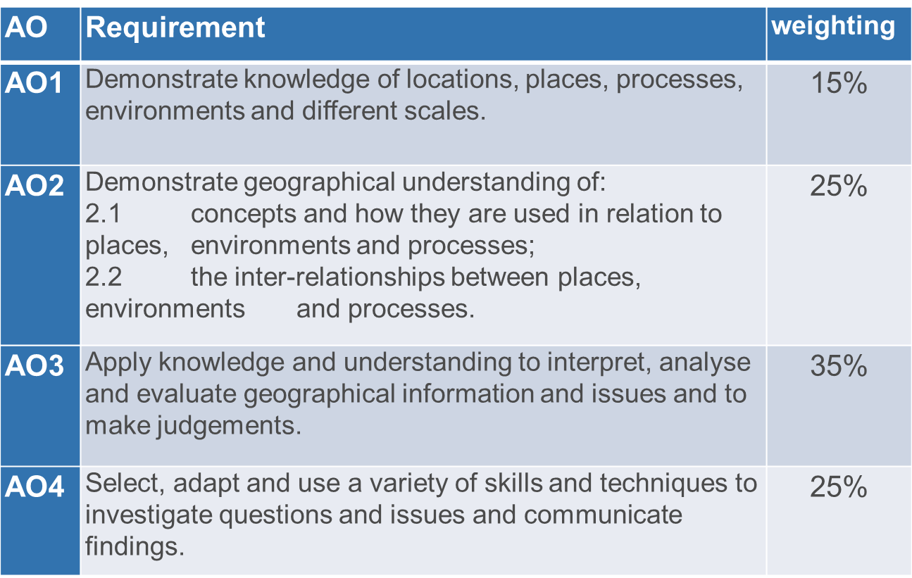
Assessment objectives
Notes:
AO’s quite important for us as teachers, less important for students. We need to understand these in order to mark students exam questions.

Slide 82
AOs per paper
Assessment Objectives (Aos) | Paper 1 (approx. %) | Paper 2 (approx. %) | Paper 3 (approx. %) | Overall weighting (approx. %)
AO1 | 7.5 | 7.5 | 0 | 15
AO2 | 11 | 11 | 3 | 25
AO3 | 8.5 | 8.5 | 18 | 35
AO4 | 8 | 8 | 9 | 25
Overall Weighting of components | 35 | 35 | 30 | 100
Notes:
Note that paper 3 has no marks for knowledge and this will become evident when we look at that section in detail

Slide 83
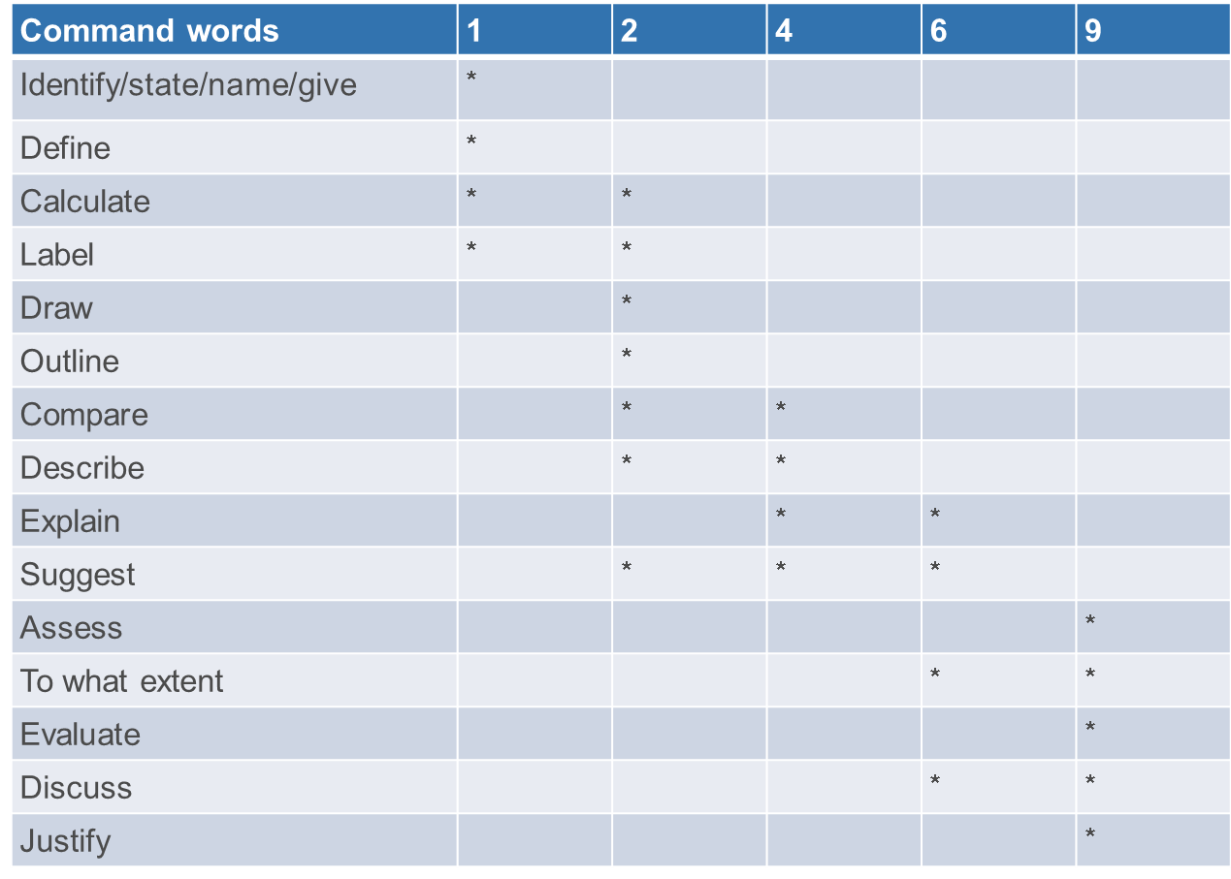
Command words
https://www.aqa.org.uk/resources/geography/gcse/geography/teach/command-words
Notes:
Hierarchy of command words

Slide 84
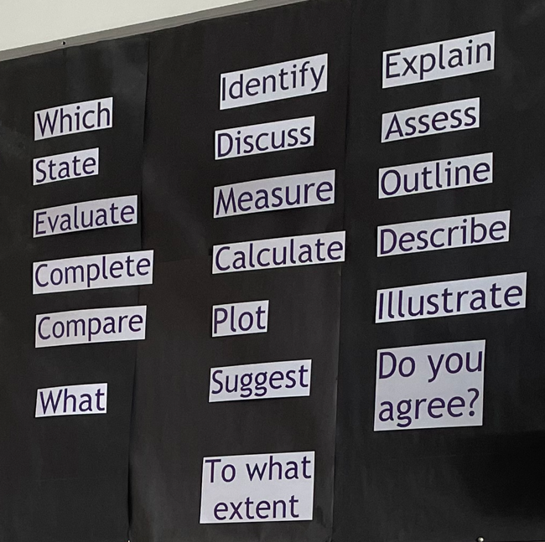

Slide 85
Questions
A range of different question types will be used within all examinations with different mark allocations.
1. Multiple-choice questions. Students are required to select the correct answer from a choice – normally 4
Point marked 1 or 2 marks - students can change their minds and indicate which one they want marked but if they choose 2 answers then there will be no marks
2. Short Answers. Usually a single word, up to a couple of sentences, for between 1 and 3 marks.
These are often describe, outline, complete or calculate questions
Point marked 1,2,or 3 marks
Notes:
You may have to choose 2 correct answers so take care to read the instructions carefully. The best way is often to eliminate the wrong answers leaving you with the correct one or ones
These are often describe, outline, complete or calculate questions. Again read the instructions for example if the question asks for one reason then do not waste your time giving more. Do not forget the units such as KMs, or metres if it a calculate or measure question
Check the command words if it says describe do not explain

Slide 86
3. Extended writing. Usually, a few sentences or a short paragraph for 4 or 6 marks.
These questions will be marked using levels
Levels marked - level 1 (1/2 marks) level 2 (3/4 marks)
4. Extended writing . Questions which require an extended written argument and to draw well-evidenced and informed conclusions about geographical questions and issues for 9 marks
These questions use levels and often have a command words such as assess, evaluate, to what extent, justify and discuss. 9 marks questions should have a conclusion
Levels marked 6 marks level 1 (1/2 marks) level 2 (3/4 marks) level 4 (5/6 marks)
Levels marked 9 marks – level 2 (1/2/3 marks) level 2 (4/5/6 marks) level 3 (7/8/9/ marks)
Notes:
3. These question will be marked using levels so think whilst you are writing
“is my answer basic, clear or detailed?”
4. These questions also use levels and often have command words such as assess, evaluate, to what extent, justify and discuss.
Make a plan to answer these questions to ensure you answer all the parts of the question and remember 9 mark questions should have a conclusion

Slide 87
2 markers
Read the question carefully, generally the examiner wants 2 points or ideas or 1 point or idea and 1 developed point or idea
Suggest one advantage of sourcing food locally in the UK (2)
This answer needs an advantage(1) and a developed point (1)
The local famers get the money(1) which supports the local economy (2)
State two reasons for the location of Tropical storms (2)
This answer needs 2 separate points
There is a large expanse of deep water (1) Sea temperatures are above 27 degrees C
Notes:
This is an easy one to sort it’s all in the question and these questions come up on all 3 papers
Examples on past paper 1 include
Paper 1
Give 2 pieces of evidence for changes in the global temperatures (2)
Outline one reason for the distribution of deserts
Paper 3
Give 2 effect of water stress (2)
Explain why the location was suitable to collect your fieldwork data (2)

Slide 88
Classroom strategies to improve exam technique
Drip, drip effect
Deconstruct questions
Different ways of using exam questions and answers
Using resources in “figure” questions and annotating resources in preparation for attempting high tariff questions
Ensure skills are secure
Notes:
Lots of practice questions – teach the content consolidate with exam question for HWK use notes and textbooks
Use question in class spend some time on this well worth it
2 lots of ways of doing this

Slide 89
1. Drip, drip effect
Talk about levels-marking, amount of time available (a mark a minute) and lines of writing (2 lines per mark)
Deconstruct the question identifying the command word, the geographical content and the focus using which ever technique you choose
Go through the question with the class to a point where everyone is happy
Plan together/for homework/in lesson
Set them off and time them according to the clock
Peer mark/teacher mark/self mark
Feedback/discuss
Possible repeat (learning from failure)
Notes:
Various ways of using exam questions with students – use them all the time low tariff ones and 6/9 mark ones
Use a question at the end of a lesson to consolidate and for HWK
Sources of Question
Exampro
Eaqa – past papers and SAMS
Internet Geography
Boost/Kerboodle – exam style questions pack
Revision guides (Hodder has student MS and model answers online)
Text Books – especially second editions

Slide 90
2. Deconstructing the question
Various systems (e.g. BUG – box, underline, glance at the marks)
Identify command word, geographical content and focus
Use boxes, underlining, highlight pens, etc
Use colours
‘Learning pit’ idea with key terms
This can be done in class, in groups or for homework prior to classroom discussion

Slide 91


BUG The Question Example
Q1. Explain how monitoring and planning can reduce the effects of earthquakes (6)
Box the command word
Underline the key words
Glance at the number of marks

Slide 92
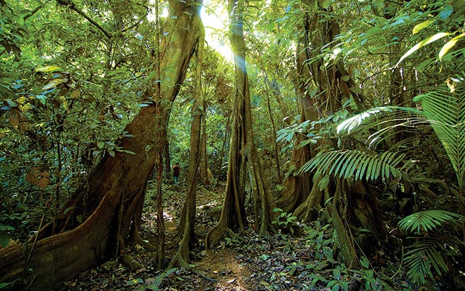
Deconstructing the question
Command words describe (write what you can see) and explain (give reasons)
Describe and explain the features of the vegetation shown in Figure 1. (6 marks)
Geography content and focus (the features)of TRF vegetation)
Instructed to refer to the photo
https://www.nature.org/ourinitiatives/urgentissues/land-conservation/forests/rainforests/rainforests-facts.xml

Slide 93
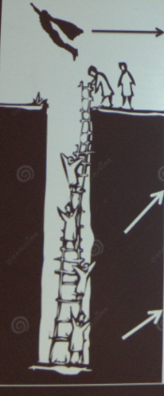
Assess the effectiveness of the immediate and long-term responses to typhoon Haiyan
If you are struggling with levels 1 or 2, ask a friend for help.
Key terms:
Short term
Long term
Sustainable
effects
Level 3: Explain your judgement. Include effects in your answer.
Level 2: Climb out of the pit:
Explain the pros and/or cons of specific immediate and long-term responses to Haiyan
Level 1: Start climbing out of the pit:
Give your judgement
The responses for Haiyan were effective to a (low/medium/high extent). A response was…

Slide 94
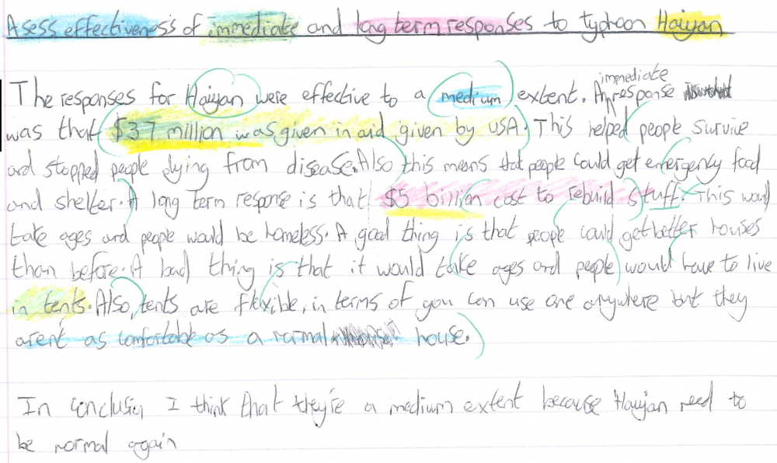

Slide 95
To what extent does a cold environment provide both opportunities and challenges for development?
If you are struggling with levels 1 or 2, ask a friend for help.
Level 3: Fly off
Explain your judgement and use case study information.
Key terms:
Jobs
Opportunities
Challenges
30°C in Longyearbyen
Mineral extraction
Fishing
Tourism
Energy Developments
Frost bite
Inaccessibility
Extreme Temperatures
Building infrastructure
Level 2: Climb out of the pit:
Explain why it is a challenge or opportunity
This is because…
Level 1: Start climbing out of the pit. Give a judgement. Describe:
A cold environment provides opportunities and challenges to a high/medium/low extent. An opportunity/challenge is…

Slide 96
Assess how economic development is affected by the difficult conditions in a hot desert ecosystem
If you are struggling with levels 1 or 2, ask a friend for help.
Key terms:
Extreme temperatures
Inaccessibility
Water supply cholera
healthy workforce commute trade services
exports and imports
extreme temperature heatstroke inaccessible camels
Mineral extraction
Tourism
Energy Developments 40°C
7000 jobs in coal mining in Thar Coal Block 1
Level 3: Fly off Assess the link between challenges and economic development by using many development points and using case study detail
Level 2: Climb out of the pit:
Explain how the difficult conditions affect economic development
This limits economic development because..
Level 1: Start climbing out of the pit:
Describe the difficult conditions
In the Thar desert there are challenges with development to a ….extent. A challenge is..

Slide 97
PEDaL
Point - make a point (e.g. high death toll)
Example – give an example, possibly using data in resource or case study information
Develop – make connections or explain causes as appropriate to the question
and
Link – link back to the question to nail the application (AO3) requirement

Slide 98
3. Different ways of using exam questions
Practising exam questions
Write the plan
Write the answer timed/not timed
Write the answer limited space – 100 words or 10 lines
Peer mark
Self mark
Model answers Marking
Which level?
What mark?
Annotate the level triggers
What to write to improve this
Notes:
Sources of model answers AQA website, Hodder exam practice, your own students from previous years – copy exam papers or questions – re type need examples in here
There are some in the pack you can use also now on AQA SAMS 1 has model answers and model answers were provided as part of 2021 assessment material adapt to your students
This year you may have got your papers back for free so you now have a bank of live answers you can use

Slide 99
Find fault and fix- waboll
1 point: spot an error
2 points: fix an error
3 points: clearly explain the mistake and how you made it better
Cambridge science perk has heavy industry busnesses. It is a good location for busnesses because it is near to the M60 so customers and employyes can commute easily. It has 20 acres of landscaped parks. It has lots of businesses located close togther.

Slide 100
4. Using Resources
Key points for students
Look at the resource carefully
Read the text through several times
Check the axes on graphs
Look carefully at the key on maps
Look really closely at photographs
Annotate the resource
Reword text
Notes:
For students!

Slide 101
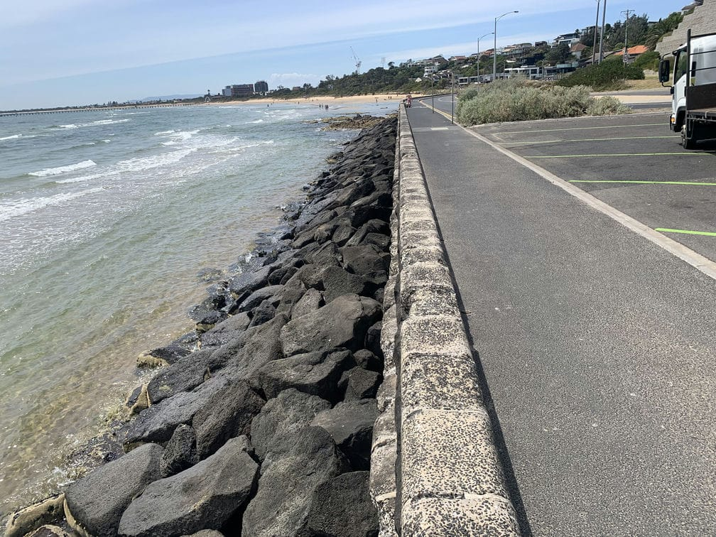
Using the photo, explain how the coast is protected (4 marks)
2 strategies
Laminate photographs
https://www.awmaritime.com/projects_cat/coastal-protection-structures/
Notes:
Waste of time to explain no marks for this

Slide 102
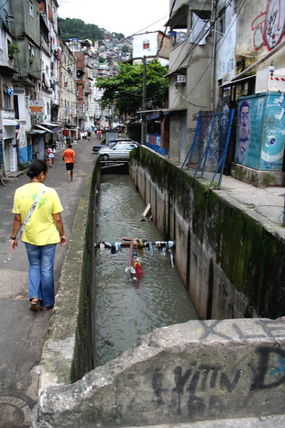
Train your students:
Rich and poor in RIO
Key words:
Social
Economic
Environmental
Challenges
Opportunities
Suggest questions
Level 1: closed questions, e.g. What… When..
Level 2 : open questions, e.g. Why…
Level 3 : probing questions, e.g. Which… To what extent…
https://www.flickr.com/photos/hadsie/3288905571

Slide 103
They can annotate the photograph in order to really look at it
Where is this?
Who owns the land?
How could this place be improved?
Why do people live here?
Do they have running water?
Do they have electricity?
Convert to exam questions
Suggest the challenges and opportunities of living in this shanty town.
https://www.flickr.com/photos/hadsie/3288905571
Notes:
Great starter activities – students write questions – mini white boards then swop and use the photo to answer them – either based purely on what they can see or on own knowledge as well up to you very clear example of this on paper 2 question 2.9

Slide 104
6. Ensure skills are secure

Slide 105
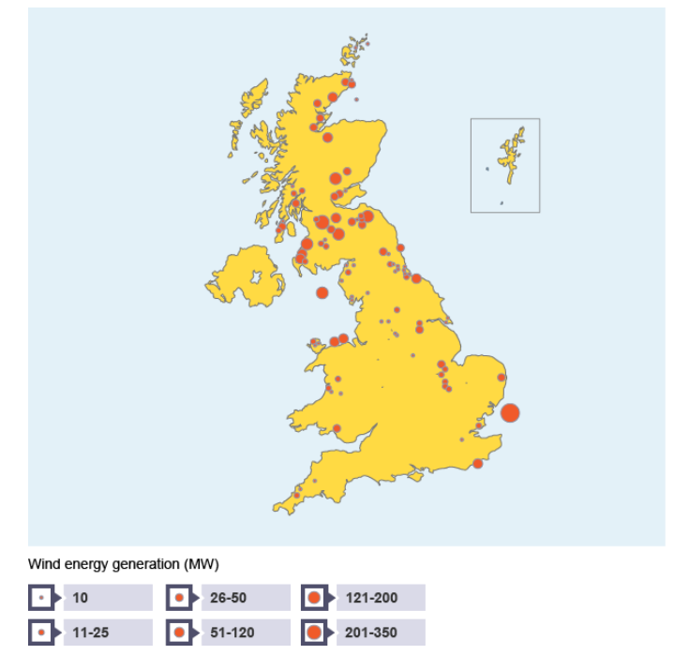
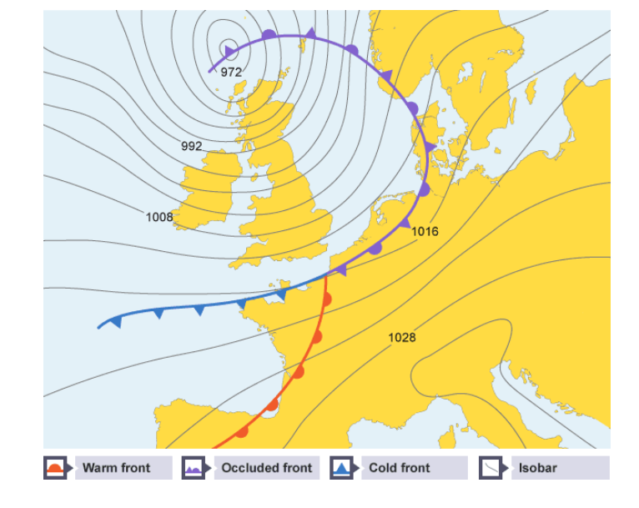
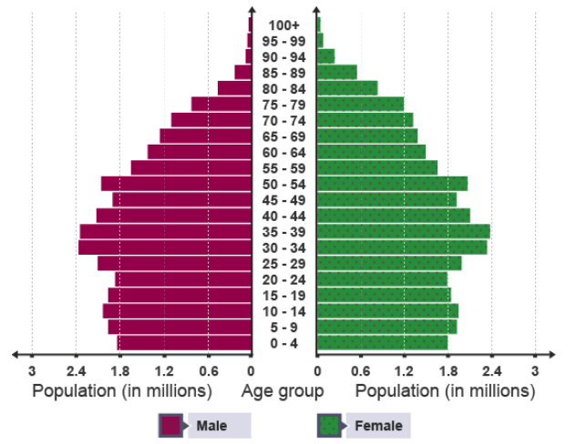
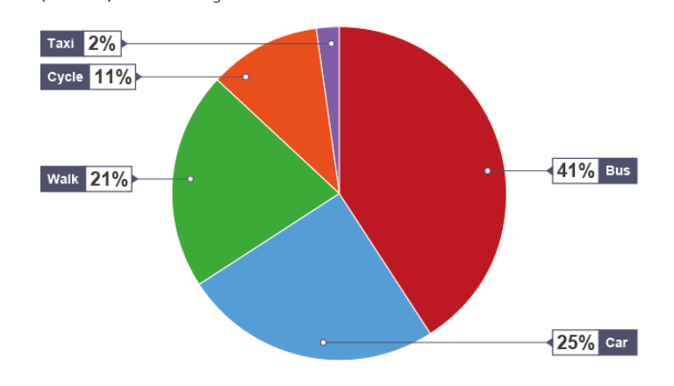
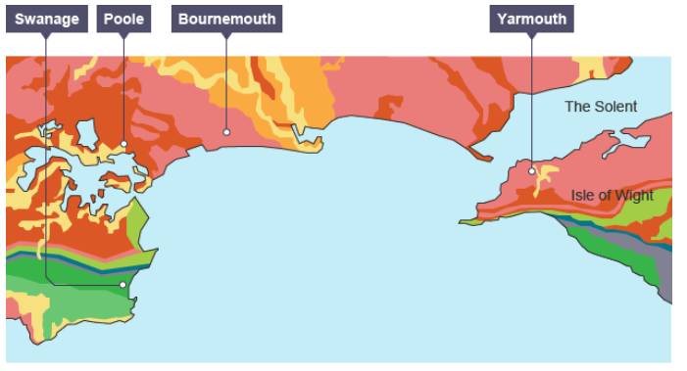
The Importance of Skills
60 marks
BBC Bitesize

Slide 106
‘Grades are an accumulation of marks’
There are 240 marks in total for the three examination papers; 216 marks are allocated to Geography and 24 marks are allocated to Maths/Stats.
36 marks are for Knowledge
60 marks are for Understanding
84 marks are for Application
60 marks are for Skills
12 additional marks are awarded for SPaG
Overall there are 252 marks available

Slide 107
Common mistakes
Confusing compass directions
Incorrect calculations
Failing to attempt completion of graphs
Lack of accuracy when completing graphs
Confusing Eastings and Northings on OS map tasks
Giving 4 fig GR when 6 are asked for and vice versa
Failure to orientate photograph with map of same area
Inability to compare two graphs or two lines on a graph
Confusing temperature and rainfall sections of climate graph
Failure to complete cross-sections from map evidence.
Notes:
From marking and an analysis of the Examiners reports these are the common mistakes made by students which hopefully we can avoid if we have covered the skills well

Slide 108
Graphical Skills for GCSE
Skill | Confidence Level
Line graphs #
Bar graphs #
Pie charts #
Pictograms #
Histograms with equal class intervals #
Divided bar graphs #
Scatter graphs #
Population pyramids #
Suggest appropriate skills for data
Choropleth maps #
Isoline maps #
Dot maps
Desire line maps #
Proportional symbols on maps #
Proportional flow lines
Understand gradient, contour and value on isoline maps #
Interpret maps, graphs and charts noted above

Slide 109

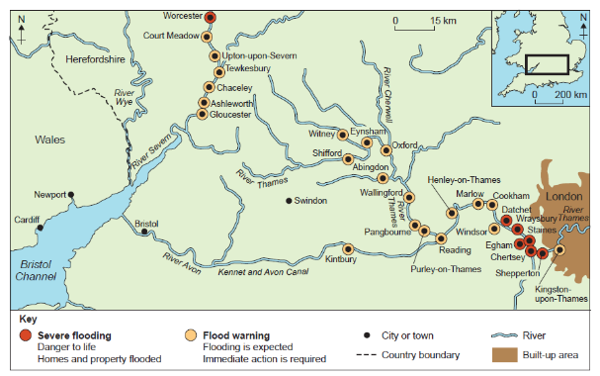

Exam Question- Describe the distribution
CALMS
C- cluster
A- anomaly/
isolated/outlier
L- line/stretch
M- mostly/fewest/
all
S- scattered

Slide 110
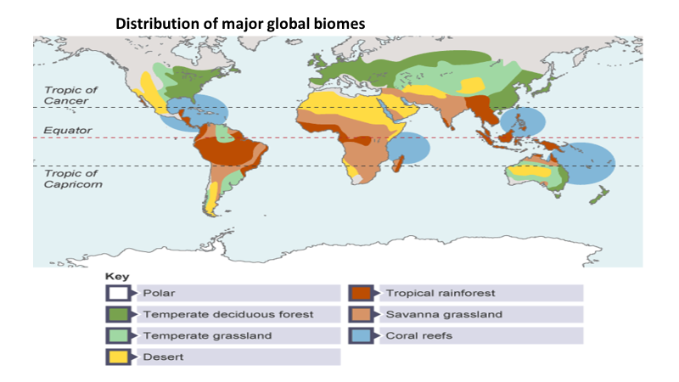
BBC Bitesize

Slide 111
BBC Bitesize

Slide 112
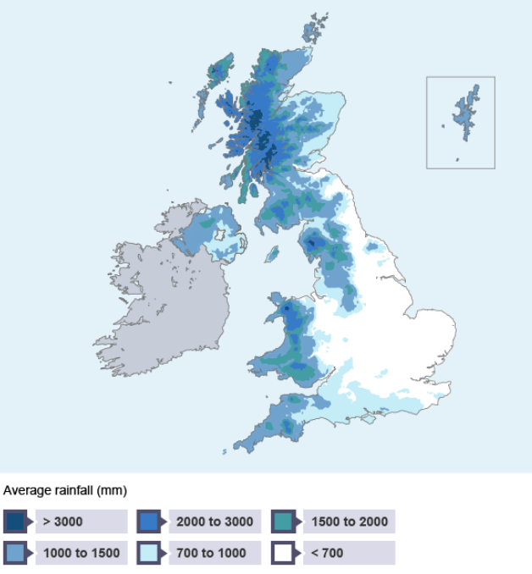

Choropleth map

Slide 113
Choropleth map
Wetter
Drier

Slide 114
Choropleth map
Wettest
Wetter
Drier
Driest

Slide 115
Discrete data
Continuous data
Discrete data take particular values, while continuous data are not restricted to separate values. ... Discrete data can take on only certain values whereas continuous data can take on any value. For instance the number of cancer patients treated by a hospital each year is discrete but your weight is continuous

Slide 116
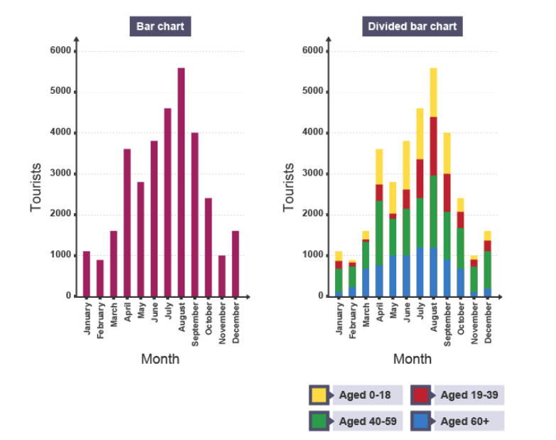

Slide 117
Transport used in Bristol
If you are required to complete a pie chart, you must be 100% accurate and use the correct key (if provided).

Slide 118
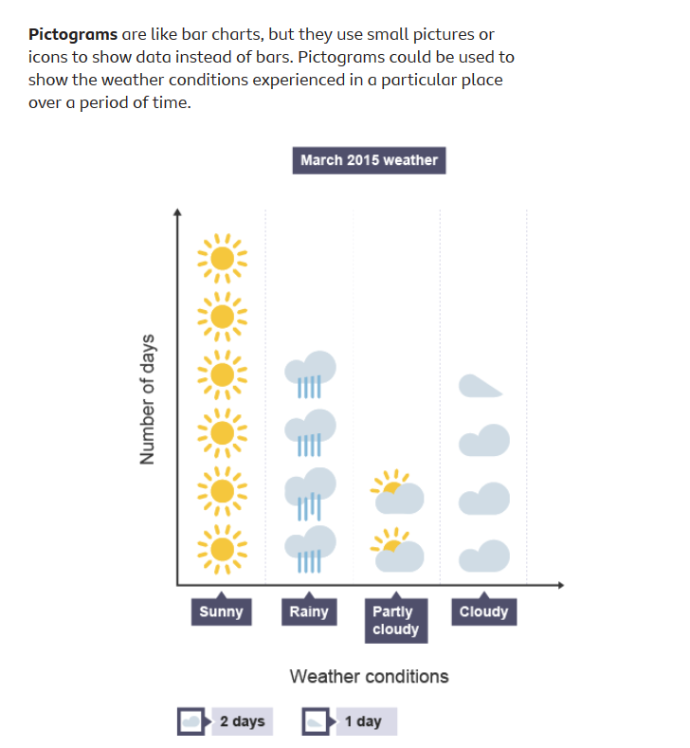

Slide 119
Population Pyramid of Japan

Slide 120
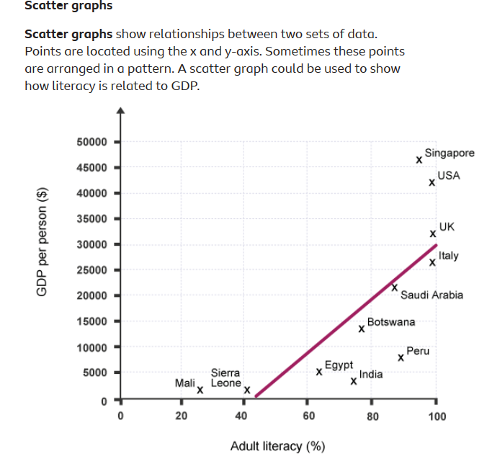

Slide 121

Calculations
Mean
Median
Mode
Quartiles
Interquartile range
Percentiles
Range
Percentages
Lines of best fit
Remember students are allowed a calculator in all three of their geography exams!

Slide 122
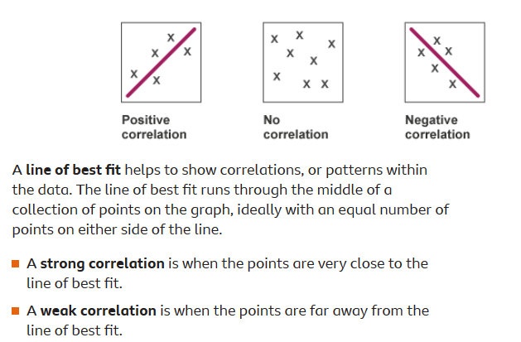

Slide 123
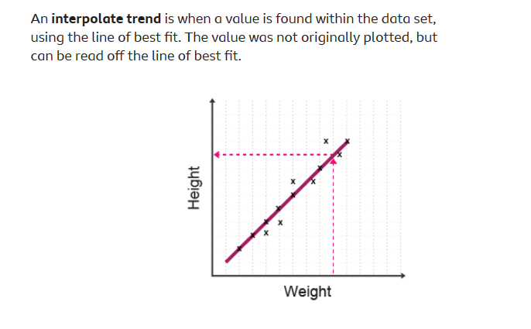

Slide 124
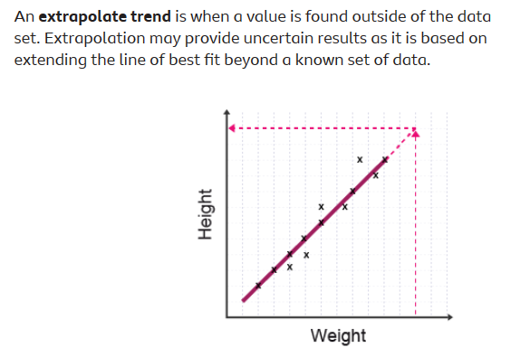

Slide 125
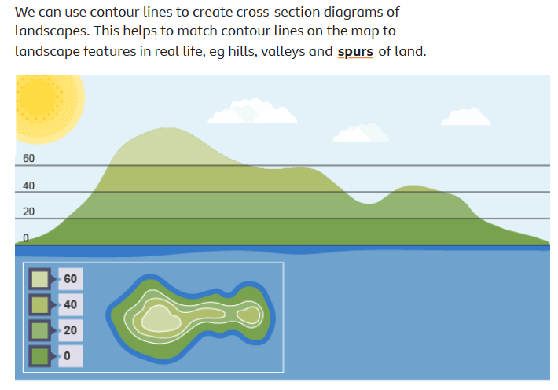

Slide 126
3. Feedback from the 2023 exams (AQA) and strategies to move forward

Slide 127
2023 Main issues in papers 1 and 2
1. Answering the question set
2. Application of concepts to case study material
3. Linking concepts
4. Use of specialist geographical terminology
5. Use of resources/stimulus material and the application of understanding AO2 to those resources along with “lifting” material
6. Following clear instructions for the maths-based questions
7. Need for organisation of information to give a clear and concise answers
8. Missing out some of the questions (especially graph completion questions
How can we tackle these?
Notes:
So from the Principal examiners report we can see these are the main issues.
Fairly predictable and as expected
Some of these can be easily fixed (hopefully) but we will go thruogh them all and look at some exemplars of the main errors

Slide 128
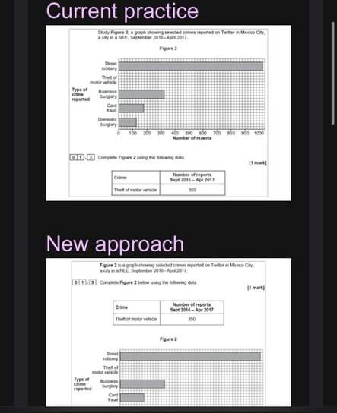

Slide 129


Slide 130
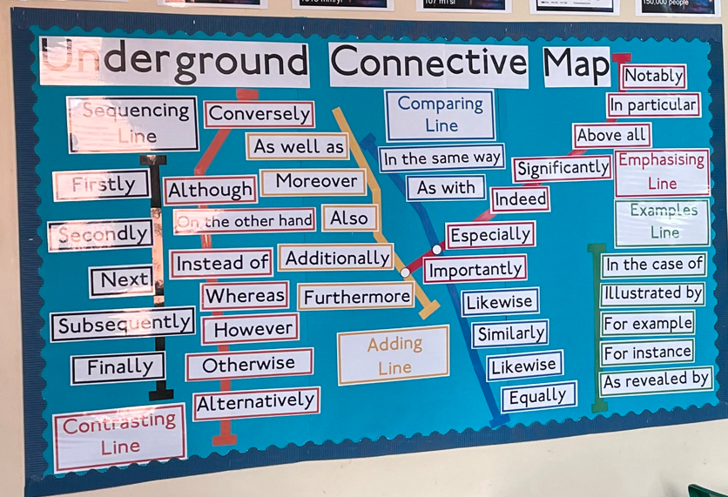
https://www.tes.com/teaching-resource/connective-underground-map-6425335

Slide 131
Consensus and key word bullseye

Slide 132
Scouring
1 mark
3 marks
crack
stack
cave
5
marks
erosion
cave
deepens
hydraulic action
stump
biological
weathering
breaks
through
base
widens
headland
cliff
arch

Slide 133
 | Target | Actual
5 point words
3 point words
1 point word
Overall total

Slide 134
How do stacks and stumps form?
Consensus- 10 minute independent activity
Shade in where the erosion would happen
Explain the process using the key words in the target
Firstly… secondly then moreover finally

Slide 136
Consensus
Consensus
Consensus
Consensus
Consensus

Slide 137
Consensus
Consensus
Consensus
Consensus
Consensus
Consensus

Slide 138
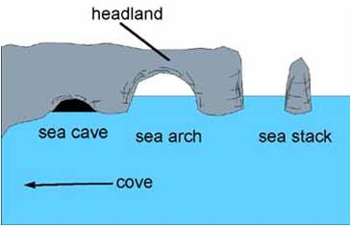
Explain how stacks and stumps form
Firstly…
secondly
then
moreover
Finally
-erosion: hydraulic action-the force of the water
-biological weathering
Level 3: Fly off
Explain the sequence in order using all of the key words
Level 2: Climb out of the pit:
Explain the sequence using key words
Level 1: Start climbing out of the pit:
Describe the sequence of the landform formation.
Firstly a crack forms in the headland by..

Slide 139
Modelling exam questions
Students need to answer the 2018 Qu 1 6 marker on a constructive plate margin independently
To do that they will first watch you model the SAM 3 Qu1 6 marker on a destructive boundary
They will then plan out their 2018 question in pairs
Then they will complete theirs on their own
‘you do’, ‘we do’, ‘I do’

Slide 140
SAM 3
Using figure 1 suggest why both volcanoes and earthquakes occur in Japan (6 marks)
How would you model this answer?
What resources would you use?
What steps would you take?
https://www.earthobservatory.sg/news/great-east-japan-tohoku-2011-earthquake-important-lessons-old-dirt

Slide 141
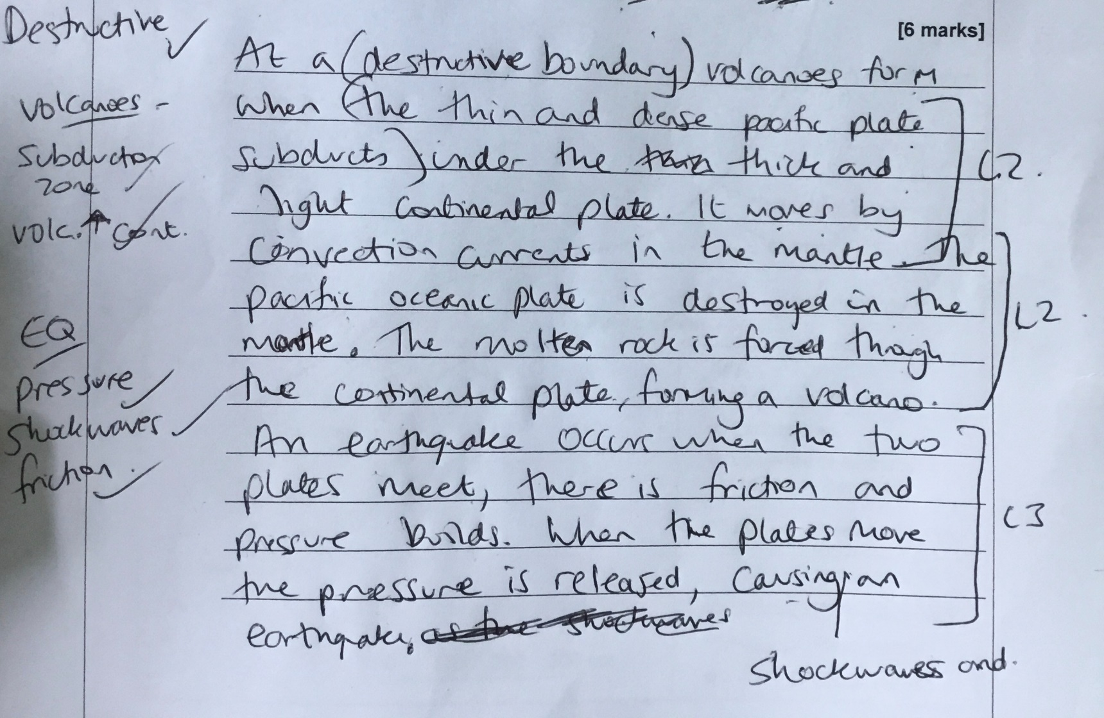

Slide 142
2018
Using figure 1 and your own understanding, suggest how plate movements cause tectonic hazards (6 marks)
https://en.m.wikipedia.org/wiki/Geology_of_Iceland

Slide 143
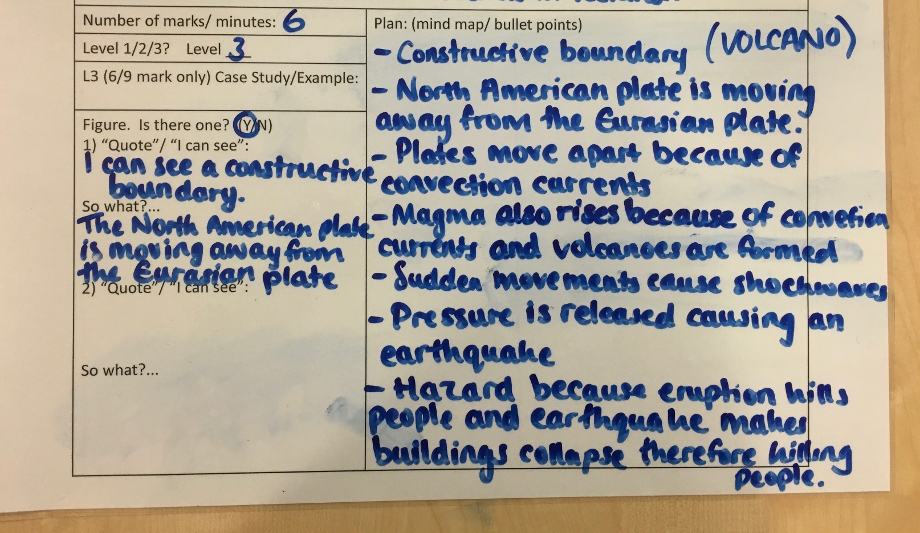
Exam question grid 2018

Slide 144
1) Copy the question. 2) Circle the command word 3) Underline important parts of the question 4) Write what the main words mean above or below each word.
Number of marks/minutes: | Plan: (bullet points / mind map, etc.)
Circle the maximum level: 1 2 3
L3 (6/9 marks) Name of the Case Study/Example(s): 2-4 specific facts:
Figure. Circle if there is a figure: Yes No Suggestions: -Text: Put the text in my own words -Graph: What is the trend? -Image: What are the important features?

Slide 145
Help sheet
This was a problem because…
This led to….because
Feature

Slide 146
Subsequently
Consequently
This leads to
However
Additionally
Because
Therefore
In addition to this
Notes:
Or you can give them a selection and they add them in
After time, you can remove them completely

Slide 147
Assessment for Learning: Effective feedback
Feedback should be timely, easy to understand, motivational, diagnostic and acted upon
Comments should be clear
Managerial feedback should be limited (task completion/ neatness) as it lacks clarity for how students can improve
Only give grades when absolutely necessary
So, reduce marking and give timely feedback.

Slide 148
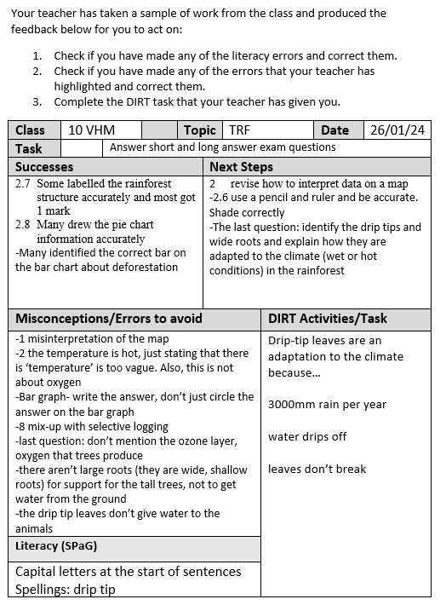
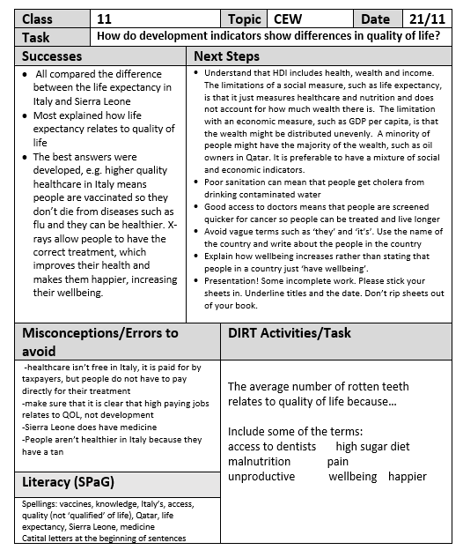

Slide 149
QR code
Free to use
Print off 50 QR codes at a time
Scan them with your phone
Record your message
Can be used for modelling,
exam feedback per question, book marking, etc
https://uk.qwiqr.education

Slide 150
4. The pre-release and fieldwork strategies

Slide 151
Going beyond the resource (developing points)
Common L2 triggers were:
-‘disposable income’
-‘attract TNC investment’
-‘improve infrastructure’
-‘biodiversity’ (for 2.6 and 3)
-‘formal and informal employment’
Students need to be aware that they need to develop copied statements. Get students to quote anything that is copied.

Slide 152
Synopticity in the pre-release
When the pre-release comes out think about:
What GCSE topics link here (synopticity)?
What opportunities are there for pattern questions, data trends and maps?
What opportunities are there for comparison questions?
What terms can you annotate that will be the ‘trigger words’ to get the students to L2?
What main ideas are involved?
Suggest the likely theme/s of the main 9 marker question

Slide 153
ENQUIRY SEQUENCE: Questions 4 and 5
Identify suitable question
Select, measure and record data
Process and present findings
Describe, analyse and explain
Conclude
Evaluate

Slide 154


Does traffic congestion increase noise pollution at school start and finish times?
Why is this a good location for a school study about noise pollution/ traffic congestion?
Decimeter vs EQS
https://www.tts-group.co.uk/decimeter-handheld-sound-meter/1003947.html
https://www.theboltonnews.co.uk/news/3744317.parents-in-parking-row-with-school/
Equipment- accurate but expensive and difficult to use
EQS- easy to conduct but less accurate

Slide 155

What could limit your data collection?
What are the risks?
What is the risk management?
Why is this a good location for a river study?
What data could you collect?
How could you present your data?
How could you improve the reliability or accuracy of your data?

Slide 156

What could limit your data collection?
What are the risks?
What is the risk management?
Why is this a good location for a coastal study?
What data could you collect?
How could you present your data?
https://www.britannica.com/place/Blackpool
How could you improve the reliability or accuracy of your data?

Slide 157
Regeneration in Blackpool (short title!)
Do the impacts of regeneration in Blackpool decrease with distance from the beach?
Site | Distance from coast (m) | Description | Building attractiveness | Traffic management | Public amenities (lighting/ signage/ benches/ bins, etc) | Accessibility | Total
1 | 0 | Seafront (west) Seating area by the mirror ball | 4 | 5 | 5 | 5 | 19
2 | 100 | Solaris Park | 4 | 5 | 4 | 5 | 18
3 | 200 | Bus Shelter on Harrowside | 3 | 4 | 3 | 5 | 15
4 | 300 | Corner of Brixham Place | 3 | 3 | 2 | 4 | 12
5 | 400 | Delphi Wellbeing near Stony Hill Avenue | 5 | 2 | 1 | 4 | 12
Suggest how the method could be adapted
Suggest an additional data collection method

Slide 158


Slide 159
 | How effective? | Benefits | Negatives/problems with reliability | Improvements
Data collection method | Mostly | 4 factor EQS enables a mean for each site, so the mean can be compared Systematic sampling removes bias 5 samples: allows for a comparison between sites. No equipment is needed, so it is easy to conduct | Only 4 factors, so any anomalies greatly affect the mean; make it higher or lower We could not sample in a straight line because of a lack of public access (residential and business properties were in the way) so we may have missed key regeneration features Only 5 sites 100m apart, so any regeneration between these points will not be recorded Opinion-based, so the data is subjective | Sampling 10 sites 50 m apart rather than 100m would enable a larger sample size and a more reliable mean. This would ensure a larger sample size and more data that is representative of the area Compare the survey with a partner and take an average of the scores to increase the reliability of the data, as there is less chance of anomalies. Any inaccurate opinions about the regeneration features will be reduced.
Data Presentation | Mostly | Located Bar charts show how regeneration scores vary between sites on the map, so they can be compared. Shows distribution of the data and anomalies (e.g. traffic management site at 5, as the junction to the East could be seen). The same units on the y axis allow an easy and reliable comparison. | unit scale on the y axis is whole numbers (0,1,2 etc), so it is hard to read the average score, e.g. site 4 is 2.3, which means that the results can be misread. | unit scale on the y axis could be in 0.5 intervals to allow for more accuracy when reading results and allows for reliable data comparisons
Results | Mostly
Conclusion | Mostly |  |  | .

Slide 160


Longshore drift in Blackpool
Does Longshore drift move from South to North along the coast at Blackpool?
How effective is the data presentation?

Slide 161

River study at Colne
Does the river become narrower and deeper after the dams?
How effective is the data presentation?

Slide 162
Cover the enquiry sequence
Ensure students know what the six stages are
How they link together
How they facilitate a geographical investigation
The 9 marker in question 5 will have 2 parts of the strand
Give students a copy of the enquiry sequence diagram.
Discuss and annotate each stage

Slide 163

Final points
Thank you
You play an important role
There are many factors affecting the success of students in your classroom
You cannot be solely responsible for their decisions, behaviour and success

Slide 164


Vicky McKinlay
Linkedin: Victoria-mckinlay-fcct
x/Twitter: @vmckinlayfcct
Email: Vicky.mckinlay@icloud.com
Please provide feedback using the link: https://forms.gle/q6JXCA2Hyz5hSvvu6

