Slide 1
How do stacks and stumps form?
Consensus- 10 minute independent activity
Shade in where the erosion would happen
Explain the process using the key words in the target
Firstly… secondly then moreover finally

Slide 2
Consensus
Consensus
Consensus
Consensus
Consensus

Slide 3
Consensus
Consensus
Consensus
Consensus
Consensus
Consensus

Slide 5
 | Target | Actual
5 point words
3 point words
1 point word
Overall total

Slide 6
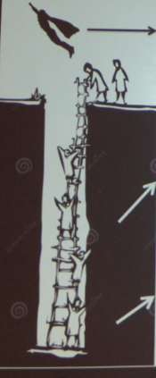
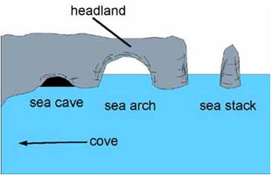
Explain how stacks and stumps form
Firstly…
secondly
then
moreover
Finally
-erosion: hydraulic action-the force of the water
-biological weathering
Level 3: Fly off
Explain the sequence in order using all of the key words
Level 2: Climb out of the pit:
Explain the sequence using key words
Level 1: Start climbing out of the pit:
Describe the sequence of the landform formation.
Firstly a crack forms in the headland by..

Slide 7
Scouring
1 mark
3 marks
crack
stack
cave
5
marks
erosion
cave
deepens
hydraulic action
stump
biological
weathering
breaks
through
base
widens
headland
cliff
arch

