Slide 1

Pillar 1: Subject Expertise
December 2023

Slide 2

Our vision
To facilitate the gathering of best practice curriculum implementation strategies.
This is so that we help subject leaders and teachers to in turn help all children to know and remember important knowledge across subject curriculums.
To support subject leaders in evaluating the impact of their subject curriculums.

Slide 3
Structure
BLA Executive Board
Hub Executive Board
Linda Emmett
Caroline Molyneux
Ed Kirk
Michelle Dickinson
Hub Leadership Team
Subject Hubs and SEND Hub

Slide 4
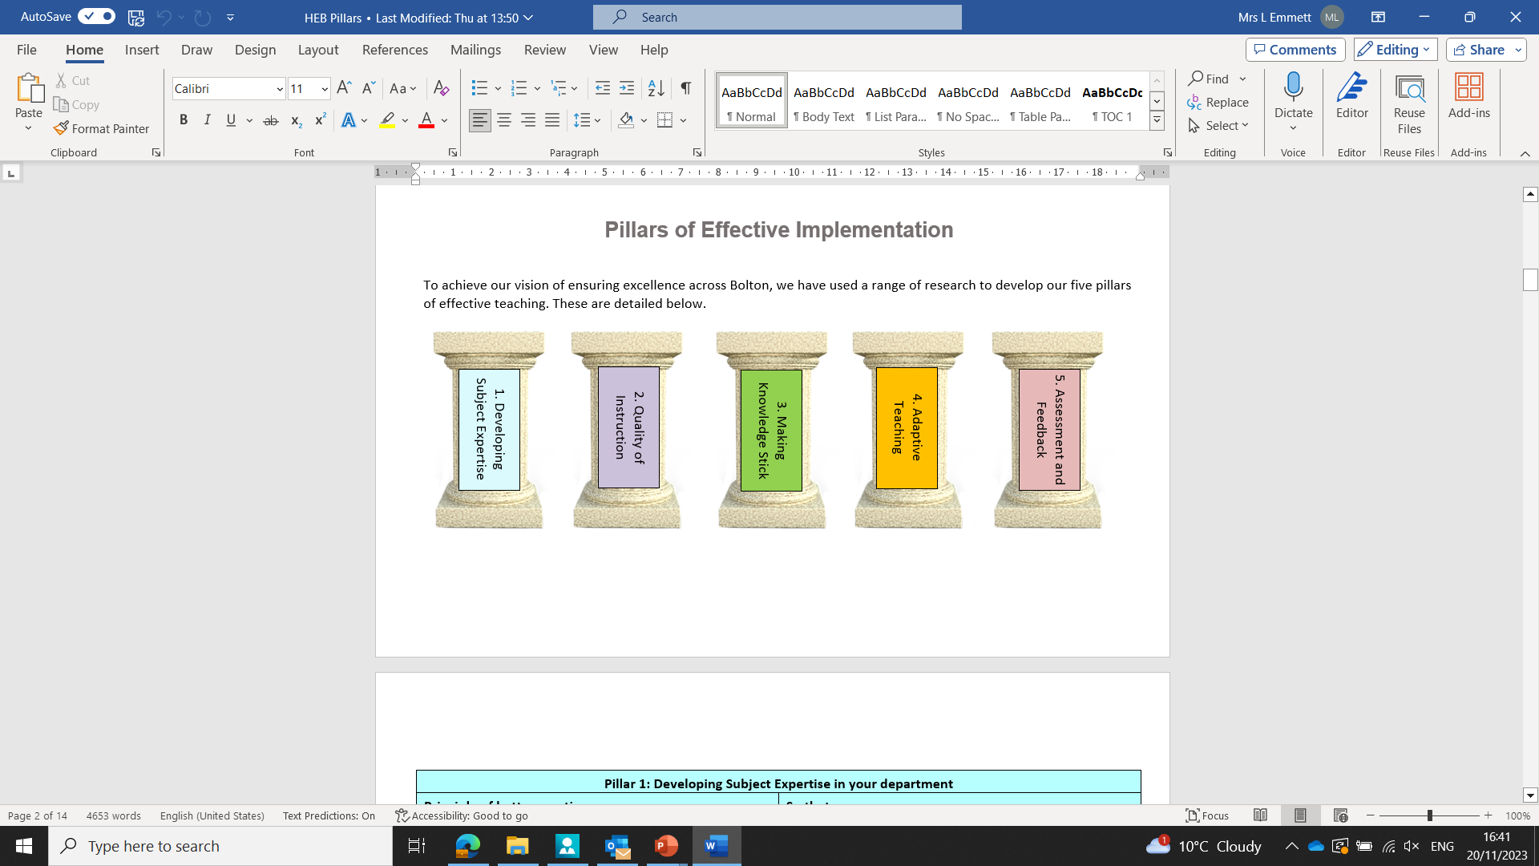
The Pillars of Effective Curriculum Implementation

Slide 5
Developing subject expertise so that teachers demonstrate strong expertise in their curriculum area.
Teachers use effective pedagogy to help pupils to know and remember more.
Pupils form a deep understanding of intended knowledge.

Slide 6

Discussion Point
What was on the agenda of your most recent subject department meeting?

Slide 7
What proportion of the time was allocated to developing colleagues’ curriculum expertise?
Discussion Point 2: What do we mean by subject expertise?

Slide 8
What does high quality subject expertise look like? In your subject?
Subject Knowledge
Subject Expertise
Relevant qualifications
Can design an appropriately sequenced lesson and develop longer term schema.
Secure knowledge of methods and facts
Can give effective explanations to help all pupils to understand
Examiner knowledge for exam board
Can adapt a lesson in response to assessment information.
Ability to readily apply facts within complex scenarios
Can pre-empt misconceptions and give effective explanations to overcome them

Slide 9

Why is subject expertise important?

Slide 10
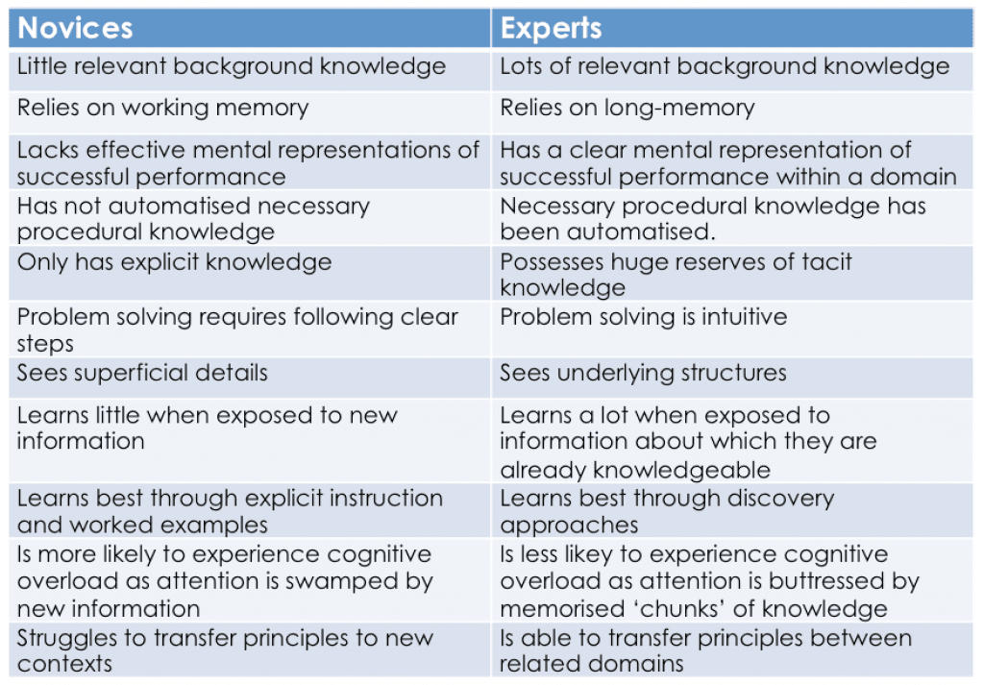

Slide 11
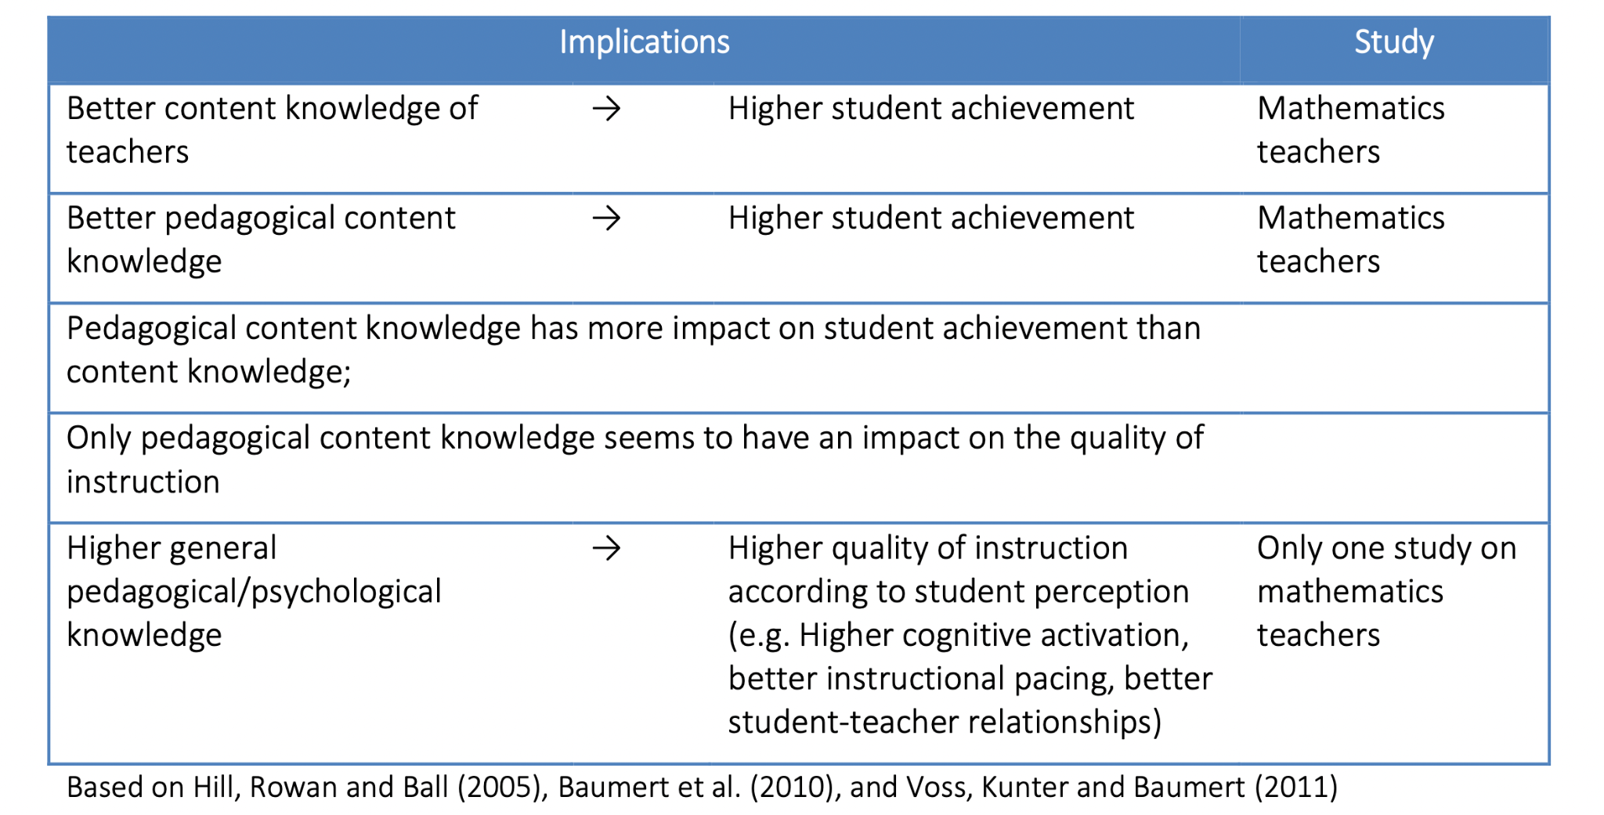
Teachers as Learning Specialists

Slide 12
How do we help with these challenges?

Slide 13





School and subject curriculum planning
Commensurate with the national curriculum (or better)
The curriculum identifies the most important knowledge that all pupils need to learn and when.
Curriculum is planned and sequenced to build on, and deepen, what has been taught before.
‘End points’ - what the curriculum is building towards.
Reading, vocabulary and cultural capital, are prioritised.

Slide 14
Powerful Curriculum Team Discussions
“Continuously curious, continuously reflective”
Allocate Regular Time
Review of prior learning
Implementation of future learning
Facilitate Peer Planning
Check!

Slide 15

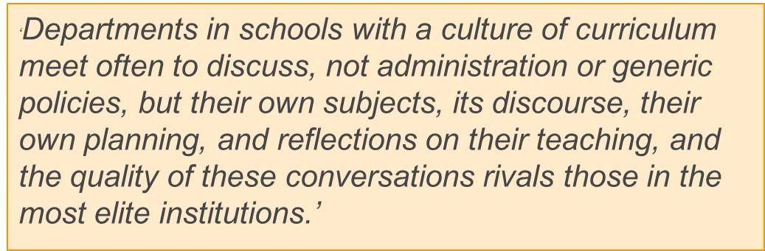

Slide 16
Activity: What might this look like?
Jane is leading her history department meeting. Last week, the department delivered lessons on ‘how William secured control of England in the 11th century’. Jane asks teachers which misconceptions were identified from formative assessment in lessons. All classes confused Harald Hardrada and Harold Godwinson. In one class, pupils struggled to understand why the Doomsday Book was so significant.

Slide 17

Discussion Point
Take a forthcoming lesson or learning point from your scheme of learning.
Use the ‘powerful curriculum discussion’ to talk about how you might have a departmental discussion in your subject.
What has been taught before?
What misconceptions arise from this?
Where do you place X in your lesson sequence and why?
What pedagogy do you use to deliver this (include abstract concepts).
How do you break X down to smaller components for pupils with SEND.

Slide 18
Facilitating Effective Curriculum Discussions
What could be on your department agenda to support the development of effective curriculum expertise in your subject department?
To help specialist teachers?
To help non-specialist teachers?

Slide 19
What would we see in X department meetings?
A review of prior learning and what learning is coming up (books).
A discussion around intent and essential knowledge.
A discussion about sequencing within an upcoming lesson.
A discussion about potential misconceptions or tricky/abstract concepts.
A discussion about effective pedagogy or explanations to support tricky concepts.
Exploring modelling or scaffolding for a particular concept.
A discussion about approaches to address misconceptions that have arisen from previous lessons.

Slide 20
Discuss and Share:
How else can we further develop our colleagues’ subject expertise?

Slide 21
Subject Hub Reflection Tool

Slide 22
Summary Points
Curriculum intents are not good when left sat on a shelf!
Subject expertise is more than knowing subject content.
Pupils all the way to Year 11 are novice learners and need to benefit from strong pedagogy which helps them to know and remember more.
Subject leaders should have regular time to develop their teachers’ expertise in how we deliver our subject to novice learners.
Be outward looking – there is a range of books, research pieces and sources of best practice across subjects.

Slide 23

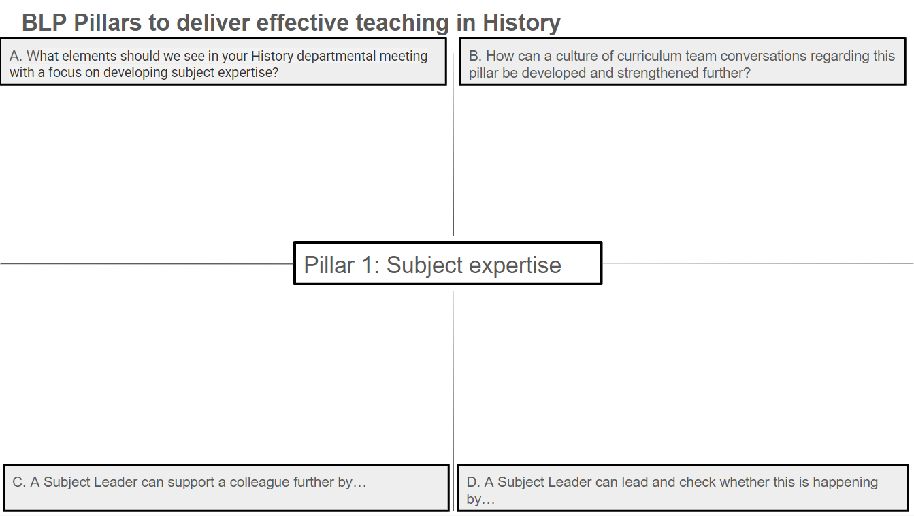
Subject Hub Reflection Tool
https://docs.google.com/forms/d/e/1FAIpQLSeMaDmkTJ-HjHxI3pyO8j0EPApYFq8bL14dPomSmVh_0sns1g/viewform?usp=sf_link
Notes:
Linda and Ed The subject hub reflection tool is one document completed with all hub members contributing. This will be fed back to the Hub Executive Board to aid next steps.
We can also use this to create a reference library for best practice resources. Please list any resources that you have discussed in your sessions.

Slide 24
Summary Points
Curriculum intents are not good when left sat on a shelf!
Subject expertise is more than knowing subject content.
Pupils all the way to Year 11 are novice learners and need to benefit from strong pedagogy which helps them to know and remember more.
Subject leaders should have regular time to develop their teachers’ expertise in how we deliver our subject to novice learners.
Be outward looking – there is a range of books, research pieces and sources of best practice across subjects.
Notes:
Michelle The subject hub reflection tool is one document completed with all hub members contributing. This will be fed back to the Hub Executive Board to aid next steps.
This will also aid member who could attend the meeting to learn from best practice discussed.

Slide 25

Summary Points
Next Meeting Alex Fairlamb will be joining us on March 19th 1.30pm - 3.30pm to share her ideas and expertise about What is History Teaching, Now!
Notes:
Michelle The subject hub reflection tool is one document completed with all hub members contributing. This will be fed back to the Hub Executive Board to aid next steps.
This will also aid member who could attend the meeting to learn from best practice discussed.

Slide 26
Summary Points
When leading a department, it is important to engage in current literature and research surrounding History.
Ideas include:
-Ofsted research review History
-Ofsted Handbook
-Podcasts
-Webinars – Tim Jenner
-Books
Notes:
Michelle The subject hub reflection tool is one document completed with all hub members contributing. This will be fed back to the Hub Executive Board to aid next steps.
This will also aid member who could attend the meeting to learn from best practice discussed.

Slide 27


The reading framework
Notes:
Michelle The subject hub reflection tool is one document completed with all hub members contributing. This will be fed back to the Hub Executive Board to aid next steps.
This will also aid member who could attend the meeting to learn from best practice discussed.

Slide 28
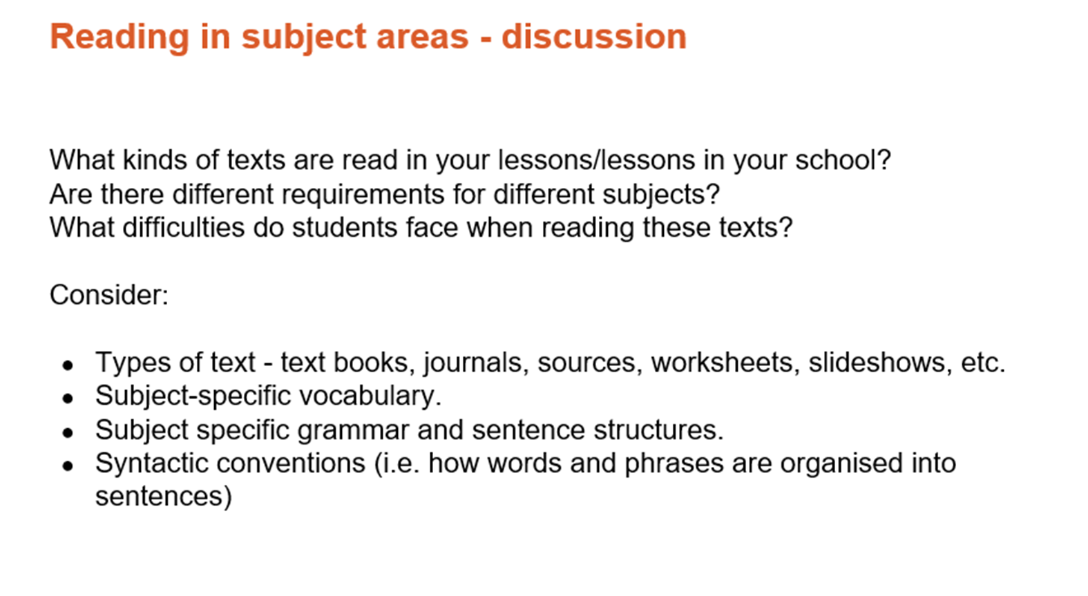

Slide 29
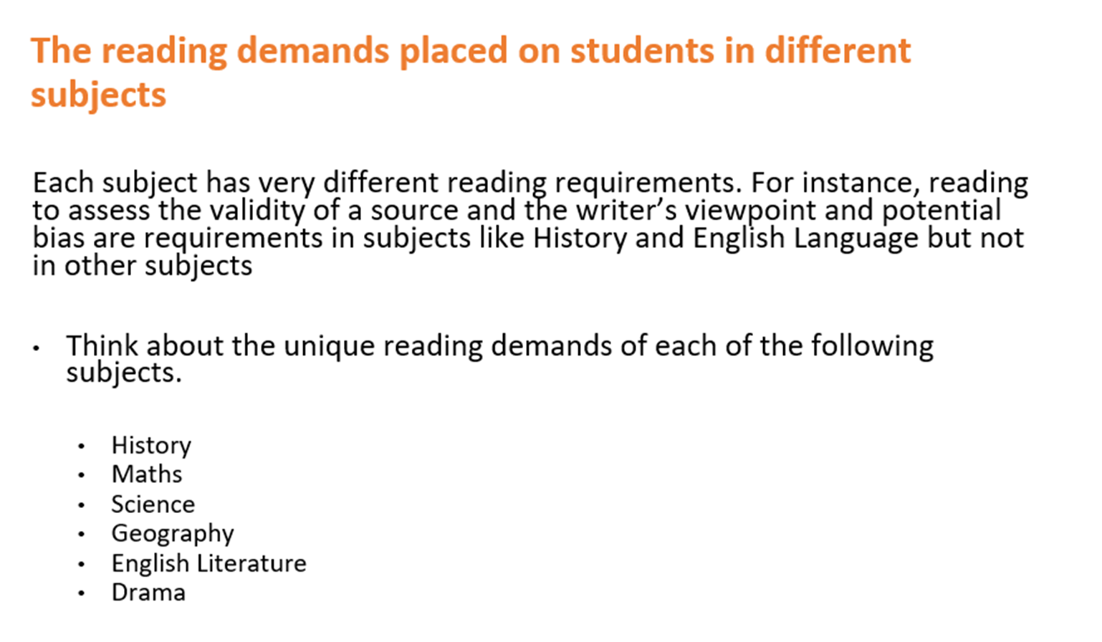

Slide 30
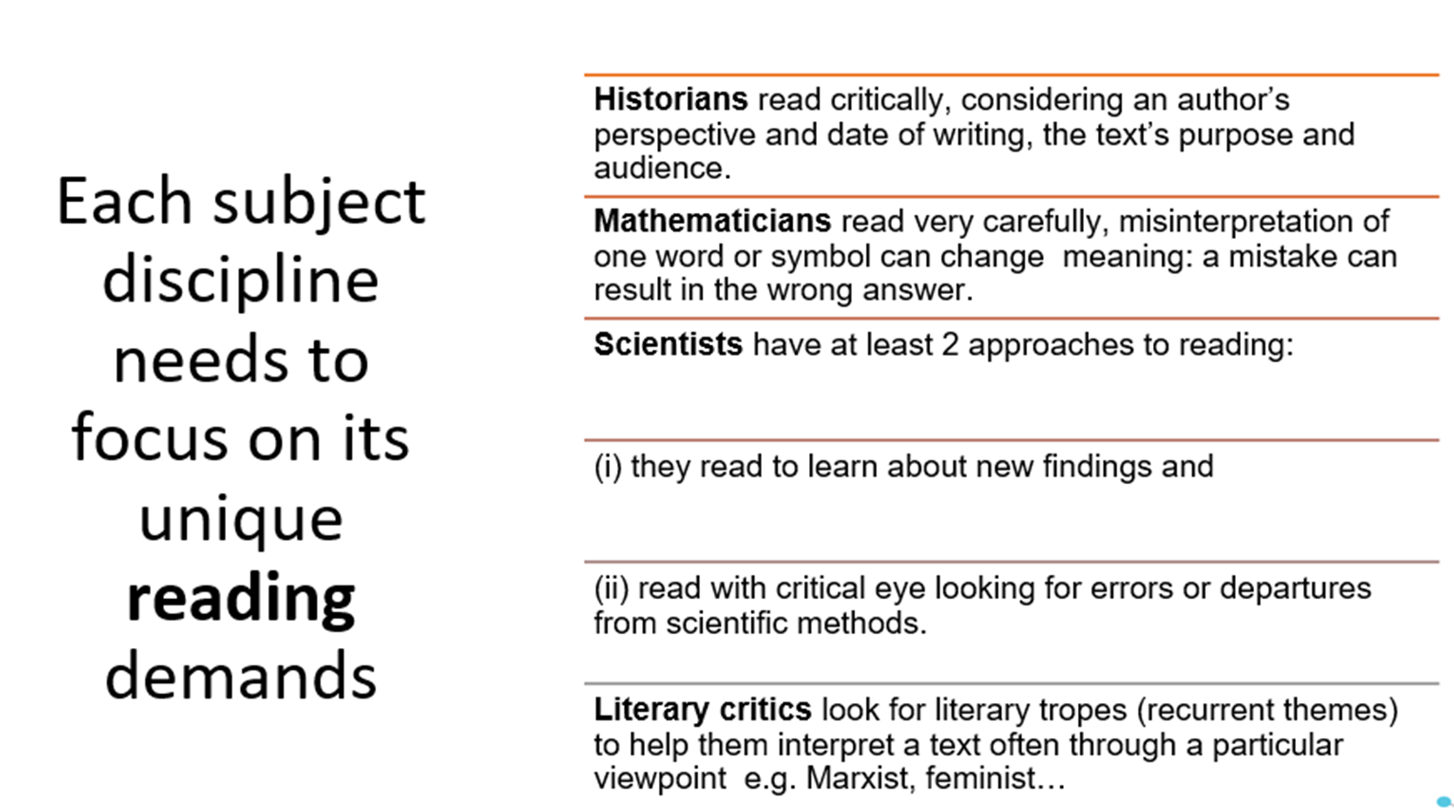

Slide 31


Reading framework 2023
Provide excellent training for breaking down the framework and bespoke training

Slide 32
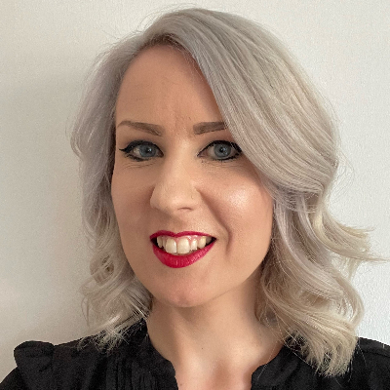
12. READING LIKE A HISTORIAN
Read the chapter
Discuss
What does reading look like in your department?
How often do you plan for the explicit teaching of disciplinary reading in your curriculum model?
How often do you teach new vocabulary?
How can you empower your students to use new vocabulary powerfully and in a malleable way?
What can you learn from primary practitioners about teaching reading?

Slide 33


Slide 34


