Slide 1

Bolton English Hub
Wednesday, 27th September 2023
1:30-4:00

Slide 2
1. Welcome and Introductions
WELCOME BACK!
Hub | Hub Lead | Time | Autumn Term |  | Spring Term |  | Summer Term
English | ESSA | 1.30pm – 4pm | 27th September |  | 16th January | 20th March
Who’s here?
What is your current role?
What do you expect from the hub?

Slide 3
Bolton English Hub
Tuesday 4th July 2023
Agenda
Results Review
Curriculum Implementation
Reading, including disciplinary reading
Culture- Behaviour and Attitudes
A.O.B. This year’s meetings and future hosts!

Slide 4



1. Results Review
Trends:
What have your results indicated?
What have examiners found?
What have your QLAs identified?
What surprises have you had?

Slide 5
1. Results Review
Trends:
More inaccuracies with predictions
English Language not performed as well as previous years:
  Higher standards of what is expected in each level:
    What was considered a ‘clear’ response in 2022 would now be considered ‘some attempt’

Slide 6
1. Results Review
Trends:
What have your results indicated?
What have examiners found?
What have your QLAs identified?
What surprises have you had?

Slide 7
1. Results Review
Trends:

Slide 8
10 minutes discussion
1. Results Review
Trends:
What have your results indicated?
What have examiners found?
What have your QLAs identified?
What surprises have you had?

Slide 9
1. Results Review
Trends:

Slide 10
2. Curriculum Implementation
Ambition and equality for all
Ambition and equality for all
‘Golden nuggets’ of knowledge in interconnected webs (schema)
‘Golden nuggets’ of knowledge in interconnected webs (schema)
Pre-empted cultural capital deficits
Systematic focus on vocabulary
Systematic focus on vocabulary
Sequencing- systematic and cumulative knowledge acquisition
Sequencing- systematic and cumulative knowledge acquisition
Vertical and horizontal thinking
Knowledge before pedagogy
Systematic assessment
Alliteration in long-term memory

Slide 11
5 minutes discussion
2. Curriculum Implementation
Ambition and Equality for all:
What are some of the different needs in your schools?
How do your schools cater for those needs?
What provisions are in place?
How do you as a department approach this element of curriculum implementation?

Slide 12
5 minutes discussion
2. Curriculum Implementation
Systematic focus on vocabulary:
What are some of the strategies you have for teaching vocabulary?
Do you have a school-wide policy or strategy for this?
What advice from the hub members might you utilise?

Slide 13
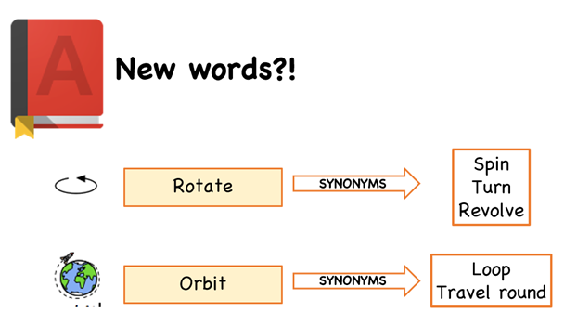
Strategies
Explicit vocabulary instruction:
When introducing new vocabulary, provide students with 3 synonyms of that word. This will develop their exposure to and use of tier 2 vocabulary and will develop their bank of vocabulary for their own usage.

Slide 14
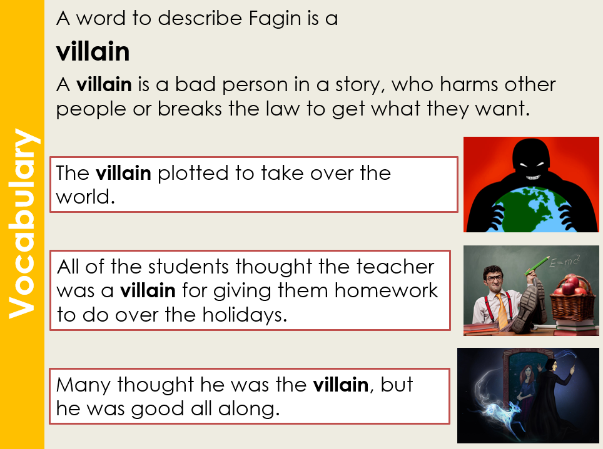
Strategies
Explicit vocabulary instruction:
When introducing new vocabulary, provide students with the use of that word in 3 separate contexts. This will develop their understanding of how to use that word and apply it to the comprehension of a text.

Slide 15
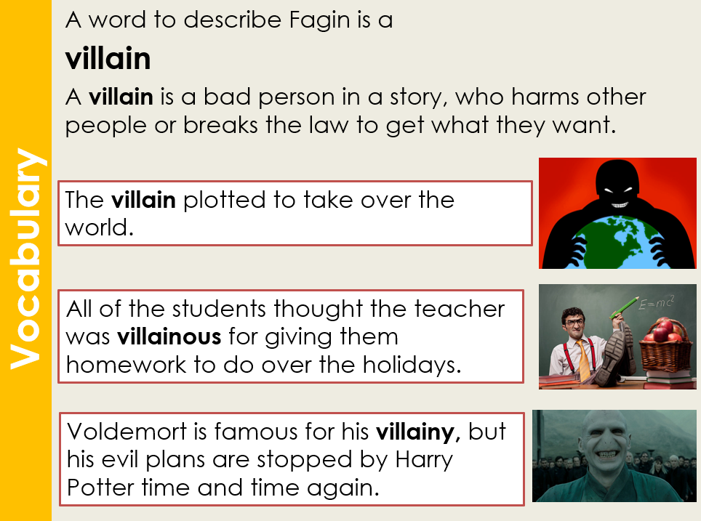
Strategies
Explicit vocabulary instruction:
When introducing new vocabulary, provide students with 4 variations of the word. This will develop their knowledge of the different versions and meanings of the root of the word thus developing their own bank of vocabulary to use.

Slide 16
3. Reading including disciplinary reading
Quick group discussion
Is this a school focus for you this year?
What strategies have your school continued with/ altered/ introduced/ adopted?

Slide 17
4. Culture- behaviour and attitudes
Open floor discussion
What trends are we currently seeing?
Any similarities from last year’s discussions?
Any surprises?
Behaviour systems and detentions- what works, what doesn’t?

Slide 18
5. A.O.B and this year’s meetings
Hub | Hub Lead | Time | Autumn Term |  | Spring Term |  | Summer Term
English | ESSA | 1.30pm – 4pm | 27th September |  | 16th January | 20th March |  | 20th June
 | Host | ESSA
We have been given the ‘OK’ to host at different schools this year just to mix it up a bit!
Essa will still be ‘hub leads’ but with more of a collaborative approach to draw on the strengths of each school!

Slide 19


Slide 21
What is NGRT?
The New Group Reading Test (NGRT) is a standardised assessment to measure reading skills of students aged 5-16 years against the national average and should be done termly.
NGRT reliably measures students’ knowledge of phonics, comprehension, decoding ability, vocabulary, grammatical knowledge, deduction and inference skills, authorial intent, and ability to deal with figurative and idiomatic language (depending on the age of the student and test selected).

Slide 22
Some facts
The year on year average growth in Reading ability is much higher at younger ages (e.g. the reading ability score average increase from 228 to 272 between ages 7 and 8 years).
For older students the year on year growth is much smaller over ages 13 years (e.g. the reading ability score average increase from 368 to 376 between ages 14 to 15 years).
Therefore, a Reading age of 17 years is unlikely to be that much different from a Reading age of 14 years.
In most cases it is not sensible to relate scores for students with above average ability to Reading age as Reading ages relate to an average, it is best to use standardised age scores (SAS) for measuring progress or monitor trends.

Slide 23
NGRT data
NGRT is in two parts: sentence completion, which measures decoding with some element of comprehension; and passage comprehension, which measures skills of increasing difficulty.
Children enter the test according to their chronological age and begin with the sentence completion section. The difficulty increases beyond the pupil’s ability, challenging their understanding, until their scores show that the difficulty level is too high. Those who complete the Phonics tasks will not be presented with the Passage Comprehension.
It is an adaptive test where students answer different questions depending on their abilities. Weaker students attempt easier questions whereas more able students attempt harder questions. Therefore, a weaker or a more able student may get the same number of questions correct but they will have different abilities.

Slide 24
NGRT Reports Available
NGRT Group Report for Teachers - The Group Report for Teachers provides a summary of the age-standardised scores, presented both in rank order and in comparison to the national population (national percentile rank).
NGRT Individual Report for Teachers - The Individual Report for Teachers shows all scores for a student plus an analysis of responses for Sentence Completion and Passage Comprehension and a short narrative report
NGRT Progress Report - This report provides a summary of the progress made over time

Slide 25
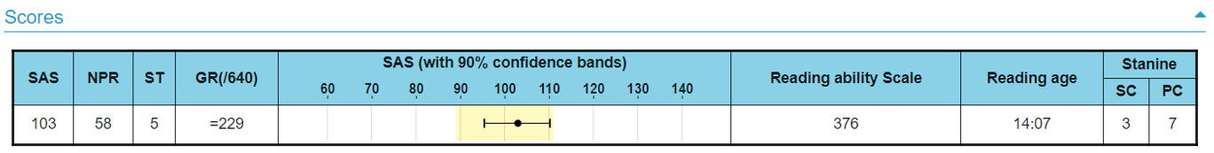
TIS-9.5
The average score for the SAS (Standard Age Score) is 100. This makes a comparison with a nationally representative sample of pupils across the UK
Stanines are closely linked to Standardised Age Scores and place students’ scores on a scale of 1 (low) to 9 (high) offering a broad overview of performance.
Discrepancies of 2 or more stanines are highlighted in the Group Report for Teachers, as these students would benefit from further investigation

Slide 26
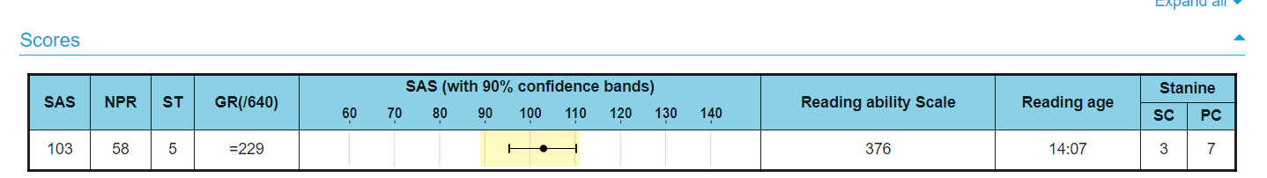
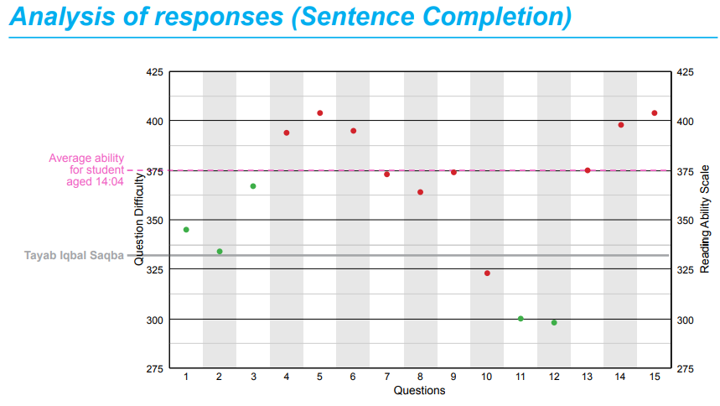
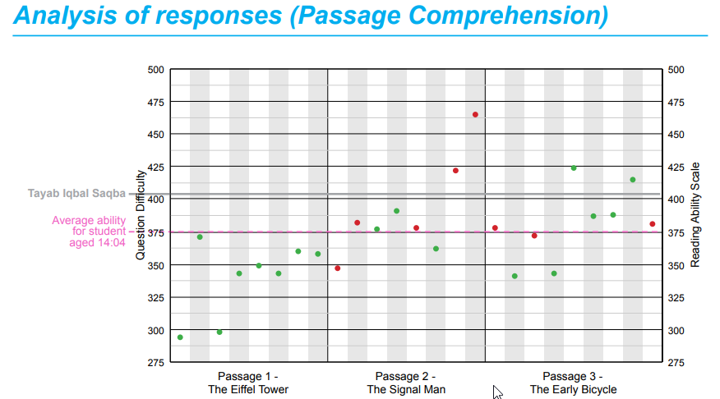
Questions – in Sentence Completion each student attempts 15 questions. In Passage Comprehension each student attempts one, two or three passages.
The dots on the graph are green for correct and red for incorrect or if no response was given

Slide 27
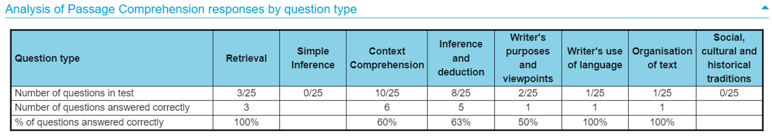

Slide 28
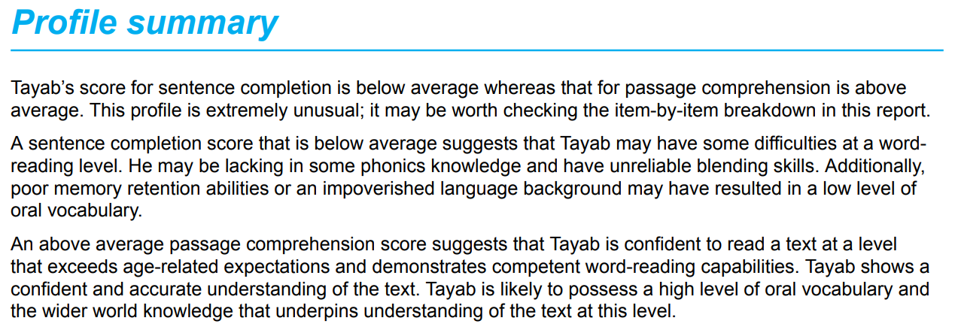

Slide 29
