Slide 1
Mode B Teaching
Caroline Molyneux
@molymemolyneux
c.molyneux@sharplesschool.co.uk

Slide 2


Slide 4


Slide 5


Slide 6
Thunder 10 secs later

Slide 8
Thunder 5 secs later

Slide 9
Thunder 2 seconds later

Slide 10
THUNDER

Slide 11


Slide 12
Light - 300,000,000 m/s
Sound - 330 m/s
How did I know that the lightning was coming closer?

Slide 13
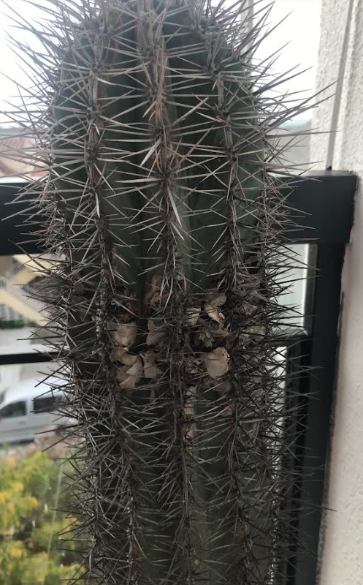

Slide 14
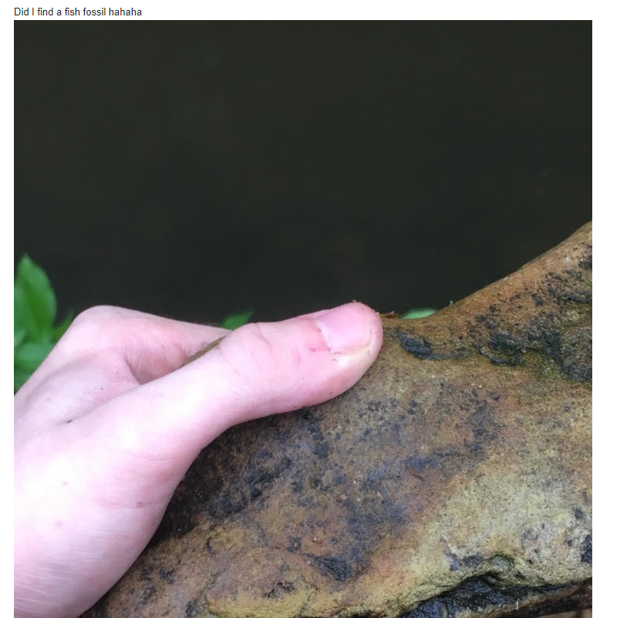
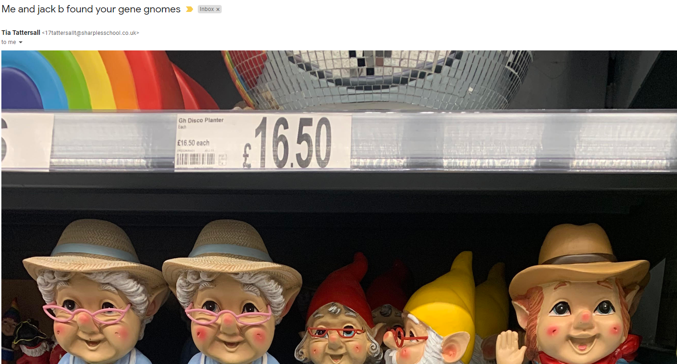
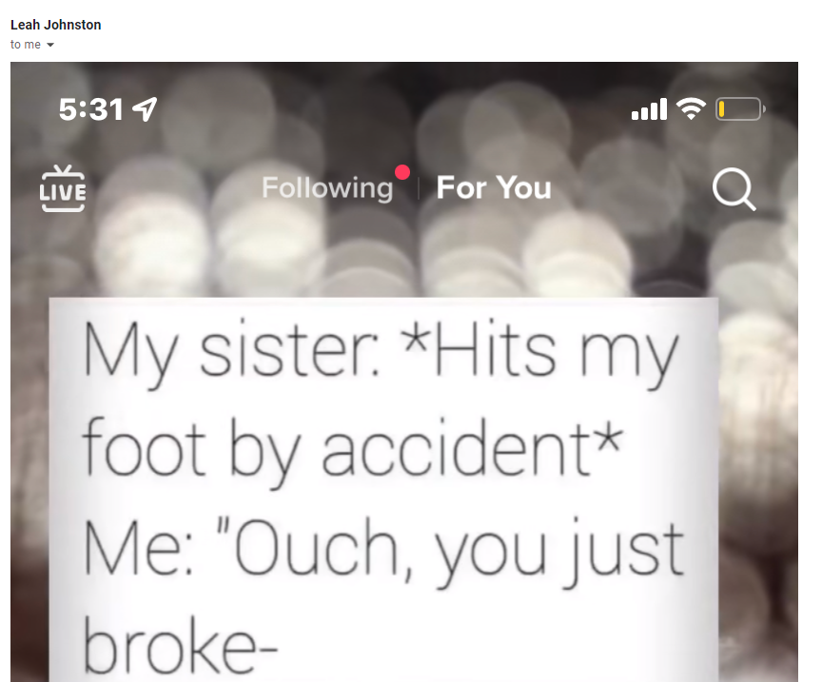
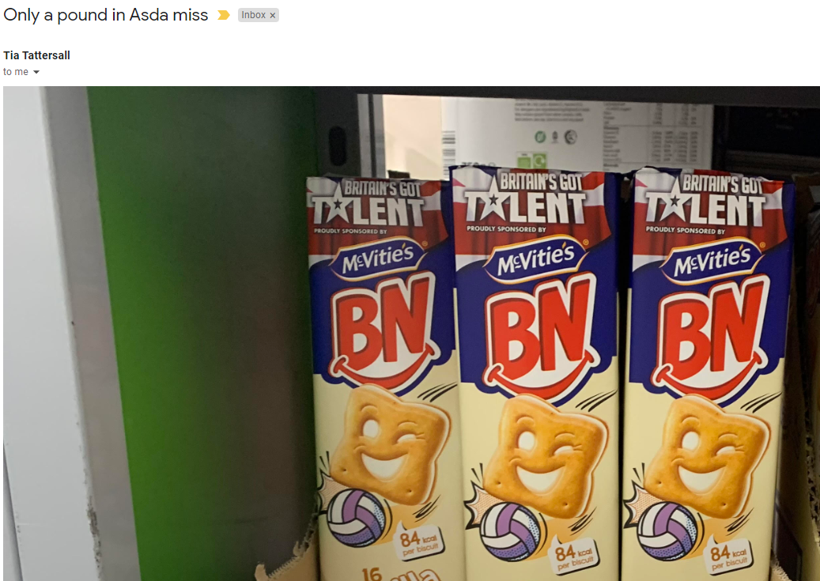

Slide 15
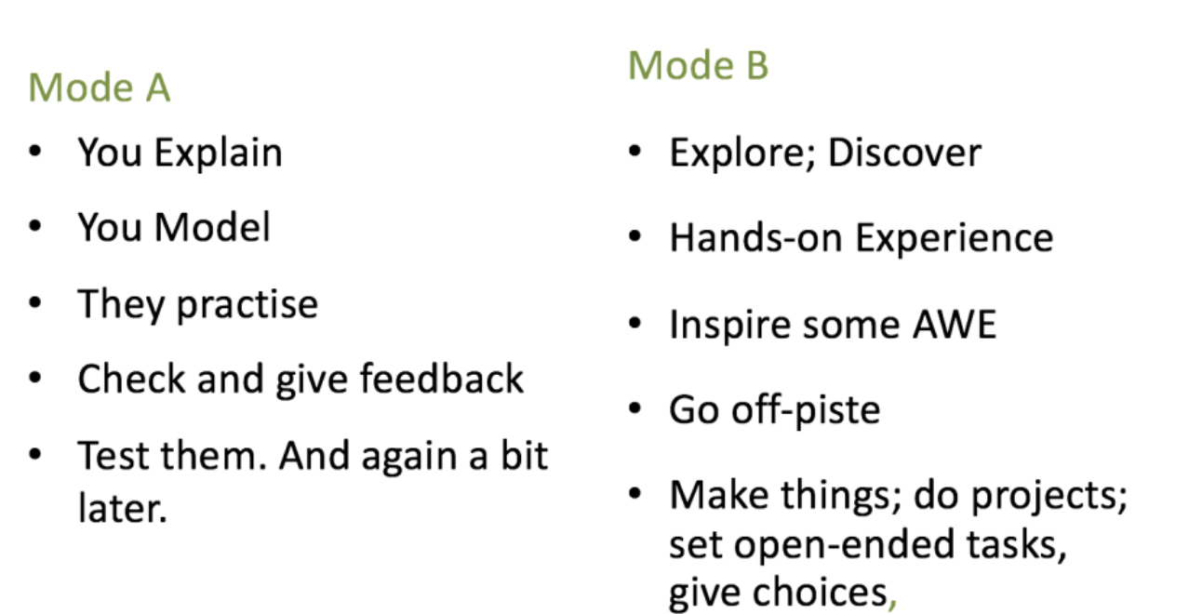

Slide 16
80%
20%

Slide 17
Mode B Teaching Ideas
Enquiry Projects
Open Response Tasks
Oracy: Debating
Oracy: Instructional Inputs
Class Forum
Pre - Reading

Slide 18

ENQUIRY PROJECTS

Slide 19
ESTABLISH AN ENQUIRY QUESTION
Give students a sense of the nature of the enquiry, e.g. the type, range and depth of knowledge; the nature of good questions; the general format of the enquiry process; the typical format of a report.
Examples;
Was Queen Elizabeth a good Monarch for the people of Britain?
What was the most important science discovery ever made?
Who is the best sportsman; Mo Salah or Andy Murray?
Which area of school is the best habitat for insects?
Model the standards by showing completed examples.
Students should now construct a headline enquiry question.

Slide 20


TEACH THE ENQUIRY SKILLS NEEDED IN ADVANCE
Identify the skills students need to pursue their enquiry. This will depend on the subject:
e.g. pre-requisite knowledge; measurement or observation techniques; online research and filtering skills; how to record and process data.
Model the individual skills you expect students to use; check for understanding and do some guided practice.

Slide 21


PROVIDE RESOURCES AND SCAFFOLDING;
SET TIMEFRAMES
Make sure all students have the resources to complete the enquiry process.
Provide them with the appropriate level of scaffolding so that they are guided enough to complete the task without being over-guided.
Map out a timeframe for completing the project.

Slide 22

MONITOR AND PROVIDE INTERIM FEEDBACK
Monitor students’ progress with their enquiry project at key points.
Give Feedback That Moves Forward; the earlier you identify areas to improve, the better.

Slide 23

SHOWCASE THE RESULTS
Provide a space to showcase completed project reports; give lesson time for students to talk about the work they did.
This is important for focusing on what students understand.
The goal of enquiry is to deepen understanding; not only to produce nice-looking artefacts, even if this is also important.

Slide 24

OPEN RESPONSE TASKS

Slide 25


ENSURE PRE-REQUISITE KNOWLEDGE IS SECURE
Ensure students have a good platform of knowledge to base their responses on, through the normal flow of lessons and
formative assessments.
Keep knowledge content in the forefront of their thinking when deciding on a presentational format.
We don’t want elaborate multimedia presentations without substance.

Slide 26



AMPLIFY THE POSSIBILITIES
Give the instruction: Showcase your knowledge of this topic in any form you choose. Encourage diversity: a video, a booklet, a website, an essay or news report, a detailed summary poster, a presentation, make some artefacts…
Show multiple examples focusing on depth of understanding, not just visual features. Modelling one response can influence students' choices unduly.

Slide 27

ENCOURAGE EXCELLENCE
Show a range of examples so students pitch high in their attempts to capture their learning. Discuss features of excellence in contrasting exemplars.
Promote two messages:
1: Be bold in making a choice about the format in which knowledge is presented.
2: Ensure that everything is done to a high standard.

Slide 28


SHOWCASE THE RESULTS
Give time to showcase students’ responses.
A good reason to encourage diversity is so you only have a few videos or PowerPoint presentations to show alongside other
paper-based responses, creating an interesting range that can be explored in a time-efficient manner.

Slide 29

ORACY: DEBATING

Slide 30

ENSURE PRE-REQUISITE KNOWLEDGE IS SECURE
Ensure the knowledge basis of any debate is taught securely. Debates based on poor knowledge are counterproductive.
Establish parameters for a debate so the process deepens students’ understanding.
e.g. Would a nuclear power station or wind farm be a better solution?
Is it ever morally acceptable to kill?

Slide 31

MODEL AND PRACTISE THE LANGUAGE OF DEBATING
Teach key phrases that help frame a debate exchange. Model them and engage students in practice:
I believe that…; In our opinion…; Firstly…, secondly…; What’s more; moreover…
Our opponents have claimed that… however…; That may be the case, however…; To recap the main points…

Slide 32

TEACH A SIMPLE DEBATE STRUCTURE
One to one: Pairs, exchanging ideas and practising the language.
Team debates: 2 vs 2 or 3 vs 3, each team
allocated to propose or oppose a motion, with rehearsal time before the exchanges.
Multi-voice: A range of inputs making a case for a different position or proposal.
Give all debaters roles. Where needed, have a moderator to monitor exchanges and keep timings.

Slide 33

REVIEW THE CONTENT AND PROCESS
Provide instructional input and feedback to highlight the key learning points, to challenge obvious misconceptions, to separate fact from opinion and to ensure deeper
understanding is consolidated.
Review the debate process so lessons can be learned to improve subsequent debate activities and individual contributions.

Slide 34

ONLINE CLASS FORUM

Slide 35

SORT THE TECHNICALITIES
Select a platform students can access online. Key features needed include the facility to:
  Link to existing classlists.
  Post and moderate messages to and from students.
  Post links and documents.
  Post interactive elements such as questionnaires.
  Control notifications via email.
Enrol a class tech team to maintain the content.

Slide 36

ESTABLISH COMMUNICATION ROUTINES & PROTOCOLS
These should include:
  Appropriate use of language
  Comment and sharing rights
  Frequency and timing of posting materials so that students know when to expect updates
  Expectations around task-setting and document sharing, especially if this is the main route for setting homework or sharing study resources

Slide 37
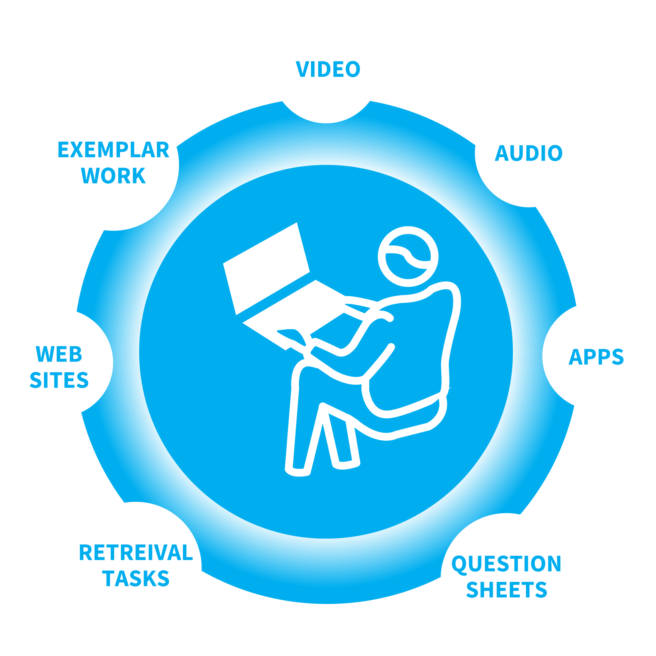
CAPTURE & SHARE MULTIMEDIA RESOURCES
Use the forum to curate resources so students gain access to selected, trusted sources of information:
  Exemplar work
  Video recordings of discussions, demonstrations or performances
  Question sheets, study materials, self-checking retrieval practice tasks
  External resources such as curated websites, video clips, software, tools

Slide 38

CULTIVATE STUDENT OWNERSHIP
When students have the maturity and confidence, give them some ownership and control over the content on the forum.
Once students share useful information with each other and give constructive feedback on each other’s work, a forum can become genuinely dynamic.
Your student tech team sidekicks can be a major asset; it’s a role they enjoy immensely.

Slide 39

INTEGRATE INTO LESSON FLOW
A good online forum supports the flow of learning from lesson to lesson:
Students know resources and tasks will be posted there; they use it to ask for help between lessons; it’s a go-to place to find out more about the subject.
Teachers rely on students using it to access material they post or make their difficulties known.
It takes time to establish this culture but it is well worth it.

Slide 40

ORACY: INSTRUCTIONAL INPUTS

Slide 41

IDENTIFY MATERIAL FOR STUDENTS TO EXPLAIN
Identify instructional inputs that a student could deliver without too much support.
e.g. a concept in maths or science; a case study scenario in geography; a specific event in history; or a particular section of a text in English.
Alternatively find questions or problems for them to present model solutions to.

Slide 42

ALLOCATE INSTRUCTIONAL TASKS
Allocate tasks to an individual, pair or group of students and ask them to prepare their instructional input on a specific date.
Walk through the timeframe and content; check that they have the resources needed.
Provide guidance, e.g. not to read text from PowerPoint slide; to include diagrams and demonstration aids; to keep explanations short, broken down in small steps.

Slide 43


INVITE STUDENTS TO REHEARSE AND PRESENT MATERIAL
Give students the opportunity to practise their input; when ready, invite the students to address the class with their material.
Stand at the back of the room to encourage them to project their voices clearly, making eye contact with students.
Where needed, give instructions to keep the class on track listening to their classmates’ input.

Slide 44

INCLUDE TASKS FOR THE REST OF THE CLASS
A good instructional input will go beyond a presentation developing into a mini lesson.
Ask students to design tasks for their class which follow from the input, e.g. practice questions, problems, writing tasks or
discussion tasks.
Clarify this in advance so students all pay attention intently during the instructional input.

Slide 45

CHECK FOR RECALL AND UNDERSTANDING
Encourage your ‘student teachers’ to engage the class in Check for Understanding procedures.
Feel free to interject, offering additional instructional input, correcting errors or misconceptions and generally supporting.
All the while, check for student understanding.

Slide 46

INDEPENDENT LEARNING:
PRE-READING

Slide 47

CONSTRUCT STRUCTURED COMPREHENSION OR RESEARCH TASKS
Make sure that pre-reading tasks are conducted to the appropriate level of depth by setting students specific goals.
e.g. to find certain words and concepts in order to explore their meaning; to gain an overview of the narrative of events;
to generate structured summarised notes.

Slide 48


MODEL THE COMPLETION OF THE TASKS
Model each aspect of the pre-reading task completion explicitly.
Show students how you skim and scan text to find key words and definitions; how to organise notes.
Set the standard for the record you expect students to keep of what they have learned, using standard formats that can be used often as part of students’ study routines.

Slide 49
INVITE RESPONSES AND CHECK FOR UNDERSTANDING
Students present the fruits of their reading tasks:
Cold Calling: select students to give an exposition of the key points.
Paired Presentations: students pool ideas and then present.
Retrieval Challenges: generative quizzes to test the depth of reading.
Problems and Errors: problems and mock responses containing errors, which students are invited to solve correctly.

Slide 50
Next steps
How can you try it?
Curriculum going forward - is there AWE and WONDER?

