Slide 1
What is Learning?
As we wait for everyone to arrive, please consider this question and write your response on your whiteboard.
Notes:
HFO + MMO
Connect Now: What is Learning?
This description makes learning sound relatively easy but we all know from our own learning experience and from observing our students that it can be a struggle.
Question to ask ourselves – do we sometimes interpret short term performance as learning?

Slide 2
Cognitive Load, Our Environment and the Theory of Learning
Michelle Moore
Helen Fowler
Little Lever School
Notes:
You may be here to talk about ‘behaviour’…

Slide 3
What is Learning?
“ Learning leads to a persistent change in our long-term memory”
Kirschner, P.A., Sweller, J., Clark, R. E. (2006)
Notes:
MMO
Connect Now: What is Learning?
This description makes learning sound relatively easy but we all know from our own learning experience and from observing our students that it can be a struggle. Often when we think we’ve ‘taught’ or ‘covered’ something we later realise that it hasn’t stuck in our students’ long term memory.
Question to ask ourselves – do we sometimes interpret short term performance as learning?

Slide 4
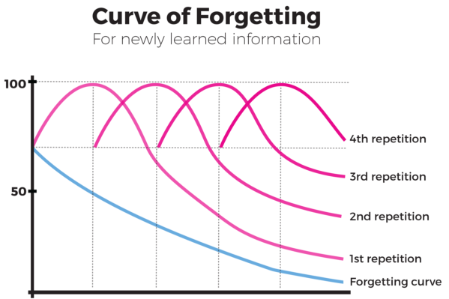
Notes:
HFO
Memory is residue of thought

Slide 5
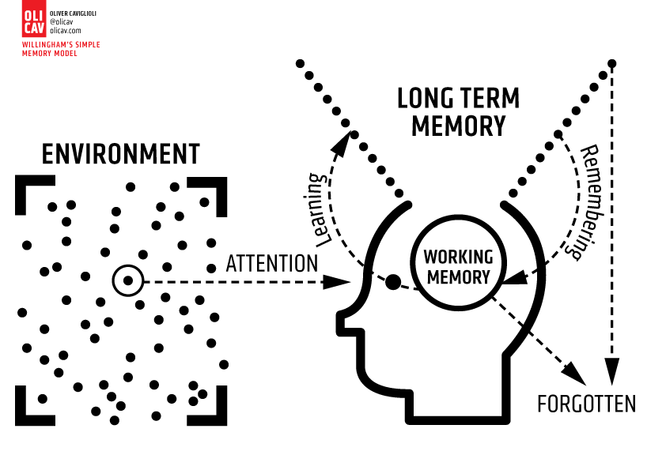
Notes:
MMO
Daniel Willingham’s simple model of memory
All learning starts with the environment and what you attend to in that environment – at any particular moment there are countless things that you could be attending to… teacher, screen, distractions in your environment – internal or external…
CLT theory is based around the idea that our WM can only consciously attend to a handful of stimuli at a time.
Teachers must ensure that students focus on what is to be learned and overcome competing demands for their attention - THE BLACK DOT.
Some of things we do as teachers may inadvertently be putting additional load onto the WM of our students so today I want us to consider how we might minimise this.

Slide 6
Notes:
The Monkey Business Illusion – YouTube So this video demonstrates that, when the viewer’s attention is drawn to one aspect of the environment (the number of passes), other aspects (such as the colour of the curtains and the departing player) are missed.

Slide 7
Notes:
HFO
Key learning point: If teachers do not explicitly draw students’ attention to what it is to be learned, there is a risk they will be distracted by something else. THE BLACK DOT
in pc2 discuss what black dots you may have in your lessons.

Slide 8

Working Memory
Notes:
MMO
We now know that working memory is where thinking takes place so why don’t we remember everything that we think about or are shown?
Well, working memory is limited. It’s different in different people, but we can generally hold about 3-4 things (for young adults) in our working memories at any one time and we can hold them for about 15-30 seconds.
If we’re shown too much information, we get something that the psychologist, John Sweller calls ‘cognitive overload’ and it becomes too much and we struggle to comprehend things.
So, working memory is like a juggler - there are only so many balls I can juggle with before I drop them and they go all over the place.
If bombarded with lots of new information, we’re not able to hold it all in our mind and consciously think about it so cannot lay down in LTM. But those things that we have been able to consciously and effort fully think about will start to be laid down in LTM – and this is where the learning starts to take place.
Think about the time you’ve given a list of instructions…

Slide 9
Memory is residue of thought
Does it have an A or U in it?
Does it rhyme with the word train?
Is it pleasant?
Notes:
“I’m going to read thirty words aloud. For each word, I’ll ask one of three questions: > Does it have an A or U in it? > Does it rhyme with the word 'train'? > Is it pleasant?
I’ll tell you the question, then the word: please just write ‘Yes’ or ‘No’: you don’t need to record the words.
For example, if I said “A or U. Cheese.” you would record no (since cheese does not have an A or U in it). If I said “Is it pleasant? Sewer.”, it’s highly likely you’d record no.
Rhymes with train? Hundred
2. Is it pleasant? Corn
3. A or U? Cool
4. Rhymes with train? Rate
5. A or U? Jump
6. Rhymes with train? Pain
7. Is it pleasant? Urge
A or U? Country
9. Rhymes with train? Main
A or U? About
Is it pleasant? Diamond
Rhymes with train? Into
Is it pleasant? Welcome
A or U? Window
Is it pleasant? Aeroplane
Ask teachers to turn over their sheet and write as many of the 15 words as they can remember.

Slide 10
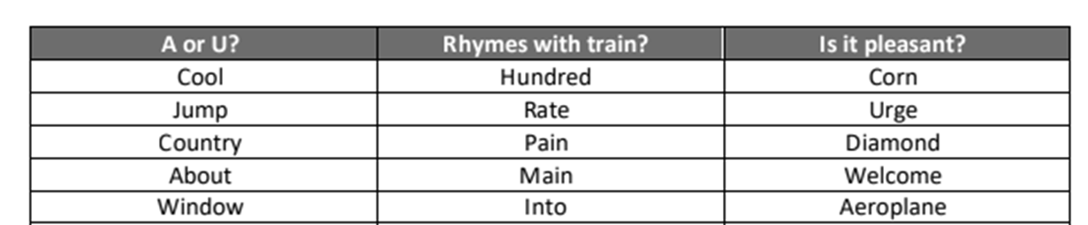
Memory is residue of thought
Notes:
Ask teachers which column they remembered the most words from.
Teachers are likely to remember the most words from the pleasant column because they were forced to think about what the words meant. Teachers could respond to A or U just by thinking of the spelling and rhyming just by listening to the sound of the words. To respond to the question ‘Is it pleasant?’, teachers had to think of meaning, and that’s what really helps memory.
Key learning point: While processing in working memory is essential for remembering (Principle 2), the kind of processing – deep and meaningful – is equally important. Thinking about meaning and connecting new concepts to existing information helps get material into memory better than thinking about other aspects of the content.

Slide 11
Warning Signs
Incomplete recall
Failure to follow instructions
Place-keeping errors
Notes:
MMO
Place keeping errors - think about reading when you’re tired.

Slide 12
Three Forms of Cognitive Load
Intrinsic
Extraneous
Germane
Notes:
MMO
Intrinsic – the inherent difficulty of the material itself – which can be influenced by prior knowledge of the topic. The intrinsic nature of such a cognitive load makes it difficult to eliminate: you will always find a difficult, new activity (e.g. solving a complex equation) more challenging than a simple task (e.g. adding two small numbers together). However, the cognitive load resulting from a complex task can be reduced by breaking it down into smaller, simpler steps for a learner to complete individually.
You are probably familiar with task of assembling flat-pack furniture, for instance. Rather than assembly instructions containing just one large diagram showing how each piece fits together, the manufacturers simplify the process, splitting it into short step-by-step tasks
Extraneous – the load generated by the way in which the material is presented and which does not aid learning. This type of cognitive load is extraneous to the learning task, and is increased by ineffective teaching methods, which unintentionally misdirect students with distracting information or make a task more complex than it needs to be.
Germane – This third type of cognitive load is the ability to build complex schemas and transfer information to new contexts and is considered to be desirable, as it assists in learning new skills and other information. The first time we experience something new (e.g. attending a first wedding) can be daunting, as we do not have a schema that tells us what to expect, and so a germane cognitive load is produced as we observe and learn about the experience to help us to anticipate and understand it in the future.
Think about our previous activity with the words - thinking about meaning and connecting to prior experience (‘is it pleasant?’) helped to increase the germane load and supported recall.

Slide 13
2-3 THINGS TO THINK ABOUT
SMALL STEPS
MODEL
PRACTICE
Notes:
HFO
We can use these solutions to guide our own practice to reduce cognitive load for our students
Therefore, we should present our pupils with small amounts of new material
Break down complex tasks into smaller steps
Help students to practise this material using techniques such as modelling
And only proceed to the next step when students have mastered the first step- checking for this understanding using lots of questioning!

Slide 14


Split Attention Effect
Notes:
MMO
Eyes have to switch to make sense of the diagram. This process puts additional load onto working memory but doesn’t actually help the learning process – extraneous load – learners are having to mentally integrate the information by holding one thing in working memory while they search for another.
Example of exam papers where diagrams and questions are on different pages…

Slide 15

Keep it Relevant
Notes:
MMO
We want to make sure that what we say is relevant and useful and that we avoid drifting off onto tangents, however interesting they may seem at the time - focus on THE BLACK DOT.
All these little tangents just add more information that our students are then trying to keep in their heads until they decide what is relevant and what isn’t – this increases the cognitive load of the task – and also takes back to our earlier point about the teacher’s role to explicitly draw students’ attention to what it is to be learned.

Slide 16

Break it Up
Notes:
HFO
Rosenshine found that the most effective teachers spoke for more minutes in a lesson, but they didn’t speak in one block. They explained, then students applied the explanation to a task, then there was more explanation and then more practice. In this way, students have the chance to do something with the new information in their working memory, improving the likelihood of embedding it in their long-term memory and thus increasing its durability.

Slide 17

Leave a Trace
Notes:
MMO
Words are transient. Once they are said they linger in the working memory and then they are gone. We can support working memory by offloading some of the information onto another source.
Write key points on the board during an explanation, or record them as a flow diagram showing your thought process. It could be that not everyone needs these notes. Leave a mini whiteboard on particular students'’ desks and add prompts as and when they need them (link to ‘glass ceilings’ and use of AfL to inform actions…)

Slide 18

Dual Coding
Notes:
HFO
One way that we can support working memory is by taking advantage of the principles of dual coding. This theory suggests that people take in information through two channels: visual and auditory. Our auditory channel is used for what we hear and also for what we read. Whereas our visual channel takes in everything we see.
The theory holds some important implications for how we teach.
Firstly we need to ensure that we don’t overload one of these channels. The most common way in which this happens is when we ask students to read a text whilst hearing it read out aloud. In the same way, never expect students to read something from the board whilst you are talking at the same time – it’s not possible to split attention between both.
Think about the difficulty you might have when trying to watch a film which is subtitled in your own language. You attention is constantly split between these two sources of information. In the same way, try to avoid reading aloud text that is already written on a slide (unless you think that students are unable to read it independently).
Secondly, we can use these insights to support our explanation by including diagrams and images to accompany our narration. Research by Mayer and Anderson found that when verbal explanation was accompanied by diagrams it was significantly more memorable then when presented in either form on its own. This is why you’ll see mnay teachers instinctively heading to the whiteboard to draw diagrams to explain difficult concepts.
For this to be effective, it is important that the images and diagrams we are using are relevant to the spoken explanation and are carefully chosen to support it. Crowing a ppt slide or worksheet with images simply to make it more attractive is going to add extraneous load to students’ working memories and make it harder for them to focus on what is important to the explanation or task.
Let’s look at an example.

Slide 19

Notes:
Using images as a aide memoire to make connections and improve recall is great. This is typical of what we see in good presentations - an image with minimal text to associate with the words that the presenter is saying. We may not be able to recall the exact words, but we may be able to remember the image and the basic message.
However, as we’ve just said, avoid using an image for the sake of using an image - if it’s not directly relevant to the message then that connection will be lost - learners may be able to recall the image but what was the message?
So, if we were talking about the number of alcohol-related admissions to A&E we could use an image of a beer glass and a percentage - there’s a clear connection which is good for memory.
However if we were teaching about how alcohol is metabolised, using the same image would be much less effective - it may help with attention but it would not improve learning. What would improve learning would be a clear diagram of the process, highlighted at relevant parts to match the words.
An image is worth a 1000 words so do use diagrams to explain concepts - but keep the material clear, use few colours and lots of white space with only necessary text for understanding to keep the extraneous cognitive load low. And keep any any explanatory text as close to the image as possible to avoid the split attention effect.

Slide 20
2-3 THINGS TO THINK ABOUT
SMALL STEPS
MODEL
PRACTICE
Notes:
MMO
Reveal processes stage by stage (focus on the BLACK DOT) on the same slide rather than on consecutive slides.
This way, students have a prompt to remind them of earlier stages and do not have to juggle too much information in working memory.

Slide 21
Think back to the last time you delivered an explanation.
What did you do to make it effective?
What could you have done differently to make it even more so?
Notes:
MMO
Business plan, prior learning
However, this is idealistic and there may be black dots where we may need to be more responsive in the moment, can we think of what we mean by this?

Slide 22
BEFORE STUDENTS ENTER YOUR CLASSROOM…
ON YOUR MARKS…
Ensure there is a clear seating plan, this ensures you have placed students where they will learn best and where their environment has the least distractions. Your seating plan is non-negotiable. This is often described as Seating for Learning.
Ensure you have looked at any data you may have on the class, this ensures you have looked at the individual needs of all the students in your class (their context, medical conditions, SEND needs, EHCPs and their prior attainment) and have planned a lesson and prepared resources to ensure no one is held back and no-one is left behind. No child should be disadvantaged by where we seat them and the resources we provide for them.
Notes:
HFO

Slide 23
BEFORE STUDENTS ENTER YOUR CLASSROOM…
GET SET…
Ensure the room is tidy and presentable, this sets the tone of high expectations. Clear any unnecessary equipment from students’ desks and ensure all their attention is on what you want them to concentrate on when they come into your classroom. Reduce the number of black dots!
Ensure exercise books and any resources you need for the starter activity are placed on the desk. This buys you time and allows you to maximise learning time by prompting students to start a task as they enter the room. If students have a task to do that is in front of them they have no time or excuse to be distracted.
GO… You are now ready to meet and greet and start your lesson!!
Notes:
HFO
Extra tips about implementing these strategies in the lesson are on the handout.

Slide 24
Over to you!

Slide 25
Key Takeaways
Students can only consciously attend to a handful of stimuli at a time
Working memory is limited
Memory is the residue of thought
Extraneous load will unintentionally misdirect students with distracting information or make a task more complex than it needs to be
You can plan to reduce the number of black dots in your classroom
How you respond to impromptu black dots will determine their impact on the learning of the students in your class

Slide 26
Further Reading
Mayer, R. (2008). Applying the science of learning: Evidence-based principles for the design of multimedia instruction. American Psychologist, 63(8), pp.760-769
Centre for Education Statistics and Evaluation (2017) Cognitive load theory in practice: Examples for the classroom. New South Wales Department for Education

