Slide 1
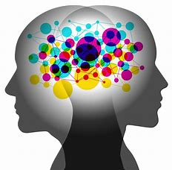

Practice and retrieval
Session 3
ECT Conference 2022

Slide 2

Getting students to retain knowledge may feel like preparing to climb Everest…for students and teachers!
Like climbing Everest, it IS achievable!

Slide 3
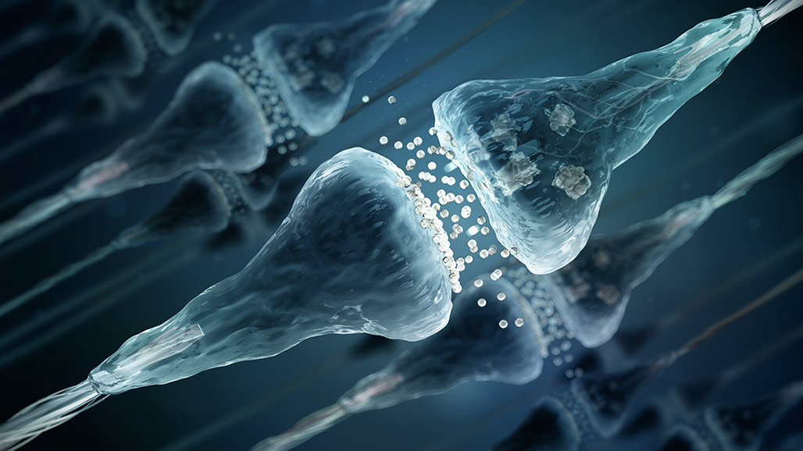
(nearly) All you need are these…
Healthy synaptic transmissions.

Slide 4
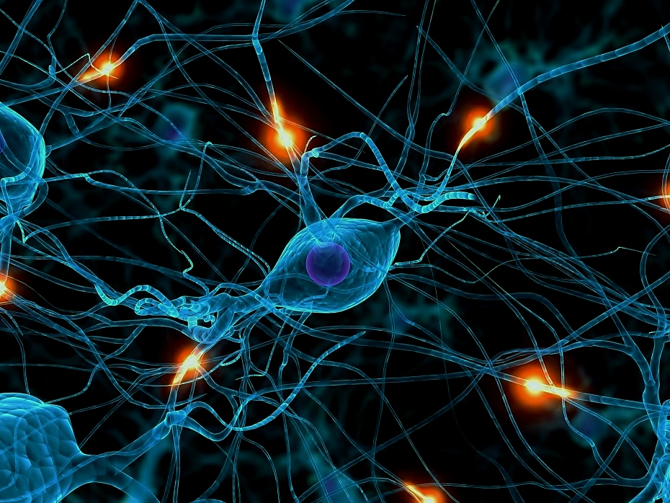
How do you get them?
Brain exercise!

Slide 5

What will they do?
Help the students to find the knowledge that is needed to be successful in each subject area and excel in exams!

Slide 6

While your memory might be working ok for you, have you truly tapped into your full potential YET?

Slide 7
First you will need to know where your strengths are.
Ready for a little test?
On the next slide, you will be shown some words.
You will have 2 minutes to memorise these.
Then you need to write down as many as you can.

Slide 8
Tree Time Face Pipe​
Clock Mouse Engine Planet Thunder Necklace Wardrobe Caterpillar Garden Treacle Picture Book

Slide 9
How did you do?
On the next slide, you will be shown some numbers.
You will have 2 minutes to memorise these.
Then you need to write them down in the correct order.

Slide 10
5 0 3 5 6 7 1 0 0 9 5

Slide 11
How did you do?
On the next slide, you will be shown some shapes.
You will have 2 minutes to memorise these.
Then you need to write them down in the correct sequence order.
Ready?

Slide 12


Slide 13
Was that any easier?
Why?

Slide 14

Tom Sherrington – Why retrieval practice is important.

Slide 15
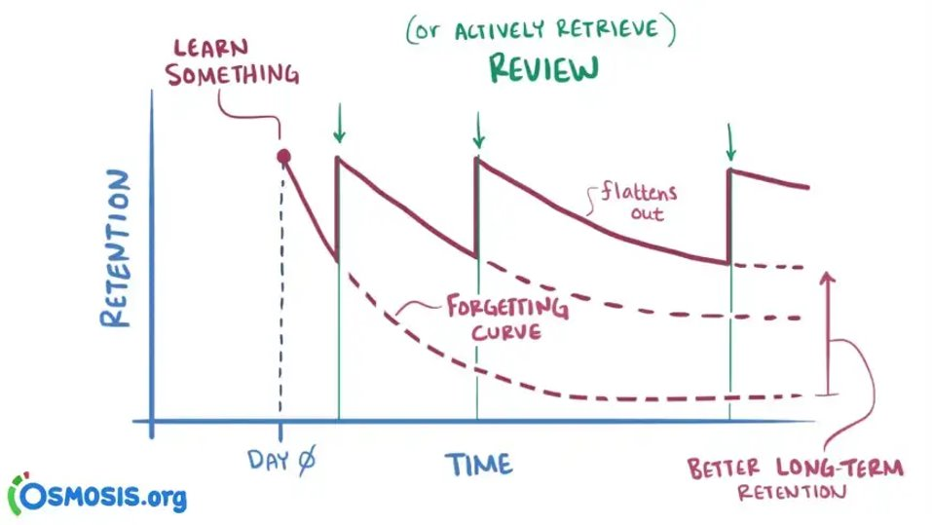
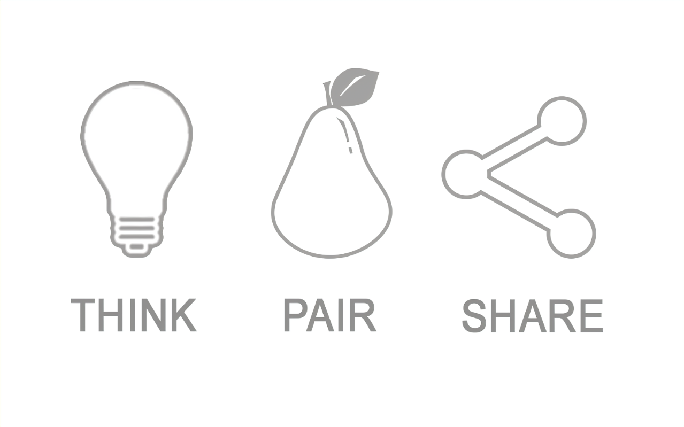
Think about what we have learnt so far – What does this graph highlight?

Slide 16
Current situation – rationale
Engagement strategies
AfL
Curriculum
Metacognition
Oracy/ Development of vocabulary
Literacy/ Development of vocabulary

Slide 17
Back to the mountain…
How can we break this down…

Slide 18

connect
Interleaving practice
What was a religious reason for the Mughals becoming wealthy? | Name two religions in the Mughal Empire | What is an Empire? | Who won the Battle of Stamford Bridge?
How did new roads improve the Mughal economy? | Who was the first emperor? | List 3 countries from today which the Mughal Empire governed? | What did Medieval people think caused the Black Death?
1 Mark: Last Lesson | 2 Marks: 1 Week ago | 3 Marks: 2 Weeks ago | 4 Marks: Way Back

Slide 19
Interleaving practice
What is it?​
Interleaving learning is the principle that information is more easily learnt when it is split into short time frames and repeated multiple times, with time passing between repetitions. For example, if you have 30 minutes to spend studying one topic, it is better to split the time into three 10-minute study sessions than to lump it into one 30-minute session, and repeat again the next day.​
Why does it matter?​
Karpicke’s research (2012) identified that memory degrades quickly if information is not reviewed. New research builds on the suggestion that spaced learning, where a topic is studied in short bursts and then reviewed at a later date, may be a more effective way of learning and retaining information.​

Slide 20
connect
Peer supported retrieval
Retrieval practice placemat
What key words did you use or learn last lesson?
Explain a key concept or idea from last week in your own words.
State 3 facts from last lesson.
Ask your partner 3 questions based on the content covered this term.
Discuss with a partner what we were studying in class last week.
No notes allowed!

Slide 21
Peer supported retrieval
1. Teach students how to ask each other questions by modelling them explicitly – providing question and answer prompts to help
2. Allocate checking partners – ensure everyone has a clear role and learning goal
3. Student 1 assesses student 2
4. Student 2 assesses student 1
5. Discuss common errors, difficulties in recall, gaps in knowledge and misconceptions.

Slide 22
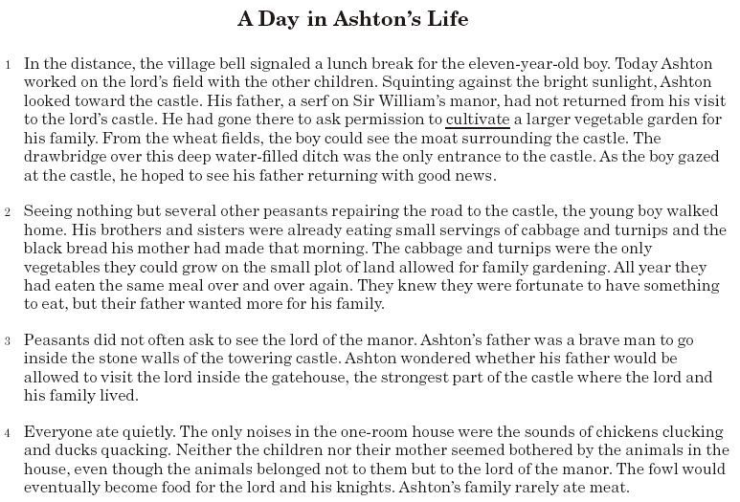

Slide 23


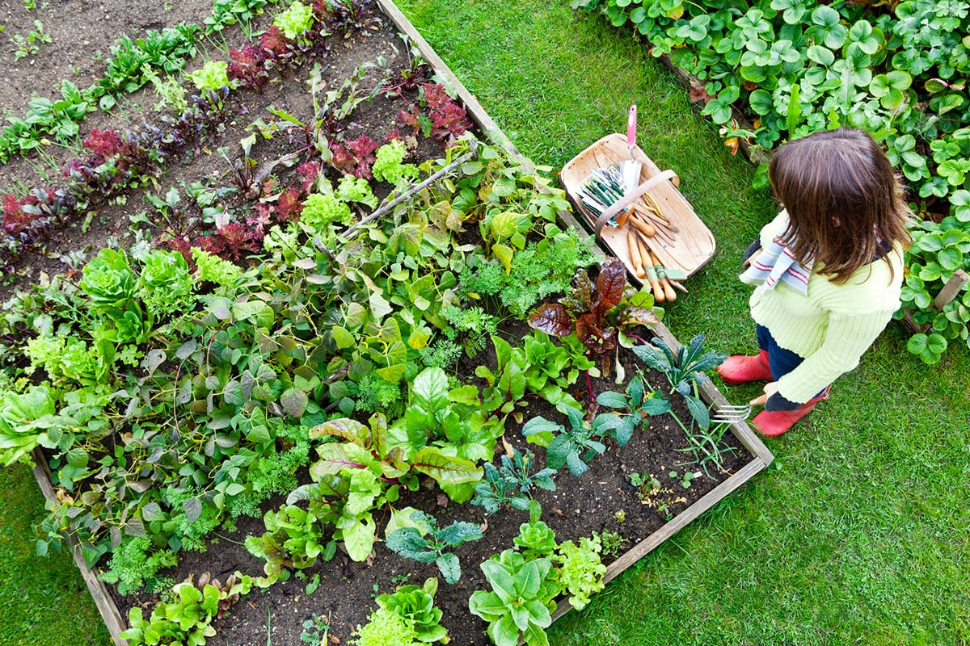
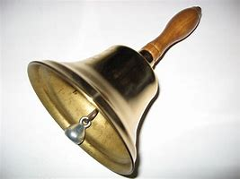


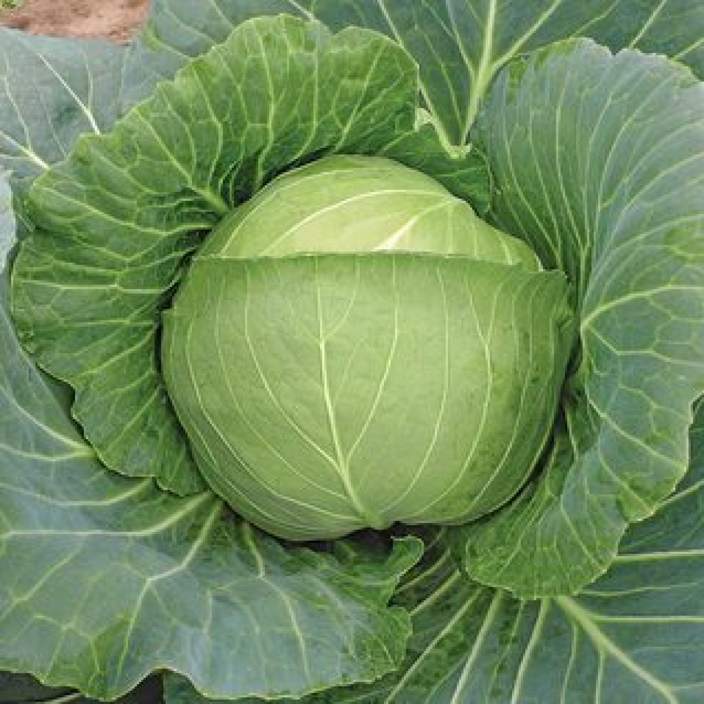
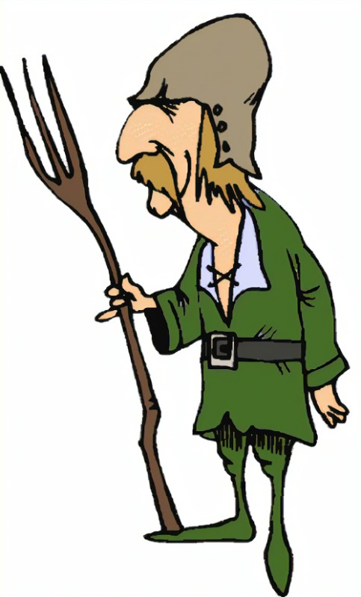
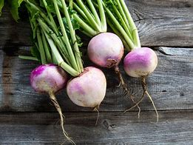
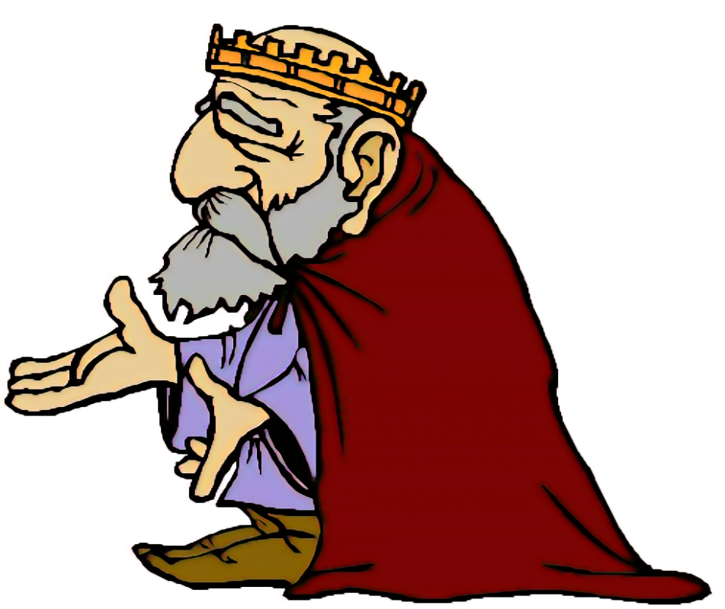


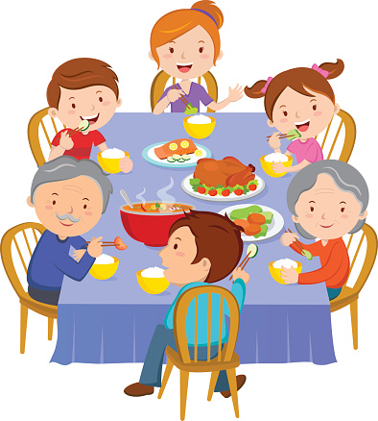
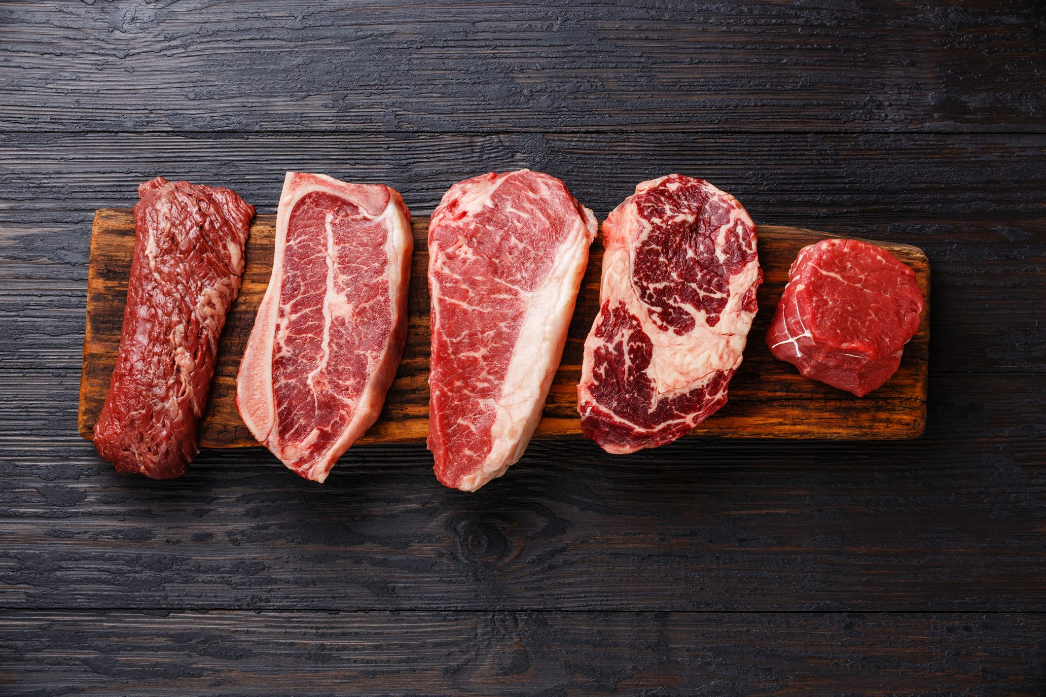
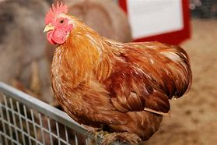
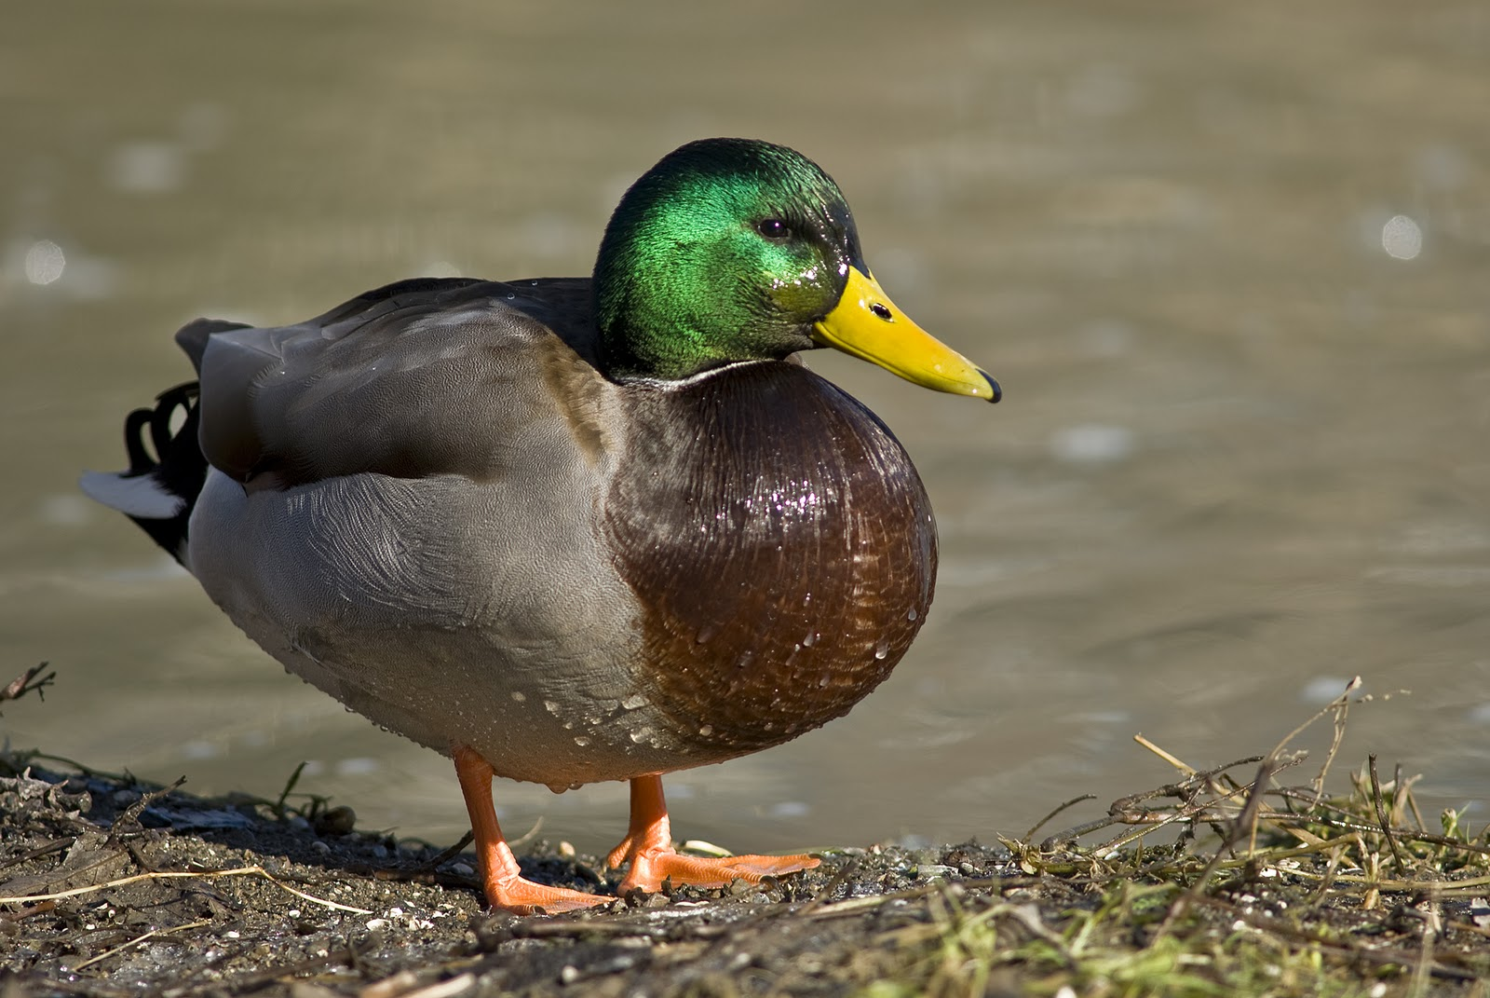
1.
2.
3.
4.

Slide 24
1.
Bell
Sunlight
Vegetable garden
Castle
2.
Brother and sister
Cabbage and turnips
All year
Father
3.
Lord of the manor
Father
Brave
Stone walls
4.
ate quietly
chickens and ducks
meat

Slide 25
connect
Dual coding
What is it?​
Dual coding is combining words and visuals such as pictures, diagrams, graphic organizers, and so on. The idea is to provide two different representations of the information, both visual and verbal, to help students understand the information better.
Why does it matter?​
Adding visuals to a verbal description can make the presented ideas more concrete, and provides two ways of understanding the presented ideas. Dual coding is about more than just adding pictures. Instead, the visuals should be meaningful, and students should have enough time to integrate the two representations (otherwise, cognitive overload could occur, see this blog). There is scientific evidence backing dual coding, showing that when we combine representations it is easier for students to learn and understand the material.​

Slide 26
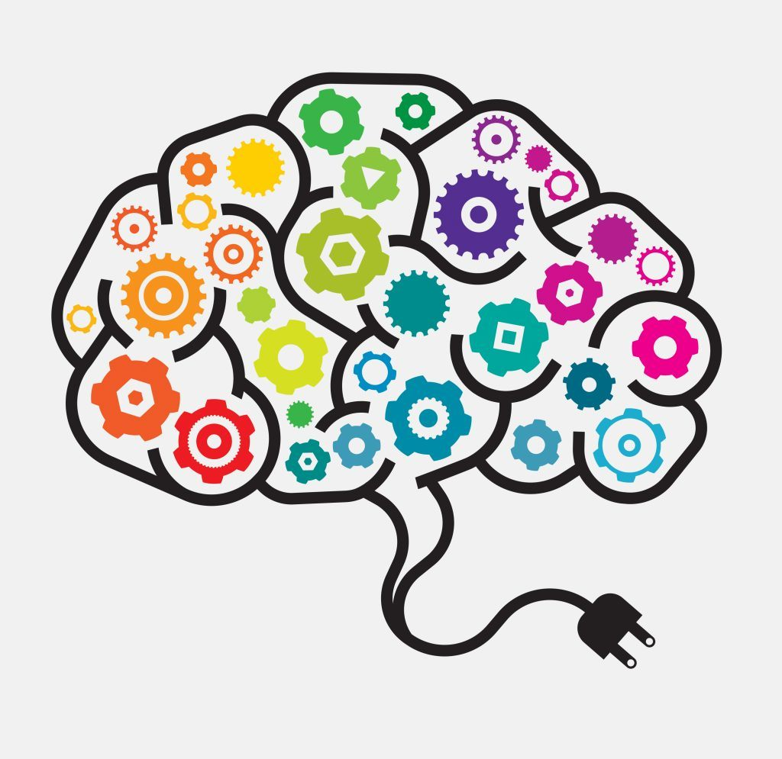
connect
Independent practice
Retrieval practice pyramid
To what extent do you think retrieval practice is an effective tool in the classroom?
Explain the benefits of retrieval practice
Explain the long-term impact of retrieval practice
Where could you use retrieval practice in your curriculum?
Name two classes you could use these strategies with
Why do you need brain exercise?
How do you get healthy synaptic transmissions?
Who spoke on the video about retrieval practice?
Name a retrieval practice activity?
What is recall?

Slide 27
Key Reading:​
- ‘Rosenshine’s Principles in Action’ by Tom Sherrington ​
- https://teacherhead.com//?s=rosenshine​
- ‘How to Learn’ by Matt Bromley​
- www.bromleyeducation.co.uk​
- ‘Retrieval Practice’ by Kate Jones​
- www.lovetoteach87.com​
- www.teachertoolkit.co.uk​
- www.educationendowmentfoundation.org.uk​
- www.retrievalpractice.org​
- www.sec-ed.co.uk​
- https://www.olicav.com​
- ‘Teach like a Champion’ – Doug Lemov​

