Slide 1

Bolton English Hub
Tuesday, 4th July 2023
2:00-4:00

Slide 2
Bolton English Hub
Tuesday 4th July 2023
Agenda
Curriculum Implementation
Reading, including disciplinary reading
Culture- Behaviour and Attitudes
Thinking time and feedback from the year
A.O.B. Next year’s meetings and schools to host!

Slide 3
1. Curriculum Implementation
Planning, designing and creating a curriculum…

Slide 4
1. Curriculum Implementation
Ambition and equality for all
‘Golden nuggets’ of knowledge in interconnected webs (schema)
‘Golden nuggets’ of knowledge in interconnected webs (schema)
Pre-empted cultural capital deficits
Systematic focus on vocabulary
Sequencing- systematic and cumulative knowledge acquisition
Sequencing- systematic and cumulative knowledge acquisition
Vertical and horizontal thinking
Knowledge before pedagogy
Systematic assessment
Alliteration in long-term memory

Slide 5
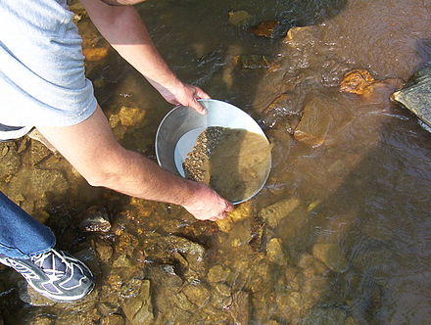
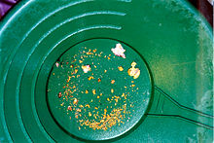
1. Curriculum Implementation
Scheme- Composite Knowledge- Components

Slide 6
Breaking end points into component knowledge
‘End points’ often come from the National Curriculum.
Throughout our curriculum design, we focus on breaking down these end points into schema and then into component knowledge.
Composite topic:
Language Analysis
Underpinning Knowledge:
Reading and Comprehension
Word Connotations
Authorial Intent
Understanding
Meaning
Inference
Explaining
Purpose
Effect

Slide 7

10 minutes discussion
Components of knowledge in English
Literary Studies
Wide range of literature
Context
Concepts
Grammar
Composition
Models
Components
Evaluation
Syntax
Linguistics
Standard English
Etymology
Written and spoken language
Rhetoric
Written and spoken rhetoric
Great speeches
Great writing
Discuss what components and end points look like in English. Prepare to feed back to the group.

Slide 8
10 minutes discussion
Collaboration and Discussion
Let’s now break out and discuss our approaches to creative writing.
Talk around the resources you have brought with you.
  What works? Why?
  What advice or support would benefit you?
  Has anyone implemented approaches shared by Charlotte last time? How’s it gone?

Slide 9
2. Reading including disciplinary reading
Quick group discussion
What is your school’s literacy strategy/ policy?
How do you track or monitor reading? NGRT/ Accelerated Reader/ Quick Reads/ Form Time Reading/ Reading for Pleasure etc

Slide 10
10 minutes
2. Reading including disciplinary reading
Reading Fluency
Read the Alex Quigley text on reading ‘fluency’ alongside the EEF learning resources and get ready to feedback your thoughts:
Why should reading and vocabulary be at the heart of everyone’s curriculum?
What consistencies do we need to see across subject and across phases?
What does ‘Reading Fluency’ look like in English?
Can we make any links between this and the component knowledge we have just looked at?

Slide 11
3. Culture- behaviour and attitudes
Open floor discussion
What trends are we currently seeing?
What are some of our concerns going into next year?

Slide 12
4. Thinking time and feedback from the year
In pairs/ groups
What do you want from the hub?
What brings you to the meetings?
What do you need to see more of next year?

Slide 13
5. A.O.B and next year’s meetings
Hub | Host | Time | Autumn Term |  | Spring Term |  | Summer Term
English | ESSA | 1.30pm – 4pm | 27th September |  | 16th January | 20th March |  | 20th June
We have been given the ‘OK’ to host at different schools next year just to mix it up a bit!
Essa will still be ‘hub leads’ but with more of a collaborative approach to draw on the strengths of each school!

Slide 14


Slide 16
What is NGRT?
The New Group Reading Test (NGRT) is a standardised assessment to measure reading skills of students aged 5-16 years against the national average and should be done termly.
NGRT reliably measures students’ knowledge of phonics, comprehension, decoding ability, vocabulary, grammatical knowledge, deduction and inference skills, authorial intent, and ability to deal with figurative and idiomatic language (depending on the age of the student and test selected).

Slide 17
Some facts
The year on year average growth in Reading ability is much higher at younger ages (e.g. the reading ability score average increase from 228 to 272 between ages 7 and 8 years).
For older students the year on year growth is much smaller over ages 13 years (e.g. the reading ability score average increase from 368 to 376 between ages 14 to 15 years).
Therefore, a Reading age of 17 years is unlikely to be that much different from a Reading age of 14 years.
In most cases it is not sensible to relate scores for students with above average ability to Reading age as Reading ages relate to an average, it is best to use standardised age scores (SAS) for measuring progress or monitor trends.

Slide 18
NGRT data
NGRT is in two parts: sentence completion, which measures decoding with some element of comprehension; and passage comprehension, which measures skills of increasing difficulty.
Children enter the test according to their chronological age and begin with the sentence completion section. The difficulty increases beyond the pupil’s ability, challenging their understanding, until their scores show that the difficulty level is too high. Those who complete the Phonics tasks will not be presented with the Passage Comprehension.
It is an adaptive test where students answer different questions depending on their abilities. Weaker students attempt easier questions whereas more able students attempt harder questions. Therefore, a weaker or a more able student may get the same number of questions correct but they will have different abilities.

Slide 19
NGRT Reports Available
NGRT Group Report for Teachers - The Group Report for Teachers provides a summary of the age-standardised scores, presented both in rank order and in comparison to the national population (national percentile rank).
NGRT Individual Report for Teachers - The Individual Report for Teachers shows all scores for a student plus an analysis of responses for Sentence Completion and Passage Comprehension and a short narrative report
NGRT Progress Report - This report provides a summary of the progress made over time

Slide 20
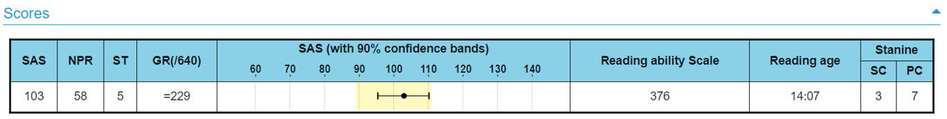
TIS-9.5
The average score for the SAS (Standard Age Score) is 100. This makes a comparison with a nationally representative sample of pupils across the UK
Stanines are closely linked to Standardised Age Scores and place students’ scores on a scale of 1 (low) to 9 (high) offering a broad overview of performance.
Discrepancies of 2 or more stanines are highlighted in the Group Report for Teachers, as these students would benefit from further investigation

Slide 21
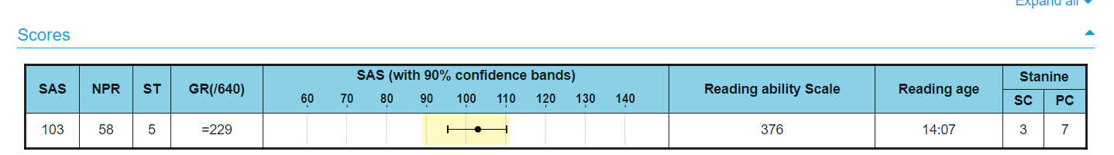
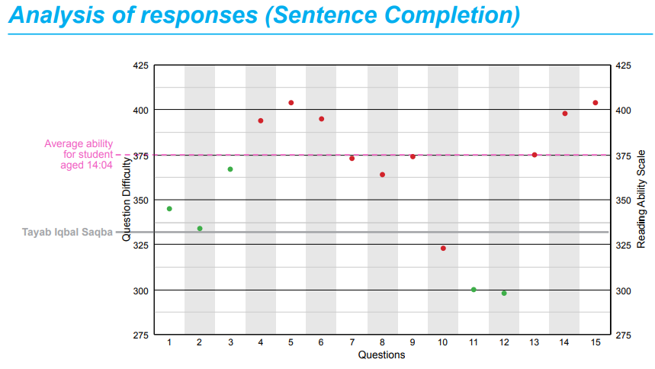
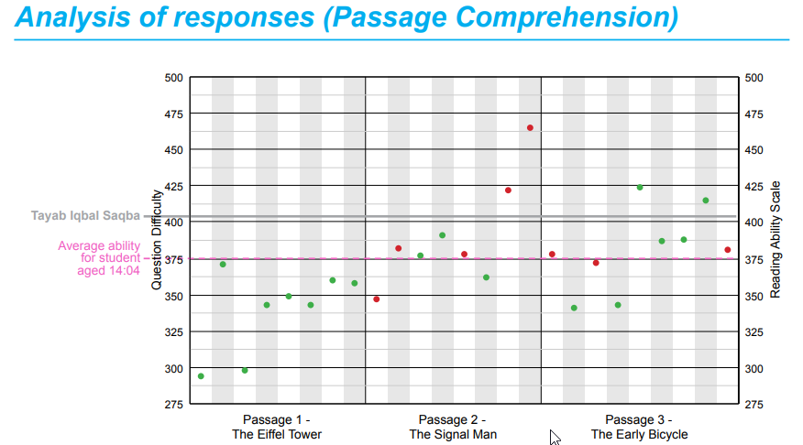
Questions – in Sentence Completion each student attempts 15 questions. In Passage Comprehension each student attempts one, two or three passages.
The dots on the graph are green for correct and red for incorrect or if no response was given

Slide 22
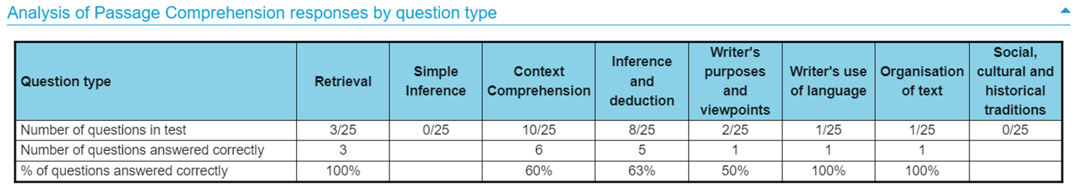

Slide 23
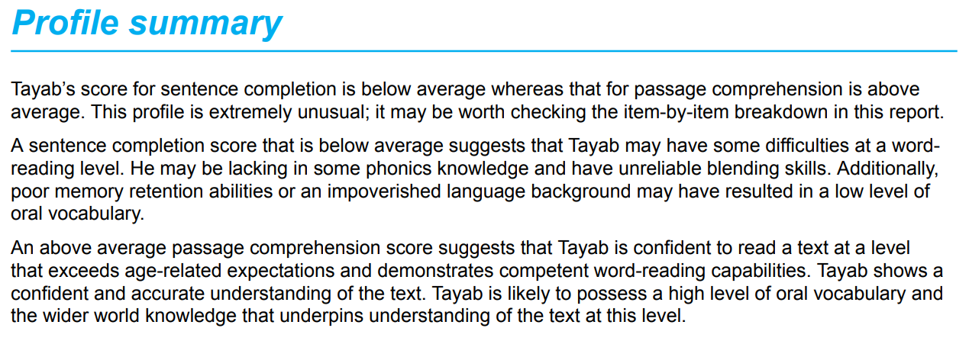

Slide 24
