Slide 1



The Bolton Learning Partnership
History Hub
www.boltonlearningpartnership.org.uk
@BLP19K

Slide 2

The Bolton Learning Partnership
Discussion point
How do you measure the knowledge gained at KS3 in your department?
www.boltonlearningpartnership.org.uk
@BLP19K

Slide 3
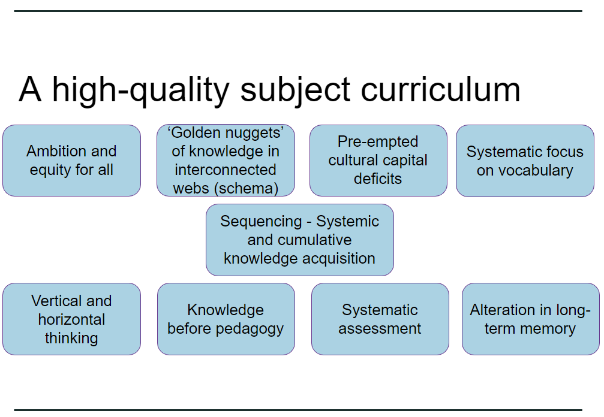
The Bolton Learning Partnership
www.boltonlearningpartnership.org.uk
@BLP19K

Slide 4
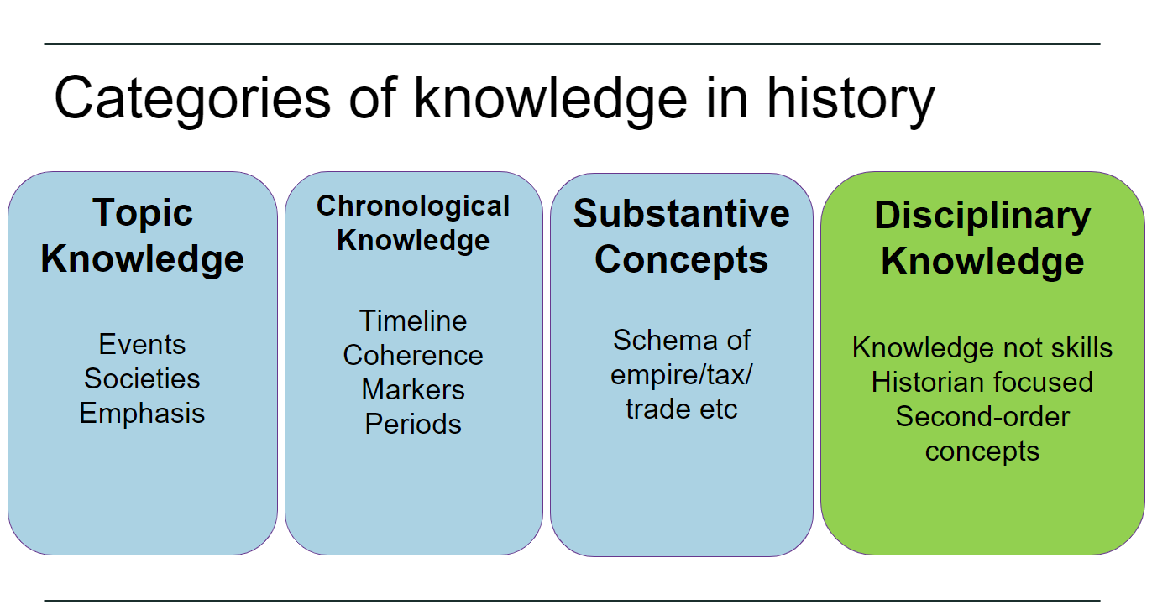
The Bolton Learning Partnership
www.boltonlearningpartnership.org.uk
@BLP19K

Slide 5

The Bolton Learning Partnership
Play from 36 mins to 47 mins
www.boltonlearningpartnership.org.uk
@BLP19K

Slide 6
The Bolton Learning Partnership
Discussion point
What does Tim Jenner suggest are meaningful ways to assess?
www.boltonlearningpartnership.org.uk
@BLP19K

Slide 7
The Bolton Learning Partnership
Summary
Avoid extended pieces of writing
(Complex and can focus on the wrong things such as writing structures and skills)
Avoid skills ladders
(not useful and can be too generic)
Assessment most effective when it identifies gaps in knowledge
www.boltonlearningpartnership.org.uk
@BLP19K

Slide 8


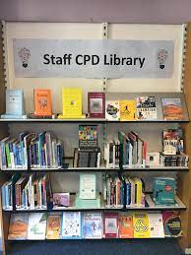
The Bolton Learning Partnership
MSJ Model
Look at the research surrounding curriculum and assessment
www.boltonlearningpartnership.org.uk
@BLP19K

Slide 9
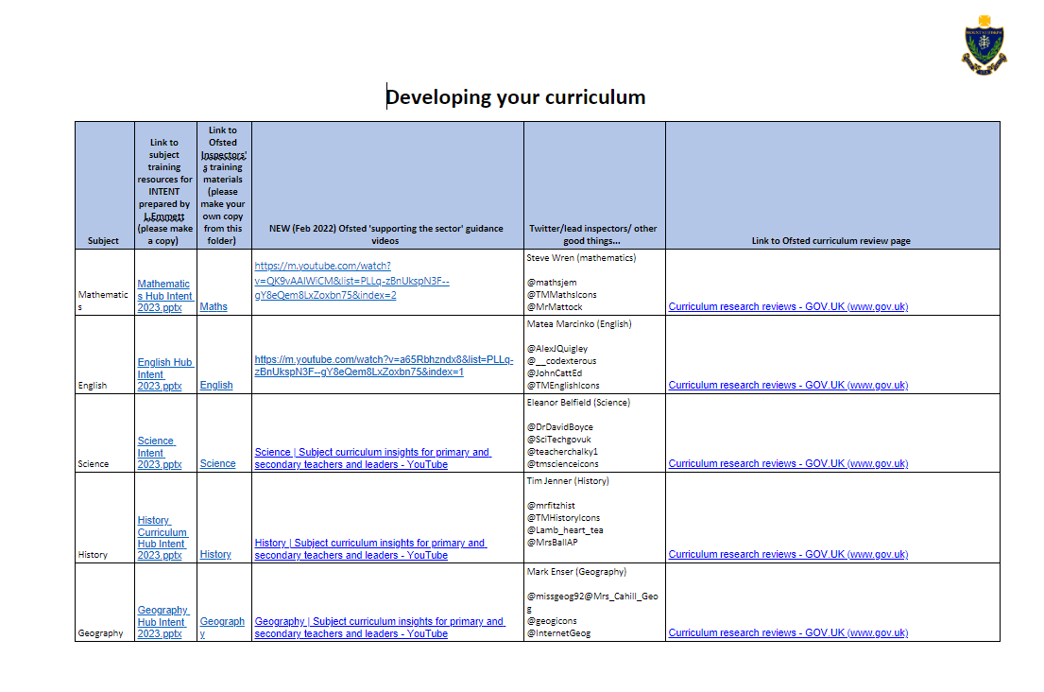
The Bolton Learning Partnership
MSJ Model
Look at the research surrounding curriculum and assessment
www.boltonlearningpartnership.org.uk
@BLP19K

Slide 10

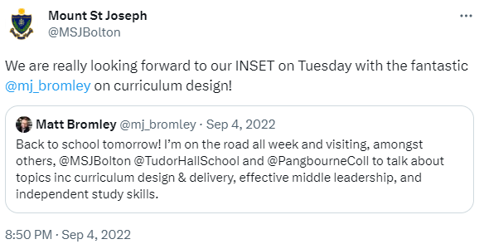

The Bolton Learning Partnership
MSJ Model
2. Whole school training on curriculum and assessment
Jan 2022 – Matt Bromley INSET
www.boltonlearningpartnership.org.uk
@BLP19K

Slide 11

The Bolton Learning Partnership
MSJ Model
3. Focus groups across school to align what a standard approach to assessment should look like
Made up from a cross section of staff from across the school. 3 after school meetings and 3 briefings to explore existing assessment framework, how a new system could be developed that focused on a knowledge rich curriculum and how this model could fit for all departments.
www.boltonlearningpartnership.org.uk
@BLP19K

Slide 12

The Bolton Learning Partnership
MSJ Model
4. Consultation with other schools
In order to create an effective model, it was important to share best practice with other schools and look at the models that they had in place or were planning to put in place.
www.boltonlearningpartnership.org.uk
@BLP19K

Slide 13

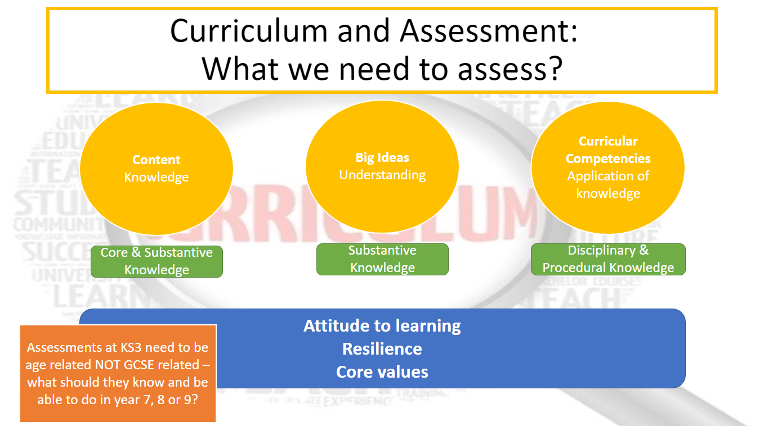
The Bolton Learning Partnership
MSJ Model
5. Develop a plan and share with SLT
www.boltonlearningpartnership.org.uk
@BLP19K

Slide 14

The Bolton Learning Partnership
MSJ Model
6. Share the plan with HODs
June 2023 – Share the final vision with the HODs and then implement for September
Year 11 gain time used and departmental meetings to aid the planning process
www.boltonlearningpartnership.org.uk
@BLP19K

Slide 15
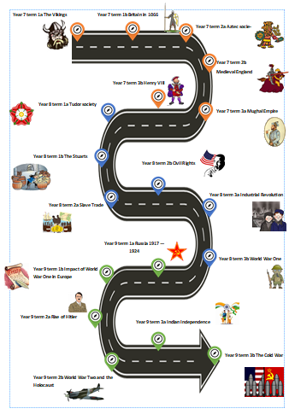
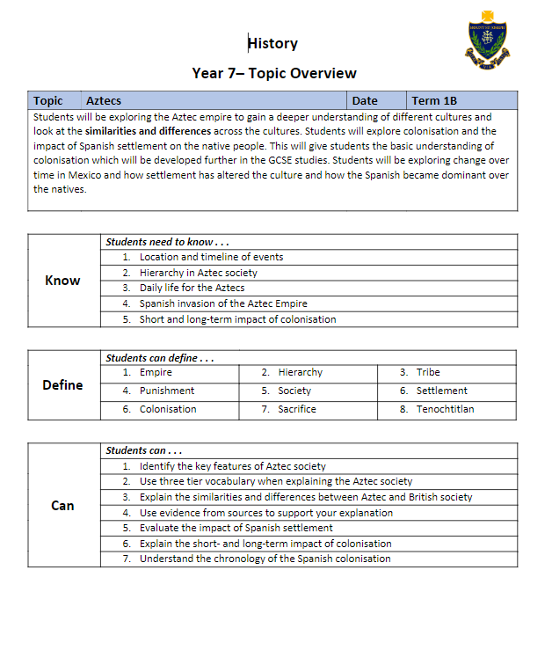

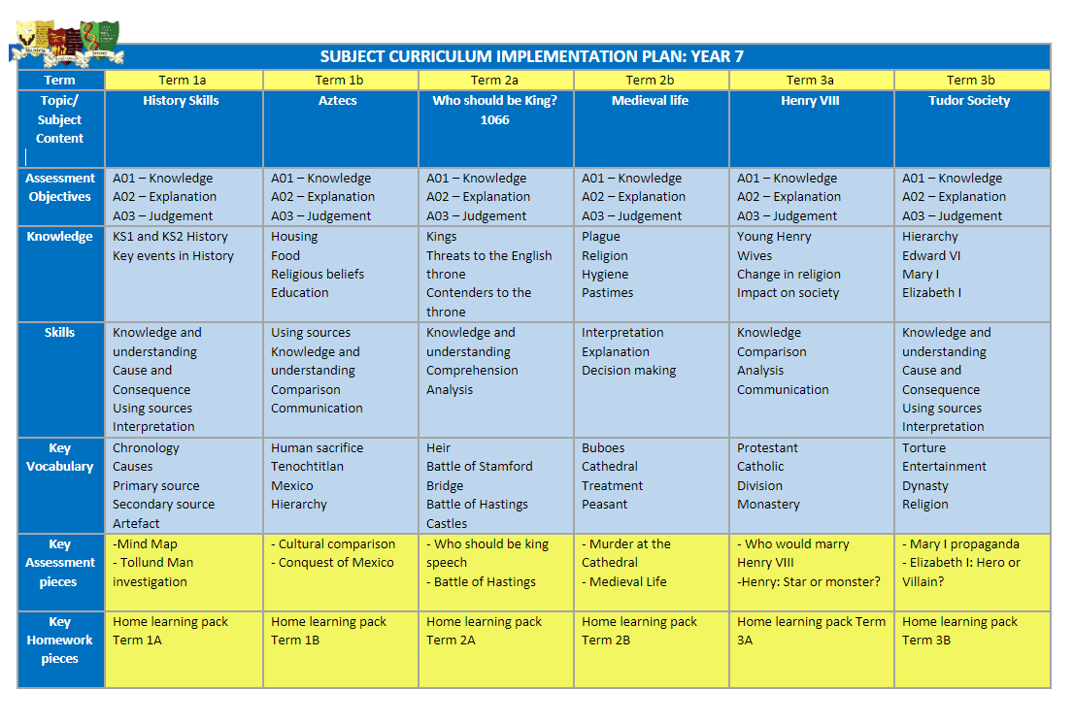
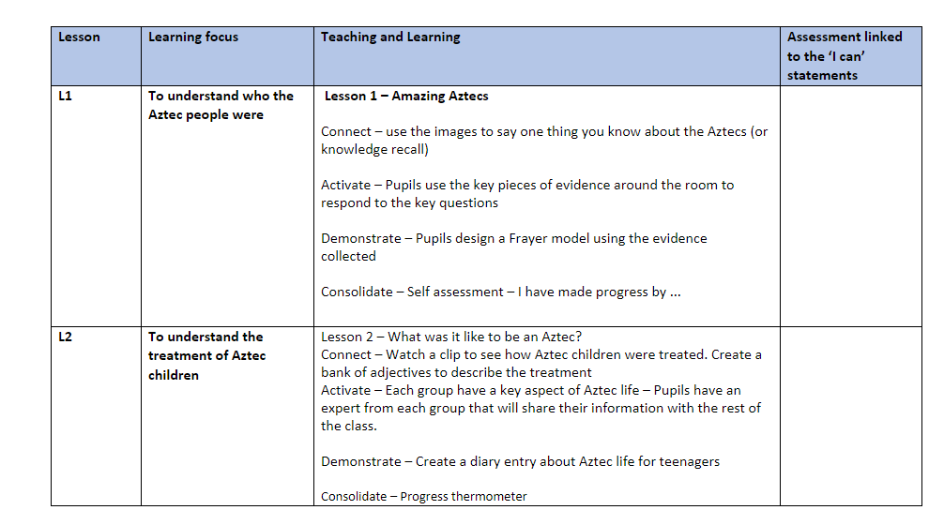
The Bolton Learning Partnership
MSJ Model – Assessment
Assessment
Curriculum maps
Schemes of learning
Big picture learning - Roadmaps
www.boltonlearningpartnership.org.uk
@BLP19K

Slide 16
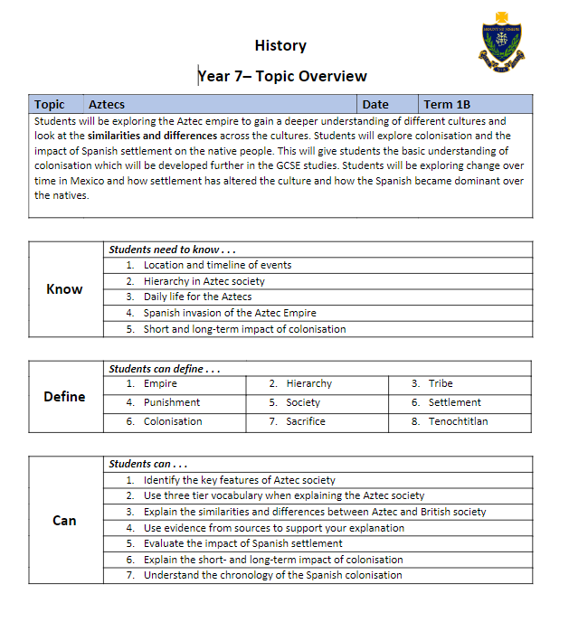
The Bolton Learning Partnership
MSJ Model – Assessment
Intent
What the students need to know
Key terms they need to be able to define
What they will be able to do by the end of the topic
www.boltonlearningpartnership.org.uk
@BLP19K

Slide 17
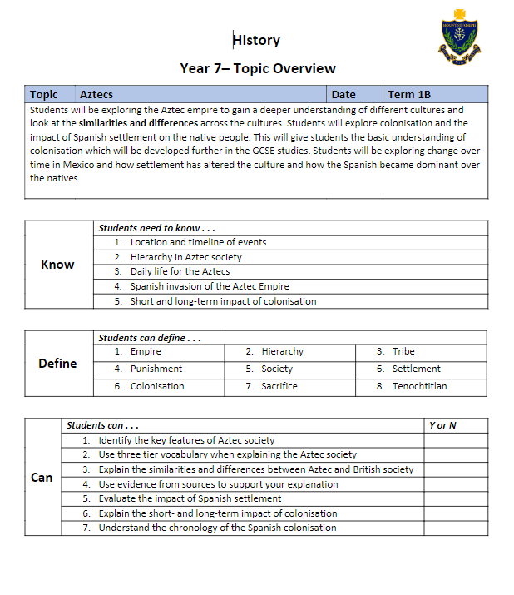
The Bolton Learning Partnership
MSJ Model – Assessment
Stuck in the books so all students are aware of what they still need to work on.
No gradings
www.boltonlearningpartnership.org.uk
@BLP19K

Slide 18
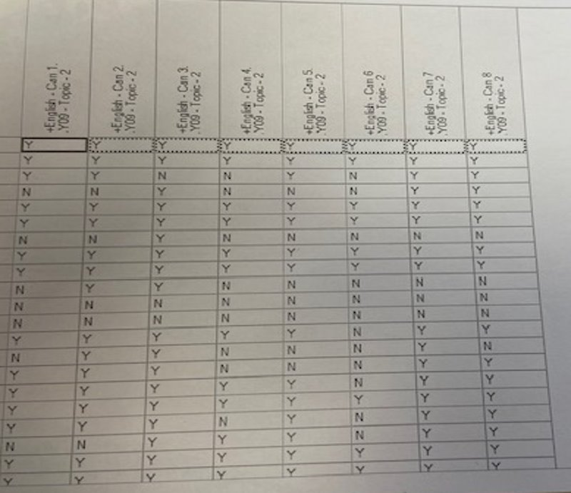
The Bolton Learning Partnership
MSJ Model – Assessment
Teachers indicate on SIMS whether students CAN DO the CAN statements. SIMS would work out a % for each student
www.boltonlearningpartnership.org.uk
@BLP19K

Slide 19
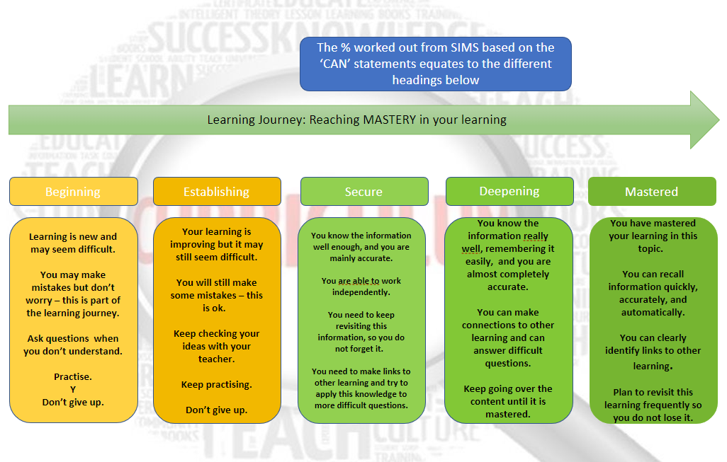
The Bolton Learning Partnership
MSJ Model – Assessment
www.boltonlearningpartnership.org.uk
@BLP19K

Slide 20
The Bolton Learning Partnership
MSJ Model – Assessment
Reporting to parents
KS3 Assessment Points (years 7-9)​ | Reporting to parents​ | Departmental Meetings: Students of concern/ Waves of Intervention​ | Raising Standards Meetings​
Term 1: 13th December 2023​ | Term 1: 16th December 2023​ | 23rd January 2024 | Wk. beginning 9th Jan 2024
Term 2: 21st March 20234 | Term 2: 24th March 2024 | 20th March 20234 | Wk. beginning 27th March 2024
Term 3: 11th July 2024​ | Term 3: 14th July 2024 | 10th July 2024 | Wk. beginning 9th July 2024
www.boltonlearningpartnership.org.uk
@BLP19K

Slide 21

The Bolton Learning Partnership
Assessments in your schools
In small groups share your assessment model with the rest of the hub.
If you are planning on changing your model discuss what this will look like
What are you testing for?
How frequent are your assessments?
How do you check for progress made?
How do you report to students / home?
www.boltonlearningpartnership.org.uk
@BLP19K

Slide 22
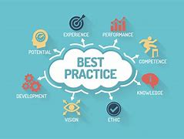
The Bolton Learning Partnership
Assessments in your schools
5-minute reflection
Best practice what could you pinch?
www.boltonlearningpartnership.org.uk
@BLP19K

Slide 23
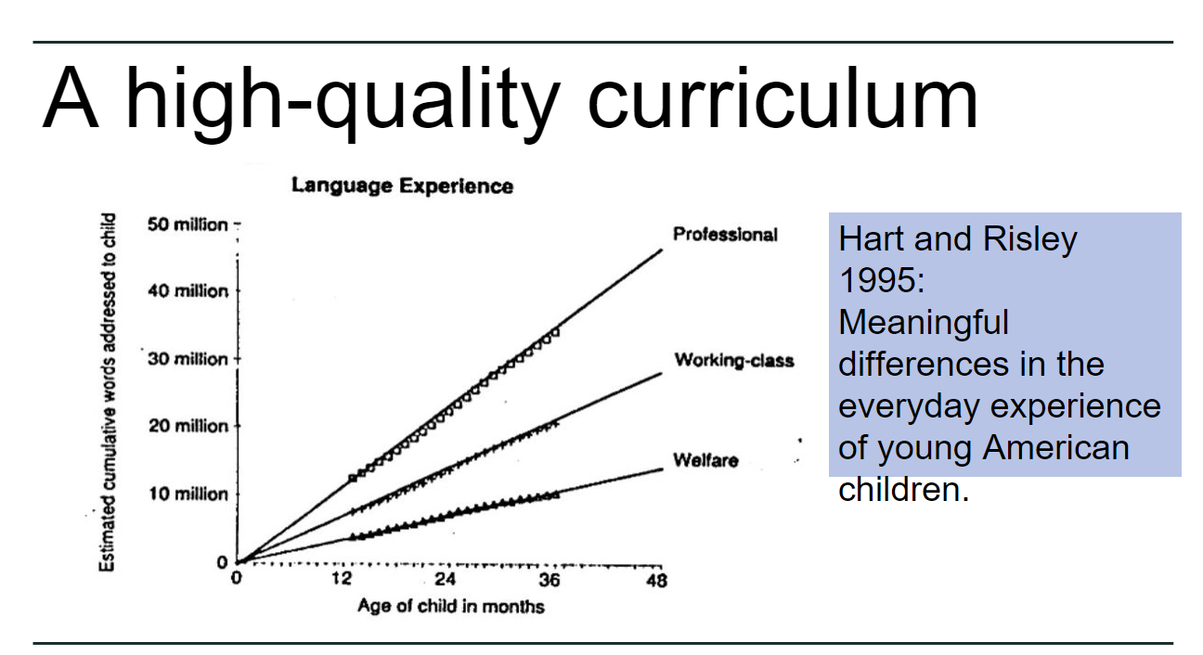
The Bolton Learning Partnership
Reading
There is a need to develop students understanding and use of vocabulary
www.boltonlearningpartnership.org.uk
@BLP19K

Slide 24

Reading
There are lifelong consequences for adults who struggle with reading. According to the Organisation for Economic Cooperation and Development (OECD), around 16% of adults in England have very poor literacy. At this level, they will struggle to understand price labels, read instructions on medicines, make sense of a train timetable or fill in a job application. Adults with low literacy are more likely to have fewer job opportunities and a lower income. The most recent data published by the Ministry of Justice shows that 57% of adult prisoners taking initial assessments had literacy levels below those expected of an 11-year-old. A quarter of young offenders in the UK have a reading age below that of the average 7-year-old.
Each year, around one quarter of 11-year-olds do not meet the expected standard in reading at the end of primary school in Year 6.This level is considered to be the threshold of functional literacy, and gives children the knowledge and skills needed to manage the demands of the secondary school curriculum. Evidence suggests that fewer than 1 in 5 of these pupils can expect to get a GCSE grade 4.
According to 2018 Programme for International Student Assessment (PISA) data, at age 15 in England there is a gap equivalent to 8.5 years of schooling between the highest and lowest achieving 10% of readers. The level of reading achievement of struggling readers suggests they will have difficulty with more complex texts that require specific subject knowledge.
www.boltonlearningpartnership.org.uk
@BLP19K

Slide 25
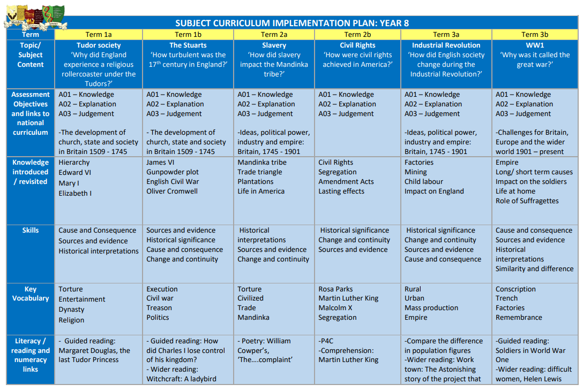
The Bolton Learning Partnership
Reading
www.boltonlearningpartnership.org.uk
@BLP19K

Slide 26
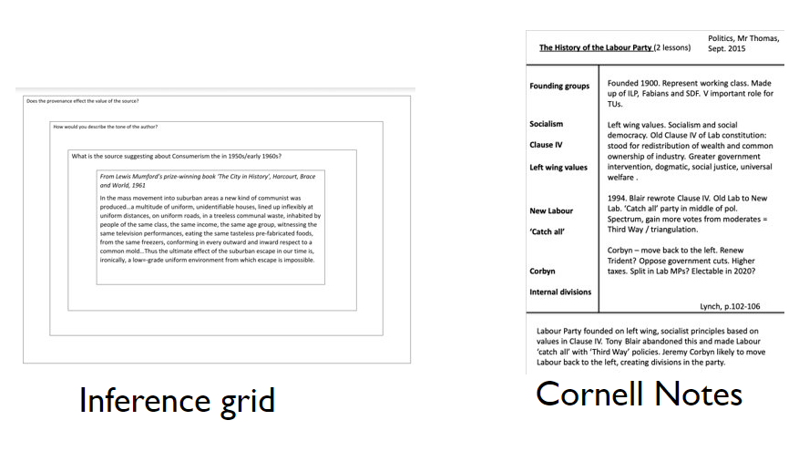
The Bolton Learning Partnership
Reading
www.boltonlearningpartnership.org.uk
@BLP19K

Slide 27
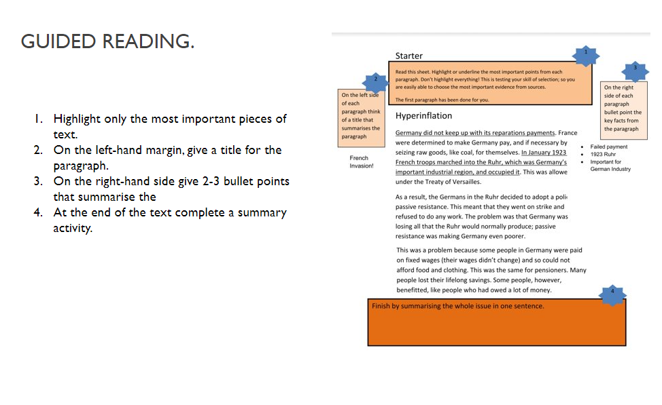
The Bolton Learning Partnership
Reading
www.boltonlearningpartnership.org.uk
@BLP19K

Slide 28
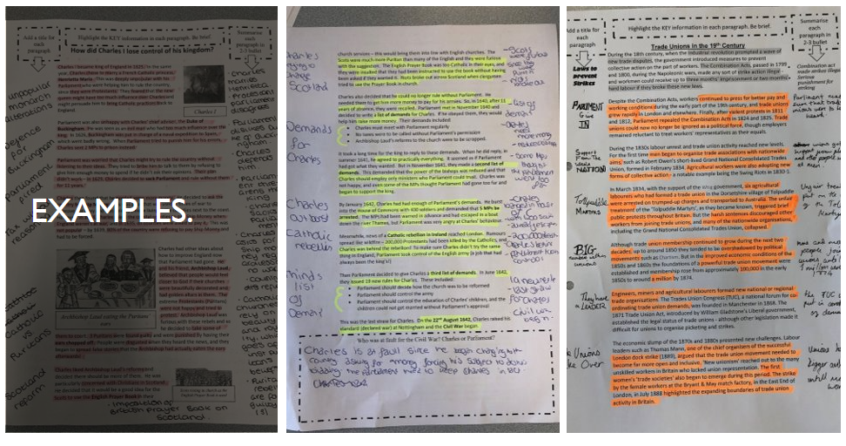
The Bolton Learning Partnership
Reading
www.boltonlearningpartnership.org.uk
@BLP19K

Slide 29
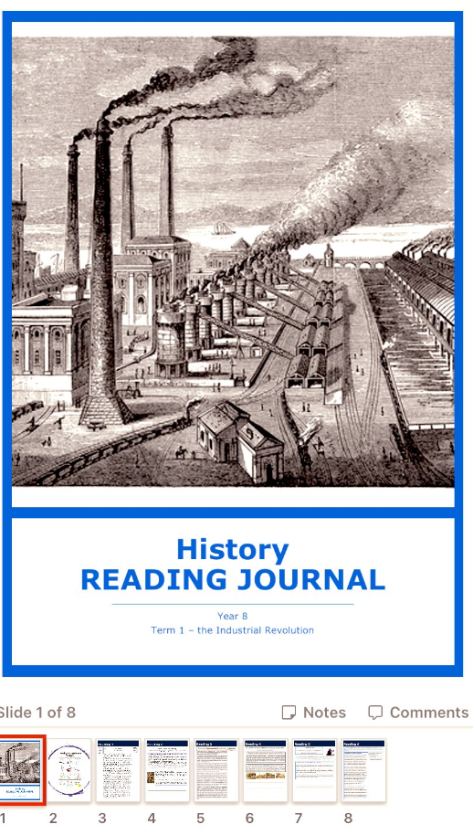
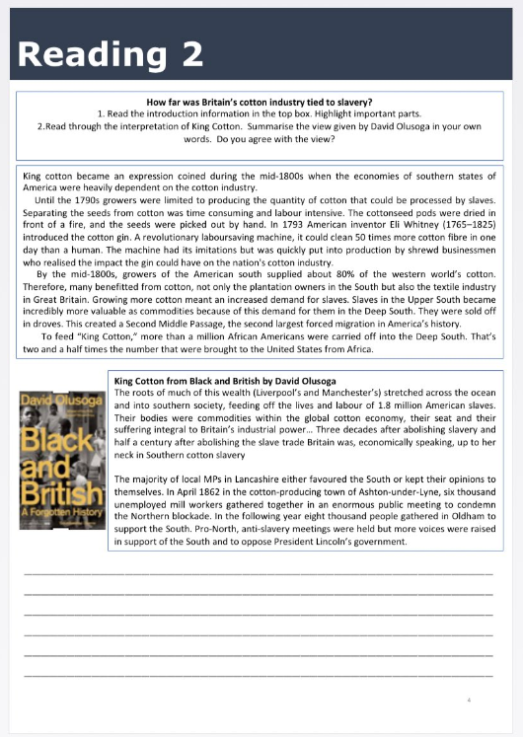
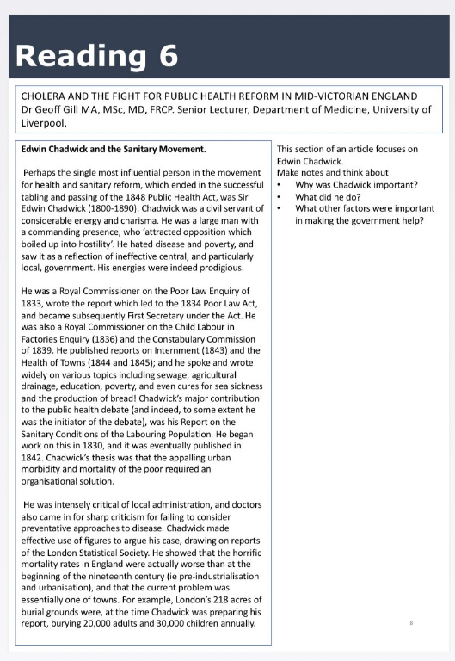
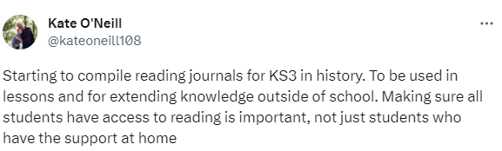
The Bolton Learning Partnership
Reading
www.boltonlearningpartnership.org.uk
@BLP19K

Slide 30
The Bolton Learning Partnership
Reading
What do you have in place in your department?
Discussion
Is reading planned for?
Does home learning support your strategy?
What strategies are effective
www.boltonlearningpartnership.org.uk
@BLP19K

Slide 31
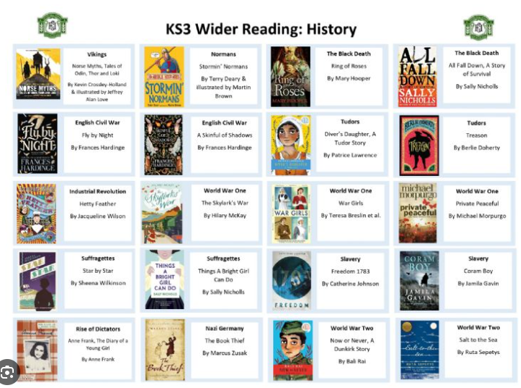
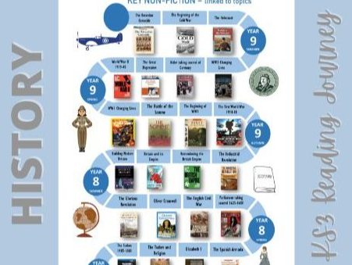

The Bolton Learning Partnership
Reading
What do you have in place in your department?
Could we work together to create a bank of resources to support all schools?
www.boltonlearningpartnership.org.uk
@BLP19K

