Slide 1

Bolton English Hub
Wednesday, 22nd March 2023
1.30pm – 3.30/4.00pm

Slide 2
Bolton English Hub
Wednesday 22nd March 2023
1:30-4:00
Agenda
Key Stage 4- exam strategies, revision and interventions
Effective Curriculum Design
Pedagogical strategies- ‘Top Tips’
HPA- Collaboration Tasks
Ofsted- Open floor
A.O.B. Future meetings and agenda requests

Slide 3
Host Venue | Time (Typical) | Autumn Term |  | Spring Term |  | Summer Term
ESSA | 1.30pm – 4pm | Wednesday 28th September |  | Tuesday 17th January | Wednesday 22nd March |  | Thursday 22nd June
Who’s here?
What is your current role?
What do you expect from the hub?

Slide 4
5 minutes discussion
1. Key Stage 4- exam strategies
Some common requests:
English Language
Analysing Structure
Critical Evaluation
Comparison- synthesis
Comparison- methods and perspectives
Choose a focus and spend 5 minutes discussing your approaches. We will feedback and share as a group

Slide 5

Effective Curriculum Design
English Curriculum Hub
Designed by:
Linda Emmett
Lydia Grellier
Ed Kirk
March 2023
Delivery: Claire Cronin
Westhoughton High School
This Photo by Unknown Author is licensed under CC BY-SA
Notes:
Welcome, introduce each other and session.
This is a practice session for subject hubs on curriculum.
It is the first of many, as part of an ambitious LA wide project
We appreciate your feedback.
It is within the remit of support without judgement. We are here to genuinely help you and to facilitate helping each other. The reason is that we impact approximately 19 thousand pupils across the LA.

Slide 6
Training Aims
To develop an understanding of the research underpinning the Education Inspection Framework
To develop an understanding of effective curriculum design, both generic and in English.
To understand the importance of effective curriculum design to aid understanding and memorisation of important knowledge.
To consider how to work effectively together as a collective group of practitioners.

Slide 7






Notes:
Each year on GCSE results day, during SATs results, at end-of year celebrations, we see many pupils and students across the country celebrate their outcomes and learning from the year. The following week, we also see pupils transition successfully from primary to secondary, and secondary to college, and to other destinations. using their prior learning. There will also be many young people in their 20s and 30s drawing on what we have taught them, in unexpected ways.
The focus of EIF aligns with our fundamental belief as teachers that we want to inspire pupils and students across our schools to excel and feel a sense of success. We are also preparing them to have such a detailed and complex web of knowledge, that they are able to draw on this knowledge with ease throughout education and employment. This is achieved through high-quality curriculum design.
English is particularly important as it supports all other subject areas, and also the development of reading.

Slide 8
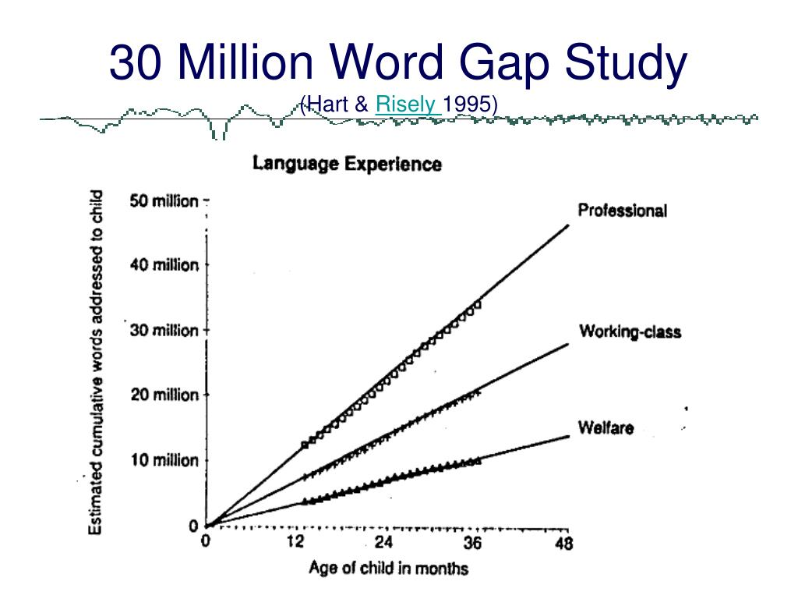
A high-quality curriculum
Notes:
Researchers recorded that in their first four years:
An average child in a professional family accumulated experience with almost 45 million words.
An average child in a working-class family, 26 million words.
An average child in a welfare family, 13 million words.
The gap in social classes is clear from this research.
Vocabulary size relates to academic success. It is a convenient proxy for a whole range of academic abilities, not just reading, writing, listening and speaking. Also relates to achievement in science, history, geography and the arts.
90% of vocabulary is only encountered in writing and not in speech.
Therefore, a rich and high-quality curriculum is needed to address vocabulary and cultural capital deficits.

Slide 9
The substance of education
“The focus on substance, on the knowledge that we want young people to acquire, is often lost…
If their entire school experience has been designed to push them through mark-scheme hoops, rather than developing a deep body of knowledge, then they will struggle in later study.”
Amanda Spielman, HMCI, October 2017
Notes:
We have had a strong focus on examination outcomes. However, underneath this sits a wealth of knowledge that we can impart on the next generation. This is our curriculum.
Author David Didau writes that ‘learning must be durable and flexible (i.e. applicable in different contexts). If we accept these ideas, then we should accept that learning cannot be observed in the here and now. The only way to see if something has been retained over time and transferred to a new context is to look at what students can do later and elsewhere’.

Slide 10

Building a high-quality curriculum
School curriculum breadth and ambition (including SEND and DP)
Subject curriculum design, including coverage, building blocks of essential knowledge, end points, sequencing, reading, vocabulary.
Delivery - pedagogy, access for SEND and PP, effective assessment, enabling memory, inspiring destinations.
The impact on pupils, such as knowing more and remembering more, external data, reading, destinations.
Notes:
When building an effective curriculum, we need to focus on the above areas.
School ambition and intent
Subject ambition and intent
Pedagogy – it how we are delivering our intent
Impact – this is much wider than data and spreadsheets. It is also what pupils know, remember and can do in their books. It is not just outcomes. It is also facilitating high-quality destinations, for example success at key stage 3 in a broad range of subjects, and in reading, and at key stage 5 across the subjects that pupils choose to study through to the end of Year 11.

Slide 11
School and subject curriculum planning
Ambitious knowledge, texts and cultural capital for all pupils.
Commensurate with the national curriculum (or better)
Pupils across the school study the full curriculum
Disadvantaged pupils or those with SEND are not given a reduced curriculum.
The curriculum identifies the most important knowledge pupils need to learn and when.
Curriculum is planned and sequenced to build on, and deepen, what has been taught before.
‘End points’ - what the curriculum is building towards.
Reading, vocabulary and cultural capital, are prioritised.
Notes:
Intent is the overarching curriculum model. It is also the curriculum planning at subject level.
How does the curriculum develop knowledge as pupils progress through the school? This may be from early years upwards in primary or through schools; key stage 3 upwards in secondary.
This does not mean that curriculums are narrowed to focus on outcomes at key stages 2, 4 and 5 – a broad and rich curriculum in line with the national curriculum.
What research did you use to design your curriculum? There are a range of universities and institutions that have done research into effective curriculum design such as York University for Science using the 10 big ideas in science as a basis. Have you sought subject-specific research and support for content and delivery?
Para 410 to 411 Ambition for all important, for example, are DP and SEND pupils able to follow the pathway they wish or are they guided away from this? Can DP and SEND do triple sciences if they wish, a language if they wish? Does SEND support have an accidental negative impact on curriculum breadth?
For us in English, has the subject leader has already ensured that DP and SEND pupils access the same texts as all pupils in English? They ensure that the wider cultural knowledge and vocabulary needed to access texts?
Do pupils study their full curriculum during time in school, or is it narrowed? For example, do Year 6 pupils still access a broad range of subjects or do they spend a lot of time on SATs? Do pupils early enter for any subjects at key stage 4? Does this mean then that they are not studying NC subjects such as lang or lit throughout their KS4? Does this also mean that any narrowing at KS2 or 4 is preventing later study in key stage 3 or 5 due to the forgetting curve?
Is any required curriculum narrowing for particular pupils well planned, with a clear rationale, with a clear plan for a return to full study so that narrowing is temporary?
Knowledge – we have more work to do in this specific area. As mentioned before, this is a mindset shift. But it has huge positive impact on our pupils. If we have defined and sequenced topics or complex tasks rather than the essential knowledge that students need to be able to perform a complex task, we may not always consistently focus on the right things. This would also impact the effectiveness of assessment, which is hindering identification of specific gaps and misconceptions for each pupil.
Vocabulary – many angles on this. Overall reading to promote a love of reading, vocabulary development and comprehension. Subject-specific reading to further promote vocabulary and knowledge. Support for the weakest readers through a phonics programme that develops pupils’ phonics knowledge, fluency and accuracy.

Slide 12
Discussion Point
What might you need to consider when looking at the curriculum ambition and equity in English?
Discuss and be prepared to feed back.
Notes:
Discuss for 2 minutes. Take feedback.
You may have thought about… (next slide…)

Slide 13
You may have considered…
National curriculum coverage through all key stages
Links to the EYFS curriculum
Support for pupils’ phonics knowledge, consistent delivery of the phonics programme.
A range of ambitious texts.
A rich range of texts
At key stage 3, two full Shakespeare plays.
Equal access to both language and literature across key stage 4.
Time-limited interventions which do not limit the curriculum for some pupils.
Cultural capital, e.g. when teaching abstract aspects such as the knowledge needed to access a poem, book or play.
Effectiveness of subject curriculum design for all
Components and sequencing to help all
Assessment information to aid learning
Support for SEND
Notes:
Curriculum ambition, including equity for all. Do all pupils have access to the same content and texts?
The same texts for all is important so that all pupils have access to the same rich vocabulary and cultural capital.
National curriculum coverage for all pupils., including across language and literature at key stage 4.
No GCSE creep into key stage 3.
In EYFS, curriculum design may look at components within communication and language and the prime areas of learning.
Effectiveness of subject curriculum design to help all pupils to remember the most important knowledge.
Components and sequencing. This is important to aid fluency.
Reading and vocabulary development. Cultural capital.
Assessment information and how this aids pedagogy and curriculum design.
Support for SEND. This may include appropriate curriculums in specialist settings, that are again broken down into components.
Enrichment and clubs.
Outcomes on an ongoing basis. This is not just terminal outcomes. It’s also what pupils know and remember on an ongoing basis.

Slide 14
A high-quality subject curriculum
Ambition and equity for all
‘Golden nuggets’ of knowledge in interconnected webs (schema)
Pre-empted cultural capital deficits
Systematic focus on vocabulary
Sequencing - Systemic and cumulative knowledge acquisition
Vertical and horizontal thinking
Knowledge before pedagogy
Systematic assessment
Alteration in long-term memory
Notes:
A summary of high-quality curriculum planning.

Slide 15
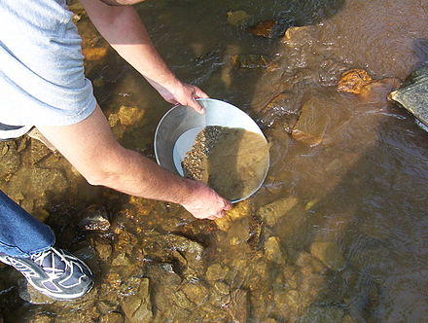
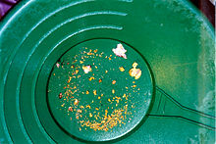
What do we mean by component knowledge?
This Photo by Unknown Author is licensed under CC BY-SA
Notes:
The components that need to be identified in a curriculum plan are those that, rooted in research, you think are the things that pupils need to have secure in their memory prior to moving onto something complex. It is what might come out when you are panning for gold.
They may be substantive knowledge components (i.e. content)
Disciplinary components (i.e. methods in mathematics, knowledge to be able to analyse data or conduct an experiment in science). Although disciplinary knowledge may be different in English, for example knowledge of how to debate or write at length (when they have the substantive knowledge to do so).
This works towards end points where pupils are able to apply knowledge in complex activities so that pupils can do complex tasks with fluent recall.

Slide 16

What do we mean by components and end points?
Reflect on what the components and end points are during the process of learning to drive.
How might you sequence the components?
Notes:
What are the components when driving a car? Which ones can you do without?
What are the end points when driving a car?
Take responses.
It is the application of knowledge learned when doing mini-assessments such as a reverse around a corner. It gives meaningful information to the instructor and learner about what components are missing.

Slide 17
Categories of knowledge in English
Literary Studies
Wide range of literature
Context
Concepts
Grammar
Composition
Models
Components
Evaluation
Syntax
Linguistics
Standard English
Etymology
Written and spoken language
Rhetoric
Written and spoken rhetoric
Great speeches
Great writing
Notes:
A focus on knowledge, not generic pedagogy or exam rubrics. Not mnemonics at the expense of subject content.
Literary Studies
A wide-range of literature (genre, form, world) or a narrow focus on GCSE texts?
Do teachers identify the components of context that need careful teaching to understand texts?
Does the curriculum identify components of literary concepts and grammar and how these shape meaning?
Composition
Rich texts given as models
Explicit identification of components such as SPAG
Do pupils have the fluency of knowledge to edit their own writing and evaluate their writing?
Do you identify the components of syntax so that pupils can compose increasingly complex sentences to convey complex meanings?
Linguistics
Importance of standard English, including its origins
Etymology and the history of the English language
Differences between written and spoken English.
Rhetoric
Plans show components around effective written and spoken rhetoric that are sequenced so that pupils embed them to fluency.
Plans help pupils to deepen knowledge or rhetoric and apply this fluently in their own oral and written compositions.
Do plans identify components of rhetoric in great speeches and writing? Is this seuqnced to help pupils to use this in their own language?

Slide 18
Other Areas
Reading for pleasure.
Social justice.
Support for the weakest readers.
Discussion and debate.
Vocabulary.
Notes:
How do you intend for pupils to read for pleasure? Across a range of quality texts? This is a social justice matter as it exposes pupils to the best that has been written and said.
What about barriers to reading? Including gaps in phonics knowledge? How do you identify and tackle gaps in components of phonics knowledge?
How do develop teachers’ subject and pedagogical knowledge to support curriculum delivery?
So, components of debate and discussion are taught, using effective pedagogy.
How do you develop tier 1, 2 vocabulary? SPAG?

Slide 19
Mirror
Signal
Manoeuvre
Notes:
In their research, they discuss how well leaders have identified the small pieces of knowledge, how they have ensured that they are sequenced well in plans and lessons, how this is deepened as pupils move through a school. This is not topics, it is the topics broken down further, to pinpoint what absolutely needs to be secure.
To exemplify the move from complex topics to well-sequenced component knowledge, we know that learner drivers don’t learn how to drive a car by getting into one and having a go.
They need to learn a lot of knowledge such as the highway code, instruments, clutch control, navigation. They do this about learning important pieces of knowledge
Now it occurs to me how well my own driving instructor, Dennis, identified what I needed to learn, and in what order. It was no point him asking me to drive a long journey. For example, lesson one was on simple things such as turning on the engine, use of handbrake, signals and clutch control.

Slide 20
Discussion Point
Discuss what components and end points look like in English. Discuss and be prepared to feed back to the group.
Notes:
On key misconception is complex activities/tasks vs components. Have a think about the actual components of English across the categories of knowledge that we have discussed.
Discuss for 2 minutes. Take feedback.
You may have considered…

Slide 21
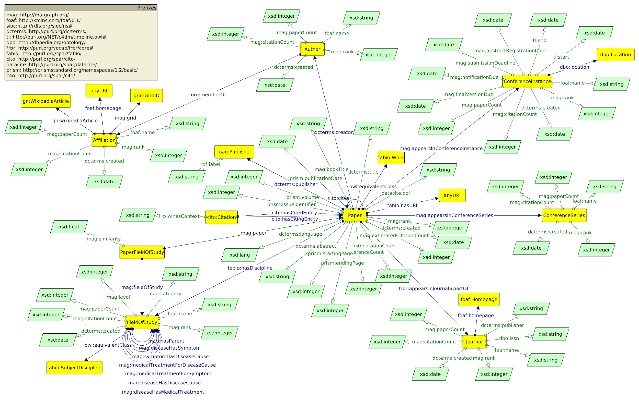
Schemas:
The complex and interconnected web of prior knowledge which allows the learning of new content.
Notes:
Our aim is to facilitate this – complex webs or schemas of knowledge, including key knowledge of elements of rhetoric, context, SPAG etc.
Discuss that knowledge is generative. The more you know, the more connections you are able to make. This dispels the idea of ‘higher order thinking’. Instead, we focus on a multiplicative effect.
When designing our curriculums, it is also the first point that we consider cognitive overload and spaced repetition. This is so that we can start to facilitate the building of strong schema.

Slide 22
Maths Y7 Autumn Term 1
Place value
Powers and Roots
Standard Form
Integers and decimals
Notes:
Let’s look at subject curriculum planning as part of intent. Pupils may be working towards complex tasks or full knowledge of topics throughout the year. These could be end points.
Topics or complex activities are the combination of many pieces of knowledge. This underpinning knowledge is the bits of knowledge needed to help pupils to complete something complicated, such as responding to an exam question. Pupils do not get better at these complex activities such as exam-style questions, playing a game of football, doing a Spanish listening, by repeating these complex tasks. We need to identify the underpinning knowledge or knowledge gaps that students may have, help them learn knowledge to fluency, and also sequence this learning well.
As such, composite complex activities, such as understanding place value, are formed of many different important pieces of knowledge. This knowledge is needed to perform skills or complex tasks. It is important that we identify what knowledge needs to be secure to enable pupils, especially disadvantaged pupils and those with SEND, to access the curriculum, be successful, know and remember increasingly more. This slide is an extract from the maths curriculum plan. In autumn term 1, pupils look at these four complex topics. Underneath these topics may sit a medium plan and a series of lessons that identify, sequence and build the most important knowledge that pupils need to learn. Let’s look in detail at place value on the next slide.

Slide 23
Effective curricular thinking
Decide what content needs to be deeply embedded in long-term memory.
Consider what pupils pay attention to.
Avoid overloading working memory.
Provide spaced repetition for overlearning.
Notes:
So, choose the right things for pupils to learn. Plan for small components, well sequenced, to avoid cognitive overload. Then, space the learning over a sequence of lessons to aid memory.
Consider why a sequence of knowledge is in place, how does it relate to existing knowledge and skills, how well is this implemented and assessed. Does it enable pupils to know and remember more?

Slide 24

Notes:
Reflections so far. What are your next steps in these areas?

Slide 25
Key points
Be ambitious for all!
Identify your ‘golden nuggets’, including context and SPaG.
Weave language and literature through plans.
Progress is knowing more and remembering more.
Learning is a change in long-term memory.
Skills is the capacity to perform drawing on what is known.
Knowledge forms connected networks or schema.
It is what is remembered, not taught, that is important.
.

Slide 26
Suggested support
Ofsted handbooks September 2022
Ofsted research documents and You Tube channel
Ofsted’s Twitter feed, including Matea Marcinko for English
Subject Associations
Peers!
How Learning Happens (Paul A. Kirschner & Carl Hendrick)
How Teaching Happens (Paul A. Kirschner, Carl Hendrick & Jim Heal)
Why Knowledge Matters (E.D. Hirsch, Jr)
Curriculum (Ruth Ashbee)

Slide 27


Slide 28
15 minutes discussion
1. Key Stage 4- collaborative task
English Literature:
Teaching developed responses
What key knowledge do students need to have to successfully respond to this question?
Discuss the question focus and how you would guide students to approach this:
Interpreting the extract
Retrieving significant content from elsewhere in the play
How to develop their responses

Slide 29
5 minutes discussion
1. Key Stage 4- collaborative task
English Literature:
Worlds and Lives poetry cluster
Read the information from AQA regarding the new cluster and get ready to share thoughts:
What are your current feelings on poetry?
How do other exam boards approach the poetry element?
Are you considering a change?

Slide 30
1. Key Stage 4- revision and intervention
When do people finish delivering content and move onto revision?
What do your revision sessions look like?
  In the classroom
  Outside of the classroom
What interventions do you currently run? What is the impact? How do you measure impact?
5 minutes discussion

Slide 31
2. Effective Curriculum Design
Curriculum Hub Lead for English- Claire Cronin

Slide 32
5 minutes to discuss
3. Pedagogical Strategies ‘Top Tips’
Vocabulary Instruction- C Parkinson
Diagnostic Questioning- C Wood
Analysing Structure- J Entwistle
Critical Evaluation- J Entwistle

Slide 33

When do we use DQs well in our lessons?
Any examples?
Are there any lessons where you find it hard to include DQs?

Slide 34
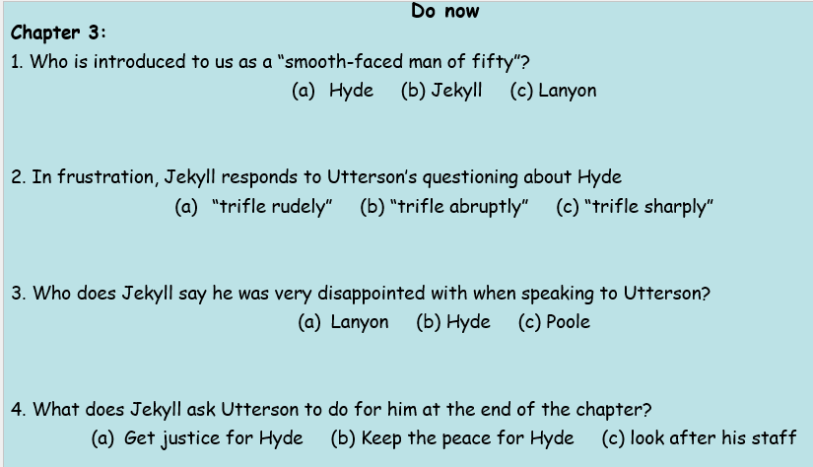
DQ common examples…
We often use DQ when we are studying literature. DQs give us quick indicators as to whether students have retained knowledge.

Slide 35
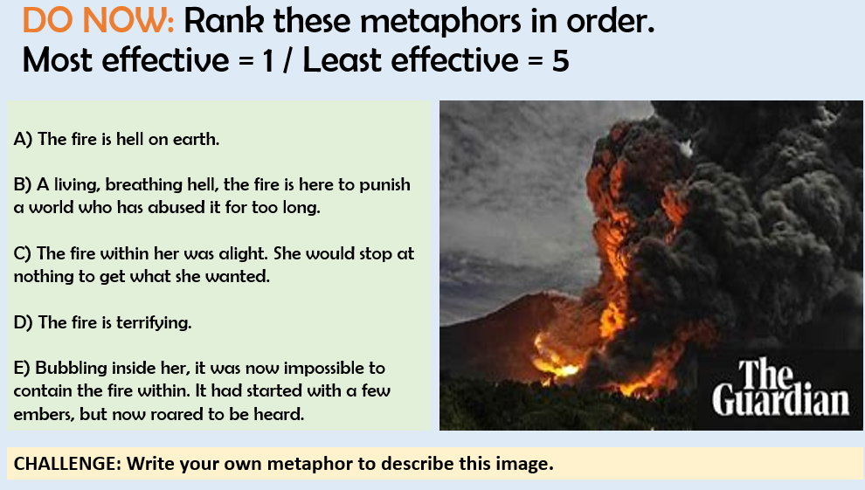
DQ common examples…

Slide 36
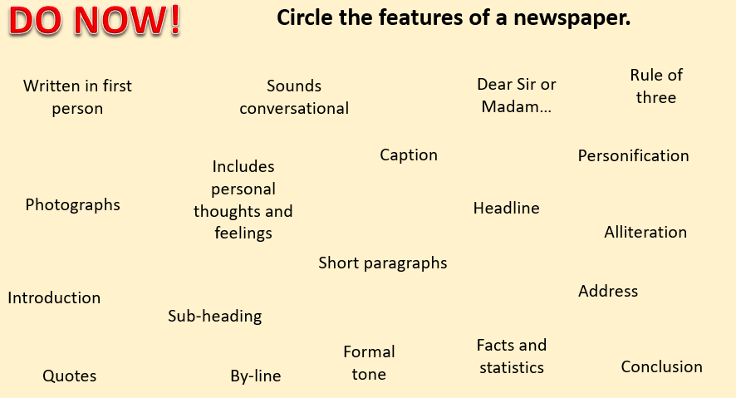
DQ common examples…

Slide 37
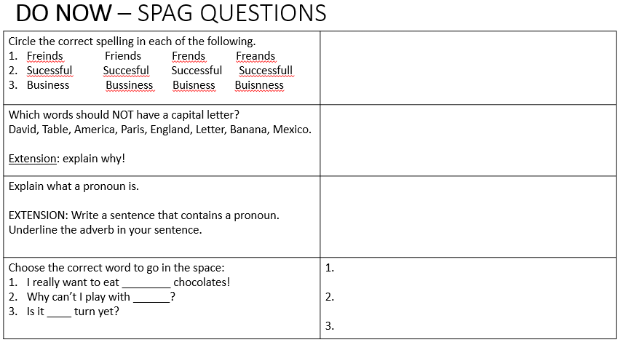
DQ common examples…

Slide 38
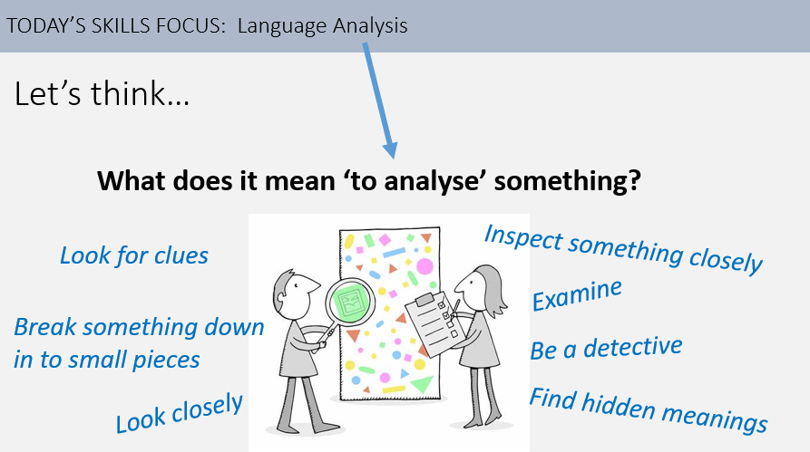
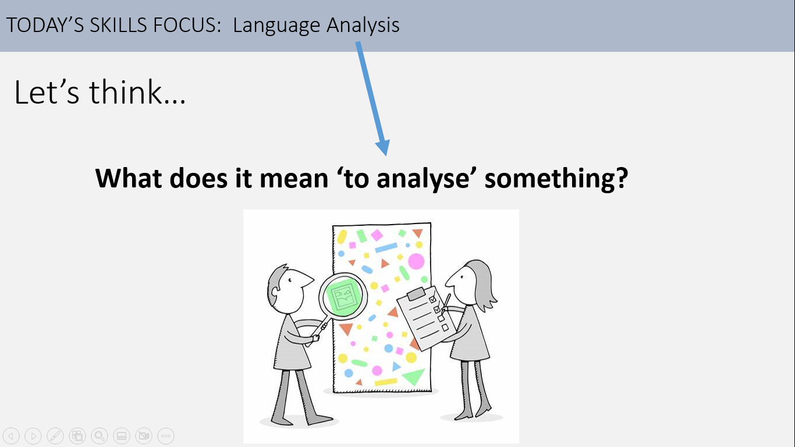
How can we make DQs work for us every lesson…
Using DQs to engage students in objectives / lesson foci…

Slide 39
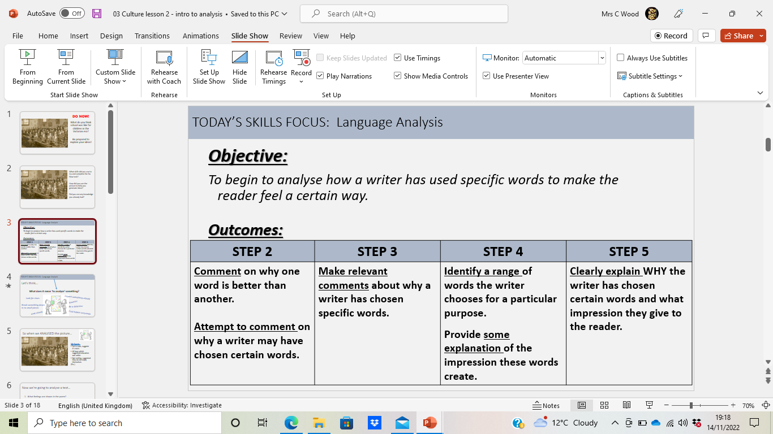
How can we make DQs work for us every lesson…
Using DQs to engage students in objectives / lesson foci…
What will we be learning in today’s lesson?
A – how to write a PEAZL paragraph | B – How to zoom in on words and explain what they mean
C – Explaining what a quotation makes a reader think/feel | D – How to explain what specific words suggest to the reader

Slide 40
How can we make DQs work for us every lesson…
Using DQs to help students engage with success criteria…
What is the difference between Step 3 and Step 5?

Slide 41
How can we make DQs work for us every lesson…
Using DQs to help students engage with success criteria…
Why are the boxes colour coded?
A – To make the slide look pretty | B – To show each step is different
C – To make it clear on the board | D – Another reason

Slide 42
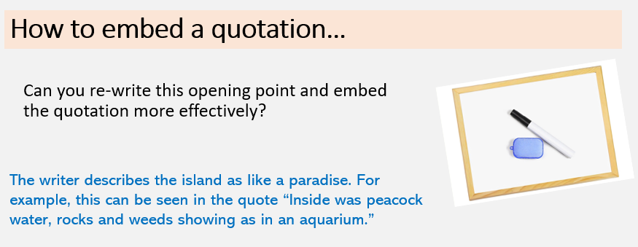
How can we make DQs work for us every lesson…
Using DQs to help students demonstrate progress in a certain skill…

Slide 43
Think back to a lesson you’ve taught this week…
Did you use DQs at any point? When? What was the impact?
Have their been any opportunities for DQs that you missed? When? Discuss how you might reflect on this for next time.
Responding to the outcome of DQs is important. Why?

Slide 44

10 minute breakout
4. HPA- Collaboration task
Collaborative task
Working in groups of 3 or 4, choose a topic from below and create a recall/ review task based on what we’ve discussed and read.
Themes in
‘A Christmas Carol’ or ‘Dr Jekyll and Mr Hyde’
Messages in ‘Bayonet Charge’ (or other poem of your choice
Summarising and synthesising two non-fiction texts
Ambition in ‘Macbeth’
Analysing language/ structure in a fiction text

Slide 45
5. Ofsted- Open floor

Slide 46
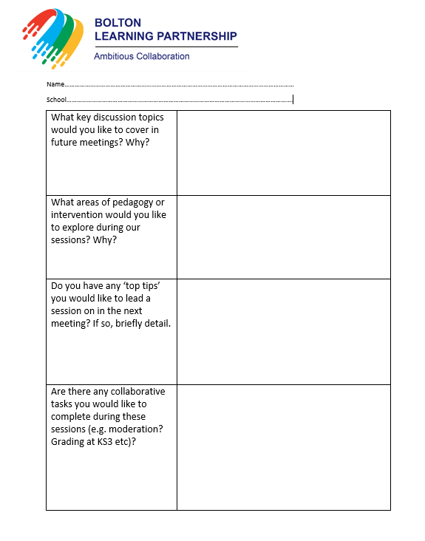
6. Future meetings and agenda requests

Slide 47
What would you like to see on the agenda for 2022-2023? Think about: • Leadership development • Pedagogy • Interventions | Further opportunities for moderation and standardisation Share strategies based on summer’s results KS3 curriculum Stretch and challenge (HAPs) Engagement of boys Teaching the structure question Effective interventions Pedagogy Discussion Visits from exam boards/ resource providers The chance to discuss successful intervention strategies used with key cohorts such as WBB To hear from colleagues who have made improvements in key areas (boys, writing etc.), unpacking how they have made an impact Further examples of how we engage students in reading Teaching top tips Accuracy of predictions Assessment points Data – PPE tracking and comparison to outcomes Leadership development Curriculum sharing Discussion on interleaving (recall/ retrieval/ metacognition)

Slide 48
A.O.B

