Slide 1


Bolton Maths Hub:
Three resource ideas
CRAIG BARTON
@mrbartonmaths
tipsforteachers.co.uk

Slide 2
Resource 1:
Completion tables

Slide 3
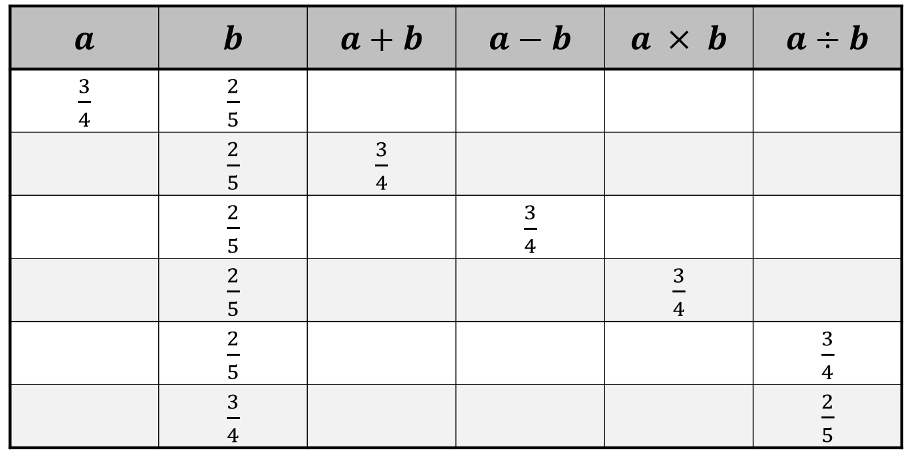

Slide 4
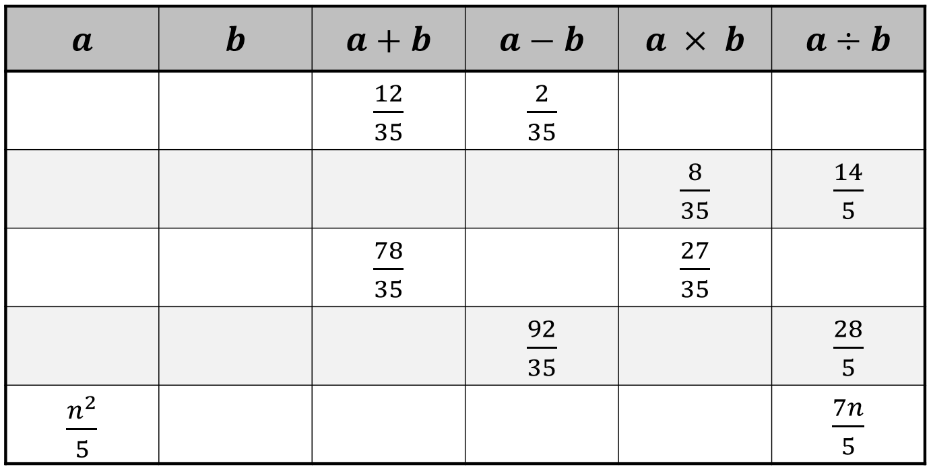

Slide 5
Adapt this task to make it easier
Adapt this task to make it harder
How would you support your colleagues in delivering this task?

Slide 6
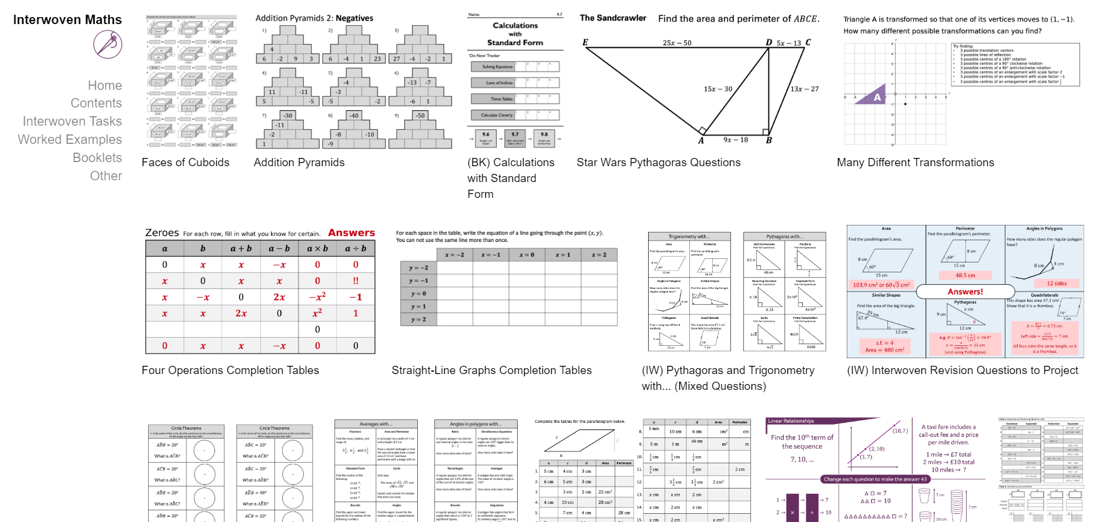
Good source of these…

Slide 7
Resource 2:
Variation Spider

Slide 8
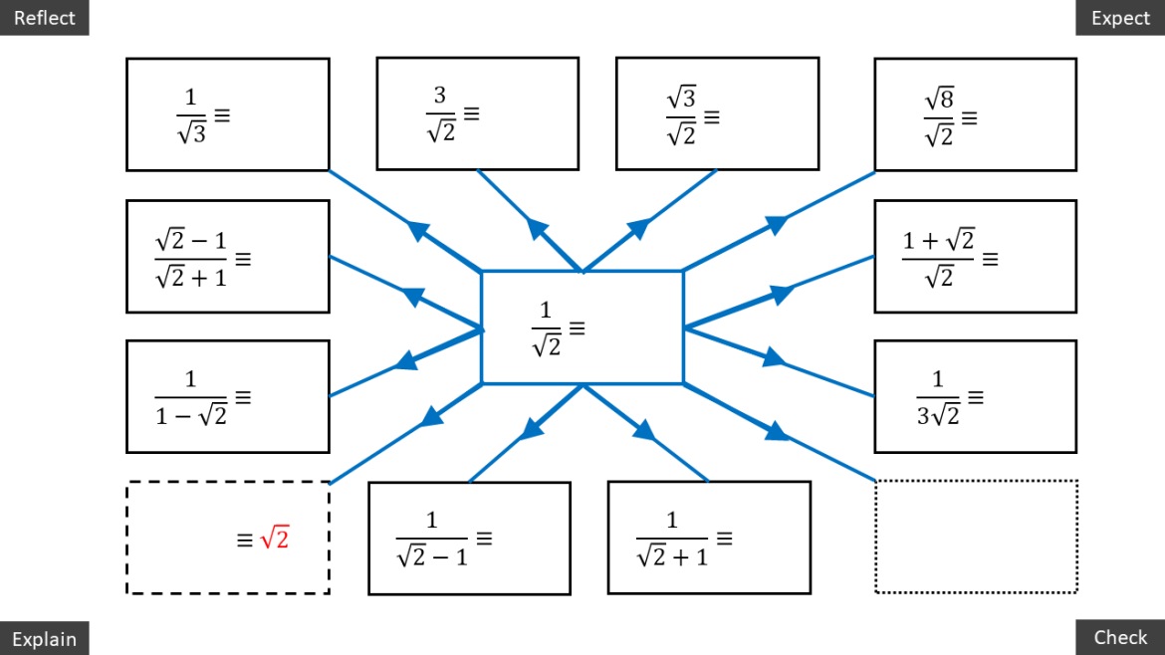

Slide 9
Adapt this task to make it easier
Adapt this task to make it harder
How would you support your colleagues in delivering this task?

Slide 10
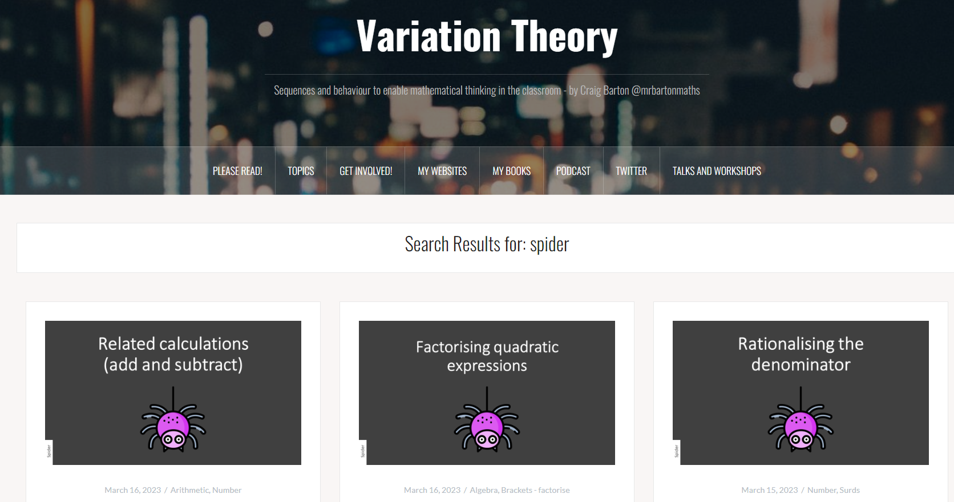
Good source of these…

Slide 11
Resource 3:
No Number questions

Slide 12
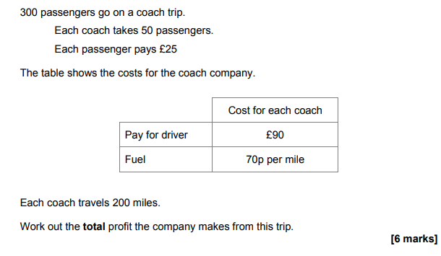

Slide 13
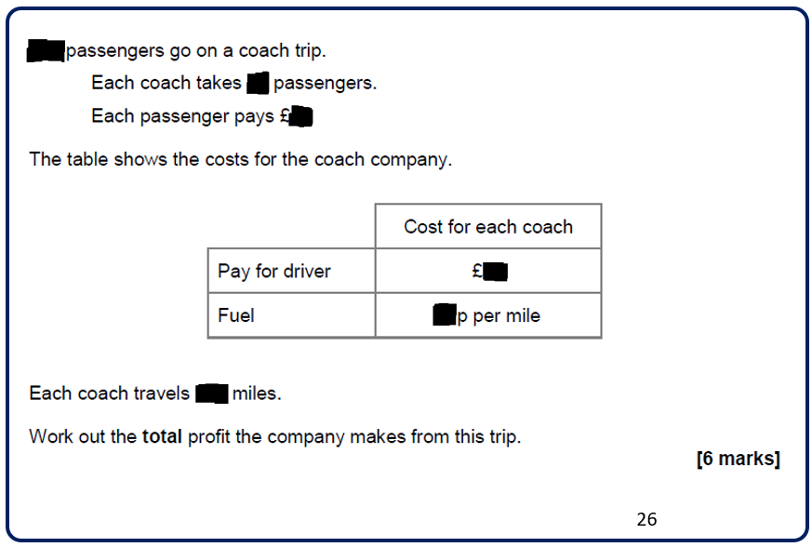

Slide 14
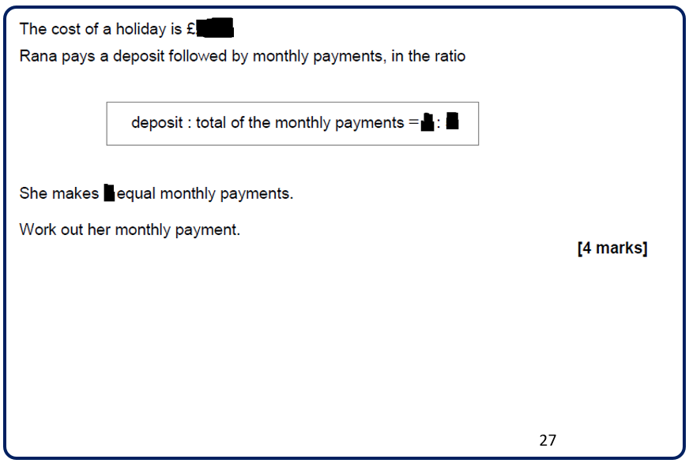

Slide 15
Adapt this task to make it easier
Adapt this task to make it harder
How would you support your colleagues in delivering this task?

Slide 16

Good source of these…

