Slide 1

Effective Curriculum Design
Languages Curriculum Hub
Linda Emmett
James Gilhooly – Deputy Head Canon Slade
Emma Lyon – Thornleigh Salesian College
9th March 2023
This Photo by Unknown Author is licensed under CC BY-SA
Notes:
Welcome, introduce each other and session.
This is a practice session for subject hubs on curriculum.
It is the first of many, as part of an ambitious LA wide project
We appreciate your feedback.
It is within the remit of support without judgement. We are here to genuinely help you and to facilitate helping each other. The reason is that we impact approximately 19 thousand pupils across the LA.

Slide 2
Training Aims
To develop an understanding of the research underpinning the Education Inspection Framework
To develop an understanding of effective curriculum design, both generic and in languages.
To understand the importance of effective curriculum implementation to aid understanding and memorisation of important knowledge.
To consider how to work effectively together as a collective group of practitioners.

Slide 3

Context
This Photo by Unknown Author is licensed under CC BY-NC-ND
Notes:
This session is part of a wider piece of work across Bolton LA.
The vision for our work is in line with the Bolton Learning Partnership of ‘Ambitious Collaboration’. 19 thousand pupils.
We have been training the curriculum hub leads on research around effective curriculum design.
We will be training them to support curriculum work going forwards.
We will also be giving the same training to subject hub leads, and then moving towards facilitating some subject-specific curriculum work.
However, we do not have all the answers to effective curriculum design. The job is never fully done.
The power of this work lies in this room and across the LA.
This is the first session with a specific subject hub, during which we will look at some of the generic and subject-specific research. However, you are the subject specialists. We will look at how we start to share research, planning and resource with each other.

Slide 4
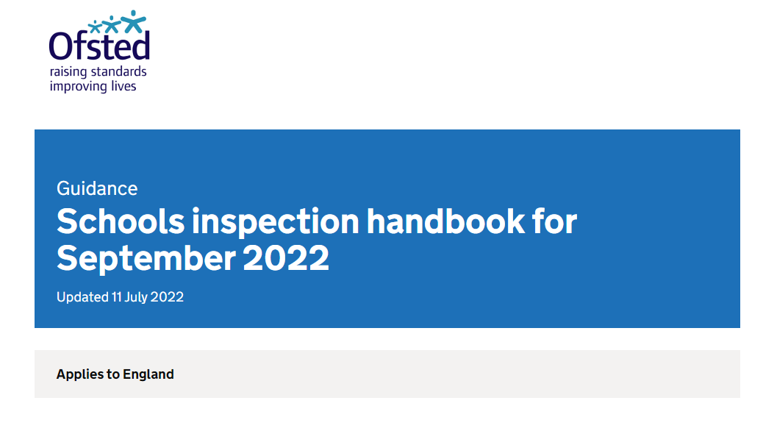
Know your handbook!
Notes:
Know your handbook!
All of the answers are within it, in the preamble as well as the evaluation schedule at the back.
Changes September 2022
The pre-amble contains detailed information about effective curriculum design.
It is not helpful to just look at the evaluation schedule.
Information about SEND, sixth form and early years are also taken from this handbook.

Slide 5






Notes:
Each year on GCSE results day, during SATs results, at end-of year celebrations, we see many pupils and students across the country celebrate their outcomes and learning from the year. The following week, we also see pupils transition successfully from primary to secondary, and secondary to college, and to other destinations. using their prior learning. There will also be many young people in their 20s and 30s drawing on what we have taught them, in unexpected ways.
The focus of EIF aligns with our fundamental belief as teachers that we want to inspire pupils and students across our schools to excel and feel a sense of success. We are also preparing them to have such a detailed and complex web of knowledge, that they are able to draw on this knowledge with ease throughout education and employment. This is achieved through high-quality curriculum design.

Slide 6
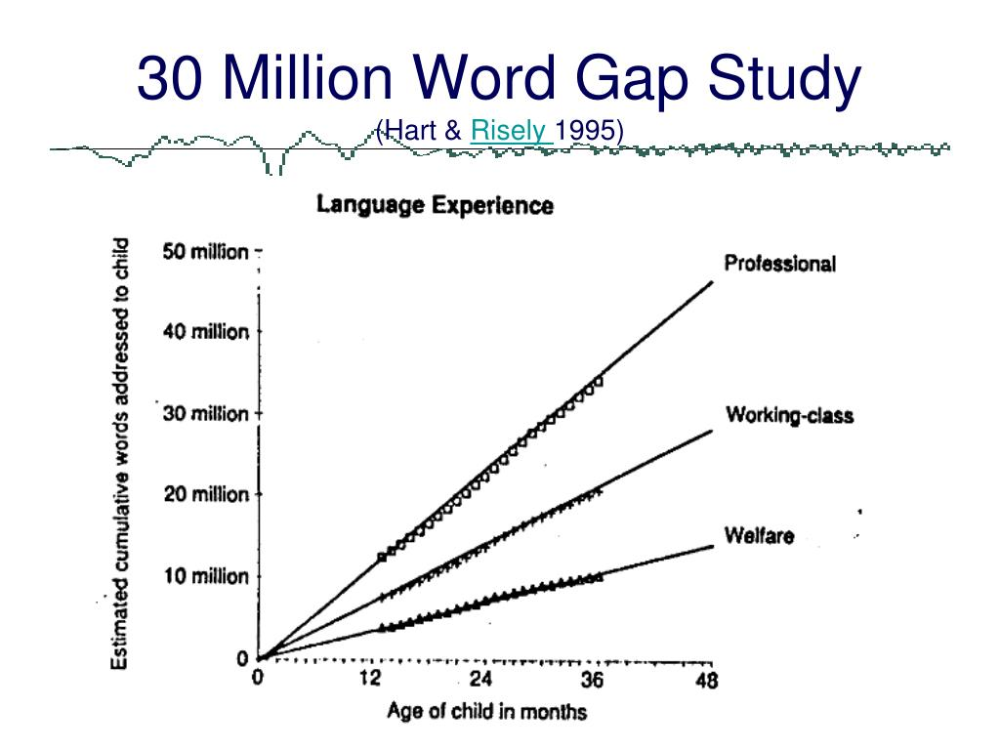
A high-quality curriculum
Hart and Risley 1995:
Meaningful differences in the everyday experience of young American
children.
Notes:
Researchers recorded that in their first four years:
An average child in a professional family accumulated experience with almost 45 million words.
An average child in a working-class family, 26 million words.
An average child in a welfare family, 13 million words.
The gap in social classes is clear from this research.
Vocabulary size relates to academic success. It is a convenient proxy for a whole range of academic abilities, not just reading, writing, listening and speaking. Also relates to achievement in science, history, geography and the arts.
90% of vocabulary is only encountered in writing and not in speech.
Therefore, a rich and high-quality curriculum is needed to address vocabulary and cultural capital deficits.

Slide 7
The substance of education
“The focus on substance, on the knowledge that we want young people to acquire, is often lost…
If their entire school experience has been designed to push them through mark-scheme hoops, rather than developing a deep body of knowledge, then they will struggle in later study.”
Amanda Spielman, HMCI, October 2017
Notes:
We have had a strong focus on examination outcomes. However, underneath this sits a wealth of knowledge that we can impart on the next generation. This is our curriculum.
Author David Didau writes that ‘learning must be durable and flexible (i.e. applicable in different contexts). If we accept these ideas, then we should accept that learning cannot be observed in the here and now. The only way to see if something has been retained over time and transferred to a new context is to look at what students can do later and elsewhere’.

Slide 8

Building a high-quality curriculum
School curriculum breadth and ambition (including SEND and DP)
Subject curriculum design, including coverage, building blocks of essential knowledge, end points, sequencing, reading, vocabulary.
Delivery - pedagogy, access for SEND and PP, effective assessment, enabling memory, inspiring destinations.
The impact on pupils, such as knowing more and remembering more, external data, reading, destinations.
Notes:
When building an effective curriculum, we need to focus on the above areas.
School ambition and intent
Subject ambition and intent
Pedagogy – it how we are delivering our intent
Impact – this is much wider than data and spreadsheets. It is also what pupils know, remember and can do in their books. It is not just outcomes. It is also facilitating high-quality destinations, for example success at key stage 3 in a broad range of subjects, and in reading, and at key stage 5 across the subjects that pupils choose to study through to the end of Year 11. In languages, this is a moral imperative for us given the low uptake of post-16 study and the vicious circle that creates for our stream of future teachers.

Slide 9
School and subject curriculum planning
Ambitious knowledge and cultural capital for all pupils.
Commensurate with the national curriculum (or better)
Pupils across the school study the full curriculum
Disadvantaged pupils or those with SEND are not given a reduced curriculum.
The curriculum identifies the most important knowledge pupils need to learn and when.
Curriculum is planned and sequenced to build on, and deepen, what has been taught before.
‘End points’ - what the curriculum is building towards.
Reading, vocabulary and cultural capital, are prioritised.
Notes:
Intent is the overarching curriculum model. It is also the curriculum planning at subject level.
How does the curriculum develop knowledge as pupils progress through the school? This may be from early years upwards in primary or through schools; key stage 3 upwards in secondary.
This does not mean that curriculums are narrowed to focus on outcomes at key stages 2, 4 and 5 – a broad and rich curriculum in line with the national curriculum.
What research did you use to design your curriculum? There are a range of universities and institutions that have done research into effective curriculum design such as York University for Science using the 10 big ideas in science as a basis. Have you sought subject-specific research and support for content and delivery?
Para 410 to 411 Ambition for all important, for example, are DP and SEND pupils able to follow the pathway they wish or are they guided away from this? Can DP and SEND do triple sciences if they wish, a language if they wish? Does SEND support have an accidental negative impact on curriculum breadth? In English, the subject leader has already ensured that DP and SEND pupils access the same texts as all pupils in English? They ensure that the wider cultural knowledge and vocabulary needed to access texts?
Do pupils study their full curriculum during time in school, or is it narrowed? For example, do Year 6 pupils still access a broad range of subjects or do they spend a lot of time on SATs? Do pupils early enter for any subjects at key stage 4? Does this mean then that they are not studying NC subjects such as lang or lit throughout their KS4? Does this also mean that any narrowing at KS2 or 4 is preventing later study in key stage 3 or 5 due to the forgetting curve?
Is any required curriculum narrowing for particular pupils well planned, with a clear rationale, with a clear plan for a return to full study so that narrowing is temporary?
Knowledge – this is a specific area where we tend to have a misconception. Many subject leaders have defined and sequenced topics rather than the essential knowledge that students need to be able to perform a complex task. However, we also need to identify and sequence components if we are to ensure the effectiveness of assessment, and the identification of specific gaps and misconceptions for each pupil.
Vocabulary – many angles on this. Overall reading to promote a love of reading, vocabulary development and comprehension. Subject-specific reading to further promote vocabulary and knowledge. Support for the weakest readers through a phonics programme that develops pupils’ phonics knowledge, fluency and accuracy.

Slide 10
Discussion Point
What might you need to consider when looking at the curriculum ambition and equity in languages?
Discuss and be prepared to feed back.
Notes:
Discuss for 2 minutes. Take feedback.
You may have thought about:
Key stage 4 – equity of access to geography, equal pathways, freedom of choice. Key stages 1 to 3, time-limited interventions which do not limit the curriculum for some pupils. Cultural capital, e.g. when teaching abstract aspects such as the weather cycle or maps. Ambition in relation to grammar, disciplinary vocabulary and conjugation (stem and ending). Scripting in Urdu and Arabic.
All schools – reading support for the lowest 20% of readers
Prior to an inspection, the team will gather this information from any previous inspection report, especially AFIs and any evidence around curriculum. The website, around overarching curriculum including reading support and phonics, any information about SEND.
Parent view
IDSR and externally published data
Website, including curriculum
Social media

Slide 11
You may have considered…
Curriculum ambition, including equity for all
National curriculum coverage through all key stages
Links to the EYFS curriculum
Effectiveness of subject curriculum design for all
Components and sequencing to help all
Grammar, phonics and vocabulary interwoven
Ambitious technical language, ambitious grammar
Assessment information to aid learning
Support for SEND
Enrichment and clubs.
Options process and uptake at key stages 4 and 5
Notes:
Curriculum ambition, including equity for all in your subject. Do all pupils have access to the same content?
National curriculum coverage for all pupils. Equal ability to take the subject at key stage 4.
Effectiveness of subject curriculum design to help all pupils to remember the most important knowledge.
In EYFS, curriculum design may look at components within communication and language and the prime areas of learning.
Components and sequencing. This is important to aid fluency.
Physical and human geography interwoven. Mapwork woven through the curriculum,
Reading and vocabulary development.
Assessment information and how this aids pedagogy and curriculum design.
Support for SEND. This may include appropriate curriculums in specialist settings, that are again broken down into components. So, for example, if pupils need a curriculum to support cognition and learning, physical development such as motor skills, what are the components and end points for these?
Enrichment and clubs.
Options process and uptake at key stages 4 and 5
Outcomes on an ongoing basis. This is not just terminal outcomes. It’s also what pupils know and remember on an ongoing basis.

Slide 12
A high-quality subject curriculum
Ambition and equity for all
‘Golden nuggets’ of knowledge in interconnected webs (schema)
Pre-empted cultural capital deficits
Systematic focus on vocabulary
Sequencing - Systemic and cumulative knowledge acquisition
Vertical and horizontal thinking
Knowledge before pedagogy
Systematic assessment
Alteration in long-term memory
Notes:
A summary of high-quality curriculum planning.

Slide 13
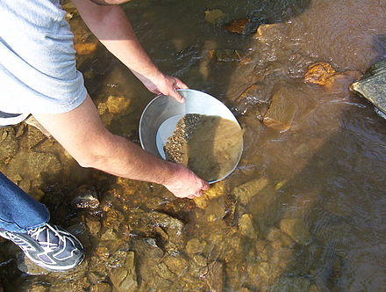

What do we mean by component knowledge?
This Photo by Unknown Author is licensed under CC BY-SA
Notes:
The components that need to be identified in a curriculum plan are those that, rooted in research, you think are the things that pupils need to have secure in their memory prior to moving onto something complex. It is what might come out when you are panning for gold.
They may be substantive knowledge components (i.e. content)
In languages, this is mainly substantive knowledge. Our disciplinary elements will be the application of knowledge across listening, speak, writing and reading.
This works towards end points where pupils are able to apply this in complex activities so that they can combine facts and methods doing complex tasks.
This is because we don’t get better at listenings or readings but doing them again and again. We need the components secure.

Slide 14

What do we mean by components (2) and end points?
Reflect on what the components and end points are during the process of learning to drive.
How might you sequence the components?
Notes:
What are the components when driving a car? Which ones can you do without?
What are the end points when driving a car?
Take responses.
It is the application of knowledge learned when doing mini-assessments such as a reverse around a corner. It gives meaningful information to the instructor and learner about what components are missing.

Slide 15
Categories of knowledge in languages
Phonics
Sounds Spelling
Dictation
Notes
Grammar
Ambitious
Step-by-step
to
full paradigm
Technical terms.
Vocabulary
High frequency
Prioritisation
Revisiting
Reading
Writing
Listening
Speaking
Notes:
New language will be met through topic areas. However, the most important knowledge that will prepare students to manipulate language and ensure successful future study lie within the categories of knowledge in blue.
In green, this is when pupils will apply their fluent knowledge (complex tasks when they are ready to do so across the paradigms).
There would also be the category of scripting in languages such as Urdu, Arabic and Mandarin.
Phonics
Within the phonics element, pupils should learn the relationship between sounds and spelling. This is the small components of sounds that pupils revisit and built upon to fluency. This knowledge can be applied through note taking, dictation, reading aloud, focus on components of phonics when listening to texts. With more knowledge of vocabulary, grammar and phonics, the more pupils can produce and understand complex language.
Grammar
Do you plan for to build up the small components of knowledge in a step-by-step approach? This includes the specific technical terminology, for example, taking an infinitive verb to remove the ending and form a stem. This needs to be in smaller components to fluency, especially for some pupils with SEND. Also may need modelling in different ways due to abstract concepts.
Vocabulary
Which words are you planning to introduce and when? How are you planning to revisit high-frequency words?
Application of these across the four paradigms. Only proficient linguists (upper GCSE or above) can note or guess patterns or meanings. Prior to this, pupils need direct instruction.

Slide 16
Other Areas
Plans identify small components.
Plans help pupils to build on prior knowledge across pillars.
Components build to fluency from simple, successful manipulation to more complex language.
Ambition for grammatical knowledge.
Pupils are novices and require explicit instruction.
Successful application of knowledge in different paradigms.

Slide 17
Mirror
Signal
Manoeuvre
Notes:
In their research, they discuss how well leaders have identified the small pieces of knowledge, how they have ensured that they are sequenced well in plans and lessons, how this is deepened as pupils move through a school. This is not topics, it is the topics broken down further, to pinpoint what absolutely needs to be secure.
To exemplify the move from complex topics to well-sequenced component knowledge, we know that learner drivers don’t learn how to drive a car by getting into one and having a go.
They need to learn a lot of knowledge such as the highway code, instruments, clutch control, navigation. They do this about learning important pieces of knowledge
Now it occurs to me how well my own driving instructor, Dennis, identified what I needed to learn, and in what order. It was no point him asking me to drive a long journey. For example, lesson one was on simple things such as turning on the engine, use of handbrake, signals and clutch control.

Slide 18
Discussion Point
Discuss what components and end points look like in languages. Discuss and be prepared to feed back to the group.
Notes:
On key misconception is complex activities/tasks vs components. Have a think about the actual components of language learning.
Discuss for 2 minutes. Take feedback.
You may have considered…

Slide 19
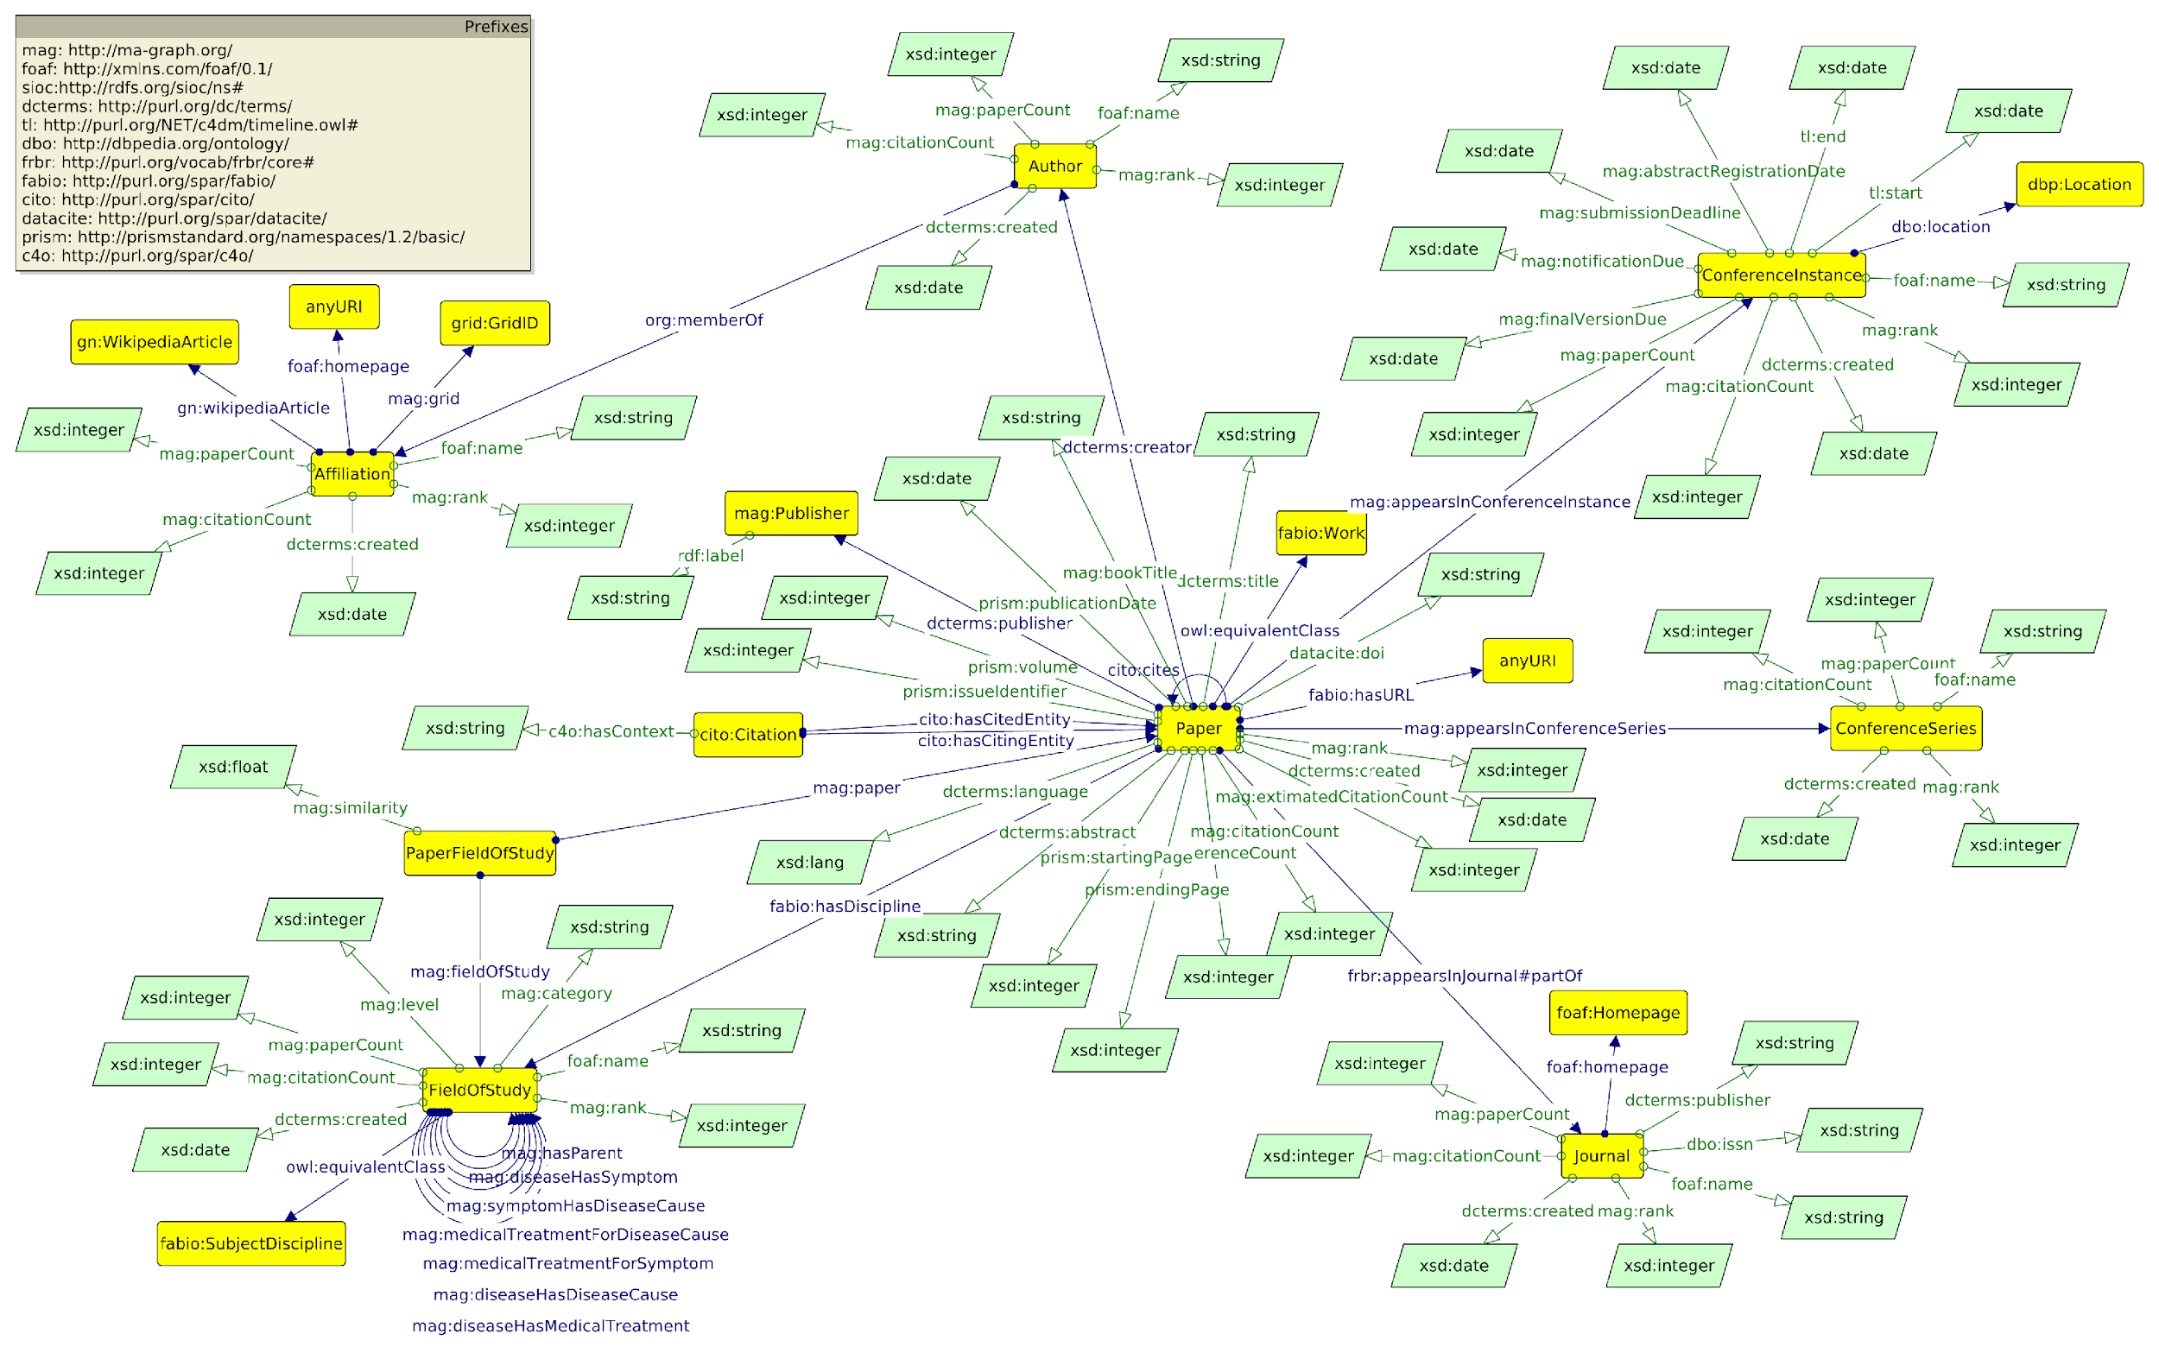
Schemas:
The complex and interconnected web of prior knowledge which allows the learning of new content.
Notes:
Our aim is to facilitate this – complex webs or schemas of knowledge, including key knowledge of linguistic components.
Discuss that knowledge is generative. The more you know, the more connections you are able to make. This dispels the idea of ‘higher order thinking’. Instead, we focus on a multiplicative effect.
When designing our curriculums, it is also the first point that we consider cognitive overload and spaced repetition. This is so that we can start to facilitate the building of strong schema.

Slide 20
Maths Y7 Autumn Term 1
Place value
Powers and Roots
Standard Form
Integers and decimals
Notes:
Let’s look at subject curriculum planning as part of intent. Pupils may be working towards complex tasks or full knowledge of topics throughout the year. These could be end points.
Topics or complex activities are the combination of many pieces of knowledge. This underpinning knowledge is the bits of knowledge needed to help pupils to complete something complicated, such as responding to an exam question. Pupils do not get better at these complex activities such as exam-style questions, playing a game of football, doing a Spanish listening, by repeating these complex tasks. We need to identify the underpinning knowledge or knowledge gaps that students may have, help them learn knowledge to fluency, and also sequence this learning well.
As such, composite complex activities, such as understanding place value, are formed of many different important pieces of knowledge. This knowledge is needed to perform skills or complex tasks. It is important that we identify what knowledge needs to be secure to enable pupils, especially disadvantaged pupils and those with SEND, to access the curriculum, be successful, know and remember increasingly more. This slide is an extract from the maths curriculum plan. In autumn term 1, pupils look at these four complex topics. Underneath these topics may sit a medium plan and a series of lessons that identify, sequence and build the most important knowledge that pupils need to learn. Let’s look in detail at place value on the next slide.

Slide 21
Composite Topic:
Place Value
Underpinning knowledge:
Knowledge of units/number bonds
Knowledge of number order in terms of size
Visual representation of place value and number size
Multiply and divide by powers of 10
100ths
10ths
Decimal Places
Notes:
Here is an example of components that need to be stored in long-term memory. These components allow pupils to do the complex task of place value effectively.
Chunking these up help long-term memory. Smaller components help low-prior-attaining pupils especially in hierarchical subjects such as mathematics and languages.
Spaced repetition aids memory and retrieval
Effective explicit instruction helps pupils to understand abstract concepts. This helps pupils to understand important facts. But the plans need to focus on the critical essential knowledge to fluency.

Slide 22
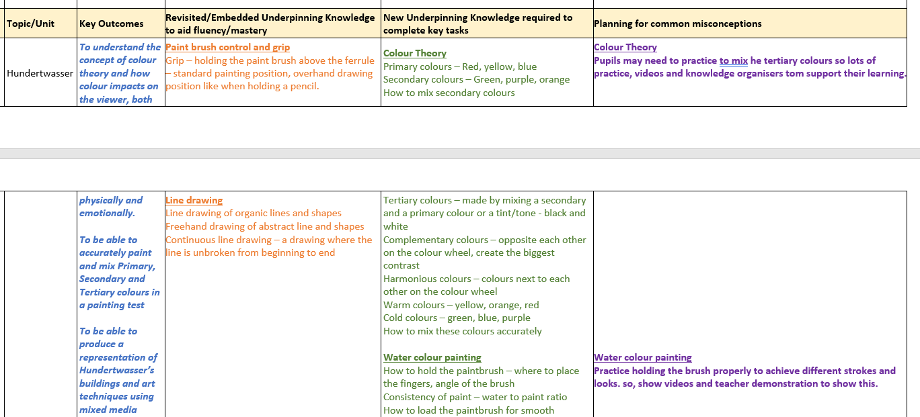
Notes:
Here is an example in art. Look at how they revisit knowledge and have detailed the most important components.
This is helpful to really pinpoint how pupils, including those with SEND, can be successful.

Slide 23
Knowledge vs skills
Doing a throw-in in football
Presenting data in a graph
Composing a piece of music for Chinese tea garden.
Notes:
To perform skilfully in languages, within reading, listening, reading or writing, you need a range of grammatical, phonetical and vocabulary knowledge.
Let’s reflect back on the skilful performance of driving a car. You can’t perform the skill of reversing round a corner without many important components.
This is the same for drawing, or for performing a set piece in football, or for baking bread, or for doing a science experiment.
Each aspect here is a combination of substantive and disciplinary knowledge. Knowing something and the knowledge needed to do something.
Let’s explore two areas above. What are the components of knowledge needed for each?

Slide 24
Effective curricular thinking
Decide what content needs to be deeply embedded in long-term memory.
Consider what pupils pay attention to through explicit instruction or activities.
Avoid overloading working memory.
Provide spaced repetition for overlearning.
Notes:
So, choose the right things for pupils to learn. Plan for small components, well sequenced, to avoid cognitive overload. Then, space the learning over a sequence of lessons to aid memory.
Consider why a sequence of knowledge is in place, how does it relate to existing knowledge and skills, how well is this implemented and assessed. Does it enable pupils to know and remember more?

Slide 25

Notes:
Reflections so far. What are your next steps in these areas?

Slide 26
Key points
Identify your ‘golden nuggets’ within the categories of knowledge.
Build knowledge sequentially on what has been learned before.
Skilful performance in reading, writing, listening and speaking is the capacity to perform drawing on fluent knowledge.
Knowledge forms connected networks or schema.
Some content must be overlearned to fluency through spaced repetition.

Slide 27
Next steps
Ambitious collaboration
Curriculum hub leads as subject links
Sharing best practice and learning from each other
Signposting any useful research
Notes:
What training would delegates like next?
Anything specific that would be useful for us to look into?

Slide 28
Suggested reading
Ofsted handbooks September 2022
Ofsted research documents and You Tube channel
Ofsted’s Twitter feed,
Subject Associations
How Learning Happens (Paul A. Kirschner & Carl Hendrick)
How Teaching Happens (Paul A. Kirschner, Carl Hendrick & Jim Heal)
Why Knowledge Matters (E.D. Hirsch, Jr)
Curriculum (Ruth Ashbee)

Slide 29


