Slide 1
Sharples History KS3 Curriculum
Director of History- Alice Solomons
“Historical thinking is the purpose of our curriculum, writing is how we communicate it.”

Slide 2
Rationale
Change back from a 2 year to 3 year KS3.
Whole school directive to enhance our offering at KS3- 10 step plan.
We wanted our curriculum to be more representative of our cohort.
Why this, why now?

Slide 3
Curriculum Journey
Key points
PDS- Vincent Ashworth- curriculum intent and sequencing.
TMHistoryIcons- examples of other curriculums and approaches.
John Tomsett- ‘Why this, why now?’, curriculum transparency, need to know vs. neat to know.
ReTeach
HA conference- is the curriculum relevant to today?

Slide 4

Curriculum Intent

Slide 5
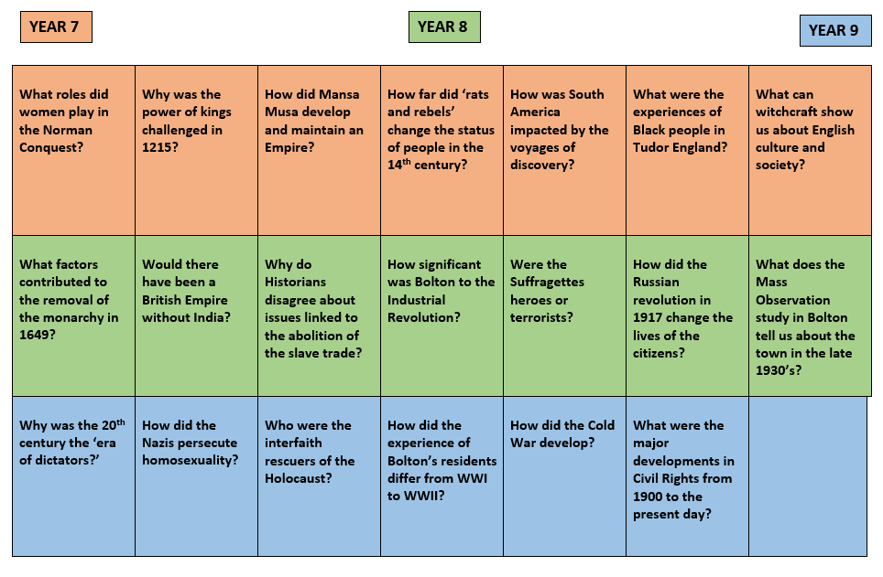
Curriculum Plan

Slide 6
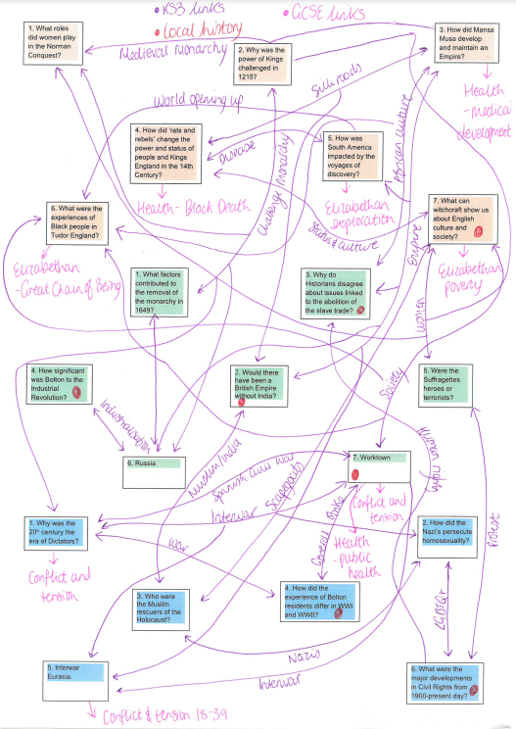
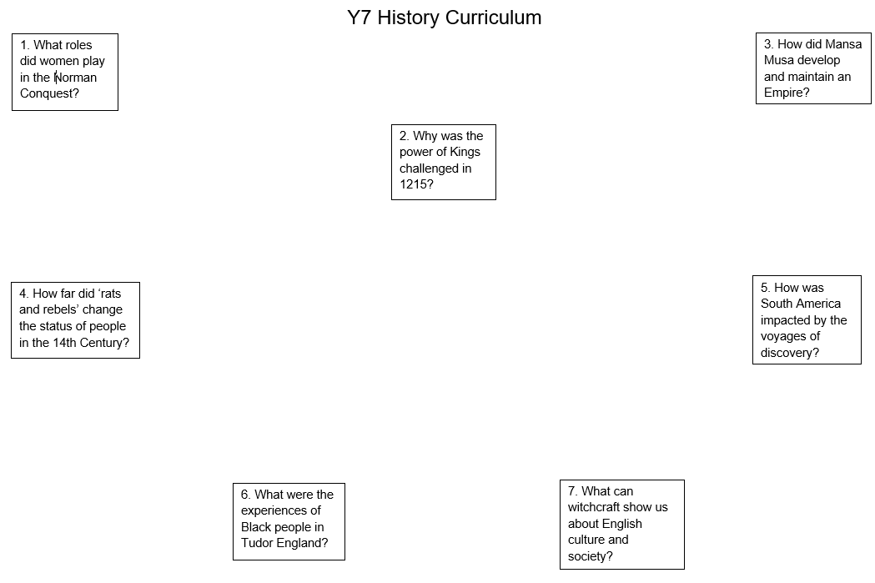
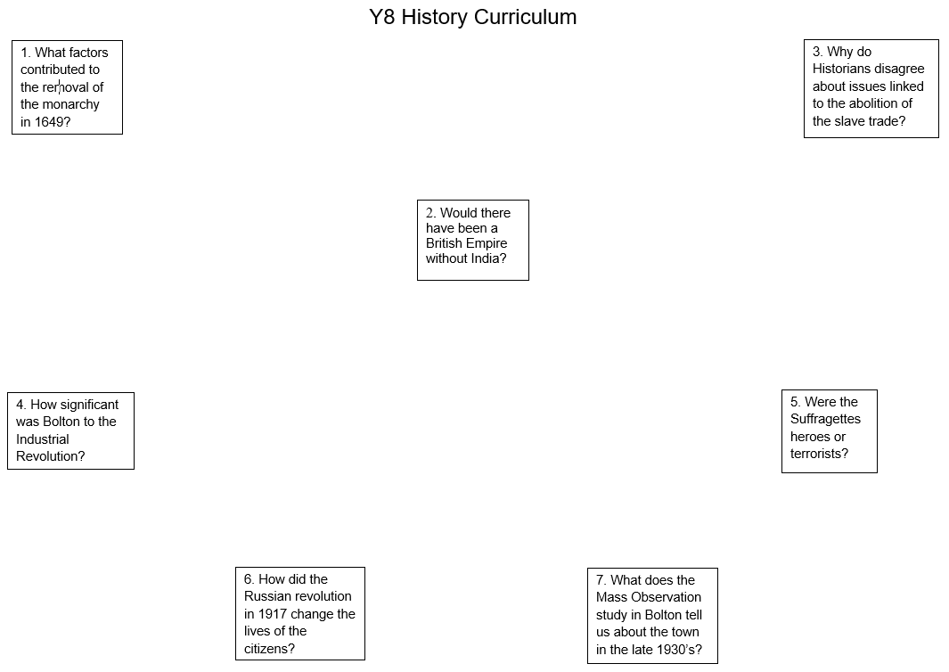
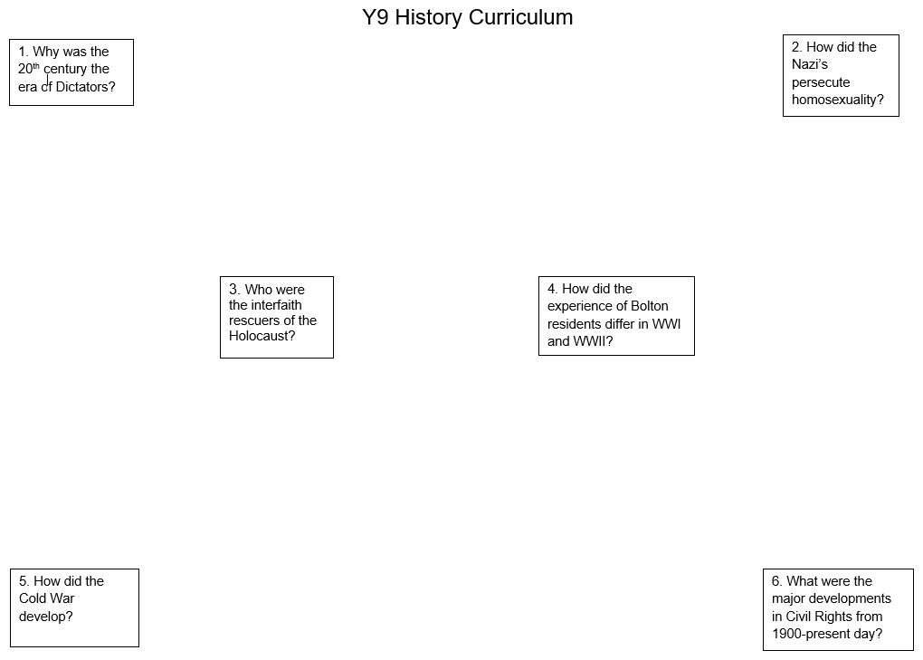
Curriculum Mapping

Slide 7



Booklets

Slide 8
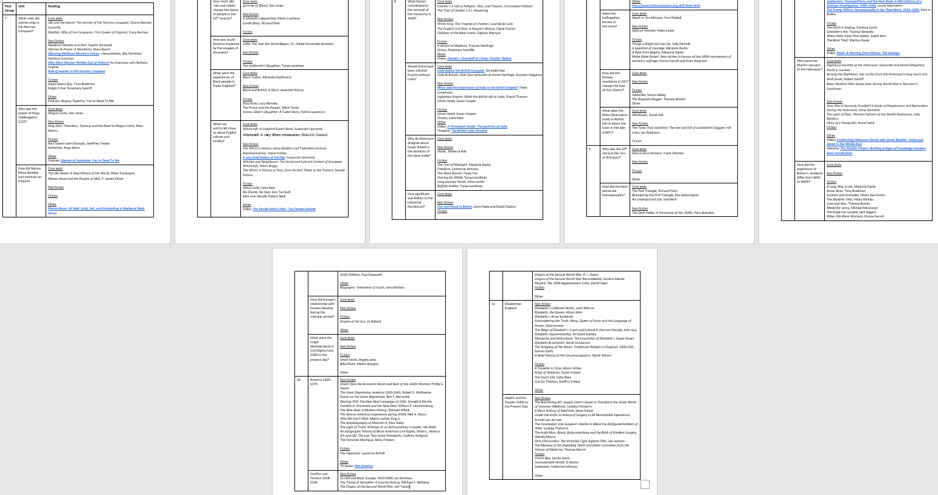
Reading list

Slide 9
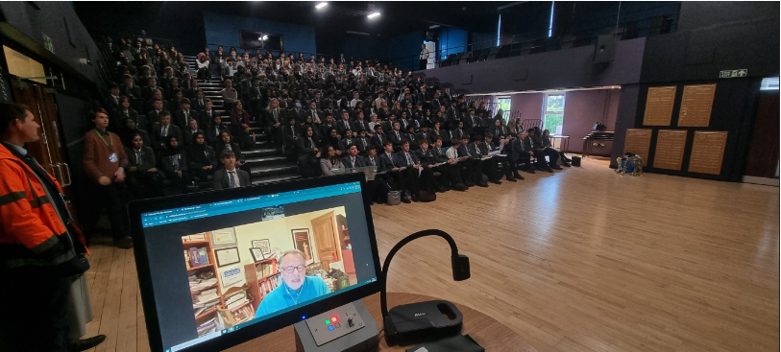
Historians

Slide 10
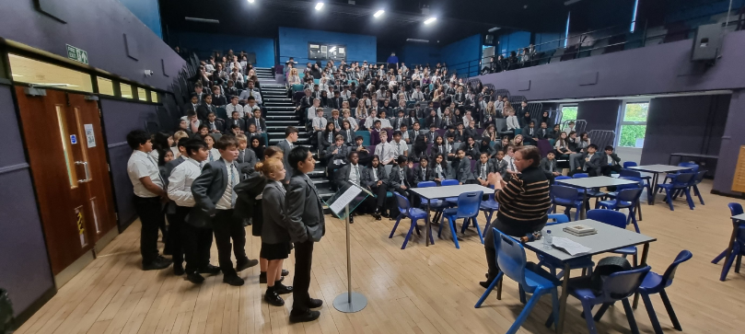
Historians

Slide 11
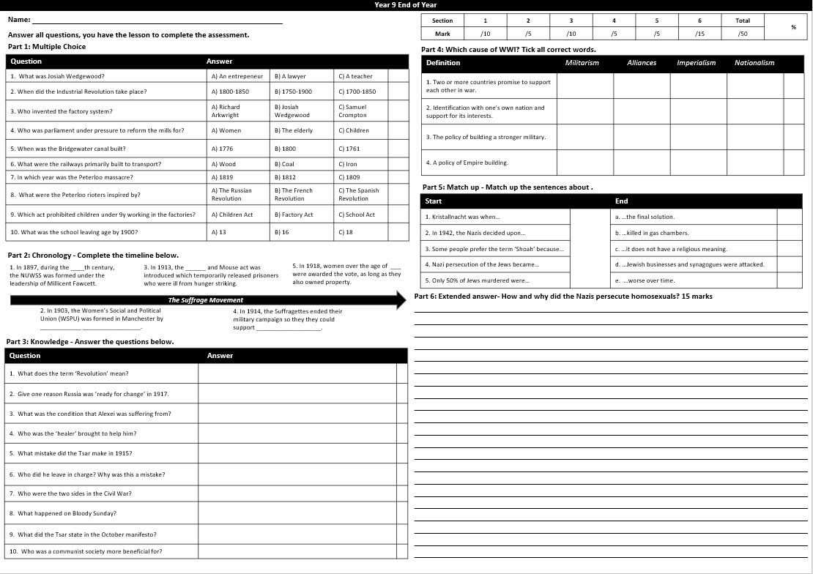
Assessment

Slide 12
Review
Snag documents
Meetings to make amendments
Pupil voice
Quiz feedback

