Slide 1
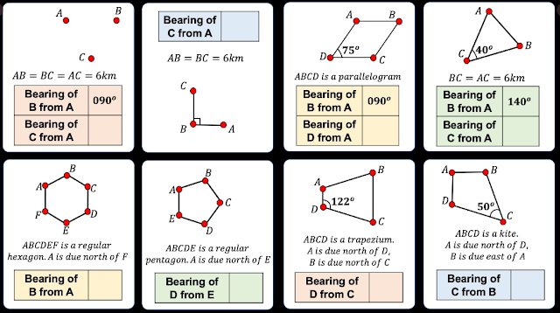
My favourite (challenging!) bearings activity to warm you up…

Slide 2
Please get your mini-whiteboard and pen ready…

Slide 3
one thing that engages your students in maths lessons
another thing that engages your students in maths lessons
an interesting thing that engages your students in lessons
one thing that does not engage your students in maths lessons

Slide 4


Student engagement in maths tasks
CRAIG BARTON
@mrbartonmaths
tipsforteachers.co.uk

Slide 5
Task 1:
Fluency practice:
Mean from a frequency table

Slide 6
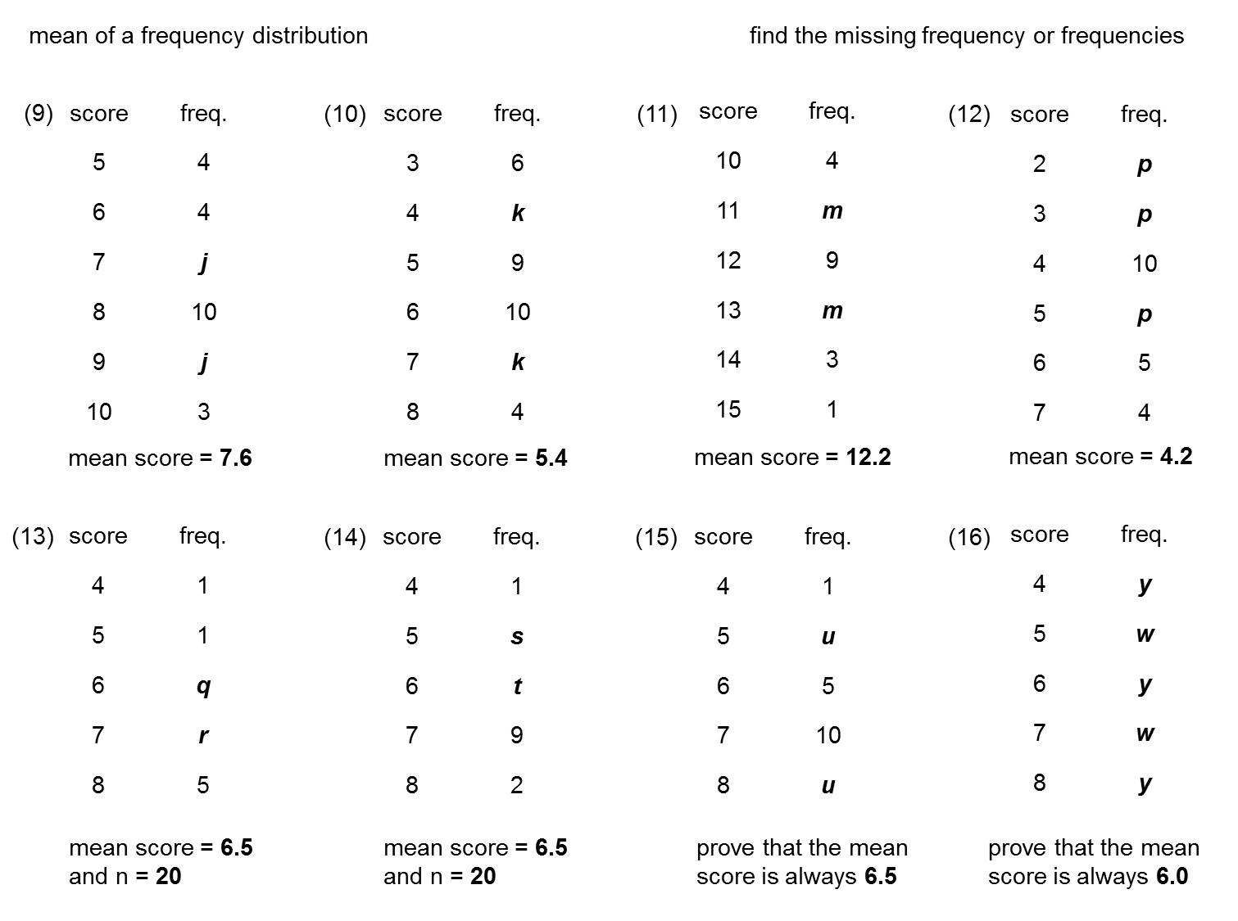

Slide 7
How would you…
Ask your students to participate?
Promote engagement?
Check for understanding?

Slide 8
Task 2:
Application practice:
Linear inequalities

Slide 9
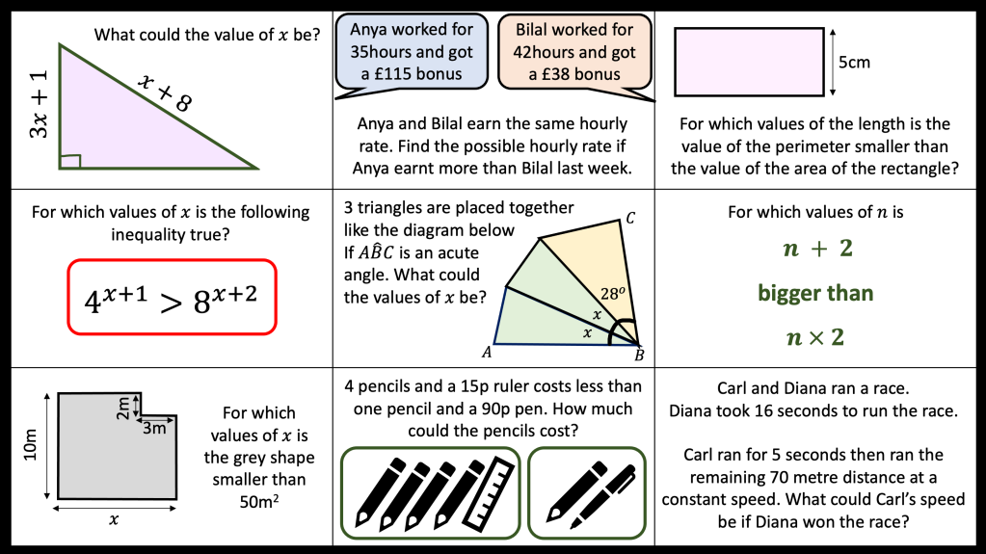

Slide 10
How would you…
Ask your students to participate?
Promote engagement?
Check for understanding?

Slide 11
Type 3:
Learner-generated examples:
Venn Diagram

Slide 12
A
B
D
G
E
F
H
C

Slide 13
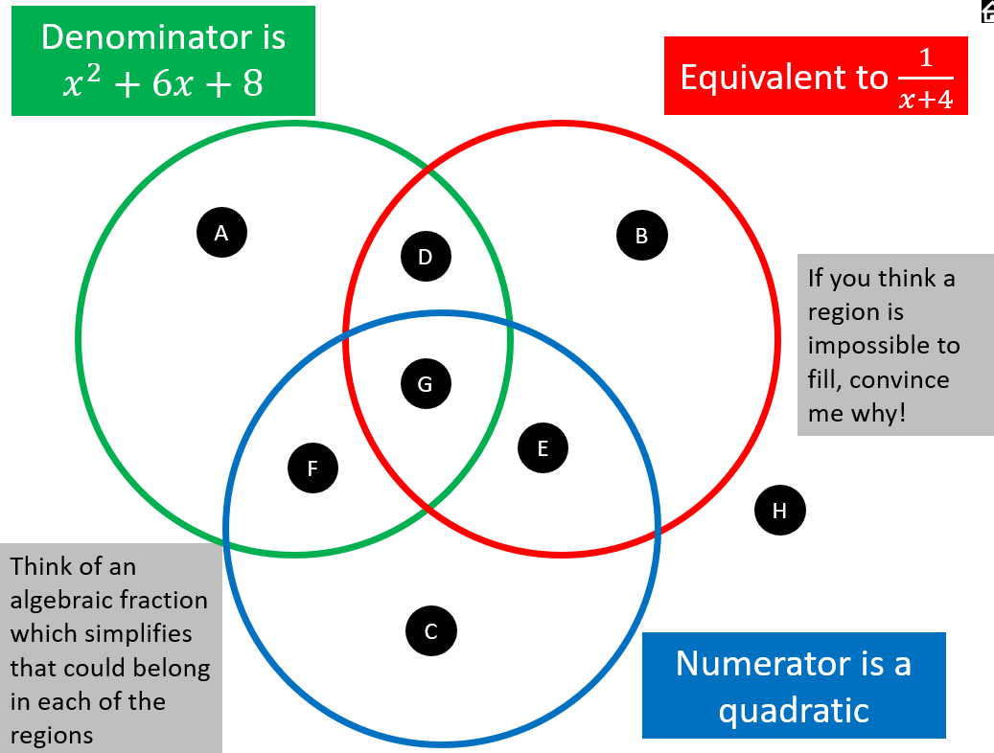

Slide 14
How would you…
Ask your students to participate?
Promote engagement?
Check for understanding?

Slide 15
Type 4:
Purposeful practice:
Open-Middle

Slide 16
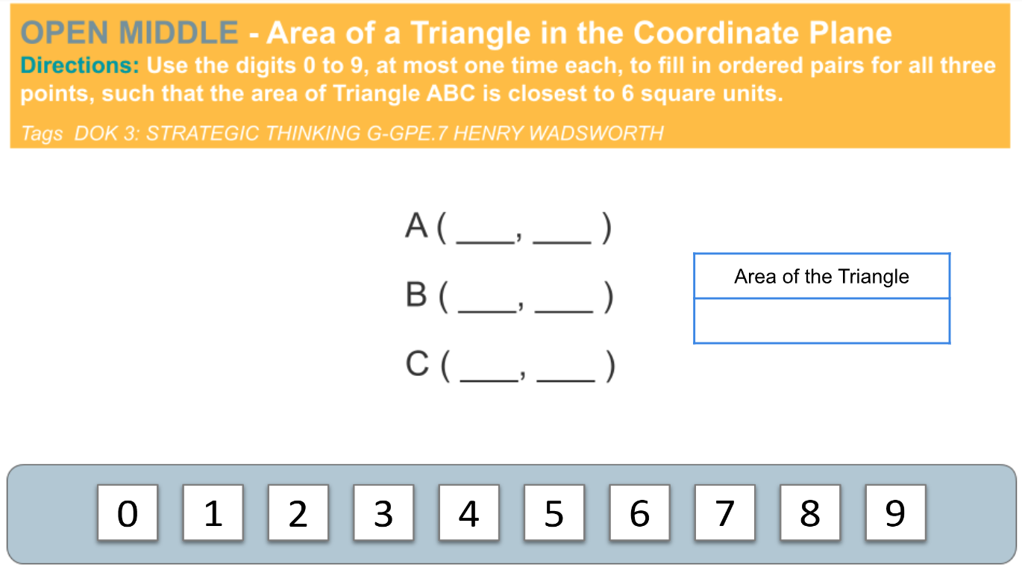

Slide 17
How would you…
Adapt this task to make it more accessible?
Ask your students to participate?
Check for understanding?
Challenge students even more?

Slide 18
Looking at all 4…

