Slide 1


Secondary Opportunities with your Maths Hub, Turing NW
A Mastery approach to teaching and learning underpins all of our work
Specialist Knowledge Work Group for non-specialist teachers of Maths
Specialist Knowledge Work Group for ECTs
Secondary Subject Leadership Work Group
Years 5-8
Continuity
Work Group
Mastery
Work Groups
Professional Learning Community, sharing and collaborating, fully-funded and supported by the DfE

Slide 2
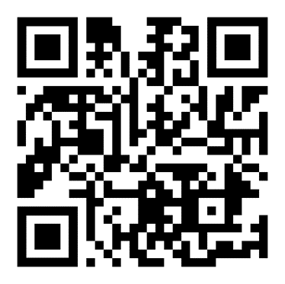
Secondary and Post 16 – recruiting for:
PRU Secondary Teaching for Mastery Development
Bolton Secondary Subject Leadership Work Group
Bolton Y5-8 Continuity Work Group
Special Schools Maths Network – National Research & Innovation Work Group
Specialist Knowledge Teaching Maths:
– Secondary Non- specialist Work Group
– Secondary ECT programme
Post 16
New to Teaching Core Maths Programme
Developing A’ Level Pedagogy Work Groups

Slide 3
Secondary Subject Leadership Work Group
Develop your own leadership skills.
Choose an area of focus to develop within your own department.
Collaborative network to support you with ideas for driving change.
Coaching opportunities.
“These meetings are the only time I ever just have time to reflect and plan strategically”
Wednesday 30th November - session 1
Wednesday 18th January - session 2
Wednesday 22nd March - session 3
Wednesday 21st June - session 4
All sessions take place at Sharples School 1.00-3.30pm (lunch provided)
To register please email A.Hart@sharplesschool.co.uk

Slide 4
Lessons Learned from GCSE 2022
Tier entry / exam board decisions
Topics
Skills
Other

Slide 5
