Slide 1
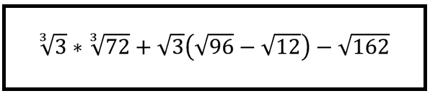
A question to warm you up
(or dry you off)…
Simplify:

Slide 2


Bolton Maths Hub:
Challenge in our schemes of work
CRAIG BARTON
@mrbartonmaths
tipsforteachers.co.uk

Slide 3
Some questions…
Where is the challenge in your Key Stage 3 schemes of work?
Where is the challenge in your Key Stage 4 schemes of work?
How confident are you that your weakest members of staff are regularly challenging students with non-routine problems?

Slide 4
Things I have seen recently…
Everything is fluency
Only challenge for higher
Never get to it
The click-through approach

Slide 5
Source 1:
Median by Don Steward

Slide 6
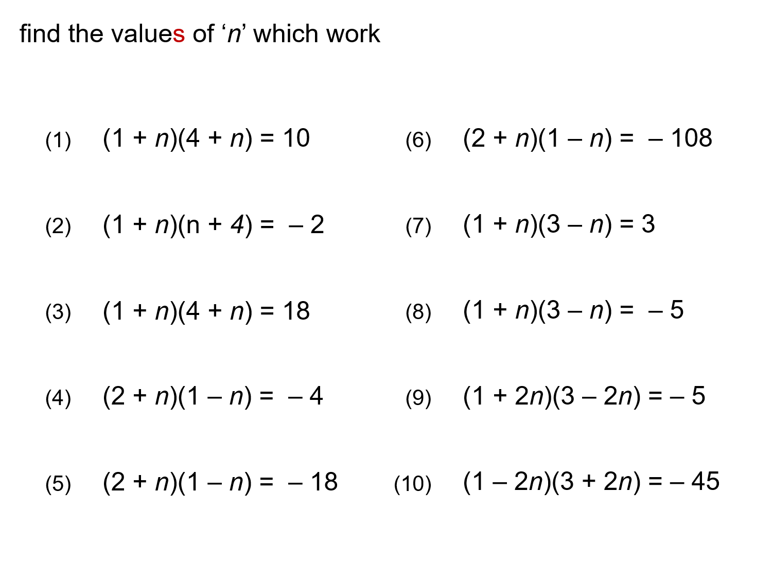

Slide 7
Adapt this task to make it easier
Adapt this task to make it harder
How would you support your colleagues in delivering this task?

Slide 8
Source 2:
Open Middle

Slide 9
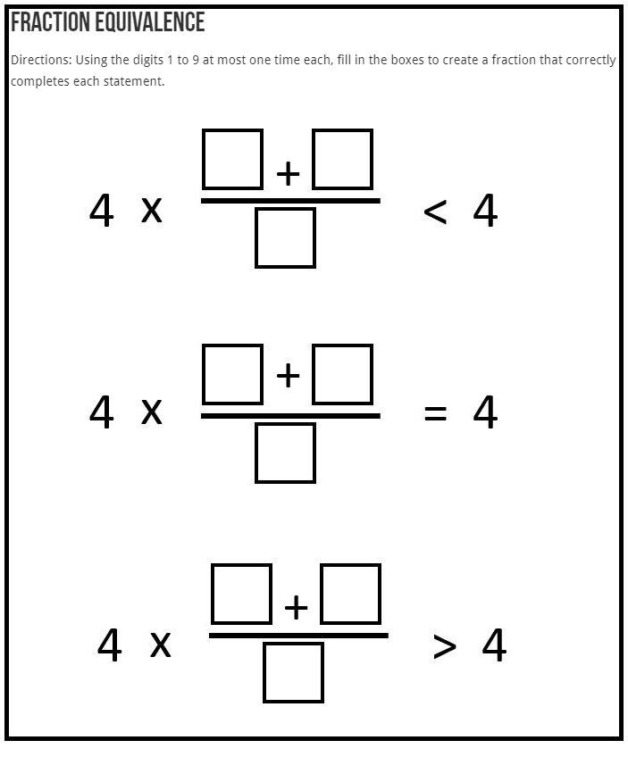

Slide 10
Adapt this task to make it easier
Adapt this task to make it harder
How would you support your colleagues in delivering this task?

Slide 11
Source 3:
Helen Konstantine

Slide 12
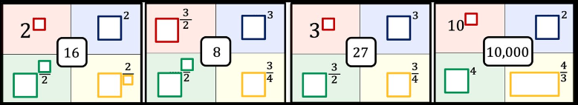

Slide 13
Adapt this task to make it easier
Adapt this task to make it harder
How would you support your colleagues in delivering this task?

Slide 14
Source 4:
Nathan Day

Slide 15
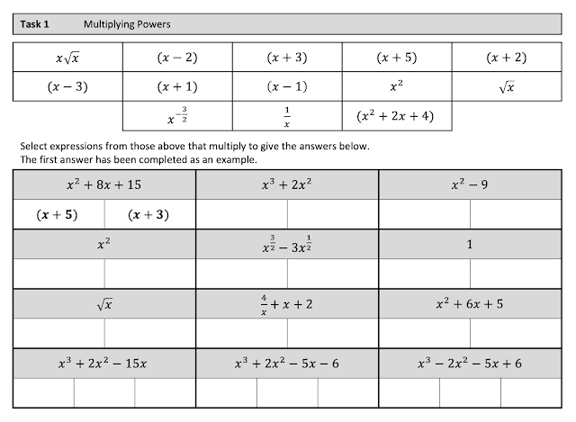

Slide 16
Adapt this task to make it easier
Adapt this task to make it harder
How would you support your colleagues in delivering this task?

Slide 17
Some questions…
Where is the challenge in your Key Stage 3 schemes of work?
Where is the challenge in your Key Stage 4 schemes of work?
How confident are you that your weakest members of staff are regularly challenging students with non-routine problems?

