Slide 1

Questioning and feedback
Chris Bingley cbingley@thornleigh.bolton.sch.uk
Assistant Headteacher, Thornleigh Salesian College

Slide 2
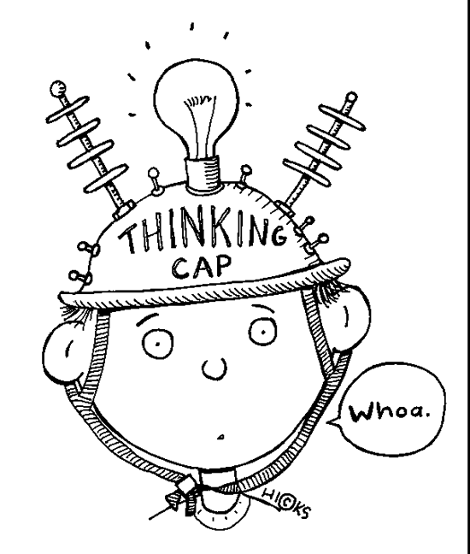





1
2
3
The purpose of assessment
4
5
6
Future

Slide 3
Assessment
Must be a powerful learning tool
1. Prompts hard thinking
2. Makes learning visible
3. Diagnose how well students have grasped knowledge and competencies.
4. Stimulates future learning by informing ‘in the moment teaching’ or a recipe of next steps for future planning
5. Provides high quality information to enable intelligent aggregated professional judgements about attainment.
6. Helps students reflect upon their own learning
Notes:
3. Scaffold. Challenge.

Slide 4

We all need an assessment tool kit
What’s inside?
Summative assessment
Longer ranging assessment of learning
At the end of a/series of scheme(s) of learning
Key assessment pieces testing fluency of a breadth of the curriculum
Formative assessment
Assessment for learning
Minute by minute, within lesson
Question grids, low stakes quizzing, QUESTIONING…

Slide 5
Questioning

Slide 6

How many questions does a teacher ask each day?

Slide 7
Questioning
A fundamental formative assessment tool
Teachers ask between 300-400 questions each day (Leven and Long, 1981)
Roughly 60,000 - 70,000 a year.
2.1 million over a 30 year career!
Are we getting it right?
“Sometimes teachers do not devote sufficient time to developing the question.” Just want answers. Think that represents learning. Pace. It's just the stuff that we know.
Daniel T. Willingham: Why Don't Students Like School?

Slide 8

Questioning
The number 1 rule: plan the questions in advance
Prepare a sequence of hinge questions based on likely misconceptions
Climb up the ladder of difficulty
Decide who you are going to ask them to
How are you going to frame/scaffold them?

Slide 9

Questioning
Create the conditions
Build trust
Its ok to make a mistake “excellent wrong answer”
Emphasise learning “we never lose, we either win or learn”
No fear of failure “as school X, failure is part of success”
First Attempt In Learning
Students will also then build confidence to ask questions

Slide 10

Questioning
Developing the hinge questions - revisiting the essentials
Be inclusive - no hands-up, cold calling
Pose | Pause | Pounce
Knowledge check To the entire class | Wait time 3 - 5 seconds | Strategic Everybody answered? Register, randomiser…
Participation is not optional
Notes:
90 - 95% of questions are answered in 1-3 seconds

Slide 11


Slide 12
Questioning
Developing the hinge questions - going deeper
Be inclusive - no hands-up, cold calling
Pose | Pause |  | Pounce
 | Think | Pair | Share
Knowledge check To the entire class An open question | Wait time 3 - 5 seconds | Discuss in pairs for X seconds | Strategic John, what did Mary suggest?
Notes:
The optimum number for developing oracy is pairs

Slide 13

Questioning
No opt out - evidence from everybody
Pose | Pause | Pounce
Knowledge check To the entire class An open question | Wait time 3 - 5 seconds | Show-me boards Red/Amber/Green cards Post it - Vote it Fingers/Thumbs Tech - Kahoot/Plickers

Slide 14
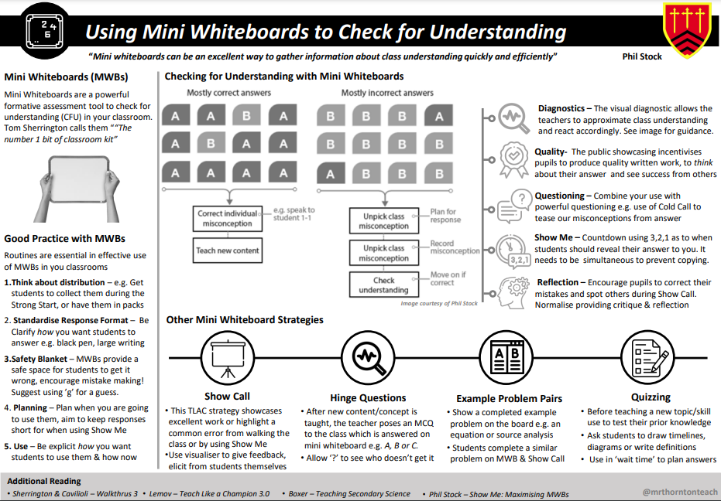

Slide 15
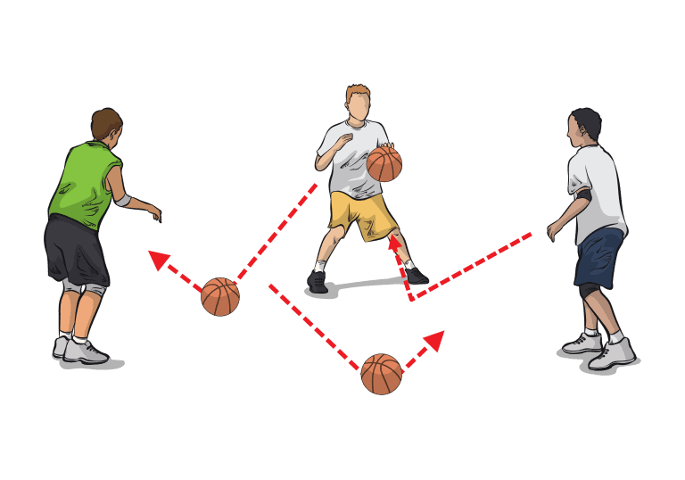
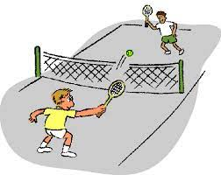
Questioning
Not
Going deeper
Pose | Pause | Pounce
BOUNCE!
Agree with Ask a student to justify why they agree with an answer
Build upon Ask a student to build upon an answer given by a student - provide an example
Challenge Ask a student to challenge an answer given by a student

Slide 16
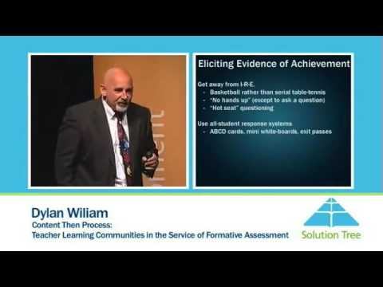

Slide 17

Questioning
Inclusive questioning
“Take a little more time. I’ll wait...”
“Give it some more thought. I’ll be back to you…”
“Let’s see how you might begin to answer. I’ll come back to you...”
“We can work on this problem together. I’ll be back to you in a moment...”
Ask a few more students in the room for their answer.
Return to the original respondent
“Which answer did you like the best/thought was correct/can you repeat it.”
Offer students multiple choice
Go 50:50 – remove two incorrect answers
Give students a chance to ‘Phone a friend’

Slide 18

Questioning
Student questions
Hands up to ask
Students should be able to ask questions about;
  What is the learning goal?
  How am I doing with achieving the learning goal?
  What do I need to do to achieve the learning goal?
Note names on the board
Turn in post-it notes at the end of lessons
Technology

Slide 19
Feedback during lessons

Slide 20

Feedback
Feedback is a common feature of successful learning and outcomes
Hattie +0.79 effect size.
Feedback must provide a specific recipe of actions that will move learning forward.
Notes:
The secret of effective feedback is that saying what’s wrong isn’t enough; to be effective, feedback must provide a specific recipe of actions for future action that will move learning forward.
Feedback has to cause change in the student, otherwise it is not feedback.
Avoid True But Useless! It is describing what needs to happen — but it is not helpful because the learner does not know how to use the feedback to improve. too much effort is wasted in describing the work students produce or in giving generic wishful evaluative feedback. It is rather like telling an unsuccessful comedian to be funnier — accurate, but not particularly helpful, advice.”

Slide 21

Feedback
Principles of feedback during lessons
Immediate feedback has a greater impact on student performance than delayed feedback.
Connect feedback specifically to the learning goal

Slide 22

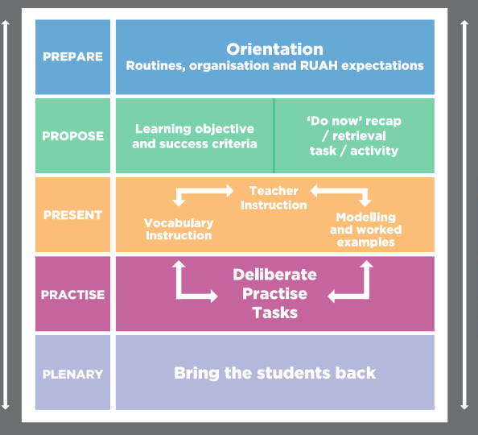
Feedback
It's tricky within a lesson right?

Slide 23

Feedback
‘Do now’ retrieval task
Feedback about misconceptions from the previous lesson
How will this influence new learning?
Check the knowledge

Slide 24

Feedback
Feedback for questions
Knowledge check throughout
Poker face
Give the students time to correct themselves using prompt questions. “It's a good start…” / “That’s not quite it…”
What went well… Even better if…
Say it again, better

Slide 25
Feedback
Deliberate practise > bring the students back
Revisit the learning goals by showcalling *ALWAYS ASK PERMISSION*
  Which of these answers was the best? Are you able to describe why?
  Provide a non-example (what success does not look like)
Conduct ‘live’ marking of a model answer WAGOLL - use a visualiser
  Verbalise each step to success and explain thinking. Language matters here, for example;
“Rachel’s first thought was… her next thought is …. then, she knew that she needed to”
“I like that Rachel chose to do it this way because…”
“The strategies that Rachel used when she got to this tricky part are impressive because…”

Slide 26
Feedback
Deliberate practise > bring the students back
Redraft the piece of work / the paragraph/ the graph and clearly point students to the parts of their writing that could be improved, with specific suggestions and examples;
… by doing X, by adding Y, by correcting Z…
Redrafting is very powerful provided that the actions are very specific
Responsive home learning?
Re-teach?!

Slide 27
Questioning and feedback
Chris Bingley cbingley@thornleigh.bolton.sch.uk
Assistant Headteacher, Thornleigh Salesian College

