Slide 1


Homework and feedback
CRAIG BARTON
@mrbartonmaths
tipsforteachers.co.uk

Slide 2
Tip:
Make homework feed into lessons

Slide 3
A question…
How does your students’ performance on homework feed into lessons?

Slide 4
A claim…
If students see their homework feeding into their lessons, they will take it more seriously

Slide 5
Three ideas to help homework feed into lessons…
Improve a piece of work
Showcase excellence
Tackle problem questions

Slide 6

Make homework feed into lessons
How does this tip fit into your current practice?
What would you need to change to make the tip work?
When could you try the tip for the first time?

Slide 7
Tip:
Make feedback into detective work

Slide 8
Three questions…
One piece of work, 30 students – how long would writing written feedback typically take?
What then happens to that written feedback?
What types of written feedback do you usually write?

Slide 9
Rather than thinking about feedback as information, think about feedback as detective work. The idea is that the feedback should cause a puzzle or a challenge for the students to engage in

Slide 10
When marking…
No ticks or crosses, just write the final score
Make a note of any whole-class issues
Prepare an Example-Problem Pair
Correct one question for students scoring 30% to 60%

Slide 11



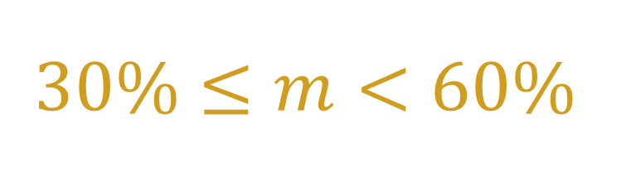
$$100\%$$
$$60\%≤m<100\%$$
Which question do you think most students got wrong?
Write an explanation that would help someone understand how to answer it
Find your mistakes and correct them
$$30\%≤m<60\%$$
$$m<30\%$$
I have corrected one of your mistakes.
Find the other mistakes and correct them
Study the example-problem pair on the board.
Then try the Your Turn

Slide 12
In class…
Independent, then paired work
Project full written solutions on board
Address whole-class issues

Slide 13
Make feedback into detective work
How does this tip fit into your current practice?
What would you need to change to make the tip work?
When could you try the tip for the first time?

Slide 14
Tip:
… or don't do written feedback

Slide 15
Instead of written feedback…
Note down trends in two columns
Re-teach the topics in the left column
Overlearning is good
Helping others is the hardest job in the classroom

Slide 16
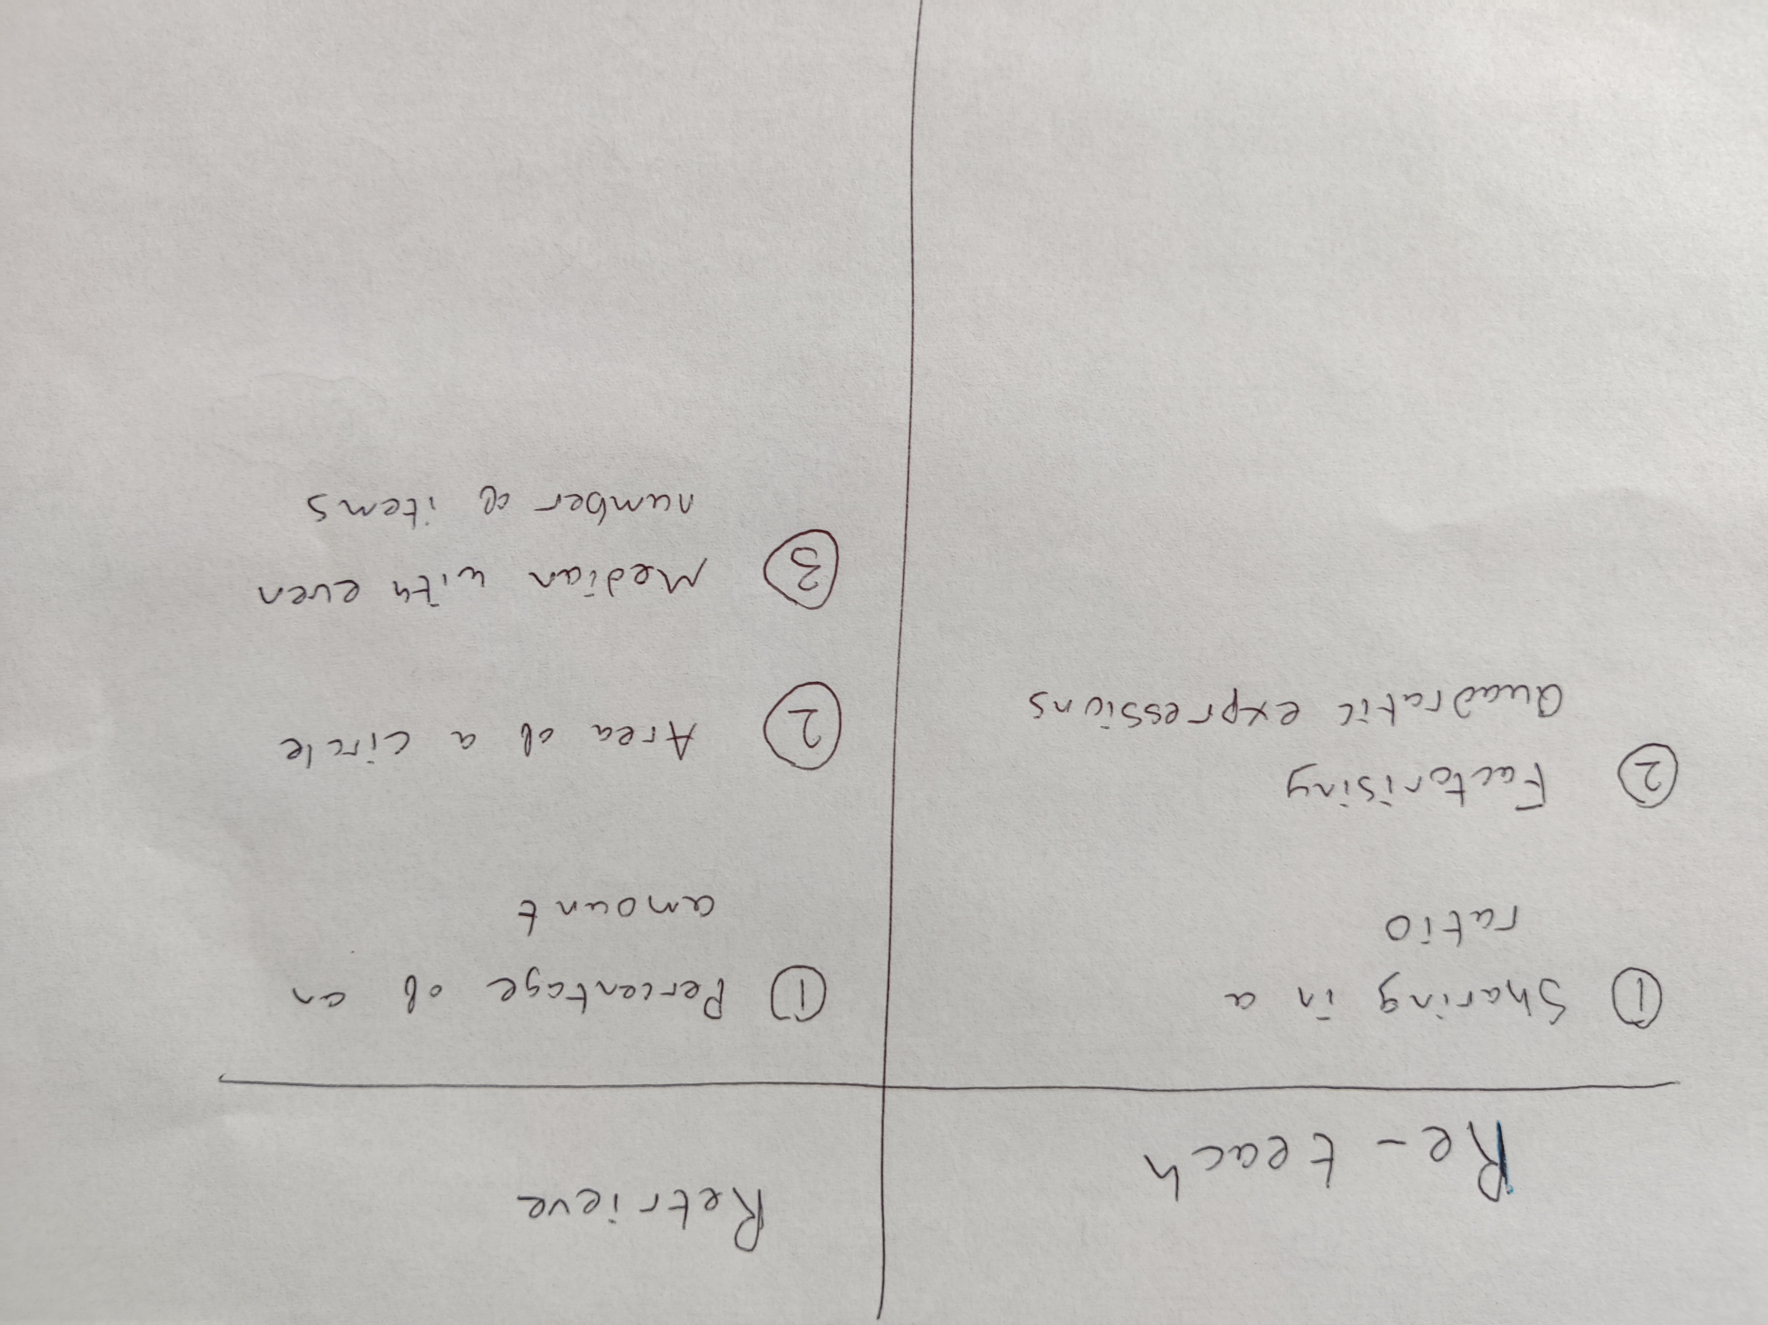

Slide 17
Instead of written feedback…
Note down trends in two columns
Re-teach the topics in the left column
Overlearning is good
Helping others is the hardest job in the classroom

Slide 18
… or don't do written feedback
How does this tip fit into your current practice?
What would you need to change to make the tip work?
When could you try the tip for the first time?

