Slide 1
Quality of Education

Slide 2
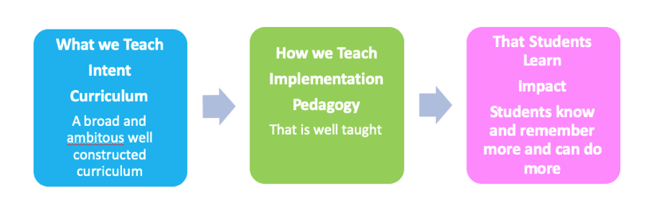
Quality of Education

Slide 3
Guiding principles
Curriculum (what we teach, in what order and what we learn) is distinct from pedagogy (how we teach)
The curriculum is the progression model, allowing students to get better at a subject
Progress in curriculum terms means students being able to know more and remember more
Overloading short-term memory with too much information will result in limited learning so information needs to be stored in long-term memory. This involves students building schemata where knowledge is linked and embedded.
Retrieval practice supports the effective retention of knowledge in long-term memory
Novice and expert learners learn differently

Slide 4
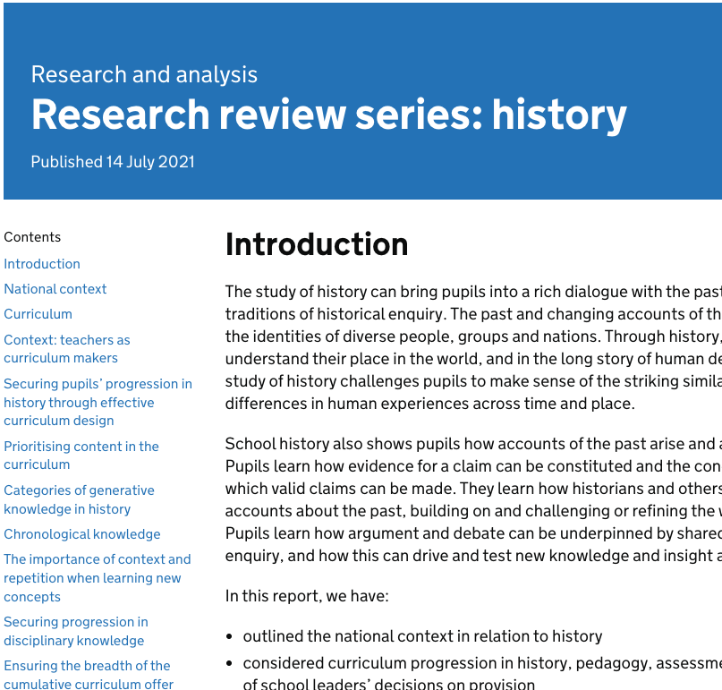
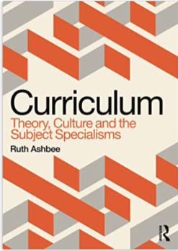
Intent

Slide 5
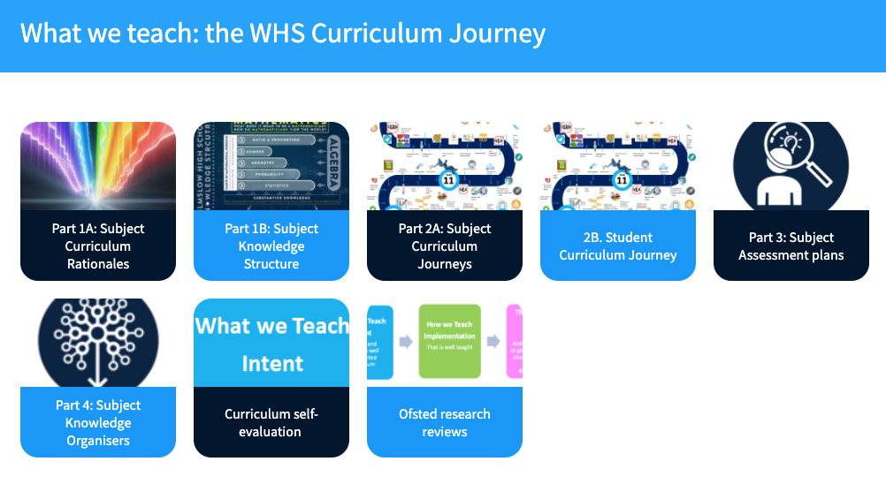
The curriculum journey

Slide 6


The subject curriculum rationale: the unique purpose of the subject
Every subject is a body of knowledge with its own rules and characteristics.
Each one has a unique purpose and the subject curriculum rationale should capture the beauty, distinctness and ‘moral purpose’ of the study of this subject.
Purpose and values
Big Ideas
Access, equity and diversity
Cultural capital
Implementation of intent

Slide 7

The subject curriculum rationale: the search for meaning of this subject
The subject curriculum rationale should capture the search for meaning of the subject and the unique way of looking at the world of its practitioners.
Do subject practitioners seek:
To describe an aspect of the world? (Science, Maths, History, Geography, RE)
To interpret? (Theology, history, literary criticism, art)
For expression? (Art, music, dance, literature, sport, design)
To design/ produce? (Design, food, languages, computing)
Ashbee pages 37-39

Slide 8
Where do disciplinary and substantive knowledge fit within this hierarchy?
Pages 40-42 of Ashbee may be worth reading here
One of the ‘unifying’ elements of a subject in the disciplinary knowledge of the subject.
How is this subject practiced/ participated in? (Ways of knowing/ working)
Subject
Subject Disciplines
Concepts & content
Subjects also include substantive knowledge.
What content & concepts make up this subject?
Knowing THAT
Knowing HOW TO
Knowing THAT
Knowing HOW TO

Slide 9
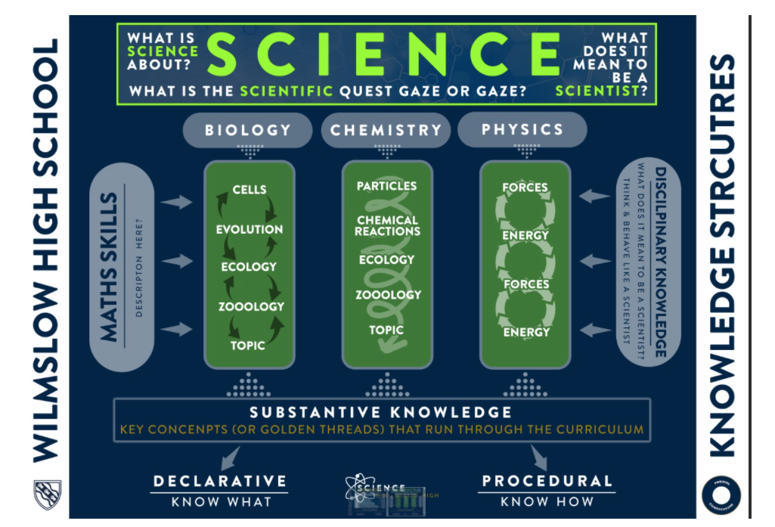
Making the structure visible to students
How do we select ‘generative’ knowledge which supports future learning?
How do we ensure students have frameworks of secure knowledge and ‘mental timelines’?

Slide 10
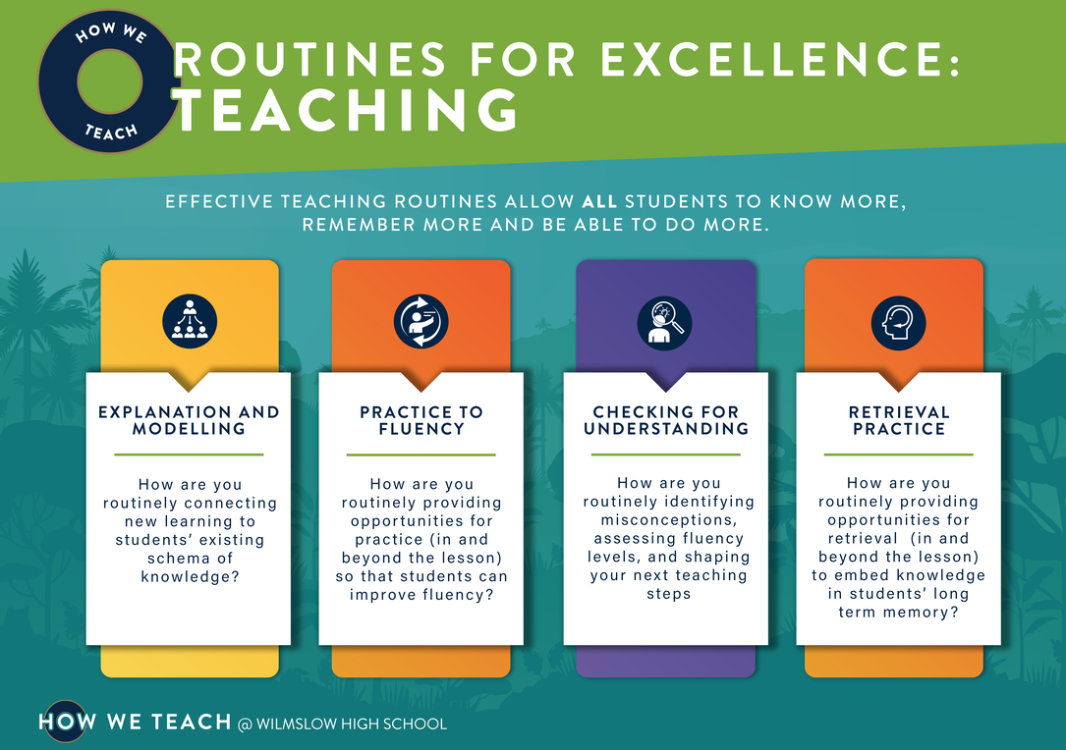
Implementation

Slide 11
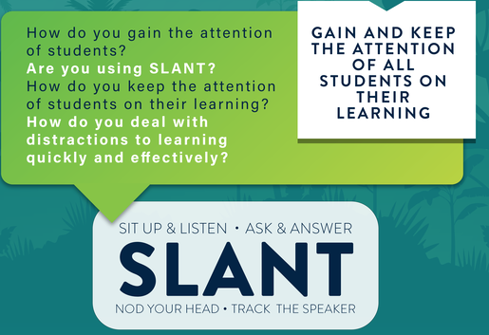
Lemov strategies

Slide 12
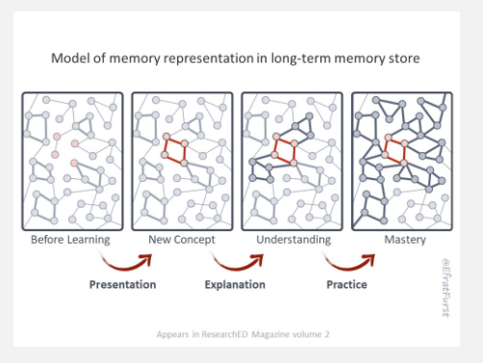
Building schema
Clear explanation linking to prior knowledge embeds frameworks of content and concepts
Teaching of abstract substantive concepts through repeated encounters with meaningful ‘concrete’ examples
Opportunities to revisit and practice with prior knowledge
Assessments to check students’ security with concepts and identify gaps/ misconceptions
Teaching for memory, practising key terms repeatedly, retrieval practice and low stakes testing
Schema development

Slide 13
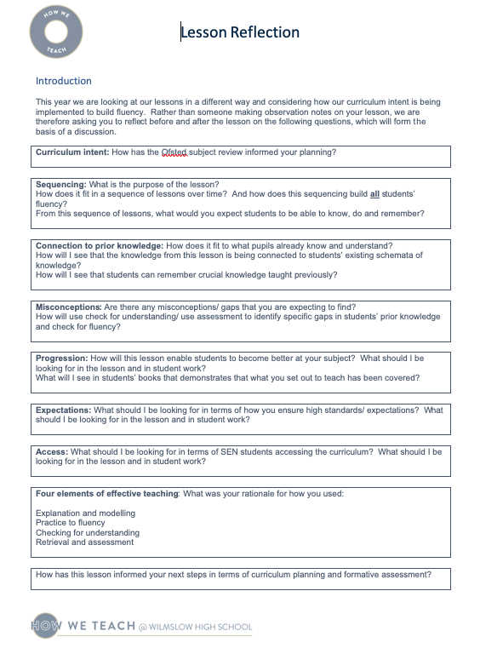
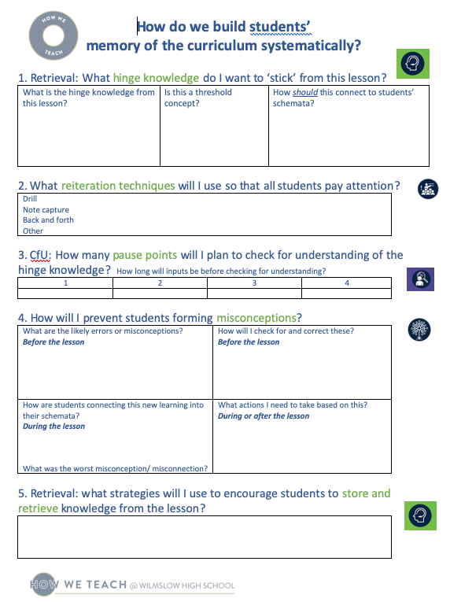
Lesson reflection to improve practice

Slide 14
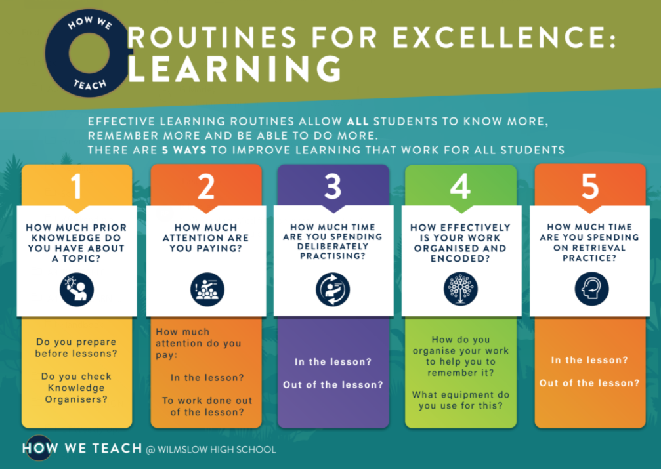
Impact: that students learn

Slide 15
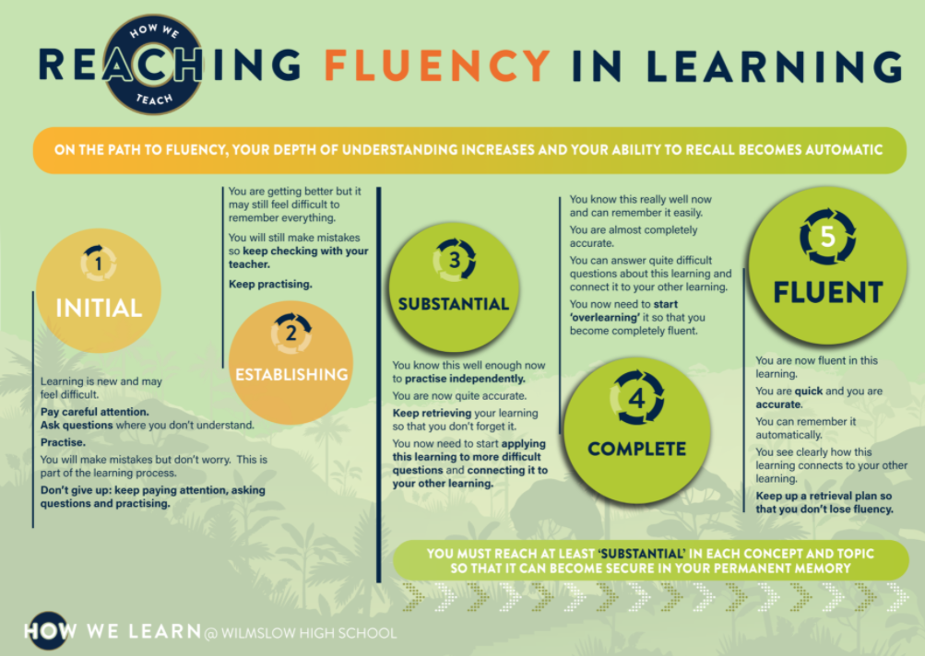
Fluency

Slide 16
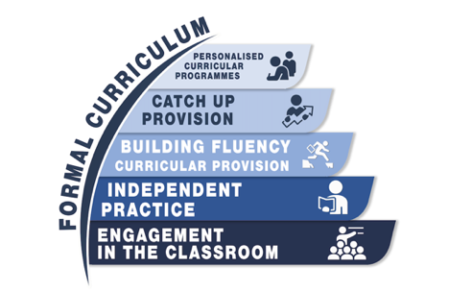
Support to access the curriculum
Years 7-13

Slide 17
Questions
How do we create a culture of challenging debate around content choice and emphasis?
How do teaching and curriculum design reflect the relationship between substantive and disciplinary knowledge?
How do we represent the complexity of academic history, avoiding generic/ oversimplified/ formulaic disciplinary approaches?

