Slide 1

BLP Safety and Welfare Hub
Virtual School update and Personal Education Plans
January 2022

Slide 2
Meet the team!
Lindsay Nelson Virtual School Head (full-time)
Catherine Hobday
Virtual School Deputy Head
Jane Westhead
Previously Looked after Lead (2 days)
Alexis Holt-Garner
SEND Lead
Kim Young
Primary PEP Lead
Gill Bentham
Secondary PEP Lead
Debbie Selby Post-16 Advisor
Vicky Lever Early-Years Advisor (2 days)
Billy Vanden
Transitions Lead (2 days)
Key Stage 4 mentor (3 days)
Well-being mentor (3 days)
Education Opportunities Lead (3 days)
Dr Julie Alfrey
Education Psychologist (3 days)
All new members of staff, including the Head and Deputy Head have QTS and experience of working in schools, some in Local authorities, to ensure effective challenge and support to schools and expertise in supporting our children.

Slide 3
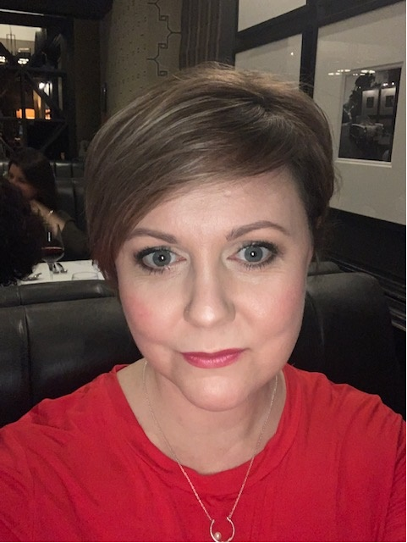
Deputy Head – Catherine Hobday
I am a qualified Secondary teacher with 10 years teaching and middle leadership experience in a Tameside school. My specialism was Science with additional pastoral leadership roles as a year group progress manager, transition lead and head of Key Stage 3. I left mainstream education in 2014 and took on a management role within a Private Early Years setting, before joining Oldham Council, first supporting the Deputy Chief Executive and then progressing to Senior SEND Officer focussing on the borough’s improvement journey towards the best outcomes for children and young people with SEND and EHCPs. As a result I have worked very closely with schools, SENDCOs, health colleagues and also with the Oldham Virtual School to ensure CLA with SEND receive the highest quality education and best possible outcomes.
To support the Virtual School Head in the overall management and leadership of the Virtual School and delivering a range of services to promote the education of Looked and Previously Looked After Children.
To be responsible for day-to-day leadership and management of PEP Caseworkers and Post-16 Advisor.
To be responsible for the Quality Assurance of Personal Education Plans.
Catherine will deputise for the Virtual School Head as appropriate at strategic meetings and in management of the Virtual School team.

Slide 4
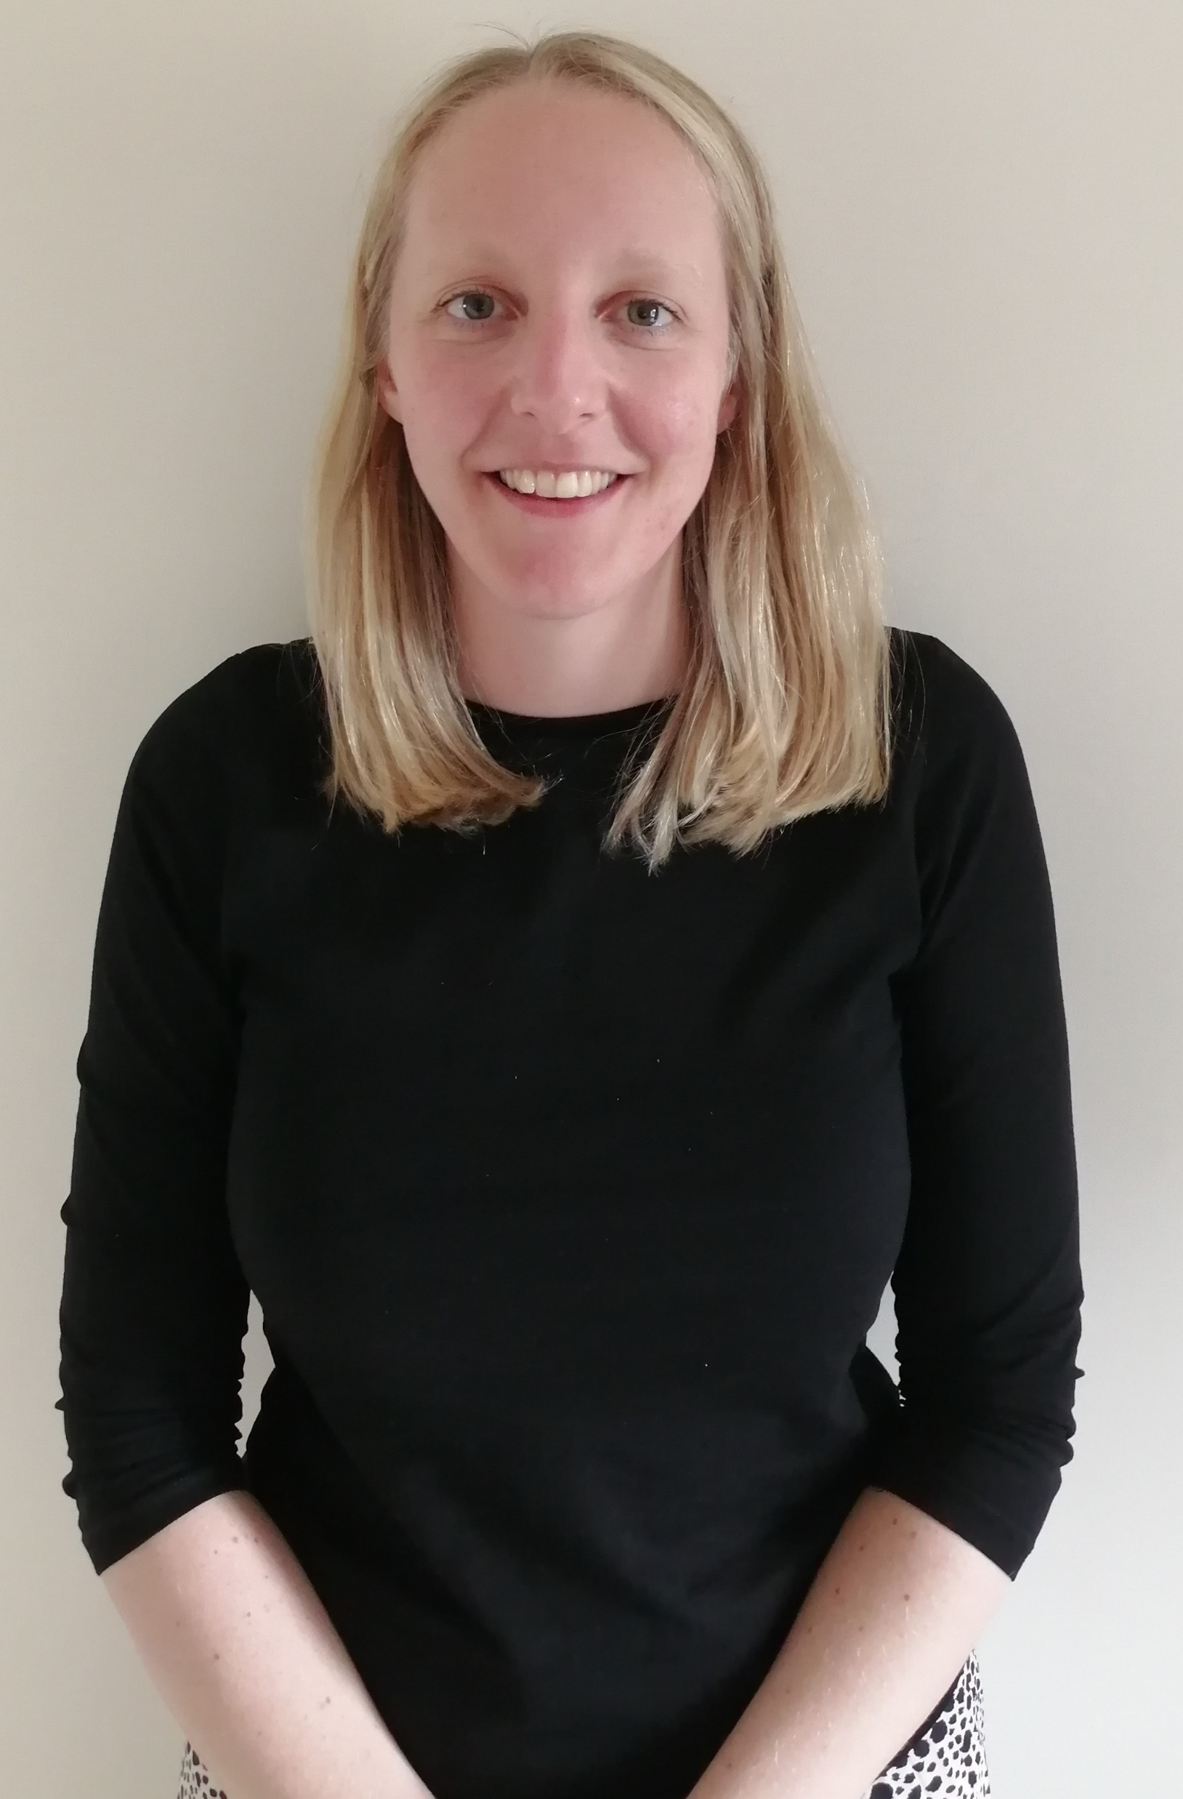
SEND Lead – Alexis Holt-Garner
I have worked in a variety of Special Education Needs schools as well as working as SENCO in a mainstream Secondary school. I am a fully qualified SENCO who has been working on the Senior Leadership Team in my current SEMH (Social, Emotional and Mental Health) school. I have written Education Health and Care Plans (EHCPs) for Tameside Council and I have worked with students with differing needs, including those with Profound Multiple Learning Difficulties, Autism and students in mainstream with Dyslexia. I have created networks for SENCOs and Designated Teacher’s to share best practice as well as support each other and I look forward to working with a variety of colleagues in Bolton to ensure high levels of support for looked after and previously looked after children.
To support the Virtual School Head in ensuring that Bolton Council fulfils its statutory duties in promoting the education of looked after and previously looked after children.
To provide guidance and support with arrangements associated with the identification, information gathering, assessment, provision, and review and monitoring for looked after and previously looked after children and young people with special educational needs.
To take a lead in cases of looked after children who have EHC Plans or where plans are in process.
To attend SEN Panel within Bolton and other Local Authorities to ensure efficient information sharing and seamless processes.

Slide 5
Bolton’s current cohort
Early Years - 86
Primary – 156
Secondary – 226
Post-16 – 70
Tuesday 11th January 2022
538

Slide 6
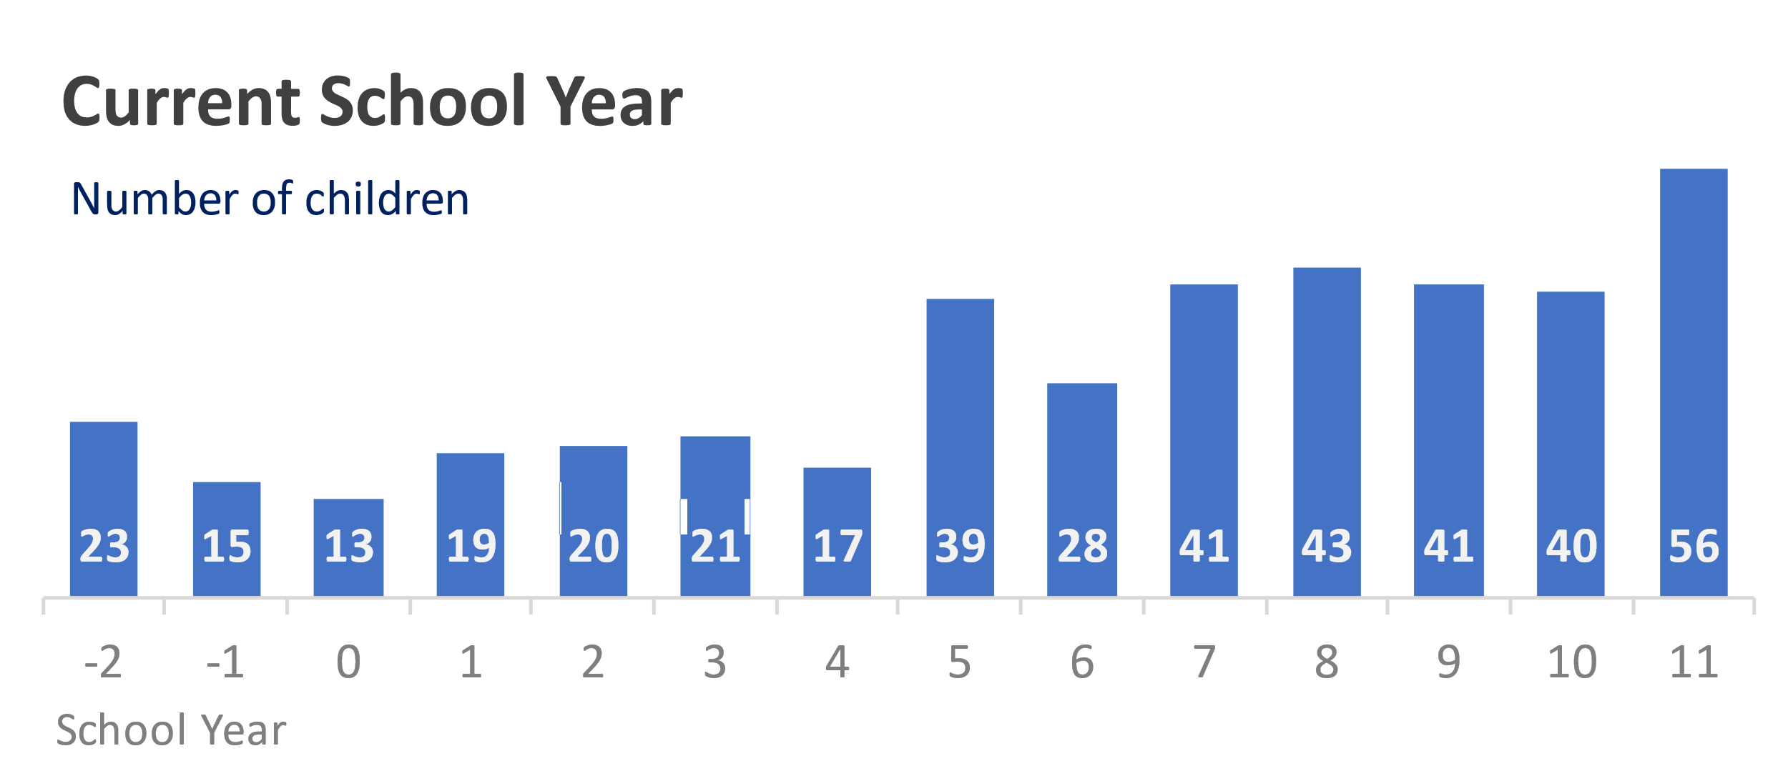
Cohort
In January 2022 there were 538 looked after children on Bolton’s Virtual School roll, this includes 382 looked after children in reception to year 11 attending 168 separate schools in 33 local authorities. 71% of Bolton’s looked after children attend school’s within Bolton, with 29% living out of borough.
 | Primary School Age | Secondary School Age
Placed in Bolton | 110 | 163
Placed outside Bolton | 46 | 63
TOTAL | 156 | 226

Slide 7
Attendance
 | Primary aged children | Secondary aged children
100% | 46 | 55
90 to 99% | 56 | 61
80% to 89% | 12 | 16
70% to 79% | 3 | 8
Below 69% | 0 | 15
The overall attendance for the Autumn Term was 92%, with 101 of our children achieving 100% attendance by the end of term!

Slide 8
Exclusions
There were no permanent exclusions during the Autumn term however there were a number of cases where the Virtual School Head intervened, in line with the national guidance on exclusions, to support or coordinative an alternative package of education to avoid a permanent exclusion. The Virtual School prevented 14 children from permanent exclusion.
During the Autumn term a total of 126 days were lost to fixed-term exclusions:
A total of 28 pupils in both Primary and Secondary school were issued with a fixed-term exclusion.
6 primary aged pupils and 23 secondary aged pupils
11 of these pupils were supported through the Virtual School Nurture Provision to prevent a permanent exclusion.
18 of these pupils are on the SEN register, 7 have EHCPs and 11 are at SEN support

Slide 9
Virtual School support through the PEP
The Virtual School are unable to attend all PEP meetings and the criteria for Virtual School involvement in PEPs is as follows:
New case on Virtual School roll
School placement move
Pupils educated out of borough
‘Red’ rated case (concerns raised at Education Referral meeting (ERM) or due to poor attendance/engagement/school rated less than ‘good’ by Ofsted).
Need for independent chair due to professional disagreement
Key year groups such as Year 11 or Year 6.

Slide 10
PEPs and the Virtual School Team
Cohort | PEP meetings taken place | PEP meetings attended by a member of the Virtual School | % PEP meetings attended by the Virtual School
Early Years: Pre-School (reception 2022) | 12 | 12 | 100%
Primary: Reception to Year 6 | 154 | 78 | 51%
Secondary: Year 7 to Year 11 | 217 | 128 | 59%
Post 16: Year 12 and 13 | 61 | 38 | 62%
TOTAL | 444 | 256 | 58%
SEND Reception-Year 13 *124 CLA with EHCPs; 37 CLA with SEN Support | 161* | 87 | 54%

Slide 11
Electronic PEP update
Throughout the Autumn Term a total number of 459 Bolton looked after children and young people required a PEP meeting from early years all the way to post-16 education. We are aware that at least 450 PEP meetings took place during the term however the statistics below reflect the number of PEP meetings completed and their PEP document uploaded onto LCS using the word document or delegation portal.
Summer term 2020: 80% within 6 months
Overall completion: 93%
Early Years: 100%
Primary: 91%
Secondary: 94%
Post-16: 86%

Slide 12
The Delegation Portal – Liquid Logic
Virtual School has set up DTs and additional staff to be able to complete the PEP electronically.
Staff register and login to the portal
Secure login - step 1 (bolton.gov.uk)
Virtual School Team delegates sections of the PEP to the appropriate member of staff to complete and submit
Find help and guidance on our virtual school website under “PEP Advice and Guidance” and “PEP documents” at the link below on our logo below:
Or contact the Virtual School Team on their personal email address or at Virtual.School@bolton.gov.uk

Slide 13
Quality Assurance – PEPs
The quality assurance process was discussed with Designated Teachers at the Autumn Term DT Forum. It was agreed to use a RAG rated system and to not use Ofsted narrative, this is still in-line with and follows DfE guidance.
We agreed to dip sample and offer informal feedback on PEPs within the Spring and Summer term and to start formal QA feedback in September 2022.
QA policy and matrix has been emailed to Headteachers and Designated Teachers for feedback.

Slide 14
Questions or Feedback??

