Slide 1


3 Resources and Ideas
Tasks special!

Slide 2
Resource 1:
Variation Theory
variationtheory.com

Slide 3
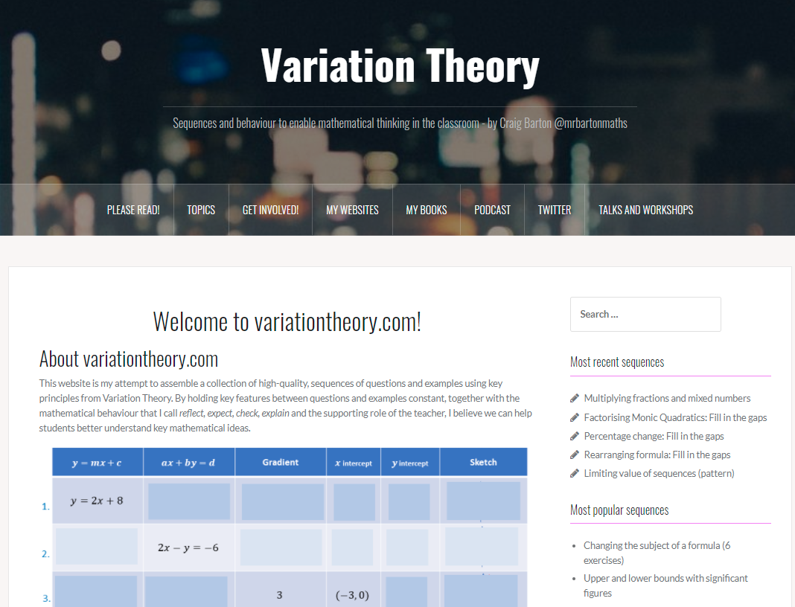

Slide 4
 | Amount (A) | Percentage (P%) | P% of A | A increased by P% | A decreased by P%
1. | 320 | 10 % | 32 | 352 | 288
2. | 320 | 25 % | 80 | 400 | 240
3. | 320 | 2.5 % | 8 | 328 | 312
4. | 320 | 1.25 % | 4 | 324 | 316
5. | 80 | 1.25 % | 1 | 81 | 79
6. | 400 | 1.25 % | 5 | 405 | 395
7. | 125 | 4 % | 5 | 130 | 120
8. | 250 | 4 % | 10 | 260 | 240
9. | 250 | 8 % | 20 | 270 | 230
10. | 625 | 16 % | 100 | 725 | 525
11. | 1859 | 16 % | 297.44 | 2156.44 | 1561.56
12. | 1234 | 16 % | 197.44 | 1431.44 | 1036.56
13. | 609 | 16 % | 97.44 | 706.44 | 511.56
14. | 84 | 16 % | 13.44 | 97.44 | 70.56
15. | 116 | 16 % | 18.56 | 134.56 | 97.44
16. | 116 | 160 % | 185.6 | 301.6 | -69.6
17. | 116 | 200 % | 232 | 348 | -116
18. | 348 | 66⅔ % | 232 | 580 | 116
 | Amount (A) | Percentage (P%) | P% of A | A increased by P% | A decreased by P%
19. | 80 | 10 % | 8 | 88 | 72
20. | 80 | 15% | 12 | 92 | 68
21. | 15 | 80 % | 12 | 27 | 3
22. | 40 | 30% | 12 | 52 | 28
23. | 60 | 20% | 12 | 72 | 48
24. | 10 | 120% | 12 | 22 | -2
25. | 240 | 5 % | 12 | 252 | 228
26. | 1 | 1200% | 12 | 13 | -11
27. | 10 | 30% | 3 | 13 | 7
28. | 10.4 | 25 % | 2.6 | 13 | 7.8
29. | 12.5 | 4% | 0.5 | 13 | 12
30. | 15 | 20% | 3 | 18 | 12
31. | 16 | 25 % | 4 | 20 | 12
32. | 80 | 85% | 68 | 148 | 12
33. | 240 | 95% | 228 | 468 | 12
34. | 480 | 97.5 % | 468 | 948 | 12
35. | 480 | 2.5 % | 12 | 492 | 468
36. | 320 | 2.5% | 8 | 328 | 312

Slide 5
Resource 2:
Interwoven Maths
interwovenmaths.com
Notes:
https://www.gov.uk/government/publications/teaching-mathematics-at-key-stage-3

Slide 6
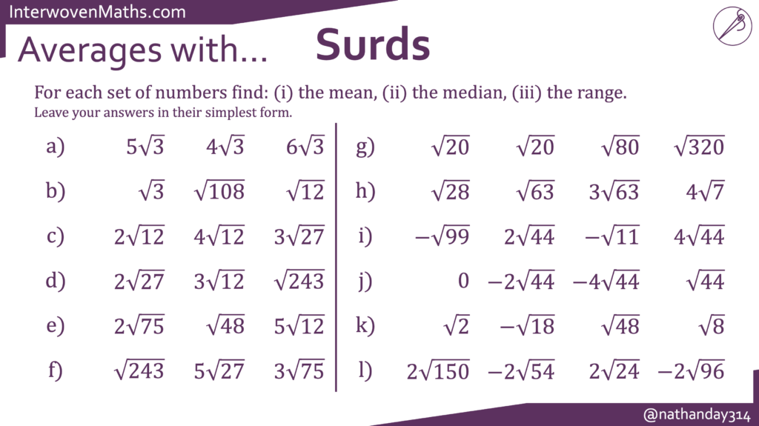

Slide 7
Resource 3:
Starting Points Maths
https://startingpointsmaths.com

Slide 8
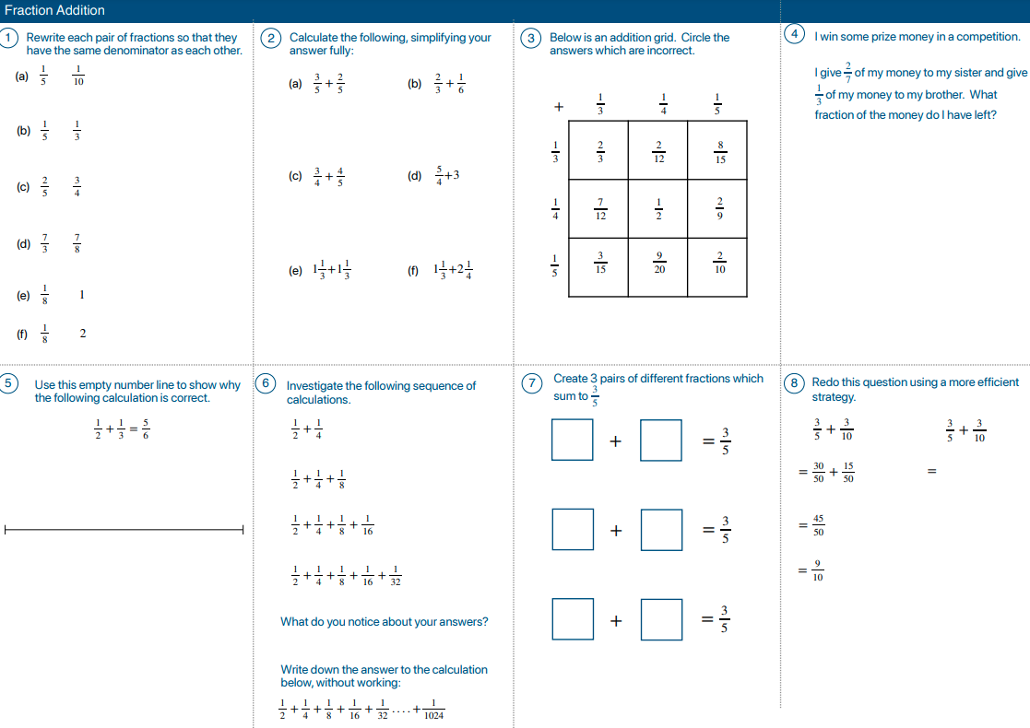

Slide 9
Breakout Rooms!

Slide 10
What did you like/not like about each task?
How would you need to change them to make them work with your students?
Will you give them a go?

Slide 11
3 Resources and Ideas
Tasks special!

