Slide 1

Instructional Coaching.
Aim: To develop a secure understanding of instructional coaching as a professional development strategy to support teacher excellence and curriculum development.
Notes:
Aims:

Slide 2
This session is an opportunity to:
Part 1: Delve deeper into instructional coaching – what it is and what it isn’t.
Part 2: Understand how instructional coaching can be applied to curriculum development.

Slide 3
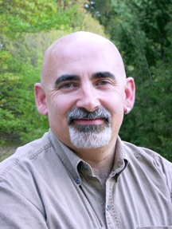
Why instructional coaching?
“Every teacher needs to improve, not because they are not good enough, but because they can be even better.”
(Wiliam, D. 2018)
Notes:
Why are we here, talking about IC?

Slide 4
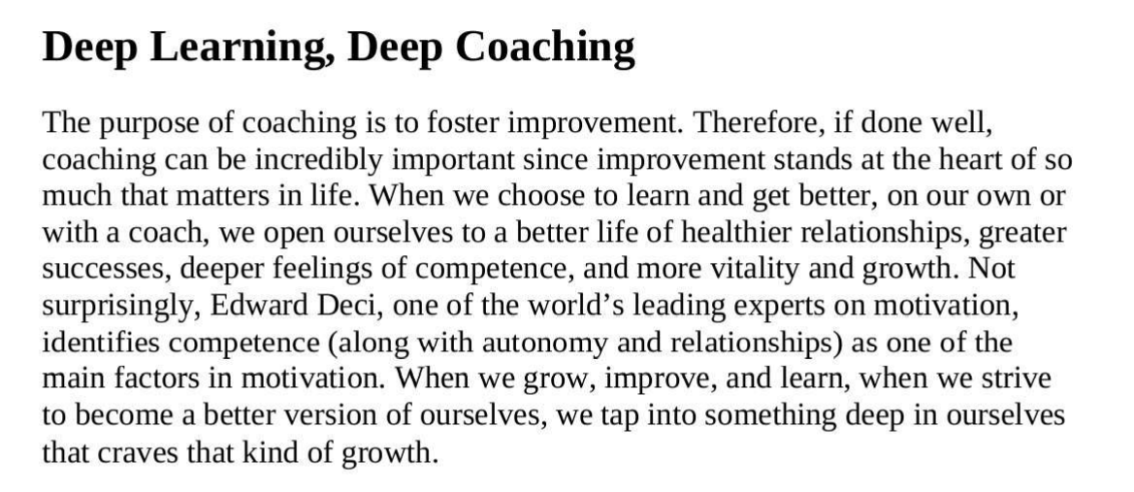
Knight, J. (2018) The Impact Cycle.
What resonates with you?
Notes:
What resonates with you?

Slide 5
Teachers’ Standard for Professional Development – DfE (2016).
Part 3 – Professional development should include collaboration and expert challenge. Professional development that aims to change teachers’ practice is most effective when it includes collaborative activities with a focus on the intended pupil outcomes. In particular, effective professional development:
Builds-in peer support for problem solving;
Includes focussed discussion about practice and supporting groups of pupils with similar needs;
Challenges existing practice, by raising expectations and bringing in new perspectives; and,
Includes support from someone in a coaching and/or mentoring role to provide modelling and challenge.
Notes:
We have a professional duty to support colleagues to improve.

Slide 6
Instructional Coaching
Notes:
10 minutes in

Slide 7

Coaching is a professional development tool that can help teachers to improve their practice so that pupil outcomes also improve.
Discuss in pairs:
Your current experience of coaching as a coach or coachee.
The benefits of this approach.
The challenges of using instructional coaching to achieve school improvement priorities.
Kraft and Papay (2014)
10 mins
Notes:
10 mins to discuss and then receive feedback from each pair.

Slide 8

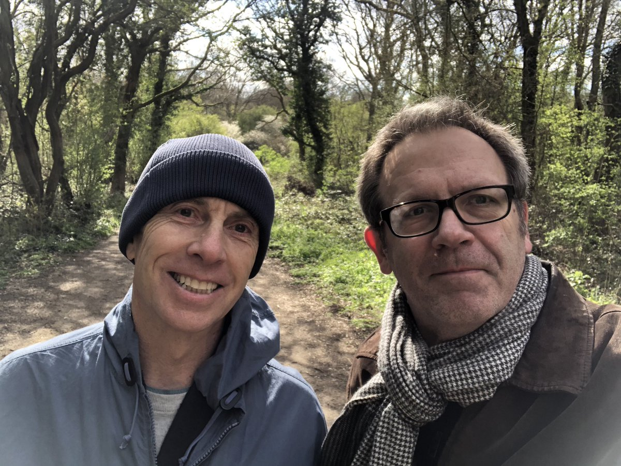

Instructional Coaching in many forms.
Fundamentally, Instructional Coaching is always based around:
Analysing current reality.
Setting goals.
Identifying and explaining teaching strategies to meet goals.
Providing support until goals are met.
Jim Knight (The Impact Cycle, 2018)
“How can we use Instructional Coaching to transform teacher quality when we don't agree about what it is and who it's for?” (Goodrich, J. 2021)
Notes:
Instructional coaches help teachers to:
Analyse current reality
Set goals
Identify and explain teaching strategies to meet goals
Provide support until goals are met.
Jim Knight (The Impact Cycle, 2018)

Slide 9

Recap: What is instructional coaching?
Instructional coaching involves a more expert teacher/leader helping another teacher to develop their practice with individual classroom-based observational feedback.
Coaches focus on bite-sized pieces of feedback and provide specific steps that the teacher can take to develop their expertise through regular coaching over time (Farndon, 2020).
Instructional coaching is not only theoretically promising as the only form of professional development that reliably affects student achievement (Kraft et al, 2018) – it’s impact is also visible in schools (Farndon, 2021).

Slide 10

How can instructional coaching support teacher excellence?
Instructional coaching has the strongest body of evidence as an effective professional development strategy (Sims, 2019).
Instructional coaching underpins the ITT/ECF/NPQs.
It is described as an essential tool to support teachers to understand and apply new theories to the specific context of their classrooms.
“Instructional coaching is a powerful tool with the potential to transform teacher development.” (Field, G. 2020)

Slide 11
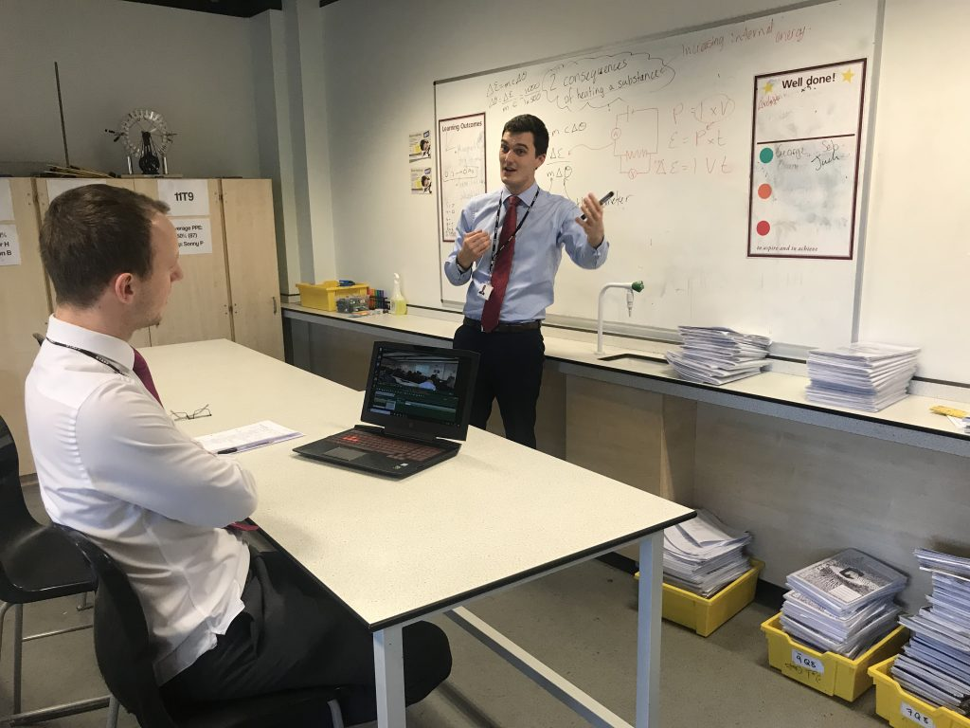
How can instructional coaching support teacher excellence?
Instructional coaching is in contrast to a more traditional coaching model where the coach asks a series of open questions in order to draw out the answer that the practitioner is already aware of.
Instructional coaching assumes that there are some areas where the teacher being coached is more novice and that the coach, being more expert, will be able to guide their improvement in those areas.
This doesn’t only apply to new teachers – all teachers have areas in which they can improve, and the most efficient way of doing this is to undergo direct, explicit instruction.
What is instructional coaching? | Ambition Institute

Slide 12

How can instructional coaching support teacher excellence?
The principles of instructional coaching are linked to the principles of developing expertise in any domain through the use of deliberate practice.
The first step is to identify a destination or outcome, often called the target performance.
Teachers can move from their current performance towards this target performance by practising a sequence of sub-goals with the aid of a coach. This allows them to overcome existing ingrained habits and adopt new behaviours.
The input of the coach is in observing the practitioner’s current performance, setting precise sub-goals and designing practice.
What is instructional coaching? | Ambition Institute
Notes:
30 mins in
Deliberate practice is defined as being effortful in nature, with the main goal of personal improvement of performance rather than enjoyment, and is often performed without immediate reward. Designing practice requires the coach to have a high level of expertise.

Slide 13
The Impact Cycle
Notes:
We will now take a closer look at the impact cycle.

Slide 14
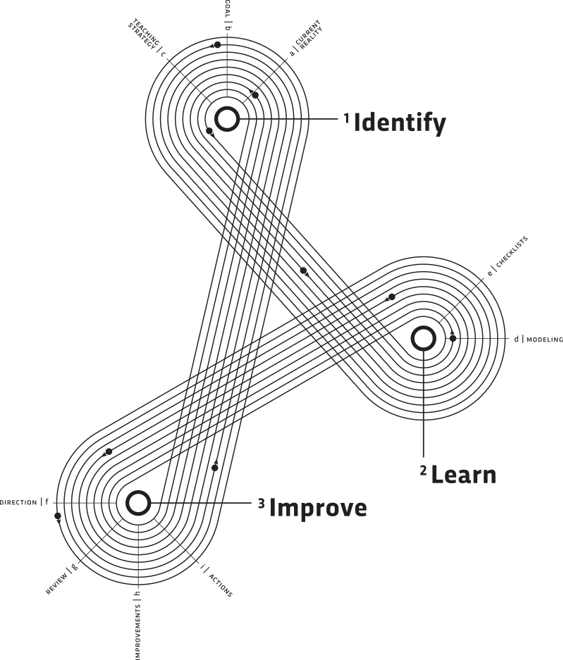
The Impact Cycle - (Jim Knight, 2018)
The impact cycle is deceptively simple – it involves setting a goal, identifying an [evidence informed] strategy to use to hit the goal, getting good at implementing the strategy, and then making adaptations until the goal is met.
IC’s partner with teachers to help them improve their teaching and learning so pupils become more successful in the classroom.
How IC’s interact with others is as important as what they do. An IC who sees themselves as an expert and believes teachers simply needs to buy into their good advice on what they did right and wrong is likely to encounter a lot of resistance.
Effective IC’s see teachers as professionals, which means they see teachers as the ultimate decision makers about what and how they learn.
The impact cycle can be applied to all circumstances that require change and improvement.
IC’s must work in ways that are consistent with ‘Partnership Principles’ as opposed to a top-down approach.
What do you think the Partnership Principles should include and why?
5 mins
Notes:
Group work:
What do you think the Partnership Principles should include and why – come up with 5?
Allow 5 minutes for groups to consider these questions and then seek feedback.

Slide 15
The Partnership Principles (Knight, 2018)
Equality
Choice
Voice
Dialogue
Reflection
Praxis
Reciprocity
In pairs:
What does this mean to you?
Why is it important?
How can it be achieved?
10 mins
Notes:
10 mins to discuss, make notes.
Feedback – make notes on the other groups feedback.

Slide 16
Equality: Instructional coaches and teachers are equal partners.
Partnership involves relationships between individuals. The instructional coaches recognise collaborating teachers as equal partners, and they truly believe that each teacher’s thoughts and beliefs are valuable. Instructional coaches listen to teachers with the intent to learn, to really understand, and then respond, rather than with the intent to persuade.
Notes:
Take feedback from the pair

Slide 17
Choice: Teachers should have choice regarding what and how they learn.
In a partnership, one individual does not make decisions for another. Because partners are equal, they make their own individual choices and make decisions collaboratively (Block, 1993). Professionalism is about making choices. Rather, an instructional coach’s goal is to meet teachers where they currently are in their practice and offer choices for learning.
Notes:
Take feedback from the pair

Slide 18
Voice: professional learning should empower and respect the voices of teachers.
In a partnership, one individual does not make decisions for another. Because partners are equal, they make their own individual choices and make decisions collaboratively (Block, 1993). Professionalism is about making choices. Rather, an instructional coach’s goal is to meet teachers where they currently are in their practice and offer choices for learning.
Notes:
Take feedback from the pair

Slide 19
Dialogue: professional learning should enable authentic dialogue.
Partners engage in conversation learning together as they explore ideas (Bohm, 2000). For instructional coaches, this means they listen more than they tell. Instructional coaches avoid manipulation, engage participants in conversation about content, and think and learn with collaborating teachers. Conditions for dialogue are humility, hope, faith, and love.
Notes:
Take feedback from the pair

Slide 20
Reflection: reflection is an integral part of professional learning.
One the most important choices collaborating partners will make is how to make sense of whatever the instructional coach proposes they learn. Instructional coaches encourage collaborating teachers to consider ideas before adopting them. Indeed, instructional coaches recognize that reflective thinkers, by definition, must be free to adopt or reject ideas, or they simply are not thinkers at all.
Notes:
Take feedback from the pair

Slide 21
Praxis: teachers should apply their learning to their real-life practice as they are learning.
One the most important choices collaborating partners will make is how to make sense of whatever the instructional coach proposes they learn. Instructional coaches encourage collaborating teachers to consider ideas before adopting them. Indeed, instructional coaches recognize that reflective thinkers, by definition, must be free to adopt or reject ideas, or they simply are not thinkers at all.
Notes:
Take feedback from the pair

Slide 22
Reciprocity: instructional coaches should expect to get as much as they give.
One the most important choices collaborating partners will make is how to make sense of whatever the instructional coach proposes they learn. Instructional coaches encourage collaborating teachers to consider ideas before adopting them. Indeed, instructional coaches recognize that reflective thinkers, by definition, must be free to adopt or reject ideas, or they simply are not thinkers at all.
Notes:
Take feedback from the pair
Take a break.

Slide 23
As senior leaders, what are the benefits and challenges of seeing coachees as equal partners rather than the coach being the ultimate expert?
10 mins
Notes:
Discussion – 10 mins
Take 15 min break after this.

Slide 24
Beyond lesson observations – extending the sphere of impact.
Think about your specific roles and responsibilities.
Discuss in pairs in what ways instructional coaching can be used to support middle leaders to develop in their role?
5 min
Notes:
5 mins

Slide 25
Instructional Coaching: Curriculum Development

Slide 26
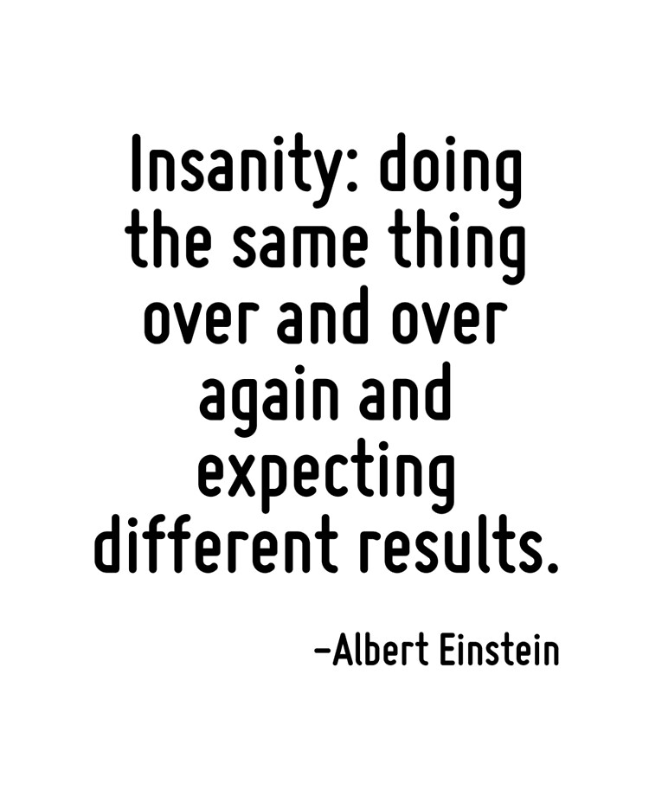
Defining ‘better’ in curriculum development: considerations for implementation.
School leaders must define what a ‘better curriculum’ looks like in their context.
The purpose of IC is to train teachers in something else – this means that senior leaders need to think carefully about what to teach their middle leaders with regards to curriculum development.
IC’s must have a clear understanding of what an excellent curriculum looks like so that they can model, design practice and offer precise feedback to support the teachers' improvements – this goes beyond their own experience as a classroom teacher.
What does a ‘better curriculum’ look like in your school? What are the features of a robust curriculum?
Notes:
Instructional coaching should be used to support change.
What does a ‘better curriculum’ look like in your school?
What are the features of an excellent curriculum?

Slide 27
Iterative curriculum design
Curriculum development is a complex task; however, it can be simplified by taking a process approach.
The Design Phase
The Implementation Phase
The Improvement Phase
Developing middle leaders subject knowledge/curriculum design expertise is a way of improving teachers practice.
It is a professional development opportunity and process.
How do we support middle leaders through each of these phases?
Notes:
In this section we will explore how coaching can use to support the curriculum development process.

Slide 28
Principles of curriculum development.
What are the features of a robust curriculum?
How can senior leaders coach middle leaders through this process?
“There is now a need for senior leaders to have a more insightful understanding of subject disciplines outside of their own; a need for subject leaders to articulate the what and why of their curriculum design; a need for a clear understanding of the curriculum as a model for progression; and a need for a wider overview of the relationship between subjects as interconnected components.” (Howard, K. & Hill, C. 2020)

Slide 29
Curriculum Development
A school’s curriculum enables it to set out the knowledge, skills, and values that its pupils learn, encompassing the national curriculum within a coherent wider vision for successful learning.
For senior leaders, the school’s curriculum aims will inform which subjects will be taught and which will get more precedence in the timetable.
Effective teaching will be supported by having a well-designed curriculum, that reflects the knowledge, skills and values that have been identified as important for pupils to learn.
For subject leaders, it means making tough decisions about the most powerful knowledge to include in their curriculum (Young, 2018).
Those that design the curriculum must have a strong knowledge about how pupils learn so that the curriculum can actually serve it’s indented purpose.

Slide 30
Curriculum Development
Middle leaders must have a broad and secure subject knowledge to allow them to make good choices on what is studied, how it is studied, the way in which it is sequenced and to ensure it is effectively understood by their pupils.
They must have a strong content knowledge and pedagogical content knowledge about the subjects that they teach. Coe et al (2020) describe the difference between these two types of knowledge:
Content Knowledge is the knowledge and understanding of the subject itself. For example, having a strong knowledge of the Physics curriculum content.
Pedagogical Content Knowledge is the knowledge of how different concepts relate to each other within a subject (for example, how number bonds relate to basic operations in Mathematics such as addition and subtraction), the skills and knowledge that pupils must have before they can learn new concepts as well as knowledge of how to teach particular concepts or ideas (such as the use of particular worked examples or practical demonstrations).
In what ways can senior leaders establish the strength of middle leaders content and pedagogical content knowledge?
5 min
Notes:
Discuss for 5 mins and then take feedback?
Essentially, it is about asking the right questions and looking for evidence to triangulate it.

Slide 31
Intent – Implementation - Impact
What questions should senior leaders be asking about curriculum intent, implementation and impact when supporting middle-leaders with curriculum development?
10 min
Notes:
What questions should senior leaders be asking when supporting middle-leaders with curriculum development?
Spend 10 mins, in your pairs considering what questions SL’s should ask ML to gain an accurate understanding of a subjects curriculum intent, implementation and impact?

Slide 32
Curriculum intent
Senior leaders must focus on the how and why of a subject’s curriculum.
“We should not be asking subject leaders for intent statements or complicated infographics of curriculum maps. Rather, we should be supporting subject leaders to get to the heart of their subject and draw out a clear rationale that underpins the curriculum so this can guide their decisions.” (Howard, K. 2020).
“It must be clear what end points the curriculum is building towards and what pupils need to know and be able to do to reach those end points.” (Ofsted, 2021)
“The curriculum must be planned and sequenced so that new knowledge and skills build on what has been taught before and towards its clearly defined end points.” (Ofsted, 2021)
Senior Leader’s must ensure that Middle Leader’s “create coherence through the curriculum by identifying the conceptual connections across the curriculum - not as an infographic - but as an exercise in ensuring prior, current and future learning is connected so that pupils have strong conceptual architecture to build their understanding .” (Howard, K. 2020).
“If we can support subject leaders in how to design and deliver their curriculum, not through quick fixes, gimmicks or generic approaches that lose sight of the subject, we can create the conditions for far more effective curriculum work.” (Howard, K. 2020).

Slide 33
Curriculum Intent.
Senior Leader’s must work with Middle Learner’s to establish:
How carefully leaders have thought about what end points the curriculum is building towards, what pupils will be able to know and do at those end points, and how leaders have planned the curriculum accordingly.
This includes considering how the intended curriculum will address social disadvantage by addressing gaps in pupils’ knowledge and skills.
How leaders have sequenced the curriculum to enable pupils to build their knowledge and skills towards the agreed end points.
How leaders have ensured that the subject curriculum contains content that has been identified as most useful, ensuring that this content is taught in a logical progression, systematically and explicitly enough for all pupils to acquire the intended knowledge and skills.
(Ofsted, 2021)

Slide 34
Curriculum Implementation
Dismantling and reassembling
Effective curriculum work requires subject leaders to diagnose, dismantle and reassemble the curriculum - evaluating and refining to seek what fits, why here, why now, what makes sense, what doesn’t fit/make sense.
The process itself offers a way to shape and develop our subject specialists by focusing on what is being taught (content knowledge) and then refining how this is taught in a way that best serves the subject (pedagogical content knowledge).
This shift ensures we move away from pursuing generic one size fits all approaches that can mangle the subject discipline and undermine the curriculum and allows us to get much closer to meaningful curriculum delivery as well as design.

Slide 35
Research and evidence suggest that the most important factors in how, and how effectively the curriculum is implemented are:
Teachers have expert knowledge of the subjects that they teach. If they do not, they are supported to address gaps in their knowledge so that pupils are not disadvantaged by ineffective teaching.
Teachers check pupils’ understanding effectively, and identify and correct misunderstandings.
Teachers ensure that pupils embed key concepts in their long-term memory and apply them fluently.
The subject curriculum is designed and delivered in a way that allows pupils to transfer key knowledge to long-term memory.
It is sequenced so that new knowledge and skills build on what has been taught before and pupils can work towards clearly defined end points.
Teachers use assessment to check pupils’ understanding in order to inform teaching, and to help pupils embed and use knowledge fluently and develop their understanding, and not simply memorise disconnected facts
Their approach to teaching remains rooted in evidence and the key elements of effective teaching.
Feedback, retrieval practice and assessment are prioritised.
(Ofsted, 2021)

Slide 36
Implementation - Curriculum sequencing.
Sequencing is far more than just “this follows this, this follows this”. It is more than the ordering of component parts - it is foreshadowing, embellishment, echoing and evolution.
To create coherence, we need to look at the relationships and connections that make up our curriculum.
This can be as simple as signposting statements: where have we seen this before? How does this have a relationship with what has been learnt previously? How does our understanding of one concept act as a threshold for understanding the next?
But to do this work and to provide this coherence, we need a clear framework for our subject and those who teach it so we can help students make strong schematic connections at each stage of the curriculum.
No matter how we approach this sequencing, it is crucial to constantly ask ourselves: Why this? Why now?

Slide 37
History – Before teaching the events of the Battle of Hastings in 1066, teachers must have a strong content knowledge of the Vikings in England. Without this knowledge, teachers would not be able to accurately explain why Harold Hardrada believed he was the Heir to the Throne. Pupils must be able to acquire a strong prior-knowledge of the Vikings in England, before being taught about the Battle of Hastings. This should be reflected in the sequencing of the curriculum.
Religious Education – Pupils must develop a strong knowledge of Original Sin (the Fall), before they can fully understand the importance of the Incarnation (when God took human form in Jesus). Therefore, the sequence of the curriculum needs to reflect this. Pupils must be aware of the fact that Jesus was Jewish, and the challenges he faced as a Jewish man, to understand events surrounding his Crucifixion.

Slide 38
How do we accurately assess the impact of the curriculum?
A well-constructed, well-taught curriculum will lead to pupils learning more and so achieving good results. Therefore, such a curriculum contributes to evidence of impact.
Disadvantaged pupils and pupils with SEND will acquire the knowledge and cultural capital they need to succeed in life.
Pupils are making progress in that they know more, remember more and are able to do more. They are learning what is intended in the curriculum.
All learning builds towards an end point. Pupils are being prepared for their next stage of education, training or employment at each stage of their learning.
(Ofsted, 2021)

Slide 39
What is the curriculum Intent?
How is progression planned for in the curriculum?
Why is this the curriculum intention?
How does the curriculum maximise pupils learning?
How is the intent, implemented?
Why have you chosen to implement it in this way?
What is the impact of the curriculum? How do they know?
What is the fundamental knowledge that pupils must learn?
How is pupils knowledge assessed?
How is the knowledge that pupils need made explicit to pupils?
How does the curriculum design mitigate the limitations of the working memory? E.G., retrieval practice, scaffolding, modelling.
How is both disciplinary and substantive knowledge demonstrated and developed through the curriculum?

Slide 40
Intent – Implementation - Impact
SELF –REFLECTION:
What knowledge do you need to gain, in order to coach middle leaders effectively on their curriculum? What actions do you need to take to develop a sufficiently deep knowledge about curriculum development?
10 min

Slide 41
Using instructional coaching to support middle leaders in curriculum development.
Two models: Deliberate practice/Impact Cycle and Powerful Action Points.

Slide 42
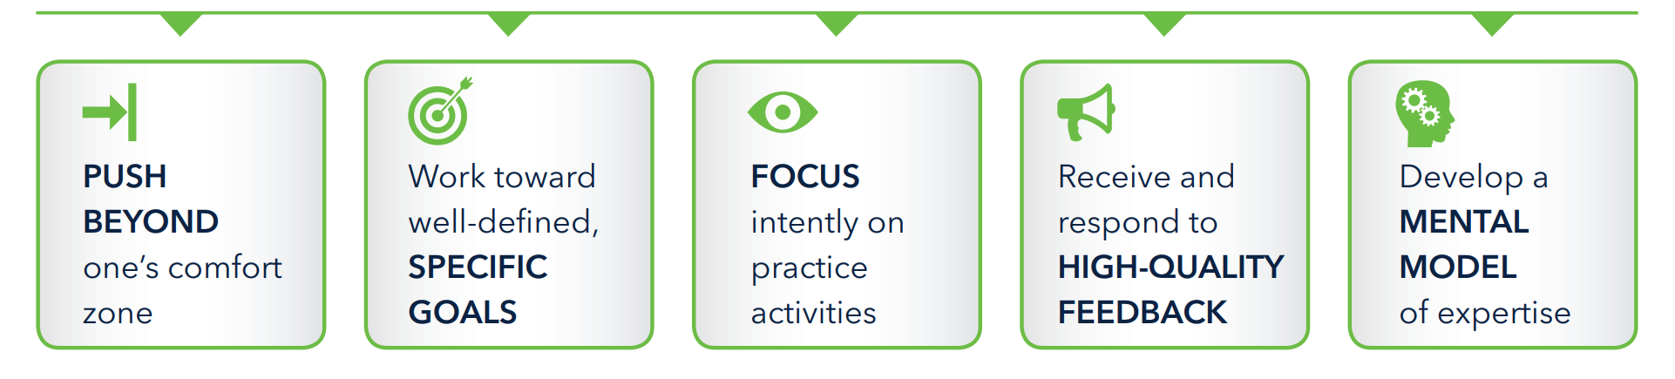
Model 1: Using instructional coaching in curriculum development: the five principles of deliberate practice.
Deliberate practice has proven useful in improving performance across a range of fields, and several of its principles can help inform how teacher development programmes improve teachers expertise. The phrase “deliberate practice” is used to refer to activities meant to improve teaching that are based in principles derived from research.
https://deansforimpact.org/resources/practice-with-purpose/

Slide 43
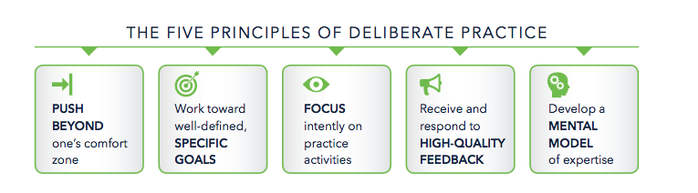
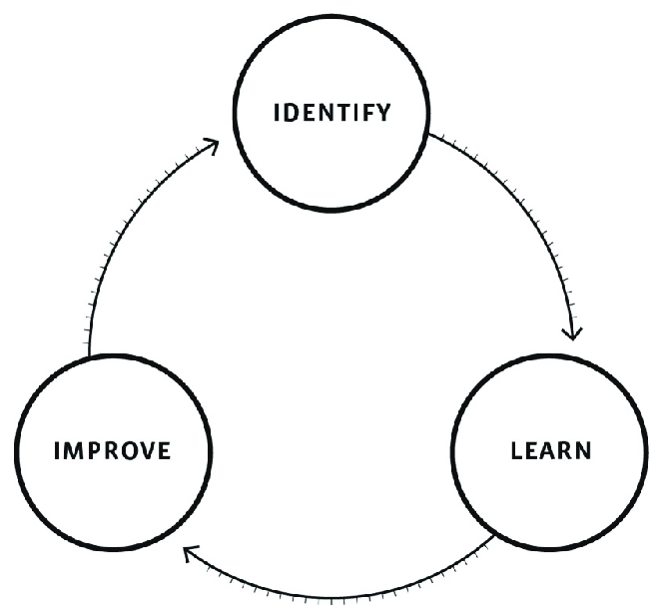
Refine and practice until it becomes automatic.
Ask teachers to challenge themselves.
Discuss in pairs, an experience of using IC in lesson observations.
How did you establish the reality, goals and actions?
How did you ensure that the practice of the chosen intervention was deliberate?
How did you ensure that your feedback was developmental/supportive rather than judgemental?
What did YOU learn from this process? What did the coachee learn from the process? How do you know?
Reality, Goals, Actions.
Developmental, supportive feedback, collaboration
Effortful practice, desirable difficulties.
10 min
Notes:
Discuss in pairs, an experience of using IC in lesson observations.
How did you establish the reality, goals and actions?
How did you ensure that the practice of the chosen intervention was deliberate?
How did you ensure that your feedback was developmental/supportive rather than judgemental?
What did YOU learn from this process? What did the coachee learn from the process? How do you know?
10 mins

Slide 44
Ask middle leaders challenging questions.
Refine and practice until new knowledge is embedded.
Reality, Goals, Actions.
Developmental, supportive feedback, collaboration
How can these principles of deliberate practice be used to support middle leaders in their curriculum development?
What activities should middle leaders be focussing on that will have the most leverage?
5 min
Notes:
How can these principles of deliberate practice be used to support middle leaders in their curriculum development?

Slide 45
Model 1: Powerful Action Steps (Goodrich, J.)
Powerful Action Steps guides coaches and coachees in selection of the most powerful next step in a teacher's development.
Setting precise, high quality action steps and holding others to account to practise are powerful levers in improving practice.
The senior leader would define the action steps for curriculum development, and through the instructional coaching process, they would work with middle leaders to agree on the action that would be the most powerful at that point in time.

Slide 46
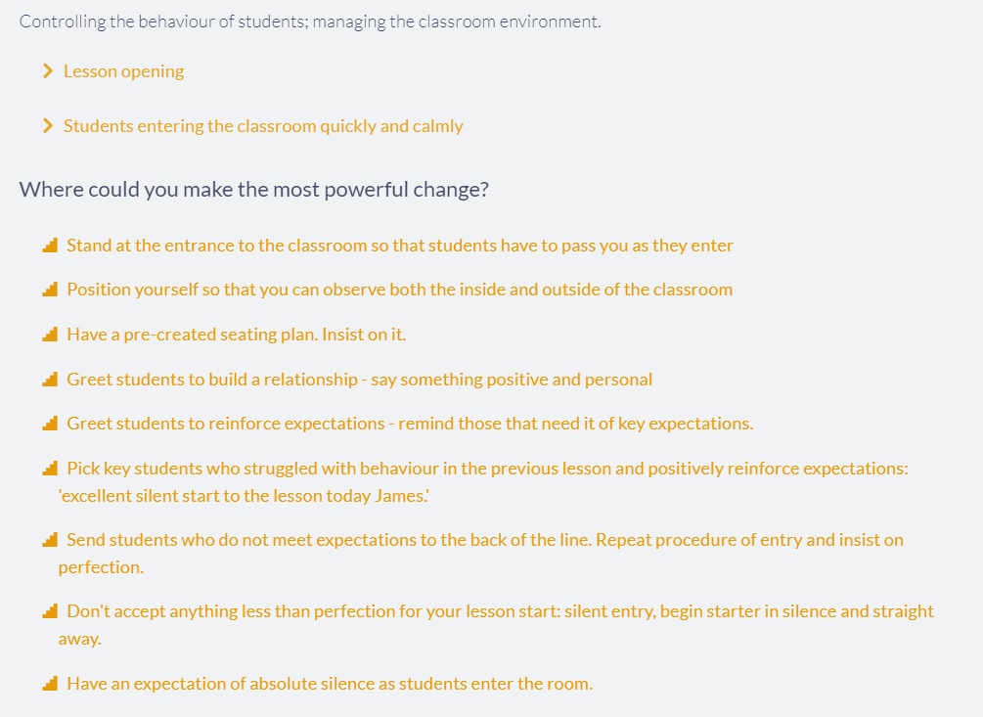
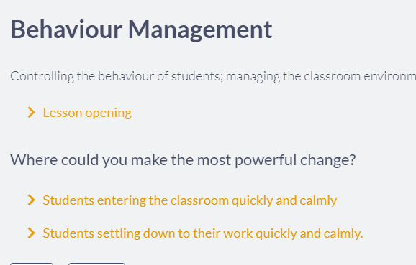
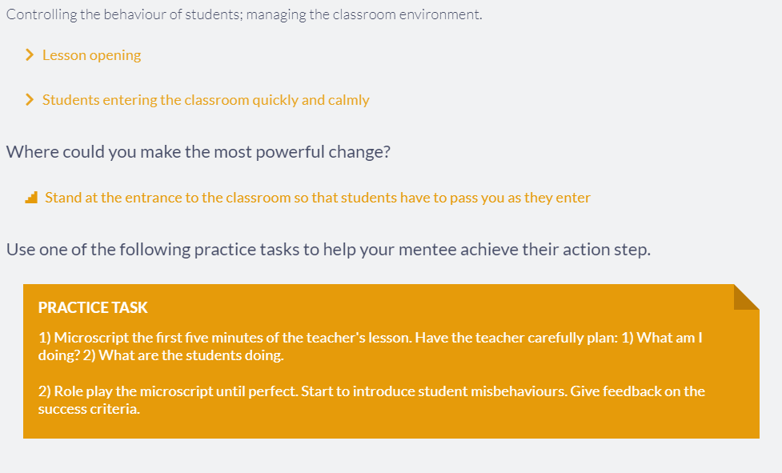
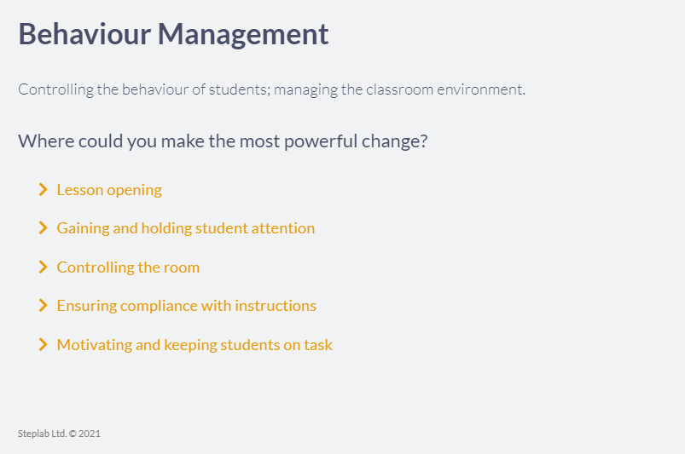

Slide 47
Powerful Action Steps for Curriculum Development – questions for middle leaders.
Where could you make the most powerful change?
Establishing the substantive and procedural knowledge that pupils need to learn effectively in this subject?
Mapping conceptual connections across the curriculum?
Evaluating the sequencing of the curriculum – is it appropriate with a clear rationale?
Identifying how pupils prior knowledge is accounted for at different stages of the curriculum?
Being explicit about building evidence informed practice through the curriculum – retrieval, high-quality questioning, modelling, scaffolding.

Slide 48
Powerful Action Steps for Curriculum Development – questions for middle leaders.
Where could you make the most powerful change?
Being explicit about building evidence informed practice through the curriculum – retrieval, high-quality questioning, modelling, scaffolding.
Practice task:
Review curriculum plans to identify where evidence-informed practice is explicit within curriculum design:
  Where is retrieval practice used? At what point in the lesson? Why is it used here?
  At what point should teachers be using high-quality questioning? Why here?
  Are the models used at the most crucial times? How do these model help pupils to solve complex problems?

Slide 49
Scenario
You are the SLT link for a subject that isn’t your specialism.
What actions should you take to:
Identify the current reality regarding the curriculum and set goals?
Ensure that deep learning happens for the coachee?
Ensure that improvement happens?
Notes:
5 mins, then feedback.

Slide 50
Practice
Look at the scenario provided to your pair. One of you will be the coach, one of you will be the coachee.
Thinking about the impact cycle, role play the coaching conversation to identify the:
Current Reality.
Set goals/action steps.
Create a learning opportunity through deliberate practice and/or modelling.
Stimulate improvement.
Total: 30 mins
Notes:
Give pairs 15 mins. 5 mins to consider the context and challenges, then ten mins to role play the conversation.
Swap the scenarios around, ask the pairs to swap roles and practice with the second scenario.
Total: 30 mins

Slide 51
Scenario 1 – You have been asked to line the manage the science department. This department was previously managed by a member of SLT who has recently retired. As part of taking on this department, you complete quality assurance review.
The department is made up on 9 teachers.
There head of department has worked at the school for 22 years.
There are 3 ECT’s, all Biologists.
Three of the teachers are part-time.
The results have been declining for the last 3 years, and the disadvantage gap is widening further year on year. During lesson observations you notice that pupils are off task and disengaged in their learning and this is not typical across the school. Pupils are often working out of textbooks and upon speaking to pupils and looking in their books, it is unclear what they have been learning.
You speak to one of the ECT’s about the curriculum and they explain that whilst they don’t have detailed schemes of work, they are given the topic and they each plan their own lessons based on that topic.
You are due to meet with the Head of Department next week to discuss your findings from the QA review.
Spend five minutes in your pair to establish the main concerns that you would like discuss in the meeting. Decide who will be the coach and who will be the coachee. Thinking about the impact cycle, role play the coaching conversation to identify the:
Current Reality.
Set goals.
Create a learning opportunity through deliberate practice and/or modelling.
Stimulate improvement.

Slide 52
Scenario 2: You are SLT responsible for curriculum and assessment. Although the school was graded ‘Good’ in its last Ofsted in 2017, standards in Maths and English have declined in this time, such that they are now both below national average for all pupils, and significantly below for disadvantaged pupils. An Ofsted inspection is now over due to the Covid-19 pandemic.
You are asked by the Headteacher to conduct a quality assurance review of the curriculum for each subject. You plan this, explain the process to middle leaders and set up meetings with each HoD as part of the review process. The MfL department has recently appointed a new HoD.
In your initial meeting with the new Head of MfL, concepts such as retrieval practice, cognitive overload, spaced practice, and scaffolding appear as unfamiliar. When asked about the curriculum intent, the HoD showed a colourful infographic that outlined each of the topics that pupils would be taught. When asked about why these topics have been selected, the HoD said the department have always taught these topics. In your informal learning walks, it is evident that pupils are not clear how to break down tasks into smaller parts, and struggle to build a secure knowledge base about the key concepts they need to learn. One teacher stated that “I have been teaching for 12 years, I know how to teach and don’t need to be quizzing the children, they need to focus on new learning”.
In examining teachers’ planning, you can see little evidence of clear curriculum plans with retrieval/spaced practice built in, and very little evidence of modelling complex problems for pupils. There appears to be no clear consistent way of planning lessons within the department. When you talk to pupils, they explain that they find it difficult to answer harder questions and often get told they need to work harder and concentrate more and they will understand.
Spend five minutes in your pair to establish the main concerns that you would like discuss in the meeting. Decide who will be the coach and who will be the coachee. Thinking about the impact cycle, role play the coaching conversation to identify the:
Current Reality.
Set goals.
Create a learning opportunity through deliberate practice and/or modelling.
Stimulate improvement.

Slide 53
Scenario 3 – You are the SLT responsible for teaching and learning.
You have been engaging with a lot of research around the impact of retrieval practice on improving pupils memory and knowledge retention and you recognise the important role that this plays in pupils learning. You deliver a series of professional development sessions on this to all teaching staff.
You ask heads of department to complete a review of the curriculum and work with their teams to ensure that retrieval practice is a common, persistent feature in lessons to support pupils with their learning. The head of food technology comes you to say that they can’t do retrieval practice in food technology because it is practical and they do something different each week.
Spend five minutes in your pair to establish the main concerns that you would like discuss in the meeting. Decide who will be the coach and who will be the coachee. Thinking about the impact cycle, role play the coaching conversation to identify the:
Current Reality.
Set goals.
Create a learning opportunity through deliberate practice and/or modelling.
Stimulate improvement.

Slide 54
What did you learn from that role play experience about the use of instructional coaching to support curriculum development?

Slide 55
Summary and key takeaways
Instructional coaching is a powerful tool to stimulate improvement in teachers practice so that pupil outcomes also improve.
Instructional coaching is incremental.
Instructional coaching is about evaluating the reality, setting goals, creating opportunities for deep learning, creating change in teachers knowledge and practice.
Instructional coaching is supportive and developmental, not judgemental or divisive.

Slide 56
Equality: Instructional coaches and teachers are equal partners. | Choice: Teachers should have choice regarding what and how they learn. | Voice: professional learning should empower and respect the voices of teachers.
Dialogue: professional learning should enable authentic dialogue. | Reflection: reflection is an integral part of professional learning. | Praxis: teachers should apply their learning to their real-life practice as they are learning.
Reciprocity: instructional coaches should expect to get as much as they give.
What does this mean to you?
Why is it important?
How can it be achieved?
Notes:
Worksheet

