Slide 1


5 Resources and Ideas

Slide 2
Resource 1:
USOW 2.0
eedi.com

Slide 3
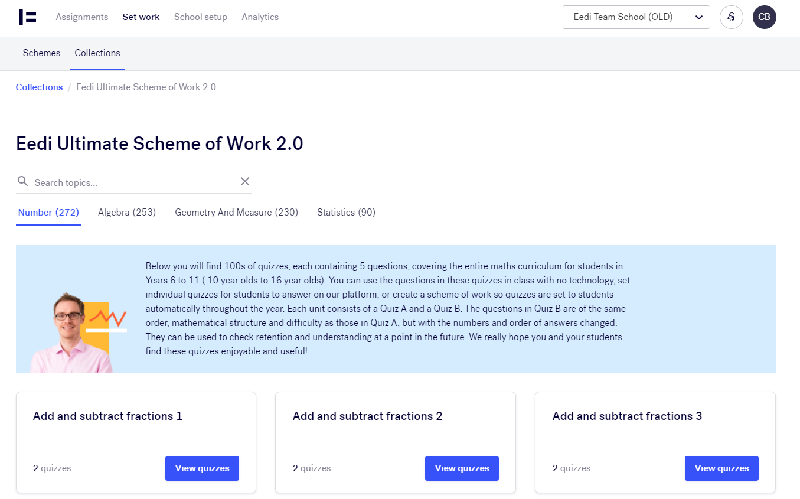

Slide 4
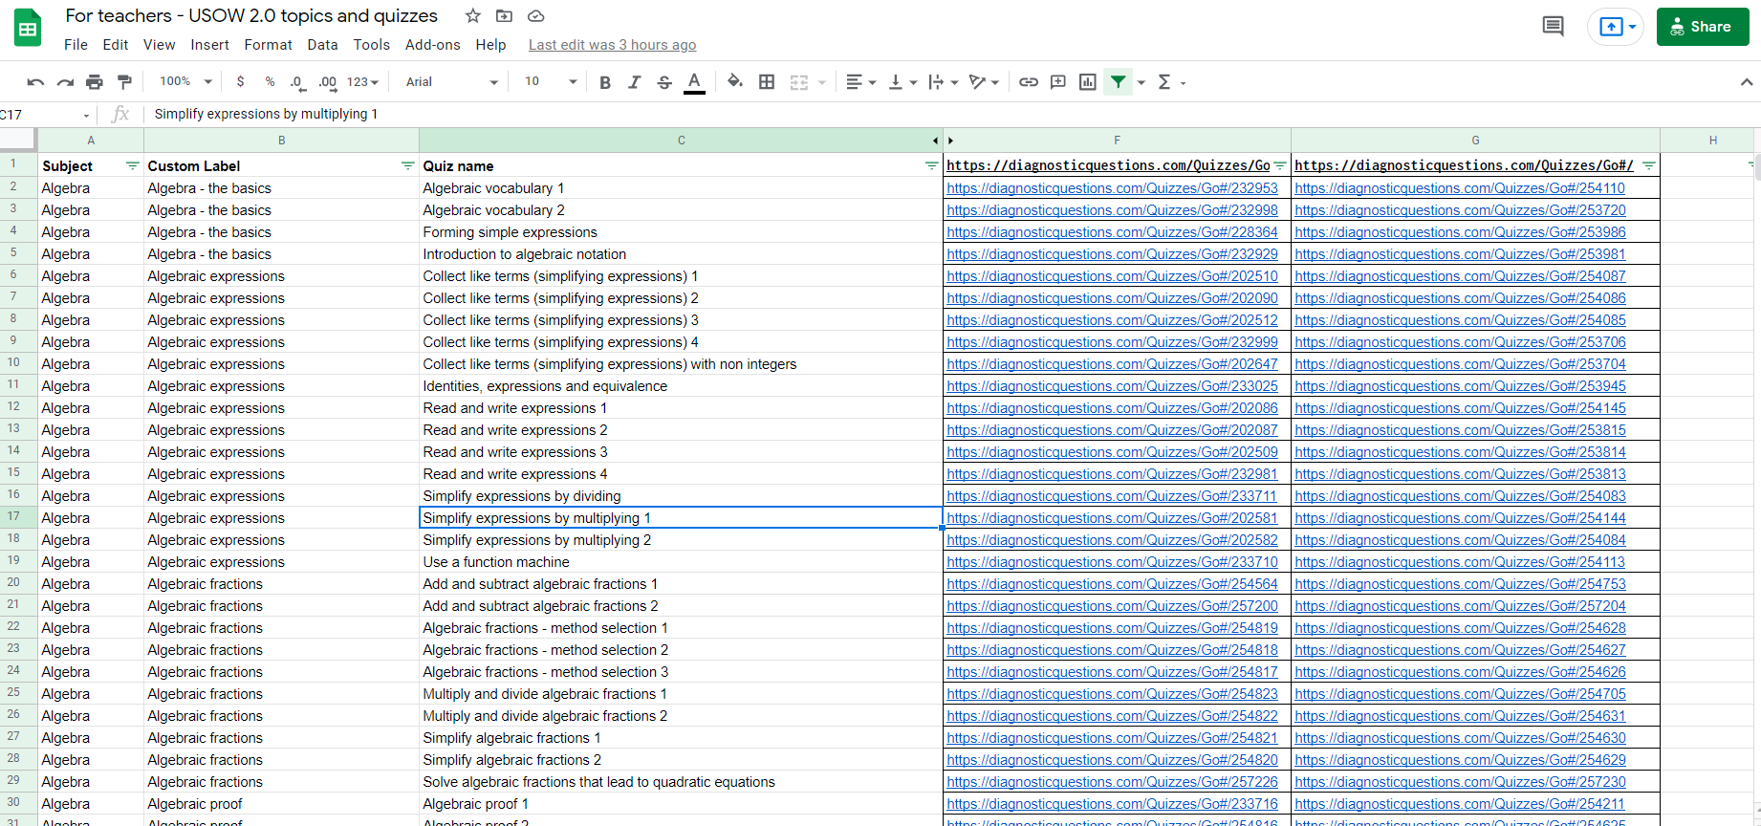

Slide 5
Resource 2:
Mathematics guidance: Key Stage 3
Notes:
https://www.gov.uk/government/publications/teaching-mathematics-at-key-stage-3

Slide 6


Slide 7
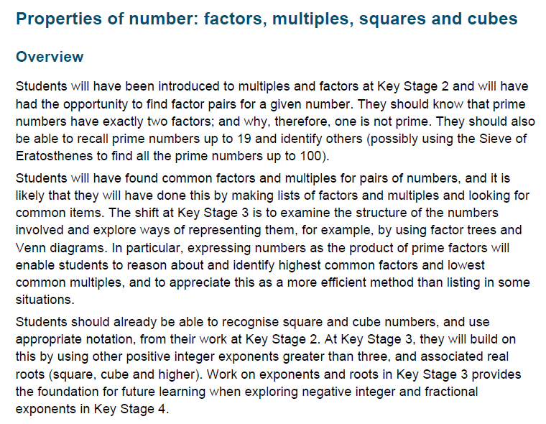

Slide 8
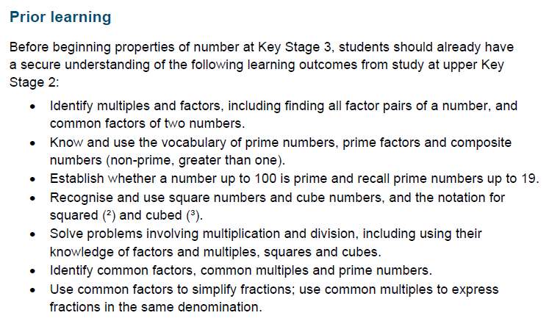

Slide 9
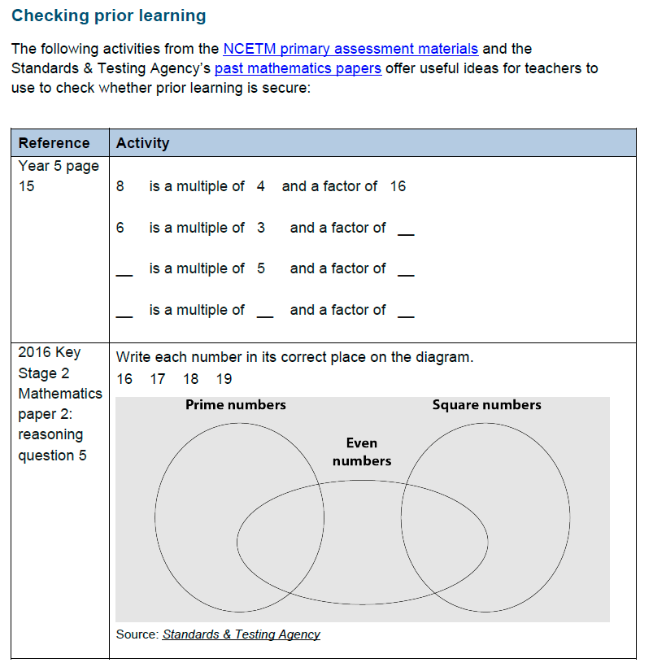

Slide 10
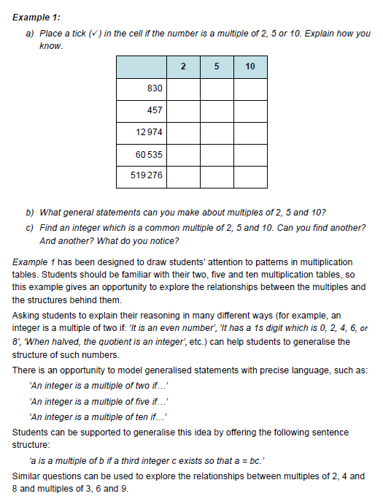

Slide 11
Resource 3:
Probability spinners
Mathspad.com

Slide 12
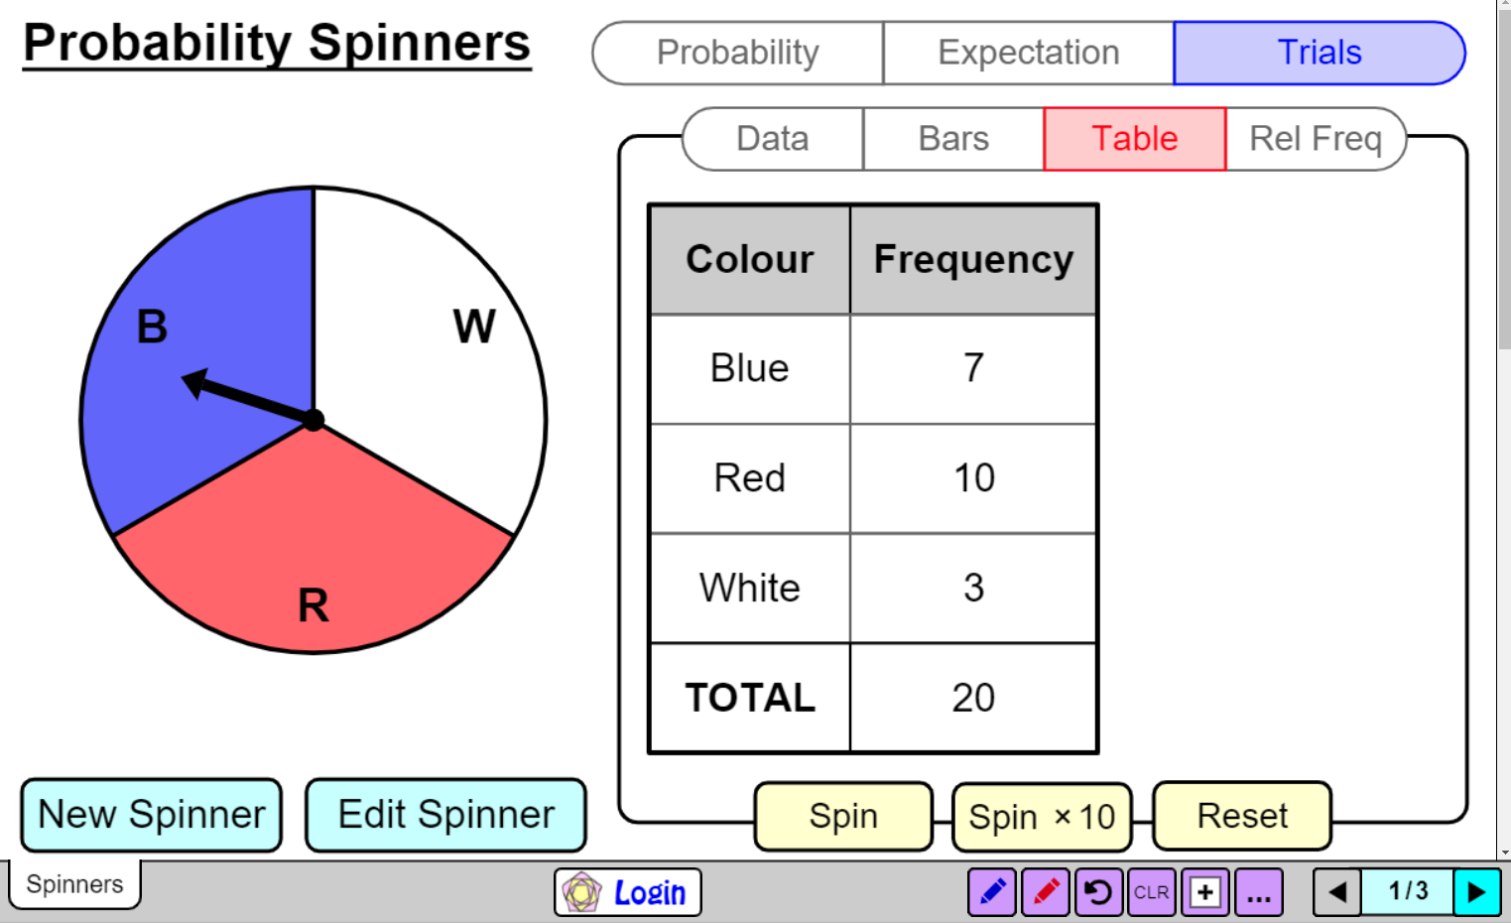
Notes:
https://www.mathspad.co.uk/i2/teach.php?id=probabilitySpinners

Slide 13
Resource 4:
Dr Austin Maths
https://www.draustinmaths.com/

Slide 14
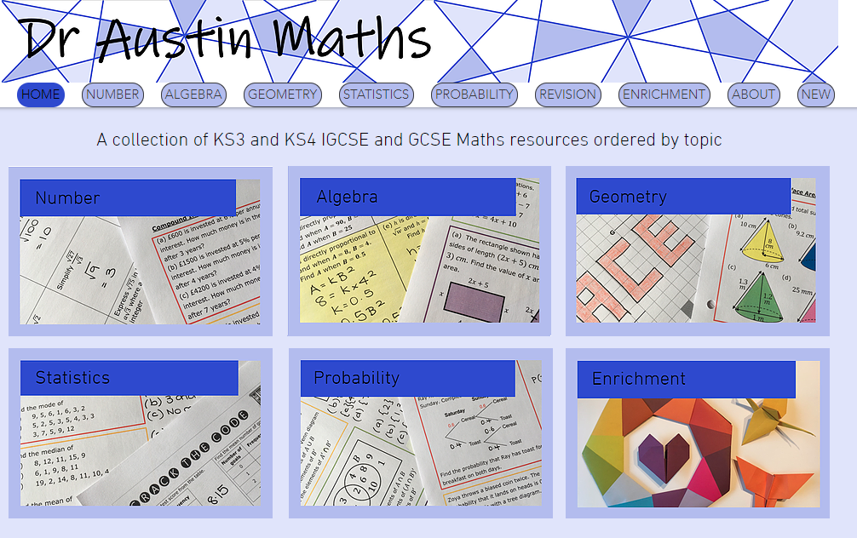

Slide 15
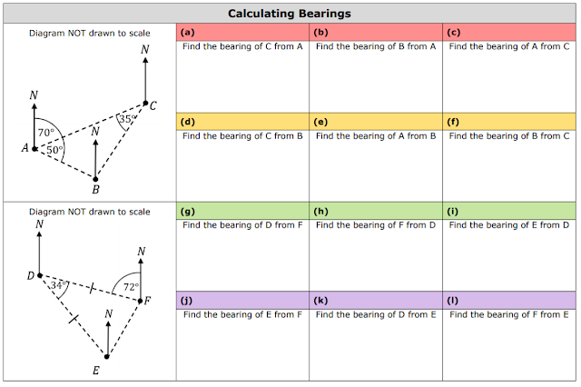

Slide 16
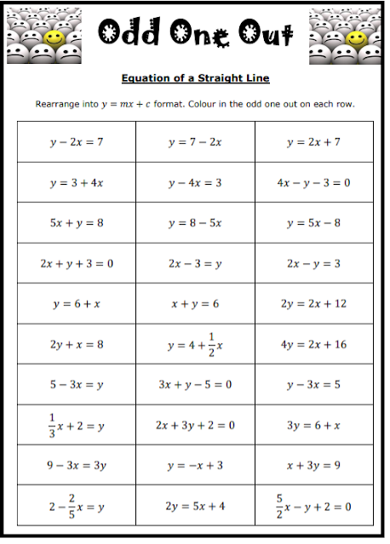

Slide 17
Resource 5:
Ofsted maths review summary
Dr Stone

Slide 18
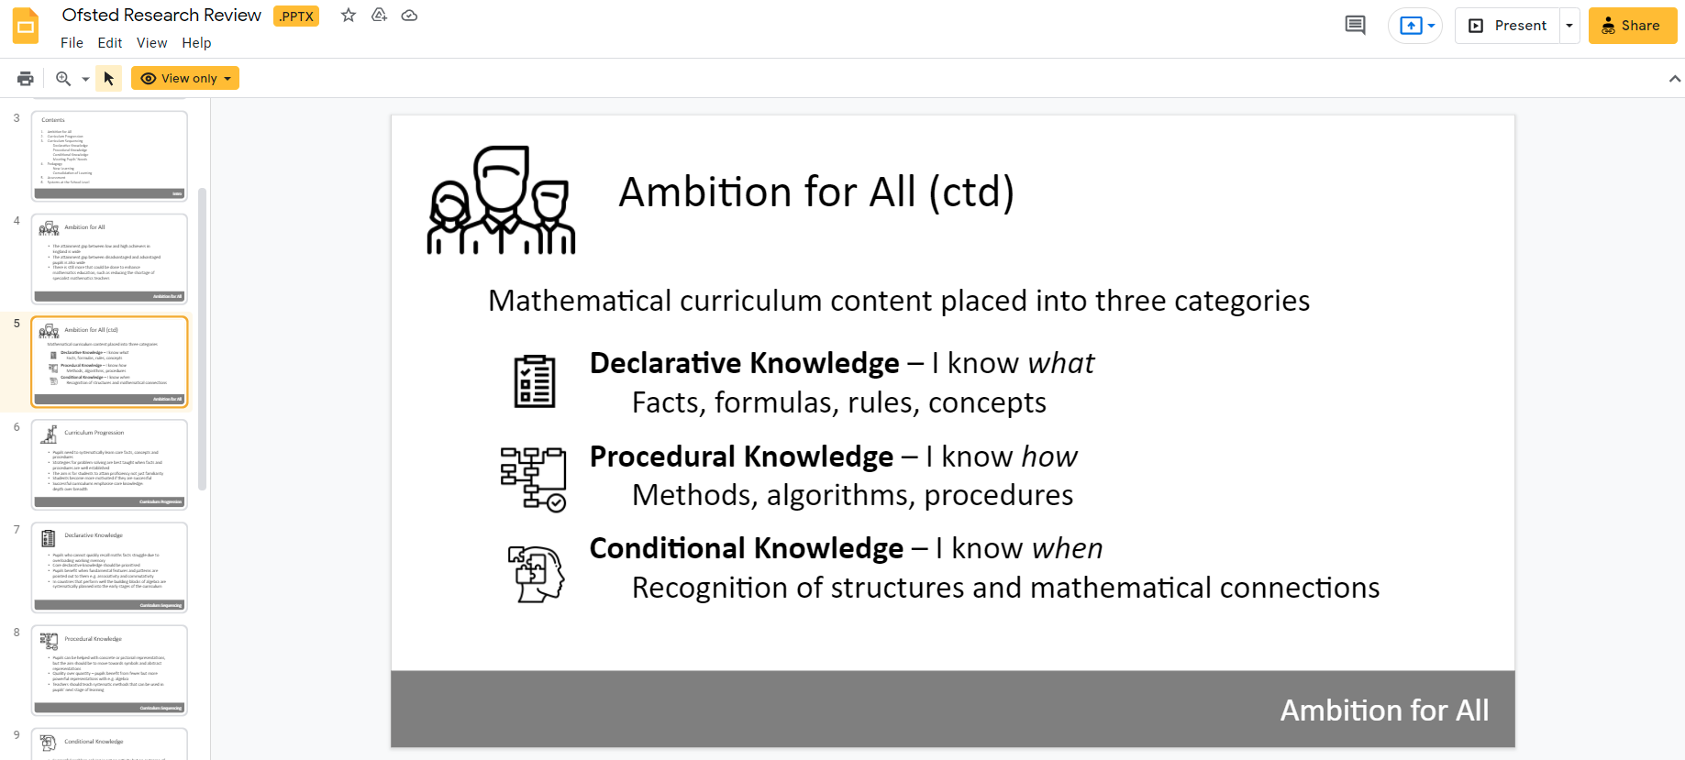
Notes:
https://docs.google.com/presentation/d/14RWuWhasAwChDV6UtIj5i5MUKlhYRm8T/edit#slide=id.p1

Slide 19
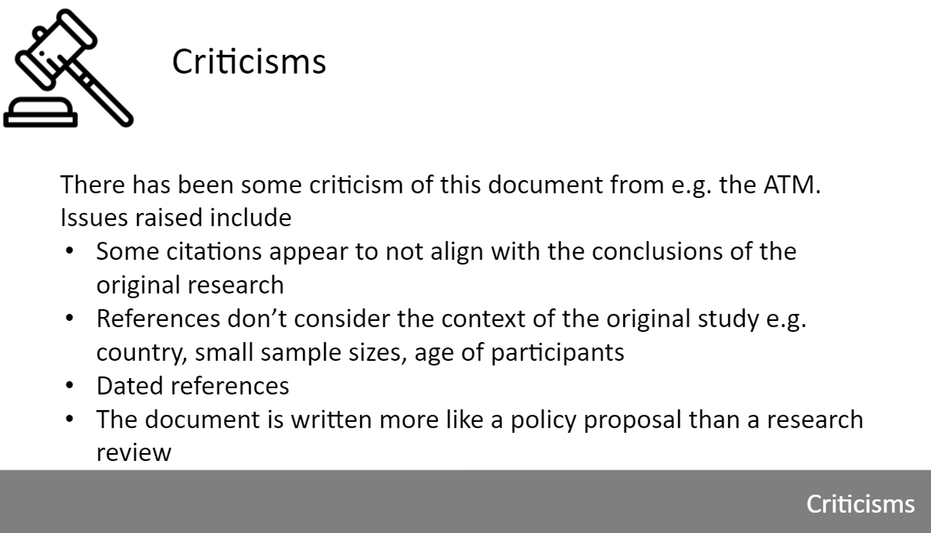
Notes:
https://docs.google.com/presentation/d/14RWuWhasAwChDV6UtIj5i5MUKlhYRm8T/edit#slide=id.p1

Slide 20
Bonus:
Free maths anxiety courses
Eedi

Slide 21
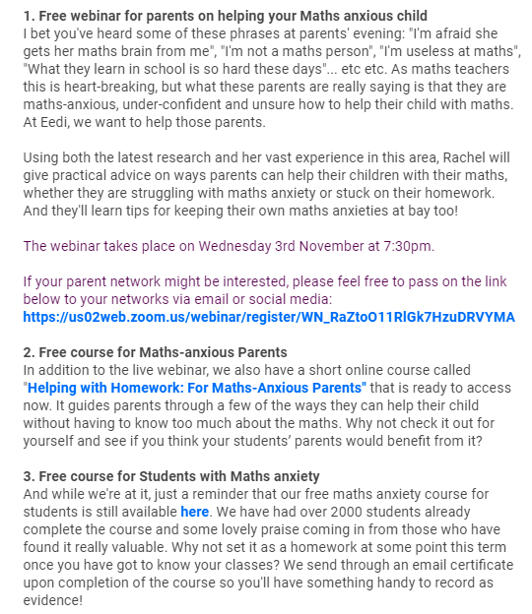

Slide 22
Webinar: https://us02web.zoom.us/webinar/register/WN_RaZtoO11RlGk7HzuDRVYMA
Parents: https://eedi.typeform.com/HelpingHomework?typeform-source=www.google.com
Students:
https://eedi.typeform.com/MACourse?typeform-source=www.google.com

Slide 23
5 Resources and Ideas

