Slide 1



The Bolton Learning Partnership
History Hub
www.boltonlearningpartnership.org.uk
@BLP19K

Slide 2
The Bolton Learning Partnership
1. Strive not to be a success, but rather to be of value
2. An investment in knowledge pays the best interest
3. In History those who learned to collaborate and improve most effectively have prevailed
4. Many of life’s failures are people who do not realise how close they are to success when they give up
5. How wonderful it is that nobody need wait a single moment before starting to improve the world
6. Our lives begin to end the day we become silent about things that matter
www.boltonlearningpartnership.org.uk
@BLP19K

Slide 3
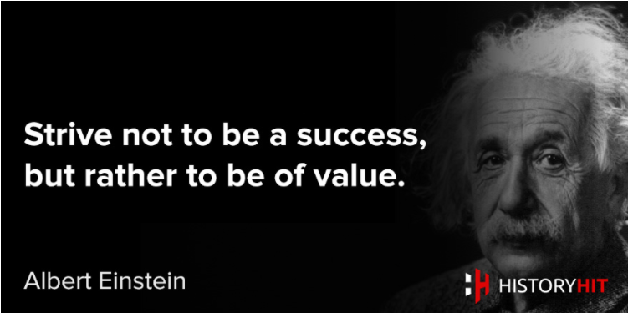
The Bolton Learning Partnership
www.boltonlearningpartnership.org.uk
@BLP19K

Slide 4
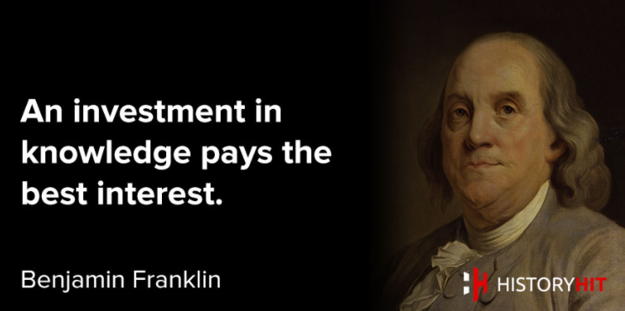
The Bolton Learning Partnership
www.boltonlearningpartnership.org.uk
@BLP19K

Slide 5
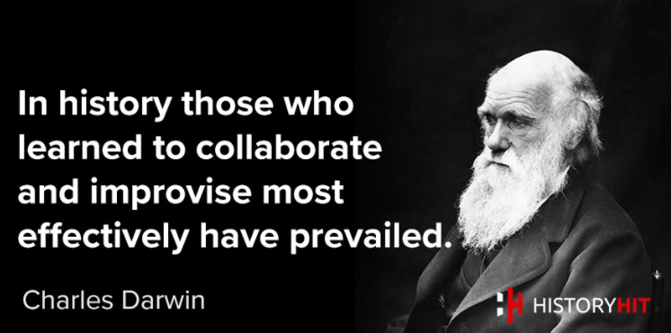
The Bolton Learning Partnership
www.boltonlearningpartnership.org.uk
@BLP19K

Slide 6
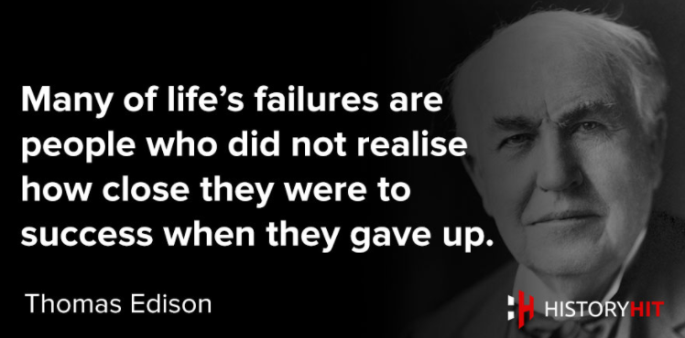
The Bolton Learning Partnership
www.boltonlearningpartnership.org.uk
@BLP19K

Slide 7
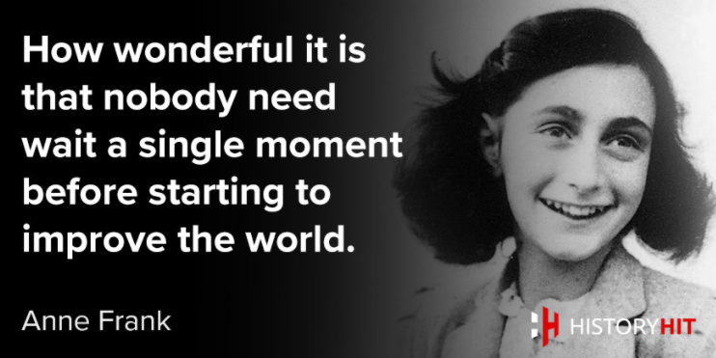
The Bolton Learning Partnership
www.boltonlearningpartnership.org.uk
@BLP19K

Slide 8
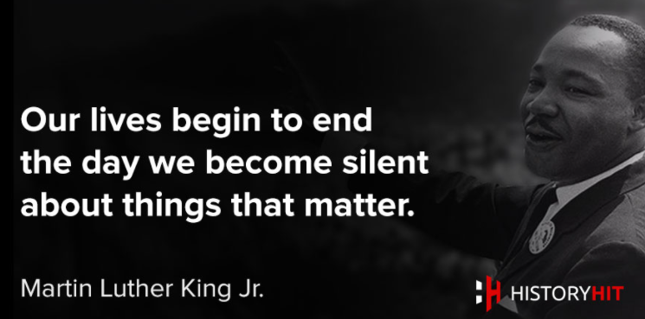
The Bolton Learning Partnership
www.boltonlearningpartnership.org.uk
@BLP19K

Slide 9
The Bolton Learning Partnership
1. Strive not to be a success, but rather to be of value – Albert Einstein
2. An investment in knowledge pays the best interest – Benjamin Franklin
3. In History those who learned to collaborate and improve most effectively have prevailed – Charles Darwin
4. Many of life’s failures are people who do not realise how close they are to success when they give up – Thomas Edison
5. How wonderful it is that nobody need wait a single moment before starting to improve the world – Anne Frank
6. Our lives begin to end the day we become silent about things that matter – Martin Luther King
www.boltonlearningpartnership.org.uk
@BLP19K

Slide 10

The Bolton Learning Partnership
Team work
Collaboration
Communication
www.boltonlearningpartnership.org.uk
@BLP19K

Slide 11

The Bolton Learning Partnership
Introductions
Which quote supports your views on education and why?
www.boltonlearningpartnership.org.uk
@BLP19K

Slide 12
The Bolton Learning Partnership
Purpose
Foster a sense of common moral purpose among all our school and local authority leaders for securing and maintaining standards across the Authority as well as for standards in our own schools
Promote the personal growth and development of all our young people (19,000+ learners) in our secondary schools to empower them to become highly effective and happy consumers, producers and citizens
Developing our capacity as self-improving schools
Through a spirit of common endeavor, reach a position where all Bolton’s secondary schools are judged to be good or better and where a significant number are judged as outstanding
Objectives/Priorities
Leadership – to develop and create leaders; to deepen the skills & knowledge of leaders; to share best leadership practice within and across schools; to create leadership capacity in schools and for school improvement.
Teaching and Learning – to develop pedagogy in schools; to share best teaching & learning practice within and across schools; to support the raising of attainment and progress of all students at all levels and from all backgrounds.
Intervention – to develop school to school support to meet the immediate needs of individual schools; to share best intervention practice within and across schools; to support schools to meet short term targets for their students and their school.
www.boltonlearningpartnership.org.uk
@BLP19K

Slide 13

The Bolton Learning Partnership
Curriculum leadership is one of the main priorities for Bolton Learning Partnership.
5 minutes - Consider how the following three sessions should look. What would be beneficial to developing your curriculum area?
21st February
22nd March
27th June
Opportunities: Guest speakers, Hub moderation, exam board, working groups, projects ….
@BLP19K

