Slide 1
GCSE History:
Approaching the 2022 exams
Eoin MacGabhann

Slide 2
This meeting will be recorded
Exam boards have an Ofqual requirement to record event audio.
Recordings are kept for one year and not shared as an accompaniment to session resources.
The recording will begin now.

Slide 3
Contents
Proposals for 2022
Exam timing and overview of principles of progression:
Basic (L1) to developed (L3)
Key skills and exemplification
directing explanations to the issue in the question (AO1/AO2, AO3, AO4)
evaluating the content and provenance of a source and interpretation in the light of the question (AO3)
coming to substantiated judgements (AO1/AO2)
Complex thinking (L4)
Threshold responses at Level 3 and 4
Important resources and upcoming free events

Slide 4
GCSE History: 2022 (to be confirmed)
If the proposals are confirmed, AQA GCSE History students will only have to answer questions on three out of four studies in Summer 2022. There will be no changes to questions or mark-schemes.
The compulsory study for all students, will be the wider world depth study (Paper 1, Section B).
Students will answer questions on two out of the following three studies:
  period Studies (Paper 1, Section A)
  thematic studies (Paper 2, Section A)
  British depth studies with the historic environment (Paper 2, Section B).
SPaG will be removed from optional thematic studies. 124 marks will be available.
Entry codes from 2021 will be used again in 2022.

Slide 5
Exam timing and overview of principles of progression:
Basic (L1) to developed (L3)

Slide 6
Recap: timing and length
4 marks, 5 minutes, one supported point/paragraph
8 marks, 10 minutes, two supported points/paragraphs
12 marks, 15 minutes, three supported points/paragraphs
16 marks, 20 minutes, three/ four supported points/paragraphs
Notes:
If students stick to this, they’ll have roughly 20 minutes left over to play with.

Slide 7
Skills based progression - basic (L1) to developed (L3)
Explain | Students use extended reasoning and knowledge to demonstrate an understanding of second-order concepts. They may also show understanding of sequencing and connections.
Identify | Students state, assert, and/or describe relevant causes, consequences, similarities.
Developed
Simple
Basic

Slide 8
PEE paragraphs progression – basic (L1) to developed (L3)
The PEE paragraph
A common approach to paragraph structuring
(though by no means the only acceptable approach!)
Point
Evidence
Explain
Copyright © AQA and its licensors. All rights reserved.

Slide 9
PEE paragraphs progression– basic (L1) to developed (L3)
Basic reasoning
P
or
E
Simple reasoning
P
+
E
Developed reasoning
P
+
E
+
E
Copyright © AQA and its licensors. All rights reserved.

Slide 10
Paper 1: WWDS – The ‘account’ question
Write an account of how the Yalta and Potsdam conferences led to international tension
[8 marks]
Students need to be able to:
demonstrate their knowledge and understanding of a sequence of events
use cause and/or consequence to demonstrate how these events led to a wider problem.
‘There is no preferred structure for the answer to this question’ (‘Examiner Guidance’ document)
Slide 52
Copyright © AQA and its licensors. All rights reserved.

Slide 11
Paper 1: WWDS – The ‘account’ question
Write an account of how the Yalta and Potsdam conferences led to international tension
[8 marks]
Students need to be able to:
demonstrate their knowledge and understanding of a sequence of events
use cause and/or consequence to demonstrate how these events led to a wider problem.
‘There is no preferred structure for the answer to this question’ (‘Examiner Guidance’ document)
Slide 52
Copyright © AQA and its licensors. All rights reserved.

Slide 12
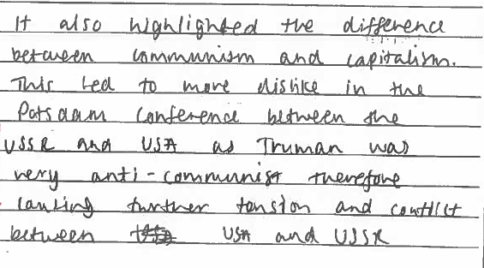
AO1/AO2 - What does basic reasoning (L1) look like?
It also highlights the difference between communism and capitalism. This led to more dislike in the Potsdam conference between the USSR and USA as Truman was very anti-communist therefore causing further tension and conflict between the USA and USSR
Write an account of how the Yalta and Potsdam conference led to international tension [8 marks]
This response identifies some relevant knowledge about the Potsdam conference

Slide 13
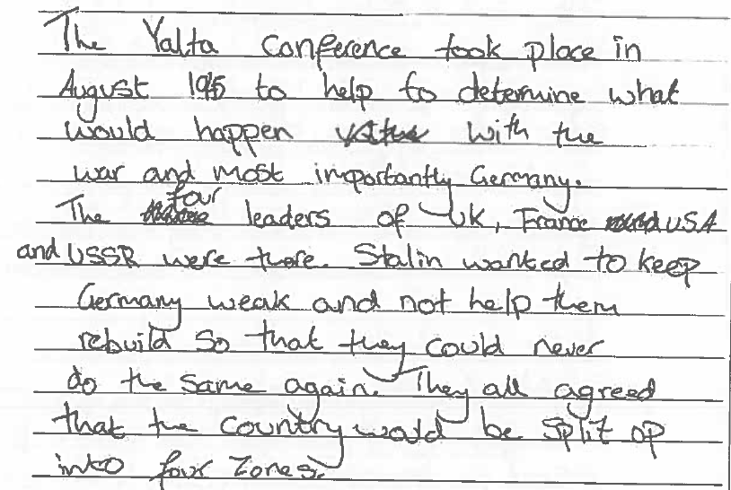
AO1/AO2 - What does simple reasoning (L2) look like?
Write an account of how the Yalta and Potsdam conference led to international tension [8 marks]
The Yalta conference took place in August 1945 to help to determine what would happen with the war and most importantly Germany. The four leaders of UK, France USA and USSR were there. Stalin wanted to keep Germany weak and not help them rebuild so that they could never do the same again. They all agreed that the country would be split up in to four zones.

Slide 14
AO1/AO2 - What does simple reasoning (L2) look like?
The Yalta conference took place in August 1945 to help to determine what would happen with the war and most importantly Germany.
The four leaders of UK, France USA and USSR were there.
Stalin wanted to keep Germany weak and not help them rebuild so that they could never do the same again.
They all agreed that the country would be split up in to four zones.
Write an account of how the Yalta and Potsdam conference led to international tension [8 marks]
A typical simple point, Some inaccuracy, but it shows the ability to place relevant events in to an accurate sequence.
The link to international tension is left implicit.

Slide 15
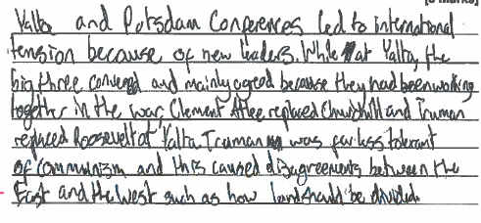
AO1/AO2 - What does developed reasoning (L3) look like?
Write an account of how the Yalta and Potsdam conference led to international tension [8 marks]
‘Yalta and Potsdam conferences led to international tension because of new leaders. While at Yalta, the big three mainly agreed because they had been working together in the war. Clement Atlee replaced Churchill and Truman replaced Roosevelt. Truman was far less tolerant of Communism and this caused disagreements between the East and the West such as how land should be divided.’
This part of the response shows developed reasoning. It identifies a point of tension (new leaders), then provides enough knowledge and understanding to support the explanation of how new leaders caused tension.

Slide 16
PEE paragraphs – basic (L1) to developed (L3)
Basic reasoning
P
or
E
Simple reasoning
P
+
E
Developed reasoning
P
+
E
+
E
Copyright © AQA and its licensors. All rights reserved.

Slide 17
Key skill: directing explanations to the issue in the question (AO1/AO2, AO3, AO4)
The ability to direct explanations to the issue in the question is central to progression in all AO1/AO2 questions.
As we’ll see below, this skill is also pertinent to analysis and evaluation of sources (AO3) and (AO4).

Slide 18
The key differentiator – address the question focus
Level 4 Complex thinking | Directly relevant to the question Substantiated with evidence
Level 3 Developed thinking
Level 2 Simple thinking | Implicitly relevant to the question Partial/ limited substantiation
Level 1 Basic thinking
No Credit | Not relevant

Slide 19
Paper 1: period study – the ‘convincing’ question (AO4)
Which interpretation gives the more convincing opinion about prohibition?
Explain your answer based on your contextual knowledge and what it says in Interpretations A and B.
[8 marks]
Students need to use their relevant knowledge and understanding of the period in order to address both interpretations and evaluate which interpretation they find more convincing.
Copyright © AQA and its licensors. All rights reserved.

Slide 20
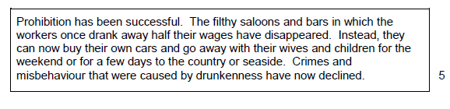
Paper 1 1A/D America – Interpretation A
Which interpretation gives the more convincing opinion about prohibition?
Explain your answer based on your contextual knowledge and what it says in Interpretations A and B
[8 marks]
Copyright © AQA and its licensors. All rights reserved.

Slide 21
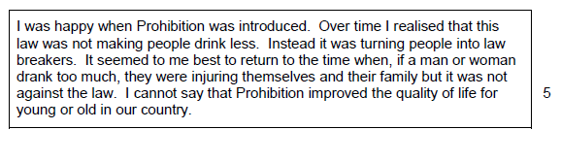
Paper 1 1A/D America – Interpretation B
Which interpretation gives the more convincing opinion about prohibition?
Explain your answer based on your contextual knowledge and what it says in Interpretations A and B
[8 marks]
Copyright © AQA and its licensors. All rights reserved.

Slide 22
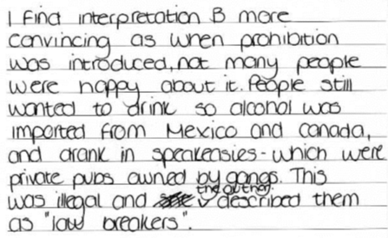
AO4- What does simple reasoning (L2) look like?
Which interpretation gives the more convincing opinion about prohibition? [8 marks]
I find interpretation B more convincing as when prohibition was introduced, not many people were happy about it. People still wanted to drink, so alcohol was imported from Mexico and Canada and drink in speakeasies – which were private pubs owned by gangs. This was illegal and the author described them as ‘law-breakers’
It uses relevant knowledge and understanding to expand upon the content of interpretation B, though the evaluation of how convincing the interpretation is about prohibition remains implicit.

Slide 23
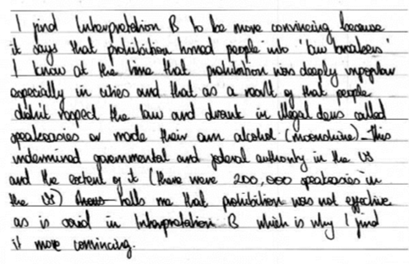
AO4- What does developed reasoning (L3) look like?
I find Interpretation B to be more convincing because it says that prohibition turned people in to ‘law-breakers’. I know at the time that prohibition was deeply unpopular especially in cities and that as a result of that people didn’t respect the law and drank in illegal bars called speakeasies or made their own alcohol (moonshine). This undermined governmental and federal authority in the US and the extent of it (there were 200,000 speakeasies in the US) tells me that prohibition was not effective as is said in B which is why I find it more convincing.
Which interpretation gives the more convincing opinion about prohibition? [8 marks]
This the response links good knowledge of law breaking with regard to alcohol consumption to the interpretation before evaluating how convincing Interpretation B is about prohibition.
NOTE: To secure level 3 marks, the other interpretation must also be addressed

Slide 24
Paper 1: wwds study – the ‘utility’ question
Study Sources B and C.
How useful are Sources B and C to an historian studying military technology and tactics in the First World War?
Explain your answer using Sources B and C and your contextual knowledge.
[12 marks]
Students are asked to evaluate utility of the content and provenance of the source for the issue in the question
Contextual knowledge should be used to explain the features of the source.
Copyright © AQA and its licensors. All rights reserved.

Slide 25
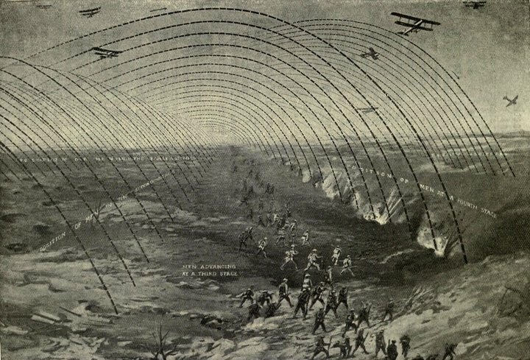
Source B (Q2, Paper 1B/A, 2019)
© Everett Collection Historical/Alamy Stock Photo

Slide 26
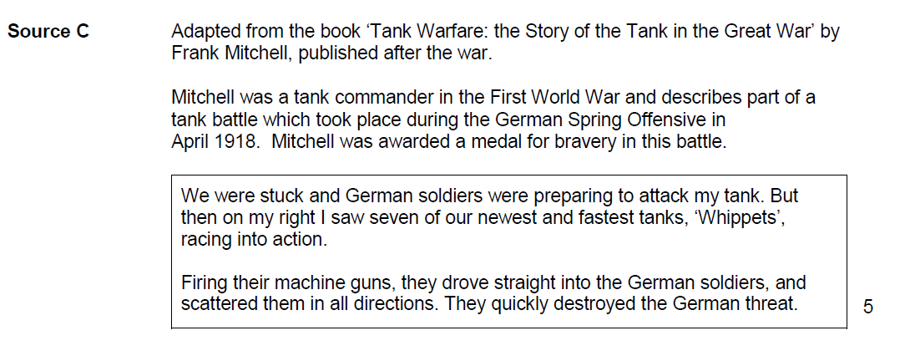
Source C (Q2, Paper 1B/A, 2019)

Slide 27
What does simple reasoning (L2) look like?
‘Source C describes the effects of tanks from a first hand British soldier. Tanks were huge heavy machines which were used on No-mans land. They were heavy and would crash barbed wire and German solders something which Mitchell describes in the source. It also allowed soldiers to advance on to no mans land especially during stalemate as the huge size of a tank acted as a protection barrier from the front line artillery.’
How useful are Sources B and C to an historian studying military technology and tactics in the First World War?
This part of a response shows what simple evaluation of content looks like. The response uses simple knowledge about tanks and technology to comment on the content of the source, though evaluation of utility for the issue in the question remains implicit.

Slide 28
What does developed reasoning (L3) look like?
‘Source C is useful to a historian studying military technology as it describes Britain’s impressive use of the tanks during the Spring offensive in April 1918. The tanks are described as the newest and fastest which is useful as it demonstrates how tanks developed in speed throughout the war. Unlike when they were first used in the Somme in 1916, when their top speed was 2-3 mph, the tanks were almost too fast by 1918 in the Spring Offensive.’
How useful are Sources B and C to an historian studying military technology and tactics in the First World War?
This extract shows developed evaluation of the content of the source with reference to the military technology, specifically about how the source is useful for showing how tanks improved during the war. Contextual knowledge is used to support the point about utility.
NOTE: To secure level 3 marks, the other source must also be addressed

Slide 29
  Key skill: evaluating the content and provenance of sources and interpretations in the light of the question (AO3, AO4)
As seen in the previous response, there are two important principles in AO3 source evaluation:
the utility of a source only emerges in the light of a given question
knowledge and understanding must be used in order place a source in context and make source evaluation meaningful.

Slide 30
  Key skill: evaluating the content and provenance of sources and interpretations in the light of the question (AO3, AO4)
The 8-mark and 12-mark ‘how useful…’ questions require students to refer to both the content and provenance of the source(s).
However, while students often display knowledge and understanding about the content of a source, they are frequently less perceptive about the provenance of a source.
For AO4 questions, the evaluation of provenance is only required for Qn2 on the Period Study

Slide 31
Source B (Q2, Paper 1B/A, 2019)
© Everett Collection Historical/Alamy Stock Photo

Slide 32
Source C (Q2, Paper 1B/A, 2019)

Slide 33
What does simple reasoning (L2) about provenance look like?
How useful are Sources B and C to an historian studying military technology and tactics in the First World War?
‘The source C was written in Britain about tanks in the Spring offensive towards the end of the war by a tank commander, so it’s useful because it shows what someone who knew a lot about tanks thought about them.’
This extract considers the provenance of source B in a simple way, with a simple inference made on the basis of the author’s background and expertise.

Slide 34
What does developed reasoning (L3) about provenance look like?
‘Source B is useful way of showing a historian how British newspapers showed an advance during the war...The picture was published in Britain in 1917, and so would be a form of visual propaganda to encourage the home front of success, particularly after the very heavy losses and death at Passendaele, so it might be very positive to keep people’s spirits up.’
How useful are Sources B and C to an historian studying military technology and tactics in the First World War?
In this instance of developed evaluation, the student identifies the source as propaganda and explores its purpose using contextual knowledge about the time and circumstances of its creation.

Slide 35
Marking Guidance to examiners about provenance
…Many answers will be seen that approach the provenance of the source from the point of view of its purpose or audience…
Examiners should be on the lookout for answers about provenance that consider the time when the source was created and the historical context of that time….
Other answers will be seen that consider the circumstances and experience of the author/artist to know about the situation or events that the Source purports to portray.’
‘Examiner Marking Guidance’ document
Copyright © AQA and its licensors. All rights reserved.
Notes:
Included to show the range of types of provenance that are credited

Slide 36
Key skill: coming to substantiated judgements (AO1/AO2)
Responses that assert or state a preference about relative importance are common.
However, a substantiated judgement is required to progress to Level 4 of the mark scheme. This level requires ‘complex thinking that leads to a substantiated judgement.’
Judgements should be substantiated by reasoning or factual knowledge and understanding.

Slide 37
Paper 2: Thematic study – the ‘factors’ question
Have governments been the main factor in the development of public health in Britain?
Explain your answer with reference to the role of government and other factors.
Use a range of examples from across your study of Health and the people:c1000 to the present day
[16 marks + 4 SPAG]
Students are asked to explain and evaluate the importance of the given factor and at least one other factor for the given development
Students should use a range of knowledge (ie. from 3 of the 4 parts of the specification) over the course of their answer.
Slide 52
Copyright © AQA and its licensors. All rights reserved.

Slide 38
AO1/AO2 Complex thinking through linking/ relating 3 factors
Have governments been the main factor in the development of public health in Britain?
Explain your answer with reference to the role of government and other factors.
The role of Government
Communication
Judgement–
‘Main factor’
The role of the individual
Copyright © AQA and its licensors. All rights reserved.

Slide 39
Paper 2: Thematic study – the ‘factors’ question
Have governments been the main factor in the development of public health in Britain?
Explain your answer with reference to the role of government and other factors.
Use a range of examples from across your study of Health and the people:c1000 to the present day
[16 marks + 4 SPAG]
The 3-2-1 rule:
3 time periods
2 factors (including the named factor)
1 judgment
Slide 52
Copyright © AQA and its licensors. All rights reserved.

Slide 40
AO1/AO2 Complex thinking through linking/ relating 2 factors
The role of Government
Have governments been the main factor in the development of public health in Britain?
Explain your answer with reference to the role of government and other factors.
Judgement –
‘Main factor’
The role of the individual
Copyright © AQA and its licensors. All rights reserved.

Slide 41
AO1/AO2 – An asserted judgment
Have governments been the main factor in the development of public health in Britain?
[16 marks + 4 SPAG]
‘In conclusion I agree that the government is the main factor for the development of public health in Britain because the government helped pass lots of health acts.’
A judgement about relative importance is stated, but the reasoning used to support the judgment remains at a simple level

Slide 42
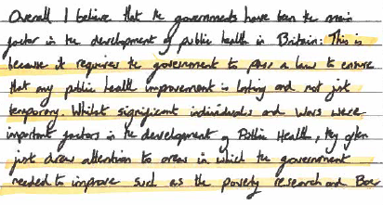
AO1/AO2 – A substantiated judgement
‘Overall I believe that the governments have been the main factor in the development of public health in Britain. This is because it requires the government to pass a law to ensure that public health improvement is lasting and not just temporary. Whilst significant individuals were important factors in the development of Public Health, they often just draw attention to areas in which the government needed to improve such as the poverty research.’
Have governments been the main factor in the development of public health in Britain?
[16 marks + 4 SPAG]
This response shows reasoning in support of the judgement about relative importance, by showing the relationship between the factors. This reasoning is demonstrated in 2 sentences

Slide 43
AO1/AO2: Complex thinking through linking/relating three factors
Cuban missile crisis
Building the Berlin Wall
Judgement
–
‘Main cause’
The Prague Spring
‘The main cause of tension between the Superpowers during the 1960s was the Cuban Missile Crisis.’
How far do you agree with this statement? Explain your answer.
Copyright © AQA and its licensors. All rights reserved.

Slide 44
AO1/AO2 Complex thinking through linking/ relating 2 factors
The Cuban Missile Crisis
‘The main cause of tension between the Superpowers during the 1960s was the Cuban Missile Crisis.’
How far do you agree with this statement? Explain your answer.
Judgement –
‘Main factor’
The Prague Spring
Copyright © AQA and its licensors. All rights reserved.

Slide 45
AO1/AO2 – An asserted judgment
‘The main cause of tension between the Superpowers during the 1960s was the Cuban Missile Crisis.’
How far do you agree with this statement? Explain your answer.
‘Overall the Cuban Missile Crisis is the most important reason for tension between the Superpowers in the 1960s. The magnitude of power in these nuclear weapons, which the US also had, meant that both countries could easily be destroyed.’
This attempts to come to an overall judgement about the main cause of tension in the concluding paragraph, but this is asserted. To progress, it could evaluate the relative importance of different causes ie why one is more important than the other(s).

Slide 46
AO1/AO2 – An asserted judgment
‘The main cause of tension between the Superpowers during the 1960s was the Cuban Missile Crisis.’
How far do you agree with this statement? Explain your answer.
‘By far the most important source of superpower tension was the Cuban Missile Crisis, which very nearly led to the start of war on many occasions. In the long term, it led to Khruschev losing power to Brezhnev in 1964 which damaged superpower relations for years to come. By contrast, the Berlin Wall and Prague Spring only affected relations in Europe and did not threaten the world like the Cuban Missile Crisis.’
Here, a judgement is substantiated. The response compares the impact of the different causes to judge their relative importance for the issue in the question.

Slide 47
Complex Reasoning for ‘Factors’ qn - Supporting Marking Guidance
‘The reasoning in Level 4 answers may seek to reconcile the factors, explore the relationship or interaction between them…recognise that aspects different factors have contributed to the causation/consequence of the development in the question.
Judgements may occur throughout answer or be seen in the concluding paragraph…a ‘judgement’ at Level 4 will require 1 or 2 sentences in which reasoning is provided and knowledge is shown for the judgement.
‘Supporting Marking Guidance’ document
Copyright © AQA and its licensors. All rights reserved.

Slide 48
Student progression: Complex thinking

Slide 49
The key differentiator – address the question focus
Level 4 Complex thinking | Directly relevant to the question Substantiated with evidence
Level 3 Developed thinking
Level 2 Simple thinking | Implicitly relevant to the question Partial/ limited substantiation
Level 1 Basic thinking
No Credit | Not relevant

Slide 50
Complex thinking at Level 4
Breaking down/
Differentiating
Complex Thinking
Linking/
Relating
Slide 16
Copyright © AQA and its licensors. All rights reserved.

Slide 51
Complex Thinking by Differentiation
Complex Thinking Differentiated by
Time
Place
Scope
People
Slide 16
Copyright © AQA and its licensors. All rights reserved.

Slide 52
Paper 2: British Depth study– the ‘importance’ question
Explain what was important about Catholic plots against Queen Elizabeth I.
[8 marks]
Students are asked to identify and explain the importance of a key event/development/individual and/or group.
Slide 52
Copyright © AQA and its licensors. All rights reserved.

Slide 53
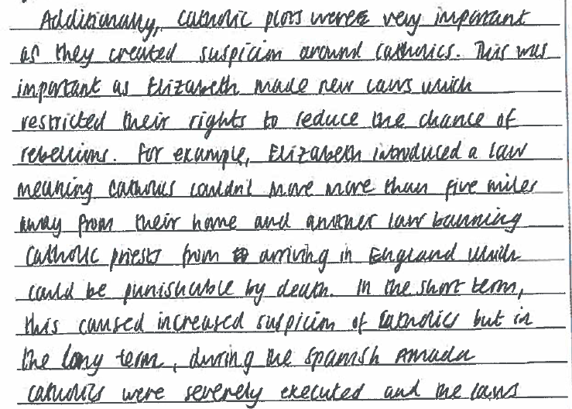
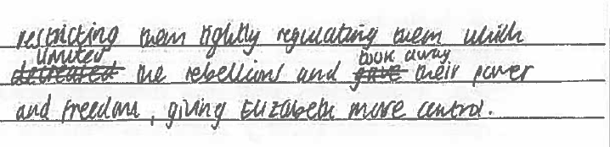
Complex thinking
Differentiation by time: short-term/ long-term
Catholic plots were important as they created suspicion around Catholics. This was
important as Elizabeth made new laws which restricted their rights, to reduce the chance of
rebellions. For example, Elizabeth introduced a law meaning Catholics couldn’t move more than 5 miles away from their home and another law banning Catholic priests from arriving in England which could be punishable by death. In the short term this caused increased suspicion of Catholics. In the long term during the Spanish Armada Catholics were severely executed and the laws restricting them tightly regulating them which limited the rebellions and took away their power and freedom, giving Elizabeth more control.
Explain what was important about Catholic plots against Queen Elizabeth I.
[8 marks]
The answer engages with the concept of long and short-term importance with enough success to be considered an example of complex thinking, albeit at the lower mark in the level.

Slide 54
Paper 2 – Thematic: the ‘significance’ Question
Explain the significance of Islamic medicine and surgery.
[8 marks]
Students are asked to identify and explain the significance of a key event/development/individual and/or group.
Slide 52
Copyright © AQA and its licensors. All rights reserved.

Slide 55
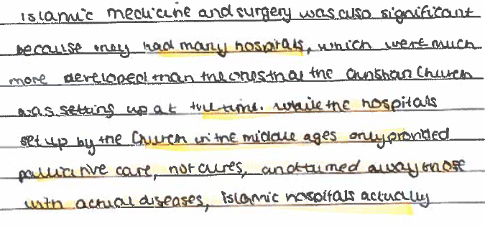
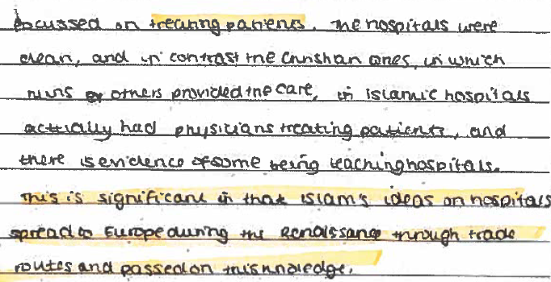
Complex thinking
Differentiation by time and place
Islamic medicine and surgery was also significant because they had many hospitals, which were much more developed than the ones that the Christian church was setting up at the time. While the hospitals set up the church in the middle ages only provided palliative care, not cures, and turned away those with actual diseases, Islamic hospitals actually focused on treating patients. The hospitals were clean, and in contrast the Christian ones, in which nuns others provided the care, in Islamic hospitals actually had physicians treating the patients, and there is evidence of some being teaching hospitals. This is significant in that Islam’s ideas on hospitals spread to Europe during the Renaissance through trade routes and passed on this knowledge.
Explain the significance of Islamic medicine and surgery.
[8 marks]
The section of the response shows complex thinking about significance of Islamic medicine by comparing its development with that of European medicine and explaining its long term influence (time).

Slide 56
Paper 2: Thematic – The ‘similarity’ question
Explain two ways in which the Peasants’ Revolt and Trade Unionism in the nineteenth century were similar.
[8 marks]
Slide 52
Copyright © AQA and its licensors. All rights reserved.

Slide 57
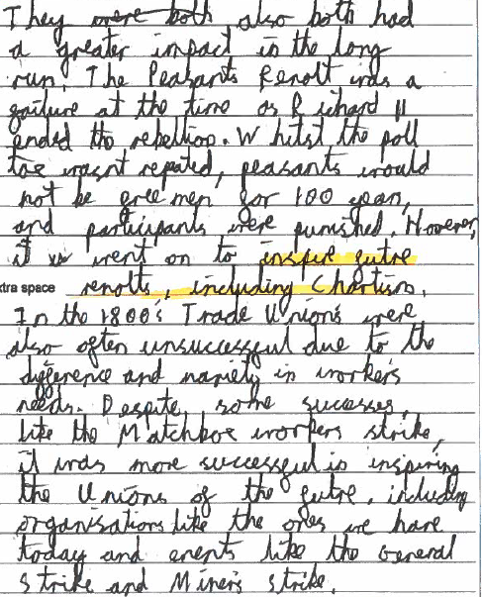
Complex thinking
Differentiation by time: the broader historical context
They also both had a greater impact in the long run. The Peasants Revolt was a failure at the time as Richard II ended the rebellion. Whilst the poll tax wasn’t repealed, peasants would not be free men for 100 years, and the participants were punished. However, it went on to inspire future revolts included Chartism. In the 1800s Trade Unions were also often unsuccessful due to the difference and variety in worker’s needs. Despite some successes, like the Matchbox workers strike, it was more successful in inspiring the Unions of the future including organisations like the ones we have today and events like the General Strike and Miner’s Strike.
Explain two ways in which the Peasants’ Revolt and Trade Unionism in the nineteenth century were similar.
[8 marks]
This response addresses the broader context chronologically (eg long term impact). The level of detail given led to a top level mark.

Slide 58
Paper 2: thematic study – the utility question
How useful is Source A to an historian studying the methods of treating disease in the eighteenth and early nineteenth centuries?
Explain your answer using Source A and your contextual knowledge.
[8 marks]
Students are asked to evaluate utility of the content and provenance of the source for the issue in the question
Contextual knowledge should be used to explain the features of the source.
Slide 52
Copyright © AQA and its licensors. All rights reserved.

Slide 59
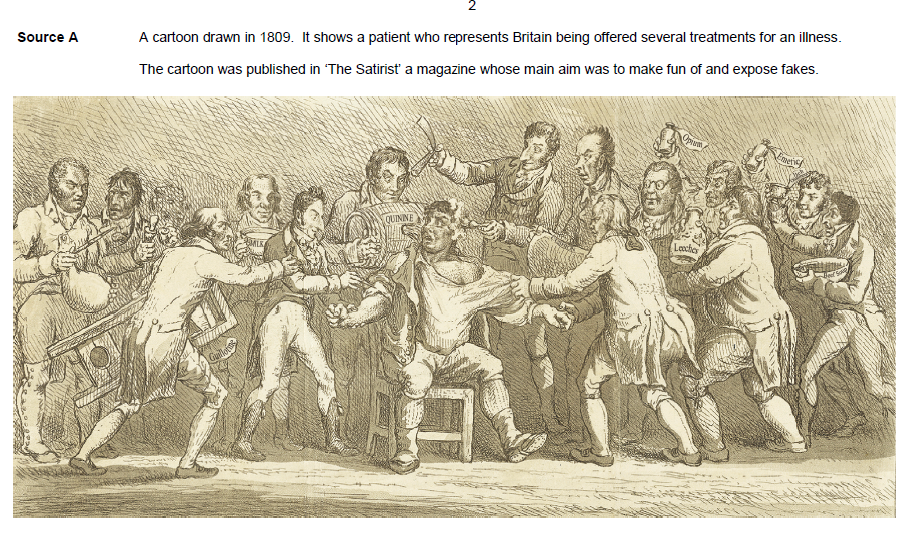
Paper 2: thematic study – the utility question
Copyright © AQA and its licensors. All rights reserved.

Slide 60
AO3 – Complex thinking for source questions
I believe this source is quite useful as it represents the Quacks in the 1800s. We can see the man being bombarded by sellers with random substances they fooled others to use so they can gain money. This relates to the meaning of the source that it was made to ‘expose fakes’. As germ theory hadn’t been discovered (discovered in 1861) society did not really know what cured illnesses. Therefore people such as Quacks would use this to benefit from it.
We can see a man holding ‘opium’, this is useful as we know back in 1340s-50s opium would be used as an anaesthetic, however wouldn’t cure an illness. This shows why the cartoon is aimed to ‘make fun of them’. People wanted them exposed as many were oblivious to what was going on due to lack of knowledge of medicine around the 17th and 18th centuries.
How useful is Source A to an historian studying the methods of treating disease in the eighteenth and early nineteenth centuries?
Explain your answer using Source A and your contextual knowledge.
[8 marks]
This level 4 answer uses relevant contextual knowledge to evaluate the utility of the source’s content. In the 2nd paragraph, it uses the time and circumstances of the source’s creation explain its purpose.

Slide 61
Threshold responses at level 3

Slide 62
AO1/AO2: responses at level 3
At level 3…
for all 8 mark questions, write about more than one point and show developed explanation somewhere in the response
for the Bullet Point question, C&T essay question and Historic Environment question, write about more than one point, including the given point and show developed explanation somewhere in the response
for the Factors question, as above but show range (3 out of 4 parts of the specification)

Slide 63
AO3: responses at level 3
At level 3…
for the 8 mark utility question, show developed evaluation of either content or provenance somewhere in the response
for the 12 mark utility question, as above but both sources will be addressed in the answer

Slide 64
AO4: responses at level 3
At level 3…
for the Paper 1 convincing question, write about both interpretations and show developed evaluation somewhere in the response
for the Paper 2 convincing question, write about more than one point and show developed evaluation somewhere in the response

Slide 65
Threshold responses at level 4

Slide 66
AO1/AO2: responses at level 4
At level 4…
for all 8 mark questions, show developed explanation of more than one point and show complex thinking somewhere in the response
for the Bullet Point question, C&T essay question and Historic Environment question, show developed explanation of more than one point, including the given point, and come to a supported judgement somewhere in the response.
for the Factors question, as above but show range (3 out of 4 parts of the specification)

Slide 67
AO3: responses at level 4
At level 4…
for the 8 mark utility question, show developed evaluation of both content and provenance somewhere in the response
for the 12 mark utility question, as above but both sources will be addressed in the answer

Slide 68
AO4: responses at level 4
At level 4…
for the Paper 1 convincing question, show developed evaluation of both interpretations and come to a supported judgement somewhere in the response.
for the Paper 2 convincing question, show developed evaluation of more than one point with a supported judgement somewhere in the response

Slide 69
Important documents and upcoming events

Slide 70
Important documents and links
Examiner Guidance documents
Notes and guidance: Supporting marking guidance: Paper 1 Section A (all options) Period studies - June 2019 (aqa.org.uk)
Notes and guidance: Supporting marking guidance: Paper 1 Section B (all options) Wider world depth studies - June 2019 (aqa.org.uk)
Notes and guidance: Supporting marking guidance: Paper 2 Section A (all options) Thematic studies - June 2019 (aqa.org.uk)
Notes and guidance: Supporting marking guidance: Paper 2 Section B (all options) British depth studies - June 2019 (aqa.org.uk)

Slide 71
Important documents and links
Assessment Objective guides
Teaching guide: AO1 and AO2 8 mark questions (aqa.org.uk)
Teaching guide: AO1 and AO2 extended response questions (aqa.org.uk)
Teaching guide: AO3 questions (aqa.org.uk)
Teaching guide: AO4 questions (aqa.org.uk)

Slide 72
Important documents and links
2023 Historic Environment packs and updated Schemes of Work
The 2023 Historic Environment packs are now available on E-aqa and Centre Services
We’ve also updated the British depth study schemes of work on the website to reflect the 2023 sites:
Scheme of work: Paper 2 Section B Option A Norman England, c1066-c1100 - June 2023 (aqa.org.uk)
Scheme of work: Paper 2 Section B Option B Medieval England: the reign of Edward I, 1272-1307 - June 2023 (aqa.org.uk)
Scheme of work: Paper 2 Section B Option C Elizabethan England, c1568-1603 - June 2023 (aqa.org.uk)
Scheme of work: Paper 2 Section B Option D Restoration England, 1660-1685 - June 2023 (aqa.org.uk)

Slide 73
Important documents and links
Free training events in the Autumn term
We are running free training events for GCSE and A-level History:
GCSE History: Supporting Student Progression
GCSE History: Virtual Community (North) meeting
A-level History: Supporting Student Progression
Further details about these courses and how to sign up can be found here:
AQA | Professional development | Course finder

Slide 74

Any questions?
Copyright © AQA and its licensors. All rights reserved.

Slide 75
Contact points
Contact us
aqa.org.uk/contact-us
Customer Support Team
0161 958 3861
history@aqa.org.uk
Events Team
0161 696 5994
events@aqa.org.uk
aqa.org.uk/professional-development

